Slide 1
CSCI 5822
Probabilistic Models of
Human and Machine Learning
Mike Mozer
Department of Computer Science and
Institute of Cognitive Science
University of Colorado at Boulder

Slide 2
Learning In Bayesian Networks:
Missing Data And Hidden Variables

Slide 3
Missing Vs. Hidden Variables
Missing
  typically observed but absent for certain data points
  missing at random or missing based on value
    e.g., netflix ratings
Hidden
  never observed but essential for predicting visible variables
    e.g., human memory state, field of study
  a.k.a. latent variables

Slide 4
Quiz
“Semisupervised learning” concerns learning where additional input examples are available, but labels are not. According to the model below, will partial data (either X or Y) inform the model parameters?
X known?
Y known?
θ_{x}
θ_{y|x}
θ_{y|~x}
X
X
X
Y
Y
Notes:
X known kind of trivial: will affect Qx, but because Y is not known, Y d-separates X from Qy|x Qy|~x
Y known: Qy|x update needs to marginalize out over X, so new Qy|x will be a mixture of betas!

Slide 5
θ_{x}
θ_{y|x}
θ_{y|~x}
X
X
Y
Y
Notes:
[*]What can we infer about Qy|x from Y
[*]Joint marginalizing over other 3 variables
[*] Two cases: X=0 and X=1

Slide 6
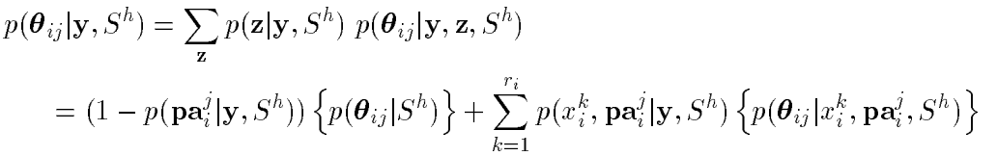
Missing Data: Exact Inference In Bayes Net
Y: observed variables
Z: unobserved variables
How do we do parameter updates for θ_{i} in this case?
  If X_{i} and Pa_{i} are observed, then situation is straightforward (everything is known to update θ_{ij}).
  If X_{i} or any Pa_{i} are missing, need to marginalize over Z
  E.g., X_{i} ~ Categorical(θ_{ij})
Note: posterior is a Dirichlet mixture
X = {Y,Z}
parameter vector for X_{i}
with parent configuration j
# values of X_{i}
Dirichlet
Dirichlet
Specific value of X_{i}
Notes:
THETA_ij: parameter vector for Xi given parent configuration j
Spiegelhalter & Lauritzen (1990) has derivation -> not intuitive
If Parents are all observed, then first term has weight 0; if parents aren’t likely -> can’t say much about theta_ij for the given j

Slide 7
Missing Data: Gibbs Sampling
Given a set of observed incomplete data, D = {y₁, ..., y_{N}}
1. Fill in arbitrary values for unobserved variables for each case ➔ D_{c}
2. For each unobserved variable z_{i} in case n, sample:
3. evaluate posterior density on complete data D_{c}’
4. repeat steps 2 and 3, and compute mean of posterior density
Notes:
D = set of N cases
D_c complete data
D_c = complete data

Slide 8





Missing Data: Gaussian Approximation
Approximate
as a multivariate Gaussian.
    Appropriate if sample size |D| is large, which is also the case when Monte Carlo is inefficient
1. find the MAP configuration by maximizing g(.)
2. approximate using 2nd degree Taylor polynomial
3. leads to approximate result that is Gaussian
~
negative Hessian of g(.) eval at
Notes:
STEP 3: g(Q) is log posterior -> p(Q|D,S) is exp(g(Q))

Slide 9

Missing Data: Further Approximations
As the data sample size increases,
      Gaussian peak becomes sharper, so can make predictions based on the MAP configuration
      can ignore priors (diminishing importance) -> max likelihood
How to do ML estimation
      Expectation Maximization
      Gradient methods
Notes:
Large data case: maximum likelihood solution – the thing we would have done before taking this course

Slide 10
Expectation Maximization
Scheme for picking values of missing data and hidden variables that maximizes data likelihood
E.g., population of Laughing Goat
  baby stroller, diapers, lycra pants
  backpack, skinny jeans
  baby stroller, diapers
  backpack, computer, saggy pants
  diapers, lycra
  computer, skinny jeans
  backpack, saggy pants
Notes:
Laughing Goat: moms, students

Slide 11
Expectation Maximization
Formally
  V: visible variables
  H: hidden variables (also, missing values)
  θ: model parameters
Model
  P(V,H|θ)
Goal
  Learn model parameters θ in the absence of H
Approach
  Find θ that maximizes P(V|θ)

Slide 12
EM Algorithm (Barber, Chapter 11)
Notes:
q: use current guess about parameters to get posterior over hidden
expectation of log(p(h,v|Q) under q distribution: marginalize over h to get p(v|Q)

Slide 13
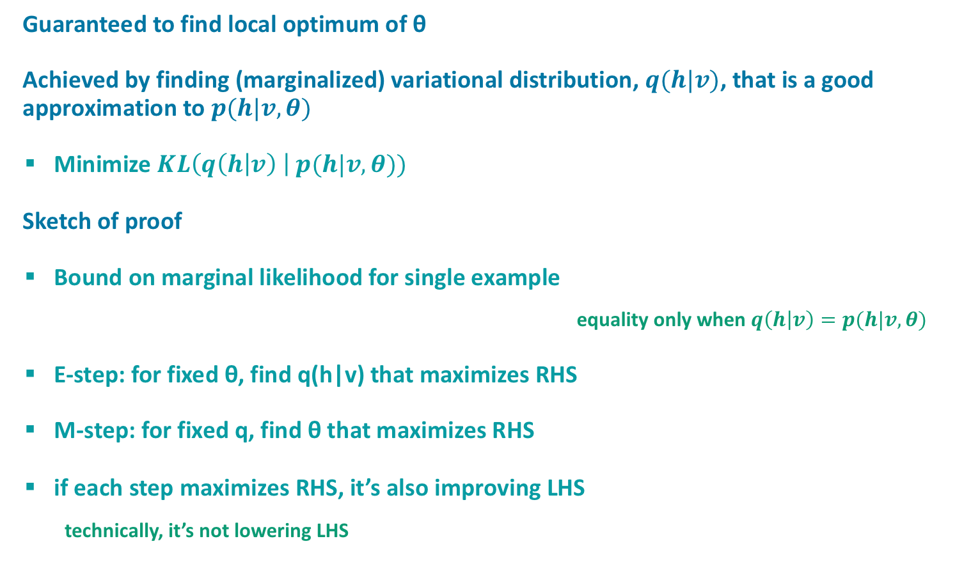
EM Algorithm
Guaranteed to find local optimum of θ
Achieved by finding (marginalized) variational distribution, $q(h|v)$, that is a good approximation to $p(h|v,θ)$
  Minimize $KL\left(q\left(h | v\right) \right| p(h|v,θ))$
Sketch of proof
  Bound on marginal likelihood for single example
    equality only when $q\left(h | v\right)=p(h|v,θ)$
  E-step: for fixed θ, find q(h|v) that maximizes RHS
  M-step: for fixed q, find θ that maximizes RHS
  if each step maximizes RHS, it’s also improving LHS
    technically, it’s not lowering LHS
Notes:
q(.) is a variational distribution: we’re going to optimize to find it
Derivation of bound comes from minimizing KL divergence between q and p(h|v,theta)
Energy term: expected complete data likelihood
Deri ation of bound in barber text based on a variational approximation
Prove equality when q(h|v)=p(h|v,Theta)

Slide 14
Barber Example
Contours are of the lower bound
Note alternating steps along θ and q axes
  note that steps are not gradient steps and can be large
Choice of initial θ determines local likelihood optimum
Notes:
Nice example in text

Slide 15
Clustering: K-Means Vs. EM
K means
  choose some initial values of μ_{k}
  assign each data point to the closest cluster
  recalculate the μ_{k} to be the means of the set of points assigned to cluster k
  iterate to step 2

Slide 16
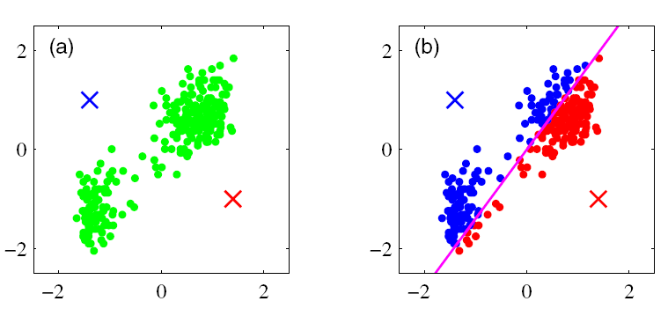
K-means Clustering
From C. Bishop, Pattern Recognition and Machine Learning

Slide 17
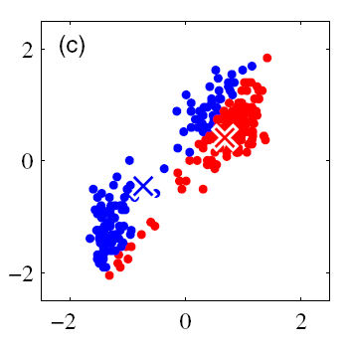
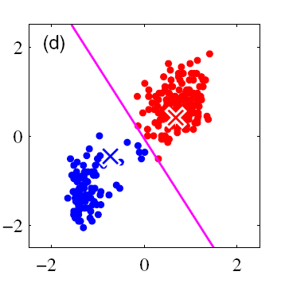
K-means Clustering

Slide 18
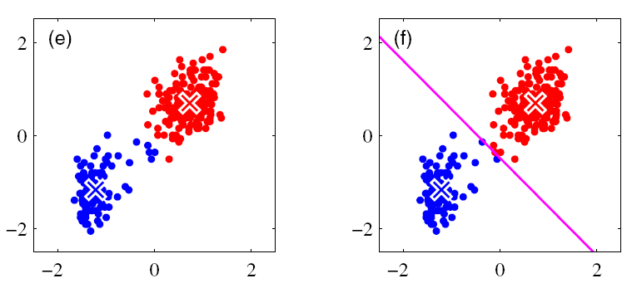
K-means Clustering

Slide 19
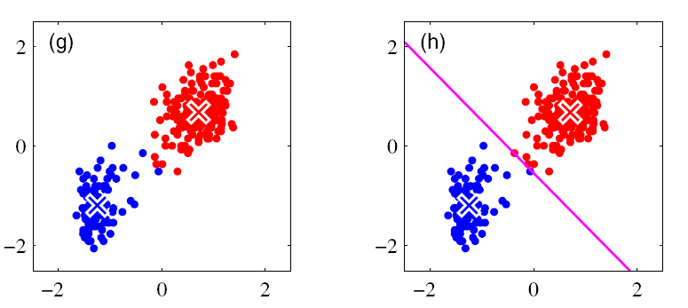
K-means Clustering

Slide 20
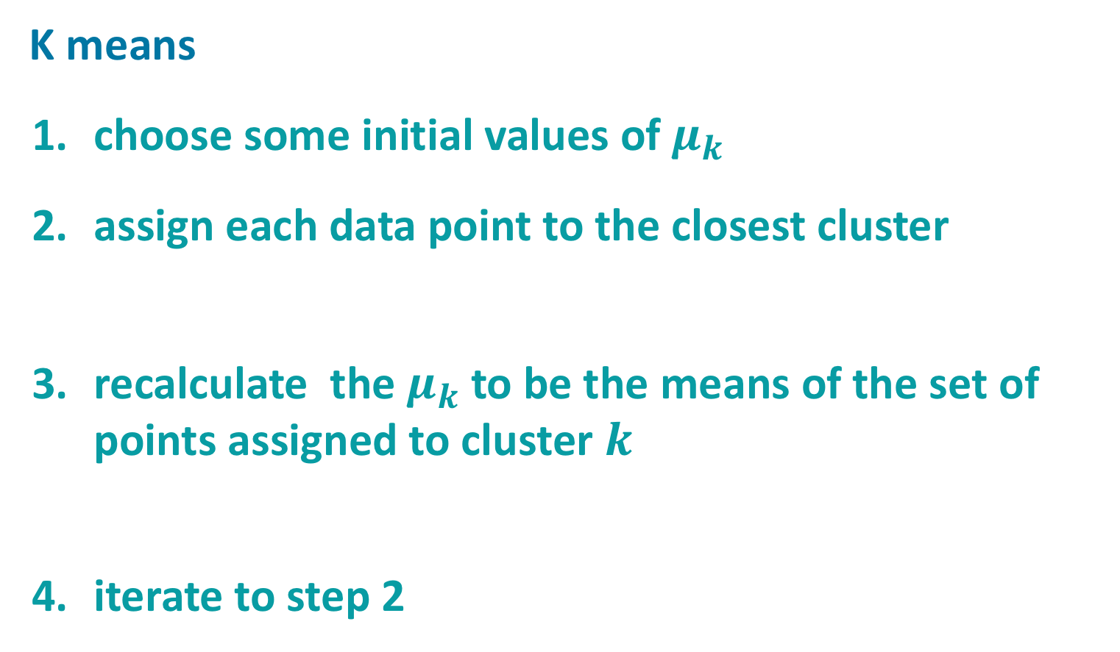
Clustering: K-Means Vs. EM
K means
  choose some initial values of $μ_{k}$
  assign each data point to the closest cluster
  recalculate the $μ_{k}$ to be the means of the set of points assigned to cluster $k$
  iterate to step 2

Slide 21
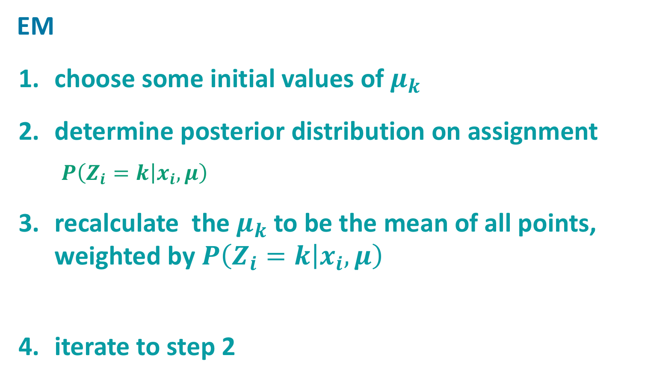
Clustering: K-Means Vs. EM
EM
  choose some initial values of $μ_{k}$
  determine posterior distribution on assignment
    $P\left(Z_{i}=k | x_{i}, μ\right)$
  recalculate the $μ_{k}$ to be the mean of all points, weighted by $P\left(Z_{i}=k | x_{i}, μ\right)$
  iterate to step 2

Slide 22
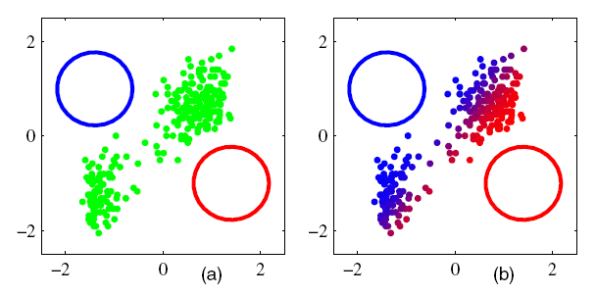
EM for Gaussian Mixtures

Slide 23
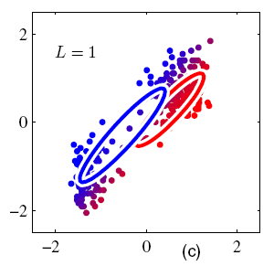
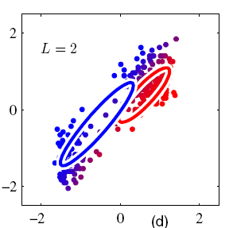
EM for Gaussian Mixtures

Slide 24
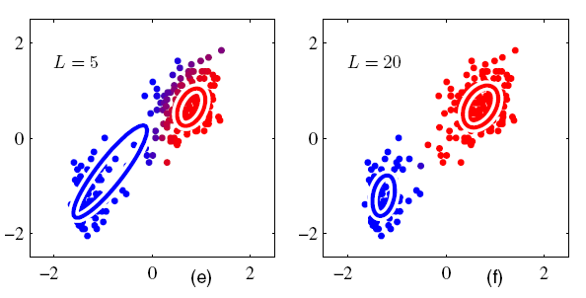
EM for Gaussian Mixtures

Slide 25

Gradient Methods
Useful for continuous parameters θ
Make small incremental steps to maximize the likelihood
Gradient update:
$$p\left(h | v,θ\right)∂log p\left(v,h | θ\right)=\frac{∂p\left(v,h | θ\right)}{p\left(v | θ\right)}$$
swap
Notes:
blue highlights:
e.g., suppose theta is the mean of a gaussian.
can compute partial log(v,h|theta) analytically
can use sampling to obtain p(h|v,theta)

Slide 26
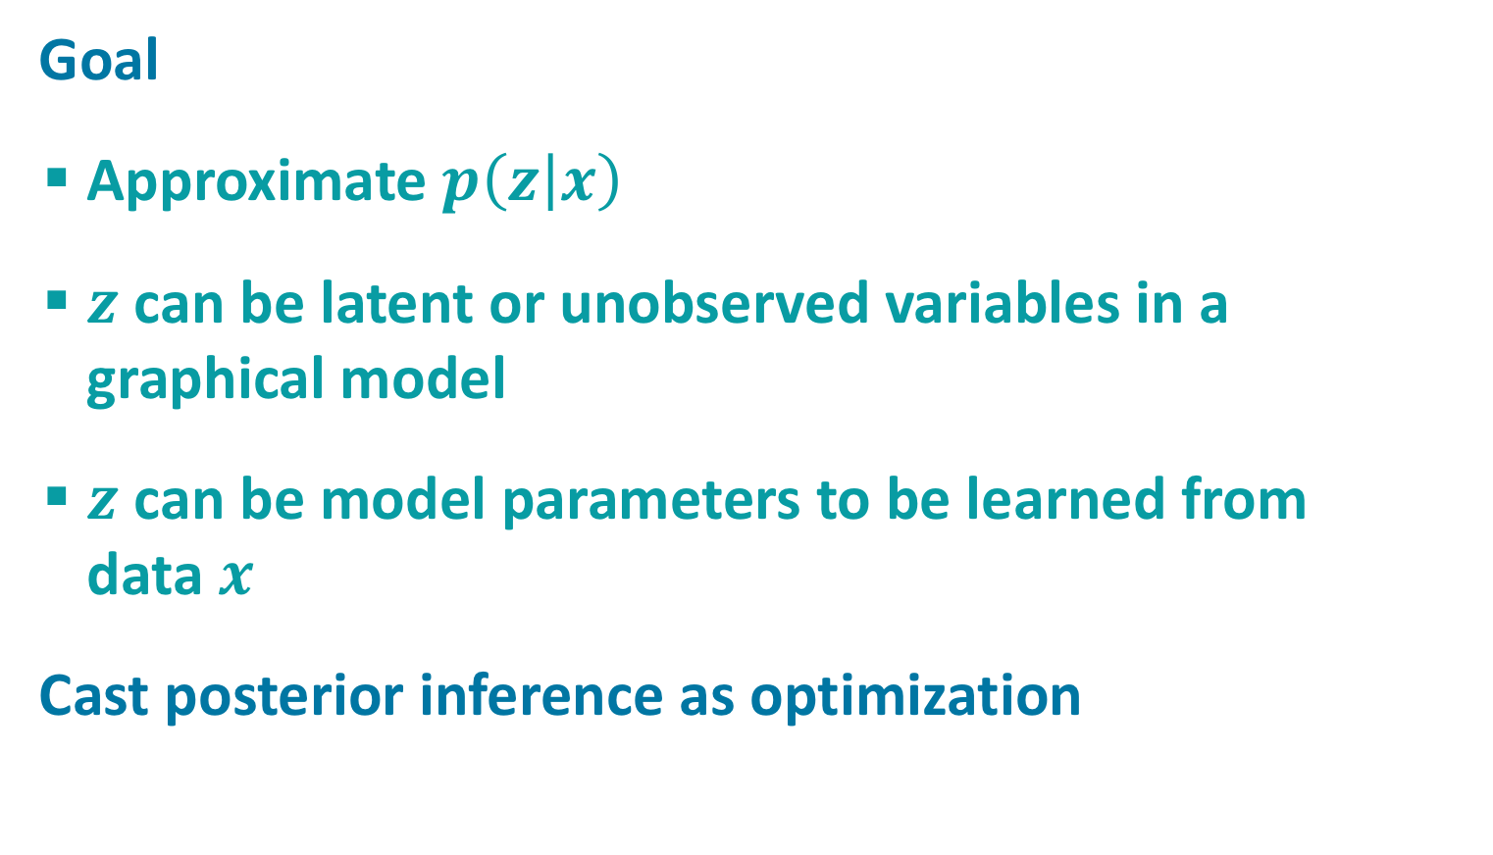
Variational Inference
Goal
  Approximate $p\left(z | x\right)$
  $z$ can be latent or unobserved variables in a graphical model
  $z$ can be model parameters to be learned from
  data $x$
Cast posterior inference as optimization

Slide 27
Variational Inference
Advantages over sampling approaches
  Deterministic
  Easy to determine whether convergence has occurred
  Requires only dozens (not thousands) of iterations
  No restrictions on model (e.g., conjugacy)
Disadvantages over sampling methods
  Hairy math
  Generic versions of variational inference, but often need to customize to the model

Slide 28
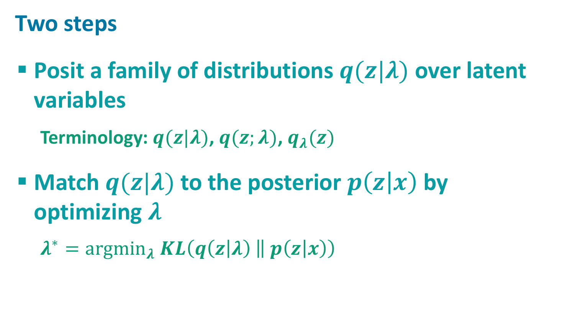
Variational Inference
Two steps
  Posit a family of distributions $q(z|λ)$ over latent variables
    Terminology: $q(z|λ)$, $q(z;λ)$, $q_{λ}(z)$
  Match $q(z|λ)$to the posterior $p\left(z | x\right)$by
  optimizing $λ$
    $λ^{∗}={argmin}_{λ} KL\left(q\left(z | λ\right) \left\| p\left(z | x\right)\right.\right)$

Slide 30
all
means
all
assignments

Slide 35
Multiply by 1
Regroup terms
Apply Jenson’s inequality

Slide 36
Notes:
Break quotient into difference
Apply definition of conditional probability
Reorganize terms

Slide 37
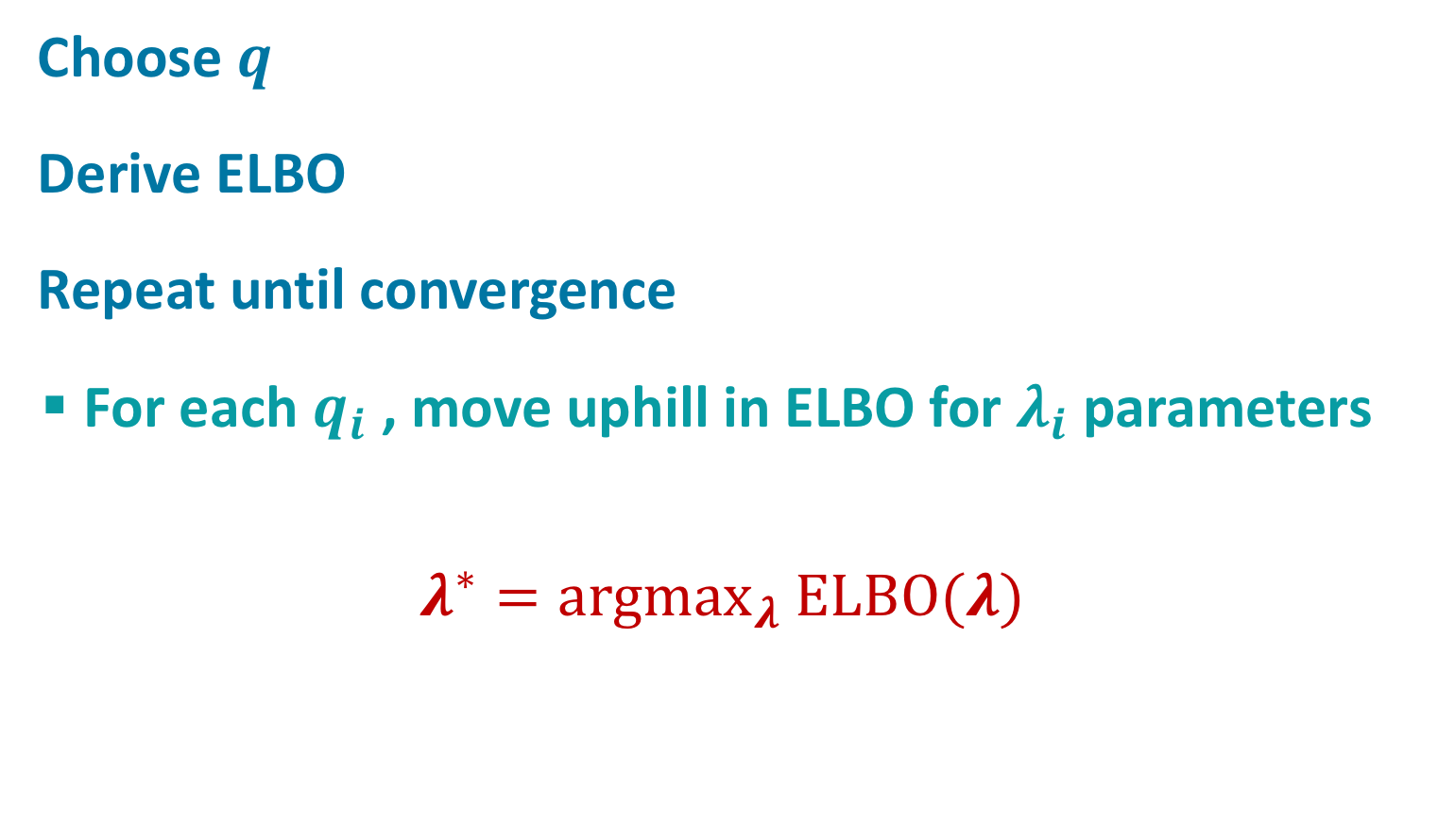
General Approach
Choose $q$
Derive ELBO
Repeat until convergence
  For each $q_{i}$, move uphill in ELBO for $λ_{i}$parameters
$$λ^{∗}={argmax}_{λ} ELBO(λ)$$

Slide 39
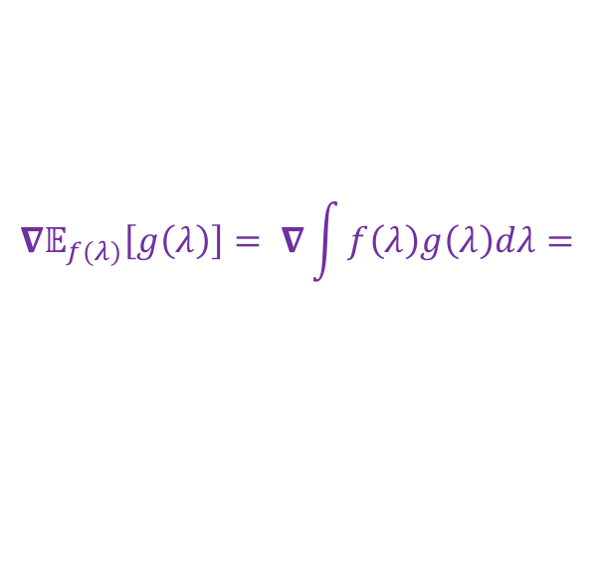
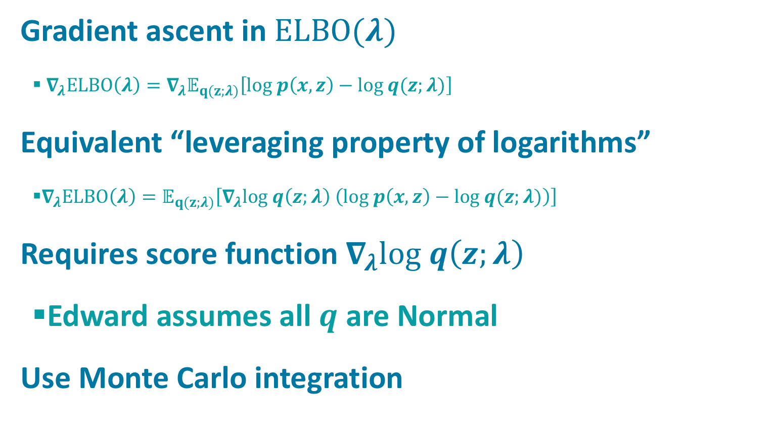
Optimization
Gradient ascent in $ELBO(λ)$
  $∇_{λ}ELBO\left(λ\right)=∇_{λ}𝔼_{q(z;λ)}\left[log p\left(x,z\right)−log q(z;λ)\right]$
Equivalent “leveraging property of logarithms”
  $∇_{λ}ELBO\left(λ\right)=𝔼_{q(z;λ)}\left[∇_{λ}log q\left(z;λ\right) \left(log p\left(x,z\right)−log q(z;λ)\right)\right]$
Requires score function${ ∇}_{λ}log q\left(z;λ\right)$
  Edward assumes all $q$ are Normal
Use Monte Carlo integration
$$∇𝔼_{f(λ)}\left[g\left(λ\right)\right]= ∇\int{f\left(λ\right)g\left(λ\right)dλ=}$$

Slide 40
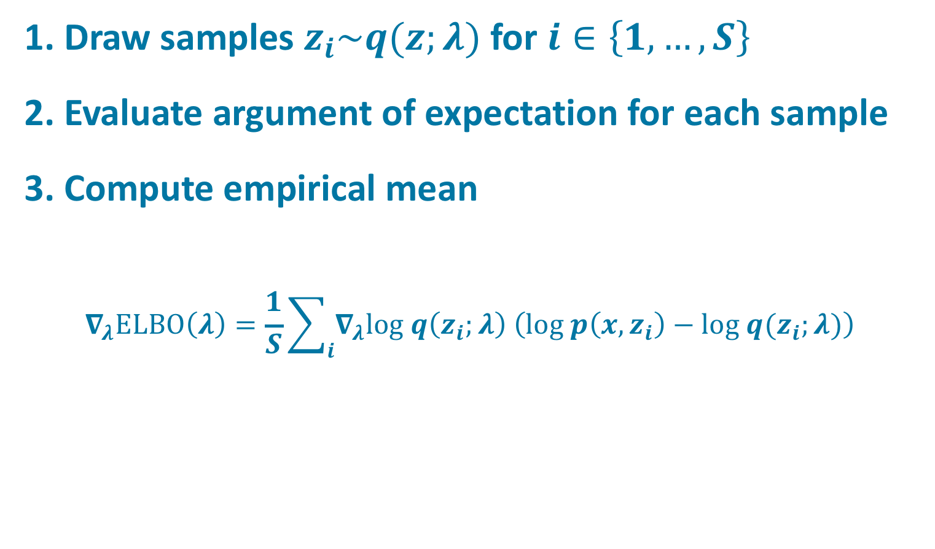
Monte Carlo Integration
1. Draw samples $z_{i}\sim q(z;λ)$ for $i∈\left\{1,…, S\right\}$
2. Evaluate argument of expectation for each sample
3. Compute empirical mean
$$∇_{λ}ELBO\left(λ\right)=\frac{1}{S}\sum_{i}{∇_{λ}log q\left(z_{i};λ\right) \left(log p\left(x,z_{i}\right)−log q(z_{i};λ)\right)}$$

Slide 41
Variational Bayes
Generalization of EM
  also deals with missing data and hidden variables
Produces posterior on parameters
  not just ML solution
Basic (0th order) idea
  do EM to obtain estimates of p(θ) rather than θ directly

Slide 42
Variational Bayes
Assume factorized approximation of joint hidden and parameter posterior:
Find marginals that make this approximation as close as possible.
Advantage?
  Bayesian Occam’s razor: vaguely specified parameter is a simpler model -> reduces overfitting
Notes:
Both E- and M-step is variational approximation

Slide 44

All Learning Methods Apply To
Arbitrary Local Distribution Functions
LOCAL DISTRIBUTION FUNCTION
Local distribution function performs either
  Probabilistic classification (discrete RVs)
  Probabilistic regression (continuous RVs)
Complete flexibility in specifying local distribution fn
  Analytical function
  Look up table
  Logistic regression
  Neural net
  Etc.

Slide 45
Summary Of Learning Section
  Given model structure and probabilities,
  inferring latent variables
  Given model structure,
  learning model probabilities
      Complete data
      Missing data
  Learning model structure

