Slide 1
Modeling Student Learning and Forgetting
Michael C. Mozer
University of Colorado, Boulder

Slide 2
Forgetting Happens
Medical students forget
25-35% of basic science knowledge after 1 yr
> 50% by the next year
80-85% after 25 years
Custers (2010) Custers & ten Cate (2011)
Notes:
REGARDLESS OF THE MATERIAL OR SKILLS BEING TAUGHT, REGARDLESS OF THE AGE OR BACKGROUND OF THE LEARNER, forgetting happens.
EVEN HIGHLY MOTIVATED LEARNERS AREN’T IMMUNE…
[*]

Slide 3
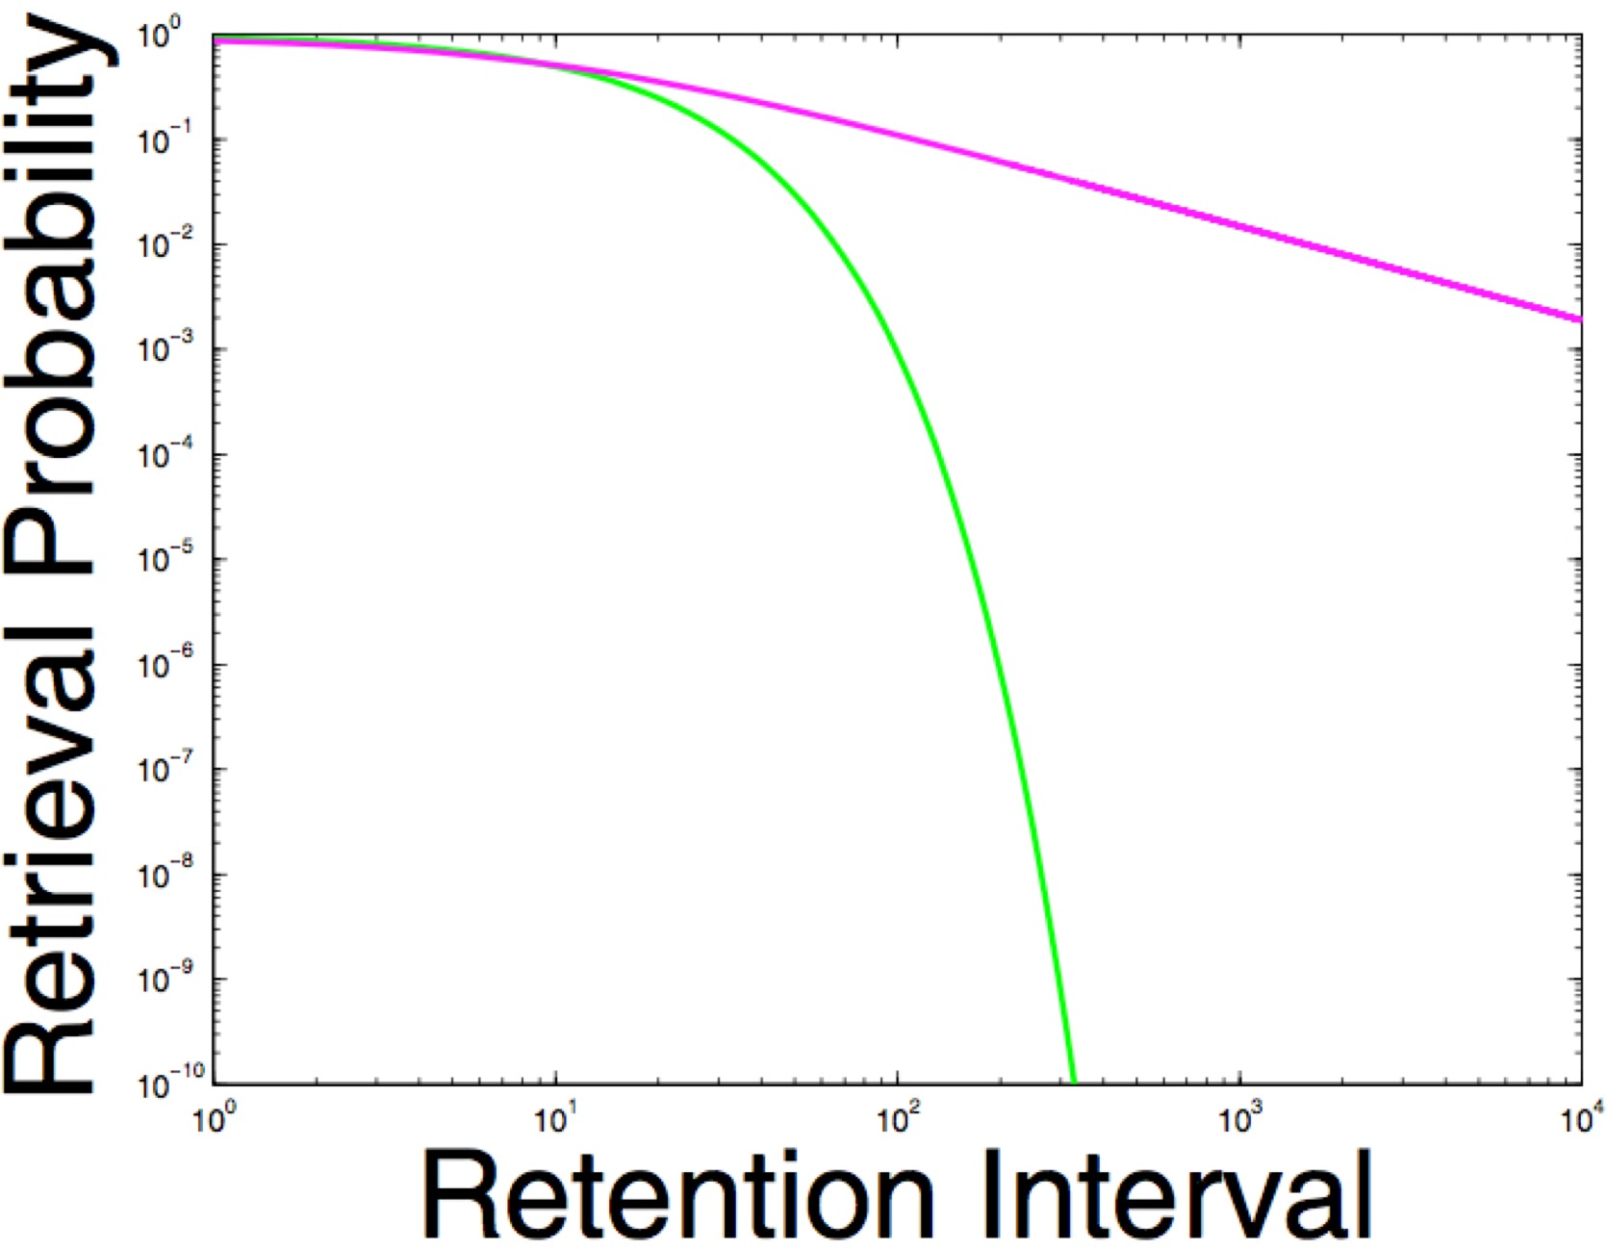
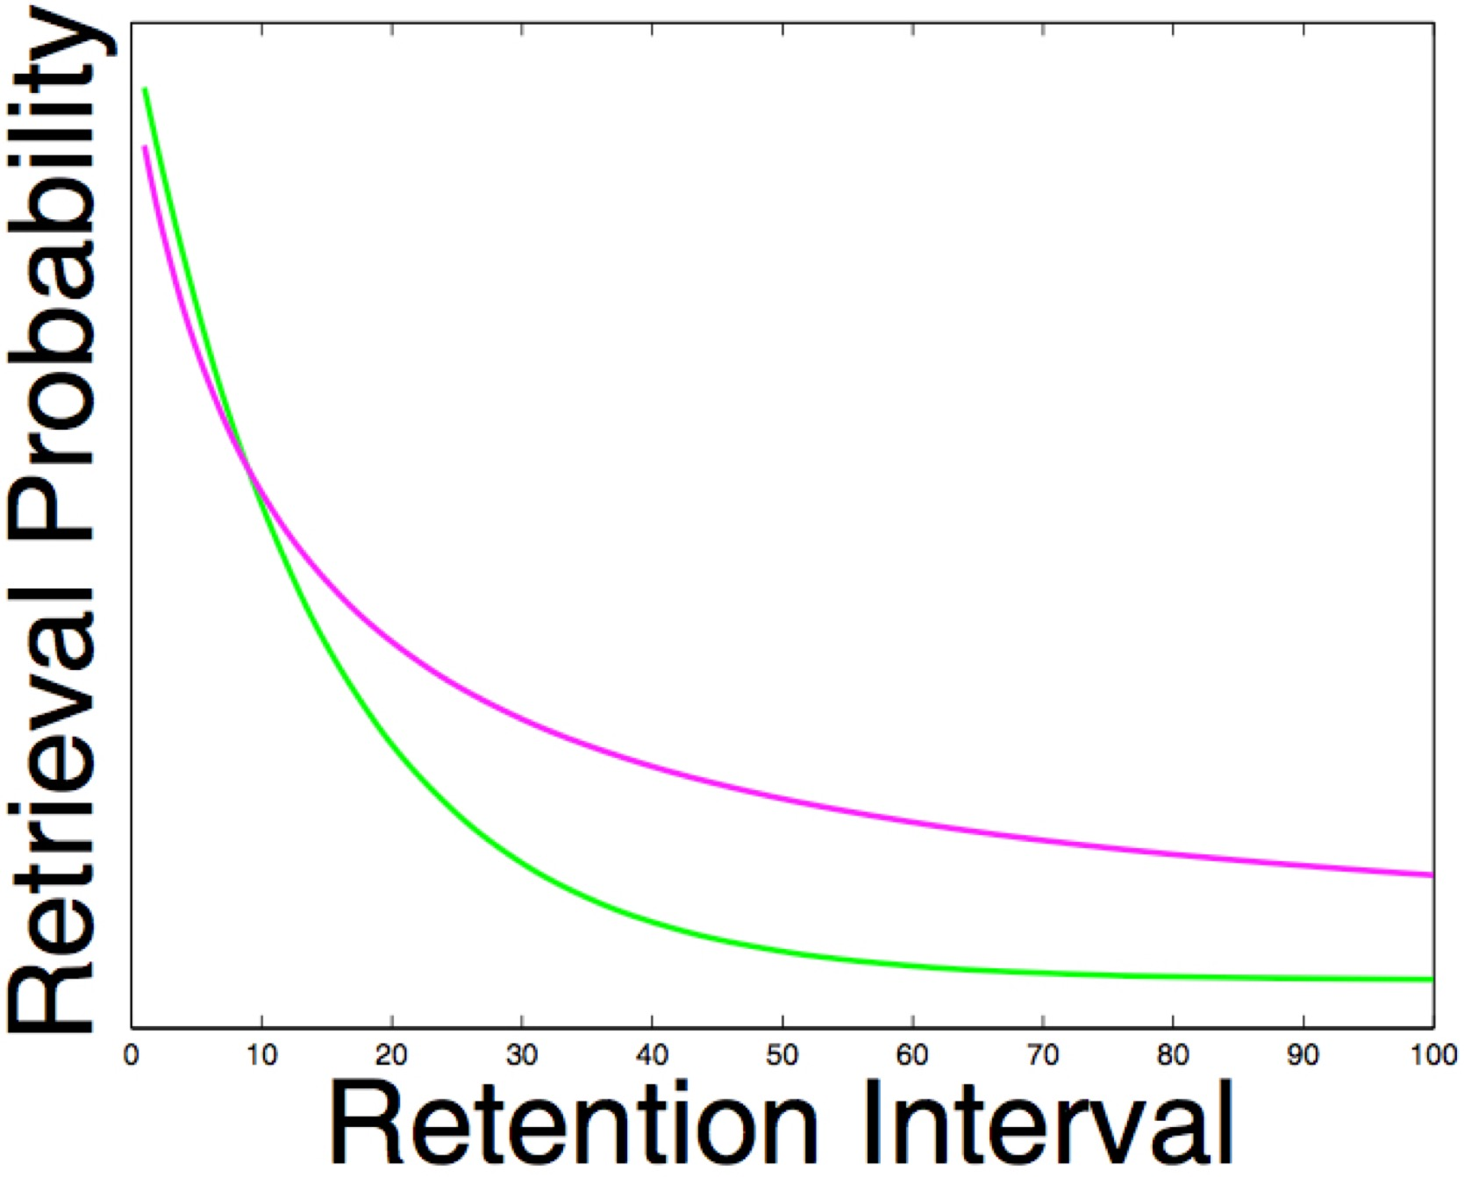
Forgetting Curves
Cepeda et al. (2008)
Power function
$Pr\left(\text{retrieval}\right)=λ{(1+ψt)}^{−φ}$
Exponential
$Pr\left(\text{retrieval}\right)=λe^{−φt}$
retention interval

Slide 4
Time Scales and Human Memory
produces more robust & durable learning than
Spaced study
Massed study
time
Notes:
Forgetting is influenced by the temporal distribution of study.
Spaced study produces more robust and durable learning than massed study.
(Usually explained in psych 1 as "don't cram for exam". That's actually a lie.
If you want to do well on the exam, ...)

Slide 5
Experimental Paradigm To Study Spacing Effect

Slide 6
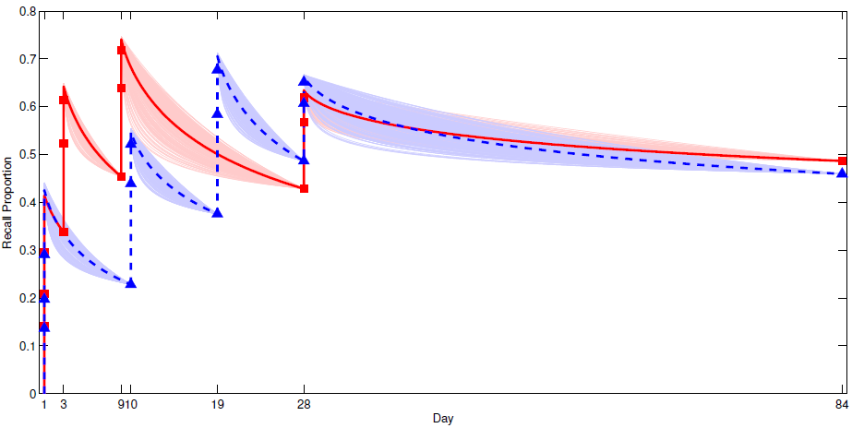
Empirical Data For Two Study Schedules (Kang et al., 2014)
Study on day 1, 3, 9, 28
Study on day 1, 10, 19, 28
Notes:
Population data. Each point is ~16 subjects and ~60 items

Slide 7
Cepeda, Vul, Rohrer, Wixted, & Pashler (2008)
% Recall
Intersession Interval (Days)
Notes:
Nonmonotonic: short spacing bad, long spacing bad. Optimum in between.
Optimal spacing increases with retention interval
Nicolas carried this further with a metaanalysis of the literature…

Slide 8
Domains
Foreign language learning
Cognitive skill acquisition
cat बिल्ली
2⁴
dog
कुत्ता
3x2
cow
गाय
4+7
Notes:
Cat = Bilee (pronounced Billy)
Dog = Kutta (pronounced Coo-tah)
Cow = Gaay (pronounced Guy)

Slide 9
Exploring Forgetting With Big Data
Time | Student | Skill | Success
3/7/18 14:27 | 384 | 77 | 0
3/7/18 14:28 | 384 | 19 | 0
3/7/18 14:50 | 119 | 26 | 1
3/12/18 09:50 | 384 | 77 | 1
3/12/18 09:51 | 384 | 19 | 0
3/12/18 09:52 | 127 | 26 | 1
3/12/18 09:53 | 384 | 19 | 1
3/12/18 09:53 | 119 | 33 | 0
3/12/18 09:55 | 119 | 33 | 1

Slide 10
Predicting Student Performance
Time | Student | Skill | Success
3/7/18 14:27 | 384 | 77 | 0
3/12/18 09:50 | 384 | 77 | 0
3/20/18 12:31 | 384 | 77 | 1
3/25/18 09:52 | 384 | 77 | 0
4/7/18 14:44 | 384 | 77 | 1
Predictive
Model
0 or 1?
4/10/18 11:05

Slide 11
The Model
Memory has a time-varying strength, $s∈[0,1].$
At outset of trial $k$, strength is $s_{k}$
Probability of a correct response depends on memory strength
${\hat{c}}_{k} \sim \text{Bernoulli}\left(s_{k}\right)$
If student is given correct answer at end of trial, memory strength is maximal.
$s_{k^{+}}=1$
Memory decays exponentially
$s_{k+1 }=e^{{−λ}_{k}Δt_{k}} s_{k^{+}}$
$$s$$
$$Δt$$

Slide 12
The Model
The memory decay rate, $λ,$ can change based on past experience.
Consistent with spacing effect
Large $λ$ = rapid decay Small $λ$ = slow decay
$λ_{k}=λ_{k−1}{\left[1+εc_{k}{\left(1−s_{k}\right)}^{γ}\right]}^{−1}$
Initial decay rate is unknown
$λ_{0}\sim \text{Gamma}(μ,ν)$
$$s$$
$$Δt$$

Slide 13
𝜀
𝛾
𝜇
𝜆₀
𝜆_{k-1}
𝜆_{k}
𝜈
t_{k-1}
t_{k}
𝛼
S₀
s_{k-1}
s_{(k-1)}
s_{k}
S_{k}
+
+
𝛽
c_{k-1}
c_{k}
Causal effect of student performance on memory decay
Inferential effect of student performance on memory decay
Notes:
Each observation of student correct or incorrect: update belief about decay rate

Slide 14
CIMM
Causal and inferential memory model

Slide 15
Heirarchical Bayesian CIMM
student
𝜀
𝛾
𝜇
𝜆₀
𝜆_{k-1}
𝜆_{k}
𝜈
t_{k-1}
t_{k}
𝛼
S₀
s_{k-1}
s_{k-1}
s_{k}
s_{k}
+
+
𝛽
item
c_{k-1}
c_{k}

Slide 16
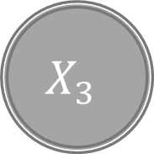
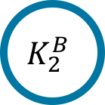
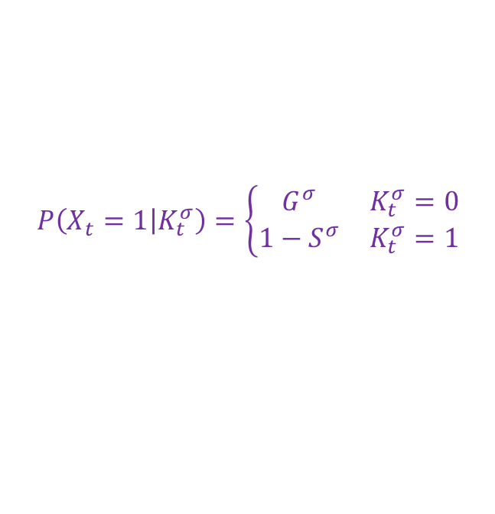
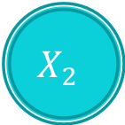
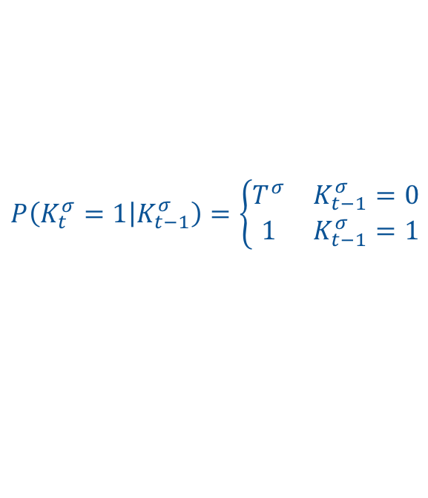
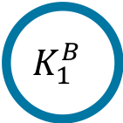
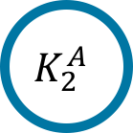
Bayesian Knowledge Tracing (BKT)
HMM with binary latent state per skill
$$P\left(K_{t}^{σ}=1 | K_{t−1}^{σ}\right)=\left\{\begin{matrix}T^{σ} & K_{t−1}^{σ}=0 \\ 1 & K_{t−1}^{σ}=1\end{matrix}\right.$$
…
$$K_{1}^{A}$$
$$K_{2}^{A}$$
…
$$K_{1}^{B}$$
$$K_{2}^{B}$$
$$P\left(X_{t}=1 | K_{t}^{σ}\right)=\left\{\begin{matrix}G^{σ} & K_{t}^{σ}=0 \\ 1−S^{σ} & K_{t}^{σ}=1\end{matrix}\right.$$
$$X_{1}$$
$$X_{2}$$
$$X_{3}$$
$$X_{4}$$
Notes:
student is performing a sequence of problems, correct or incorrect (X)
Latent knowledge state for each skill: learned or not learned
Here 2 skills
Each skill is embodied in a very simple HMM with the dynamics here
Typical implementation: can only learn, not forget. Seems sensible if you’re not modeling long term memory

