Slide 1
Exact Inference (Last Class)
variable elimination
polytrees (directed graph with at most one undirected path between any two vertices; subset of DAGs)
computing specific marginals
belief propagation
polytrees
computing any marginals
polynomial time algorithm
junction tree algorithm
arbitrary graphs
computing any marginals
may be exponential
Notes:
may be exponential (see next slide)

Slide 2
Example Of Intractability
Multiple cause model: X_{i} are binary hidden causes
Compute
What happens as number of X’s increases?
X₁
X₂
X₃
X₄
X₅
X₆
Y
Notes:
Suppose we add an x7. (in the figure, x7=0). Then we need to look at all combinations of values for x1-x6 for each x7 -> exponential in # causes

Slide 3
Approximate Inference
Exact inference algorithms exploit conditional independencies in joint probability distribution.
Approximate inference exploits the law of large numbers.
sums and products of many terms behave in simple ways
Approximate an intractable integral/sum with samples from distribution
Appropriate algorithm depends on
can we sample from p(x)?
can we evaluate p(x)?
can we evaluate p(x) up to the normalization constant?

Slide 4
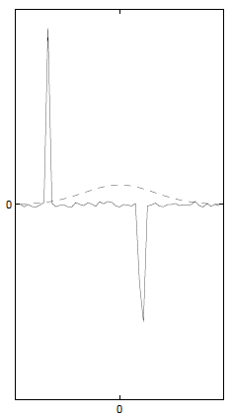
Monte Carlo Sampling
Instead of obtaining p(x) analytically, sample from distribution.
draw i.i.d. samples {x^{(i)}}, i = 1 ... N
e.g., 20 coin flips with 11 heads
With enough samples, you can estimate even continuous distributions empirically.
This works if you can sample from p(x) directly
e.g., Bernoulli, Gaussian random variables
Challenge if F(x) varies a lot in regions of low p(x)
Notes:
Integral is an expectation of F(.) under p(x)

Slide 5
Sampling From A Bayes Net
P(C)
0.50
P(C)
0.50
Cloudy
Cloudy
C | P(S|C)
T | .10
F | .50
C | P(S|C)
T | .10
F | .50
C | P(R|C)
T | .80
F | .20
C | P(R|C)
T | .80
F | .20
Sprinkler
Sprinkler
Rain
Rain
Wet Grass
Wet Grass
S | R | P(W|S,R)
T | T | .99
T | F | .90
F | T | .90
F | F | .01
S | R | P(W|S,R)
T | T | .99
T | F | .90
F | T | .90
F | F | .01

Slide 6
What if you can’t sample from p(x)
… but you can evaluate p(x)?
…but you can evaluate p(x) only up to a proportionality constant?

Slide 7
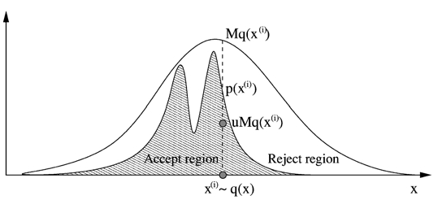
Rejection Sampling
Cannot sample from p(x), but can evaluate p(x) up to proportionality constant.
Instead of sampling from p(x), use an easy-to-sample proposal distribution q(x).
p(x) <= M q(x), M < ∞
Reject proposals with probability 1-p(x)/[Mq(x)]
Notes:
we talked about how rejection sampling gives you the right posteriors.
shoot a dart under Mq curve. if lands in light region the reject.
same thing to draw from q and reject with prob ratio

Slide 8
Rejection Sampling
Problems
It may be difficult to find a q(x) with a small M that is easy to sample from
Very expensive if x is high dimensional
Examples
Sample P(X₁|X₂=x₂) from a Bayes net
Sample from full joint, P(X₁, X₂, X₃, X₄, X₅, …), and reject cases where X₂ ≠ x₂
E(x²|x>4) where x ~ N(0,1)
arbitrary function (next slide)
Notes:
P(x) drops off exponentially with number of dimensions of x
The next scheme is going to work better in high dimensional cases.

Slide 9
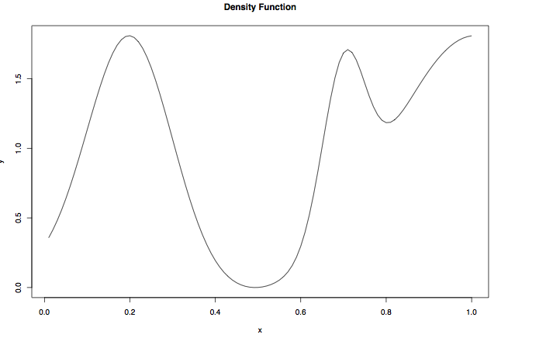
Rejection Sampling
What should we use as proposal distribution?
Notes:
how about uniform distribution?

Slide 10
Importance Sampling
Use when
Can evaluate p(x)
An easily sampled proposal distribution q(x) similar to p(x) is available
Reweight each sample by w = p(x^{(i)})/q(x^{(i)})

Slide 11
Importance Sampling
When normalizing constant of p(x) is unknown, it's still possible to do importance sampling with ŵ^{(i)}
w^{(i)} = p(x^{(i)}) / q(x^{(i)})
ŵ^{(i)} = w^{(i)} / ∑_{j} w^{(j)}
Note that any scaling constant in p(.) will be removed by the normalization.
Problem with importance and rejection sampling
May be difficult to find proposal distribution that is easy to sample from and a good match to p(x)

Slide 12
Likelihood Weighting: Special Case Of Importance Sampling
Goal: estimate conditional distribution, p(x|e), by sampling (the nonevidence variables) from unconditional distribution p(x)
We discussed how to do this with rejection sampling.
Importance sampling reweights each sample by w = p(x^{(i)})/q(x^{(i)}) = p(x|e) / p(x) = [p(e|x) p(x) / p(e)] / p(x) = p(e|x) /p(e) ~ p(e|x)
Weight each sample by likelihood it accords the evidence
Notes:
P(e) is constant so can be discarded

Slide 13
Likelihood Sampling
P(C)
0.50
P(C)
0.50
Cloudy
Cloudy
C | P(S|C)
T | .10
F | .50
C | P(S|C)
T | .10
F | .50
C | P(R|C)
T | .80
F | .20
C | P(R|C)
T | .80
F | .20
Sprinkler
Rain
Rain
Wet Grass
S | R | P(W|S,R)
T | T | .99
T | F | .90
F | T | .90
F | F | .01
S | R | P(W|S,R)
T | T | .99
T | F | .90
F | T | .90
F | F | .01
W = .10 x .90

Slide 14
Markov Chain Monte Carlo (MCMC)
Notation change
warning
Goal
Generates sequence of samples from a target distribution p*(x)
Markov Chain property
Sample t+1 depends only on sample t
Key assumption
Although we do not know how to sample from p*(x) directly, we know how to update samples in a way that is consistent with p*(x)
Notes:
using p* as target distribution, not p

Slide 15
MCMC Updating
P(C)
0.50
Cloudy
C | P(S|C)
T | .10
F | .50
C | P(R|C)
T | .80
F | .20
Sprinkler
Rain
Wet Grass
S | R | P(W|S,R)
T | T | .99
T | F | .90
F | T | .90
F | F | .01

Slide 16
MCMC
Define a Markov chain where each state is an assignment of values to each variable
x¹ → x² → x³ → ...
X^{i} ~ p^{i} (X)
With property p^{i}(X^{i} = x^{i}) = ∑ p^{i-1} (X^{i-1} = x^{i-1})T(x^{i-1}→x^{i})
T(x^{i-1}→x^{i}) is the Markov chain transition probability = p(X = x^{i}|X^{i-1} = x^{i-1})
We’ll achieve goal if the invariant or stationary distribution of the chain is p*(X):
p*(X^{i} = x^{i}) = ∑ p*(X^{i-1} = x^{i-1})T(x^{i-1}→x^{i})
Notes:
invariant/stationary distribution: once you get there, you stay there

Slide 17
MCMC
Procedure
Start X in a random state
Repeatedly resample X based on current state of X
After sufficient burn in, X reaches a stationary distribution.
Use next s samples to form empirical distribution
Idea
Chain will draw X from more probable regions of p*(X)
Chain is efficient because you can get from one sample drawn from p* (X) to another (after the burn in)
MCMC sampler
Requires means of sampling from transition probability distribution

Slide 18
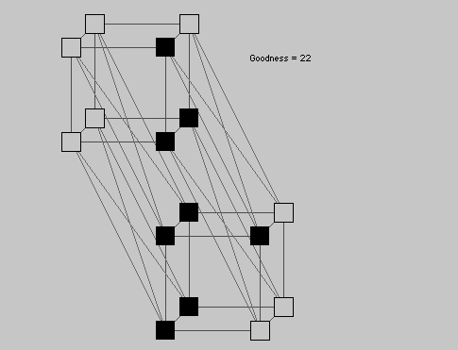
Example: Boltzmann Machine
http://www.cs.cf.ac.uk/Dave/JAVA/boltzman/Necker.html

Slide 19
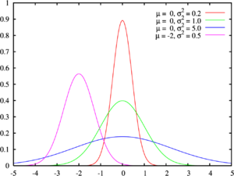
Example: Gaussian Mixture Model
Suppose you know that data samples are generated by draws of a Gaussian mixture model with a fixed number of components.
Chicken and egg problem
Don’t know assignment of samples to components (z)
Don’t know individual Gaussian means and covariances (λ)
Start off with guesses about assignments and mixture model parameters
Update guesses assuming current assignments and parameters

Slide 20
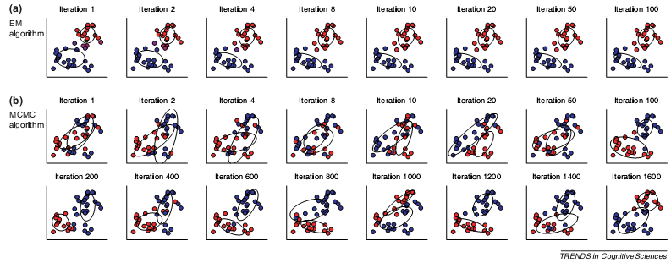
Example: Gaussian Mixture Model
Note contrast to EM which finds local maximum only not distribution

Slide 21
Equilibrium Distribution
Want to obtain a unique equilibrium (stationary) distribution regardless of the initial conditions p⁰ (X⁰)
i.e.,

Slide 22
Equilibrium Distribution
A stationary (equilibrium) distribution will be reached regardless of the initial state if a Markov chain is ergodic.
Ergodicity:
1. Irreducible (can get from any state to any other)
2. Aperiodic (cannot get stuck in cycles)
Notes:
T^k : means transition in k states.
Cycles limit how frequently you can return to a state (e.g., every 3 transition -> GCD = 3)

Slide 23
Equilibrium Distribution
Stronger condition than ergodicity
detailed balance (time reversibility)
Stronger condition still
symmetry of transition matrix
Both guarantee equilibrium distribution will be reached
Notes:
detailed balance: likelihood of P(x, x’) = P(x’, x)

Slide 24
Burn In
The idea of the burn in period is to stabilize chain
i.e., end up at a point that doesn't depend on where you started
e.g., person's location as a function of time
Justifies arbitrary starting point.
Mixing time
how long it takes to move from initial distribution to p*(X)
Notes:
I know where you’re going to be 1 second after class ends, maybe 1 min later I have some uncertainty, 1 hour later, 1 decade later…

Slide 25
MCMC Via Metropolis Algorithm
Does not require computation of conditional probabilities (and hence normalization)
Procedure
at each step, i, where chain is in state x^{i}
choose a new value for state, x*, from a symmetric proposal distribution q, i.e., q(x*| x^{i}) = q(x^{i} |x*) e.g., q(x*| x^{i}) = N(x*; x^{i},σ²)
accept new value with probability
Notation change
warning
Notes:
Sampling in neighborhood of x^I
Requirement of proposal distribution: it can be sampled from

Slide 26
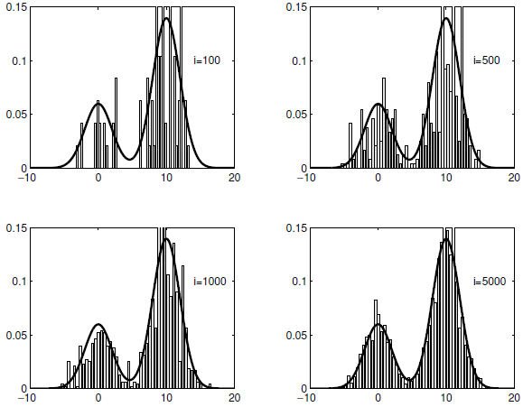
p(X): mixture of Gaussians q(X): single Gaussian

Slide 27
Extension To Metropolis Algorithm
Acceptance probability:
If proposal distribution is asymmetric, then we have a more general algorithm: Metropolis-Hastings Intuition
q ratio tests how easy is it to get back to where you came from
ratio is 1 for Metropolis algorithm
Notes:
For metropolis-hastings, need not only to be able to sample from proposal distribution, but also evaluate probability (up to normalization constant)

Slide 28
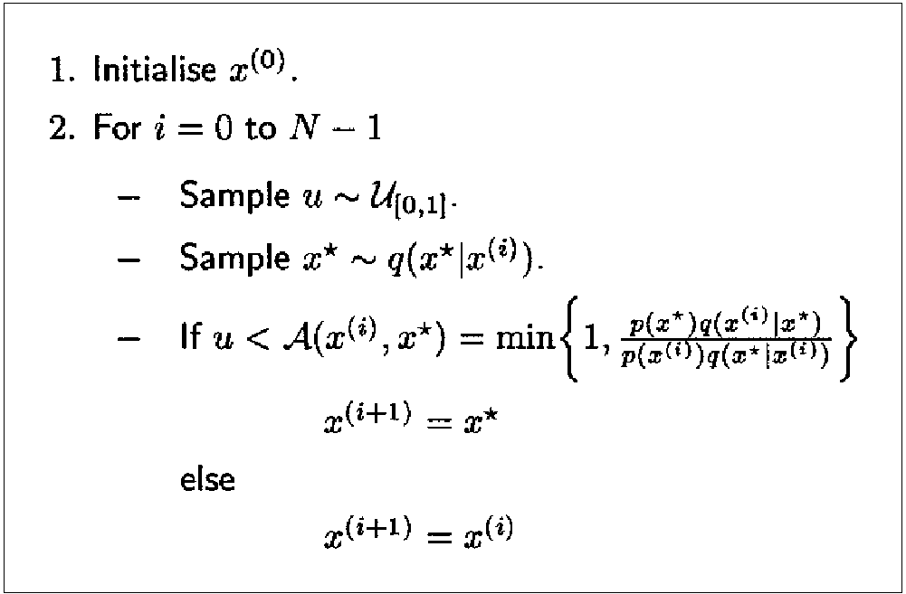
Metropolis Hastings Algorithm
Notes:
NOTE that when new sample is rejected, old x is resampled. why does this matter? what are we going to do with the vector x?

Slide 29
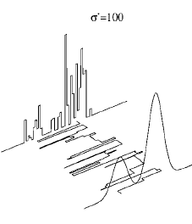
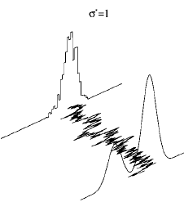
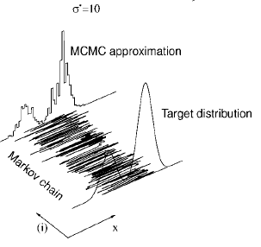
Convergence: Why Proposal Distribution Matters
Proposal distribution is too broad → Acceptance probability low → Slow convergence
Proposal distribution is too narrow → Long time to explore state space → Slow convergence

Slide 30
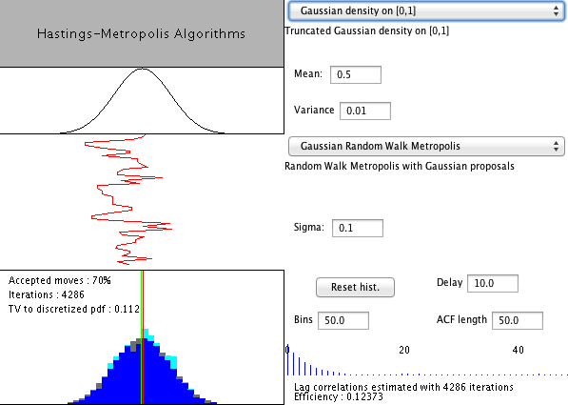
Neat Web Demo
http://www.lbreyer.com/classic.html

Slide 31
Gibbs Sampling
Useful when full conditional distribution can be computed and efficiently sampled from
Overview
at each step, select one variable x_{j} (random or fixed seq.)
Compute conditional distribution p(x_{j} | x_{-j})
a value is sampled from this distribution
Replace the previous value of x_{j} with the sample
cliques containing x_{j}
Notes:
Special case of metropolis hastings…as I’ll explain in a bit.
J is index over nodes; U markov blanket
note that you can do Gibbs sampling with any discrete Bayes net pretty easily
This is what I was doing with the sprinkler/rain example

Slide 32
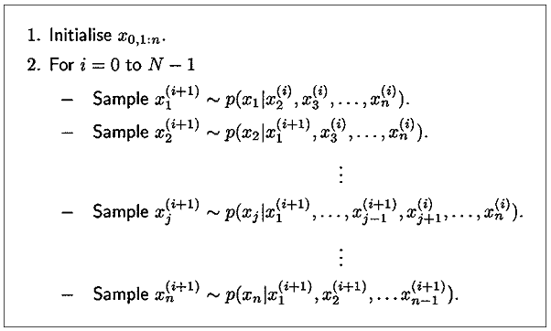
Gibbs Sampling Algorithm

Slide 33
Gibbs Sampling
Assumes efficient sampling of conditional distribution
Efficient if C_{j} is small: includes cliques involving parents, children, and children's parents – a.k.a. Markov blanket
Normalization term is often the tricky part

Slide 34
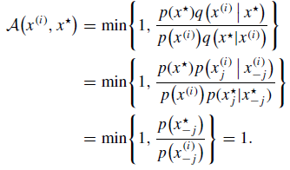
Gibbs Sampling
Proposal distribution
With this proposal distribution, acceptance probability under Metropolis-Hastings is 1
Notes:
Second line of derivation: P(x*)/P(x*j/x*-j) : P(x1*,x2*,x3*)/P(x1*|x2*,x3*) … P(a,b,c)/P(a | b,c) = P(b,c)
Because all values except xj are clamped, ratio at bottom is = 1

Slide 35
Gibbs Sampling Example: Gaussian Mixture Model
Resample each latent variable conditional on the current values of all other latent variables
Start with random assignments for the Z_{i}
Loop through all latent variables in random order
Draw a sample: P(Z_{i}=z | x, λ) ~ p(x | z, λ) P(z)
Reestimate λ (either after each sample or after an entire pass through the variables?). Same as M step of EM

Slide 36
Comments on Gibbs Sampling
Straightforward with DAGs due to Bayes net factorization
Can conceptually update variables with no conditional dependencies in parallel
E.g., Restricted Boltzmann machine

Slide 37
Comment On Sampling Schemes
Obtains time series of samples
Can bin to approximate posterior
Can compute MAP

Slide 38
Particle Filters
Time-varying probability density estimation
E.g., tracking individual from GPS coordinates
state (actual location) varies over time
GPS reading is a noisy indication of state
Could be used for HMM-like models that have no easy inference procedure
Basic idea
represent density at time t by a set of samples (a.k.a. particles)
weight the samples by importance
perform sequential Monte Carlo update, emphasizing the important samples

Slide 39
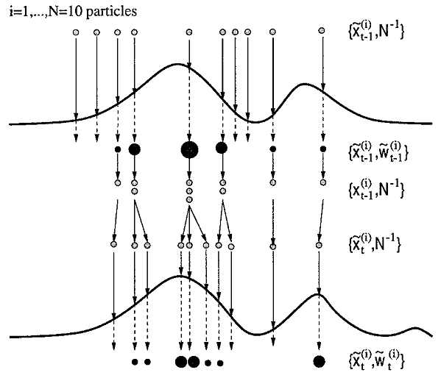
Weight by importance
Discrete resampling
time
MCMC step
Notes:
Relative weighting is all that matters -> pdf needs to be estimated up to normalization constant

Slide 40
Variational Methods
Like importance sampling, but...
instead of choosing a q(.) in advance, consider a family of distributions {q_{v}(.)}
use optimization to choose a particular member of this family
i.e., find a q_{v}(.) that is similar to the true distribution p(.)
Optimization
minimize variational free energy = Kullback-Leibler divergence between p and q = ‘distance’ between p and q

Slide 41
Variational Methods: Mean Field Approximation
X
P(X)
.5
Consider this simple Bayes net
What does joint look like?
What is E(X), E(Y)?
E(X)=E(Y)=.5
Mean field approximation involves building a net with no dependencies, and setting priors based on expectation.
X | P(Y|X)
0 | .9
1 | .1
Y
X | Y | P(X,Y)
0 | 0 | .05
0 | 1 | .45
1 | 0 | .45
1 | 1 | .05
X
Y
Notes:
Explain mean field approximation: suppose P(x)=.5 and P(y|x)=.9 and P(y|~x)=.1

Slide 42
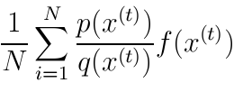
Variational Methods: Mean Field Approximation
Restrict q to the family of factorized distributions
Procedure
initialize approximate marginals q(x_{i}) for all i
pick a node at random
update its approximate marginal fixing all others
sample from q and to obtain an x^{(t)} and use importance sampling estimate
Expectation with respect
to factorized distribution
of joint probability
normalization term
Σf(x)p(x)
where
f(x) = log Ψ_{C}(x)
t
Notes:
expectation with respect to factorized distribution
Ignore first summation to explain: rest is the expectation of the log clique potential with respect to the factorized distribution
but the [Prod_j q_j] term i

Slide 43
Variational Methods: Bethe Free Energy
Approximate joint distribution in terms of pairwise marginals, i.e., q_{ij}(x_{i},x_{j})
Yields a better approximation to p
Do a lot of fancy math and what do you get?
loopy belief propagation
i.e., same message passing algorithm as for tree-based graphical models
Appears to work very well in practice

