Slide 1
Hidden Markov Models

Slide 2
Room Wandering
I’m going to wander around my house and tell you objects I see.
Your task is to infer what room I’m in at every point in time.

Slide 3
Observations
Sink
Toilet
Towel
Bed
Bookcase
Bench
Television
Couch
Pillow
…
{bathroom, kitchen, laundry room}
{bathroom}
{bathroom}
{bedroom}
{bedroom, living room}
{bedroom, living room, entry}
{living room}
{living room}
{living room, bedroom, entry}
…

Slide 4
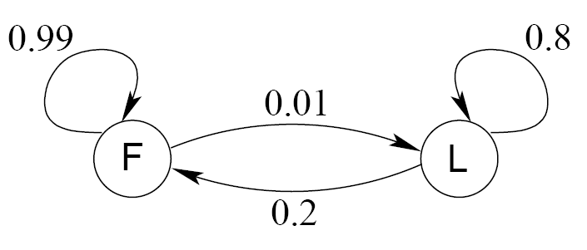
Another Example:
The Occasionally Corrupt Casino
A casino uses a fair die most of the time, but occasionally switches to a loaded one
Emission probabilities
  Fair die: Prob(1) = Prob(2) = . . . = Prob(6) = 1/6
  Loaded die: Prob(1) = Prob(2) = . . . = Prob(5) = 1/10, Prob(6) = ½
Transition probabilities
  Prob(Fair | Loaded) = 0.01
  Prob(Loaded | Fair) = 0.2
  Transitions between states obey a Markov process

Slide 5
Another Example:
The Occasionally Corrupt Casino
Suppose we know how the casino operates, and we observe a series of die tosses
3 4 1 5 2 5 6 6 6 4 6 6 6 1 5 3
Can we infer which die was used?
F F F F F F L L L L L L L F F F
Note that inference requires examination of sequence not individual trials.
Note that your best guess about the current instant can be informed by future observations.

Slide 6
Formalizing This Problem
  Observations over time
    Y(1), Y(2), Y(3), …
  Hidden (unobserved) state
    S(1), S(2), S(3), …
  Hidden state is discrete
  Here, observations are also discrete but can be continuous
  Y(t) depends on S(t)
  S(t+1) depends on S(t)

Slide 7
Hidden Markov Model
Markov Process
  Given the present state, earlier observations provide no information about the future
  Given the present state, past and future are independent

Slide 8
Application Domains
Character recognition
Word / string recognition

Slide 9
Application Domains
Speech recognition

Slide 10
Application Domains
Action/Activity Recognition
Figures courtesy of B. K. Sin
Notes:
Factorial HMM – we’ll discuss

Slide 11
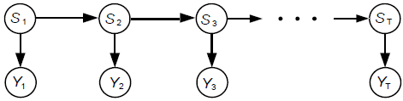
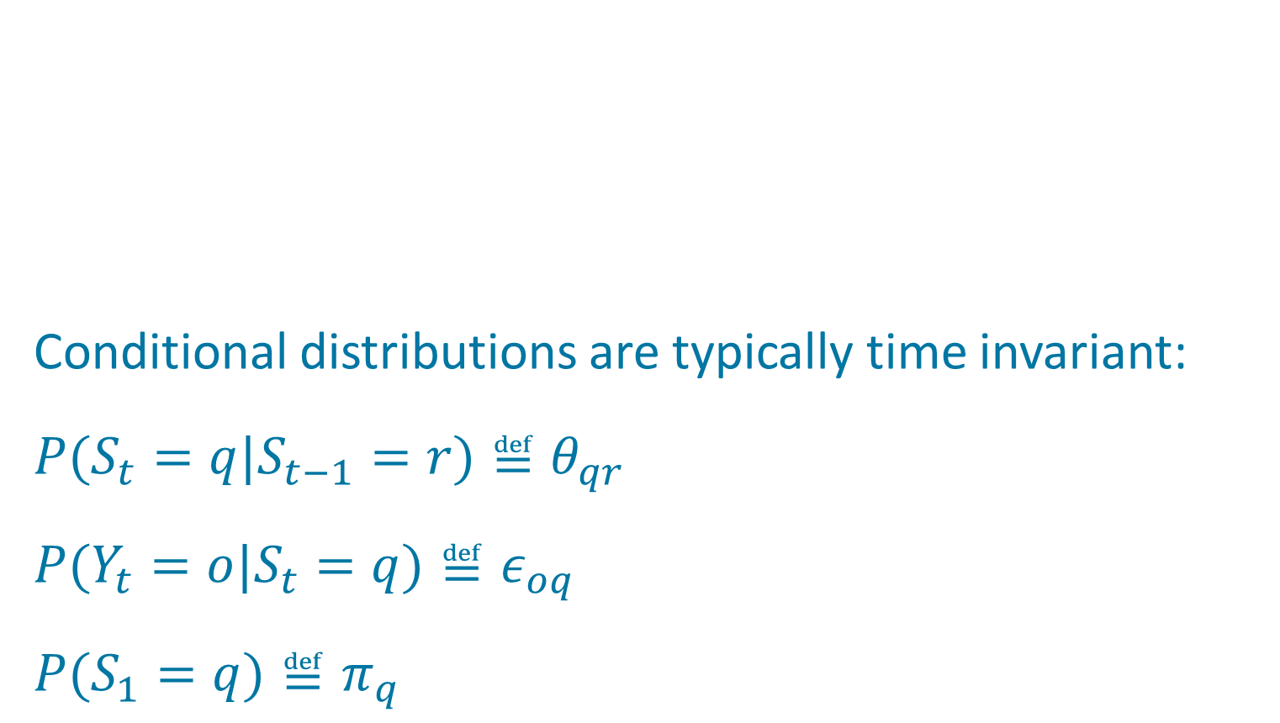
HMM Is A Probabilistic Generative Model
hidden state
observations

Slide 12
Inference on HMM
State inference and estimation
    P(S(t)|Y(1),…,Y(t))
    Given a series of observations, what’s the current hidden state?
    P(S|Y)
    Given a series of observations, what is the distribution over hidden states?
    argmax_{S}[P(S|Y)]
    Given a series of observations, what’s the most likely values of the hidden state? (a.k.a. decoding problem)
Prediction
    P(Y(t+1)|Y(1),…,Y(t)): Given a series of observations, what observation will come next?
Evaluation and Learning
    P(Y|model):
    Given a series of observations, what is the probability that the observations were generated by the model?
    What model parameters would maximize P(Y|model)?
Notes:
Like all probabilistic generative models, HMM can be used for various sorts of inference

Slide 13
Is Inference Hopeless?
1
1
1
1
…
1
2
2
2
2
2
…
2
…
…
…
…
N
N
K
N
…
N
S₁
S₂
S₃
S_{T}
X₁
X₂
X₃
X_{T}
Complexity is O(N^{T})
S₁
S₁
S₁
S₁
Notes:
Dynamic programming -> O(T * N^2)?

Slide 14
State Inference: Forward Agorithm
Goal: Compute P(S_{t} | Y_{1…t}) ~ P(S_{t}, Y_{1…t}) = ≅α_{t}(S_{t})
Computational Complexity: O(T N²)

Slide 15
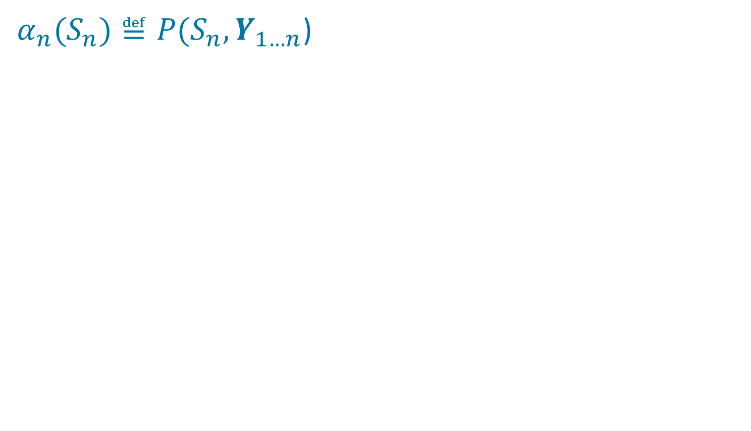
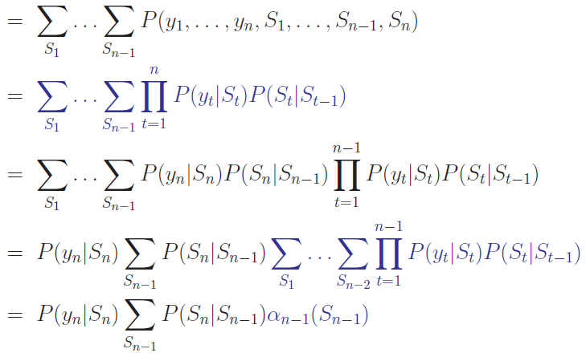
Deriving The Forward Algorithm
Notation change warning:
n ≅ current time (was t)
Slide stolen
from Dirk
Husmeier

Slide 16
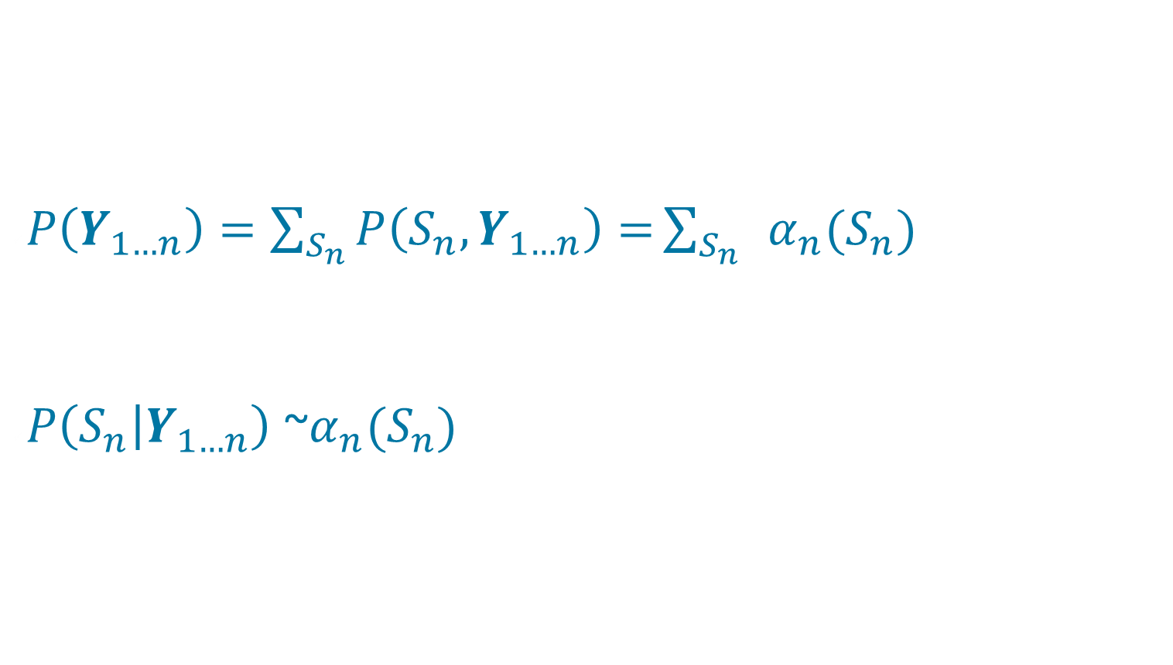
What Can We Do With α?
Notation change warning:
n ≅ current time (was t)

Slide 17
State Inference: Forward-Backward Algorithm
Goal: Compute P(S_{t} | Y_{1…T})

Slide 18
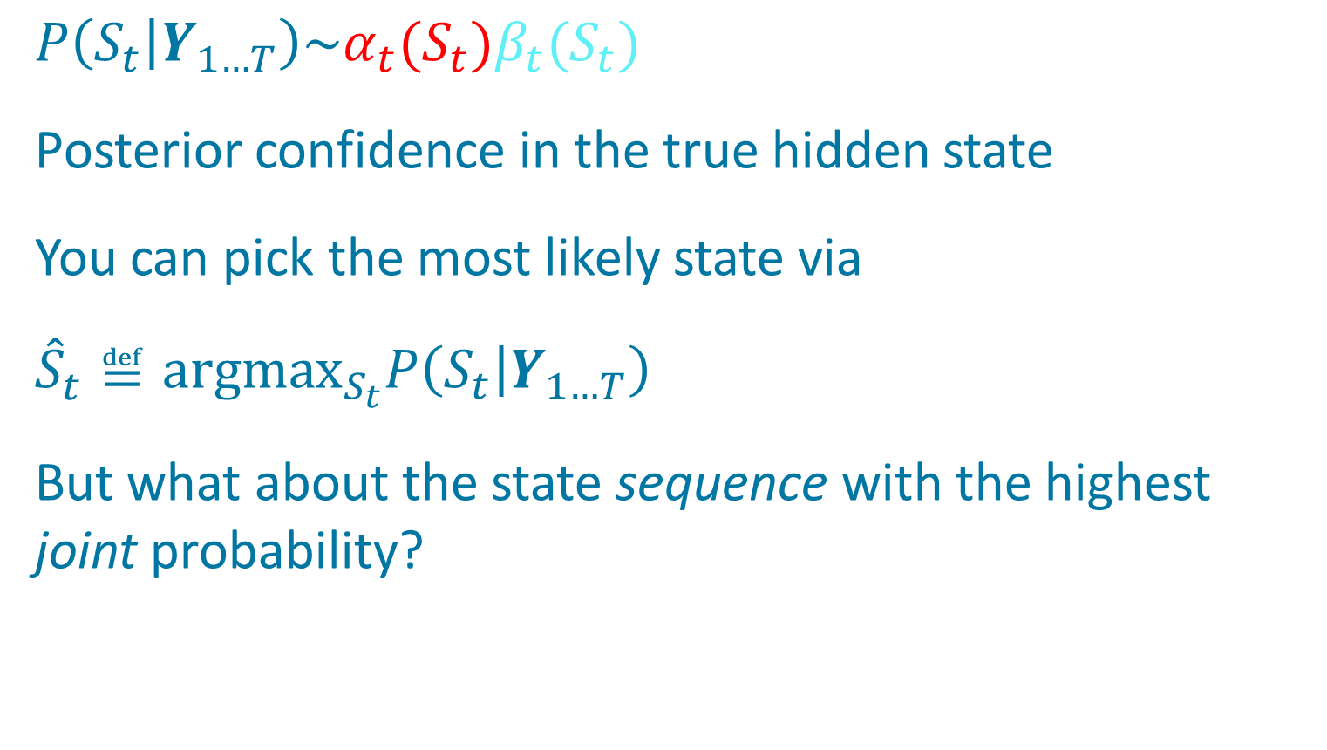
Optimal State Estimation

Slide 19
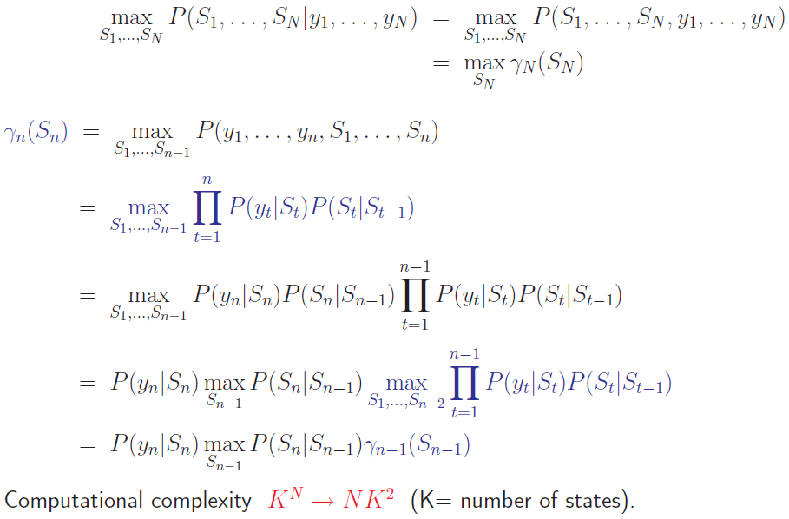
Viterbi Algorithm:
Finding The Most Likely State Sequence
Notation change warning:
n ≅ current time step (previously t)
N ≅ total number time steps (prev. T)
Slide stolen
from Dirk
Husmeier
Notes:
gamma: take the best sequence up to the current time and then explore alternative states
like alpha except with max instead of sum

Slide 20




Viterbi Algorithm
Relation between Viterbi and forward algorithms
    Viterbi uses max operator
    Forward algorithm uses summation operator
Can recover state sequence by remembering best S at each step n
Practical trick: Compute with logarithms

Slide 21
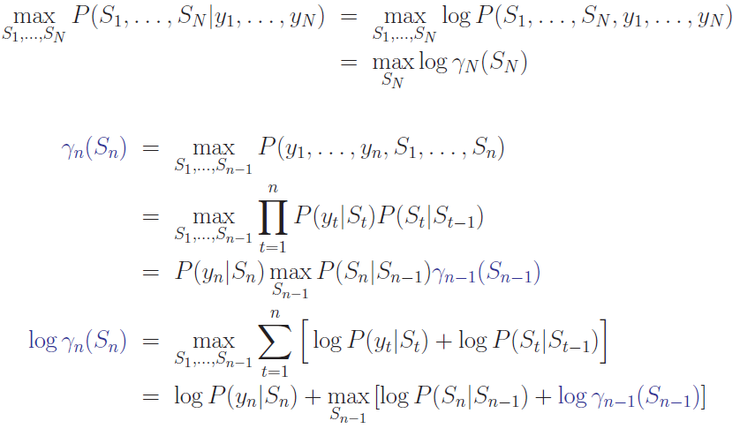
Practical Trick: Operate With Logarithms
Notation change warning:
n ≅ current time step (previously t)
N ≅ total number time steps (prev. T)
Prevents numerical underflow
Notes:
All the math works out to compute log gamma incrementally

Slide 22
Training HMM Parameters
Baum-Welsh algorithm, special case of
Expectation-Maximization (EM)
    1. Make initial guess at model parameters
    2. Given observation sequence, compute hidden state posteriors, P(S_{t} | Y_{1…T}, π,θ,ε) for t = 1 … T
    3. Update model parameters {π,θ,ε} based on inferred state
Guaranteed to move uphill in total probability of the observation sequence: P(Y_{1…T} | π,θ,ε)
    May get stuck in local optima
Notes:
model parameter updates: NEXT SLIDE

Slide 23
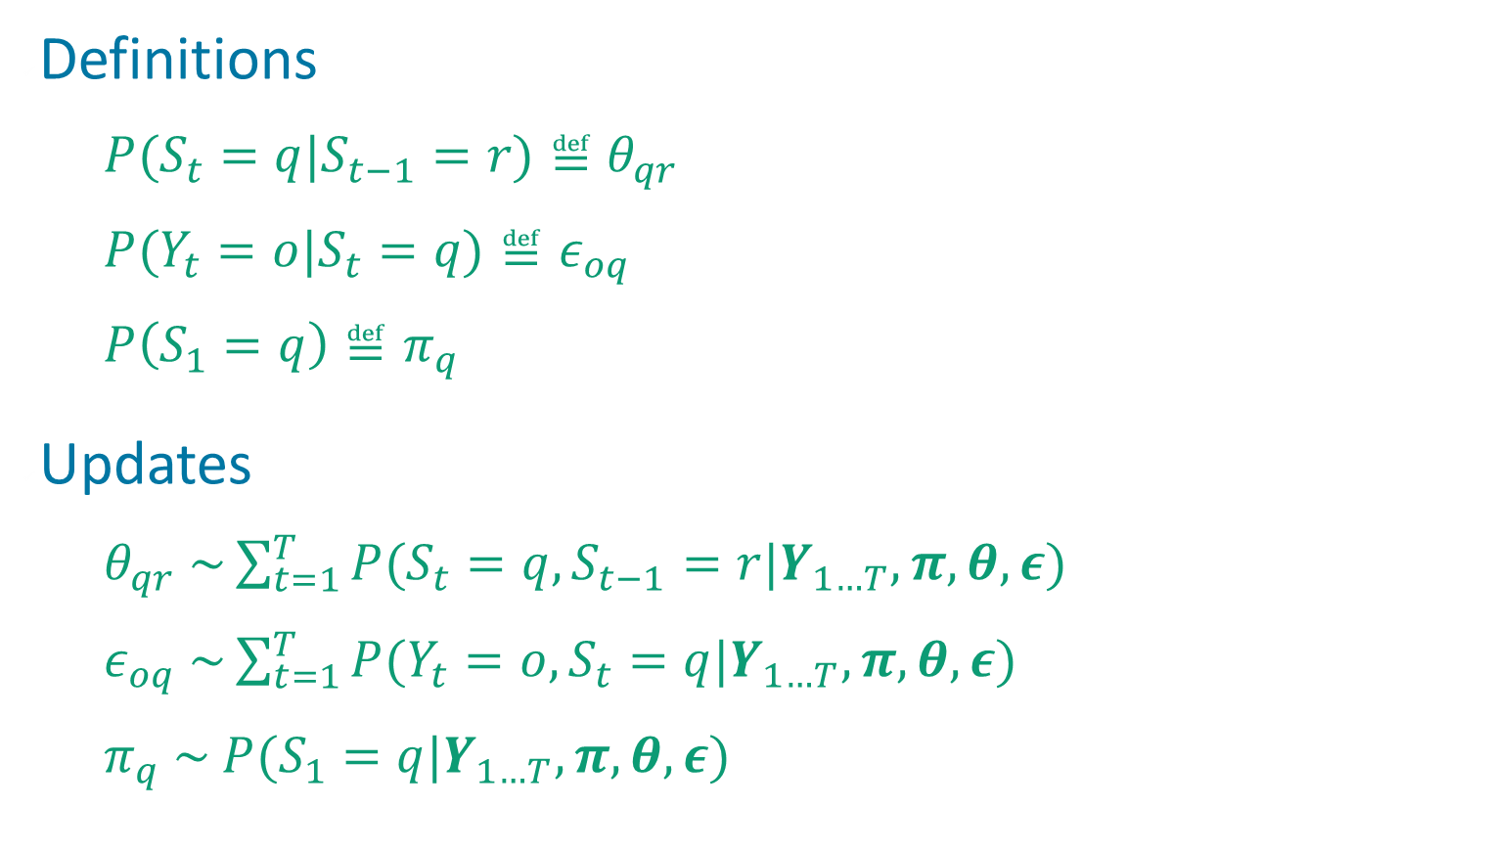
Updating Model Parameters

Slide 24
Using HMM For Classification
Suppose we want to recognize spoken digits 0, 1, …, 9
Each HMM is a model of the production of one digit, and specifies P(Y|M_{i})
    Y: observed acoustic sequence
        Note: Y can be a continuous RV
    M_{i}: model for digit i
We want to compute model posteriors: P(M_{i}|Y)
Use Bayes’ rule

Slide 25
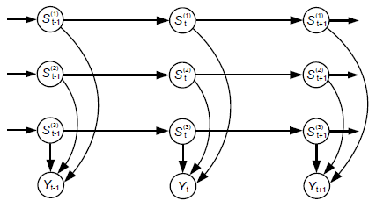
Factorial HMM

Slide 26
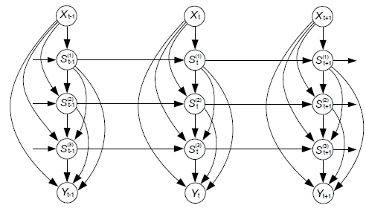
Tree-Structured HMM

Slide 27
The Landscape
Discrete state space
        HMM
Continuous state space
    Linear dynamics
        Kalman filter (exact inference)
    Nonlinear dynamics
        Particle filter (approximate inference)

Slide 28
The End

Slide 29
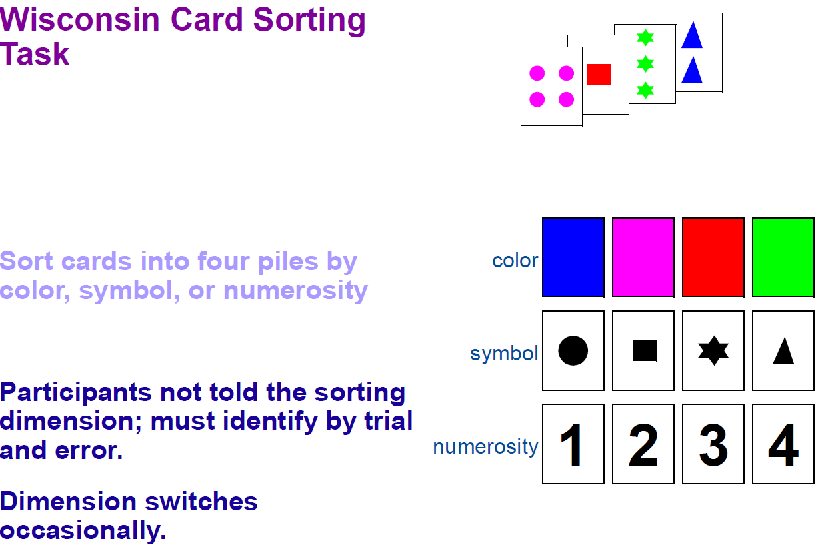
Cognitive Modeling
(Reynolds & Mozer, 2009)

Slide 30
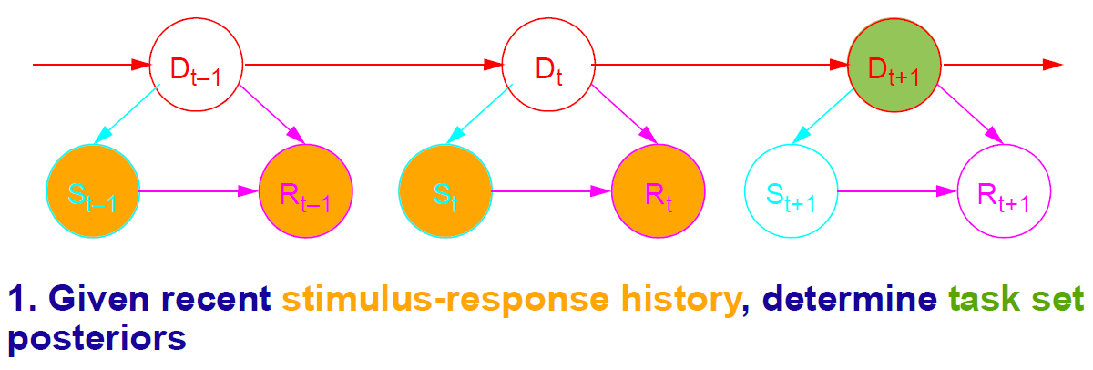
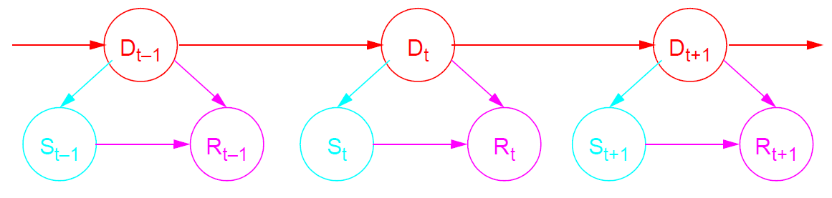
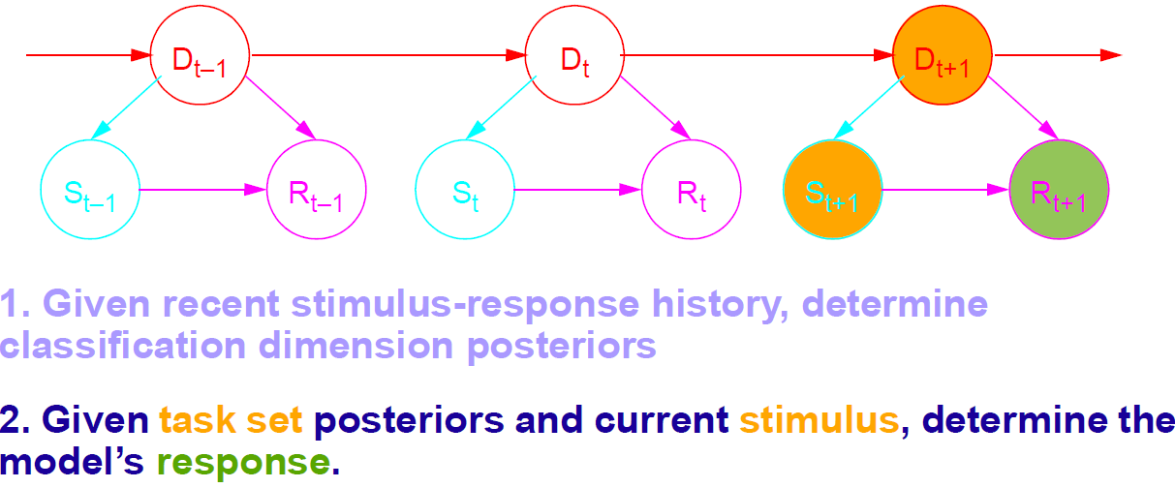
Cognitive Modeling
(Reynolds & Mozer, 2009)

Slide 31
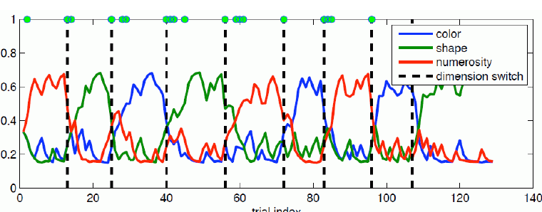
Cognitive Modeling
(Reynolds & Mozer, 2009)

Slide 32
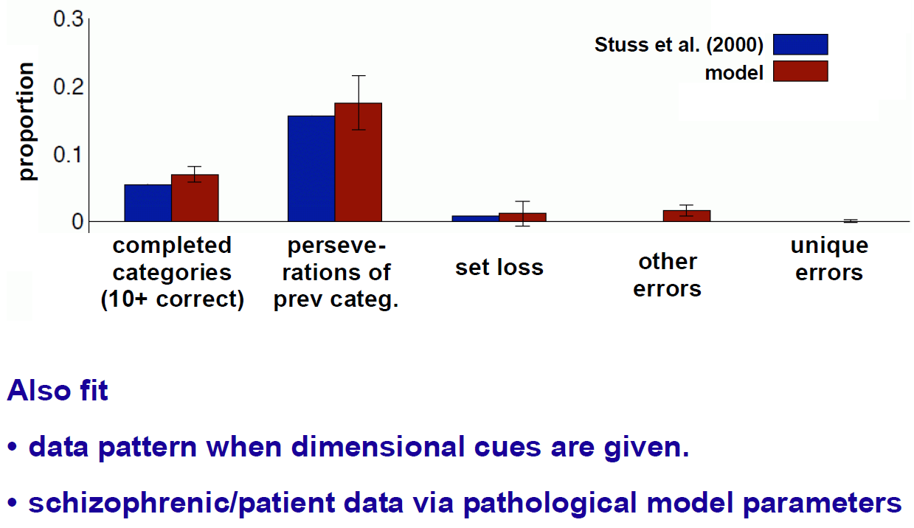
Cognitive Modeling
(Reynolds & Mozer, 2009)

Slide 33
Speech Recognition
Given an audio waveform, would like to robustly extract & recognize any spoken words
Statistical models can be used to
  Provide greater robustness to noise
  Adapt to accent of different speakers
  Learn from training
S. Roweis, 2004

