Slide 1
CSCI 5922
Neural Networks and Deep Learning:
Recurrent Networks
Mike Mozer
Department of Computer Science and
Institute of Cognitive Science
University of Colorado at Boulder

Slide 2
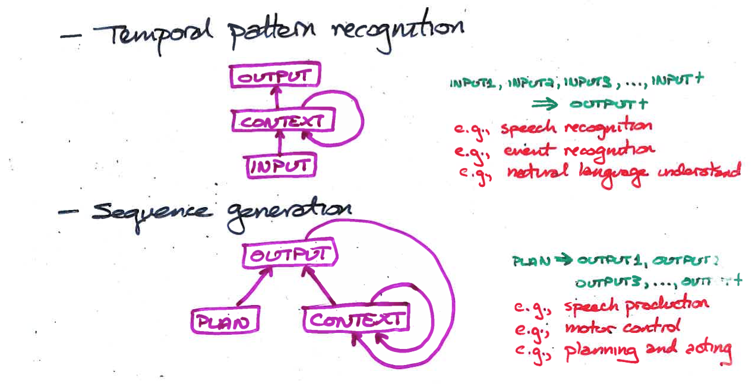
Recurrent Neural Nets For Sequence Processing
Notes:
redo slide with addition of sequence-to-sequence net (intermediate embedding)

Slide 3
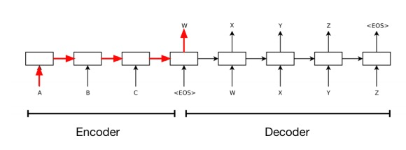
End-To-End Sequence Generation
REDO SLIDE

Slide 4
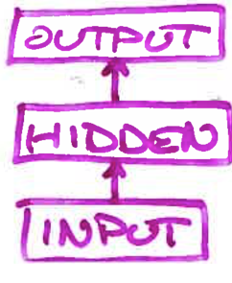
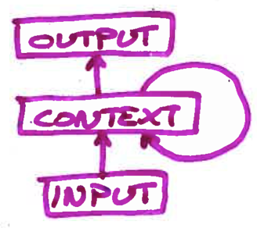
Challenge
Back propagation is designed for feedforward nets
What would it mean to back propagate through a recurrent network?
  error signal would have to travel back in time

Slide 5
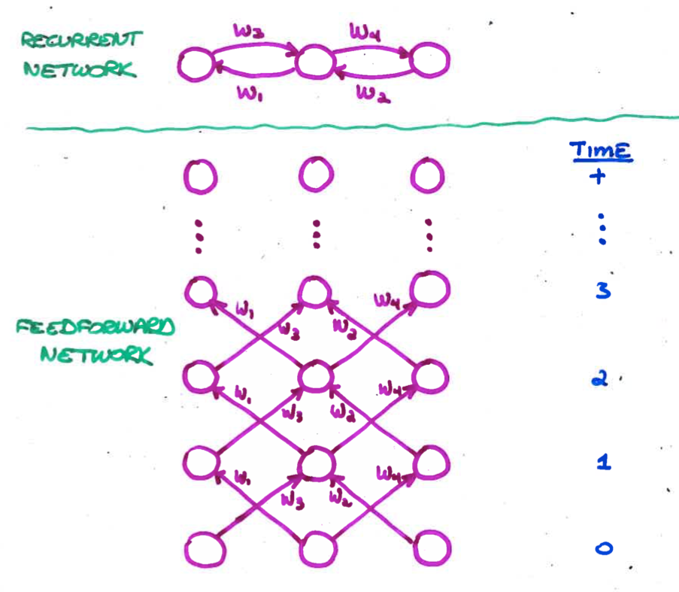
Unfolding A Recurrent Net
Requires duplication of hardware (units and weights)
  one layer for each discrete time step
Unfolded net has dynamics identical to that of recurrent net run for a fixed number of time steps
BP may violate the constraint that corresponding weights are equal.
  To enforce the constraint, assume a single set of underlying parameters
Unfolding is necessary only during learning.
  Once weights are trained, can run as an ordinary RNN

Slide 6
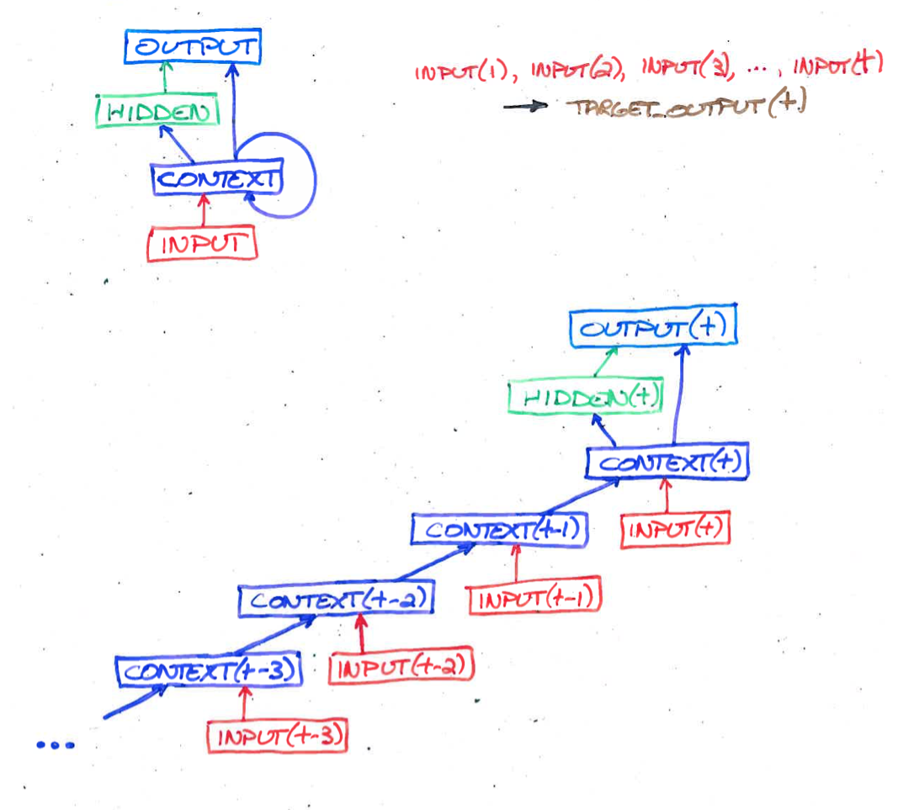
Back Propagation Through Time (BPTT)
For Sequence Recognition
Notes:
TensorFlow implementation?

Slide 7
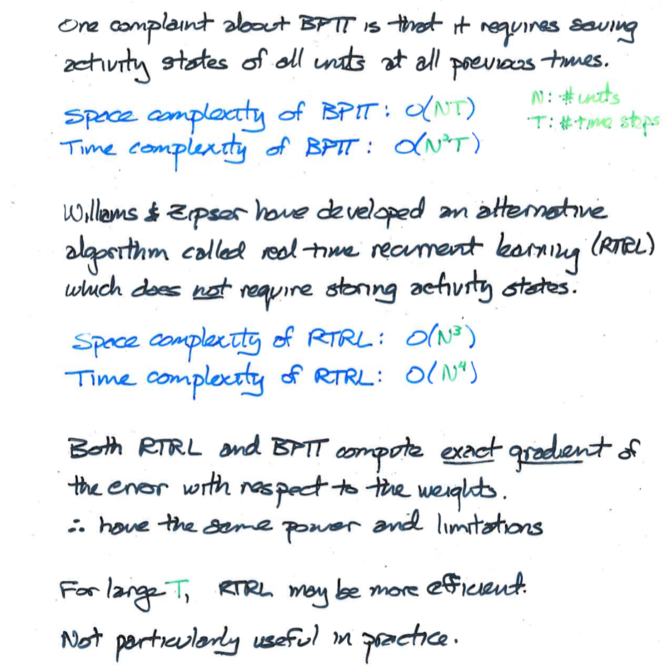
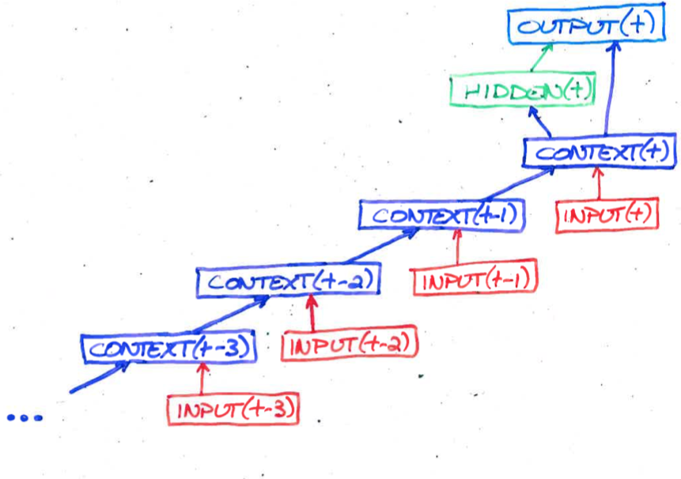
Alternative To BPTT:
Real Time Recurrent Learning (RTRL)

Slide 8
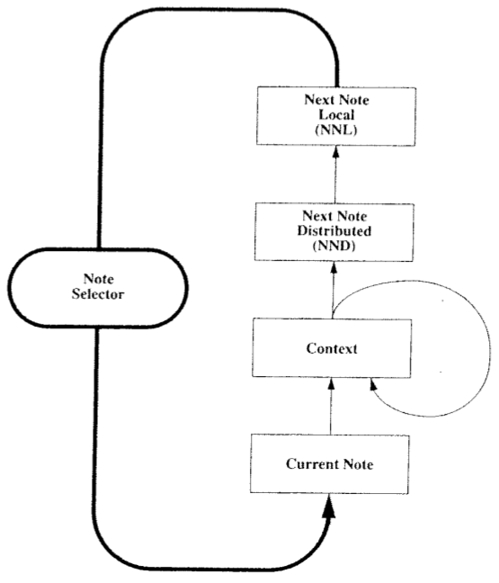
Neural Network Music Composition
(Mozer, 1994)

Slide 9
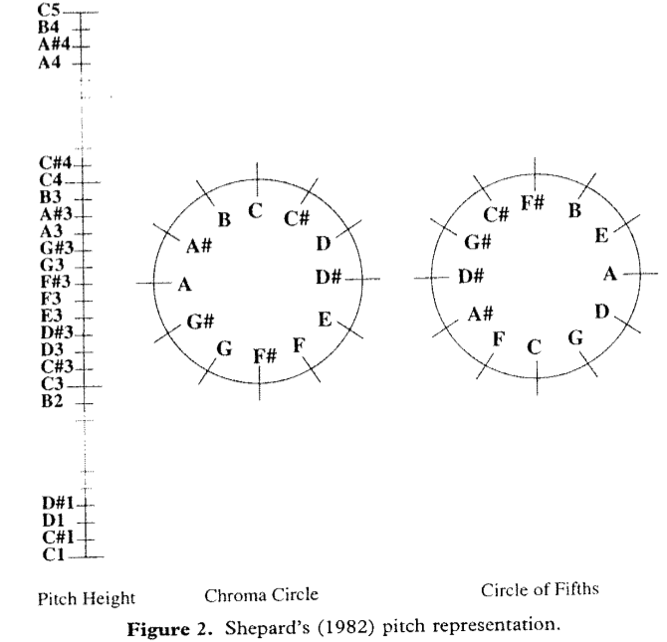
Psychologically Grounded
Representation Of Pitch
Each pitch as point in 5 dimensional space

Slide 10
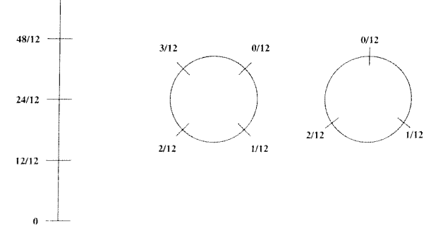
Analogous Representation Of Duration

Slide 11
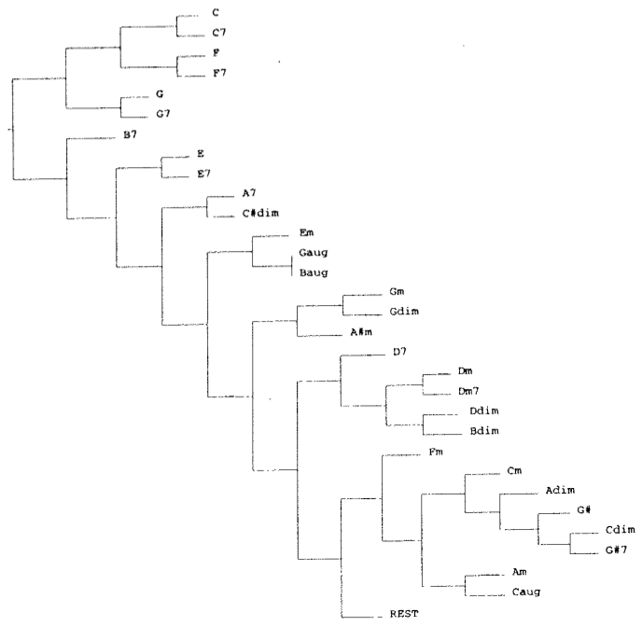
Psychologically Grounded Chord Representation
Hierarchical clustering

Slide 12

Simulation Experiments
All pieces transposed to common key
  C major or A minor
Bach (10 training examples)
European folk melodies (25 examples)
Waltzes (25 examples with harmonic accompaniment)
Outcome
  Network learns local structure but not global structure of musical organization

Slide 13
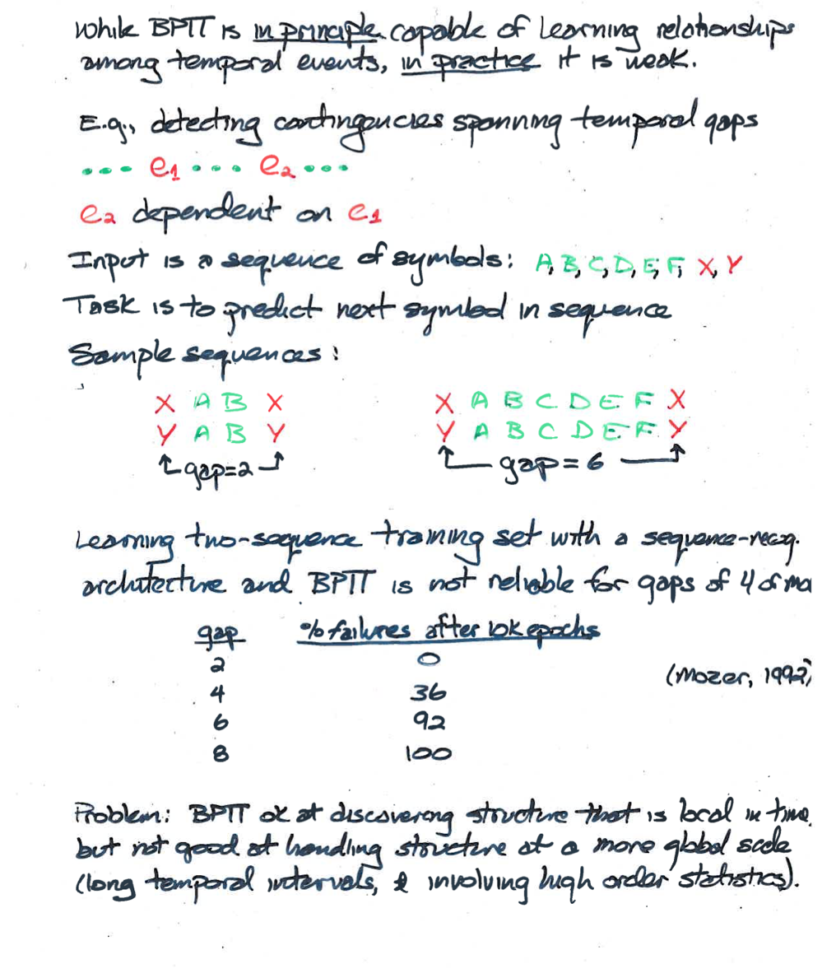
Vanishing gradients are a big problem with recurrent networks
Nets cannot learn long-term dependencies

Slide 14
One Solution To Vanishing Gradients:
Inject Error At Every Time Step
Elman autopredictor network
  like autoencoder but in time
Target at each time step is next
sequence element
  E.g., “I like to eat bread and …”
next
hidden
current

Slide 15
Truncated Gradient
With training signal at each time step, may be able to get away with truncating the number of steps of back propagation for time efficiency.
Elman’s cheesy limit
next
next(t)
hidden
hidden(t)
next(t-1)
current
current(t)
hidden(t-1)
next(t-2)
current(t-1)
hidden(t-2)
next(t-3)
current(t-2)
hidden(t-3)
current(t-3)

Slide 16
Elman Simulation
Sentence generator constructs 2 and 3 word utterances using grammar.
  woman smash plate
  monster eat mouse
  dog smell
10000 random sentences concatenated to form 27,354 element sequence
  Each word represented by one-hot 30-bit binary vector
30-50-30 autoencoder
  trained on 5 passes through input stream
  (not sufficient to memorize training set)

Slide 17
Grammar + Selection Restrictions

Slide 18
Training Sequence

Slide 19
What Internal Representation Has The Network Learned In Carrying Out Prediction Task?
For every instance of a given word in training set, obtain hidden representation.
Average representations together to obtain a ‘prototypical’ hidden response.
Perform hierarchical cluster analyses on these (50-element) vectors to determine which words are similar to one another
next
hidden
current

Slide 20
Hierarchical Clustering

Slide 21
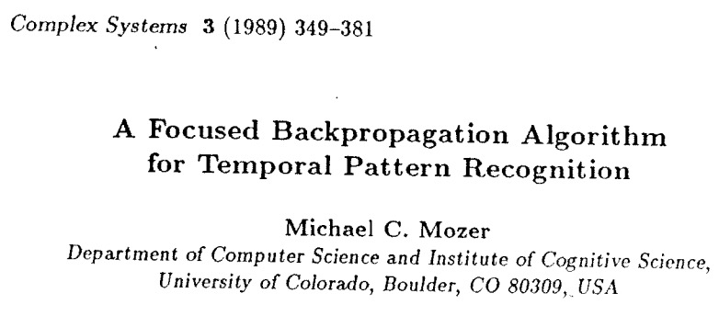
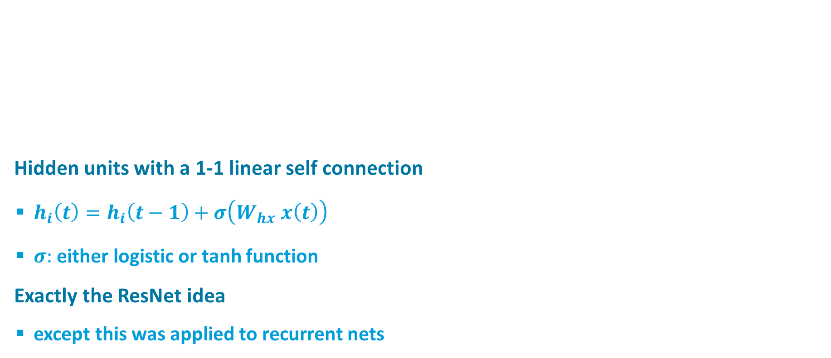
Another Solution To Vanishing Gradients
Hidden units with a 1-1 linear self connection
  $h_{i}\left(t\right)=h_{i}\left(t−1\right)+σ\left(W_{hx} x\left(t\right)\right)$
  $σ:$ either logistic or tanh function
Exactly the ResNet idea
  except this was applied to recurrent nets
y
h
x

Slide 22






Unfolding the Focused Recurrent Architecture
y
Hidden units with a 1-1 linear self connection
  $h_{i}\left(t\right)=h_{i}\left(t−1\right)+σ\left(W_{hx} x\left(t\right)\right)$
h
x
y(t)
y(t)
h(t)
$$Σ$$
x(t)
h (t-1)
$σ$(t)
$σ$(t-1)
$σ$(t-2)
$σ$(t-3)
x(t-1)
h(t-2)
x(t)
x(t-1)
x(t-2)
x(t-3)
x(t-2)
h(t-3)
x(t-3)

Slide 23
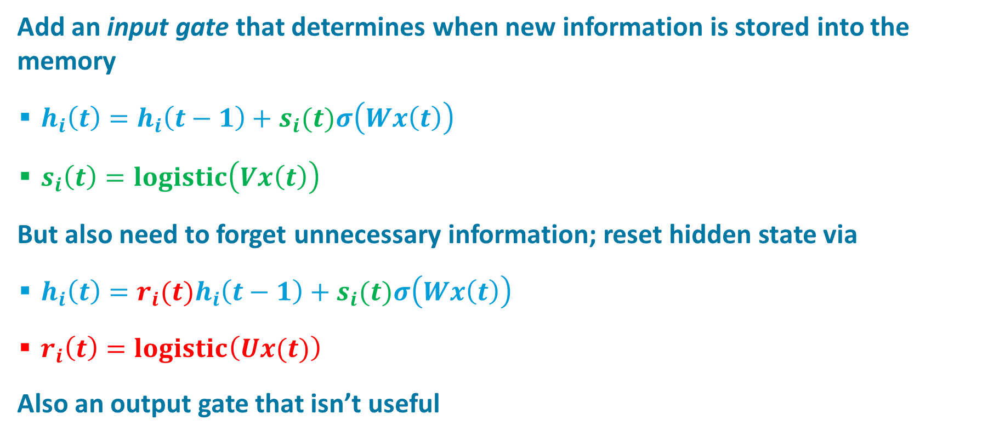
Long Short-Term Memory (LSTM)
Hochreiter & Schmidhuber (1997)
Add an input gate that determines when new information is stored into the memory
  $h_{i}\left(t\right)=h_{i}\left(t−1\right)+s_{i}(t)σ\left(Wx\left(t\right)\right)$
  $s_{i}\left(t\right)=logistic\left(Vx\left(t\right)\right)$
But also need to forget unnecessary information; reset hidden state via
  $h_{i}\left(t\right)={r_{i}(t)h}_{i}\left(t−1\right)+s_{i}(t)σ\left(Wx\left(t\right)\right)$
  $r_{i}\left(t\right)=logistic\left(Ux(t)\right)$
Also an output gate that isn’t useful

Slide 24
Hinton LSTM Video

Slide 25
Solving The Problem Of Training RNNs
Why it is hard to train RNNs
Solutions
  Long short term memory (LSTM)
  Hessian free optimization
  Echo state networks
  Learning to predict the next character

Slide 26
LSTM Needs Self Connections For Propagating Gradients
And Also Full Connectivity To Construct Representations
classification /
prediction /
translation
. . .
memory
LSTM
LSTM
LSTM
LSTM
. . .
sequence
element
Notes:
[*] Basic RNN arch
Feed in a sequence, one element at a time
[*] LSTM
[*] GRU

Slide 27
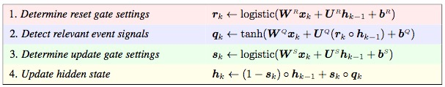








Gated Recurrent Unit (GRU)
(Chung, Ahn, & Bengio, 2016)
Similar to LSTM
  no output gate
  memory activation$h ∈[−1,+1]$
$$r$$
$$h_{k−1}$$
$$x_{k}$$
$$s$$
$$q$$
$$h$$
$$h_{k}$$
Notes:
x_k input at step k; h_{k-1} previous hidden
input and prev hidden feed into:
[*] r: reset gate: determine how much of the hidden state should be fed back
[*] q: event signal based on input and whatever portion of hidden state is fed back
[*] s: storage gate: determine what fraction of the event signal to store (they call UPDATE gate)
[*] hidden update

Slide 28
Echo State Networks
Link to summary paper

Slide 29
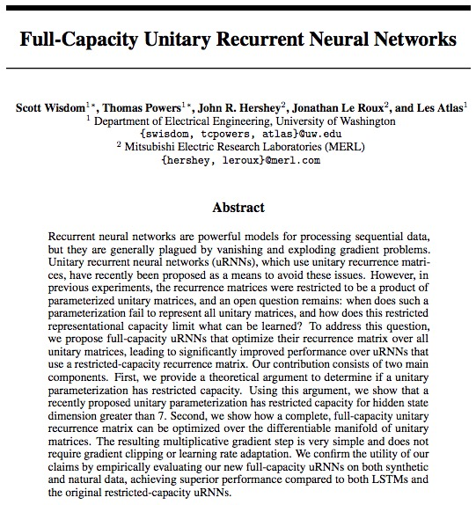
Unitary RNNs
(Worth Checking Out?)

Slide 30
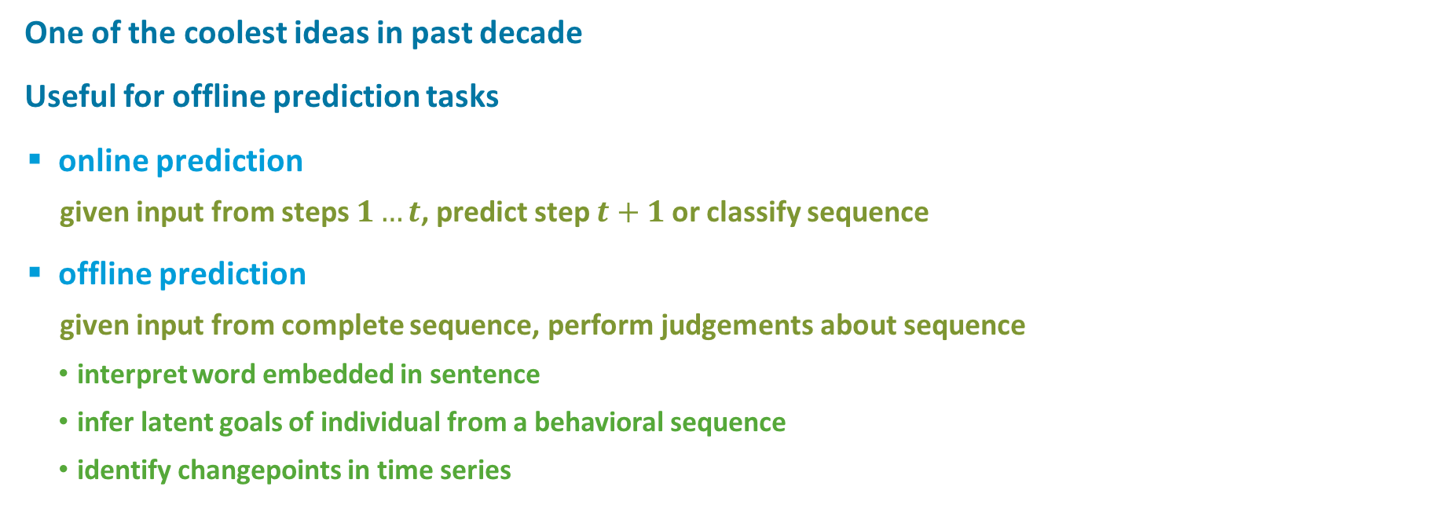
Bidirectional Recurrent Nets
One of the coolest ideas in past decade
Useful for offline prediction tasks
  online prediction
    given input from steps $1…t$, predict step $t+1$or classify sequence
  offline prediction
    given input from complete sequence, perform judgements about sequence
      interpret word embedded in sentence
      infer latent goals of individual from a behavioral sequence
      identify changepoints in time series
y(1)
y(2)
y(t-2)
y(t-1)
y(t)
…
g (1)
g (2)
g(t-2)
g (t-1)
g(t)
…
h (1)
h (2)
h (t-2)
h (t-1)
h(t)
x(1)
x(2)
x(t-2)
x(t-1)
x(t)
Notes:
latent goals: start to make tea, pull out a pencil, jot down the time, walk out of room, come back and grab tea.
what was pulling out pencil about?

Slide 31
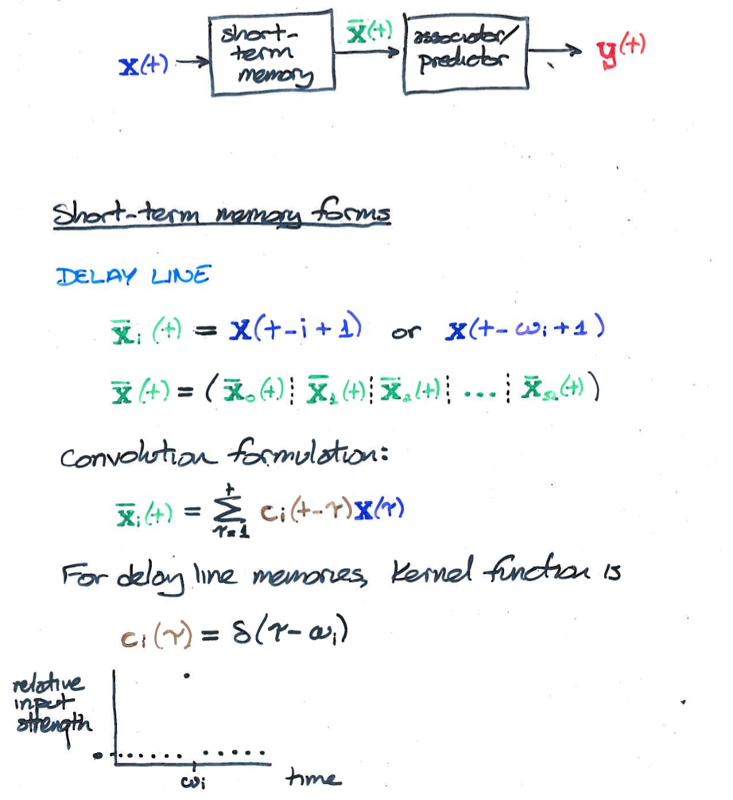
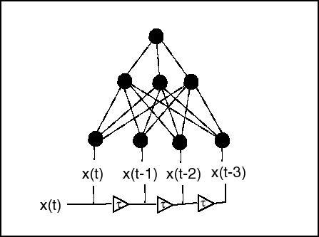
Handling Temporal Sequences With Feedforward Networks
Turn temporal sequence into spatial pattern over input neurons

Slide 32
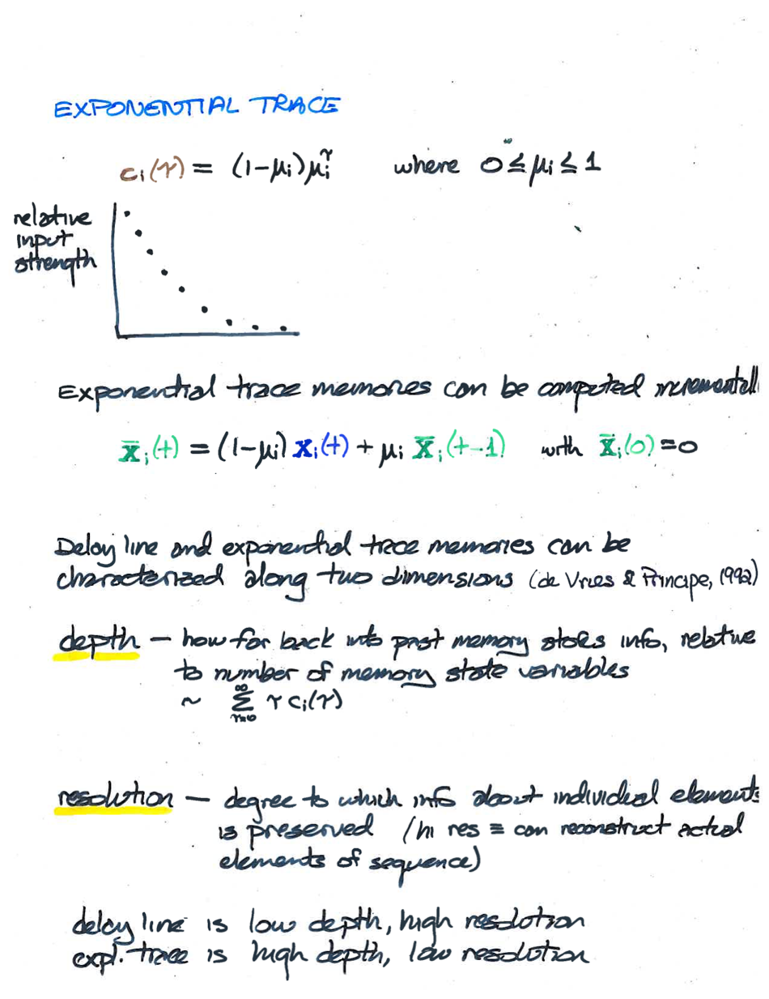
Note: mixture of exponentials approximates power function
Power function interesting because it has both depth and resolution

Slide 33
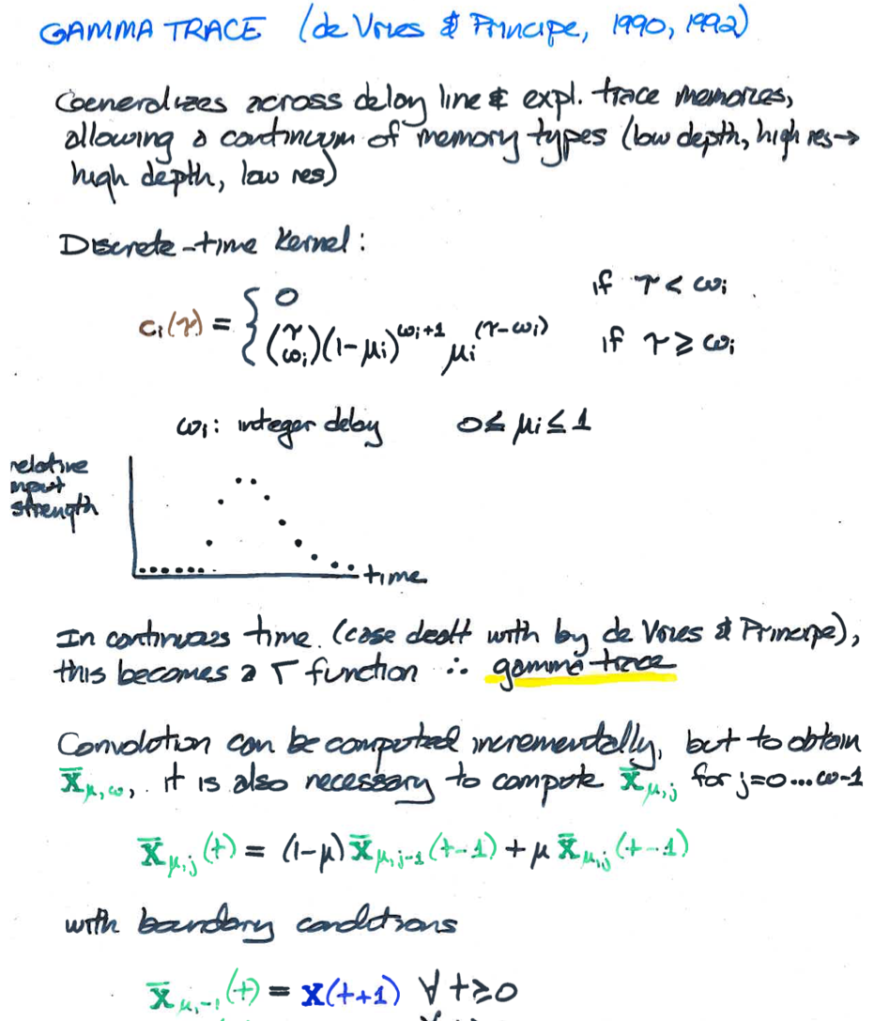
Notes:
combines delay line and exponential kernel

Slide 34
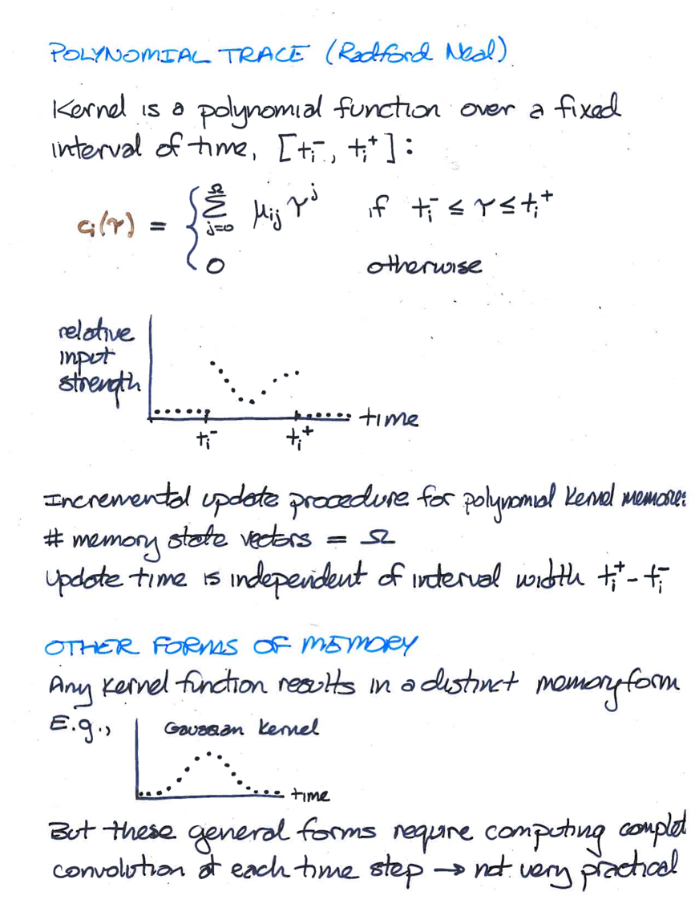

Slide 35
STOP HERE

Slide 36
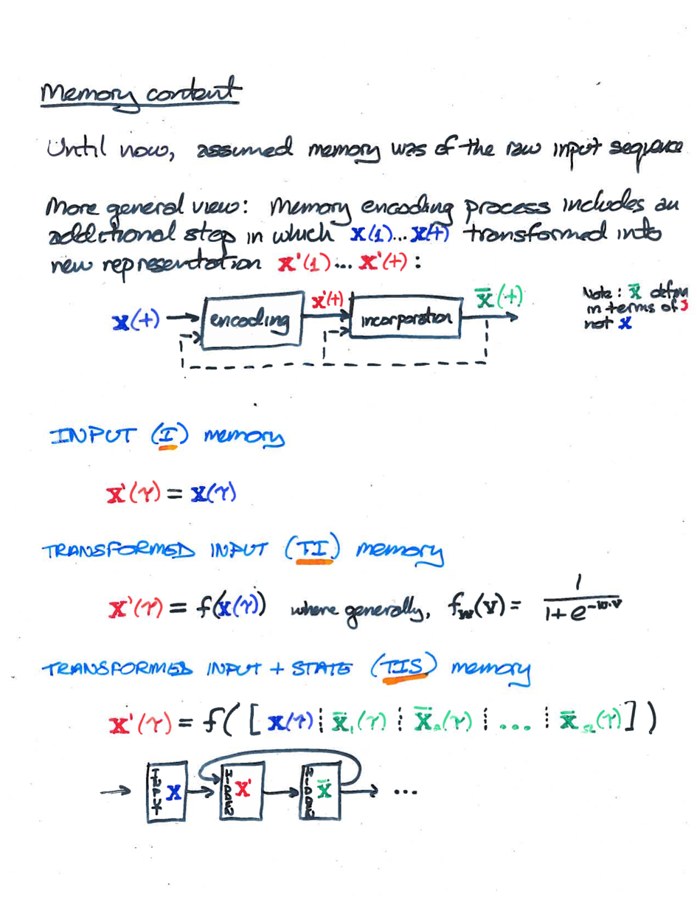

Slide 37
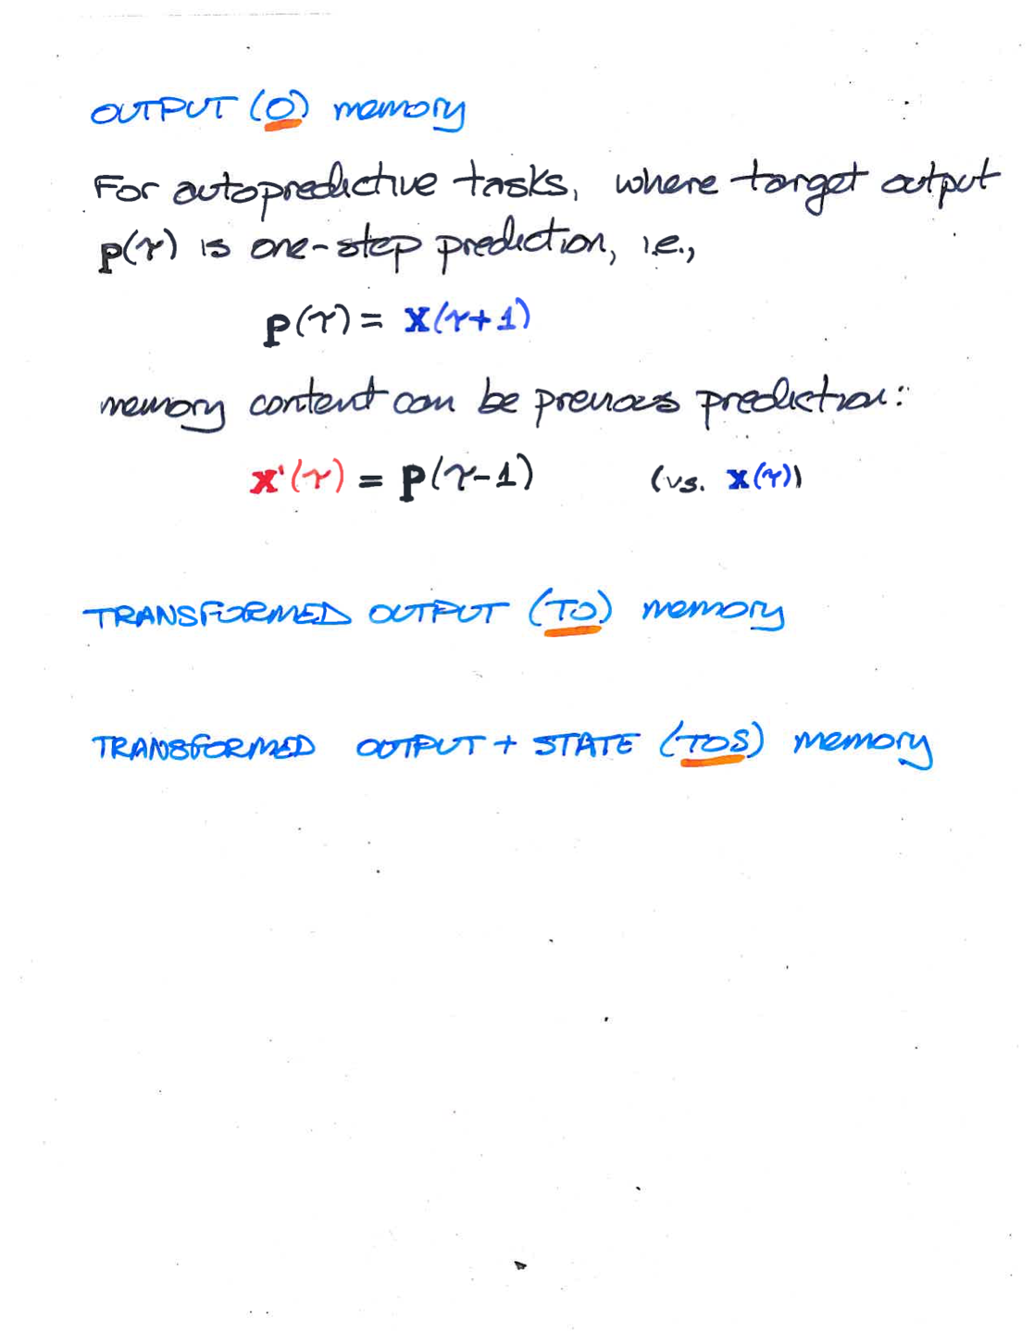

Slide 38
