Slide 1
CSCI 5922 Neural Networks and Deep Learning: NIPS Highlights
Mike Mozer
Department of Computer Science and Institute of Cognitive Science University of Colorado at Boulder
Notes:
position
audience

Slide 2
Y-W Teh – concrete VAE [discrete variables]
Deep sets

Slide 3
Gradient Descent GAN Optimization is Locally Stable (Nagarajan & Kolter, 2017)
Explores situation where generator and discriminator are trained simultaneously
no alternation, inner/outer loops, running one to convergence, etc.
This situation does not correspond to a convex-concave optimization problem (i.e., no saddle point)
“Under suitable conditions on the representational powers of the discriminator and the generator, the resulting GAN dynamical system is locally exponentially stable.”
gradient updates will converge to an equilibrium point at an exponential rate

Slide 4
Gradient Descent GAN Optimization is Locally Stable (Nagarajan & Kolter, 2017)
Simple case with
$D\left(x\right)=w_{2}x^{2}$
$G\left(z\right)=az$
Distributions
$x\sim Uniform({\left[−1,1\right]}^{2})$
$z\sim Uniform({\left[−1,1\right]}^{2})$
$η$ is a regularizer of some sort
Notes:
regularizer considers the discriminator updates when updating the generator

Slide 5
Bayesian GAN (Saatchi & Wilson, 2017)
Problem with GANs: mode collapse
GAN memorizes a few examples to fool the generator
GAN doesn’t reproduce full diversity of environment
Traditional GAN is conditioned on a noise sample, $z$
instead, marginalize over $z$ to obtain
iteratively e$stimate p\left(θ_{g} | θ_{d}\right)$ and $p\left(θ_{d} | θ_{g}\right)$ with samples of $z$
and represent each distribution via a set of samples

Slide 6
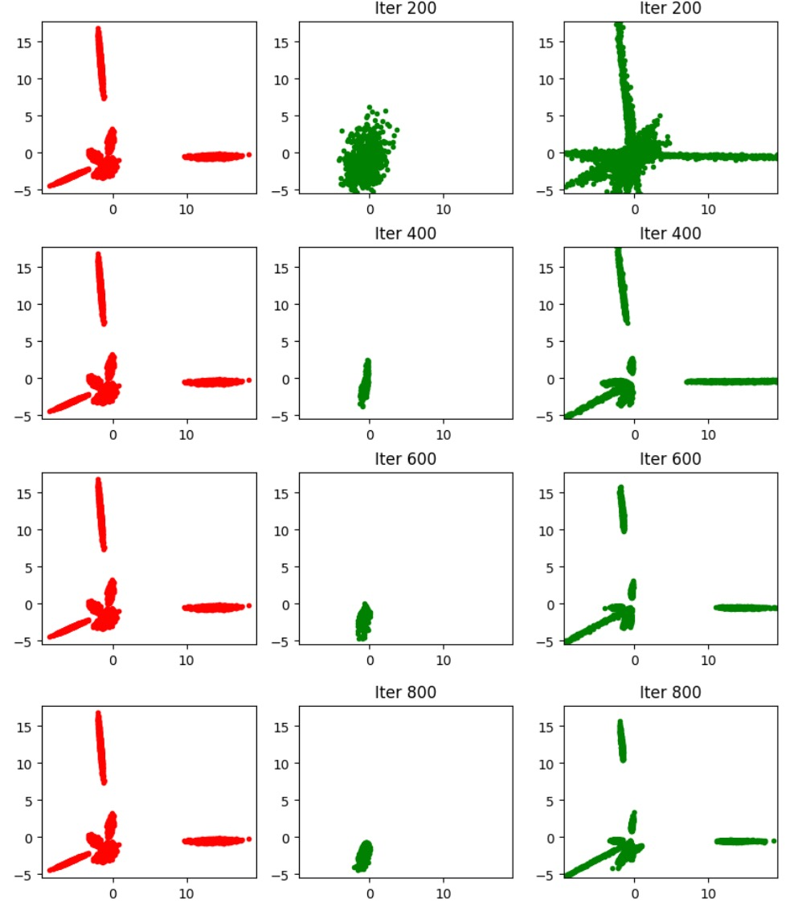
Bayesian GAN (Saatchi & Wilson, 2017)
PCA representation of output space (top 2 dimensions
data GAN BGAN

Slide 7
Bayesian GAN
https://www.youtube.com/watch?v=24A8tWs6aug&feature=youtu.be

Slide 8
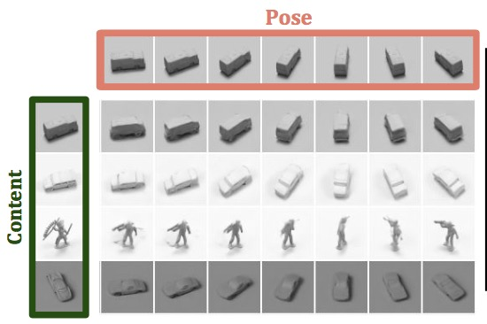
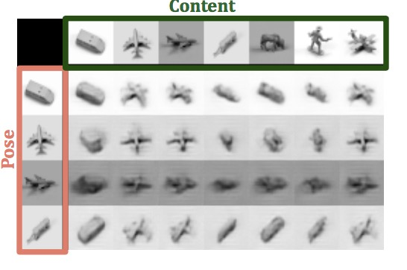
Unsupervised Learning of Disentangled Representations from Video (Denton & Birodkar, 2017)
their work
previous work

Slide 9
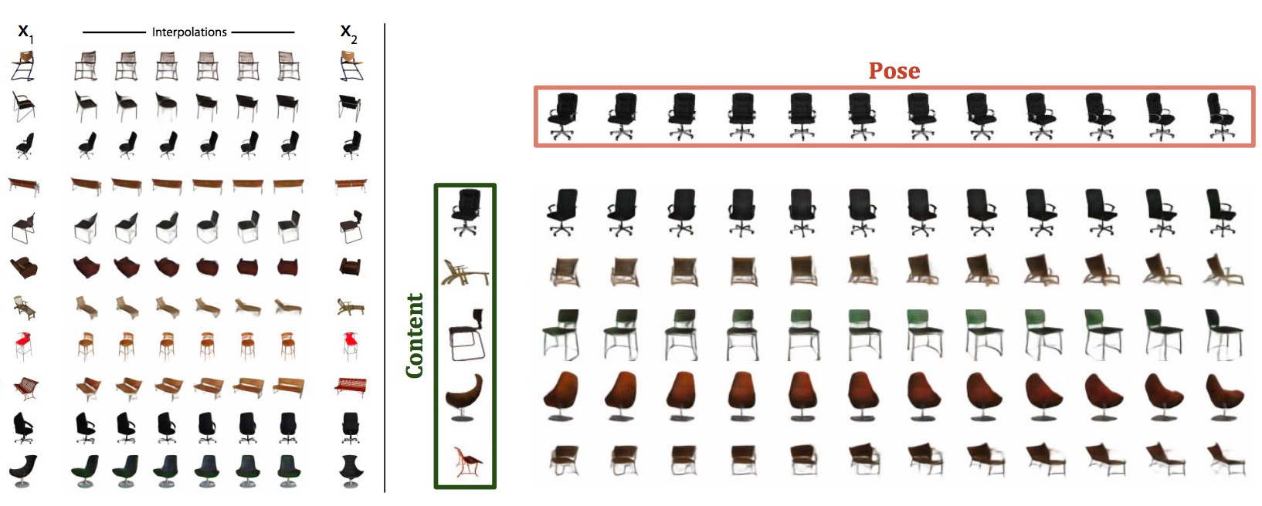
Unsupervised Learning of Disentangled Representations from Video (Denton & Birodkar, 2017)
interpolating between two views via linear interpolation in pose space

Slide 10
Unsupervised Learning of Disentangled Representations from Video (Denton & Birodkar, 2017)
Key idea (which has been leveraged in a lot of work)
in two successive frames of a video, we’re likely to see the same object(s) but in slightly different poses
true whether camera is panning or objects are moving
also true of an individual who is observing static scene while moving eyes

Slide 11
Unsupervised Learning of Disentangled Representations from Video (Denton & Birodkar, 2017)
Reconstruction loss
predict frame $t+k$ from content at $t$ and pose at $t+k$
Similarity loss
content should not vary from $t$to $t+k$

Slide 12
Unsupervised Learning of Disentangled Representations from Video (Denton & Birodkar, 2017)
Adversarial loss 1
good pose vectors are ones that can fool a discriminator trying to determine whether two samples are from same or different video
Adversarial loss 2
good pose vectors are ones that don’t provide any information to the discriminator about whether two samples from the same video are from same or diff. video

Slide 13
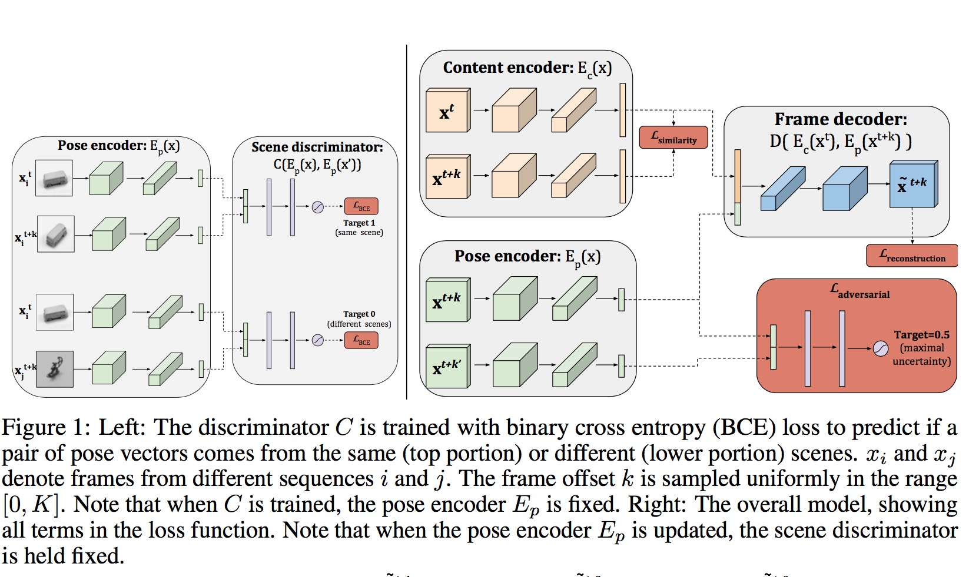
Unsupervised Learning of Disentangled Representations from Video (Denton & Birodkar, 2017)

Slide 14
Gumbel distribution trick

Slide 15
