Slide 1
Recurrent Nets
Deep Learning and Neural Nets
Spring 2015

Slide 2
Agenda
Weight initialization explorations
Next assignment
Recurrent nets

Slide 3
Does Weight Initialization Scheme Matter?
Trained 3 layer net on 2500 digit patterns
  10 output classes, tanh units
  20-1600 hidden units
  automatic adaptation of learning rates
  10 minibatches per epoch
  500 epochs
  12 replications of each architecture

Slide 4
Does Weight Initialization Scheme Matter?
Weight initialization schemes
  Gaussian random weights, N(0,.001²)
  Gaussian random weights, N(0,.01²)
  L₁ constraint on Gaussian random weights
  [conditioning for worst case]
  Gaussian weights, N(0, 4/FanIn)
  [conditioning for average case]
  Gaussian weights, N(0, 1/FanIn)
  [conditioning for average case]

Slide 5
Small Random Weights
Strangeness
  training set can’t be learned
    caveat: plotting accuracy not MSE
  if there’s overfitting, doesn’t happen until 200 hidden

Slide 6
Mike’s L₁ Normalization Scheme
About the same as small random weights

Slide 7
Normalization Based On Fan In
Perfect performance on training set
Test set performance dependent on scaling
Notes:
Should someone explore weight initializations? Would be a fun project.

Slide 8
What Can We Conclude?
Weight initialization
  Probable that weight initialization is serving as a bias on learning
  May interact with minibatch size, use of momentum, etc.
Overfitting
  Doesn’t appear to be a huge problem
  Networks are much larger than I would have made 20 yr ago

Slide 9
Assignment 4
ISOLET speech recognition data set
  150 speakers producing letters A-Z twice
  150 x 26 x 2 examples (- 3 missing)
  617 input features
  26 output categories
Data split
  120 speakers for training
  30 speakers for testing
  evaluation based on generalization to new speakers
  test set should be saved until very end of assignment
  use validation set to select model and training characteristics
compare to digits:
more input features
more output categories
fewer training examples
-> easier to overfit?

Slide 10
Assignment 4
Part 1
    build a standard network
    you choose activation functions, loss function, # hidden, weight initialization scheme, etc.
Part 2
    add regularization methods to the mix
    e.g., dropout, soft or hard weight constraints
Part 3
    explore ReLU units for the hidden instead of sigmoid
    maybe compare the smooth fn vs. the hack approximation
Part 4
    evaluate the final networks from parts 1-3 on the test set

Slide 11
Assignment 4: My Initial Results
I cheated and used test set for this figure.
I want you to use only a validation set in determining network architecture
Plain old neural net
  doesn’t seem to show
  overfitting

Slide 12
Assignment 4: My Initial Results

Slide 13
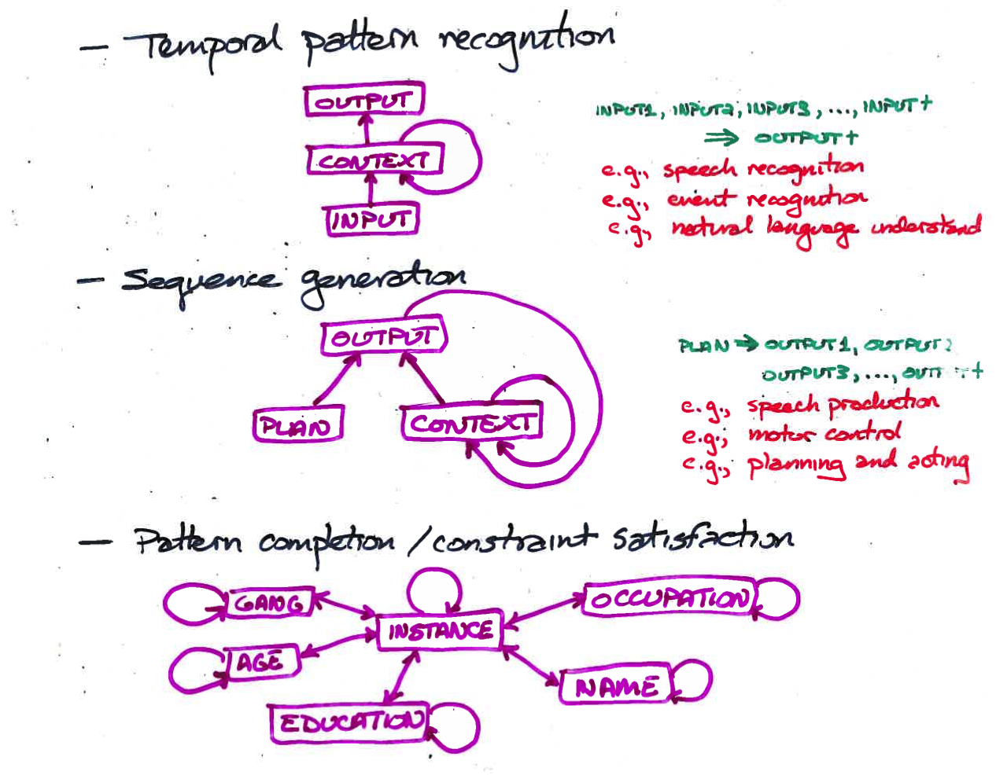
Recurrent Neural Nets

Slide 14
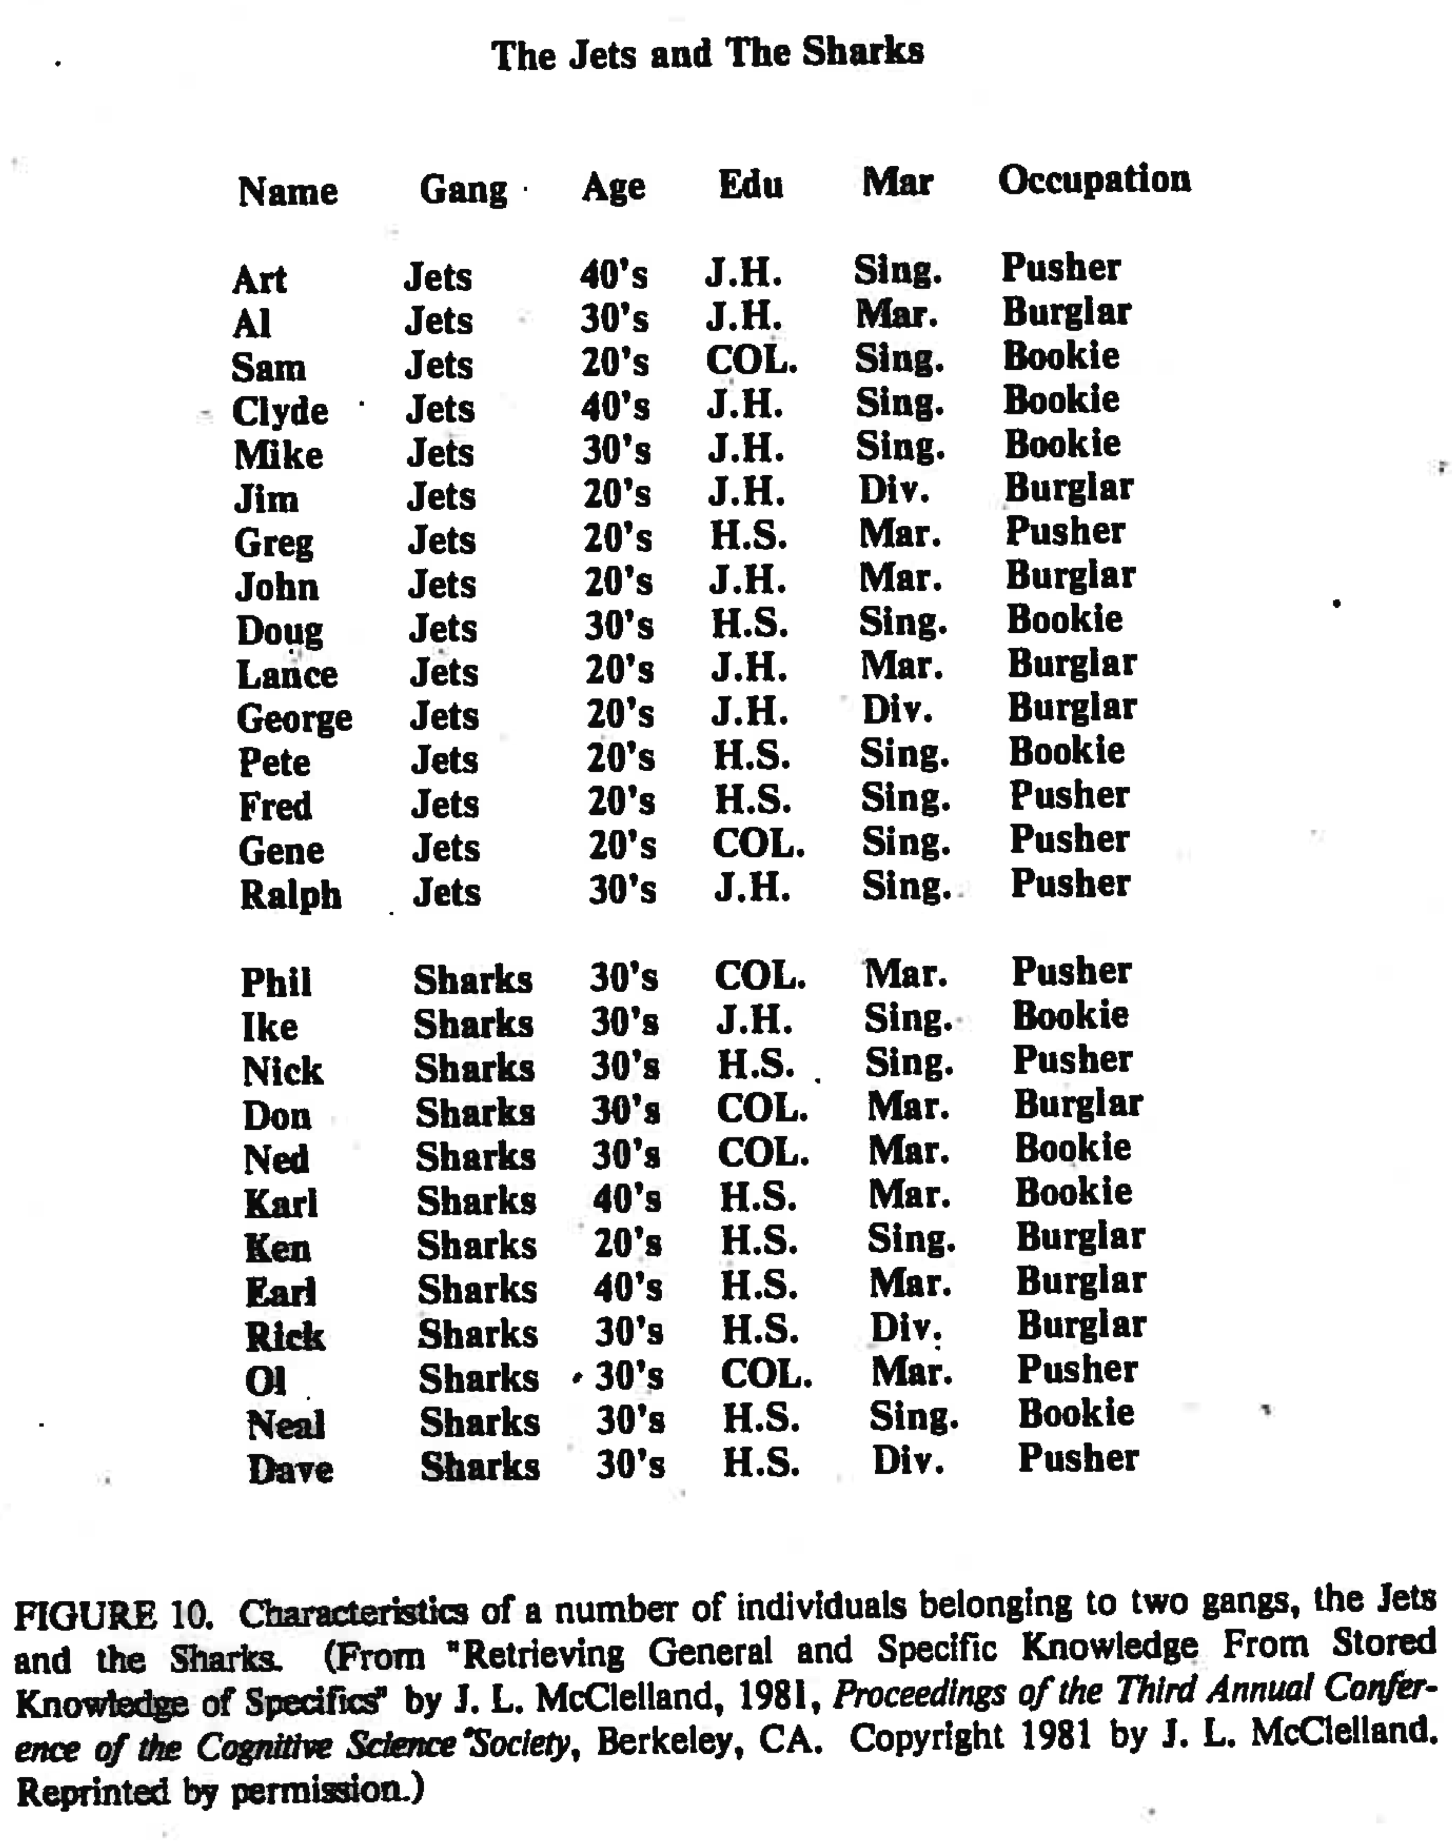
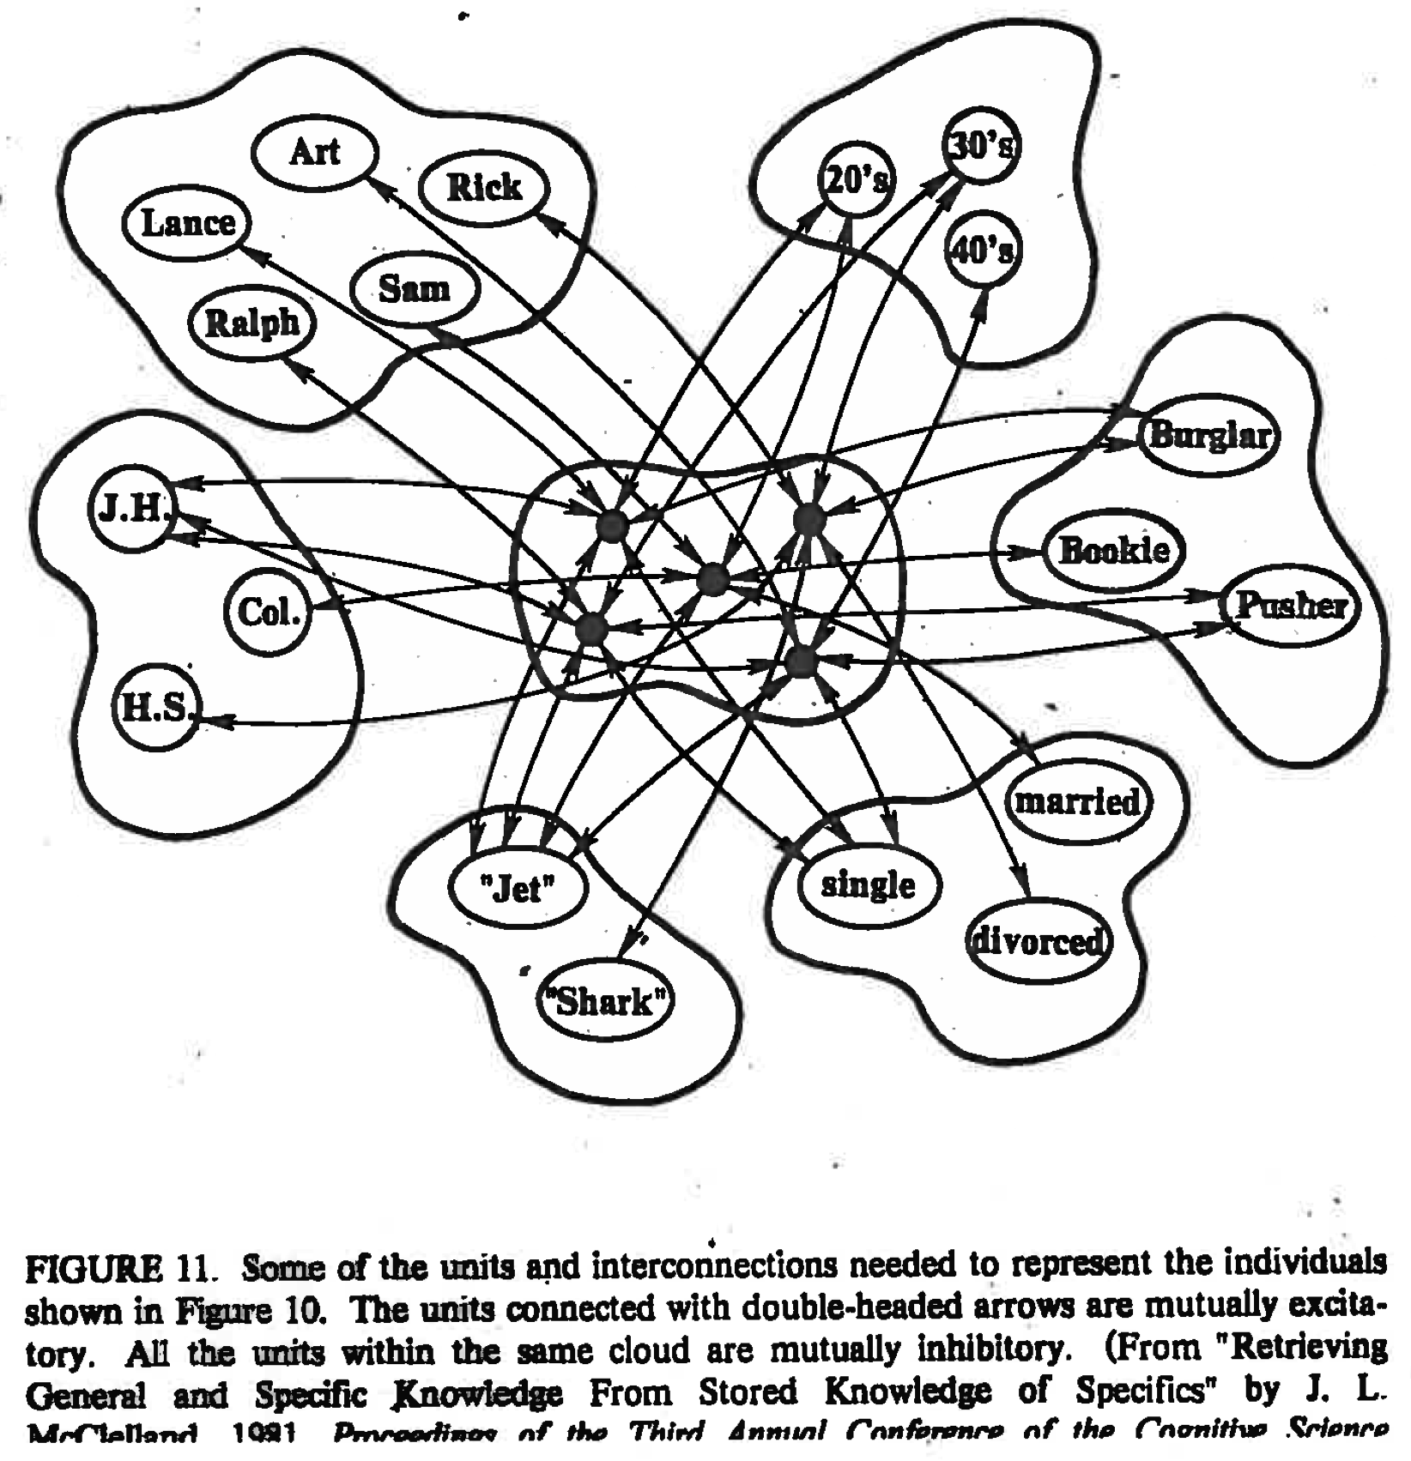
Recurrent Neural Nets
For Pattern Completion
Interactive Activation Model Demo

Slide 15
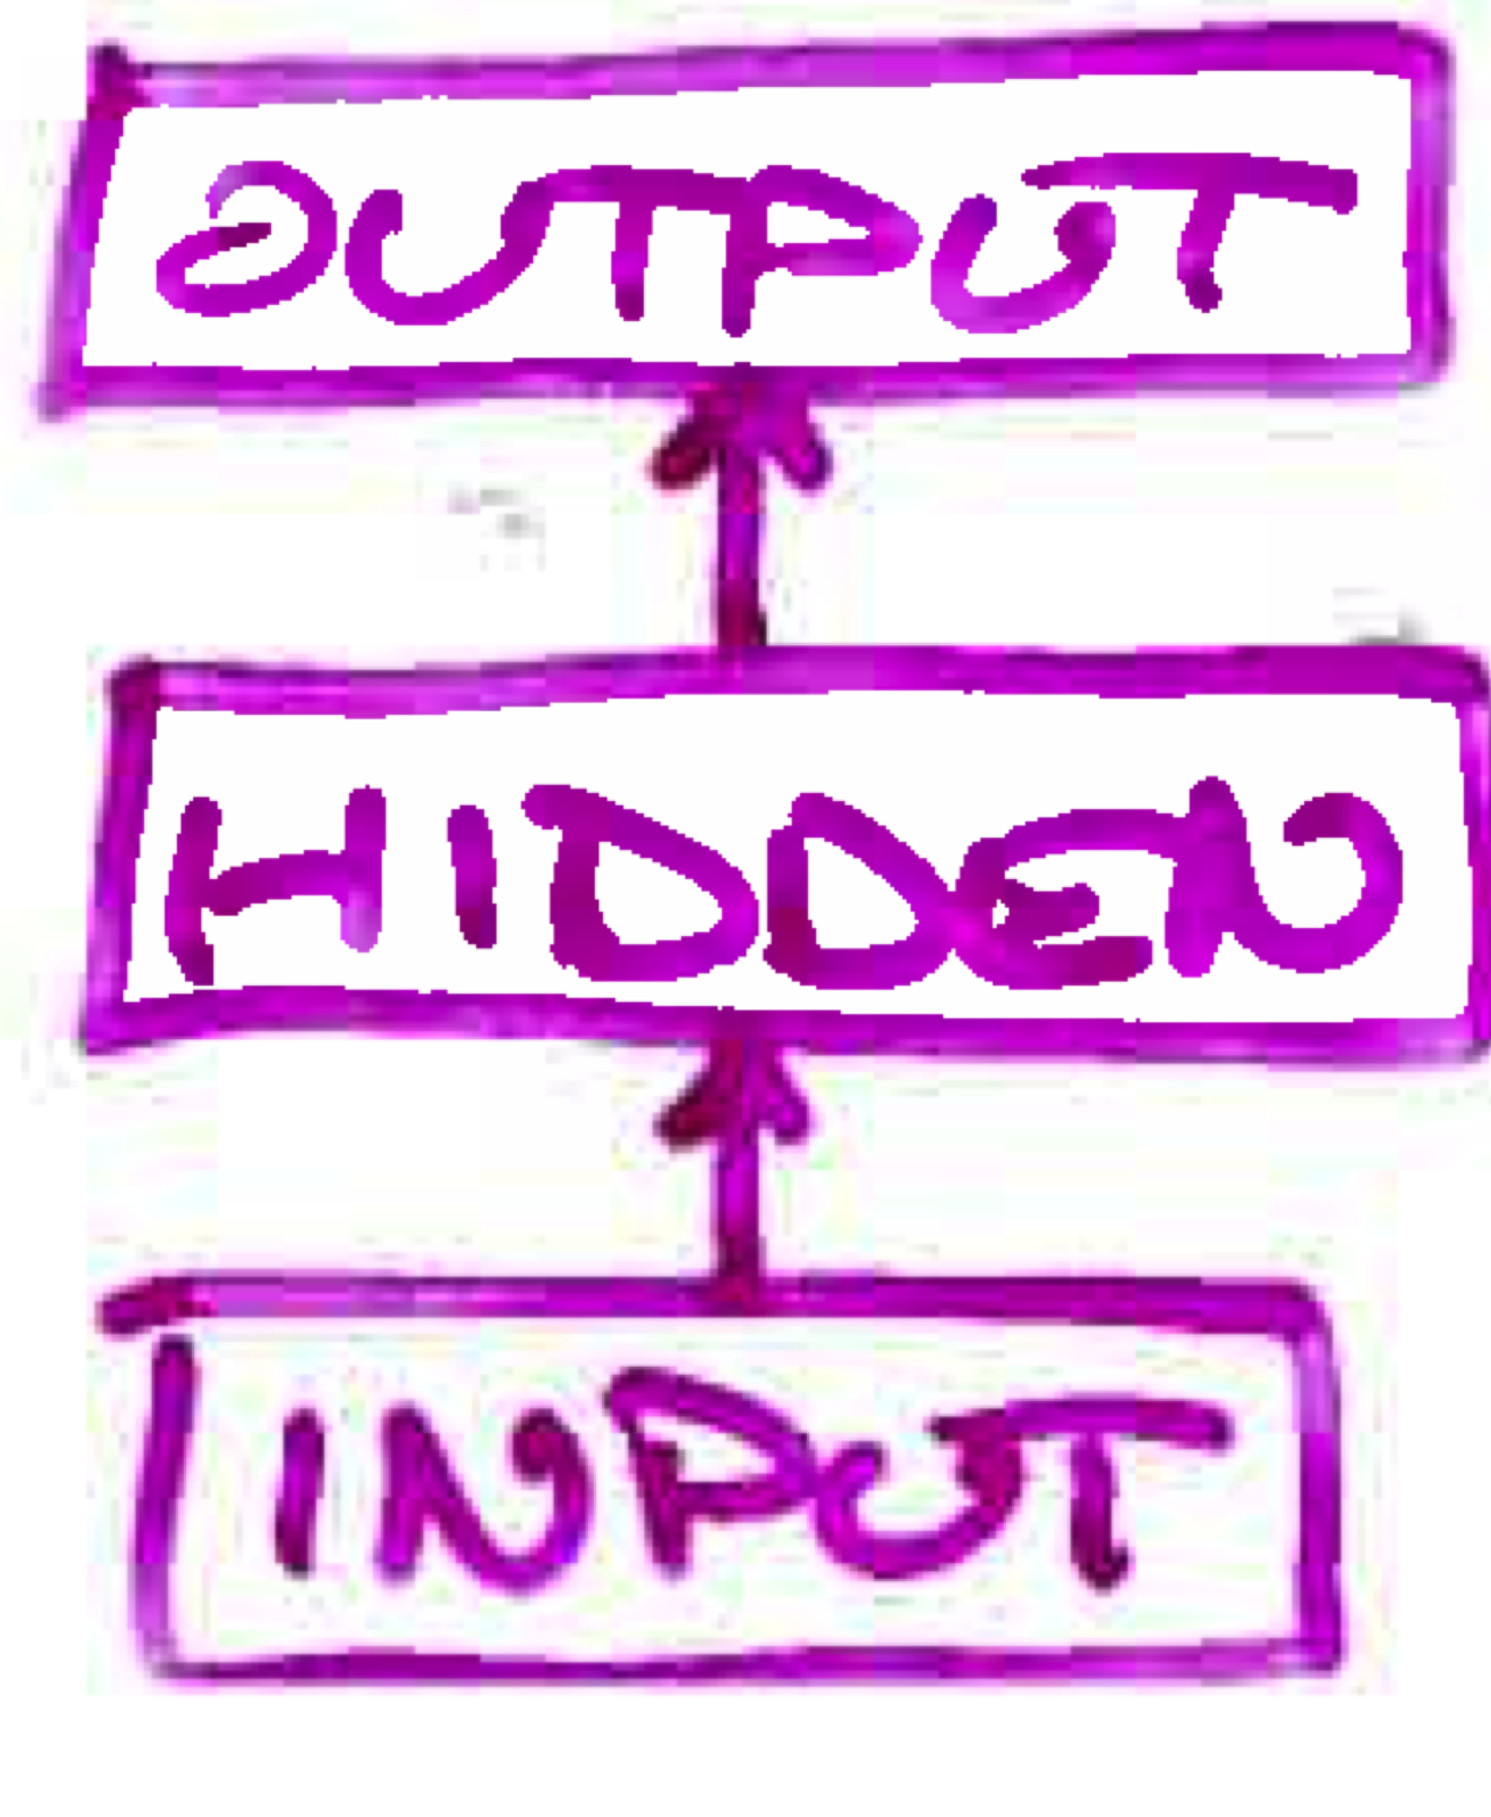
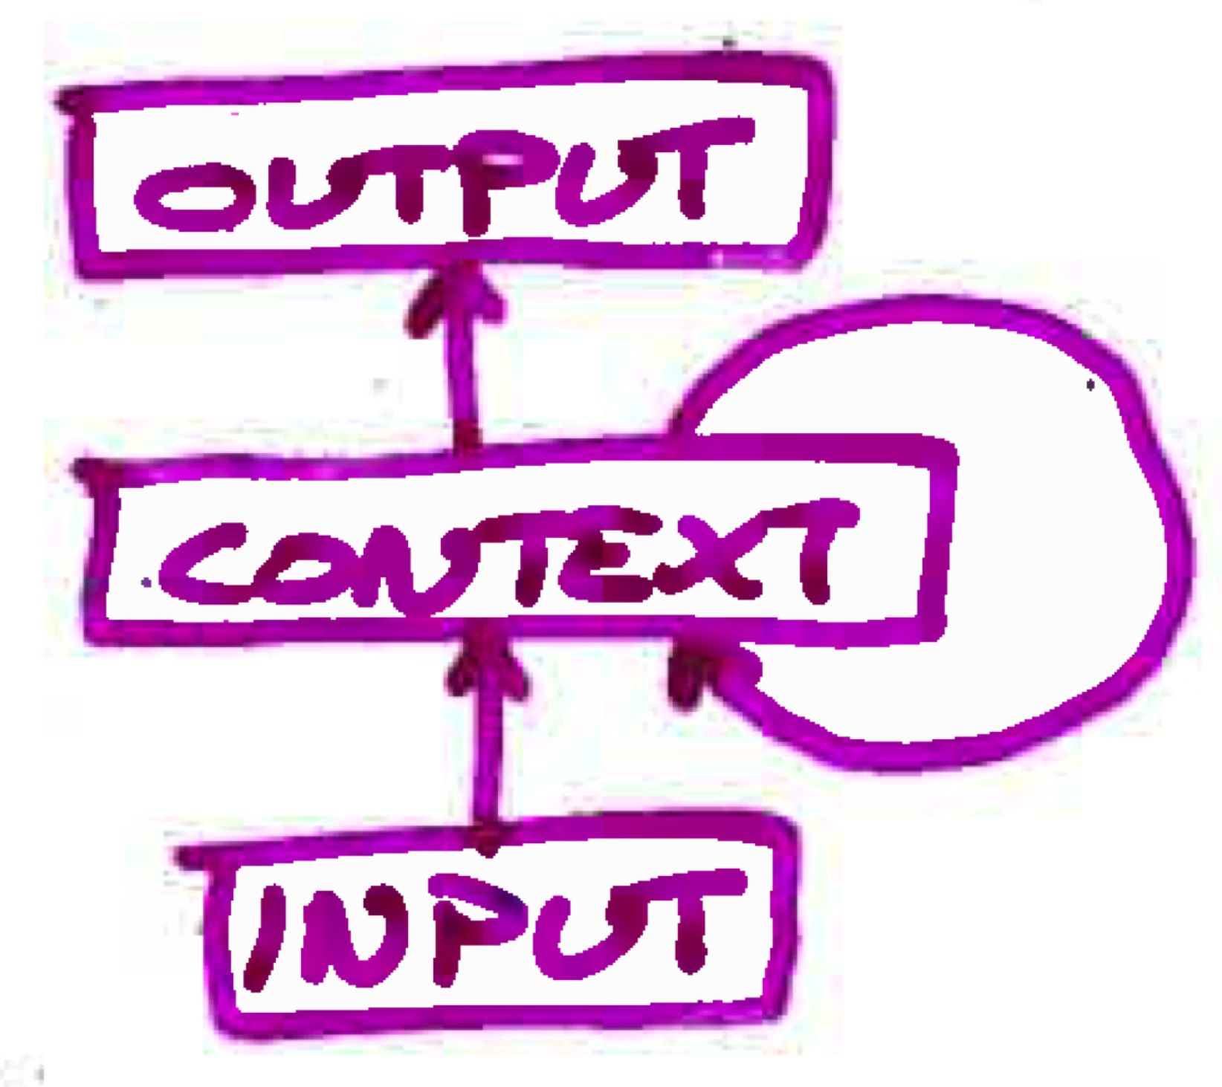
Challenge
Back propagation is designed for feedforward nets
What would it mean to back propagate through a recurrent network?
  error signal would have to travel back in time

Slide 16
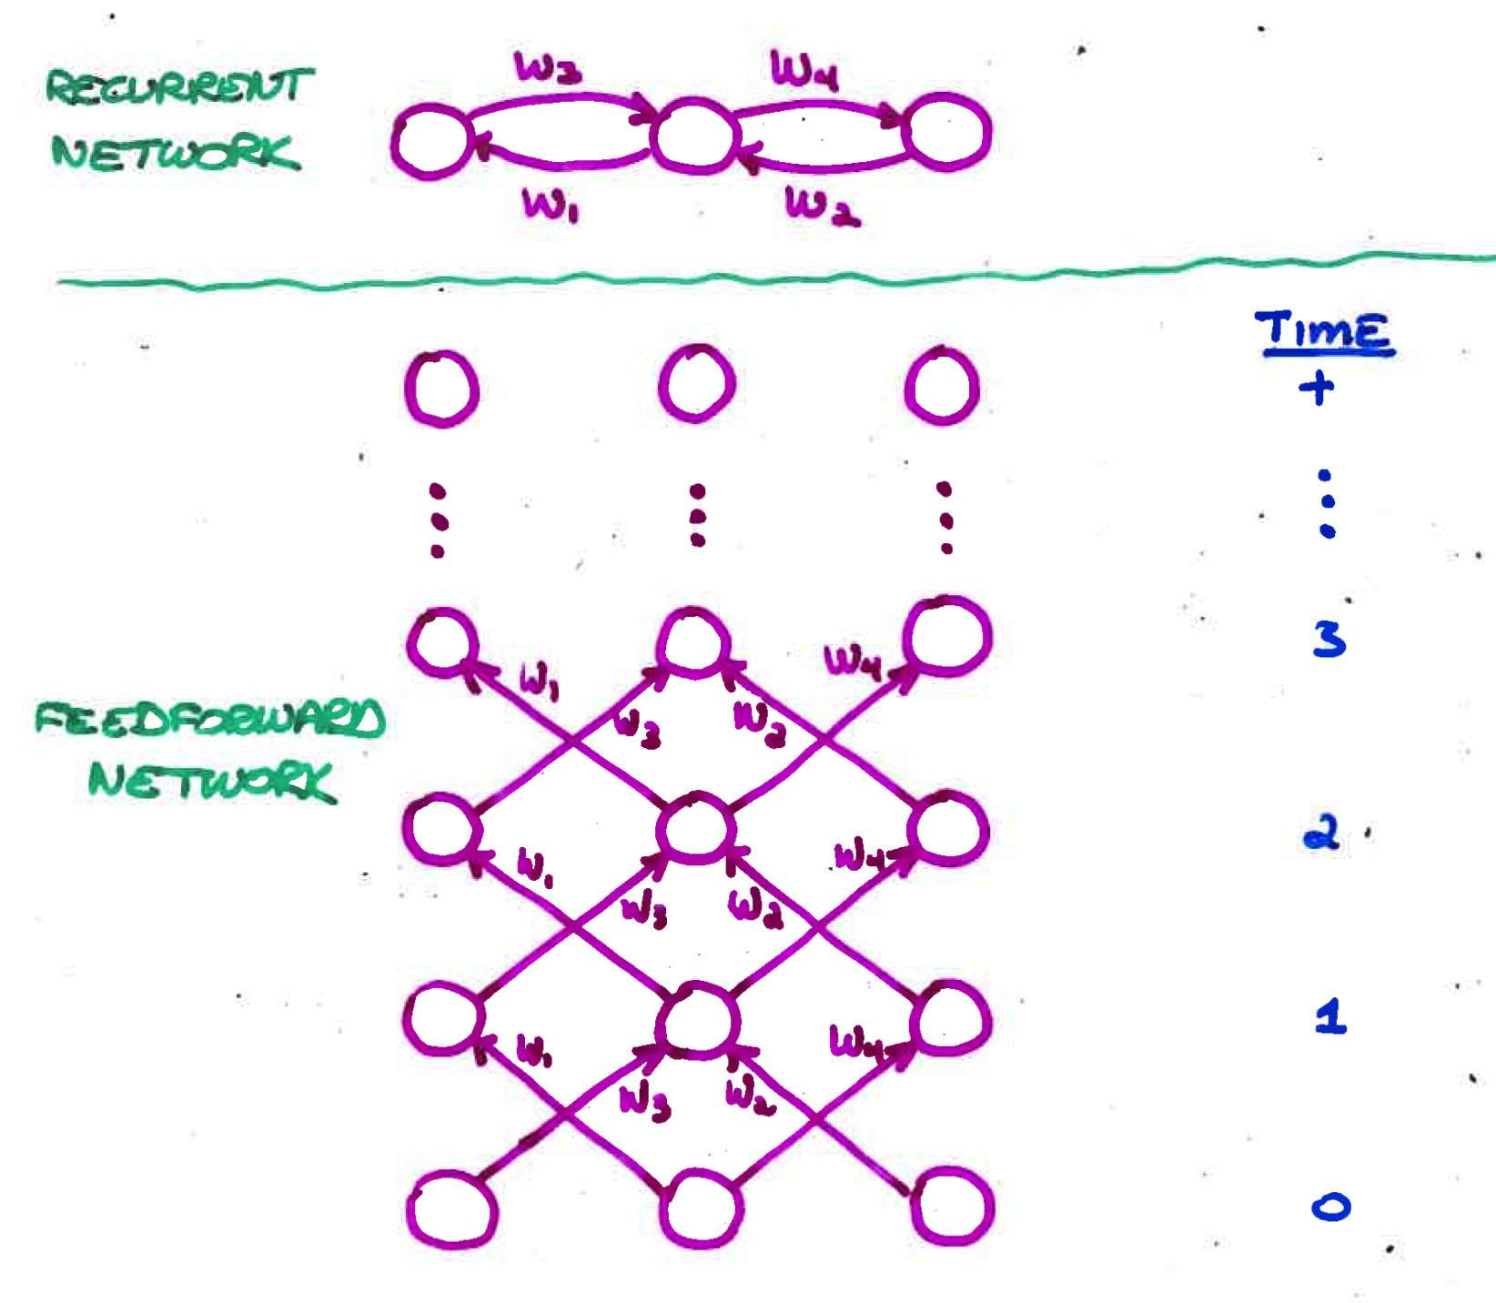
Unfolding To Turn Recurrent Net
Into Feedforward Net
Requires duplication of hardware (units and weights)
  one layer for each discrete time step
Unfolded net has dynamics identical to that of recurrent net run for a fixed number of time steps
BP may violate the constraint that corresponding weights are equal.
  To enforce the constraint, assume a single set of underlying parameters
  Boils down to adding together the Δw’s of corresponding weights
Unfolding is necessary only during learning.
  Once weights are trained, can run as an ordinary RNN

Slide 17
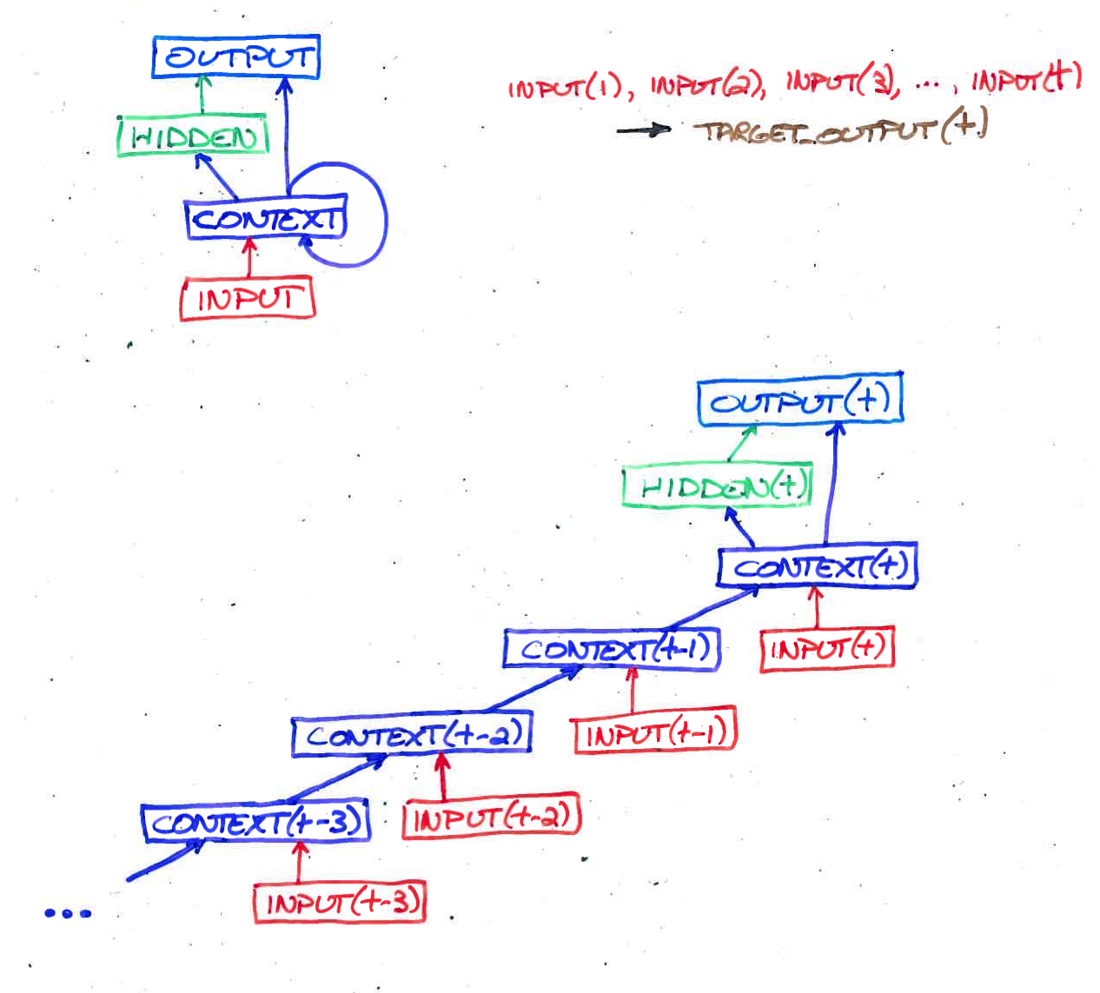
Back Propagation Through Time (BPTT)
For Sequence Recognition

Slide 18
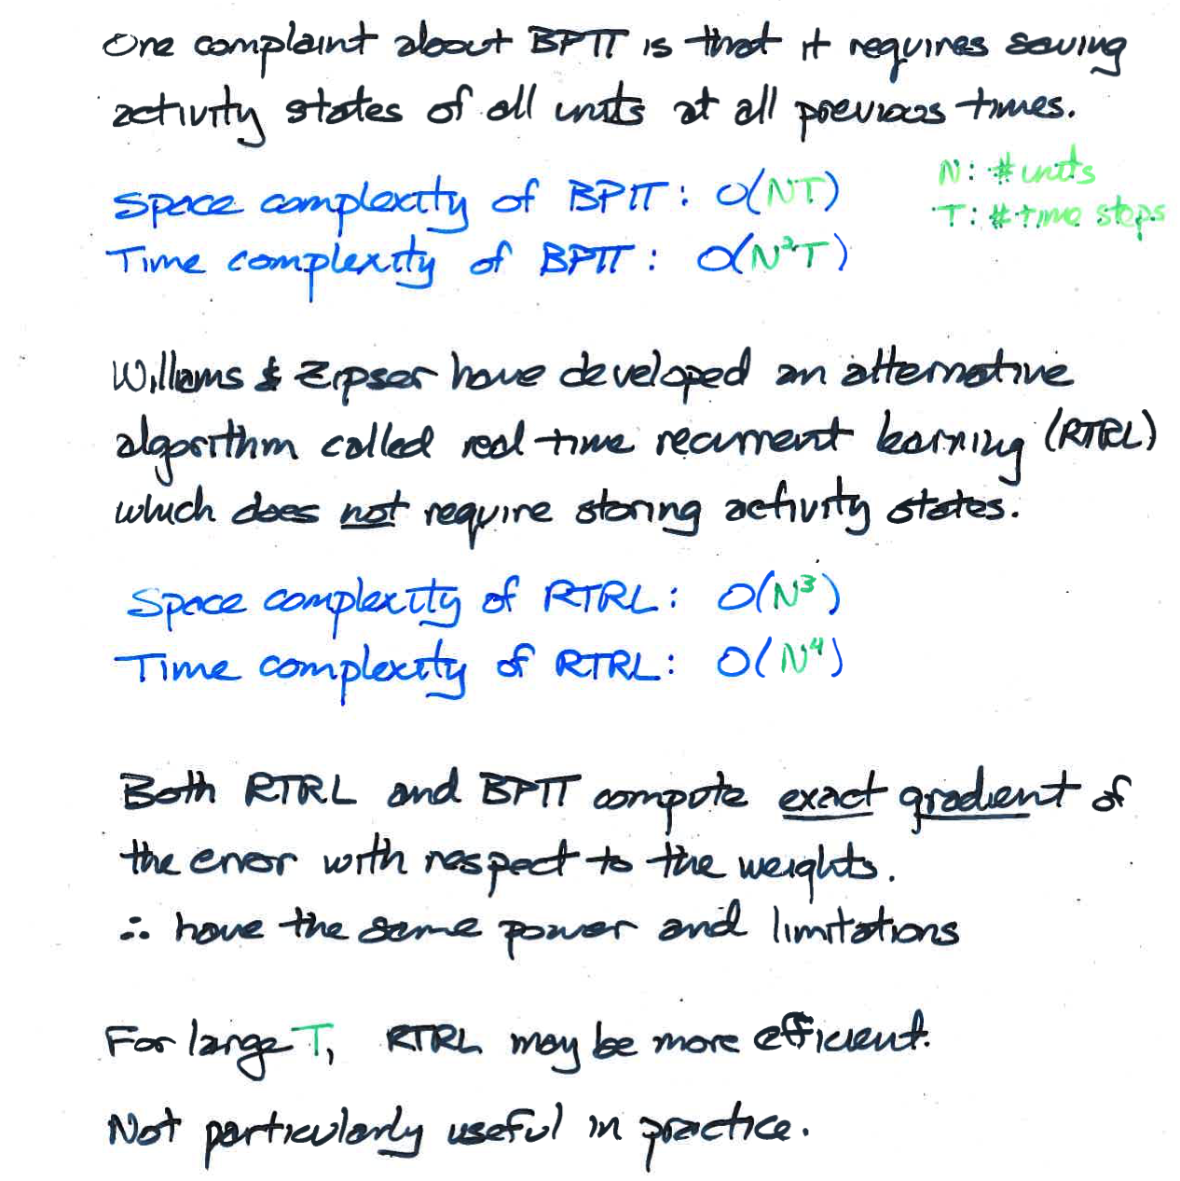
Alternative To BPTT:
Real Time Recurrent Learning (RTRL)

Slide 19
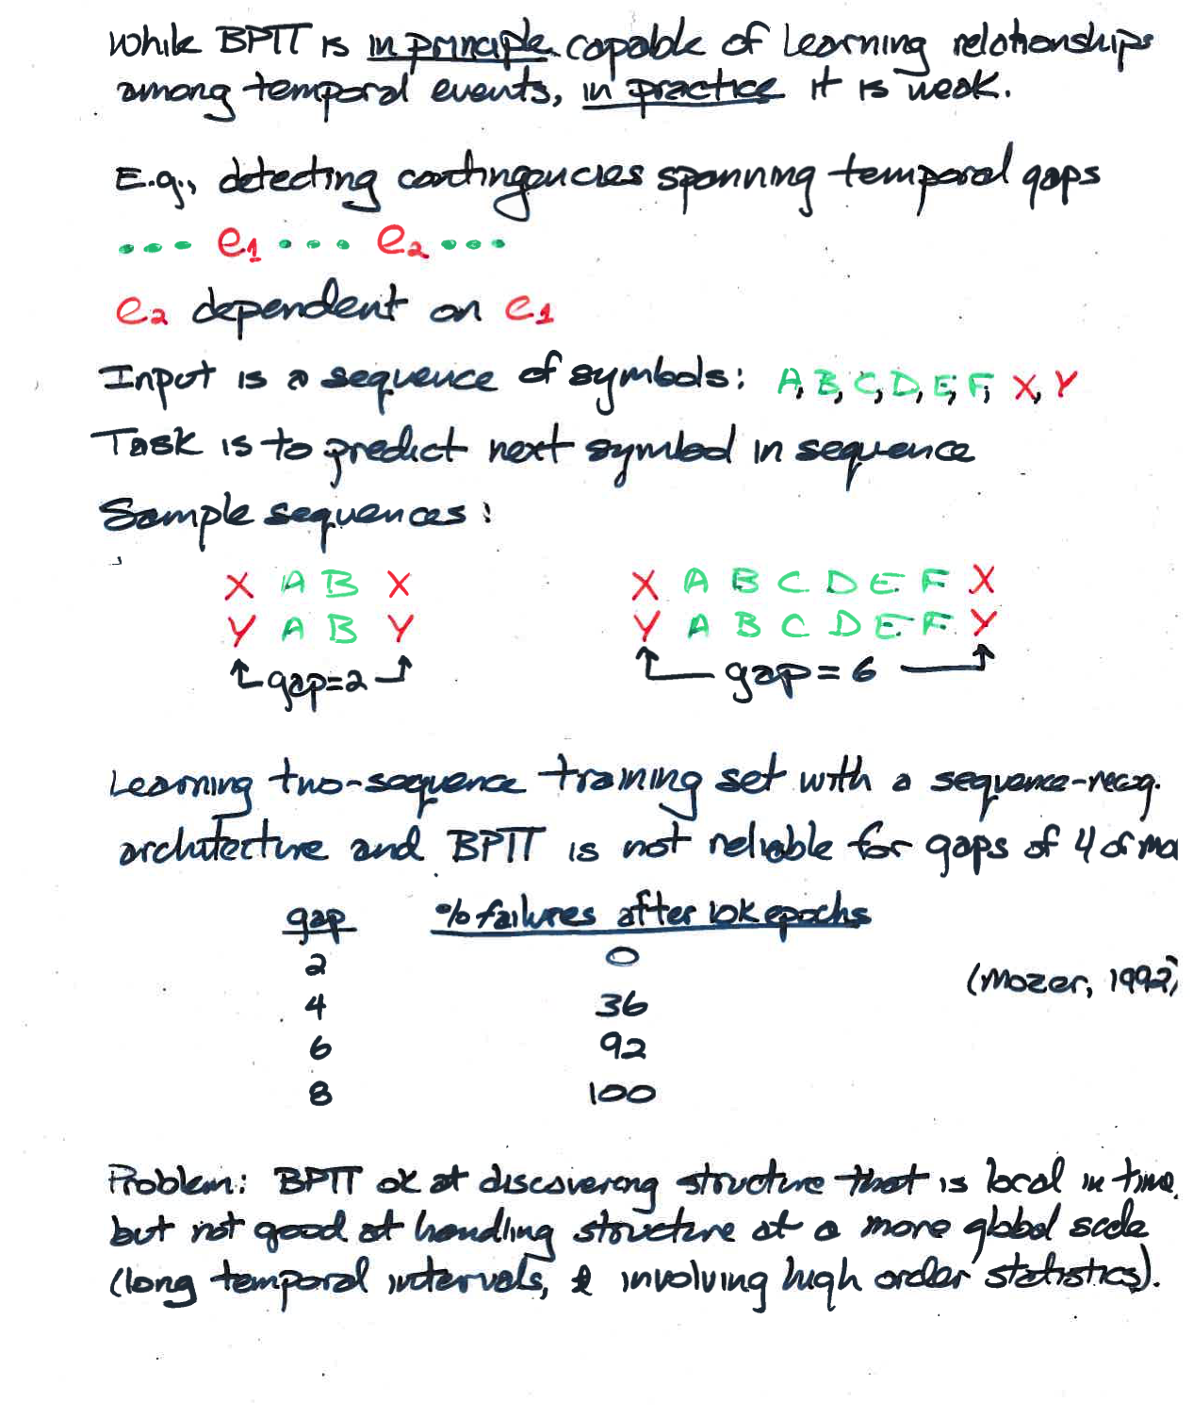
Problem With BPTT and RTRL

Slide 20
One Solution: Inject Error At Every Time Step
Elman autopredictor network
  like autoencoder but in time
Target at each time step is next
sequence element
  E.g., “I like to eat bread and …”
Cheesy training procedure
next
hidden
current
next
hidden
hidden(t)
current
context
hidden(t-1)

Slide 21
Simulation
Sentence generator constructs 2 and 3 word utterances using grammar.
  woman smash plate
  monster eat mouse
  dog smell
10000 random sentences concatenated to form 27,354 element sequence
  Each word represented by localist 30-bit binary vector
30-50-30 autoencoder
  trained on 5 passes through input stream
  (not sufficient to memorize training set)

Slide 22
Grammar + Selection Restrictions

Slide 23
Training Sequence

Slide 24
What Internal Representation Has The Network Learned In Carrying Out
Prediction Task?
For every instance of a given word in training set, obtain hidden representation.
Average representations together to obtain a ‘prototypical’ hidden response.
Perform hierarchical cluster analyses on these (50-element) vectors to determine which words are similar to one another
next
hidden
current

Slide 25
Hierarchical Clustering

Slide 26
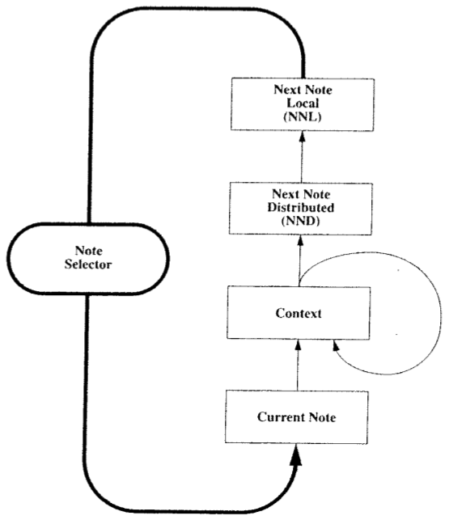
Neural Network Music Composition
(Mozer, 1994)

Slide 27
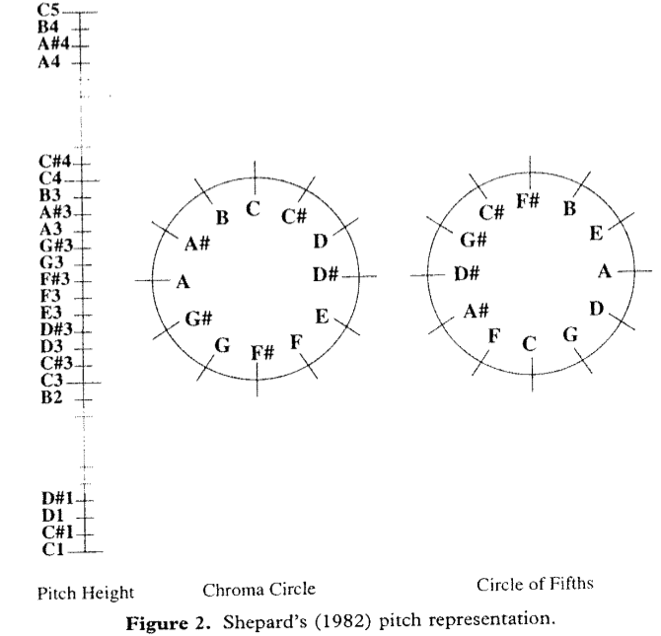
Psychologically Grounded
Representation Of Pitch
Each pitch as point in 5 dimensional space

Slide 28
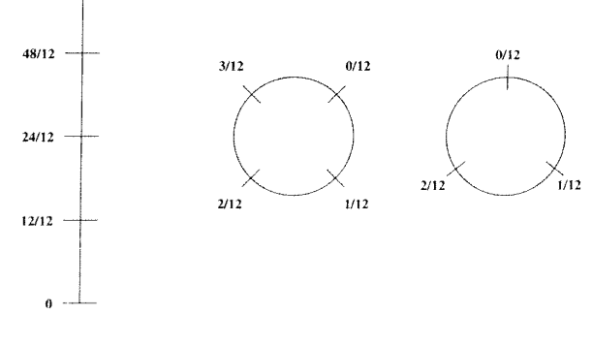
Analogous Representation Of Duration

Slide 29
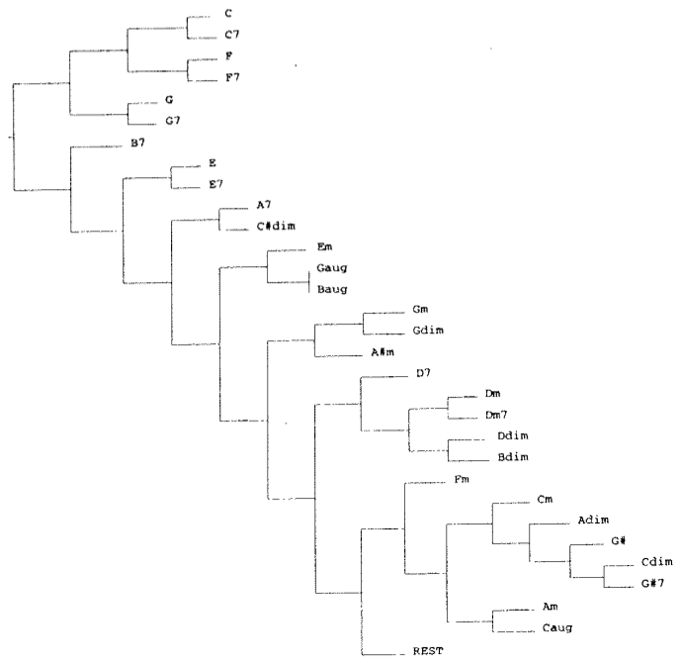
Psychologically Grounded Chord Representation
Hierarchical clustering

Slide 30

Simulation Experiments
Three training sets
  all pieces transposed to C major (or A minor)
Bach (10 training examples)
European folk melodies (25 examples)
Waltzes (25 examples with harmonic
accompaniment)

Slide 31
Solving The Problem Of Training RNNs
Why it is hard to train RNNs
Solutions
  Long short term memory (LSTM)
  Hessian free optimization <save for after class>
  Echo state networks
  Echo state initialization + momentum
Learning to predict the next character

Slide 32
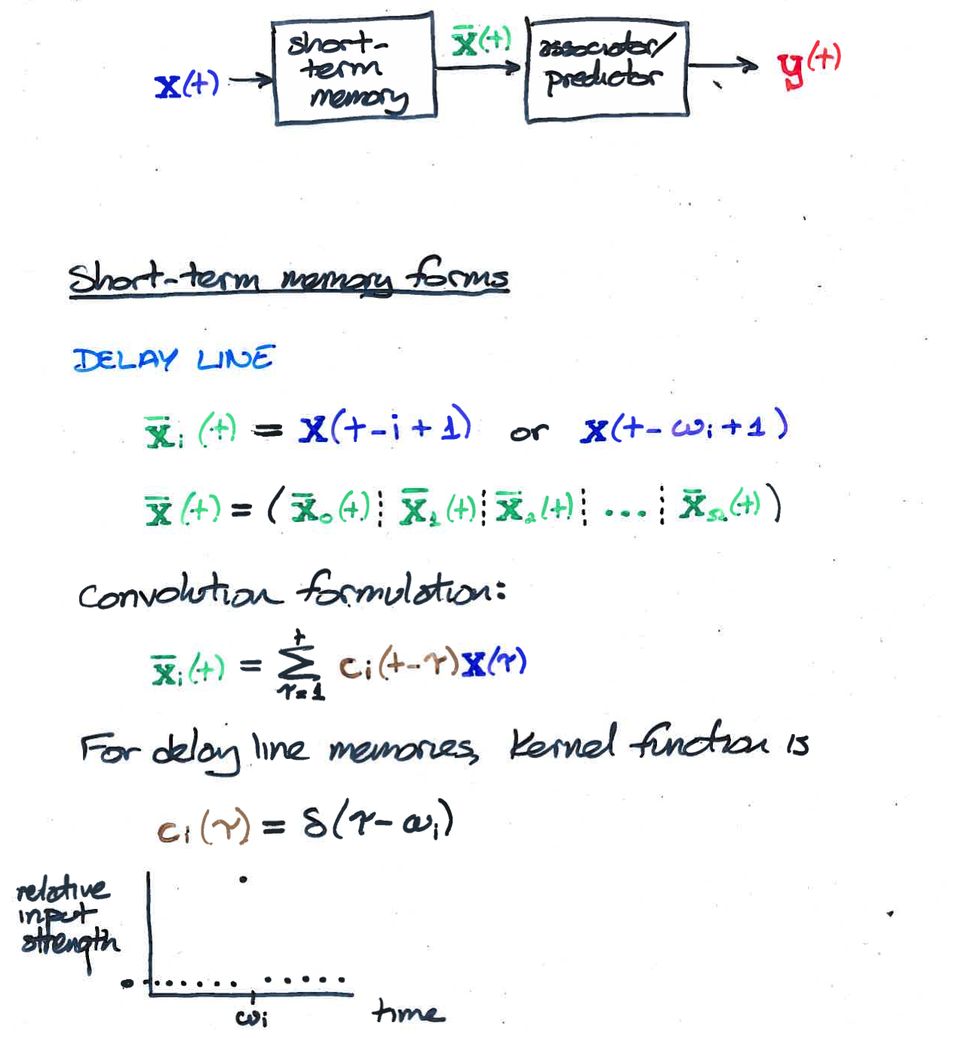
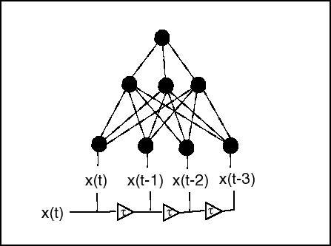
Handling Temporal Sequences With Feedforward Networks
Turn temporal sequence into spatial pattern over input neurons

Slide 33
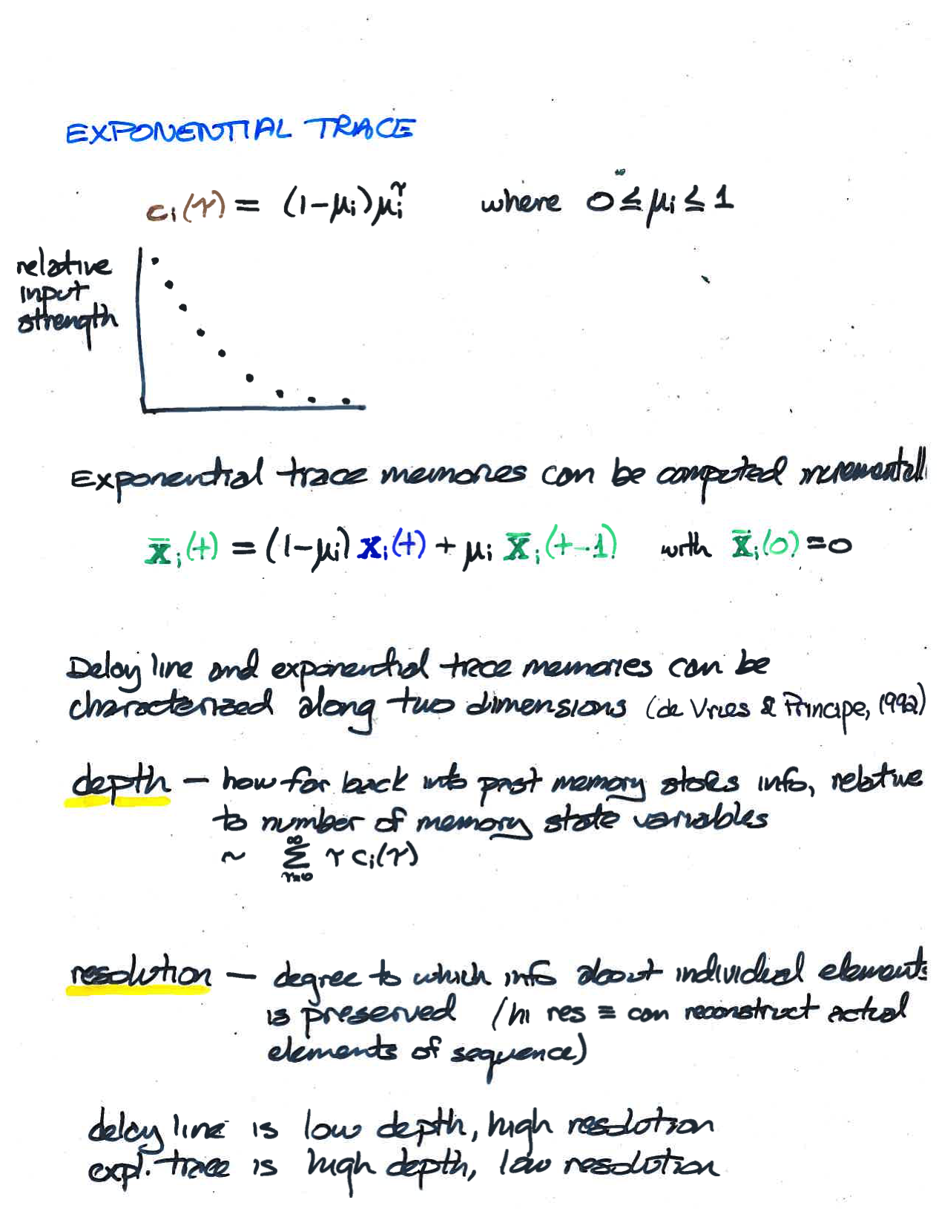
Note: mixture of exponentials approximates power function
Power function interesting because it has both depth and resolution

Slide 34
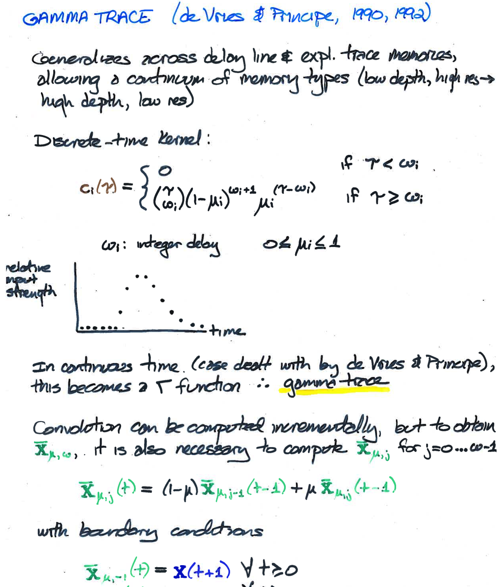
Notes:
combines delay line and exponential kernel

Slide 35
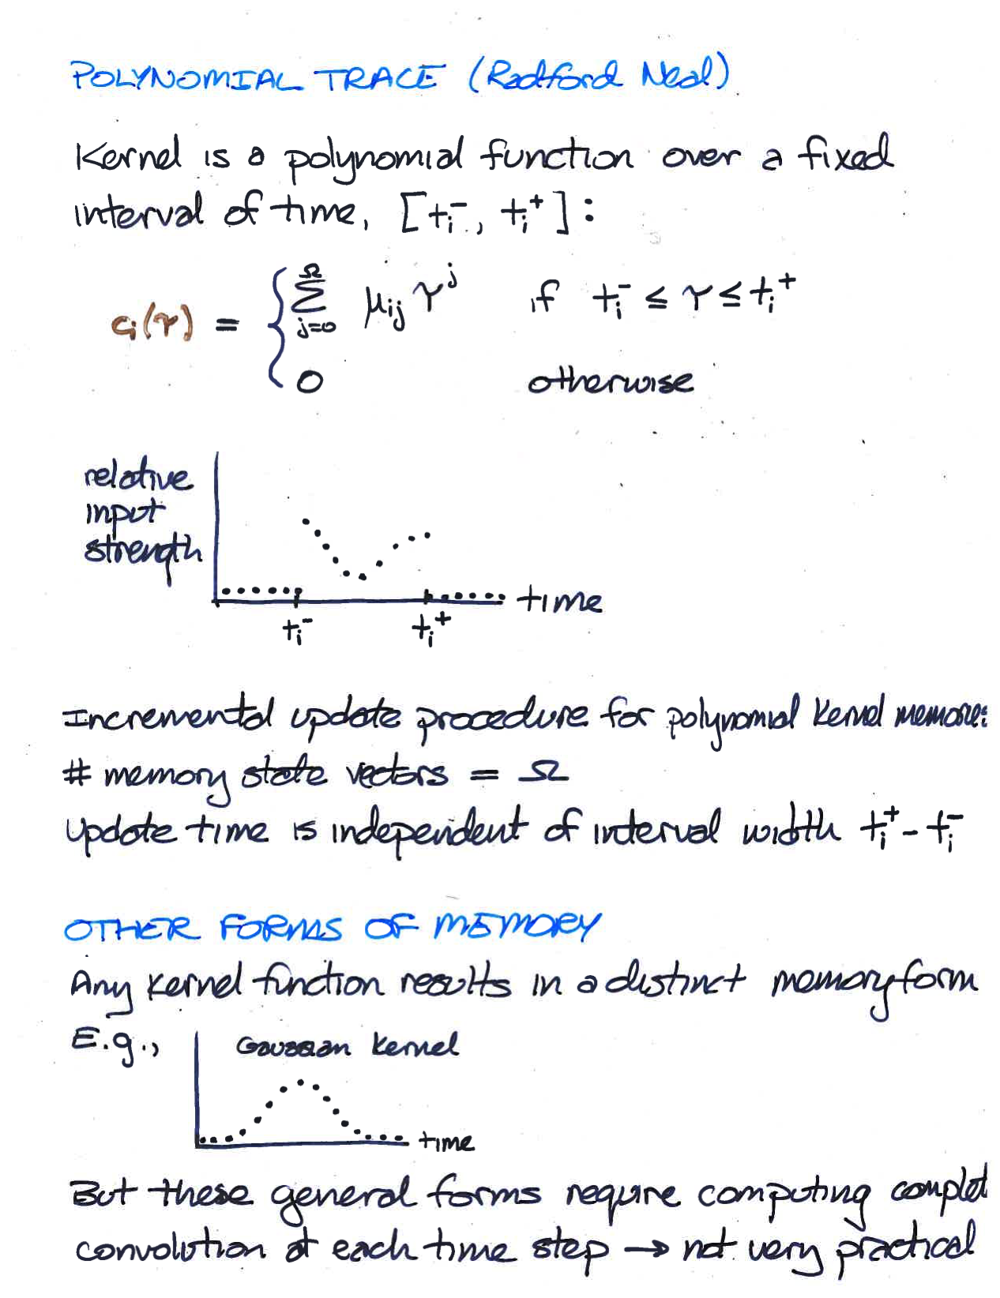

Slide 36
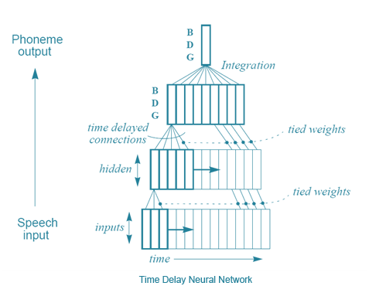
Time Delay Neural Networks
Just as tapped delay line memory can be incorporated into input, you can do the same with each hidden layer.
image from https://electroviees.wordpress.com/2013/08/06/speech-recoginition/

Slide 37
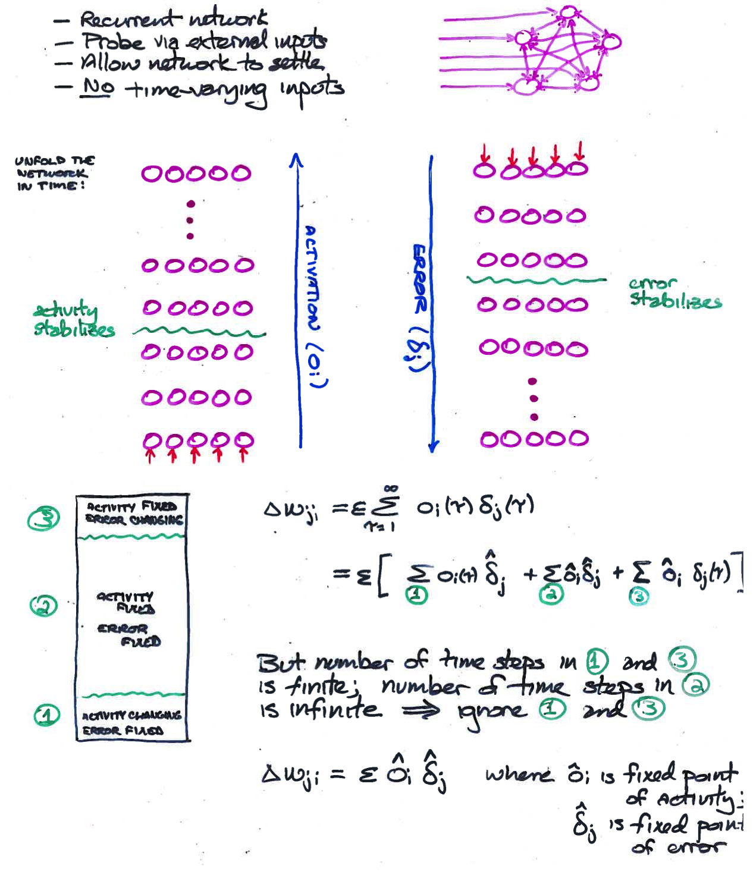
Leftover: Training Attractor Networks
Almeida /
Pineda
algorithm

Slide 38
Comments on Almeida / Pineda Algorithm
This method works only if network reaches a fixed (stable) point in both forward and backward phases
  can show that if network is stable in forward direction, it is also stable in the backward direction.
  Can show that network will be stable in the forward direction if weights are symmetric (wij = wji)
    We’ll see this next week with Hopfield network
Algorithm makes no guarantee about network dynamics
  i.e., can’t train the net to settle in a short amount of time

Slide 39
Summary:
Approaches To Time Varying Inputs
Using Neural Nets
Recurrent networks
  trained weights with BPTT or RTRL
    full recurrent nets, LSTM
  untrained weights
    echo state networks
Map time into space
  input buffer
  compute summary statistics of input history
  buffer at each layer
    time delay neural net (TDNN)

Slide 40
STOP HERE

Slide 41
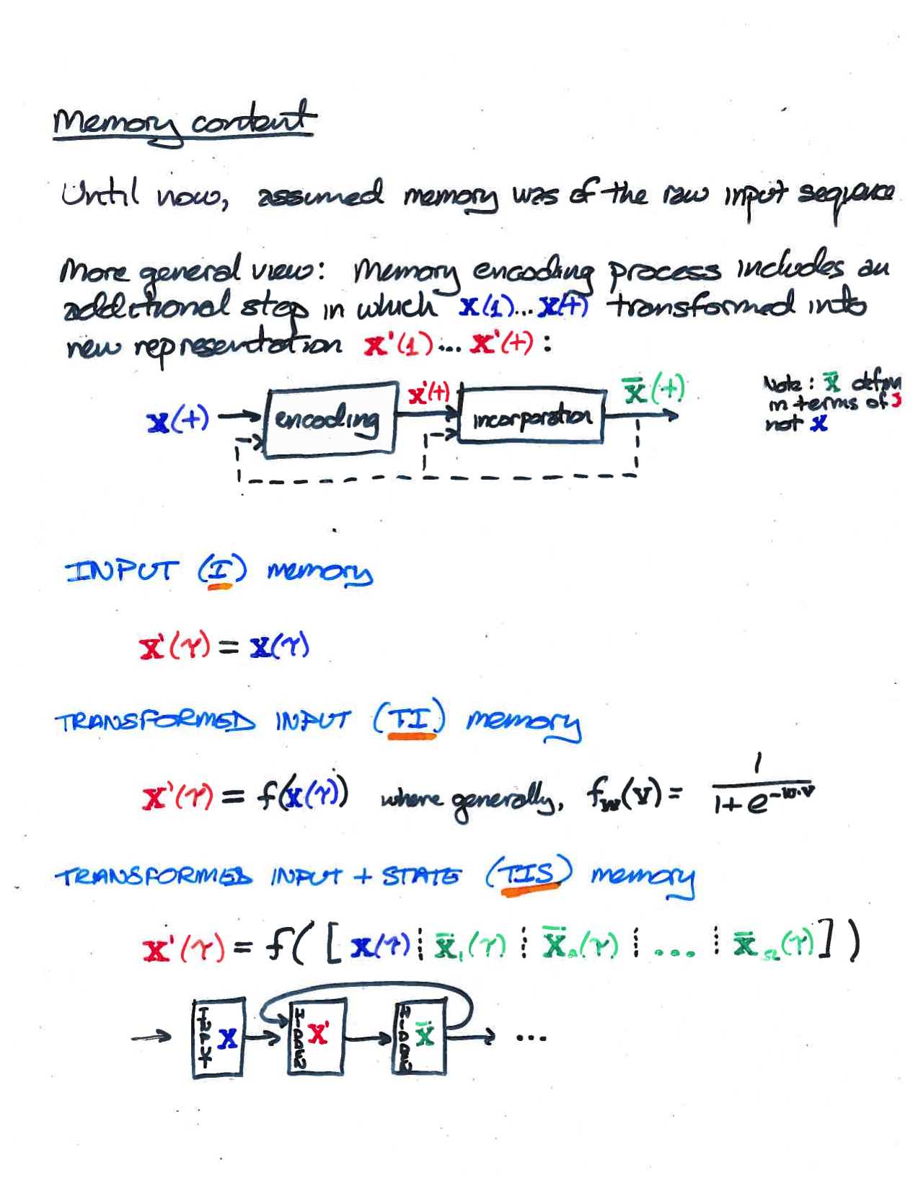

Slide 42
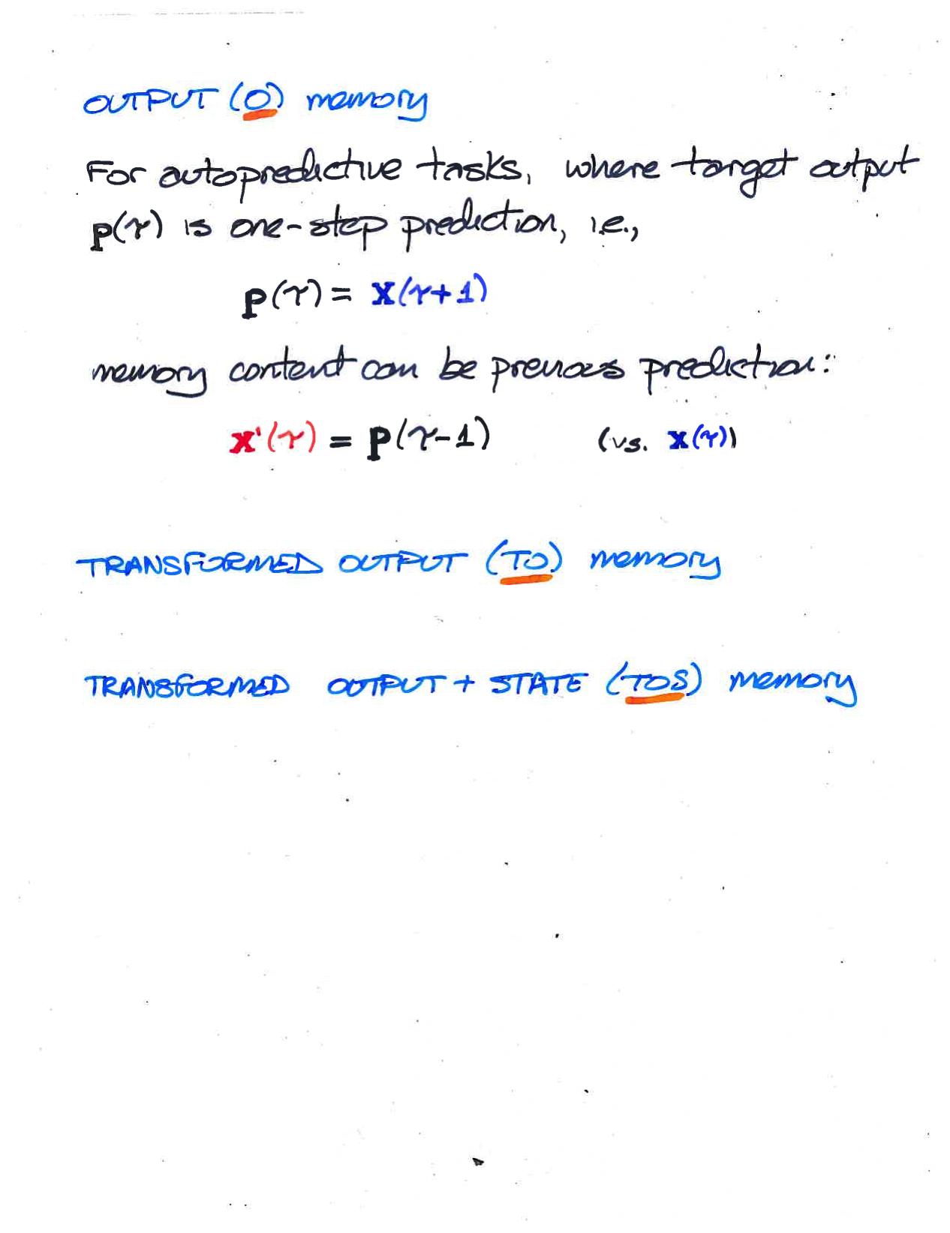

Slide 43
