Slide 1
Object Recognition and Convolutional Networks
Deep Learning and Neural Nets
Spring 2015

Slide 2
Recognizing An Image
Input is 5x5 pixel array
Simple back propagation net like you used in Assignment 3
output
hidden

Slide 3
Recognizing An Object With Unknown Location
Object can appear either in the left image or in the right image
Output indicates presence of object regardless of position
What do we know about the weights?
output
hidden
hidden

Slide 4
Recognizing An Object With Uknown Location
Object can appear either in the left image or in the right image
Output indicates presence of object regardless of position
output
hidden
hidden

Slide 5
Generalizing To Many Locations
Each possible location the object can appear in has its own set of hidden units
Each set detects the same features except in a different location
Locations can overlap
output
hidden
hidden
hidden

Slide 6
Convolutional Neural Net
Each patch of the image is processed by a different set of hidden units (‘detectors’, ‘features’)
But mapping from patch to hidden is the same everywhere
Can be in 2D as well as 1D
Achieves translation invariant recognition
output
hidden
hidden
hidden

Slide 7
The Input Layer
Input layer typically represents pixels present
at a given (x,y) location
of a particular color (R, G, B)
3D lattice
height X width X # channels

Slide 8
The Hidden Layer
Each hidden unit (i) is replicated across (x,y) positions of every patch
Instead of drawing pools of hidden, draw one (x,y) map for each hidden unit type (i)
Hidden unit i at (x,y) gets input from a cube of activity from its corresponding input patch
Each hidden unit in a map has the same incoming weights
output
hidden
hidden
hidden

Slide 9
Jargon
Each hidden unit channel
also called map, feature, feature type, dimension
Weights for each channel
also called kernels
Input patch to a hidden unit at (x,y)
also called receptive field

Slide 10
Transformation From Input To Hidden
Input dimensions
X by Y
Input is processed in M by M patches
One hidden pool per complete patch in the image
hidden dimensions (X-M+1) by (Y-M+1)
Ifpools are offset by S pixels in both horizontal and vertical directions (instead of S=1)
S: stride
hidden dimensions (X-M+1)/S by (Y-M+1)/S

Slide 11
Pooling
If all the hidden units are detecting the same features, and we simply want to determine whether the object appeared in any location, we can combine hidden representations
Sum pooling vs. max pooling
output
sum of hidden
hidden
hidden
hidden

Slide 12
Transformation types
Each layer in a convolutional net has a 3D lattice structure
width X height X feature type
Three types of transformations between layers
convolution
activation function
pooling
Full blown convolutional net performs these transformations repeatedly -> Deep net
higher-order feature detectors after convolution
lower spatial resolution after pooling

Slide 13
Videos And Demos
Hinton video
Convolutional nets for digit recognition
LeCun’s work
LeNet-5
Yann’s early convolutional nets
Javascript convolutional net demo
Hinton video
Convolutional nets for object recognition

Slide 14
ImageNet Competition
ImageNet
> 15M high resolution images
over 22K categories
labeled by Mechanical Turk workers
ImageNet Large-Scale Visual Recognition Challenge (ILSVRC)
2010-2015
2010 competition
1.2 M training images, 1000 categories (general and specific)
200K test images
output a list of 5 object categories in descending order of confidence
two error rates: top-1 and top-5

Slide 15
Krizhevsky, Sutskever, & Hinton (2012)
Downsampled images
shorter dimension 256 pixels, longer dimension cropped about center to 256 pixels
R, G, B channels
Mean subtraction from inputs
Data set augmentation
Generate image translations by selecting random 224 x 224 sub-images
Horizontal reflections (std trick in computer vision)
increases size of training set by factor of 2048
When testing, extract 10 distinct 224x224 sub-images and average predictions
More data set augmentation
Vary intensity and color of the illumination from epoch to epoch
Notes:
10 test images: anchored at upper left, upper right, lower left, lower right, and center of image

Slide 16
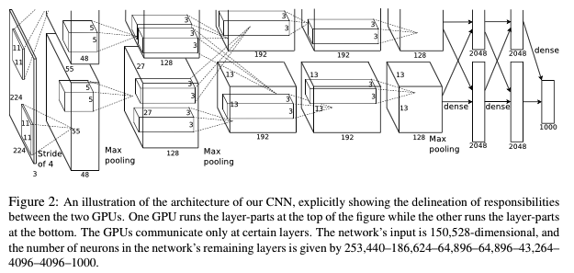
Krizhevsky, Sutskever, & Hinton (2012)
5 convolutional layers, split across two GPUs
3 fully connected layers
1000-way softmax output layer

Slide 17
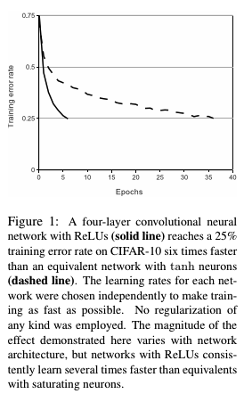
Key Ideas
ReLU instead of logistic or tanh units
Training on multiple GPUs
cross talk only in certain layers
balance speed vs. connectivity
Normalize output of ReLU output in map i at (x,y) based on activity of features in adjacent maps at (x,y)
Overlapping pooling
pooling units spaced s pixels apart, summing over a z X z neighborhood, with s < z
Notes:
a^i_{x,y} is ReLU output, b is normalized output, k, n, alpha, beta are chosen by cross validation

Slide 20
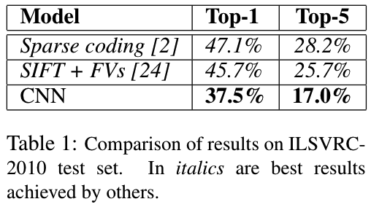
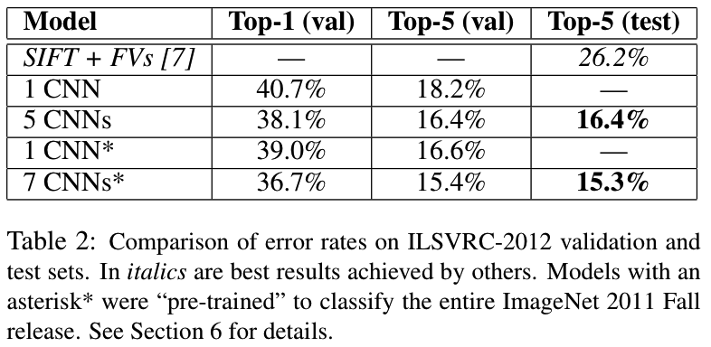
Results

Slide 21
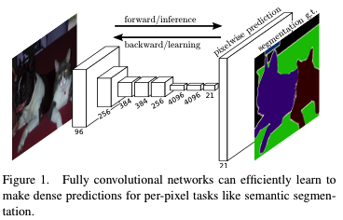
Using Convolutional Nets For Segmentation (Long, Shelhamer, Darrell, 2015)
Determine what objects are where
“what” depends on global information
“where” depends on local information

Slide 22
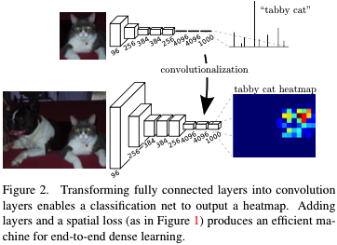
Fully Convolutional Networks
Higher layers of typical convnets are nonspatial
If every layer remains spatial, then output can specify where as well as what (albeit coarsely)

Slide 23
Upsampling
How do we connect coarse output to dense pixels?
Naïve approach
interpolation
Deconvolution approach
if you want to increase resolution by a factor f, use convolution with fractional input stride 1/f

Slide 24
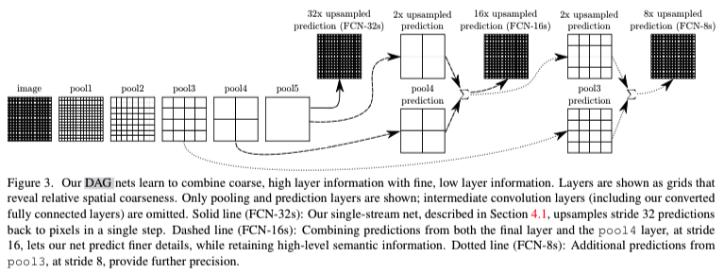
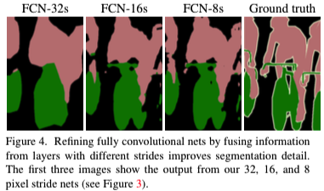
Architecture
Note: pool 5 reflects single pixel in coarse heatmap
Notes:
pool

Slide 25
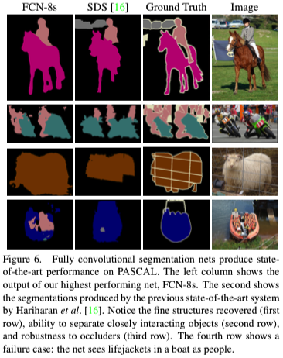
Results
20% relative improvement over state-of-the-art (SDS)
…And runs faster

