Slide 1
CSCI 5822 Probabilistic Models of Human and Machine Learning
Mike Mozer
Department of Computer Science and Institute of Cognitive Science University of Colorado at Boulder

Slide 2
Approximate Inference I

Slide 3
Exact Inference: Summary
Variable elimination
polytrees (directed graph with at most one undirected path between any two vertices; subset of DAGs)
computing specific marginal
Belief propagation
polytrees
computing any marginals
polynomial time algorithm
Junction tree algorithm
arbitrary graphs
computing any marginals
may be exponential…
Notes:
polynomial in # of nodes
may be exponential…. see next slide

Slide 4
Example Of Intractability
Multiple cause model: X_{i} are binary hidden causes
Compute marginal
What happens as number of X’s increases?
X₁
X₂
X₃
X₄
X₅
X₆
Y
Notes:
Suppose we add an x7. (in the figure, x7=0). Then we need to look at all combinations of values for x1-x6 for each x7 -> exponential in # causes
computing marginals same problem: P(Xi | Y)

Slide 5
Example Of Intractability
X₁
X₂
X₃
Y
Notes:
Suppose we add an x7. (in the figure, x7=0). Then we need to look at all combinations of values for x1-x6 for each x7 -> exponential in # causes
computing marginals same problem: P(Xi | Y)

Slide 6
Approximate Inference
Exact inference algorithms exploit conditional independencies in joint probability distribution.
Approximate inference exploits the law of large numbers.
Sums and products of many terms behave in simple ways
Approximate an intractable integral/sum with samples from distribution
Appropriate algorithm depends on
can we sample from p(x)?
can we evaluate p(x)?
can we evaluate p(x) up to the normalization constant?

Slide 7
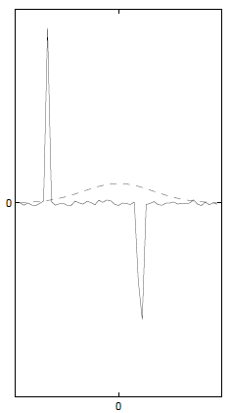
Monte Carlo Sampling
Instead of obtaining p(x) analytically, sample from distribution.
draw i.i.d. samples {x^{(i)}}, i = 1 ... N
e.g., 20 coin flips with 11 heads
With enough samples, you can estimate even continuous distributions empirically.
This works if you can sample from p(x) directly
e.g., Bernoulli, Gaussian random variables
Challenge if F(x) varies a lot in regions of low p(x)
dirac delta
Notes:
Integral is an expectation of F(.) under p(x)
SEE NOTES ON MONTE CARLO: http://ib.berkeley.edu/labs/slatkin/eriq/classes/guest_lect/mc_lecture_notes.pdf

Slide 8
Sampling From A Bayes Net
P(C)
0.50
P(C)
0.50
Cloudy
Cloudy
C | P(S|C)
T | .10
F | .50
C | P(S|C)
T | .10
F | .50
C | P(R|C)
T | .80
F | .20
C | P(R|C)
T | .80
F | .20
Sprinkler
Sprinkler
Rain
Rain
Wet Grass
Wet Grass
S | R | P(W|S,R)
T | T | .99
T | F | .90
F | T | .90
F | F | .01
S | R | P(W|S,R)
T | T | .99
T | F | .90
F | T | .90
F | F | .01

Slide 9
What if you can’t sample from p(x)
… but you can evaluate p(x)?
…but you can evaluate p(x) only up to a proportionality constant?

Slide 10
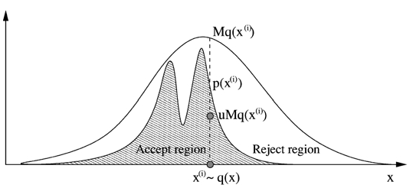
Rejection Sampling
Cannot sample from p(x), but can evaluate p(x) up to proportionality constant.
Instead of sampling from p(x), use an easy-to-sample proposal distribution q(x).
p(x) <= M q(x), M < ∞
Reject proposals with probability 1-p(x)/[Mq(x)]
Notes:
we talked about how rejection sampling gives you the right posteriors.
shoot a dart under Mq curve. if lands in light region the reject.
same thing to draw from q and reject with prob ratio

Slide 11
Rejection Sampling
Problems
It may be difficult to find a q(x) with a small M that is easy to sample from -> many rejections
Many rejections (expensive) if x is high dimensional
Notes:
P(x) drops off exponentially with number of dimensions of x
The next scheme is going to work better in high dimensional cases.

Slide 12
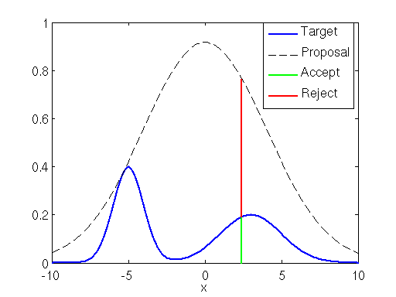
Rejection Sampling
Sample a Gaussian mixture using a single Gaussian proposal distribution
see code

Slide 13
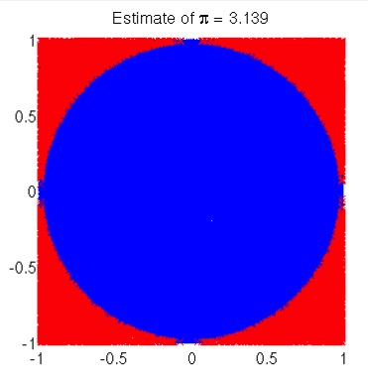
Rejection Sampling
Area of circle = $πr^{2}$
Sample within square of diameter 2 (radius 1)
Reject sample if outside unit circle: $x^{2}+y^{2}>1$
From theclevermachine.wordpress.com

Slide 14
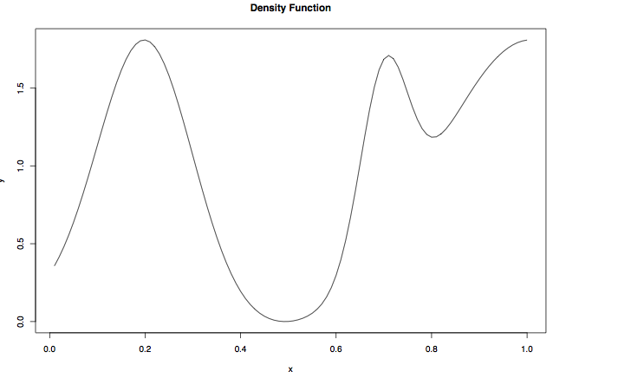
Rejection Sampling
What should we use as proposal distribution?
Notes:
how about uniform distribution?

Slide 15
Importance Sampling
Nice
reference
Use when
Can evaluate p(x)
An easily sampled proposal distribution q(x) similar to p(x) is available
Reweight each sample by w = p(x^{(i)})/q(x^{(i)})
Notes:
MIKE ***** SEE NOTES http://ib.berkeley.edu/labs/slatkin/eriq/classes/guest_lect/mc_lecture_notes.pdf
importance sampling is also used when you want to get a low variance estimator
give an example of some function f(x) which is mostly zero and p(x) is uniform over a large range.
a small number of samples from p(x) are not going to be useful
simply sampling where f(x) is large is not going to be useful (you’ll overestimate)
importance sampling: sample from regions where f(x) is ’interesting’ or ‘informative’ and downweight them.

Slide 16
Importance Sampling
Also used when goal is a low variance estimator
E.g., estimate E[f(x)] with p(x) uniform
A small number of samples from p(x) may not hit the “interesting” region of f(x) and will underestimate E[f(x)]
Simply sampling where f(x) is large will overestimate E[f(x)].
Importance sampling
sample from regions where f(x) is ’interesting’ or ‘informative’ and downweight them.

Slide 17
Importance Sampling
When normalizing constant of p(.) or q(.) is unknown, it's still possible to do importance sampling with ŵ^{(i)}
w^{(i)} = p(x^{(i)}) / q(x^{(i)})
ŵ^{(i)} = w^{(i)} / ∑_{j} w^{(j)}
Note that any scaling constant in p(.) or q(.) will be removed by the normalization.
Problem with importance and rejection sampling
May be difficult to find proposal distribution that is easy to sample from and a good match to p(x)

Slide 18
Likelihood Weighting: Special Case Of Importance Sampling
Goal: estimate conditional distribution, p(x|e), by sampling (the nonevidence variables) from unconditional distribution p(x)
We discussed how to do this with rejection sampling.
Importance sampling reweights each sample by w = p(x^{(i)})/q(x^{(i)}) = p(x|e) / p(x) = [p(e|x) p(x) / p(e)] / p(x) = p(e|x) /p(e) ~ p(e|x)
Weight each sample by likelihood it accords the evidence
Notes:
P(e) is constant so can be discarded

Slide 19
Likelihood Sampling
P(C)
0.50
P(C)
0.50
Cloudy
Cloudy
C | P(S|C)
T | .10
F | .50
C | P(S|C)
T | .10
F | .50
C | P(R|C)
T | .80
F | .20
C | P(R|C)
T | .80
F | .20
Sprinkler
Rain
Rain
Wet Grass
S | R | P(W|S,R)
T | T | .99
T | F | .90
F | T | .90
F | F | .01
S | R | P(W|S,R)
T | T | .99
T | F | .90
F | T | .90
F | F | .01
W = .10 x .90

Slide 20
Markov Chain Monte Carlo (MCMC)
Goal
Generate sequence of samples from a target distribution p*(x)
Markov Chain property
Sample t+1 depends only on sample t
Key assumption
Although we do not know how to sample from p*(x) directly, we know how to update samples in a way that is consistent with p*(x)
Notation change
warning
Notes:
NOTATION CHANGE: using p* as target distribution, not p
what are we going to do with a sequence of samples? e.g., compute the mean of a variable, compute the correlation between two variables

Slide 21
MCMC Updating
P(C)
0.50
Cloudy
C | P(S|C)
T | .10
F | .50
C | P(R|C)
T | .80
F | .20
Sprinkler
Rain
Wet Grass
S | R | P(W|S,R)
T | T | .99
T | F | .90
F | T | .90
F | F | .01
Notes:
If we have a sampled state – values on all variables – we can update a variable, e.g., wet grass, via the CPT

Slide 22
MCMC
Define a Markov chain where each state is an assignment of values to each variable
x¹ → x² → x³ → …
x^{i} ~ p^{i} (X)
With property p^{i}(X^{i} = x^{i}) = ∑ p^{i-1} (X^{i-1} = x^{i-1})T(x^{i-1}→x^{i})
T(x^{i-1}→x^{i}) is the Markov chain transition probability = p(X = x^{i}|X^{i-1} = x^{i-1})
We’ll achieve goal if the invariant or stationary distribution of the chain is p*(X):
p*(X^{i} = x^{i}) = ∑ p*(X^{i-1} = x^{i-1})T(x^{i-1}→x^{i})
Notes:
invariant/stationary distribution: once you get there, you stay there

Slide 23
MCMC
Procedure
Start X in a random state
Repeatedly resample X based on current state of X
After sufficient burn in, X reaches a stationary distribution.
Use next s samples to form empirical distribution
Idea
Chain will draw X from more probable regions of p*(X)
Chain is efficient because you can get from one sample drawn from p* (X) to another (after the burn in)
MCMC sampler
Requires means of sampling from transition probability distribution

Slide 24
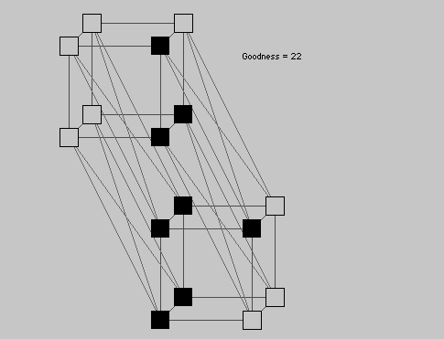
Example: Boltzmann Machine
link
Open in Firefox or Safari: Java won’t run in Chrome
Notes:
QUIZ: what does the potential function look like for (a) pair of nodes in the same interpretation, (b) nodes in different interpretations
http://www.cs.cf.ac.uk/Dave/JAVA/boltzman/Necker.html
http://www.psy.uq.edu.au:80/~mav/java/Necker.java"

Slide 25
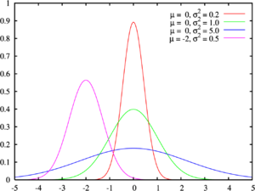
Example: Gaussian Mixture Model
Given: data samples generated by draws of a Gaussian mixture model with a fixed number of components.
Chicken and egg problem
Don’t know assignment of samples to components (z)
Don’t know individual Gaussian means and covariances (λ)
Start off with guesses about assignments and mixture model parameters
Update guesses assuming current assignments and parameters

Slide 26
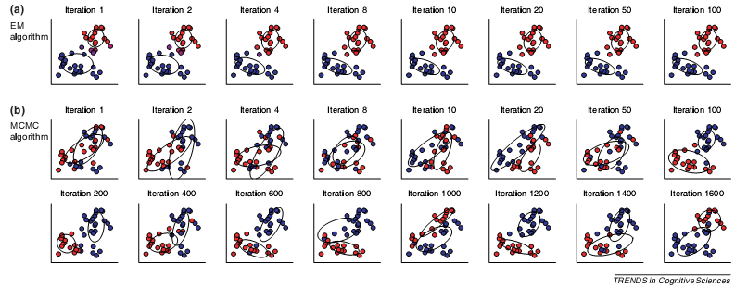
Example: Gaussian Mixture Model
Compare EM to MCMC
EM finds local optimum assignment
MCMC draws samples from posterior
Notes:
Kind of question you could ask: What’s the probability that x1 and x2 belong to the same cluster?

Slide 27
Equilibrium Distribution
Want to obtain a unique equilibrium (stationary) distribution regardless of the initial conditions p⁰ (X⁰)
i.e.,

Slide 28
Equilibrium Distribution
A stationary (equilibrium) distribution will be reached regardless of the initial state if a Markov chain is ergodic.
Ergodicity conditions:
1. Irreducible (can get from any state to any other)
2. Aperiodic (cannot get stuck in cycles
Circles are states not nodes in
A graphical model
Notes:
T^k : means transition in k states.
GDC = greatest common denominator
Cycles limit how frequently you can return to a state (e.g., every 3 transition -> GCD = 3)

Slide 29
Equilibrium Distribution
Stronger condition than ergodicity
detailed balance (time reversibility)
Stronger condition still
symmetry of transition matrix
Both guarantee equilibrium distribution will be reached
Notes:
detailed balance: likelihood of P(x at time t, x’ at t+1) = P(x’ at time t, x at t+1)

Slide 30
Convergence (often called Burn In)
The idea of the convergence period is to stabilize chain
i.e., end up at a point that doesn't depend on where you started
e.g., person's location as a function of time
Justifies arbitrary starting point.
Mixing time
how long it takes to move from initial distribution to p*(X)
Notes:
I know where you’re going to be 1 second after class ends, maybe 1 min later I have some uncertainty, 1 hour later, 1 decade later…

Slide 31
MCMC Via Metropolis Algorithm
Does not require computation of conditional probabilities (and hence normalization)
Procedure
at each step, i, where chain is in state x^{i}
choose a new value for state, x*, from a symmetric proposal distribution q, i.e., q(x*| x^{i}) = q(x^{i} |x*) e.g., q(x*| x^{i}) = N(x*; x^{i},σ²)
accept new value with probability
Notation change
warning
Notes:
Sampling in neighborhood of x^I
Requirement of proposal distribution: it can be sampled from

Slide 32
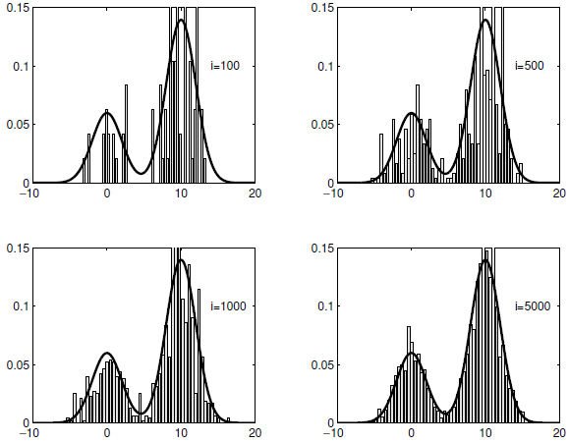
p(X): mixture of Gaussians q(X): single Gaussian

Slide 33
Extension To Metropolis Algorithm
Metropolis acceptance probability:
Metropolis-Hastings
proposal distribution can be asymmetric
more general algorithm
Intuition
q ratio tests how easy is it to get back to where you came from
ratio is 1 for Metropolis algorithm
Notes:
For metropolis-hastings, need not only to be able to sample from proposal distribution, but also evaluate probability (up to normalization constant)

Slide 34
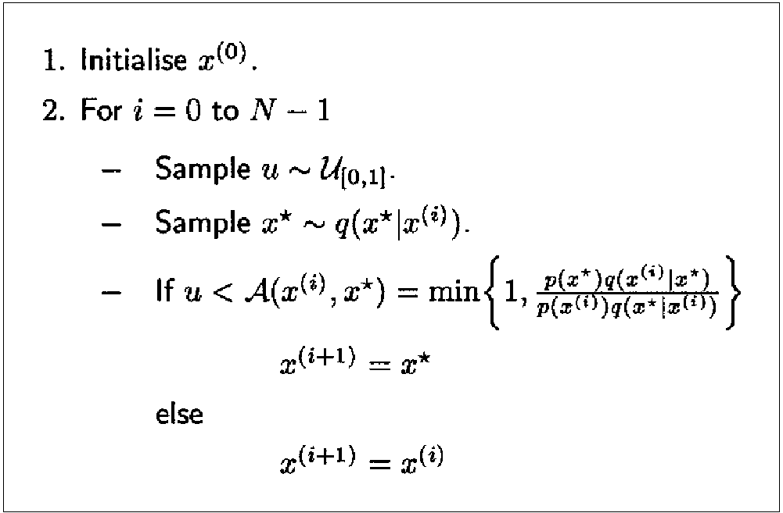
Metropolis Hastings Algorithm
Notes:
NOTE that when new sample is rejected, old x is resampled. why does this matter? what are we going to do with the vector x?

Slide 35
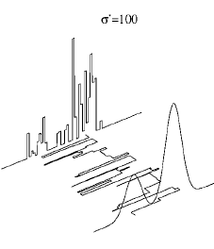
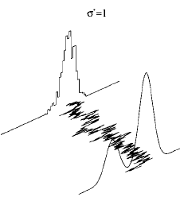
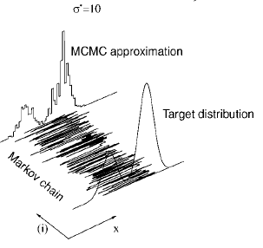
Convergence: Why Proposal Distribution Matters
Proposal distribution is too broad → Acceptance probability low → Slow convergence
Proposal distribution is too narrow → Long time to explore state space → Slow convergence
Notes:
Necker cube example: too ”narrow”

Slide 36
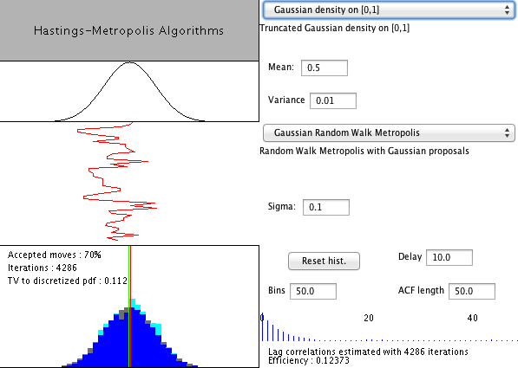
Neat Web Demo
http://www.lbreyer.com/classic.html

Slide 37
Gibbs Sampling
Useful when full conditional distribution can be computed and efficiently sampled from
Overview
At each step, select one variable x_{j} (random or fixed seq.)
Compute conditional distribution p(x_{j} | x_{-j})
Sample a value from this distribution
Replace the previous value of x_{j} with the sample
cliques containing x_{j}
Notes:
Special case of metropolis hastings…as I’ll explain in a bit.
J is index over nodes; U markov blanket
From “C in C” to “C in C_j”: all clicks not containing j are constant in numerator and denominator
note that you can do Gibbs sampling with any discrete Bayes net pretty easily
This is what I was doing with the sprinkler/rain example

Slide 38
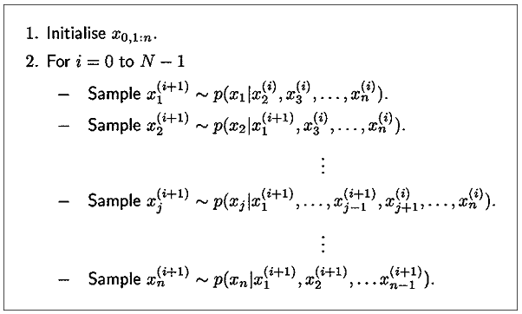
Gibbs Sampling Algorithm

Slide 39
Gibbs Sampling
Assumes efficient sampling of conditional distribution
Efficient if C_{j} is small
In a directed graphical model, these cliques will include nodes in the Markov blanket of node j
Normalization term is often the tricky part

Slide 40
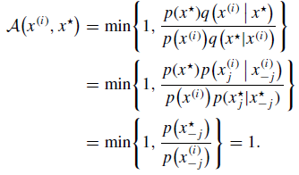
Gibbs Sampling
Proposal distribution
With this proposal distribution, acceptance probability under Metropolis-Hastings is 1
Notes:
Second line of derivation: P(x*)/P(x*j/x*-j) : P(x1*,x2*,x3*)/P(x1*|x2*,x3*) … P(a,b,c)/P(a | b,c) = P(b,c)
Because all values except xj are clamped, ratio at bottom is = 1

Slide 41
I’ve Already Shown Examples Of Gibbs Sampling
Cloudy
Sprinkler
Rain
Wet Grass

Slide 42
Comments on Gibbs Sampling
Straightforward with DAGs due to Bayes net factorization
Can conceptually update variables with no conditional dependencies in parallel
E.g., Restricted Boltzmann machine
$$y$$
$$P\left(y_{i}=1 | x\right)=logistic\left(\sum_{j}{w_{ij}x_{j}}\right)$$
$$x$$
$$P\left(x_{j}=1 | y\right)=logistic\left(\sum_{i}{w_{ji}y_{i}}\right)$$

Slide 43
Particle Filters
Time-varying probability density estimation
E.g., tracking individual from GPS coordinates
state (actual location) varies over time
GPS reading is a noisy indication of state
Could be used for HMM-like models that have no easy inference procedure
Basic idea
represent density at time t by a set of samples (a.k.a. particles)
weight the samples by importance
perform sequential Monte Carlo update, emphasizing the important samples

Slide 44
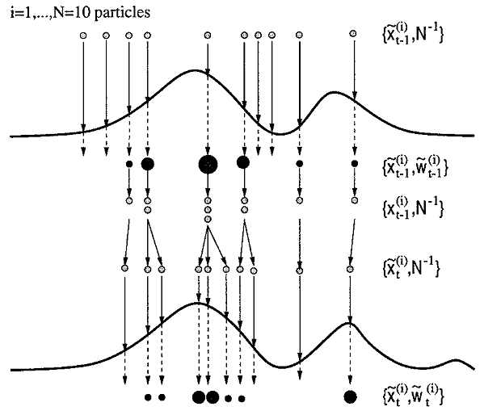
Particle Filters: The Basic Idea
Sample
Probability distribution
represent density at time t-1 by a set of samples (a.k.a. particles)
weight by
importance
discrete resampling to
emphasize important samples
time
perform sequential Monte Carlo update to obtain samples at time t
Notes:
Relative weighting is all that matters -> pdf needs to be estimated up to normalization constant

Slide 45
Variational Methods For MCMC
Like importance sampling, but...
instead of choosing a q(.) in advance, consider a family of distributions {q_{v}(.)}
use optimization to choose a particular member of this family
i.e., find a q_{v}(.) that is similar to the true distribution p(.)
Optimization
minimize variational free energy = Kullback-Leibler divergence between p and q = ‘distance’ between p and q

Slide 46
Variational Methods: Mean Field Approximation
X
P(X)
.5
Consider this simple Bayes net
Full joint
What is E(X), E(Y)?
E(X) = .50 E(Y) = .25
Mean field approximation involves building a net with no dependencies, and setting priors based on expectation.
X | Y | P(X,Y) | P(X)P(Y)
0 | 0 | .30 | .375
0 | 1 | .20 | .125
1 | 0 | .45 | .375
1 | 1 | .05 | .125
X | P(Y|X)
0 | .4
1 | .1
Y
X
Y
Notes:
Explain mean field approximation: suppose P(x)=.5 and P(y|x)=.9 and P(y|~x)=.1

Slide 47
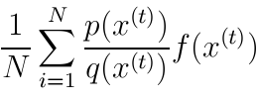
Variational Methods: Mean Field Approximation
Restrict q to the family of factorized distributions
Procedure
initialize approximate marginals q(x_{i}) for all i
pick a node at random
update its approximate marginal fixing all others
sample from q and to obtain an x^{(t)} and use importance sampling estimate
Expectation with respect
to factorized distribution
of joint probability
normalization term
Σf(x)p(x)
where
f(x) = log Ψ_{C}(x)
t
Notes:
How do we get the marginals? Not trivial to compute for arbitrary joint distributions (vs. Bayes nets)
PRODUCT over cliques ( C ) of the expectation of the clique potential with respect to factorized distribution

Slide 48
Variational Methods: Bethe Free Energy
Approximate joint distribution in terms of pairwise marginals, i.e., q_{ij}(x_{i},x_{j})
Yields a better approximation to p
Do a lot of fancy math and what do you get?
loopy belief propagation
i.e., same message passing algorithm as for tree-based graphical models
Appears to work very well in practice

Slide 49
The Big Picture
Various schemes that perform approximate inference by drawing samples
Rejection Sampling
Importance Sampling
Likelihood Weighting
Metropolis-Hastings
Gibbs Sampling
Particle Filter
What do we do with samples?
Identify MAP values of variables
Histogram (bin) samples to approximate marginal or joint posteriors
Compute statistics on variables (e.g., expected value)
Notes:
MCMC: Gibbs and MH

Slide 50
The Bigger Picture
Sampling-based methods
Variational Bayesian methods
Lower bounds on marginal likelihood of data
$P\left(y | d\right)=\frac{p(d|y)p(y)}{p(d)}$
Analytical approximation to posterior probability
Advantage of sampling methods over variational Bayes
You don’t need to do clever/fancy math to invent variational approximation
Advantage of variational Bayes over sampling methods
Inference to a given level of accuracy can be faster

