Slide 1
Basic Probability
(most slides borrowed, with permission, from Andrew Moore of CMU and Google)
http://www.cs.cmu.edu/~awm/tutorials

Slide 2
Notes:
A has one of two states, but you don’t know which state it is in

Slide 4
Notes:
NEXT SLIDE HAS EXPLANATION

Slide 5
Notes:
[read the red and blue text]
no world ever have A true = FALSE state

Slide 8
A
$$P\left(A or not A\right)=P\left(A\right)+P\left(not A\right)−P\left(A and not A\right)$$ $1=P\left(A\right)+P\left(not A\right)−0$
Notes:
P(A or not A) = P(A) + P(not A) – P(A and not A)
P(A or not A) = P(true) = 1
P(A and not A) = P(false) = 0

Slide 9
Marginalization
B
A
Notes:
rearranging P(A v B) : P(A) = P(A ^ B) + (P(B) – P(A v B))

Slide 10
Notation Digression
Binary valued variables
P(A) is shorthand for P(A=true)
P(~A) or P(Ā) is shorthand for P(A=false)
For binary variables that aren’t true/false: P(Printer=online), P(Printer=offline)
Multi-valued (Categorical) variables
P(Major=history), P(Age=19)
Notes:
note that P(Q) isn’t inconsistent with P(A): P(A=true) tells you the whole distribution; likewise P(Q) tells you the whole distribution

Slide 11
Notation Digression
Note: upper case letters/names for variables, lower case letters/names for values
P(X) vs P(x)
For multivalued RVs, P(Q) is shorthand for P(Q=q) for some unknown q
Conjunctions
P(X, Y) equivalent to P(X and Y)
How many values associated with
P(Gender, Adult=true, ClassYear)
P(Gender=F, Adult=true, ClassYear=freshman)

Slide 12
…

Slide 13
…
k
…
k

Slide 14
k
k

Slide 15
k
k
Marginalization
Notes:
integration over nuisance variables

Slide 16
Notes:
read: “A given B” or “A conditional on B”

Slide 19
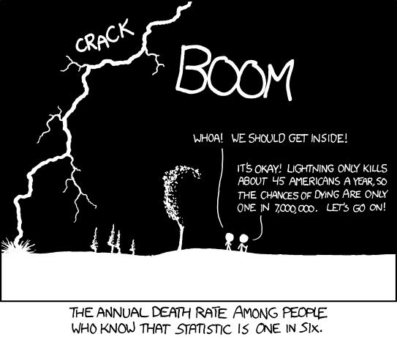
Notes:
What is wrong with the logic here?

Slide 21
Q
R
S
P(H|F) = R/(Q+R)
P(F|H) = R/(S+R)

Slide 22
Notes:
Reverend Bayes… Matt’s kid

Slide 24
Notes:
50 cents

Slide 25
$$P\left(W | B\right)=\frac{P\left(B | W\right)P(W)}{P\left(B | W\right)P\left(W\right)+P\left(B | \overline{W}\right)P(\overline{W})}$$
Notes:
P(Win|Black) = P(Black|Win)P(Win) / (P(Black|Win)P(win) + P(Black|Lose)P(Lose))
.5/(.5+.66) = .43
P(Win|Red) = .60

Slide 26
Let’s-Make-A-Deal Problem
Game show with 3 doors
Behind one door is a prize
Player chooses a door, say door 1
Host opens door 2 to reveal no prize
Host offers player opportunity to switch from door 1 to door 3.
Should player stay with door 1, switch to door 3, or does it not matter?

Slide 27
Let’s-Make-A-Deal Problem
D = door containing prize (1,2,3) C = contestant’s choice (1,2,3) H = door revealed by host (1,2,3)
P(D = d | C, H)
P(D = d | C, H) ~ P(H | D=d, C) P(D = d|C)
P(D = d | C, H) ~ P(H | D=d, C) P(D = d)
E.g., C=1, H=2:
P(H=2|C=1,D=1) = .5
P(H=2|C=1,D=2) = 0
P(H=2|C=1,D=3) = 1

Slide 28
Let’s-Make-A-Deal Problem: Lessons
Likelihood function is based on a generative model of the environment (host’s behavior)
Griffiths and Tenenbaum made their own generative assumptions
About how the experimenter would pick an age t_{total}
Solving a problem involves modeling the generative environment
Equivalent to learning the joint probability distribution

Slide 38
If you have joint distribution, you can perform any
inference in the domain.

Slide 39
Notes:
What’s this called? CHAIN RULE

Slide 43
e.g., model of the environment

Slide 44
Notes:
Classifiers and regressors are the workhorse of 5622; Density estimation is the workhorse of 7222

Slide 46
Notes:
record = row from table

Slide 48
0.000
0.000

Slide 51
Notes:
natural log

Slide 52
e.g., P(MPG=bad | maker=asia)

Slide 54
Notes:
OVERFITTING: curve fitting example

Slide 60
Notes:
analogous results for multivalued variables

Slide 65
Bayes Classifier
Assume you want to predict some output Y which has arity n and values y₁, y₂, y₃, … y_{n}.
Assume there are m input attributes called X₁, X₂, X₃, … X_{m}.
For each of n values y_{i}, build a class-conditional density estimator
P(X₁, X₂, X₃, … X_{m} |Y=y_{i})
Use Bayes rule for classification
Y^{predict} = argmax_{y} P(Y=y| X₁, X₂, X₃, … X_{m} )
= argmax_{y} P(X₁, X₂, X₃, … X_{m} | Y=y) P(Y=y)
Notes:
building density estimator

Slide 66
Naïve Bayes Model
$$P\left(Y | X_{1},X_{2},…, X_{m}\right)= \frac{P(X_{1},X_{2},…, X_{m}|Y)P(Y)}{P(X_{1},X_{2},…,X_{m})}$$
naïve Bayes assumption: $X_{i}$ and $X_{j}$ are conditionally independent
$$P\left(Y | X_{1},X_{2},…, X_{m}\right)= \frac{P(X_{1}|Y)P(X_{2}|Y)…P(X_{m}|Y)P(Y)}{P(X_{1},X_{2},…,X_{m})}$$
Remember that denominator is normalization constant, so
$$P\left(Y | X_{1},X_{2},…, X_{m}\right) \sim P(X_{1}|Y)P(X_{2}|Y)…P(X_{m}|Y)P(Y)$$
And if $Y$ is boolean
$$P\left(Y | X_{1},X_{2},…, X_{m}\right)=\frac{P(X_{1}|Y)P(X_{2}|Y)…P(X_{m}|Y)P(Y) }{P\left(X_{1} | Y\right)P\left(X_{2} | Y\right)…P\left(X_{m} | Y\right)P\left(Y\right) +P(X_{1}|\overline{Y})P(X_{2}|\overline{Y})…P(X_{m}|\overline{Y})P(\overline{Y}) }$$

Slide 68
Machine Learning Vs. Cognitive Science
For machine learning, density estimation is required to do classification, prediction, etc.
For cognitive science, density estimation under a particular model is a theory about what is going on in the mind during learning/cognition/perception.

