Slide 1
Comment on Barber Text
Course not going in same order as text, so I’m jumping around in text
As a result, some text sections may assume more background than you have
Use the text as a reference and a way to be exposed to notation

Slide 2
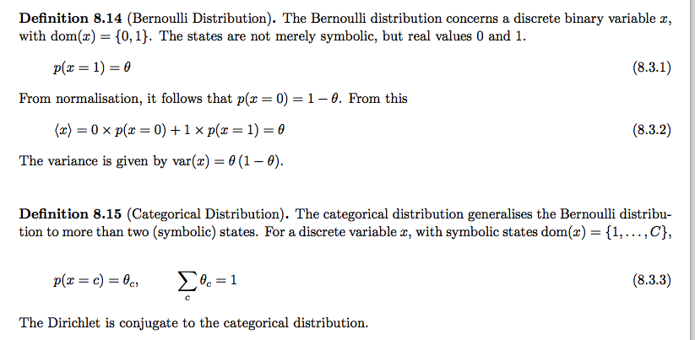
Barber Text Notation
Text does not use the “upper case for variable name, lower case for variable value” convention

Slide 3
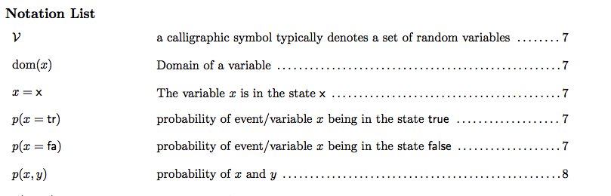
See Notation List In Text

Slide 4
Continuous Random Variables
(most slides borrowed with permission from Andrew Moore of CMU and Google)
http://www.cs.cmu.edu/~awm/tutorials

Slide 5
Random Variables
Previous lecture discussed discrete random variables
  true, false
  freshman, sophomore, junior, senior
Some variables are intrinsically continuous
  Age, Height, Distance
Can sometimes quantize real variables to make them discrete
  Age ∈ {child,teen,adult,elderly}
  Height ∈ {50”, 51”, 52”, …, 100”}
Today: how to handle variables that cannot be quantized

Slide 6
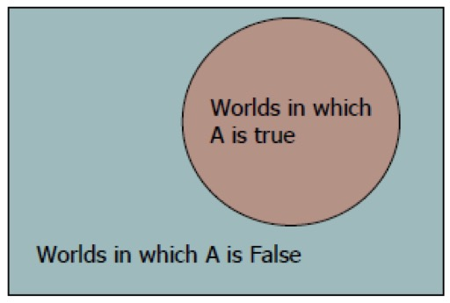
Probability Mass
Discrete RVs have a probability associated with each value of the variable
  P(Bored=true)=.7, P(Bored=false)=.3
These probabilities indicate an area in the space of “all possible worlds”
In probability, this
area is referred to
as the probability
mass

Slide 7
Probability Mass Vs. Density
Imagine if a random variable had an infinite
number of values instead of a finite number…

Slide 8
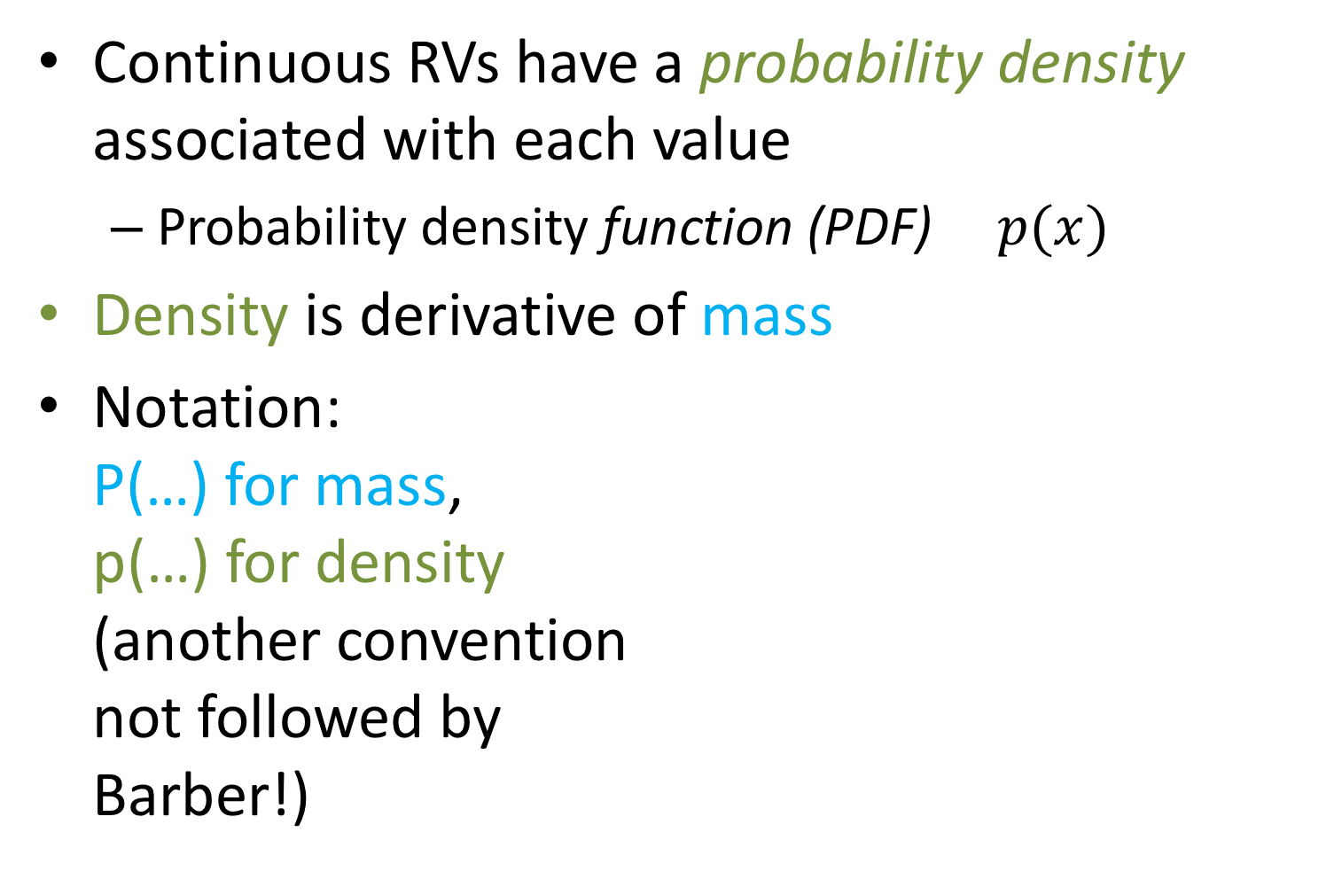
Probability Mass Vs. Density
Continuous RVs have a probability density associated with each value
  Probability density function (PDF) $p(x)$
Density is derivative of mass
Notation:
P(…) for mass,
p(…) for density
(another convention
not followed by
Barber!)

Slide 9
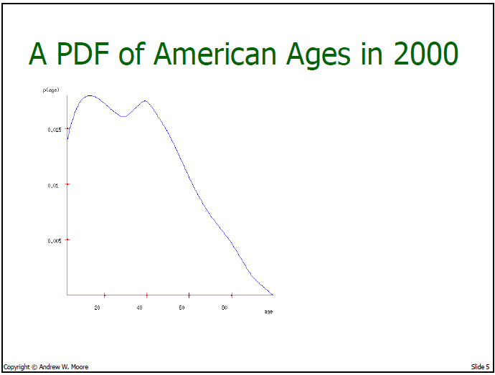

Slide 10
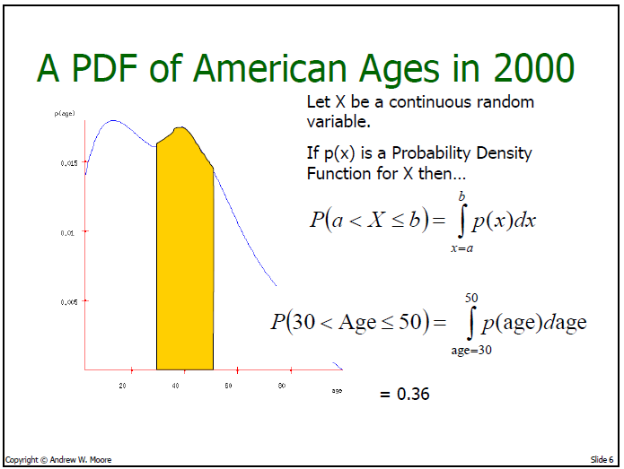

Slide 11
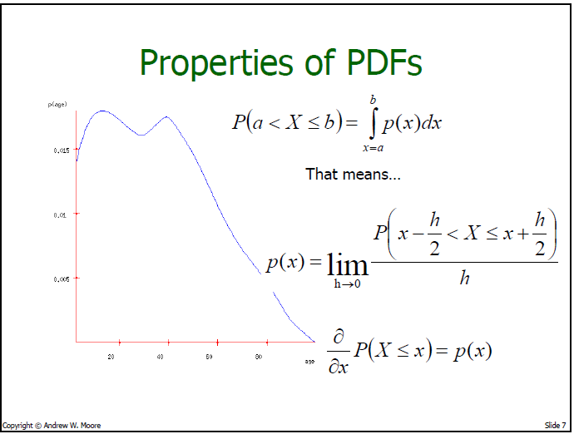

Slide 12
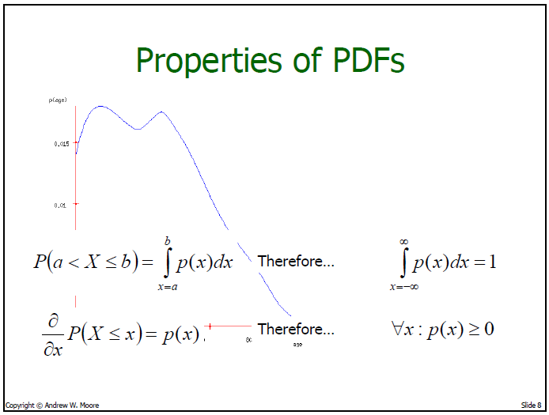

Slide 13
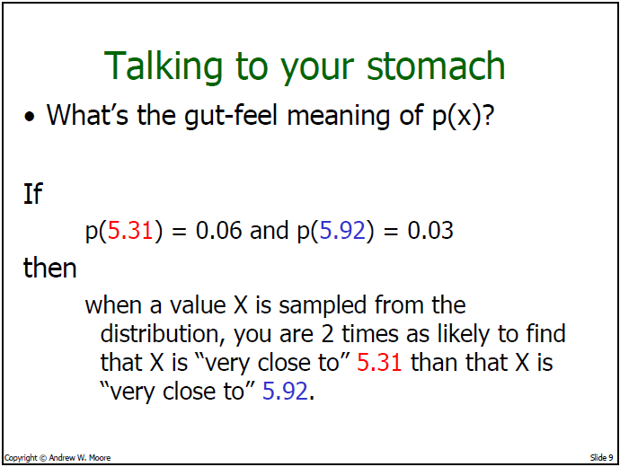

Slide 14
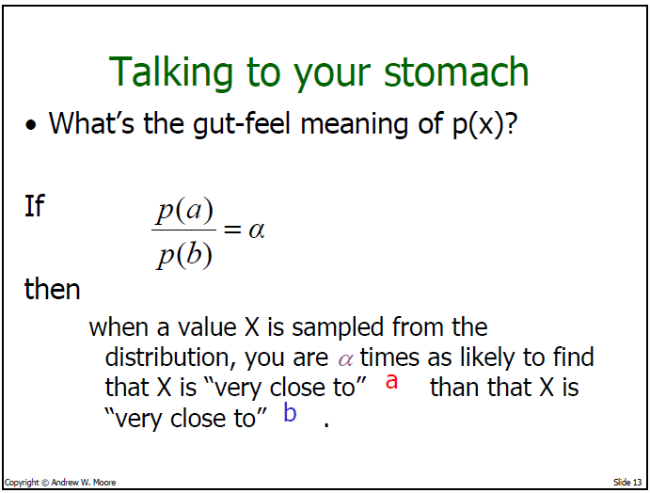

Slide 15
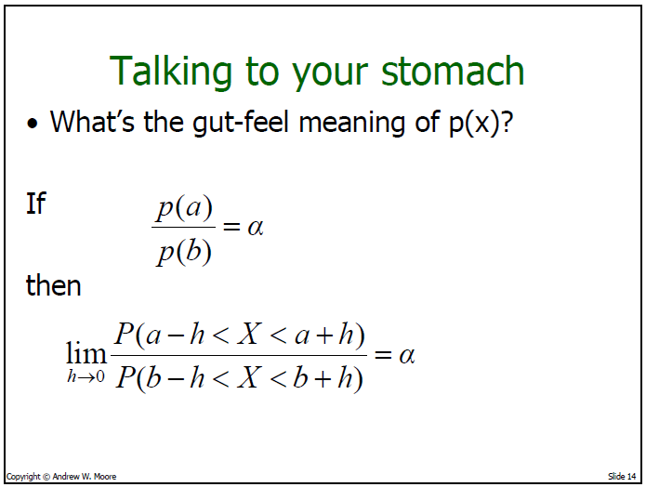
Notes:
More formally

Slide 16
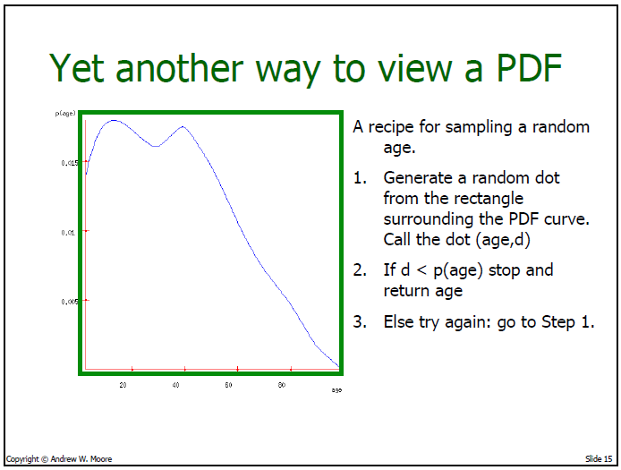
Notes:
Uniformly sampling from the region under the curve, and returned sample is the projection onto x axis

Slide 17
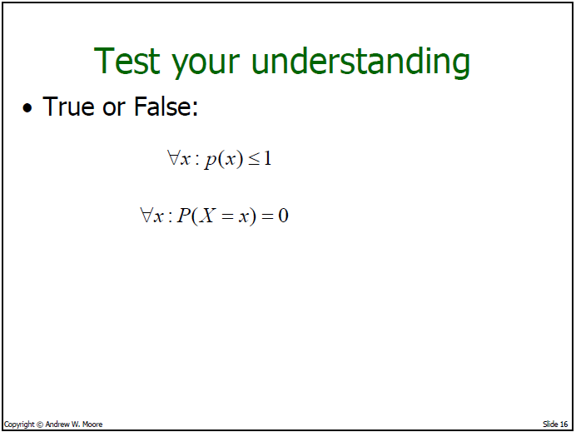

Slide 18
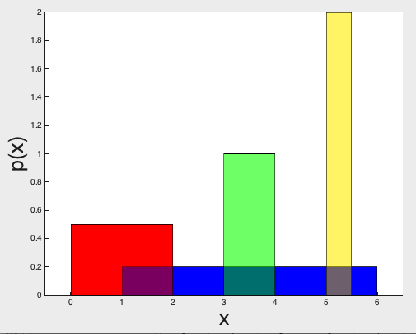
PDF of a Uniform Distribution
X ~ Uniform(0,k)
p(X=k/2) = ?
p(X= 2k) = ?
0 k

Slide 19
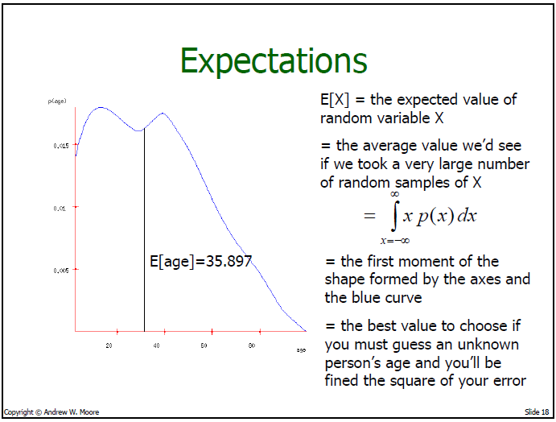

Slide 20
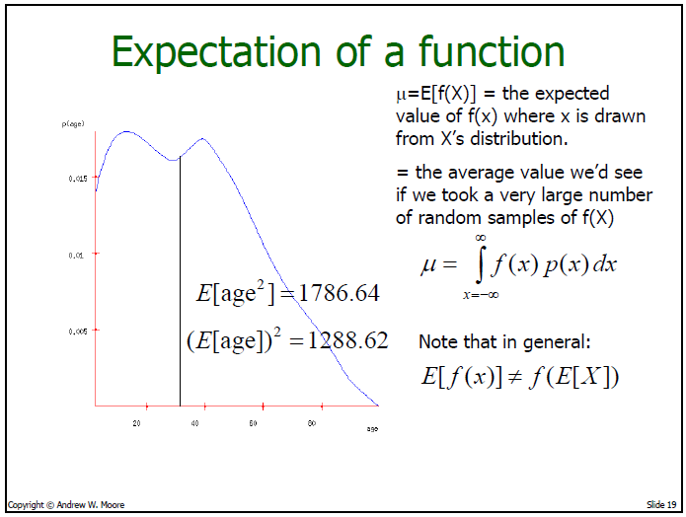
y
Notes:
When is E[f(x)] = f(E[x])? f is linear

Slide 21
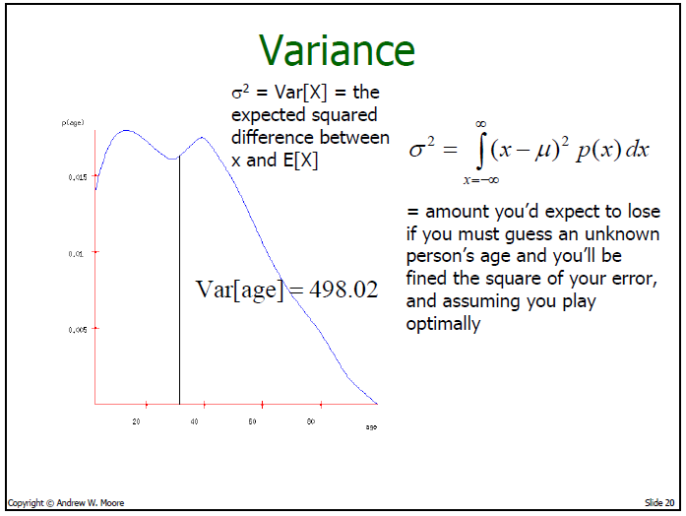
= E[X²] - E[X]²
Notes:
smallest value of the variance?

Slide 22
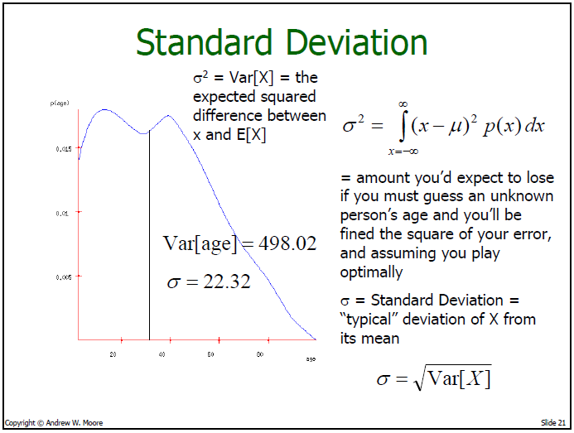

Slide 23
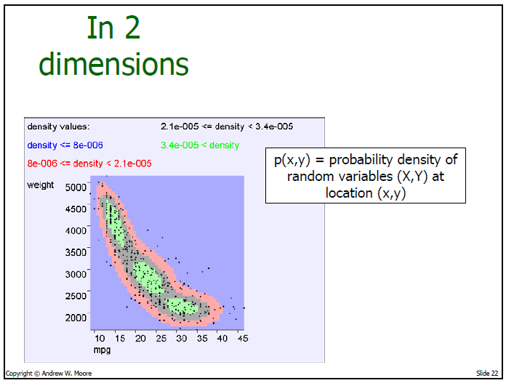
Density estimate of automobile
weight and MPG
Note change in
notation: Previously
used P(x^y) for
joint
Notes:
explain density estimator: dots are data points, contours are representation of continuous density function

Slide 24
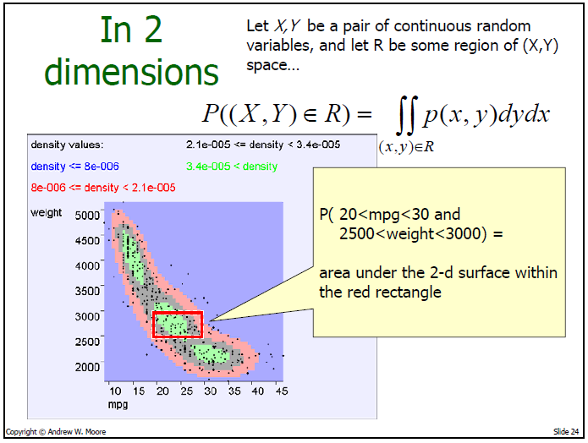

Slide 25
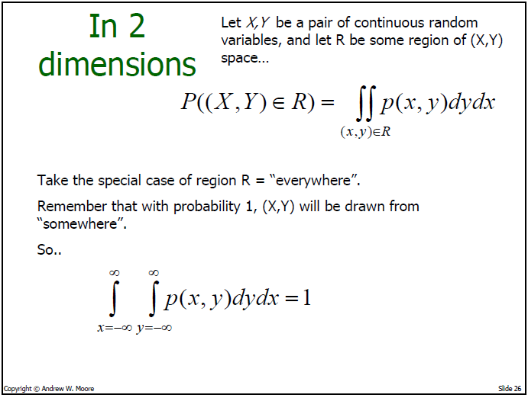

Slide 26
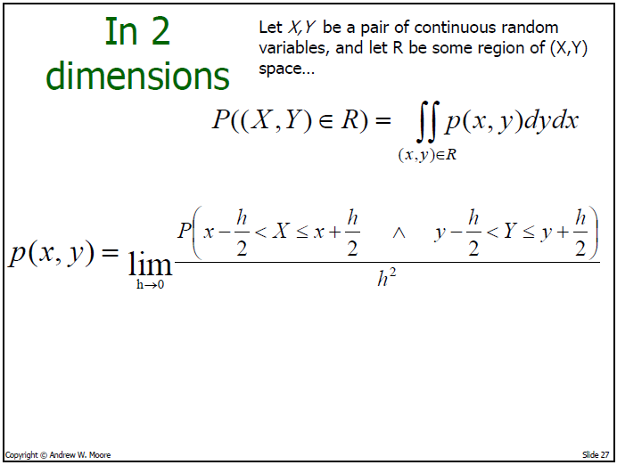

Slide 27
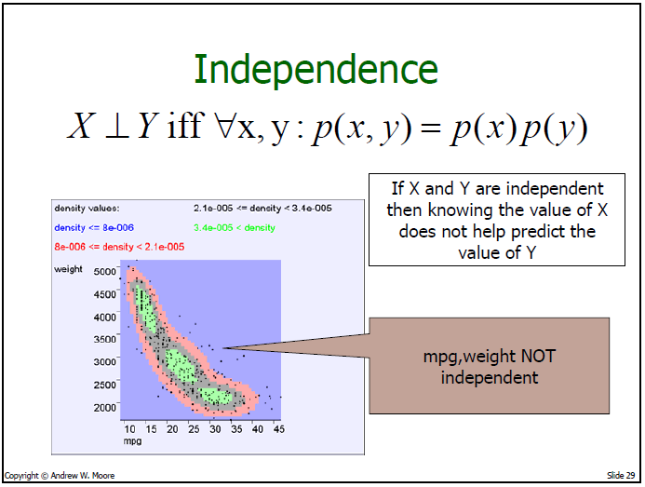
Notes:
What shape will distribution have if independent?

Slide 28
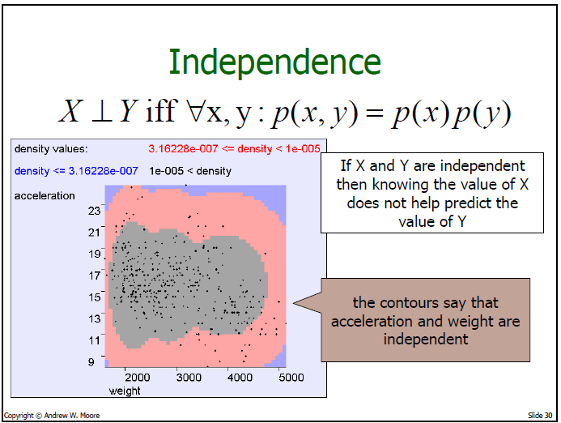

Slide 29
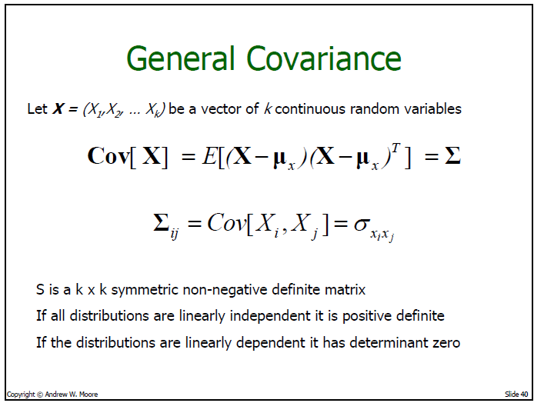
Notes:
SIGMA is matrix. What are dimensions of SIGMA? What characteristics does sigma have? Can elements of covariance be negative?

Slide 30
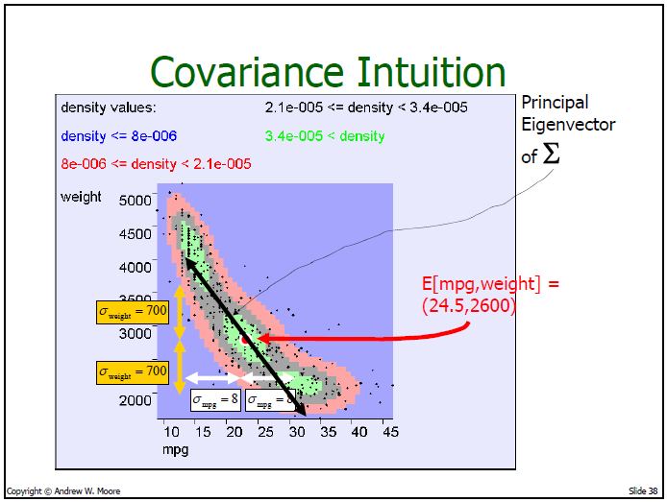
Notes:
Eigenvectors of SIGMA = principal components

Slide 31
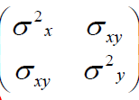

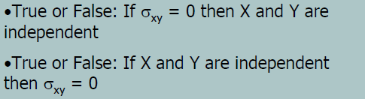
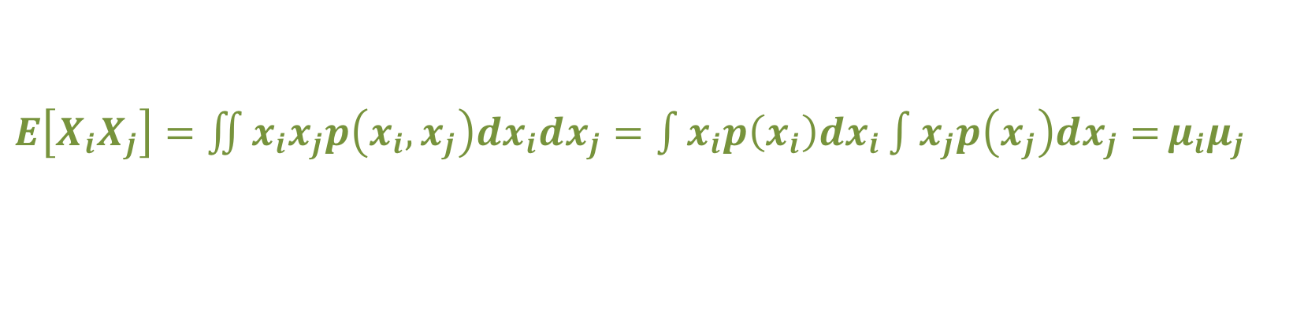
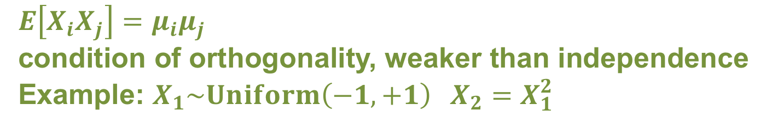
Covariance Facts
Consider 2D case with (X,Y)
FALSE
TRUE
$E\left[X_{i}X_{j}\right]={\iint{x_{i}x_{j}p\left(x_{i},x_{j}\right)dx_{i}dx_{j}=\int{x_{i}p\left(x_{i}\right)dx_{i}}\int{x_{j}p\left(x_{j}\right)dx_{j}=}}μ}_{i}μ_{j}$
$E\left[X_{i}X_{j}\right]=μ_{i}μ_{j}$
condition of orthogonality, weaker than independence
Example: $X_{1}\sim Uniform\left(−1,+1\right) X_{2}=X_{1}^{2}$
Notes:
1: if cov=0 then E(XY)=E(X)E(Y) which is condition of orthogonality, which is weaker than independence.
Example: X ~ Uniform(-1,+1), Y = X^2. Dependent but sigma^2_xy = 0
2. E(XY) = E(X)E(Y) -> sigma^2_xy = 0

Slide 32
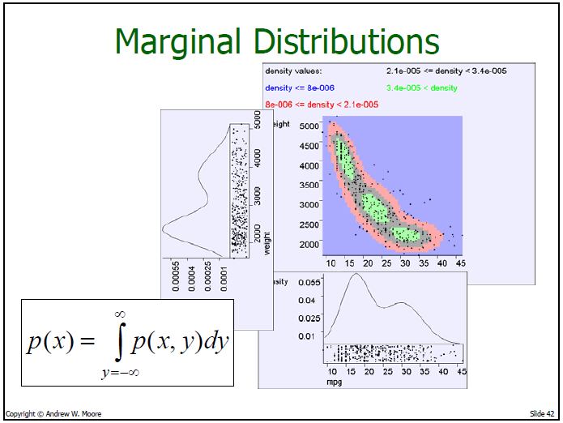
Notes:
Remember “marginalization” from previous class

Slide 33
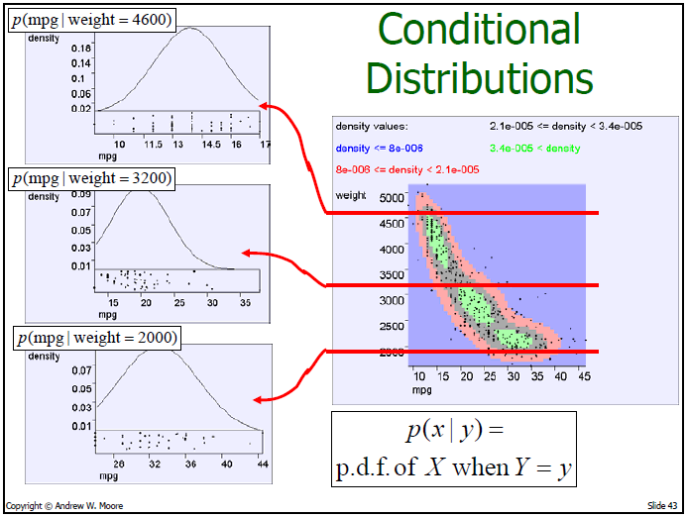

Slide 34
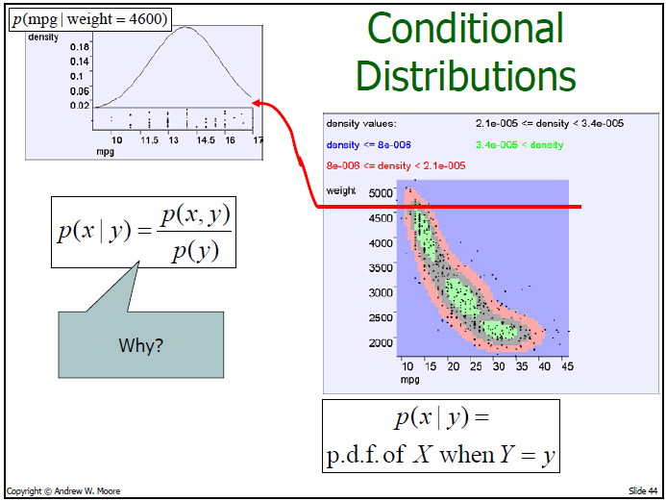
Notes:
when we integrate over all x for a given y, then we need to get unity

Slide 35
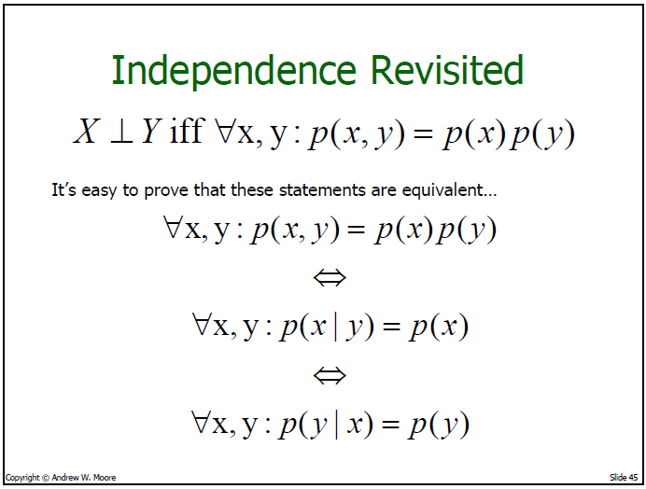

Slide 36
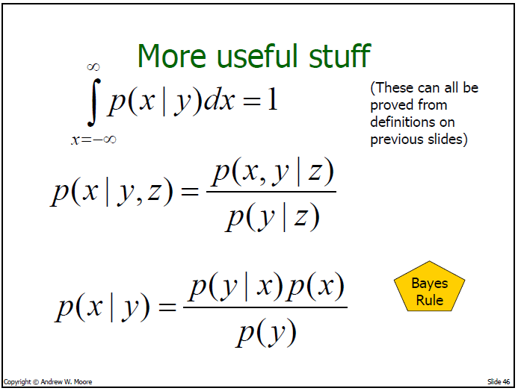

Slide 37
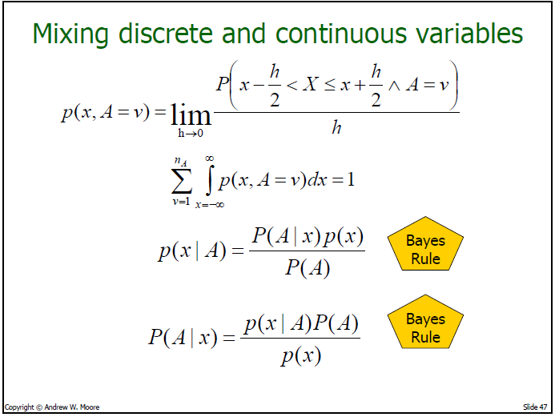
Notes:
note bayes rule is the same whether we have densities or masses

Slide 38
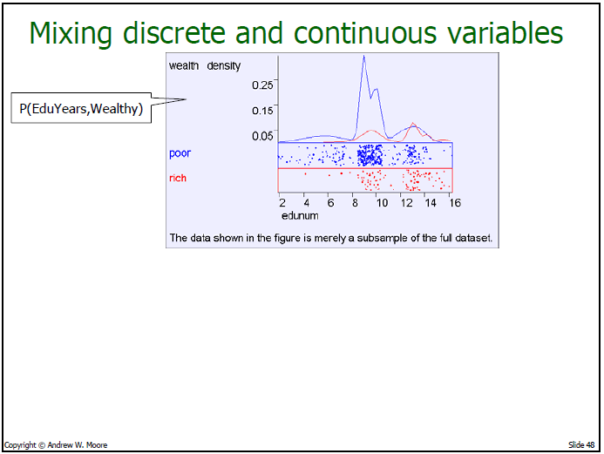

Slide 39
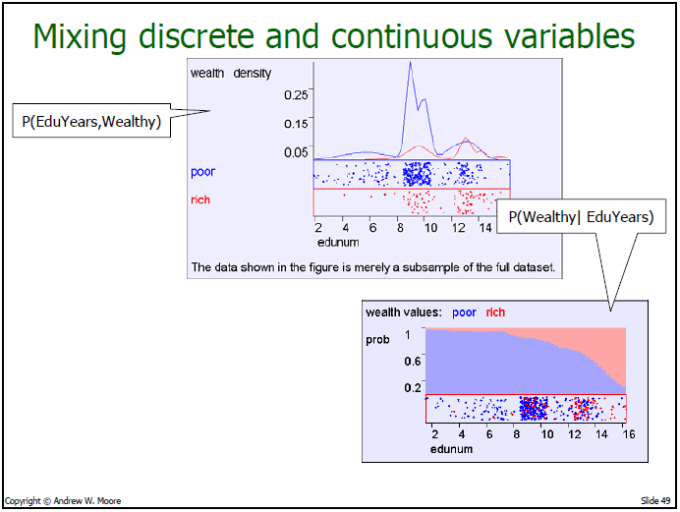

Slide 40
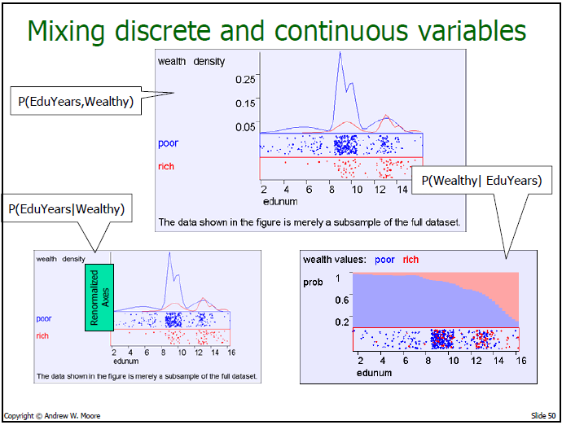

Slide 41
Mike’s Basic Advice on Continuous Random Variables
Ignore the fact that p(x) is a probability density function and treat it just as a mass function, and the algebra all works out.
Alternatively, turn densities to masses with dx terms, and they should always cancel out.
Don’t be freaked when you see a probability density >> 1.
Do be freaked if you see a probability mass or density < 0.

