Slide 1
CSCI 5822
Probabilistic Models of
Human and Machine Learning
Mike Mozer
Department of Computer Science and
Institute of Cognitive Science
University of Colorado at Boulder

Slide 2
Expectation Propagation: Parameter-Free Training of Multilayer Neural Networks with Continuous or Discrete Weights
Soudry, Hubara, Meir (2014)

Slide 3
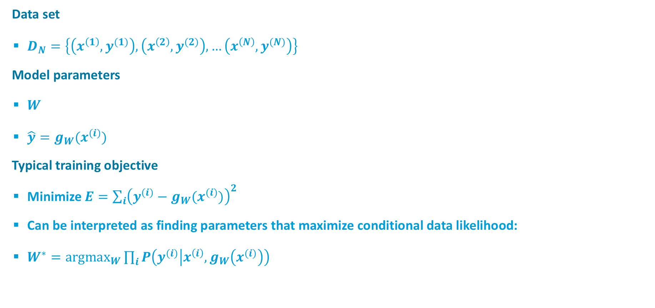
Standard Training of a Neural Network
Data set
  $D_{N}=\left\{\left(x^{\left(1\right)},y^{(1)}\right),\left(x^{\left(2\right)},y^{(2)}\right),…\left(x^{\left(N\right)},y^{(N)}\right)\right\}$
Model parameters
  $W$
  $\hat{y}=g_{W}(x^{(i)})$
Typical training objective
  Minimize $E={\sum_{i}{\left(y^{(i)}−g_{W}(x^{(i)})\right)}}^{2}$
  Can be interpreted as finding parameters that maximize conditional data likelihood:
  $W^{∗}={argmax}_{W}\prod_{i}{P\left(y^{(i)} | x^{\left(i\right)},g_{W}\left(x^{(i)}\right)\right)}$

Slide 4
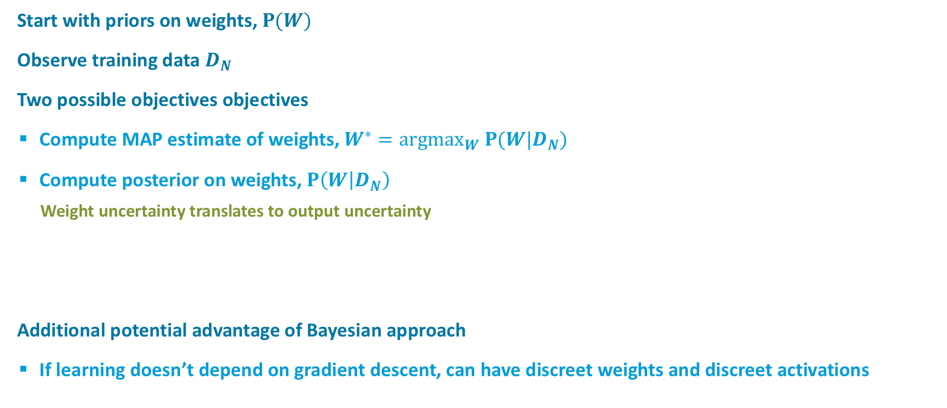
Bayesian Inference on a Neural Networ
Start with priors on weights, $P(W)$
Observe training data $D_{N}$
Two possible objectives objectives
  Compute MAP estimate of weights, $W^{∗}={argmax}_{W} P(W|D_{N})$
  Compute posterior on weights, $P\left(W | D_{N}\right)$
    Weight uncertainty translates to output uncertainty
Additional potential advantage of Bayesian approach
  If learning doesn’t depend on gradient descent, can have discreet weights and discreet activations

Slide 5
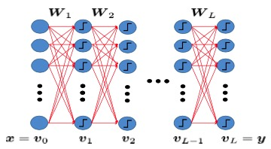

Binary neurons $\left(+1,−1\right)$
Discreet weights
  $W_{i,j,l}∈S_{i,j,l}$
Activation function

Slide 6



MAP weight estimate
Marginalize over uncertainty in weights
  Sensible if outputs are discrete
Sequential updating of weights
Exact inference not possible:
Exponential # weight configurations

Slide 7

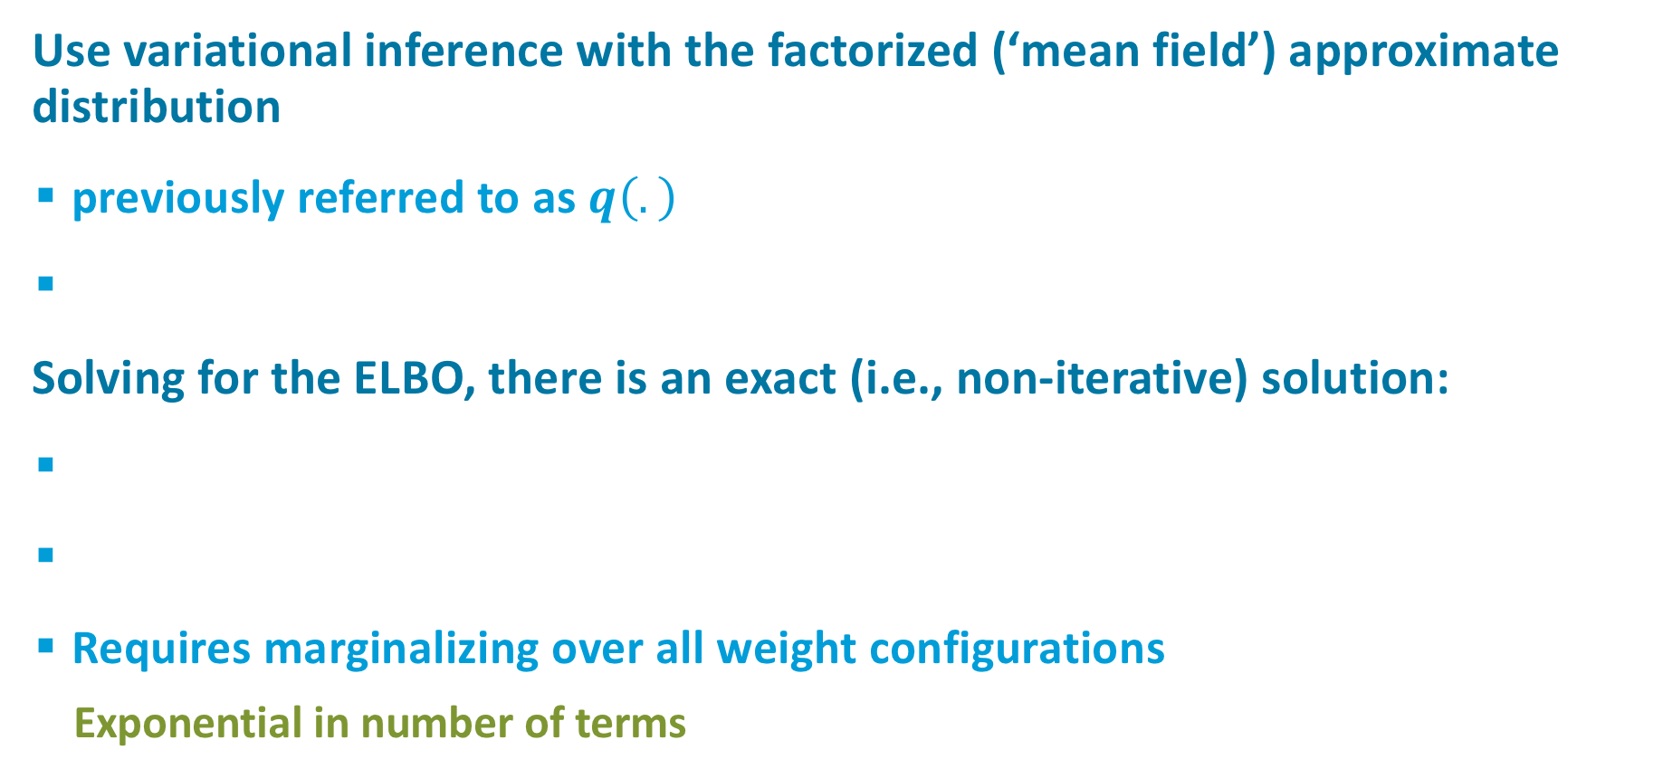
Mean-Field Approximation
Use variational inference with the factorized (‘mean field’) approximate distribution
  previously referred to as $q\left(.\right)$
Solving for the ELBO, there is an exact (i.e., non-iterative) solution:
  Requires marginalizing over all weight configurations
    Exponential in number of terms
Notes:
What’s the rub: requires marginalizing over all weight configurations. Summation is over exponential number of terms.

Slide 8

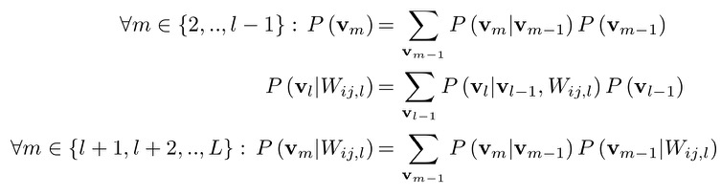
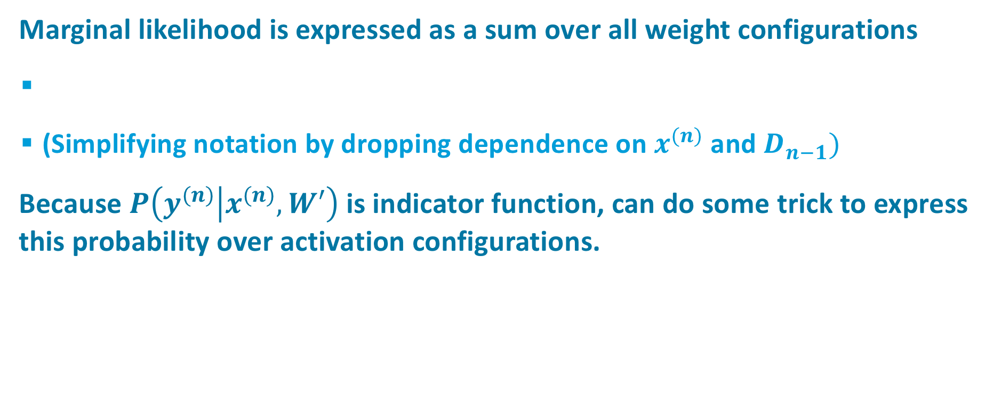

Trick #2
Marginal likelihood is expressed as a sum over all weight configurations
  (Simplifying notation by dropping dependence on $x^{(n)}$ and $D_{n−1})$
Because $P\left(y^{(n)}\left|x^{(n)},W′\right.\right)$ is indicator function, can do some trick to express this probability over activation configurations.
$$P\left(y | W_{i,j,l}\right)≡P(v_{L}=y|W_{i,j,l})$$
Notes:
What does P(v|…) distribution look like: Gaussian approximation

Slide 9
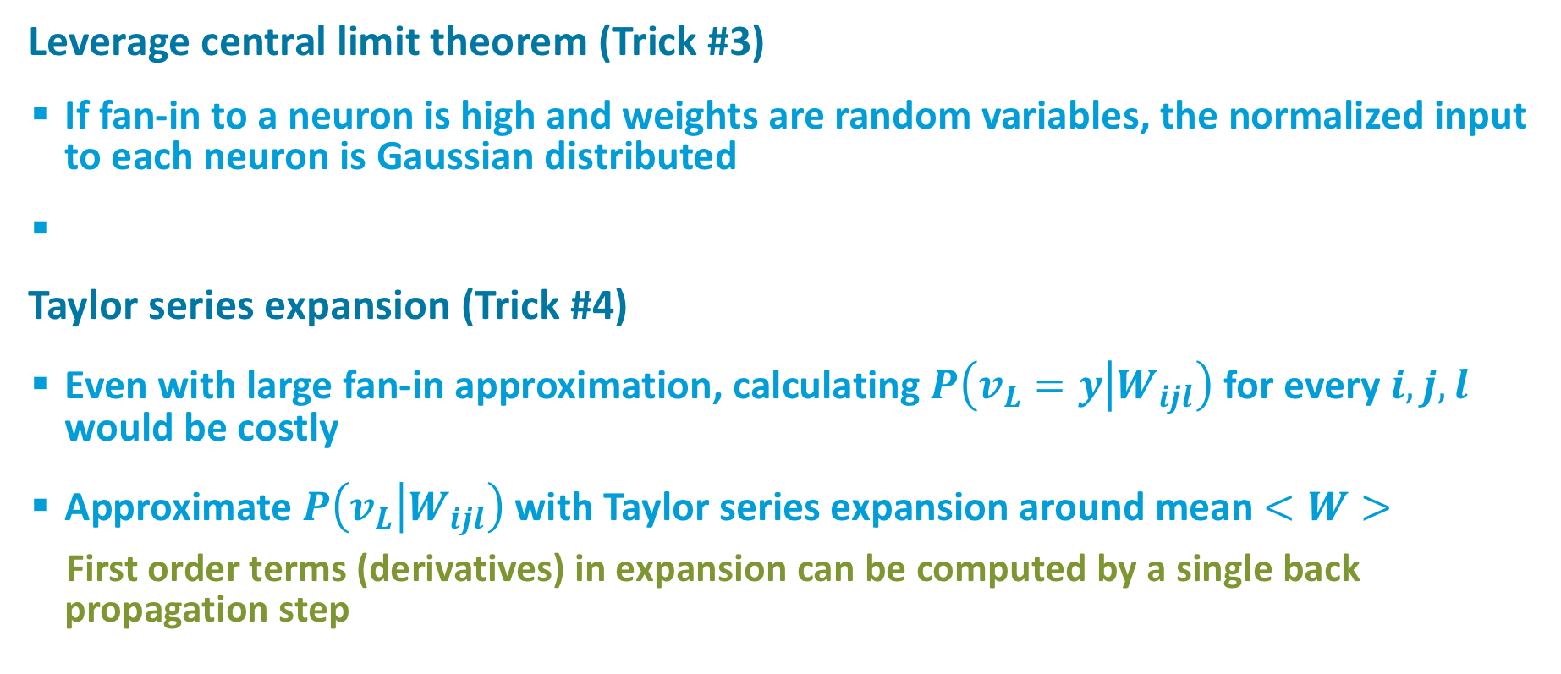
Large Fan-In Approximation
Leverage central limit theorem (Trick #3)
  If fan-in to a neuron is high and weights are random variables, the normalized input to each neuron is Gaussian distributed
Taylor series expansion (Trick #4)
  Even with large fan-in approximation, calculating $P\left(v_{L}=y | W_{ijl}\right)$ for every $i,j,l$ would be costly
  Approximate $P\left(v_{L} | W_{ijl}\right)$ with Taylor series expansion around mean $<W>$
    First order terms (derivatives) in expansion can be computed by a single back propagation step
Notes:
U_m is input to layer m

Slide 10
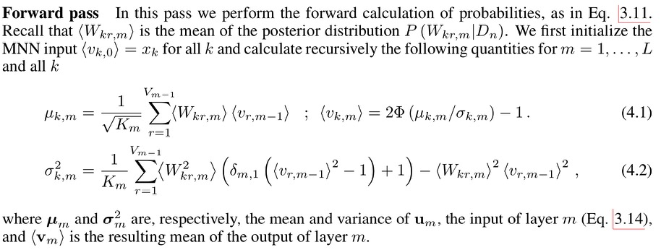
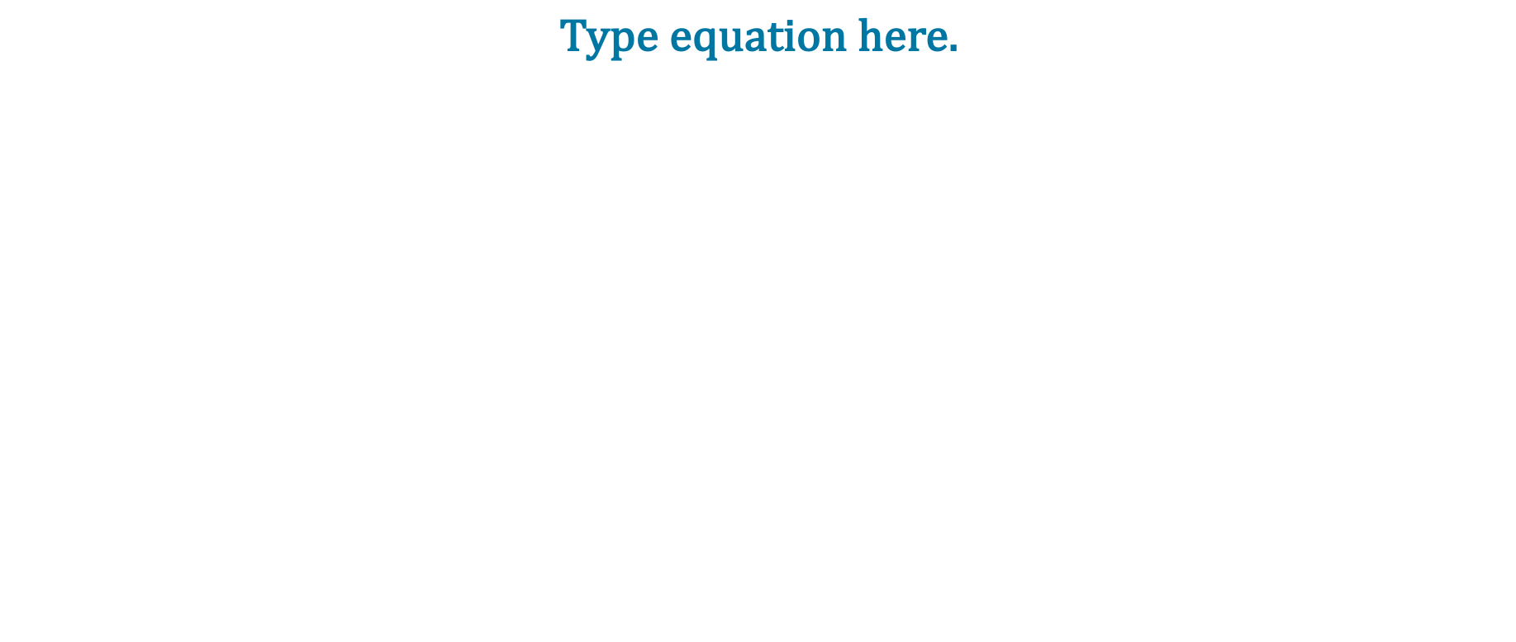
The Resulting Forward Pass Algorithm

Slide 11
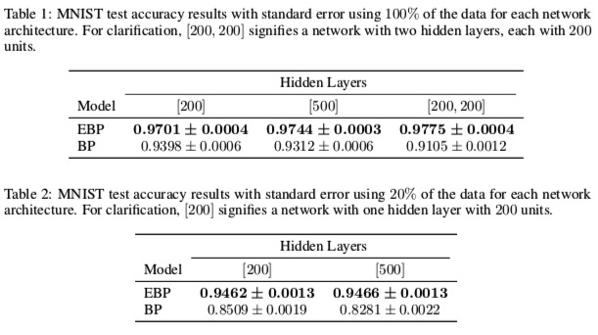
Tyler Scott’s Final Project
Binary weights
MNIST: 10-way classification

Slide 12
Neural Hawkes Process Memory
Michael C. Mozer
University of Colorado, Boulder
Robert V. Lindsey
Imagen Technologies
Denis Kazakov
University of Colorado, Boulder

Slide 13


Predicting Student Knowledge
?
time
Notes:
I work in ML & education, and am interested in predicting student knowledge.

Slide 14
Time Scales and Human Memory
produces more
robust & durable
learning than
Spaced study
Massed study
time
Notes:
Forgetting is influenced by the temporal distribution of study.
Spaced study produces more robust and durable learning than massed study.
(Usually explained in psych 1 as "don't cram for exam". That's actually a lie.
If you want to do well on the exam, ...)

Slide 15
Temporally Distributed Study and Memory Retention
Massed study
Spaced study
Memory decays more slowly with spaced study
?
time
?
time
Notes:
Experimental psychologists know a lot about how the temporal distribution of study influences memory retention.
[*] As anyone who has taken psych 1 has heard, massed study is not as effective as spaced study for long-term retention.
[*] Memory may not be as strong with spaced study but it decays more slowly
[plot pwr function decay]

Slide 16


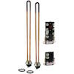
Time Scales and Human Preferences
?
time
Notes:
Now switch gears. Let’s think about a different domain – product recommendation
[*] Over many years, I've hopped on shopping sites and looked for electronic toys.
[*] And other times, I have to replentish my stock of my favorite lentils.
[*] And then every once in a while, I have an emergency that requires a quick purchase.
E.g., water heater
[*] question is: what to recommend at this time?

Slide 17
Time Scale and Temporal Distribution of Behavior
Critical for modeling and predicting many human activities:
  Retrieving from memory
  Purchasing products
  Selecting music
  Making restaurant reservations
  Posting on web forums and social media
  Gaming online
  Engaging in criminal activities
  Sending email and texts
x₁
x₂
x₃
x₄
t₁
t₂
t₃
t₄
Notes:
The time scale and temporal distribution of behavior is critical for modeling and predicting many human activities.
Not just the 2 I mentioned but ...[*]
[*] All of these activities are characterized by events in time.
[*] Discrete events, each associated with a time tag
Typical sequence processing tasks we do with RNNs (e.g., language understanding) do not have the time tags
Also important: gap between events can vary by many orders of magnitude

Slide 18
Recent Research Involving Temporally Situated Events
Discretize time and use tensor factorization or RNNs
  e.g., X. Wang et al. (2016), Y Song et al. (2016), Neil et al. (2016)
Hidden semi-Markov models and survival analysis
  Kapoor et al. (2014, 2015)
Include time tags as RNN inputs and treat as sequence processing task
  Du et al. (2016)
Temporal point processes
  Du et al. (2015), Y. Wang et al. (2015, 2016)
Our approach
  incorporate time into the RNN dynamics
Notes:
...
Our approach: incorporate time into the RNN dynamics
We do this by defining a new type of recurrent neuron, like an LSTM neuron, that leverages the math of temporal point processes

Slide 19

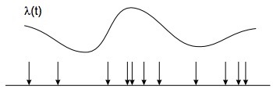
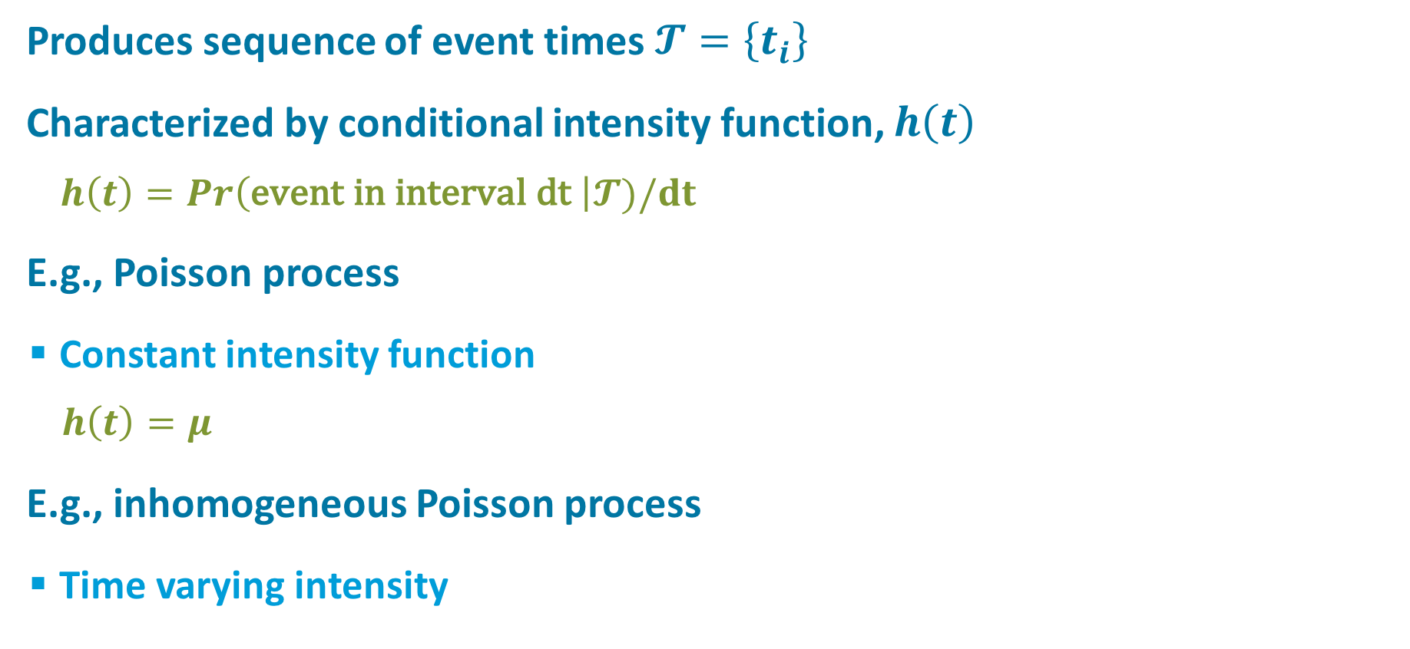

Temporal Point Processes
Produces sequence of event times $𝓣=\left\{t_{i}\right\}$
Characterized by conditional intensity function, $h\left(t\right)$
    $h\left(t\right)=Pr\left(\text{event} \text{in} \text{interval} \text{dt} \right|𝓣)/dt$
E.g., Poisson process
  Constant intensity function
    $h\left(t\right)=μ$
E.g., inhomogeneous Poisson process
  Time varying intensity
$$h\left(t\right)$$
Notes:
Temporal point process is a stochastic process that produces a sequence of event times
Characterized by conditional intensity function, calling it h(t)
Within some small interval dt, h(t) is the event rate
h(t) is the rate of events occurring

Slide 20
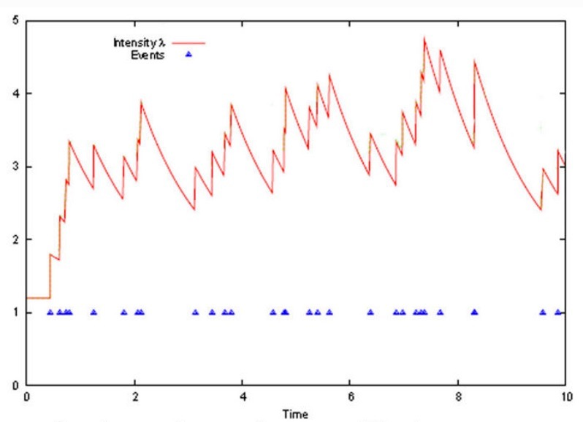
Hawkes Process
Intensity depends on event history
  Self excitatory
  Decaying
Intensity decays over time
  Used to model earthquakes,
  financial transactions, crimes
  Decay rate determines time
  scale of persistence
intensity
h(t)
event stream
Time
Notes:
We've explored HP, where the intensity depends on event history.
Self excitatory: INTENSITY INCREASES WITH EACH EVENT
Decays over time:
EXPONENTIAL KERNEL
[*] Bursty property: useful for modeling phenomena like earthquakes, financial transactions crimes
Just to give you an intuition of where I’m going,
Suppose that events are purchases of a particular product or class of products
The more purchases you make, the more likely you are to make them in the NEAR future
What “near” means depends on the rate of decay here
[*] Decay rate determines time scale of behavioral persistence
Now look at h(t) as hidden unit’s activation:
decaying memory of past events. Like LSTM if decay rate is slow, unlike LSTM, it has built in forgetting

Slide 21
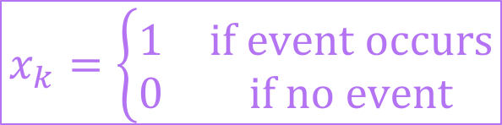

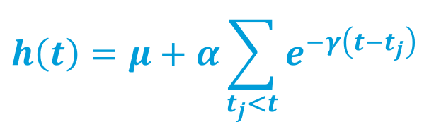




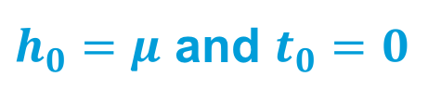
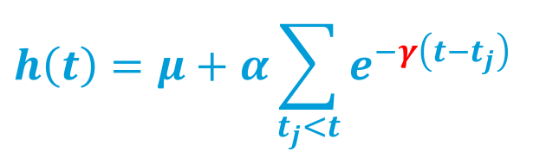

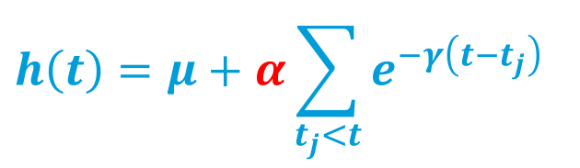

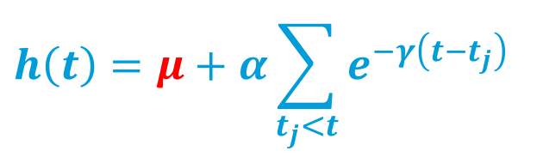

Hawkes Process
Conditional intensity function
Incremental formulation with discrete updates
$$h\left(t\right)=μ+α\sum_{t_{j}<t}{e^{−γ\left(t−t_{j}\right)}}$$
$$h\left(t\right)=μ+α\sum_{t_{j}<t}{e^{−γ\left(t−t_{j}\right)}}$$
$$h\left(t\right)=μ+α\sum_{t_{j}<t}{e^{−γ\left(t−t_{j}\right)}}$$
$$h\left(t\right)=μ+α\sum_{t_{j}<t}{e^{−γ\left(t−t_{j}\right)}}$$
with $𝓣≡\left\{t_{1}, …, t_{j},…\right\}$ times of past events
$h_{0}=μ$ and $t_{0}=0$
$$h$$
$$γ$$
$$μ$$
$$h_{k}=μ+e^{−γ{Δt}_{k}}\left(h_{k−1}−μ\right)+αx_{k}$$
$$α$$
$$x$$
$$Δt$$
$$Δt_{k}≡t_{k}−t_{k−1}$$
$$x_{k}=\left\{\begin{matrix}1 & \text{if} \text{event} \text{occurs} \\ 0 & \text{if} \text{no} \text{event}\end{matrix}\right.$$
Notes:
Here's the conditional intensity function...
[*][*][*]
Incremental formulation :
initialize, and then perform discrete updates at event times, capturing the exponential decay that has occured during [*] the intervening time
add one bit of notation: x
Neural net formulation
h is a recurrent hidden unit which accept input x from the layer below
a bunch of these units each looking for a different event type
[*] may think of mu, alpha, and gamma as neural net parameters but I’m going to make it a bit more interesting in a sec
[*] delta t

Slide 22
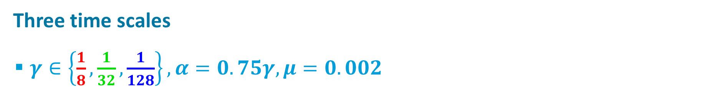
Hawkes Process As A Generative Model
Three time scales
  $γ∈\left\{\frac{1}{8},\frac{1}{32},\frac{1}{128}\right\}, α=0.75γ, μ=0.002$

Slide 23


Prediction
Observe a time series and predict what comes next?
Given model parameters, compute intensity from observations:
Given intensity, compute event likelihood in a $Δt$ window:
?
$$h_{k}=μ+e^{−γ{Δt}_{k}}\left(h_{k−1}−μ\right)+αx_{k}$$
$$\text{Pr}\left(t_{k}≤t_{k−1}+Δt,x_{k}=1|t_{1}, …, t_{k−1}\right)=1−e^{−\left(h_{k−1}−μ\right)\left(1−e^{−γΔt}\right)/γ−μΔt}$$
$$≡Z_{k}(Δt)$$
Notes:
Observe a time series of some event, like purchases of electronics, and predict what comes next...
Given model parameters...
Given intensity, compute likelihood of another event in a given window of the future.
[*] give this expression a name, Z

Slide 24

Key Premise
The time scale for an event type may vary from sequence to sequence
Therefore, we want to infer time scale parameter $γ$ appropriate for each event and for each sequence.
Notes:
MY INTEREST IN WATER HEATERS MAY BE SHORT LIVED, BUT WATER HEATERS ARE JUERGEN'S OBSESSION.
LADY GAGA MAY BE A FLEETING INTEREST OF SEPP'S, BUT SHE IS MY FAVORITE.
can't treat gamma as a parameter to be trained by gradient descent

Slide 25
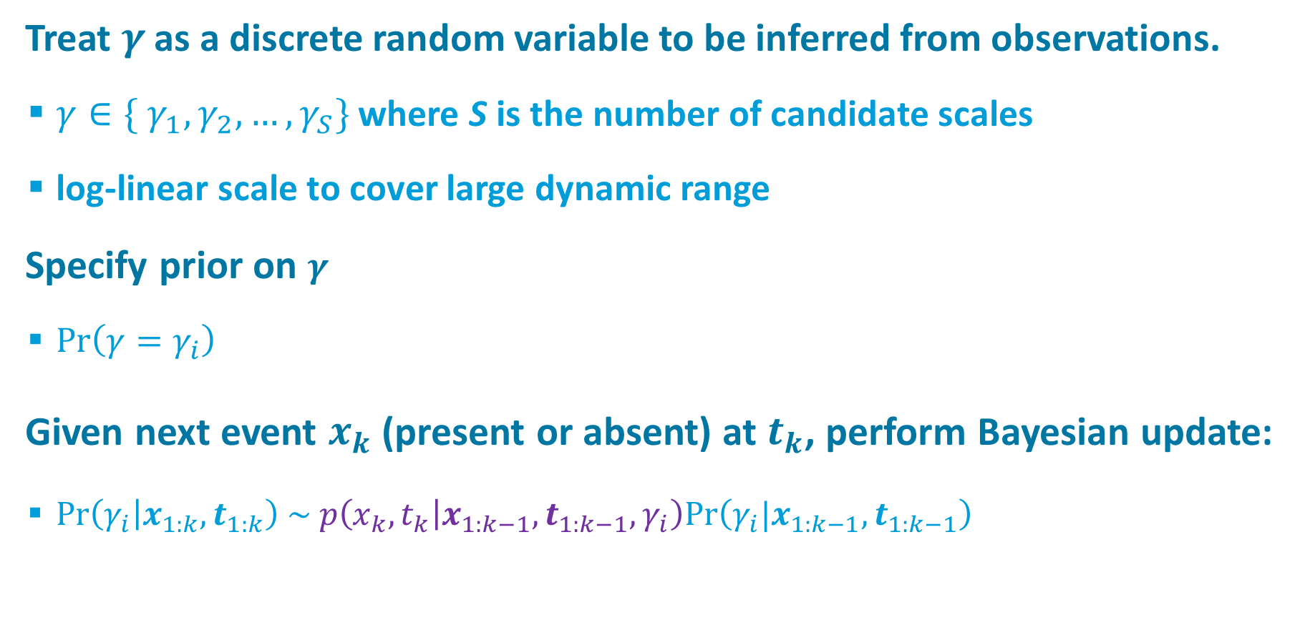
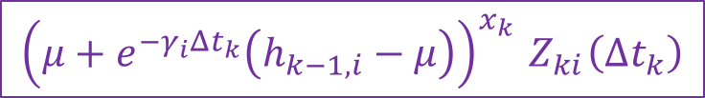
Bayesian Inference of Time Scale
Treat $γ$ as a discrete random variable to be inferred from observations.
  $γ∈\{ γ_{1}, γ_{2}, …, γ_{S}\}$ where S is the number of candidate scales
  log-linear scale to cover large dynamic range
Specify prior on $γ$
  $Pr\left(γ=γ_{i}\right)$
Given next event $x_{k}$(present or absent) at $t_{k}$, perform Bayesian update:
  $\text{Pr}\left(γ_{i} | x_{1:k}, t_{1:k}\right) \sim p\left(x_{k},t_{k} | x_{1:k−1}, t_{1:k−1},γ_{i}\right)\text{Pr}\left(γ_{i}|x_{1:k−1},t_{1:k−1}\right)$
$${\left(μ+e^{−γ_{i}Δt_{k}}\left(h_{k−1,i}−μ\right)\right)}^{x_{k}}{ Z}_{ki}\left(Δt_{k}\right)$$
Notes:
log-linear set to cover a large dynamic range
likelihood comes from HP

Slide 26

$$γ$$
long
medium
short
long
X
Intensity
medium
short
marginal
Notes:
event sequence
[*] resulting intensity functions at short, medium, long time scales
[*] inference over gamma
- each vertical slice represents the posterior over time scales at a given moment
- the distribution shifts from unifrom to focused on the medium time scale
which is what i used to generate the sequence
[*] you can marginalize over gamma
[*] to obtain an expected intensity
without providing the time scale, the medium scale is inferred from data

Slide 27
Notes:
[*] expected intensity marginalizing over time scale

Slide 28
Effect of Spacing

Slide 29

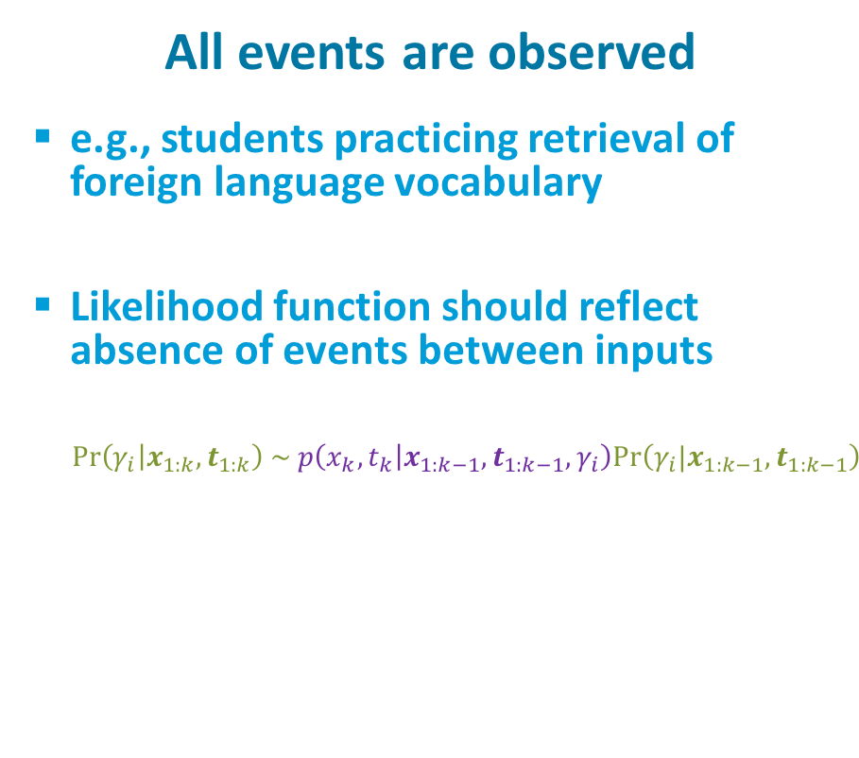
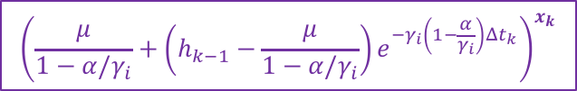
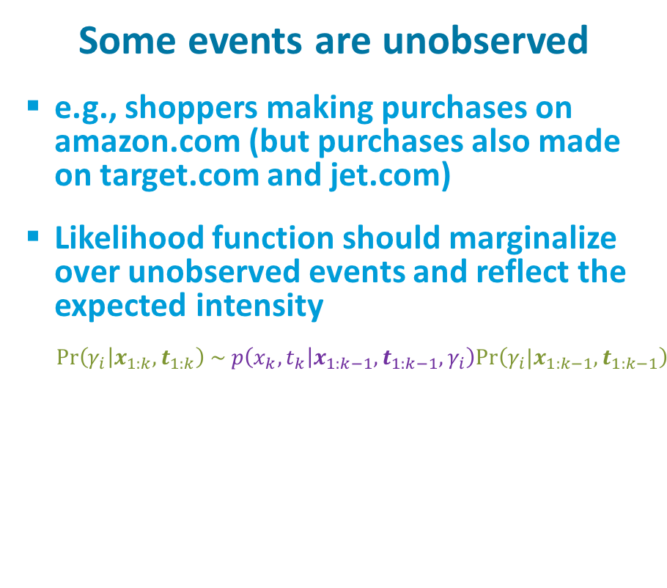
Two Alternative Characterizations of Environment
All events are observed
  e.g., students practicing retrieval of foreign language vocabulary
  Likelihood function should reflect absence of events between inputs
    $\text{Pr}\left(γ_{i} | x_{1:k}, t_{1:k}\right) \sim p\left(x_{k},t_{k} | x_{1:k−1}, t_{1:k−1},γ_{i}\right)\text{Pr}\left(γ_{i}|x_{1:k−1},t_{1:k−1}\right)$
Some events are unobserved
  e.g., shoppers making purchases on amazon.com (but purchases also made on target.com and jet.com)
  Likelihood function should marginalize over unobserved events and reflect the expected intensity
    $\text{Pr}\left(γ_{i} | x_{1:k}, t_{1:k}\right) \sim p\left(x_{k},t_{k} | x_{1:k−1}, t_{1:k−1},γ_{i}\right)\text{Pr}\left(γ_{i}|x_{1:k−1},t_{1:k−1}\right)$
$${\left(μ+e^{−γ_{i}Δt_{k}}\left(h_{k−1,i}−μ\right)\right)}^{x_{k}}{ Z}_{ki}\left(Δt_{k}\right)$$
$${\left(\frac{μ}{1−α/γ_{i}}+\left(h_{k−1}−\frac{μ}{1−α/γ_{i}}\right)e^{−γ_{i}\left(1−\frac{α}{γ_{i}}\right)Δt_{k}}\right)}^{x_{k}}$$

Slide 30






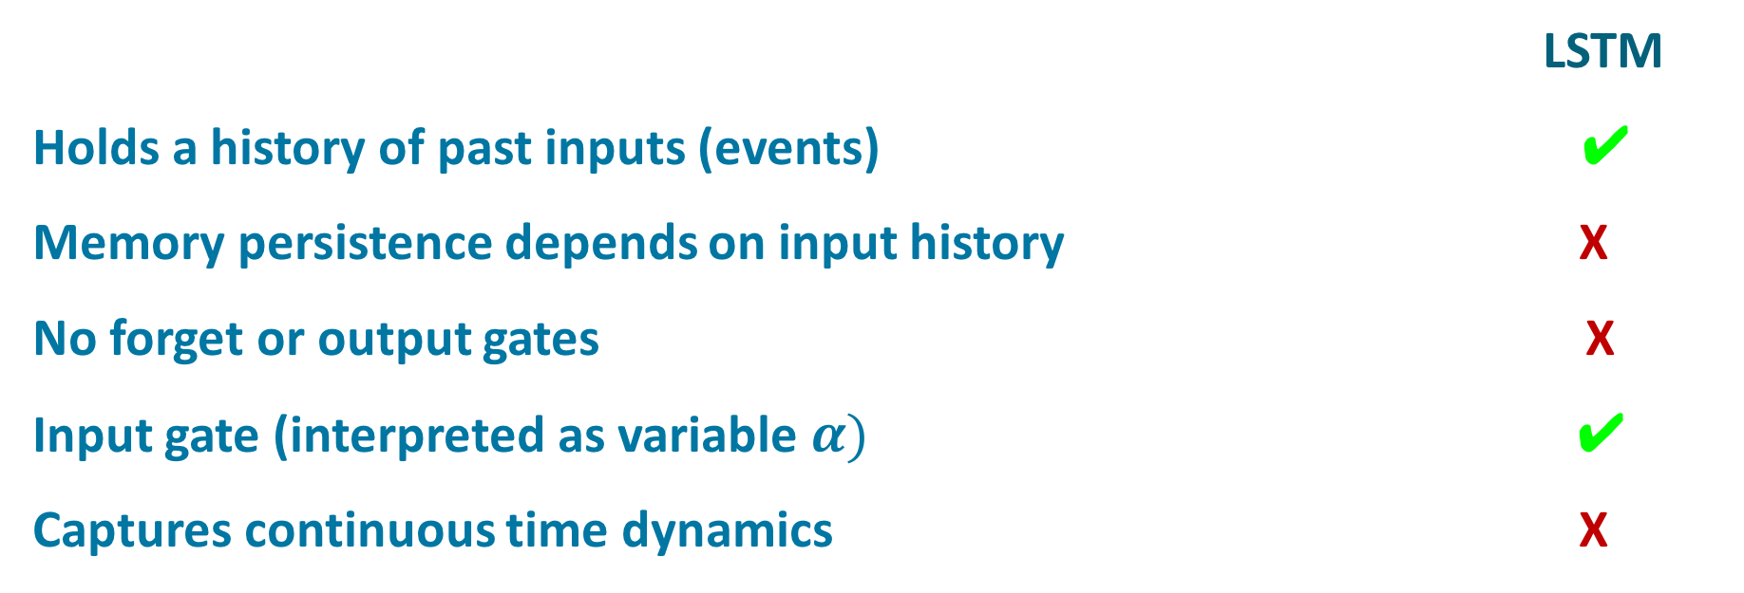
Hawkes Process Memory (HPM) Unit
LSTM
Holds a history of past inputs (events) ✔
Memory persistence depends on input history X
No forget or output gates X
Input gate (interpreted as variable $α)$ ✔
Captures continuous time dynamics X
$$h$$
$$γ$$
$$μ$$
$$α$$
$$x$$
$$Δt$$
Notes:
holds history of past events
ESSENTIALLY, BUILDS MEMORIES AT MULTIPLE TIME SCALES
[*] LSTM...
[*] memory persistence depends on input history
SELECTS APPROPRIATE TIME SCALE GIVEN INPUT HISTORY

Slide 31
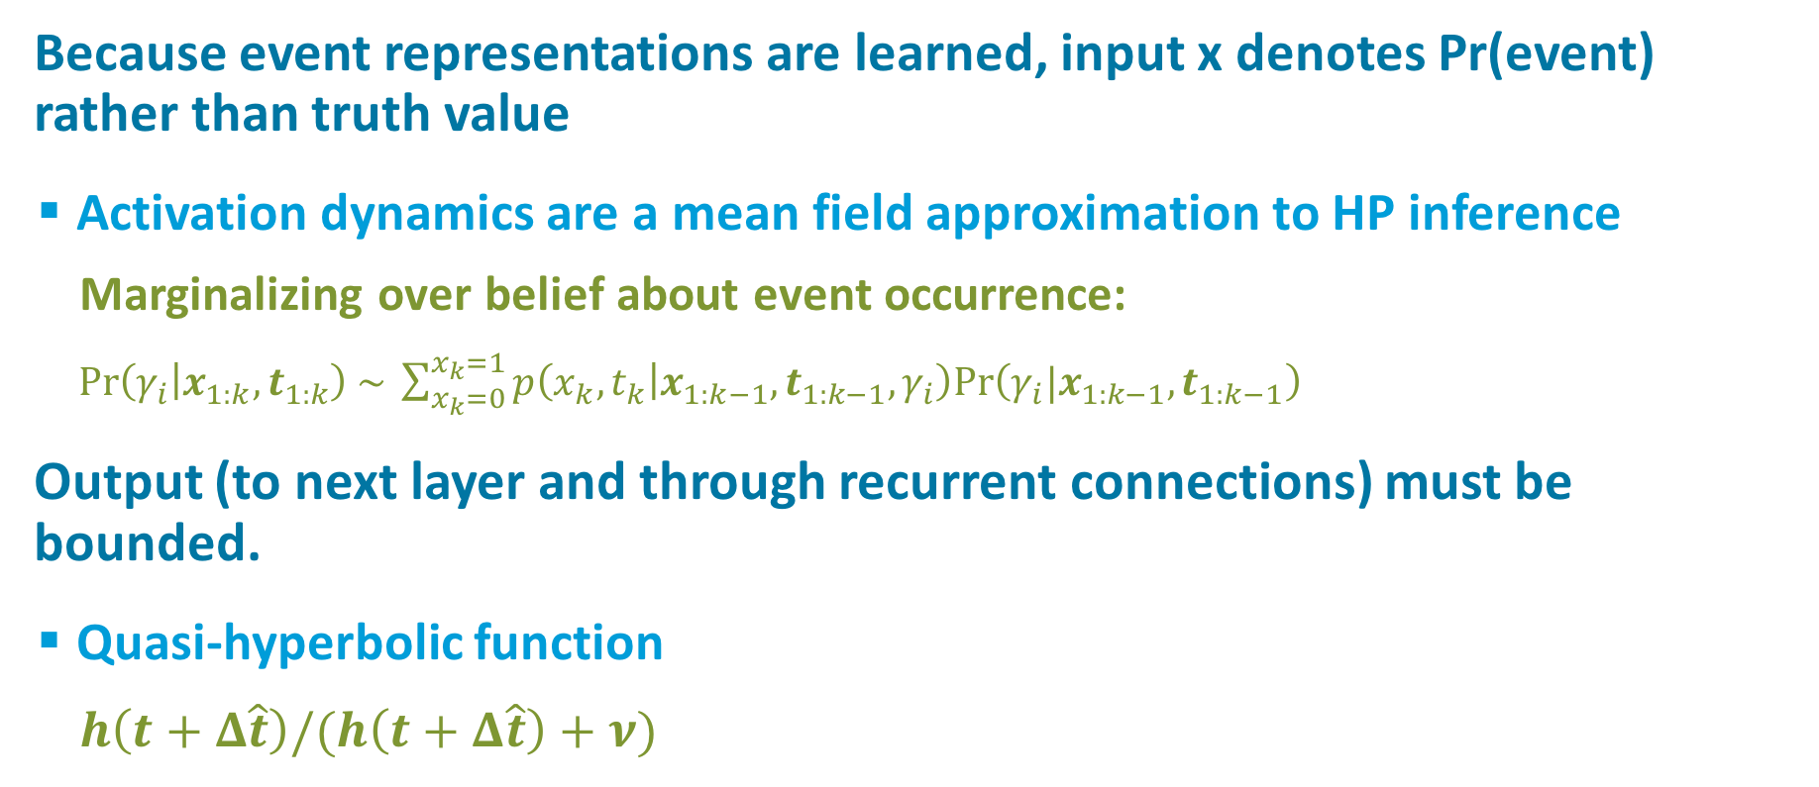
Embedding HPM in an RNN
Because event representations are learned, input x denotes Pr(event) rather than truth value
  Activation dynamics are a mean field approximation to HP inference
    Marginalizing over belief about event occurrence:
    $\text{Pr}\left(γ_{i} | x_{1:k}, t_{1:k}\right) \sim \sum_{x_{k}=0}^{x_{k}=1}{p\left(x_{k},t_{k} | x_{1:k−1}, t_{1:k−1},γ_{i}\right)\text{Pr}\left(γ_{i}|x_{1:k−1},t_{1:k−1}\right)}$
Output (to next layer and through recurrent connections) must be bounded.
  Quasi-hyperbolic function
    $h\left(t+Δ\hat{t}\right)/(h\left(t+Δ\hat{t}\right)+ν)$
Notes:
DETAILS YOU DON'T WANT TO SEE

Slide 32
Generic LSTM RNN
. . .
predicted event
A
B
C
LSTM
LSTM
LSTM
LSTM
. . .
current event
A
B
C
Notes:
To explain HP net, let's start with generic LSTM net

Slide 33


HPM RNN
. . .
predicted event
A
B
C
HPM
HPM
HPM
HPM
. . .
current event
$$Δ\hat{t}$$
$$Δt$$
A
B
C
time to
predicted
event
time
since last
event

Slide 34
Reddit Postings

Slide 35
Reddit
Data
  30,733 users
  32-1024 posts per user
  1-50 forums
  15,000 users for training (and validation), remainder testing
Task
  Predict forum to which user will post next, given the time of the posting
Notes:
OPTIONAL:
Representation
User-relative encoding of forum

Slide 36
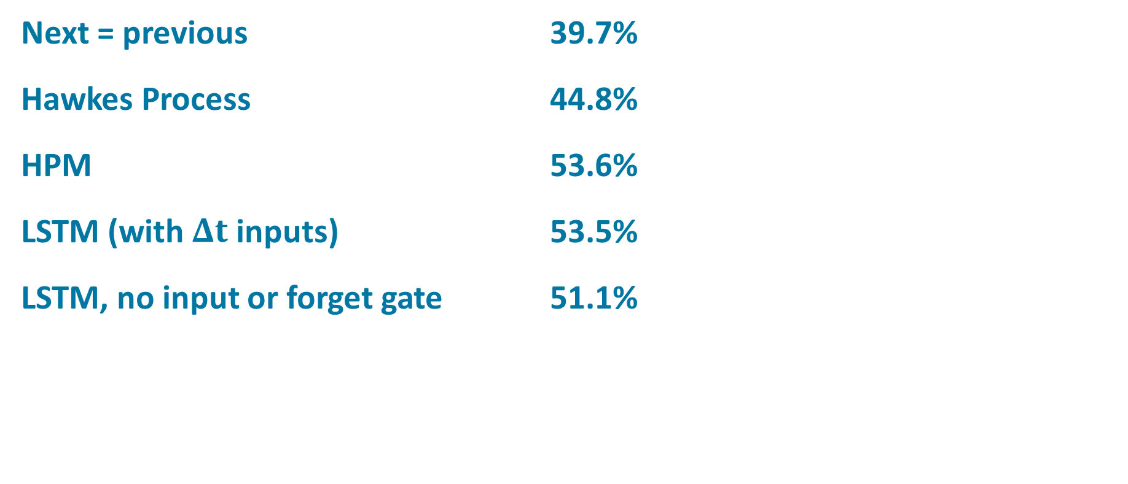
Reddit Results
Next = previous 39.7%
Hawkes Process 44.8%
HPM 53.6%
LSTM (with $Δt$ inputs) 53.5%
LSTM, no input or forget gate 51.1%
Notes:
hope is that HPM is picking up on different aspects of the data than LSTM, since LSTM relies on input gate whereas HPM does not
BEFORE ADVANCING:
last.fm artist choice data set that i won’t talk about. produced results much like reddit

Slide 37
Two Tasks
Event prediction
  Given time of occurrence, which of n event types is most likely?
Event outcome
  Given event type and time of occurrence, predict event outcome.
  E.g., if a student is prompted to apply some knowledge or recall a fact, will they succeed?
      input: `student retrieved item X at time T successfully or unsuccessfully’
      output: `will student retrieve item X’ at time T’ successfully or unsuccessfully?’

Slide 38
Word Learning Study
(Kang et al., 2014)
Data
  32 human subjects
  60 Japanese-English word associations
  each association tested 4-13 times over
  intervals ranging from minutes to
  several months
  655 trials per sequence on average
Task
  Given study history up to trial t,
  predict accuracy (retrievable from memory
  or not) for next trial.

Slide 39
Word Learning Results
Majority class (correct) 62.7%
Traditional Hawkes process 64.6%
Next = previous 71.3%
LSTM 77.9%
HPM 78.3%
LSTM with 𝚫t inputs 78.3%

Slide 40
Other Data Sets
last.fm
  30,000 user sequences
  predict artist selection
  time interval between selections varies from hours to years
COLT
  300 students practicing Spanish vocabulary (~200 words) over a semester
MSNBC
  sequence of web page views categorized by topic (sports, news, finance, etc.)
  10k sequences used for training, 110k for testing
Synthetic bursty
  Poisson distributed events over a finite window, with rate ~ 1/window_duration
  5 event streams

Slide 41
Multiple Performance Measures
Test log likelihood
Test top-1 accuracy
Test AUC

Slide 42
Alternative Models
Symmetric HPM with positive and negative intensities and inputs
Single time scale HPM
  typically does a tiny bit worse than multiscale model
  single scale symmetric HPM reduces to LSTM without forget and output gates
Hybrid HPM-LSTM layer
Mixture HPM
  Model I described assumes that a single time scale is responsible for the observed event sequence
  Alternative: observed events are a mixture of events produced by processes operating in parallel at multiple time scales simultaneously

Slide 43
LSTM Is Robust:
Synthetic “One Popular” Data Set
  11 event types
  in each sequence, one event is ‘popular’
  (50%) and other 10 are unpopular (5%)
  randomized order and times
Results
model | logL | Acc | AUC
next = cur |  | ~0.250
identify popular |  | ~0.500
LSTM (20 hid) | 1.849 | 0.485 | 0.756
HPM (20 hid) | 1.845 | 0.486 | 0.762
HP (10 hid, 1-1, ff) | 1.920 | 0.474 | 0.676

Slide 44
A Couple of Worrisome Results:
(1) Synthetic Data Generated By Hawkes Process
  10 interspersed event streams
  1000 training sequences, 1000 testing sequences
Results
  cur = previous 13.34%
  HP, parameterized by max likelihood 17.94%
  LSTM 16.46%
  HPM 16.40%
  LSTM and HPM have full input-hidden, hidden-output, hidden-hidden connectivity, versus restricted architecture of HP

Slide 45
Synthetic Data Generated By Hawkes Process
Results
  cur = previous 13.34%
  HP, parameterized by max likelihood 17.94%
  LSTM 16.46%
  HPM 16.40%
LSTM and HPM have full input-hidden, hidden-output, hidden-hidden connectivity, versus restricted architecture of HP

Slide 46
A Couple of Worrisome Results:
(2) Student Modeling
Interspersed practice of multiple items
Can treat as one long sequence of n different events, or as n shorter sequences each with a single event type
time stamp | problem index | accuracy
0.0 | 1 | -1
12.7 | 2 | -1
19.2 | 2 | +1
47.0 | 1 | +1
192.0 | 1 | +1
490.0 | 2 | -1
495.2 | 3 | +1
497.9 | 1 | +1

Slide 47
Student Modeling
One sequence per student-item
  HPM 81.14% AUC 0.853
  LSTM 81.31% AUC 0.853
One sequence per student
  HPM 78.69% AUC 0.841
  LSTM 78.05% AUC 0.839
  [same result from HPM when recurrent connections removed, and in->hid and hid->out connections are initialized to be 1-1]
Notes:
input_map_constraint = 0.5: 78.71% AUC 0.833
input_map_constraint = 2.0: 78;68% AUC 0.830

Slide 49
Human behavior and preferences have dynamics that operate across a range of time scales.
It seems like a model based on these dynamics should be a good predictor of human behavior.
… and hopefully also a good predictor of other multiscale time series.
Notes:
To wrap up, ...

Slide 50
Key Idea of Hawkes Process Memory
Represent memory of sequences at multiple
time scales simultaneously
Output ‘appropriate’ time scale based on
input history
Notes:
To wrap up,

Slide 51
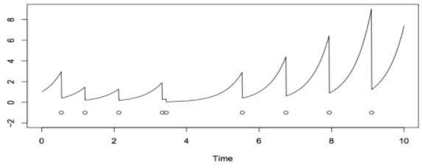
State of the Research
LSTM is pretty darn robust
Some evidence that HPM and LSTM are picking up on distinct information in the sequences
  Possibility that mixing unit types will
  obtain benefits
  Can also consider other types of units
  premised on alternative temporal point
  processes, e.g., self correcting processes
Potential for using event-based model even for traditional sequence processing tasks
Notes:
…picking up on distinct information in sequences.
IF SO, possibility that mixing unit types...
...
e.g., self correcting processes
USEFUL FOR REPRESENTING PERIODIC STRUCTURE OR SATIATION OF INTEREST (if you’ve just had dessert you’re unlikely to want another for a while)

Slide 52
Novelty
The neural Hawkes process memory belongs to two new classes of neural net models that are emerging.
  Models that perform dynamic parameter inference as a sequence is processed
    see also Fast Weights paper by Ba, Hinton, Mnih, Leibo, & Ionescu (2016), Tau Net paper by Nguyen & Cottrell (1997)
  Models that operate in a continuous time environment
    see also Phased LSTM paper by Neil, Pfeiffer, Liu (2016)

