Slide 1
CSCI 5822
Probabilistic Models of Human and Machine Learning
Mike Mozer
Department of Computer Science and
Institute of Cognitive Science
University of Colorado at Boulder

Slide 2
Nonparametric Bayesian Models

Slide 3
Parametric Model
Fixed number of parameters that is independent of the data we’re fitting

Slide 4
Nonparametric Model
Number of free parameters grows with amount of data
Potentially infinite dimensional parameter space
Only a finite subset of parameters are used in a nonparametric model to explain a finite amount of data
    ➔Model complexity grows with amount of data

Slide 5
Example: k Nearest Neighbor (kNN) Classifier
x
o
?
x
o
x
x
o
?
o
x
o
?

Slide 6
Bayesian Nonparametric Models
Model is based on an infinite dimensional parameter space
But utilizes only a finite subset of available parameters on any given (finite) data set
  i.e., model complexity is finite but unbounded
Typically
  Parameter space consists of functions or measures
  Complexity is limited by marginalizing out over surplus dimensions
nonnegative function over sets

Slide 7
For parametric models, we do inference on
random variables θ
For nonparametric models, we do inference on stochastic processes
  Think about stochastic process as ‘infinite-dimensional random variable’
Content of most slides borrowed from
Zhoubin Ghahramani and Michael Jordan

Slide 8
What Will This Buy Us?
Distributions over
  Partitions
    E.g., for inferring topics when number of topics not known in advance
    E.g., for inferring clusters when number of clusters not known in advance
  Directed trees of unbounded depth and breadth
    E.g., Antonio Blanca’s phylogenetic trees
    E.g., for inferring category structure
  Sparse binary infinite dimensional matrices
    E.g., for inferring implicit features
  Functions
    E.g., prior specifying function smoothness

Slide 9
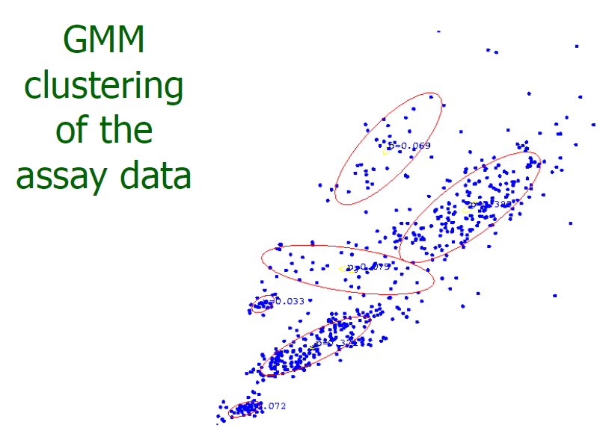
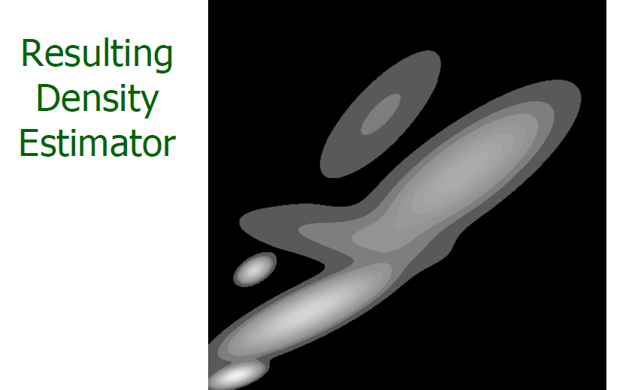
Intuition: Mixture Of Gaussians
Standard GMM has a fixed number of components.
    θ: means and variances
Quiz: What sort
of prior would
you put on π?
On θ?

Slide 10
Intuition: Mixture Of Gaussians
Standard GMM has a fixed number of components.
Equivalent form:
But suppose instead we had
G: mixing
distribution
= 1 unit of
probability
mass iff θ_{k}=θ
Notes:
Dirac delta

Slide 11
Being Bayesian
Can we define a prior over π?
    Yes: stick-breaking process
Can we define a prior over the mixing distribution G?
    Yes: Dirichlet process

Slide 12
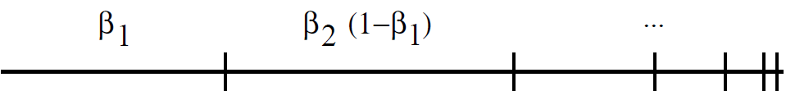
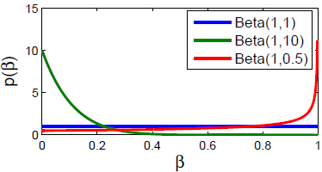
Stick Breaking
Imagine breaking a stick by recursively breaking off bits of the remaining stick
Formally, define infinite sequence of beta RVs:
And an infinite sequence based on the {β_{i}}
Produces distribution on countably infinite space
Notes:
What effect does alpha have?

Slide 13
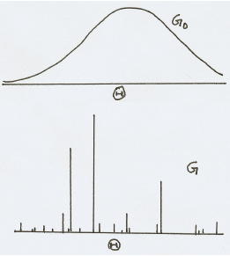

Dirichlet Process
infinite dimensional
Dirichlet distribution
Stick breaking gave us
For each k we draw θ_{k} ~ G₀
And define a new function
The distribution of G is known
as a Dirichlet process
    G ~ DP(α, G₀)
Borrowed from Gharamani tutorial
concentration
parameter
base
distribution
Notes:
lower graph: height = length of stick broken off, position = THETA sampled from G0

Slide 14
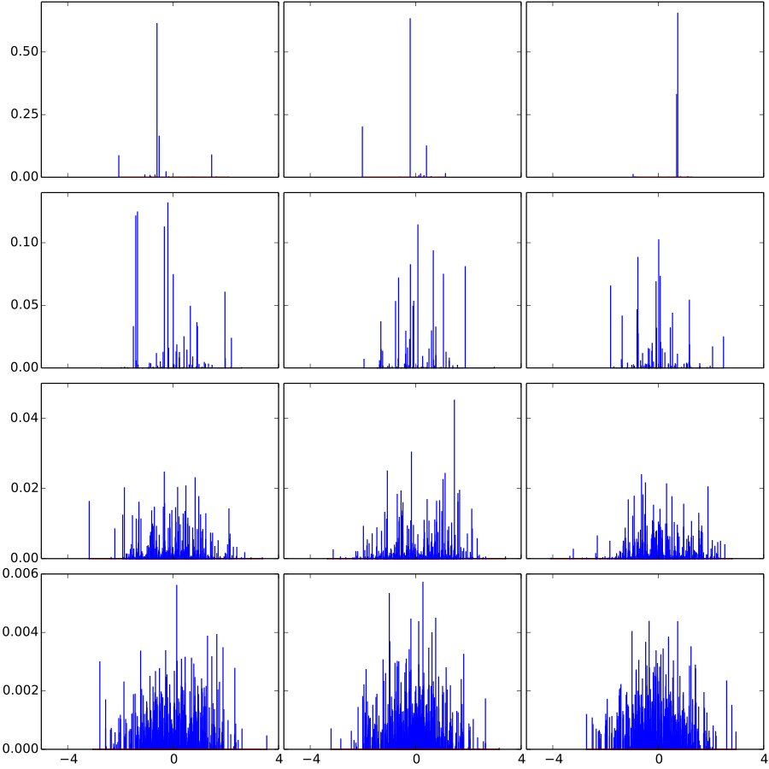
Dirichlet Process Draws
α= 1
α= 10
α= 100
α= 1000
Figure from wikipedia
Notes:
3 columns are 3 different draws

Slide 15
Dirichlet Process
Stick breaking gave us
For each k we draw θ_{k} ~ G₀
And define a new function
The distribution of G is known
as a Dirichlet process
    G ~ DP(α, G₀)
QUIZ:
For GMM…
What is θ?
What is θ_{k}?
What is G_{0?}
What does G represent?
What is a draw from G?
How do we get G that have fewer observed mixture components?
Notes:
As alpha goes to infinity, bits of stick get very small, and repeated sampling from G0 causes G-> G0

Slide 16
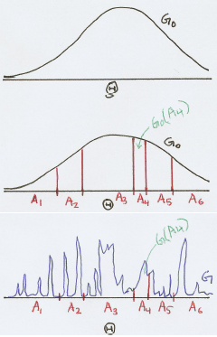


*Digression*
Relation of Dirichlet Process and Dirichlet Distribution
For all finite partitions (A₁, A₂, A₃, …, A_{K}) of Θ,
if G ~ DP(α, G₀) and
Partitioning defines Dirichlet dist.
Partitions do not have to be
exhaustive
Adapted from Gharamani tutorial
Notes:
DIGRESSION – not essential to rest of what we’re doing
Can turn INFINITE DIMENSIONAL DIRICHLET DISTRIBUTION (dirichlet process) into a FINITE DIM DIRICHLET BY SELECTING PARTITIONS OF THETA

Slide 17
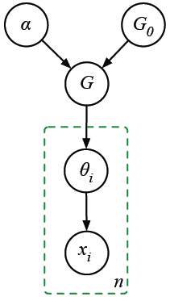
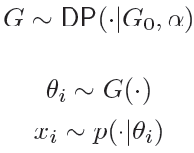
Dirichlet Process Mixture of Gaussians
Instead of prespecifying number of components, draw parameters of mixture model from a DP
→ infinite mixture model
Quiz: After n observations,
what’s the max # of distinct
clusters (𝜃)?
what’s the min # of distinct
clusters?

Slide 18
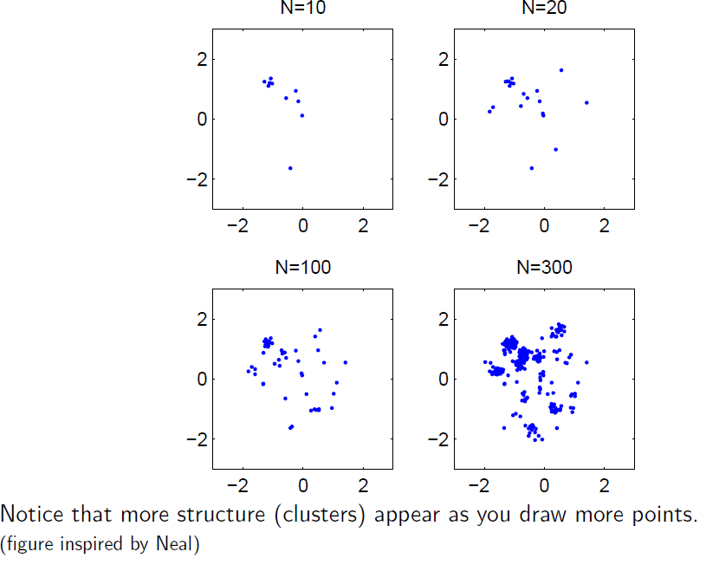
Sampling From A DP Mixture of Gaussians
Borrowed from Gharamani tutorial

Slide 19
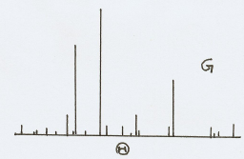
Drawing From A Dirichlet Process
As you draw more points from
    G ~ DP(α, G₀)
you are more likely to get repetitions.
    θ_{i} ~ G
So you can think about a DP as inducing a partitioning of the points by equality
    θ_{i} = θ₃ = θ₄ ≠ θ₂ = θ₅
Chinese restaurant process (CRP) induces the corresponding distribution over these partitions
    CRP is generative model for sampling from DP, then from G

Slide 20
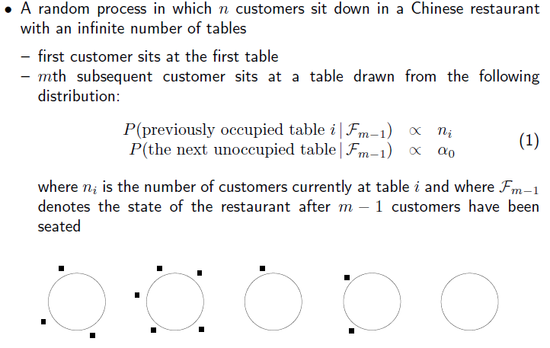
Chinese Restaurant Process:
Informal Description
Borrowed from Jordan lecture

Slide 21
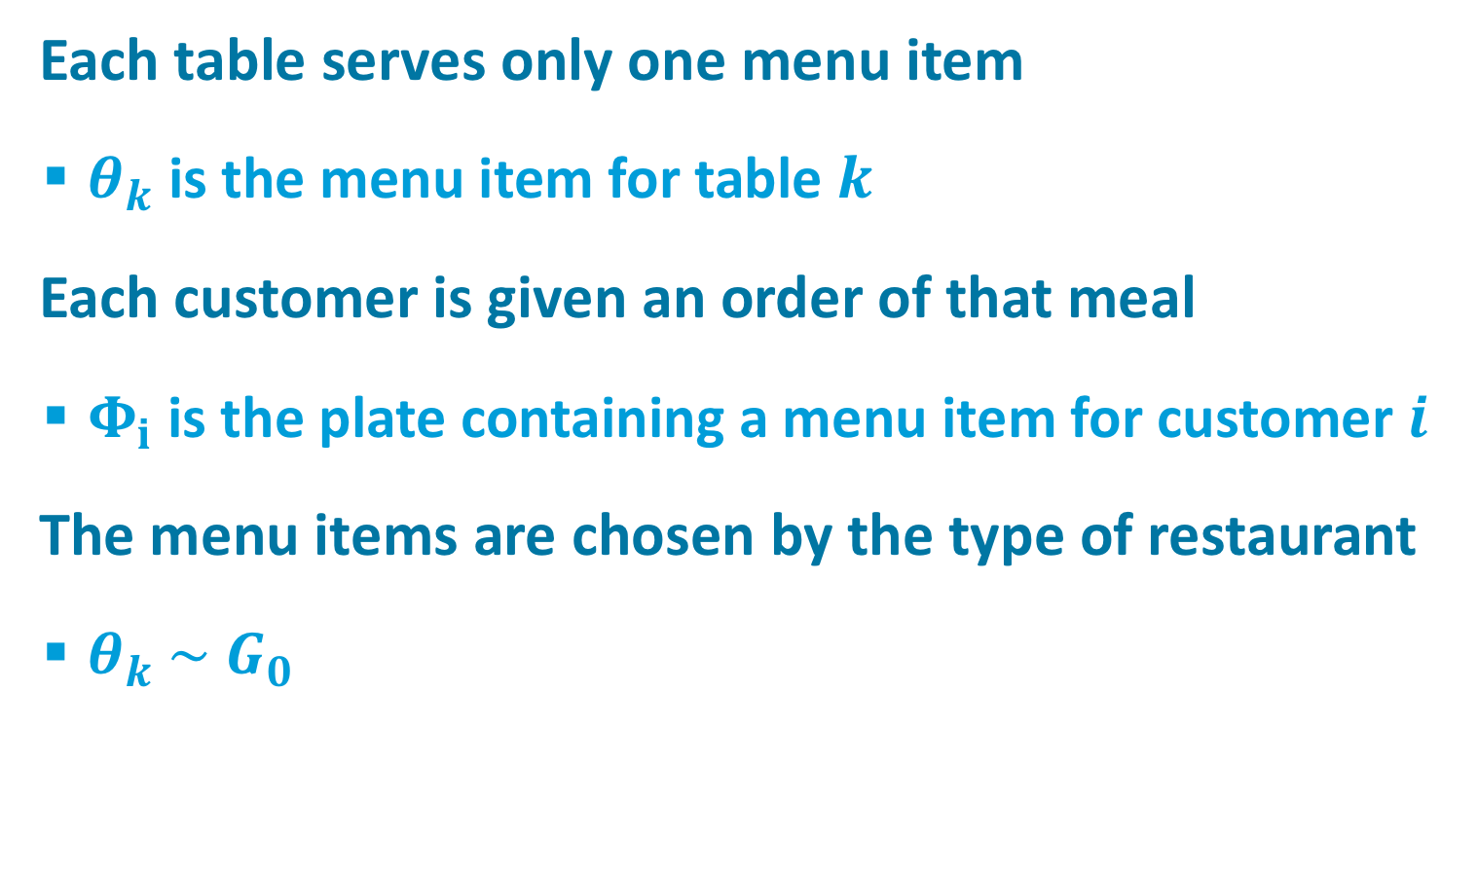
Chinese Restaurant Process
Each table serves only one menu item
  $θ_{k}$ is the menu item for table $k$
Each customer is given an order of that meal
  $Φ_{i}$ is the plate containing a menu item for customer $i$
The menu items are chosen by the type of restaurant
  $θ_{k} \sim { G}_{0}$
φ₁
φ₂
φ₄
φ₅
θ₁
θ₂
θ₃
θ₄
φ₃
φ₆

Slide 22
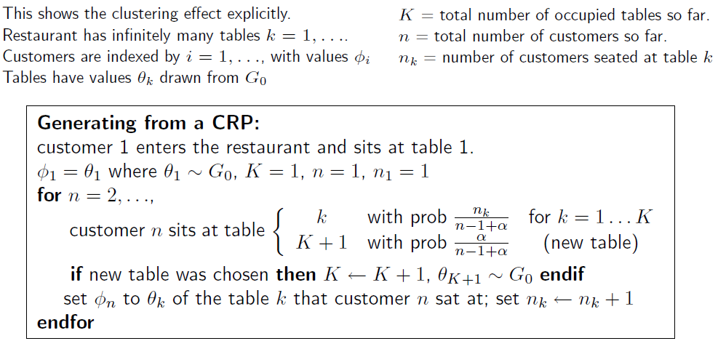
Chinese Restaurant Process:
Formal Description
meal (instance)
meal (type)
φ₁
φ₂
φ₄
φ₅
θ₁
θ₂
θ₃
θ₄
φ₃
φ₆
Borrowed from Gharamani tutorial
Notes:
Suppose different meal for each table: THETA is MEAL TYPE; PHI is MEAL INSTANCE
What does this mean in terms of GMM example?

Slide 23
Comments On CRP
Rich get richer phenomenon
    The popular tables are more likely to attract new patrons
CRP produces a sample drawn from G, which in turn is drawn from the DP, without explicitly specifying G
    Analogous to how we could sample the outcome of a biased coin flip (H, T) without explicitly specifying coin bias ρ
    ρ ~ Beta(α,β)
    X ~ Bernoulli(ρ)

Slide 24
Infinite Exchangeability of CRP
Sequence of variables X₁, X₂, X₃, …, X_{n} is exchangeable if the joint distribution is invariant to permutation.
  With σ being any permutation of {1, …, n},
An infinite sequence is infinitely exchangeable if any subsequence is exchangeable.
Quiz
  Relationship to iid (indep., identically distributed)?
Notes:
if iid -> exchangeable; if exchangeable, not necessarily iid
EXAMPLE: permut(1:n)

Slide 25

Inifinite Exchangeability of CRP
Probability of a configuration is independent of the particular order that individuals arrived
Convince yourself with a simple example:
φ₁
φ₂
φ₄
φ₁
φ₃
φ₅
φ₅
θ₁
θ₂
θ₃
φ₄
θ₁
θ₂
θ₃
φ₃
φ₆
φ₂
φ₆
Notes:
ru

Slide 26

De Finetti (1935)
If {X_{i}} is exchangeable, there is a random θ such that:
If {X_{i}} is infinitely exchangeable, then θ may be a stochastic process (infinite dimensional).
Thus, there exists a hierarchical Bayesian model for the observations {X_{i}}.
Notes:
Theorem guarantees that we can find stochastic processes to serve as priors for nonparametric bayesian models if the observations are inf exchangeable
and … can perform collapsed gibbs sampling

Slide 27
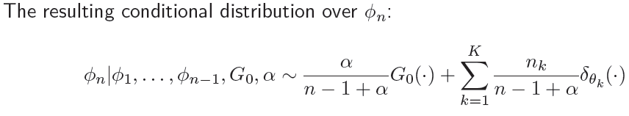
Consequence Of Exchangeability
Exists collapsed Gibbs sampler
Collapsing the sequence of
  sampling from DP
  sampling from G
Similar to topic modeling where we were able to collapse sampling from Dirichlet distribution and then sample from Multinomial/Categorical distribution
Notes:
Why n-1 and not n: we have removed one item so n-1 remain

Slide 28
REVIEW: Dirichlet Process
Stick breaking gives us
For each k we draw θ_{k} ~ G₀
And define a new function
The distribution of G is a Dirichlet process
    G ~ DP(α, G₀)
G₀
α
G
θ
concentration
parameter
base
distribution
X

Slide 29
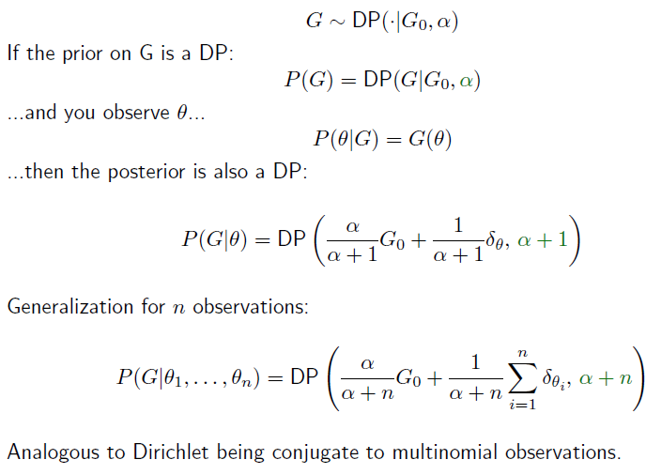
Dirichlet Process: Conjugacy
G₀
α
G
θ
X
Borrowed from Gharamani tutorial

Slide 30
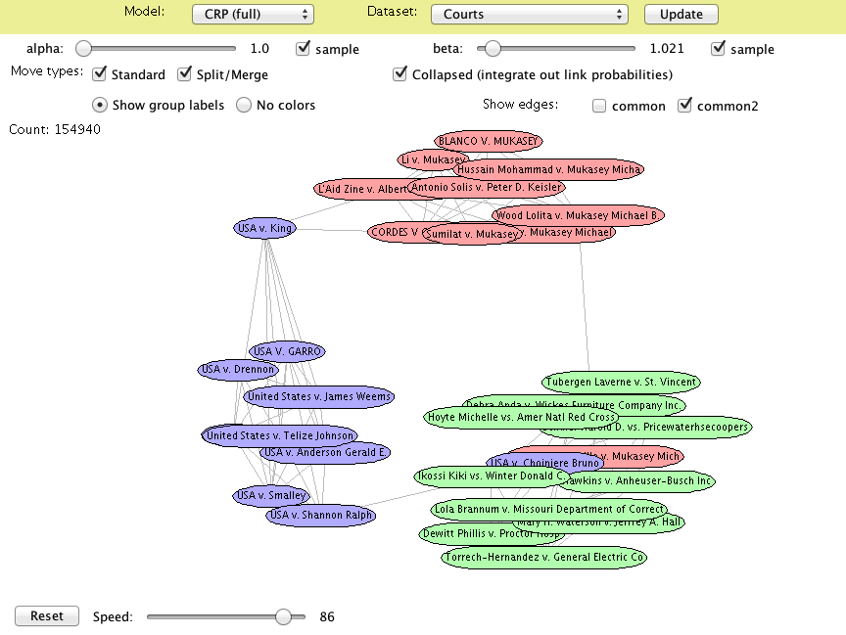
CRP-Based Gibbs Sampling Demo
http://chris.robocourt.com/gibbs/index.html

Slide 31
Parameters Vs. Partitions
G₀
α
G₀
α
G
G
Rather than a generative model that
spits out mixture component
parameters, it could equivalently
spit out partitions of the data.
  Use S^{(i)} to denote the partition or indicator of X^{(i)}
Casting problem in terms of indicators
will allow us to use the CRP
Let’s first analyze the finite mixture case
S^{(i)}
Θ^{(i)}
X^{(i)}
X^{(i)}
n
n
Notes:
Explain superscript notation

Slide 32
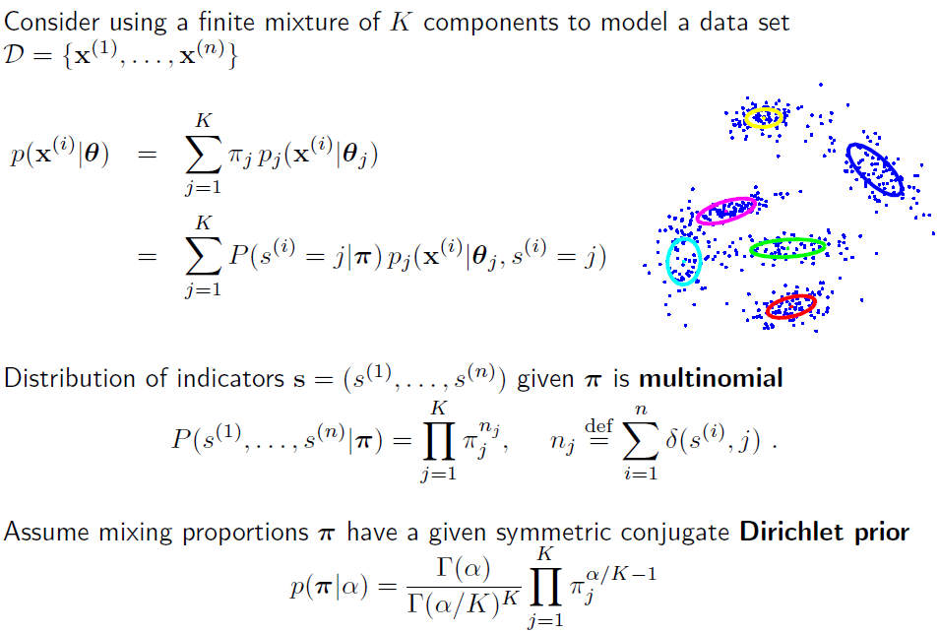
Bayesian Mixture Model (Finite Case)
Gharamani tutorial
Notes:
symmetric = all alpha values are the same, as we did with topic model
why alpha/k instead of alpha: think of alpha

Slide 33


Bayesian Mixture Model (Finite Case)
Integrating out the mixing proportions, π, we obtain
Allows for Gibbs sampling over indicator priors
Rich get richer effect
    more populous classes are likely to be joined
Notes:
Top distribution is over indicators in the absence of any data (i.e., before you’ve seen where the points lie)
derivation of gibbs sampling on next slide

Slide 34
Gibbs Sampler Derivation
Courtesy of Amir Ghasemian (2015 student in class)

Slide 35
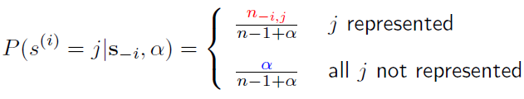
From Finite To Infinite Mixtures
Finite case
Infinite case: CRP

Slide 36
Incorporating Observations
Previous slide describes prior over indicators
Given observations, x = {x_{i}}, Gibbs can be used to sample over posterior
G₀
α
e.g., Gaussian
likelihood
defined on
previous
slide
G
S^{(i)}
Θ
X^{(i)}
n

Slide 37
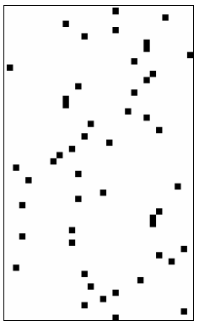
Partitioning Performed By CRP
You can think about CRP as creating a binary matrix
    Rows are diners
    Columns are tables
    Cells indicate assignment of diners to tables
Columns are mutually exclusive ‘classes’
    E.g., in DP Mixture Model
Infinite number of columns in matrix

Slide 38
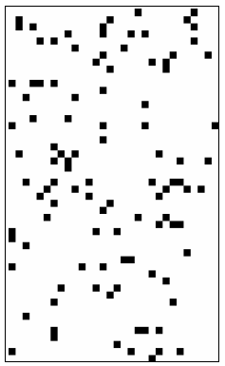
More General Prior On Binary Matrices
Allow each individual to be a member of multiple classes
    … or to be represented by multiple features
    ‘distributed representation’
    E.g., an individual is male, married, Democrat,
    fan of CU Buffs, etc.
As with CRP matrix, fixed number of
rows, infinite number of columns
But no constraint on number of columns
that can be nonzero in a given row

Slide 39
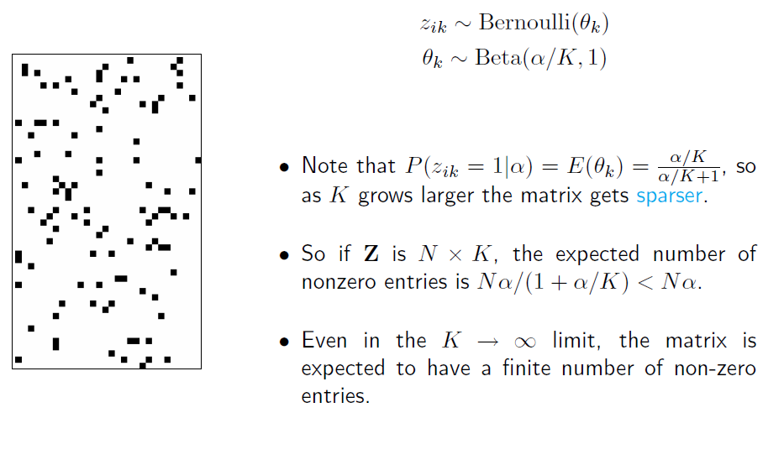
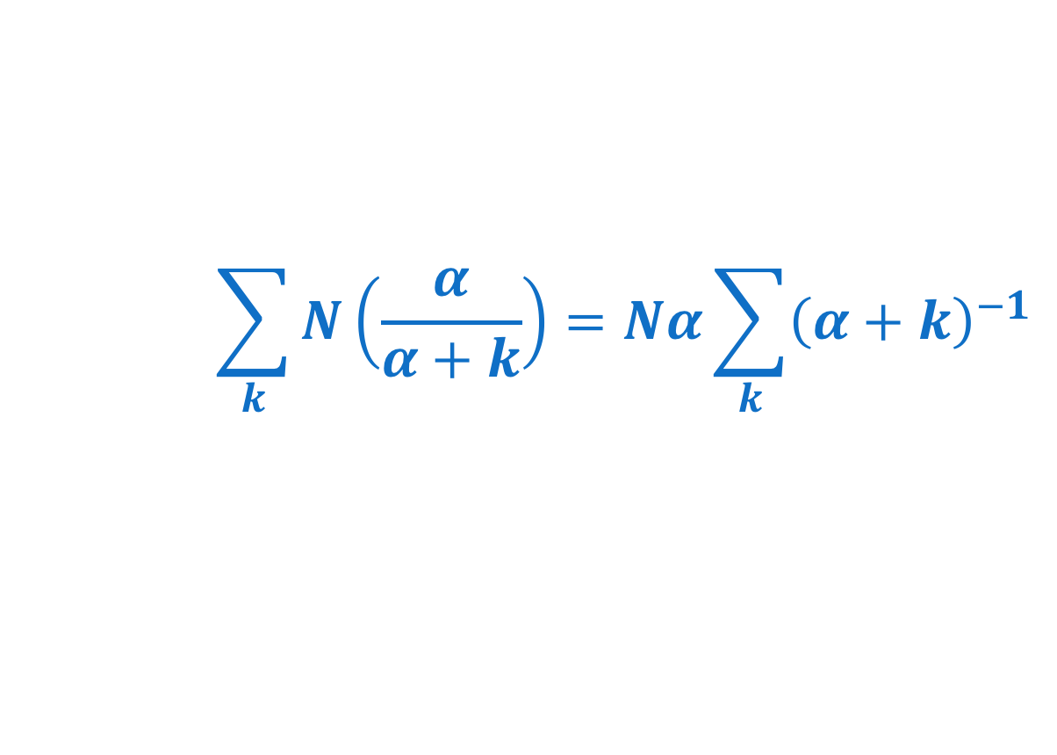
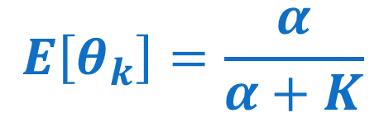
Finite Binary Feature Matrix
K
$$E\left[θ_{k}\right]=\frac{α}{α+K}$$
N
$$\sum_{k}{N\left(\frac{α}{α+k}\right)}=Nα\sum_{k}{{\left(α+k\right)}^{−1}}$$
Borrowed from Gharamani tutorial
Notes:
K: analog to # occupied tables
The bigger K gets, the closer expectation of theta_k gets to 0
\sum_k N * (a/(a+K)) = Na \sum_k

Slide 40
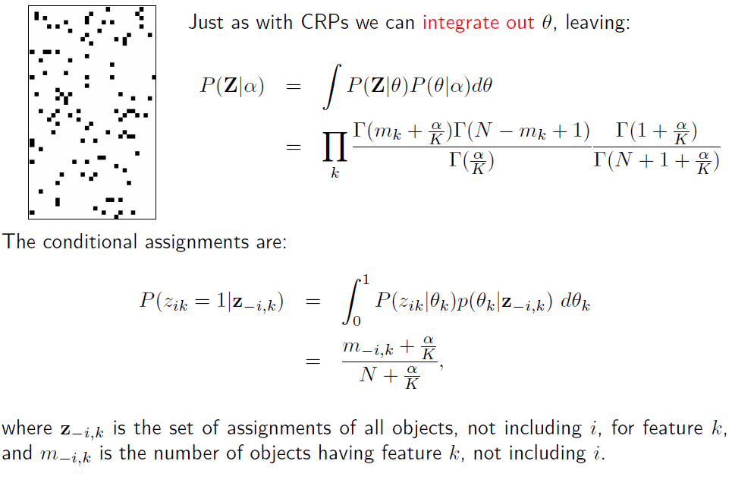
Borrowed from Gharamani tutorial

Slide 41
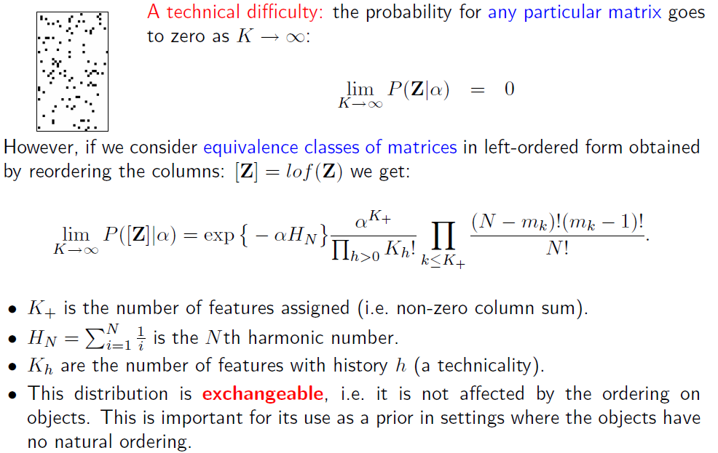
Borrowed from Gharamani tutorial
Notes:
ANY PARTICULAR MATRIX: number of bits increases, each has a probability < 1
but all matrices with permuted columns are equivalent...
Exchangeability: the probability doesn't depend on ordering of rows

Slide 42
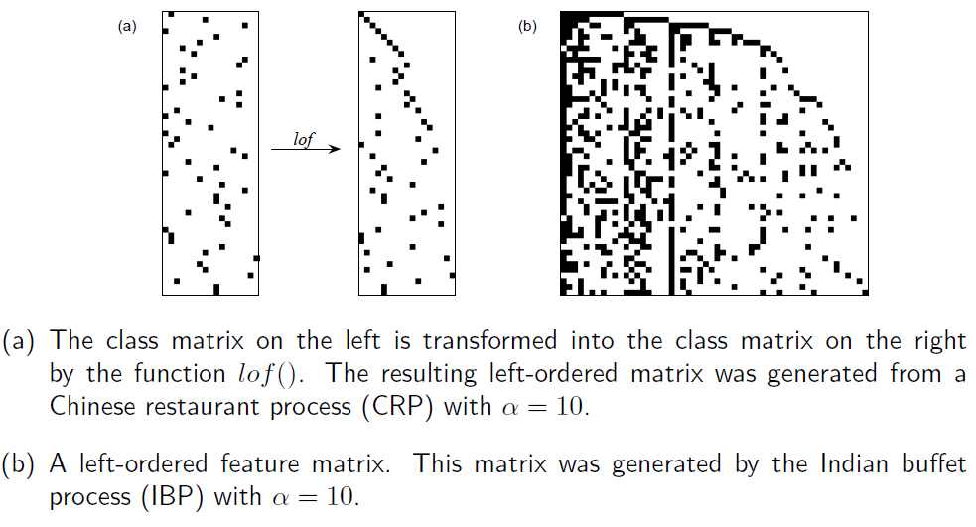
Binary Matrices In Left-Ordered Form
Borrowed from Gharamani tutorial
Notes:
Left ordered form: rearrange columns leaving rows alone. For the first row above, the second column has a nonzero value -> move it to first column of LOF
is a CRP: only one value filled in per row
is a IBP

Slide 43
Borrowed from Gharamani tutorial
Notes:
ANY PARTICULAR MATRIX: number of bits increases, each has a probability < 1
but all matrices with permuted columns are equivalent...
Exchangeability: the probability doesn't depend on ordering of rows

Slide 44
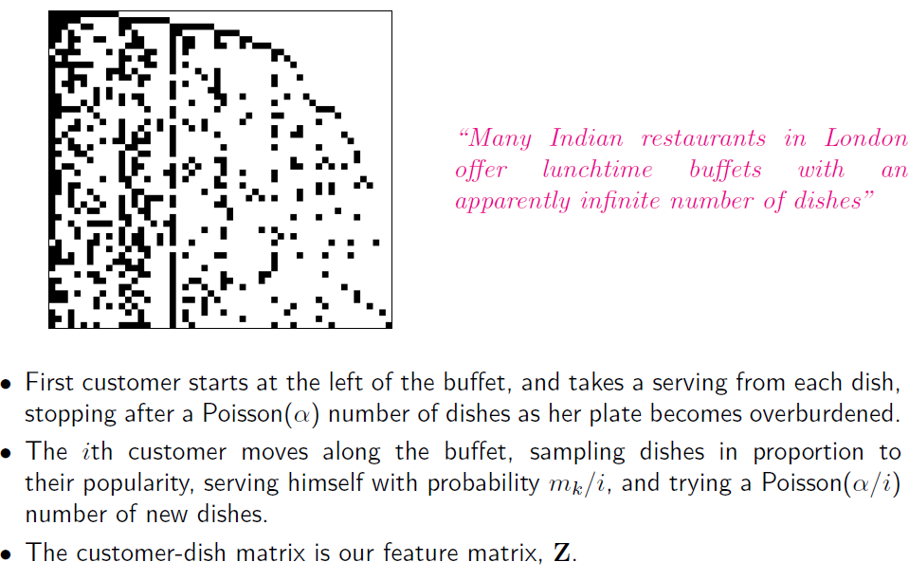
Indian Buffet Process
Number of diners who
chose dish k already
Notes:
Poisson (distribution over counts

Slide 45
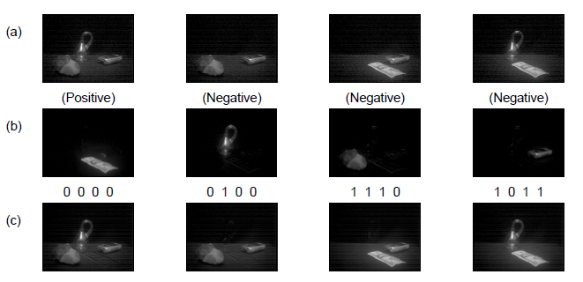
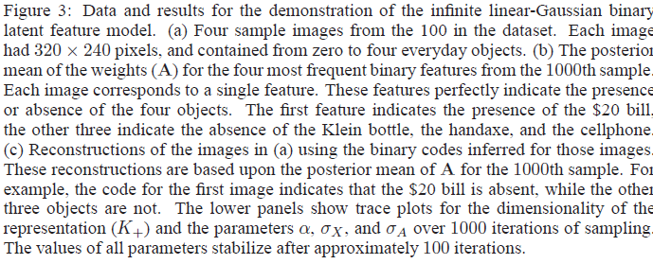
IBP Example (Griffiths & Ghahramani, 2006)
Data set
Recovered
features
Images
from
features
Notes:
Each image has 0-4 every day objects
Row 1: 4 images sampled from data set.
Negative and positive refer to whether the presence of features in (b) is denoted by a 0 or by a 1 in the feature vector. (Symmetry)

Slide 46
Ghahramani’s Model Space

Slide 48
Hierarchical Dirichlet Process (HDP)
Suppose you want to model where people hang out in a town.
    Not known in advance how many locations need to be modeled
Some spots in town are generally popular, others not so much.
But individuals also have preferences that deviate from the population preference.
      E.g., bars are popular, but not for individuals who don’t drink
Need to model distribution over locations at level of both population and individual.

Slide 49
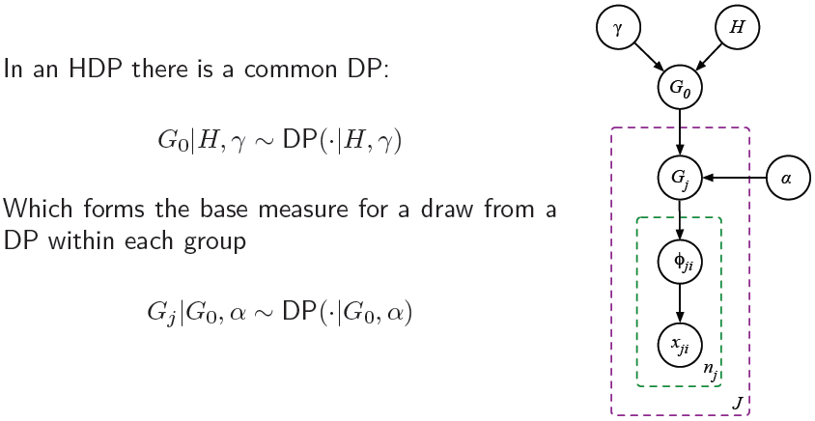
Hierarchical Dirichlet Process
Population
distribution
Individual
distribution

Slide 50
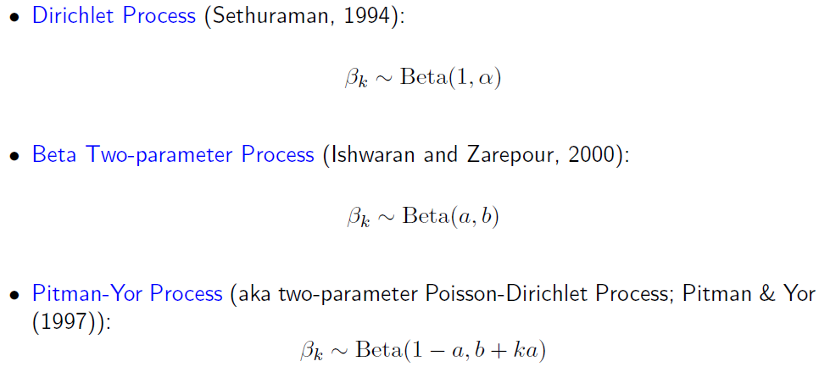
Other Stick Breaking Processes
Borrowed from Gharamani tutorial

