Slide 1
CSCI 5822 Probabilistic Models of Human and Machine Learning
Mike Mozer
Department of Computer Science and Institute of Cognitive Science University of Colorado at Boulder

Slide 2
Learning Structure and Parameters
The principle
Treat network structure, S^{h}, as a discrete RV
Calculate structure posterior Integrate over uncertainty in structure to predict
The practice
Computing marginal likelihood, p(D|S^{h}), can be difficult.
Learning structure can be impractical due to the large number of hypotheses (more than exponential in # of nodes)

Slide 3
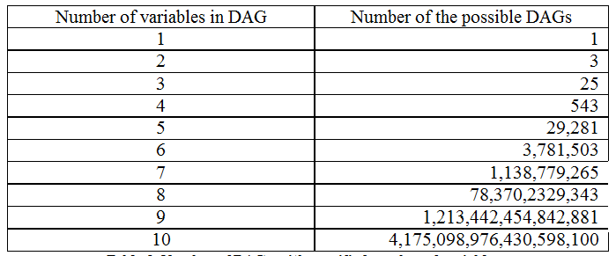
source: www.bayesnets.com

Slide 4
Approach to Structure Learning
model selection
find a good model, and treat it as the correct model
selective model averaging
select a manageable number of candidate models and pretend that these models are exhaustive
Experimentally, both of these approaches produce good results.
i.e., good generalization

Slide 5
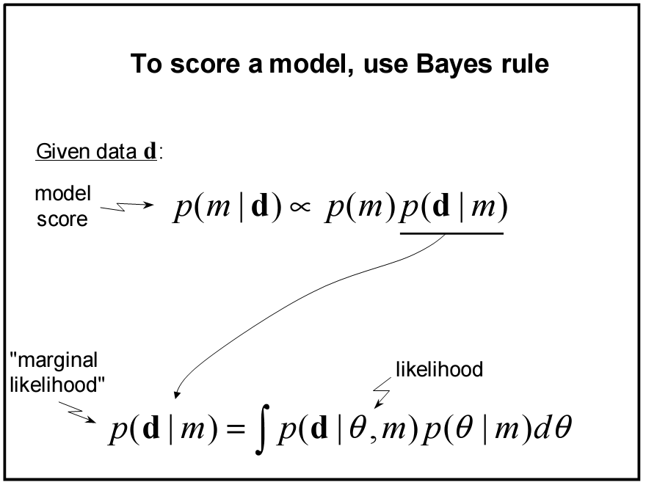

Slide 6
SLIDES STOLEN FROM DAVID HECKERMAN

Slide 8
Interpretation of Marginal Likelihood
Using chain rule for probabilities
Maximizing marginal likelihood also maximizes sequential prediction ability!
Relation to leave-one-out cross validation
Problems with cross validation
can overfit the data, possibly because of interchanges (each item is used for training and for testing each other item)
has a hard time dealing with temporal sequence data

Slide 9
Coin Example

Slide 10
α_{h}, α_{t}, #h, and #t all indexed by these conditions

Slide 11
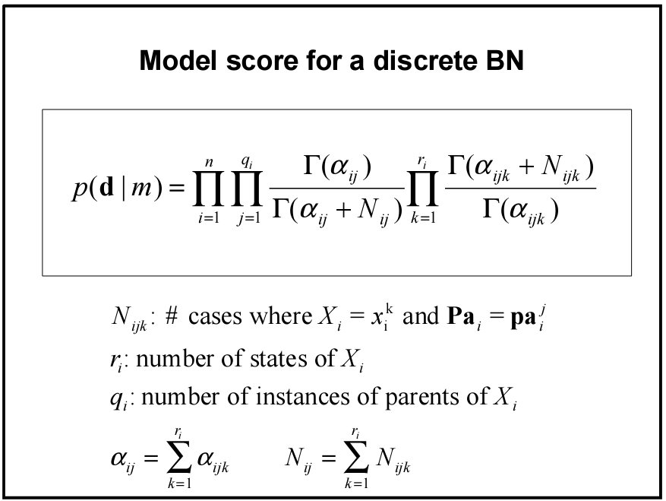
# parent config
# node states
# nodes

Slide 12
Computation of Marginal Likelihood
Efficient closed form solution if
no missing data (including no hidden variables)
mutual independence of parameters θ
local distribution functions from the exponential family (binomial, Poisson, gamma, Gaussian, etc.)
conjugate priors

Slide 13
Computation of Marginal Likelihood
Approximation techniques must be used otherwise.
E.g., for missing data can use Gibbs sampling or Gaussian approximation described earlier.
Bayes theorem
1. Evaluate numerator directly, estimate denominator using Gibbs sampling
2. For large amounts of data, numerator can be approximated by a multivariate Gaussian

Slide 14
Structure Priors
Hypothesis equivalence
identify equivalence class of a given network structure
All possible structures equally likely
Partial specification: required and prohibited arcs (based on causal knowledge)
Ordering of variables + independence assumptions
ordering based on e.g., temporal precedence
presence or absence of arcs are mutually independent -> n(n-1)/2 priors
p(m) ~ similarity(m, prior Belief Net)

Slide 15
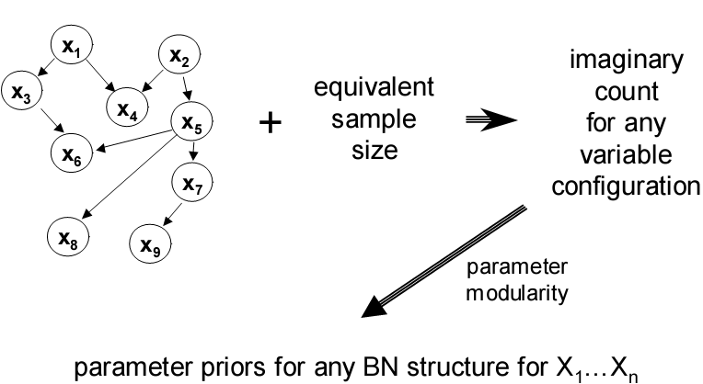
Parameter Priors
all uniform: Beta(1,1)
use a prior Belief Net
parameters depend
only on local structure

Slide 16
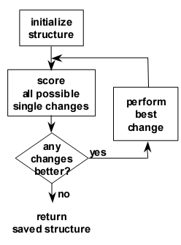
Model Search
Finding the belief net structure with highest score among those structures with at most k parents is NP-hard for k > 1 (Chickering, 1995)
Sequential search
add, remove, reverse arcs
ensure no directed cycles
efficient in that changes to arcs affect only some components of p(D|M)
Heuristic methods
greedy
greedy with restarts
MCMC / simulated annealing

Slide 17
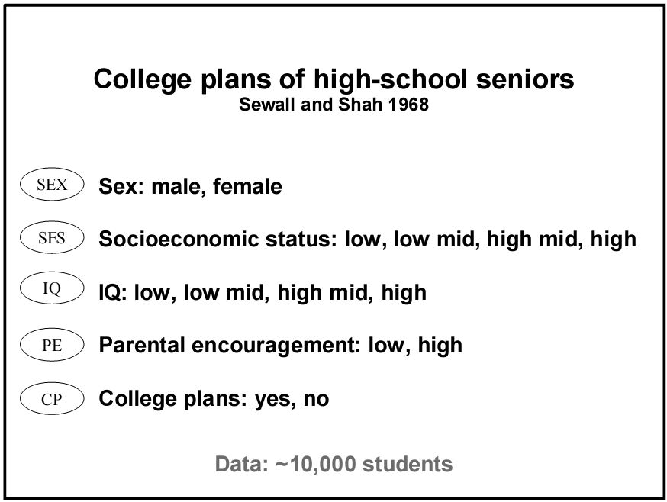

Slide 19
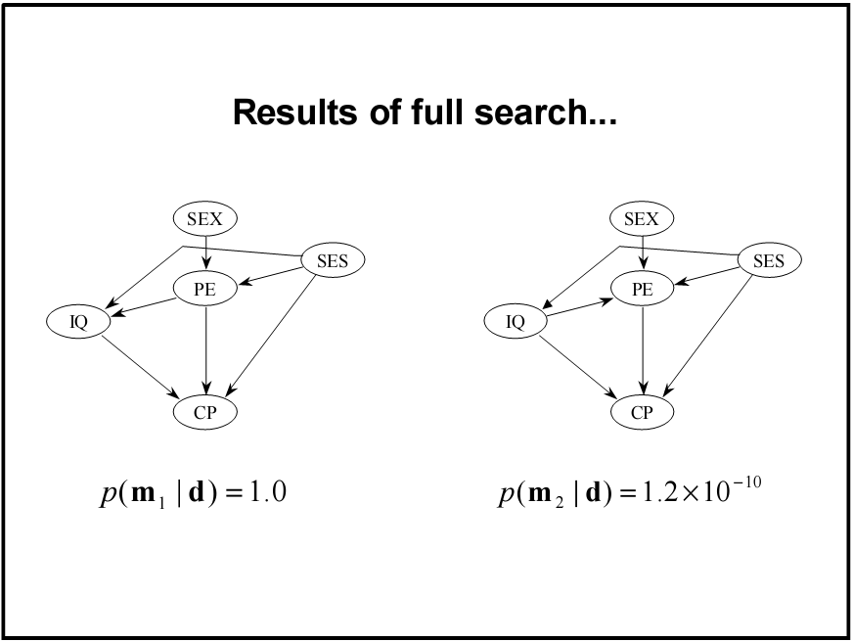
two most likely structures

Slide 21
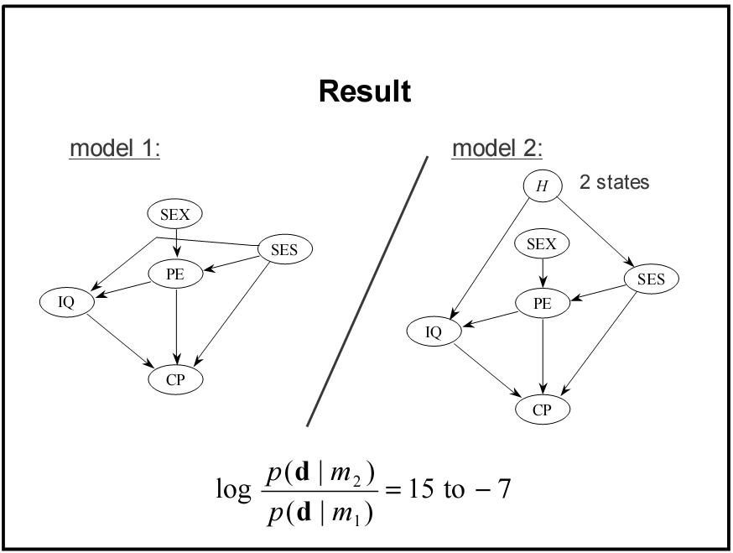
2x10¹⁰

