Slide 1
CSCI 5822
Probabilistic Models of
Human and Machine Learning
Mike Mozer
Department of Computer Science and
Institute of Cognitive Science
University of Colorado at Boulder

Slide 2
Hidden Markov Models

Slide 3
Room Wandering
I’m going to wander around my house and tell you objects I see.
Your task is to infer what room I’m in at every point in time.

Slide 4
Observations
Sink
Toilet
Towel
Bed
Bookcase
Bench
Television
Couch
Pillow
…
{bathroom, kitchen, laundry room}
{bathroom}
{bathroom}
{bedroom}
{bedroom, living room}
{bedroom, living room, entry}
{living room}
{living room}
{living room, bedroom, entry}
…

Slide 5
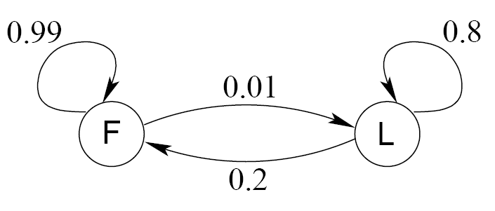
Another Example:
The Occasionally Corrupt Casino
A casino uses a fair die most of the time, but occasionally switches to a loaded one
Observation probabilities
  Fair die: Prob(1) = Prob(2) = . . . = Prob(6) = 1/6
  Loaded die: Prob(1) = Prob(2) = . . . = Prob(5) = 1/10, Prob(6) = ½
Transition probabilities
  Prob(Fair | Loaded) = 0.01
  Prob(Loaded | Fair) = 0.2
  Transitions between states obey a Markov process

Slide 6
Another Example:
The Occasionally Corrupt Casino
Suppose we know how the casino operates, and we observe a series of die tosses
3 4 1 5 2 5 6 6 6 4 6 6 6 1 5 3
Can we infer which die was used?
F F F F F F L L L L L L L F F F
  Inference requires examination of sequence not individual trials.
  Your best guess about the current instant can be informed by future observations.

Slide 7
Formalizing This Problem
  Observations over time
    Y(1), Y(2), Y(3), …
  Hidden (unobserved) state
    S(1), S(2), S(3), …
  Hidden state is discrete
  Here, observations are also discrete but can be continuous
  Y(t) depends on S(t)
  S(t+1) depends on S(t)

Slide 8
Hidden Markov Model
Markov Process
  Given the present state, earlier observations provide no information about the future
  Given the present state, past and future are independent

Slide 9
Application Domains
Character recognition
Word / string recognition

Slide 10
Application Domains
Speech recognition

Slide 11
Application Domains
Action/Activity Recognition
Figures courtesy of B. K. Sin
Notes:
Factorial HMM – we’ll discuss

Slide 12
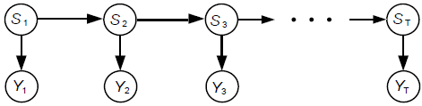
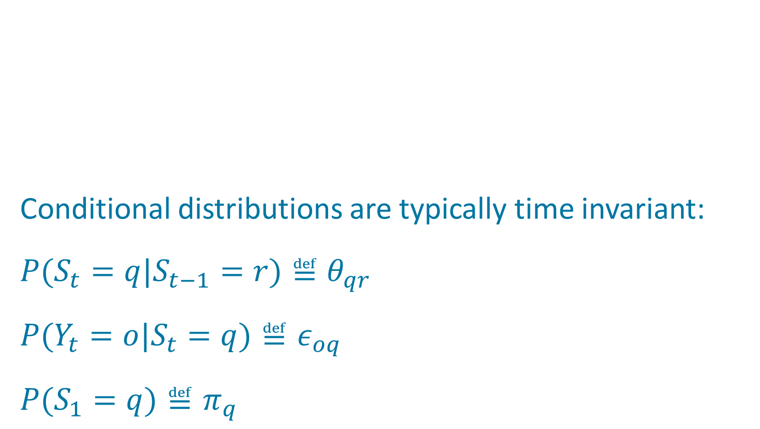
HMM Is A Probabilistic Generative Model
hidden state
observations

Slide 13
Inference on HMM
State inference and estimation
    P(S(t)|Y(1),…,Y(t))
    Given a series of observations, what’s the current hidden state?
    P(S|Y)
    Given a series of observations, what is the joint distribution over hidden states?
    argmax_{S}[P(S|Y)]
    Given a series of observations, what’s the most likely values of the hidden state? (decoding problem)
Prediction
    P(Y(t+1)|Y(1),…,Y(t))
    Given a series of observations, what observation will come next?
Evaluation and Learning
    P(Y|𝜃,𝜀,𝜋)
    Given a series of observations, what is the probability that the observations were generated by the model?
    argmax_{𝜃,𝜀,𝜋} P(Y|𝜃,𝜀,𝜋)
    What model parameters maximize the likelihood of the data?
Notes:
Like all probabilistic generative models, HMM can be used for various sorts of inference

Slide 14
Is Inference Hopeless?
1
1
1
1
…
1
2
2
2
2
2
…
2
…
…
…
…
N
N
K
N
…
N
S₁
S₂
S₃
S_{T}
X₁
X₂
X₃
X_{T}
Complexity is O(N^{T})
S₁
S₁
S₁
S₁
Notes:
Dynamic programming -> O(T * N^2)?

Slide 15
State Inference: Forward Agorithm
Goal: Compute P(S_{t} | Y_{1…t}) ~ P(S_{t}, Y_{1…t}) ≐α_{t}(S_{t})
Computational Complexity: O(T N²)
Notes:
DERIVATION ON NEXT SLIDE

Slide 16
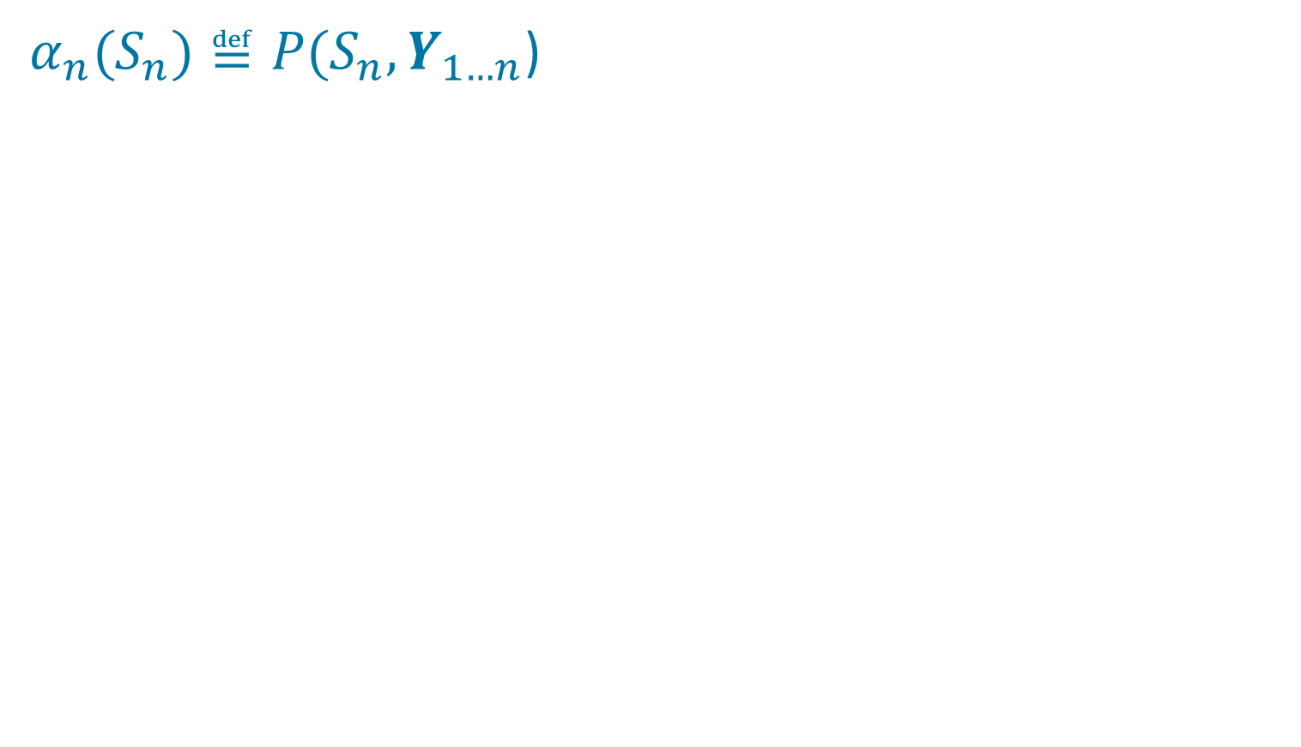
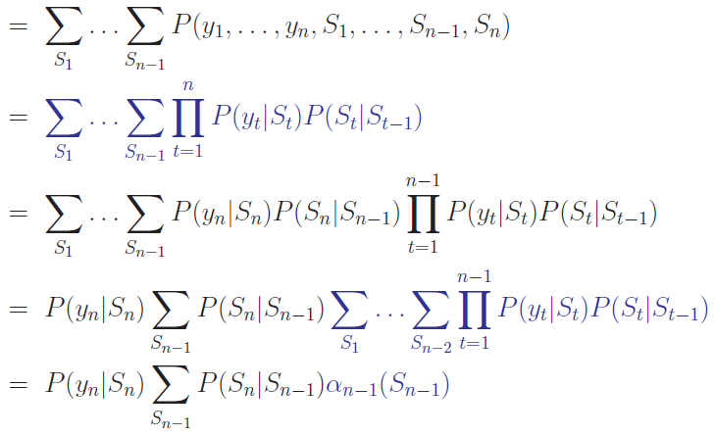
Deriving The Forward Algorithm
Notation change warning:
n ≅ current time (was t)
Slide stolen
from Dirk
Husmeier

Slide 17
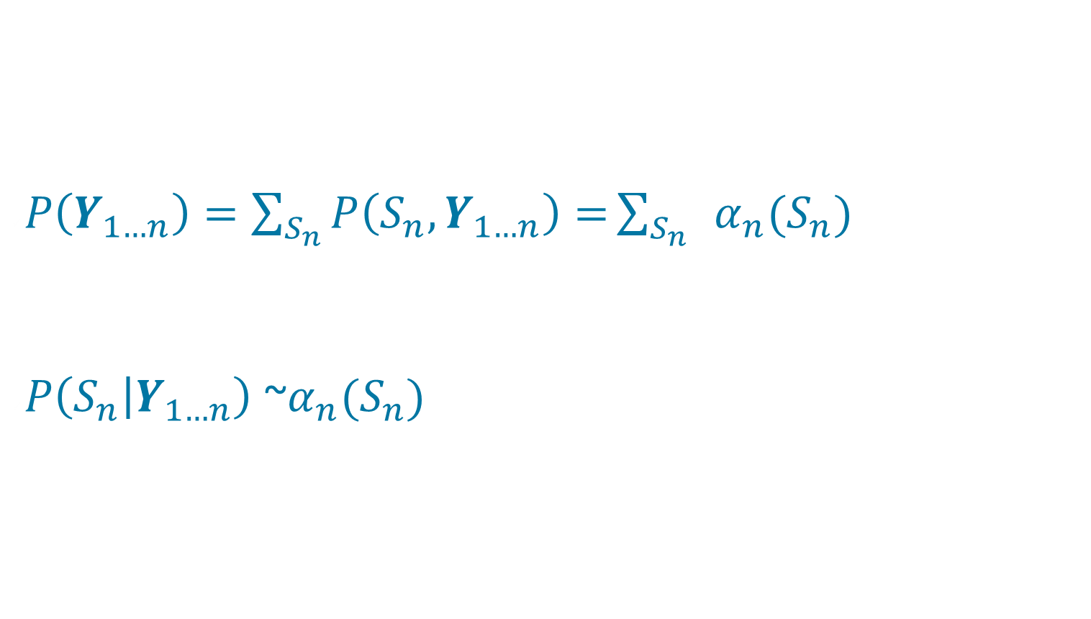
What Can We Do With α?
Notation change warning:
n ≅ current time (was t)

Slide 18
State Inference: Forward-Backward Algorithm
Goal: Compute P(S_{t} | Y_{1…T})
Notes:
NOTE: capital T
* joint proportional to conditional
* chain rule to break out Y1...t
* ignore Y1...t because it's a constant over St
* use Bayes rule
* conditional independent of Y1...t and Y...T given St

Slide 19
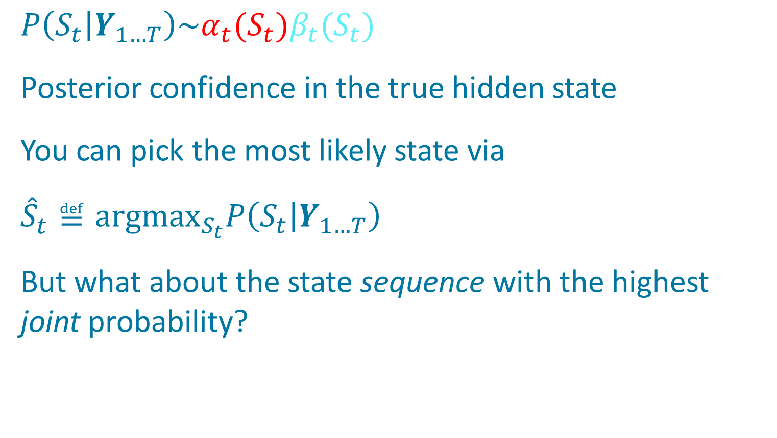
Optimal State Estimation

Slide 20
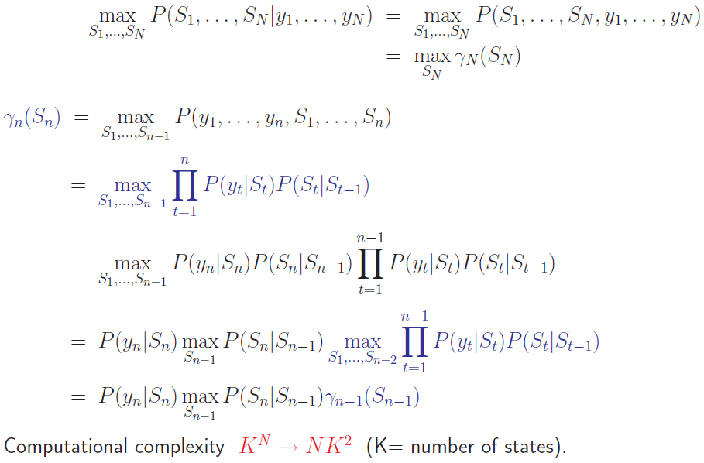
Viterbi Algorithm:
Finding The Most Likely State Sequence
Notation change warning:
n ≅ current time step (previously t)
N ≅ total number time steps (prev. T)
Slide stolen
from Dirk
Husmeier
Notes:
gamma: take the best sequence up to the current time and then explore alternative states
like alpha except with max instead of sum

Slide 21




Viterbi Algorithm
Relation between Viterbi and forward algorithms
    Viterbi uses max operator
    Forward algorithm uses summation operator
Can recover state sequence by remembering best S at each step n
Practical issue
  Long chain of probabilities -> underflow
Notes:
compute with logarithms – see next slide

Slide 22
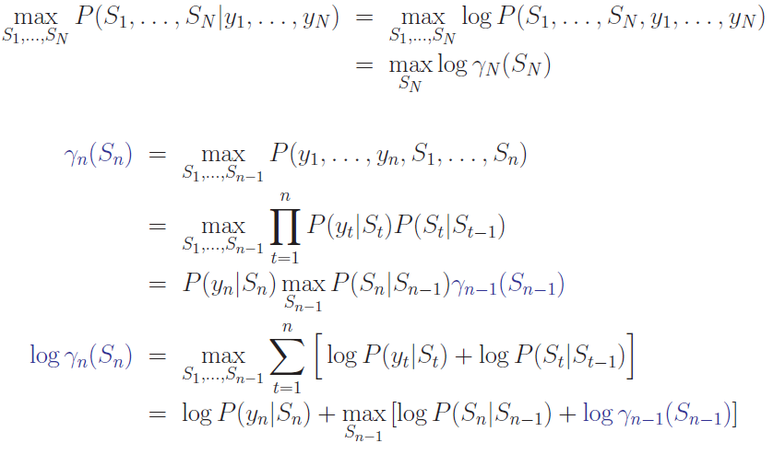
Practical Trick: Operate With Logarithms
Notation change warning:
n ≅ current time step (previously t)
N ≅ total number time steps (prev. T)
Prevents numerical underflow
Notes:
All the math works out to compute log gamma incrementally

Slide 23
Training HMM Parameters
Baum-Welsh algorithm, special case of
Expectation-Maximization (EM)
    1. Make initial guess at model parameters
    2. Given observation sequence, compute hidden state posteriors, P(S_{t} | Y_{1…T}, π,θ,ε) for t = 1 … T
    3. Update model parameters {π,θ,ε} based on inferred state
Guaranteed to move uphill in total probability of the observation sequence: P(Y_{1…T} | π,θ,ε)
    May get stuck in local optima
Notes:
model parameter updates: NEXT SLIDE

Slide 24
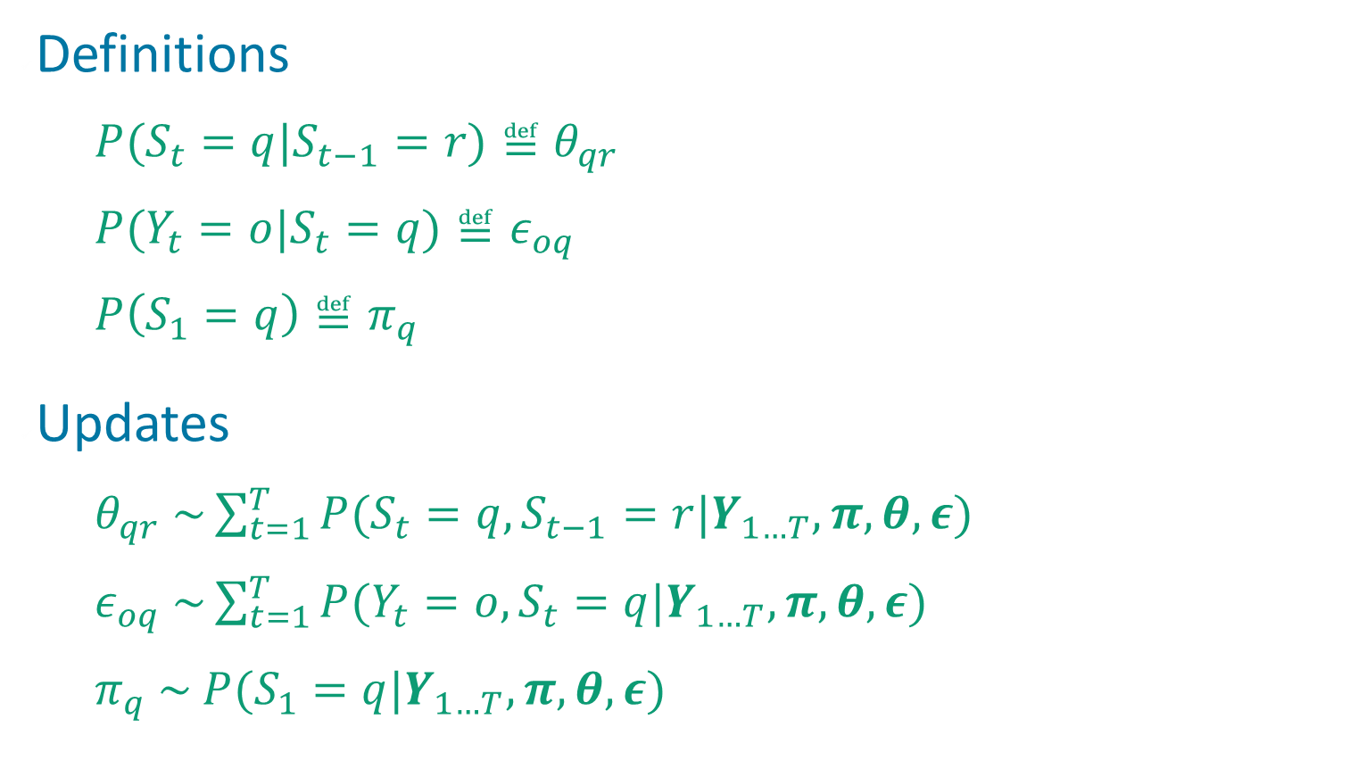
Updating Model Parameters

Slide 25
Using HMM For Classification
Suppose we want to recognize spoken digits 0, 1, …, 9
Each HMM is a model of the production of one digit, and specifies P(Y|M_{i})
  Y: observed acoustic sequence
    Note: Y can be a continuous RV
  M_{i}: model for digit i
We want to compute model posteriors: P(M_{i}|Y)
Use Bayes’ rule

Slide 26
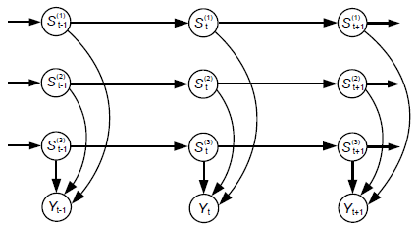
Factorial HMM

Slide 27
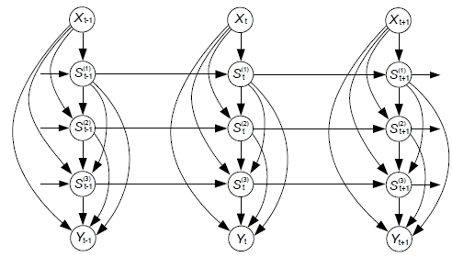
Tree-Structured HMM
Notes:
Input as well as output (e.g., control signal is X, response is Y)

Slide 28
The Landscape
Discrete state space
  HMM
Continuous state space
  Linear dynamics
    Kalman filter (exact inference)
  Nonlinear dynamics
    Particle filter (approximate inference)

Slide 29
The End

Slide 30
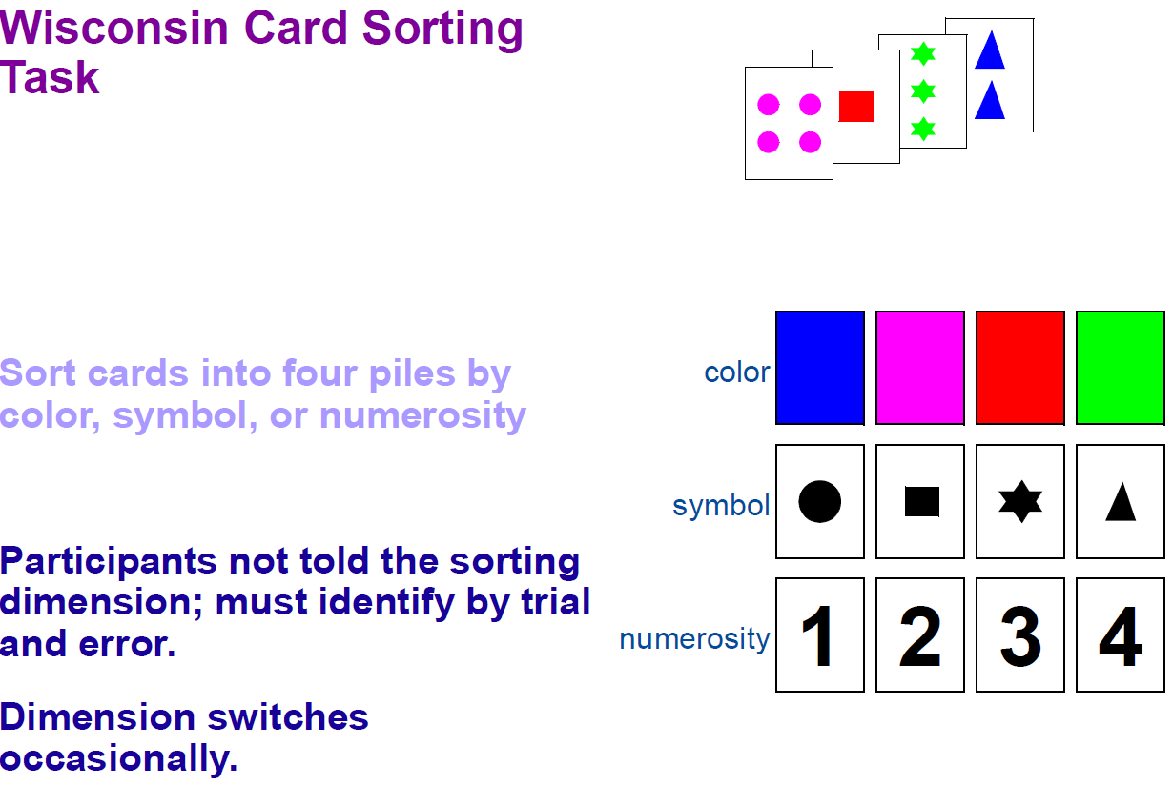
Cognitive Modeling
(Reynolds & Mozer, 2009)

Slide 31
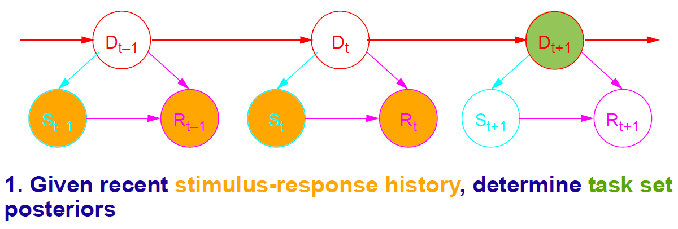
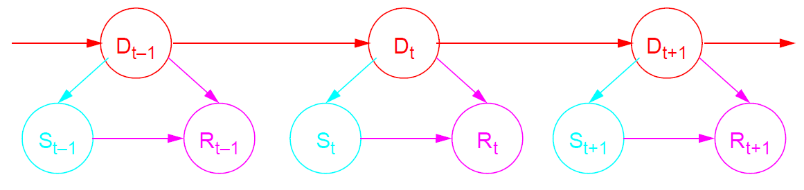
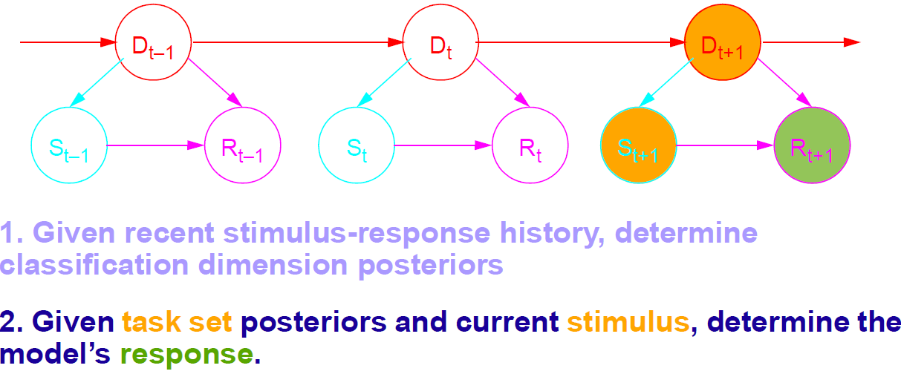
Cognitive Modeling
(Reynolds & Mozer, 2009)

Slide 32
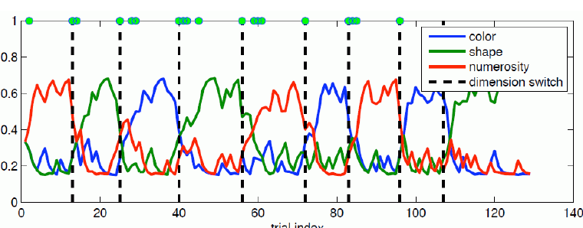
Cognitive Modeling
(Reynolds & Mozer, 2009)

Slide 33
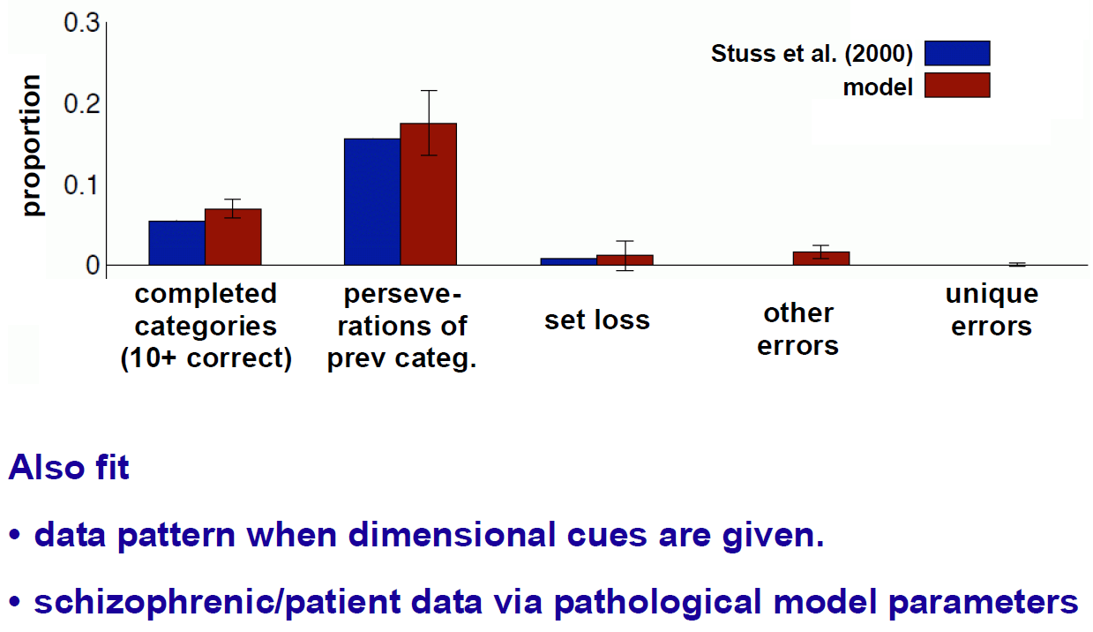
Cognitive Modeling
(Reynolds & Mozer, 2009)

Slide 34
Speech Recognition
Given an audio waveform, would like to robustly extract & recognize any spoken words
Statistical models can be used to
  Provide greater robustness to noise
  Adapt to accent of different speakers
  Learn from training
S. Roweis, 2004

