Slide 1
CSCI 5822
Probabilistic Models of Human and Machine Learning
Mike Mozer
Department of Computer Science and
Institute of Cognitive Science
University of Colorado at Boulder

Slide 2
Today’s Plan
1. Left over topics from HW 1
  How to handle positive and negative examples
  How to handle noisy examples
  Plotting P(Q|X) versus P(y|X)
  Similar issue in motion perception
2. Continue discussing perceptual inference (motion illusions)
3. Ockham’s razor and Bayesian inference
This will put us one lecture behind original syllabus. I’ve already modified syllabus.

Slide 3
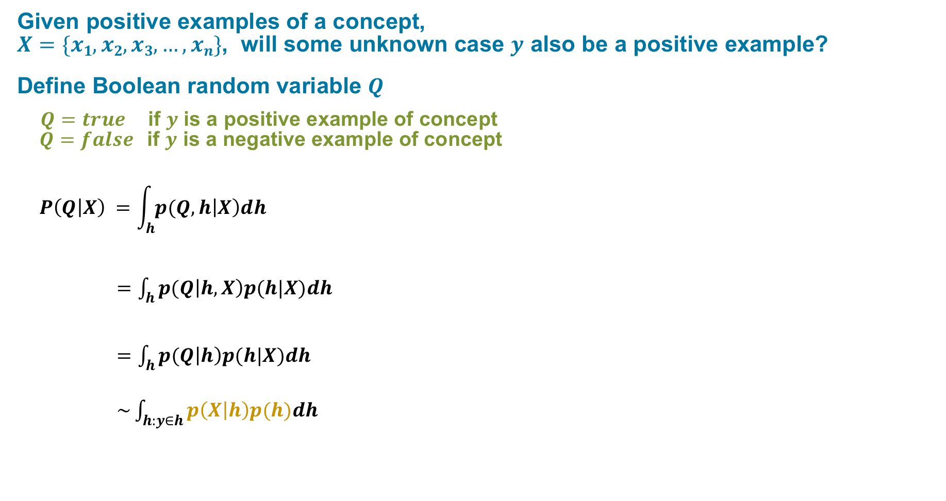
Prediction Via Model Averaging
Given positive examples of a concept,
$X=\{x1, x2, x3, …, xn\}$, will some unknown case $y$ also be a positive example?
Define Boolean random variable $Q$
    $Q=true$if $y$ is a positive example of concept
    $Q=false$if $y$ is a negative example of concept
    $$P\left(Q | X\right) =\int_{h}{p(Q,h\left|X\right)dh}$$
    $=\int_{h}{p(Q\left|h,X\right)p(h|X)dh}$
    $=\int_{h}{p(Q\left|h\right)p(h|X)dh}$
    $\sim \int_{h:y∈h}{p\left(X | h\right)p(h)dh}$

Slide 4
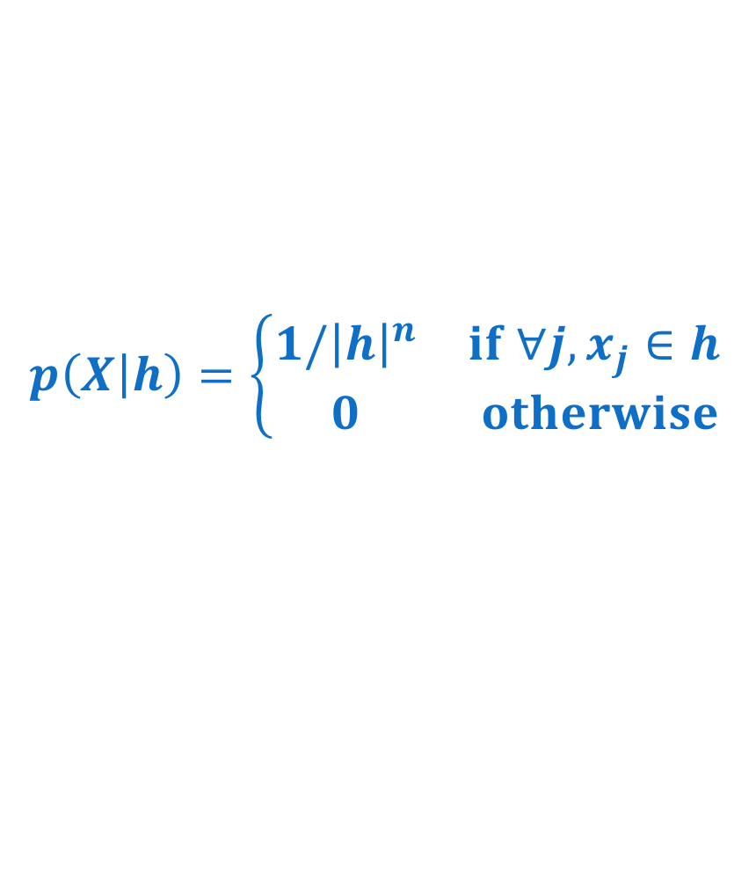





Size Principle
$$p\left(X | h\right)=\left\{\begin{matrix}1/{\left|h\right|}^{n} & if ∀j, x_{j}∈h \\ 0 & otherwise\end{matrix}\right.$$
$$h$$
$$x_{2}$$
$$h$$
$$x_{1}$$
$$x_{1}$$

Slide 5
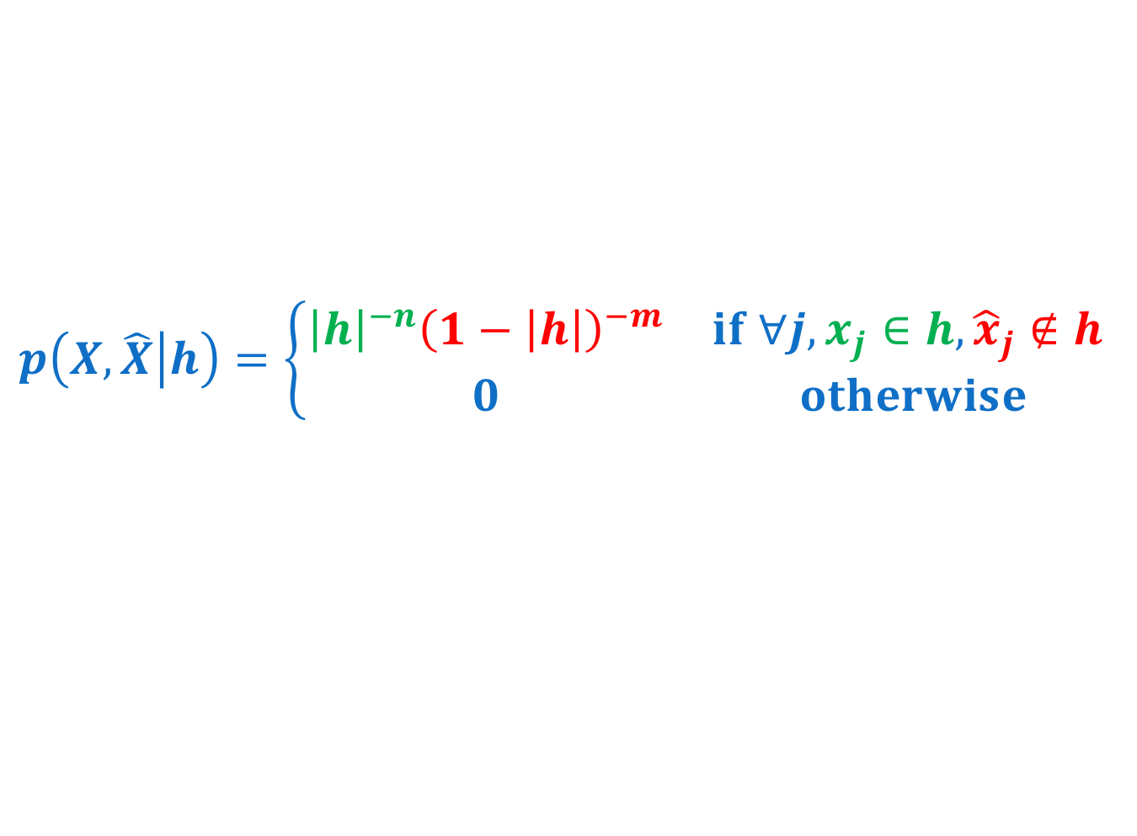
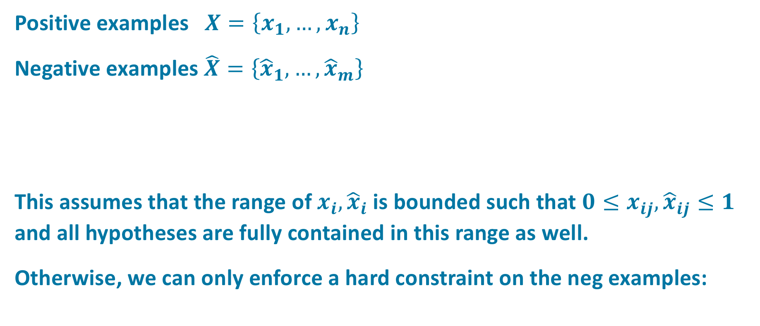
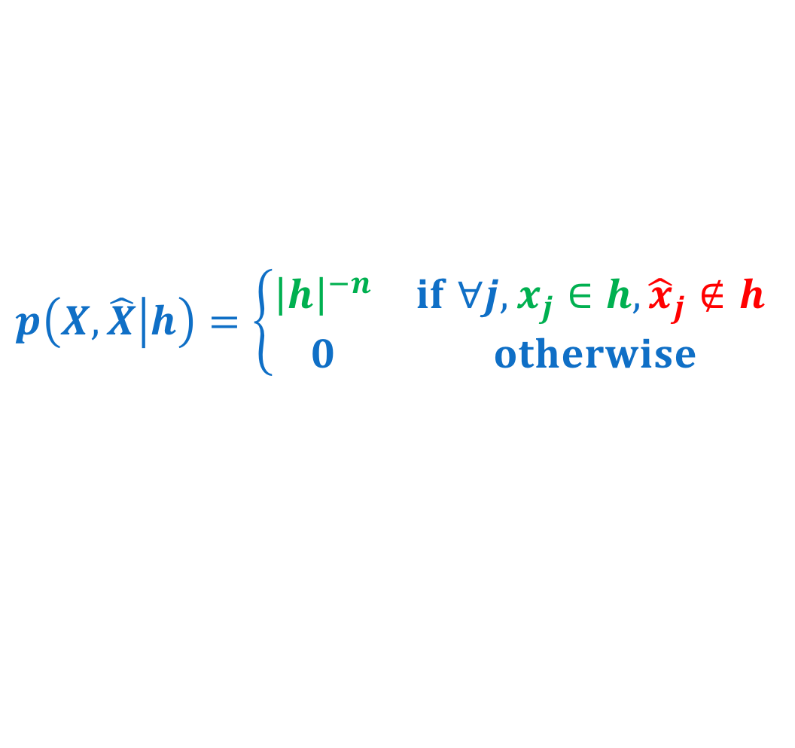
Positive and Negative Examples
Positive examples $X=\left\{x_{1}, …, x_{n}\right\}$
Negative examples $\hat{X}=\left\{{\hat{x}}_{1}, …,{\hat{x}}_{m}\right\}$
This assumes that the range of $x_{i},{\hat{x}}_{i}$ is bounded such that ${0≤x}_{ij},{\hat{x}}_{ij}≤1$ and all hypotheses are fully contained in this range as well.
Otherwise, we can only enforce a hard constraint on the neg examples:
$$p\left(X,\hat{X} | h\right)=\left\{\begin{matrix}{\left|h\right|}^{−n}{\left(1−\left|h\right|\right)}^{−m} & if ∀j, x_{j}∈h, {\hat{x}}_{j}∉h \\ 0 & otherwise\end{matrix}\right.$$
$$p\left(X,\hat{X} | h\right)=\left\{\begin{matrix}{\left|h\right|}^{−n} & if ∀j, x_{j}∈h, {\hat{x}}_{j}∉h \\ 0 & otherwise\end{matrix}\right.$$

Slide 6
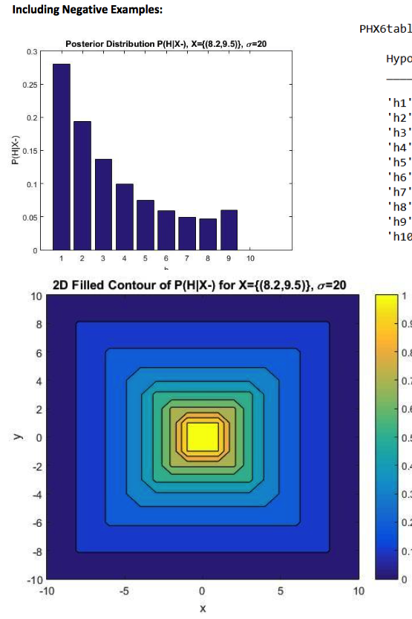
Assignment 1:
Negative Examples (Rohit)

Slide 7
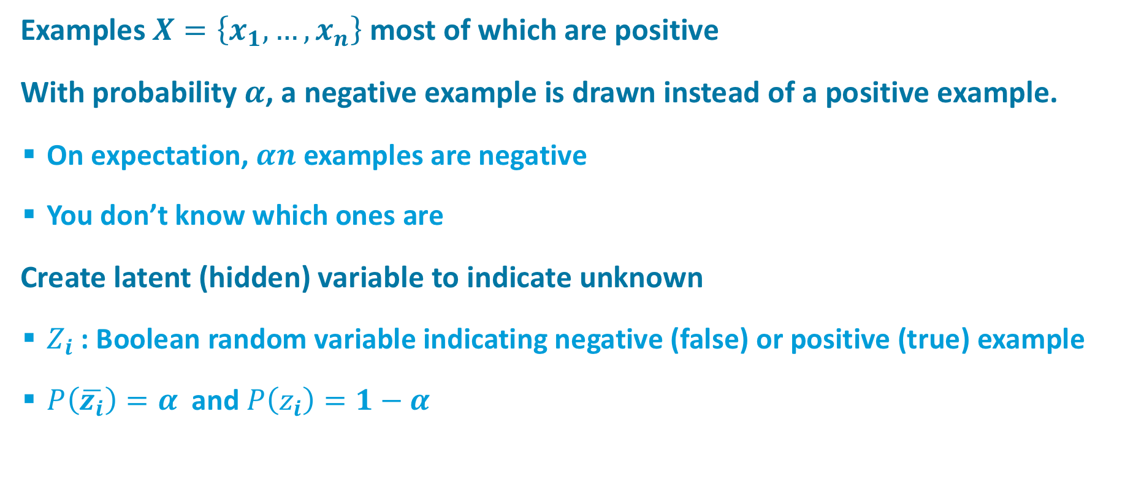
Noisy Examples:
Small Fixed Probability of Drawing Negative Example
Examples $X=\left\{x_{1}, …, x_{n}\right\}$ most of which are positive
With probability $α$, a negative example is drawn instead of a positive example.
  On expectation, $αn$ examples are negative
  You don’t know which ones are
Create latent (hidden) variable to indicate unknown
  $Z_{i}$ : Boolean random variable indicating negative (false) or positive (true) example
  $P\left(\overline{z_{i}}\right)=α \text{and} P\left(z_{i}\right)=1−α$

Slide 8
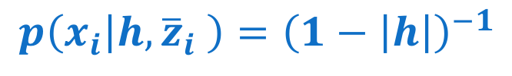

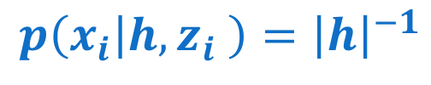
Noisy Examples
Examples $X=\left\{x_{1}, …, x_{n}\right\}$
  $P\left(\overline{z_{i}}\right)=α$and $P\left(z_{i}\right)=1−α$
$$p\left(x_{i} | h,z_{i} \right)={\left|h\right|}^{−1}$$
$$p\left(x_{i} | h,{\overline{z}}_{i} \right)={\left(1−\left|h\right|\right)}^{−1}$$
$$p\left(x_{i} | h\right)=p\left(x_{i} | h,z_{i} \right)P\left(z_{i}\right)+p\left(x_{i} | h,{\overline{z}}_{i} \right)P({\overline{z}}_{i})$$
$$=\left(1−α\right){\left|h\right|}^{−1}+α{\left(1−\left|h\right|\right)}^{−1}$$
$$p\left(X | h\right)={\left[p\left(x_{i} | h,z_{i} \right)P\left(z_{i}\right)+p\left(x_{i} | h,{\overline{z}}_{i} \right)P({\overline{z}}_{i})\right]}^{n}$$

Slide 9
Noisy Observations
Z: true feature vector
X: noisy observation
X ~ Normal(z, s²)
We need to compute P(X|H)
Φ: cumulative density fn
of Gaussian

Slide 10
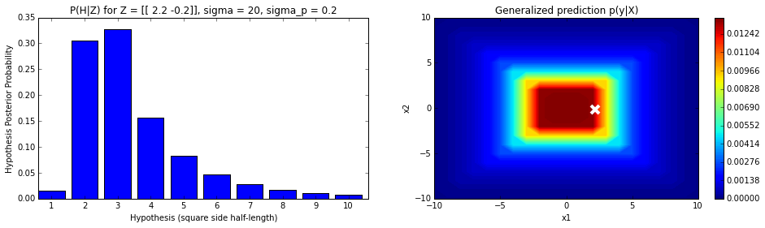
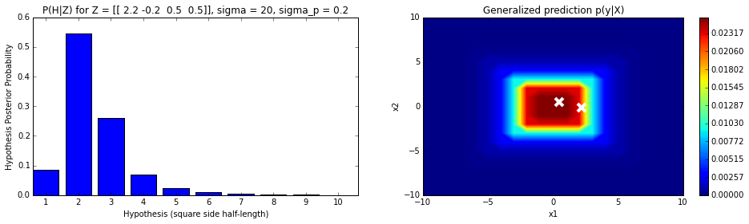
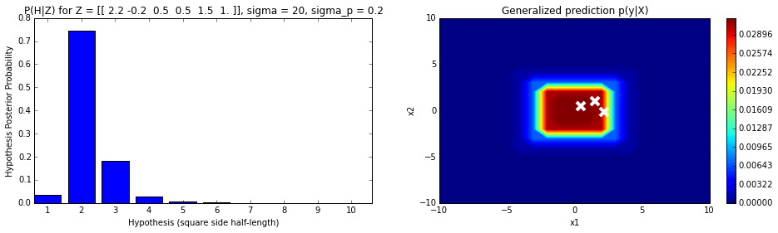
Noisy Observations

