Slide 1
CSCI 5922
Neural Networks and Deep Learning
Unsupervised Learning
Mike Mozer
Department of Computer Science and
Institute of Cognitive Science
University of Colorado at Boulder

Slide 2
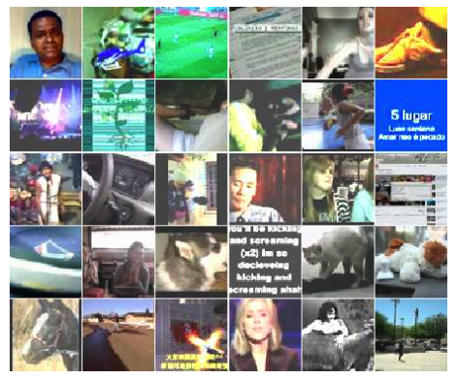
Discovering High-Level Features Via Unsupervised Learning
(Le et al., 2012)
Training set
  10M YouTube videos
  single frame sampled
  from each
  200 x 200 pixels
  fewer than 3% of
  frames contain
  faces (using OpenCV
  face detector)

Slide 3
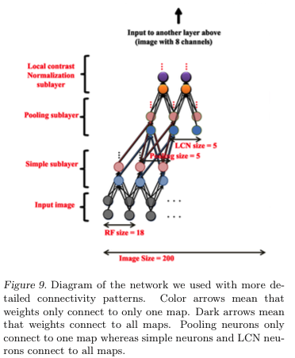
Sparse deep encoder architecture
  3 encoding layers
  each “layer” consists of three transforms
    spatially localized receptive fields to detect
    features
    spatial pooling to get translation
    invariance
    subtractive/divisive normalization to
    get sparse activation patterns
  not convolutional
  1 billion weights
  train with version of sparse PCA
C
B
A
X

Slide 4
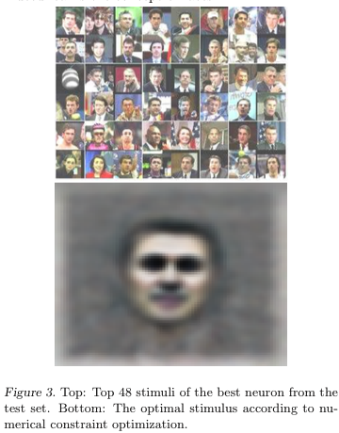
Some Neurons Become Face Detectors
Look at all neurons in final
layer and find the best face
detector

Slide 5
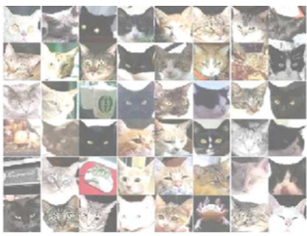
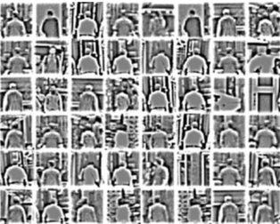
Some Neurons Become Cat and Body Detectors
Notes:
Most responsive stimuli on the test set for the cat neurons
Most responsive human body stimuli on the test set for the human body neuron

Slide 6
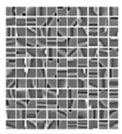
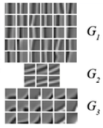
How Fancy Does Unsupervised Learning
Have To Be?
Coates, Karpathy, Ng (2012)
  K-means clustering – to detect
  prototypical features
  agglomerative clustering – to
  pool together features that
  are similar under transformation
  multiple stages
Face detectors emerge

Slide 7
Autoencoders
Self-supervised training procedure
Given a set of input vectors (no target outputs)
Map input back to itself via a hidden layer bottleneck
How to achieve bottleneck?
  Fewer neurons
  Sparsity constraint
  Information transmission constraint (e.g., add noise to unit, or shut off randomly, a.k.a. dropout)

Slide 8
Autoencoder Combines
An Encoder And A Decoder
Decoder
Encoder

Slide 9
Stacked Autoencoders
...
copy
deep network
Note that decoders can be stacked to produce a generative domain model

Slide 10
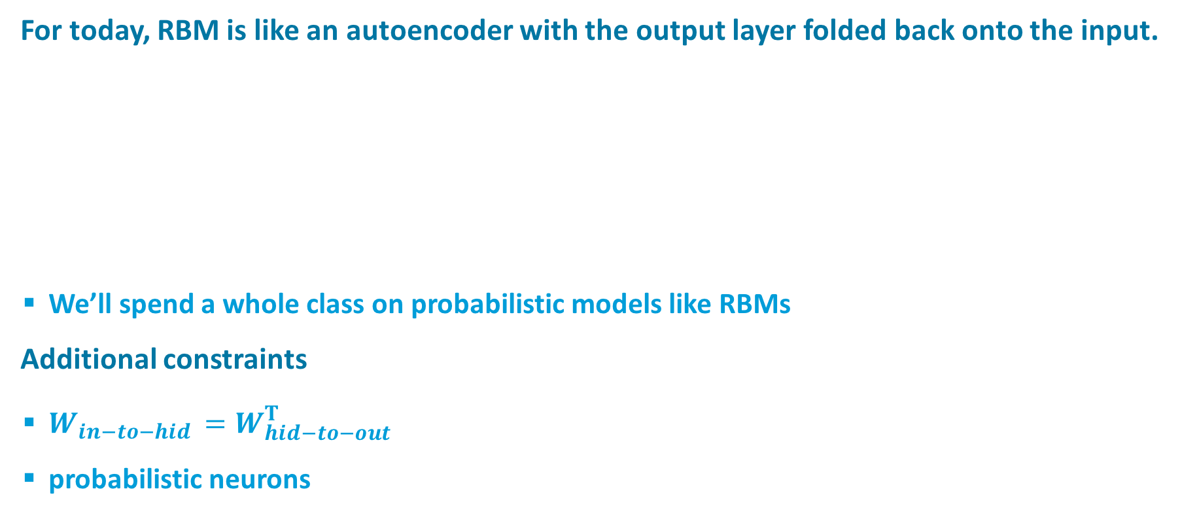
Restricted Boltzmann Machines (RBMs)
For today, RBM is like an autoencoder with the output layer folded back onto the input.
  We’ll spend a whole class on probabilistic models like RBMs
Additional constraints
  $W_{in−to−hid }=W_{hid−to−out}^{T}$
  probabilistic neurons

Slide 11
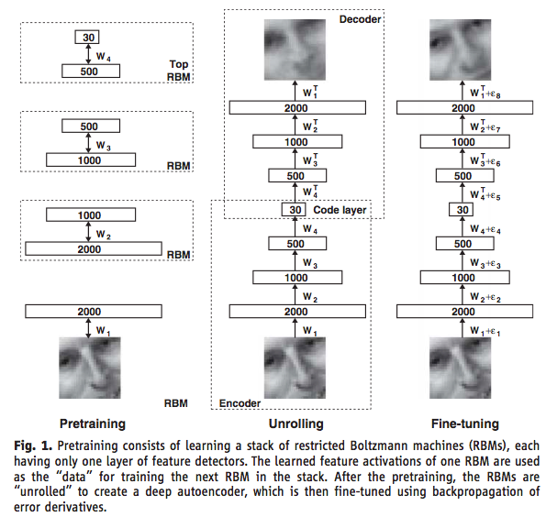
Deep RBM Autoencoder
Hinton & Salakhutdinov (2006)
Notes:
Guarantee that stacking improves

Slide 12
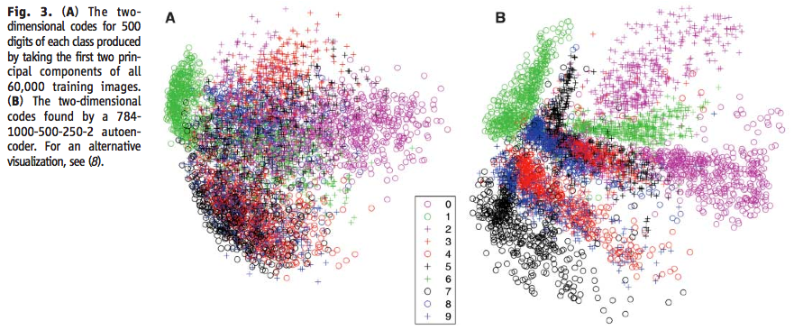

Slide 13
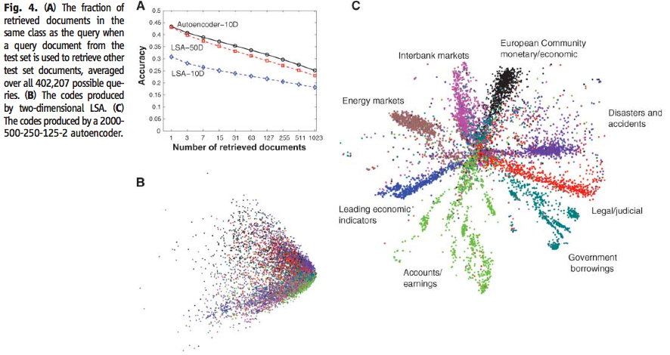

Slide 14
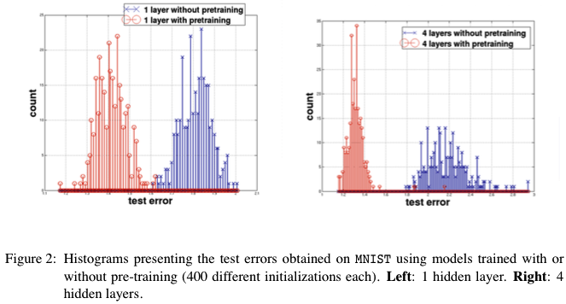
Why Does Unsupervised Pretraining Help Deep Learning?
(Erhan, Bengio, Courville, Manzagol, Vincent, & Bengio 2010)
“Unsupervised training guides the learning toward basins of attraction of minima that support better generalization from the training set”
  More hidden layers ->
  increase likelihood of
  poor local minima
  result is robust to random
  initialization seed

Slide 15
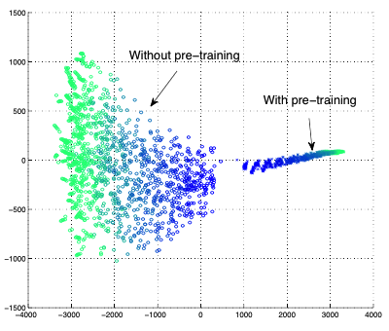
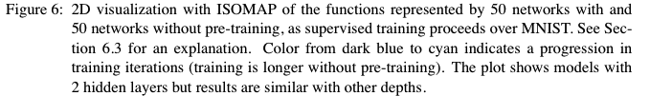
Visualizing Learning Trajectory
Train 50 nets with and without pretraining on MNIST
  No easy way to compare weights, but it is possible to compare functions
Comparison procedure
  At various points in training, form giant vector of output for each
  training example
  Perform dimensionality reduction using ISOMAP
Observations
  Pretrained and not-pretrained models start and stay in different
  regions of function space
  More variance (different local optima?) with not-pretrained models

Slide 16
Using Autoencoders To Initialize Weights
For Supervised Learning
Effective pretraining of weights should act as a regularizer
  Limits the region of weight space that will be explored by supervised learning
Autoencoder must be learned well enough to move weights away from origin

Slide 17

The Danger Of Unsupervised Pretraining:
Simple Autoencoder
Architecture
  $y = tanh⁡(w2h)$
  $h = tanh⁡(w1x)$
100 training examples with
  $x \sim Uniform(−1,+1)$
  $ytarget = x$
What are the optimal weights?
How many solutions are there?
y
w₂
h
w₁
x
Notes:
unsupervised pretraining isn’t guaranteed to help

Slide 18
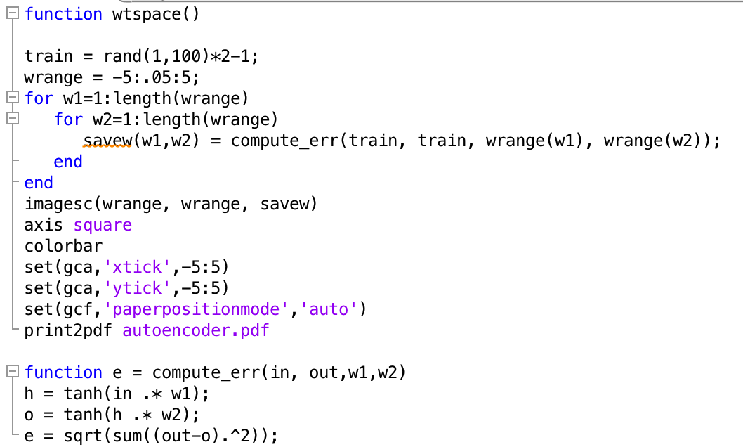
Simple Autoencoder: Weight Search

Slide 19
Simple Autoencoder: Error Surface
w₁
log sum squared error
w₂
Notes:
note symmetry about origin
note symmetry of solution: two equivalent solutions with sign(w1)=sign(w2)
note origin is a saddle point

Slide 20

Simple Supervised Problem
Architecture
  $y =tanh⁡(w2 h+1)$
  $h =tanh⁡(w1 x−1)$
100 training examples with
  $x \sim Uniform(−1,+1)$
  $ytarget=tanh⁡(−2 tanh⁡(3x+1)−1)$
What are the optimal weights?
How many solutions are there?
y
w₂
h
w₁
x

Slide 21
Simple Supervised Problem: Error Surface
w₁
w₁
log sum squared error
w₂
w₂
supervised
unsupervised
Notes:
RED star solution to unsupervised would be a lousy starting place for supervised
BROWN star solution would be a reasonable starting point

Slide 22

Variational Autoencoders For Pattern Synthesis
Suppose we want to use an autoencoder to generate images.
random
activation
pattern
($z$)
Decoder
Encoder

Slide 23
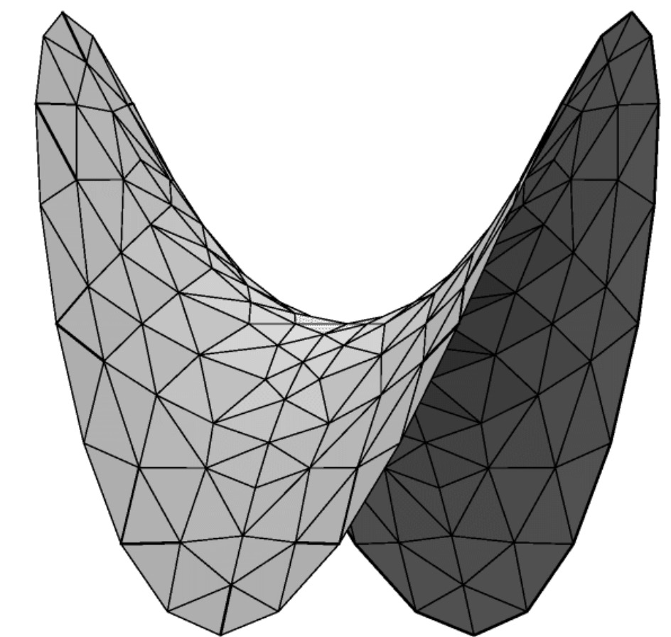
Problem With Using Decoder For Generation
Because we don’t know the distribution of data in the latent space…
No assurance that random activation pattern will produce a sensible output

Slide 24









Reinterpreting Decoder As Probabilistic Model
Notation
  $x$: input vector
  $z$: hidden (latent) vector
  $θ$: parameters of decoder
(1) draw a $z$ vector from prior $p(z)$
(2) draw $x$ given $z$ from $p(x|z)$
$$x$$
$$θ$$
$$z$$
$$x$$
$$p_{θ}\left(x,z\right)=p\left(z\right)p_{θ}\left(x | z\right)$$
$$p_{θ}\left(x | z\right)=𝒩(x;f_{θ}\left(z\right),σ^{2}I)$$
$$z$$
$$p\left(z\right)=𝒩(z;0,I)$$
Notes:
probabilistic perspective: x and z are random vectors, and the probabilistic model is specified by the joint distribution over the variables

Slide 25
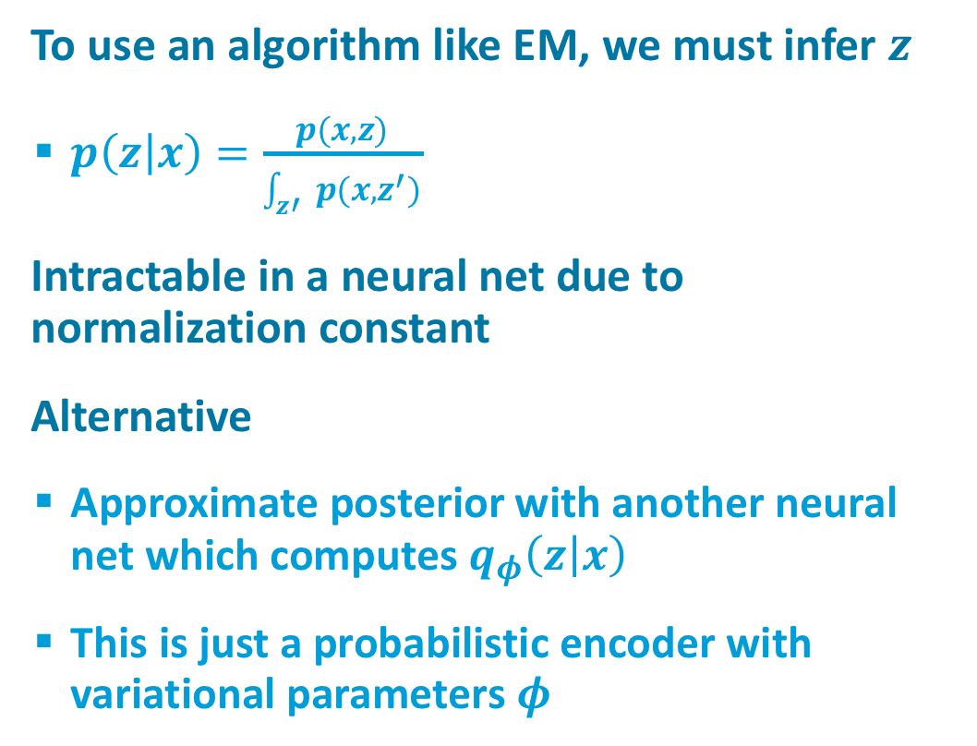
How Do We Train Decoder?
To use an algorithm like EM, we must infer $z$
  $p\left(z | x\right)=\frac{p(x,z)}{\int_{z′}{p(x,z^{′})}}$
Intractable in a neural net due to normalization constant
Alternative
  Approximate posterior with another neural net which computes $q_{φ}\left(z | x\right)$
  This is just a probabilistic encoder with variational parameters $φ$
$$x$$
$$θ$$
$$z$$

Slide 26




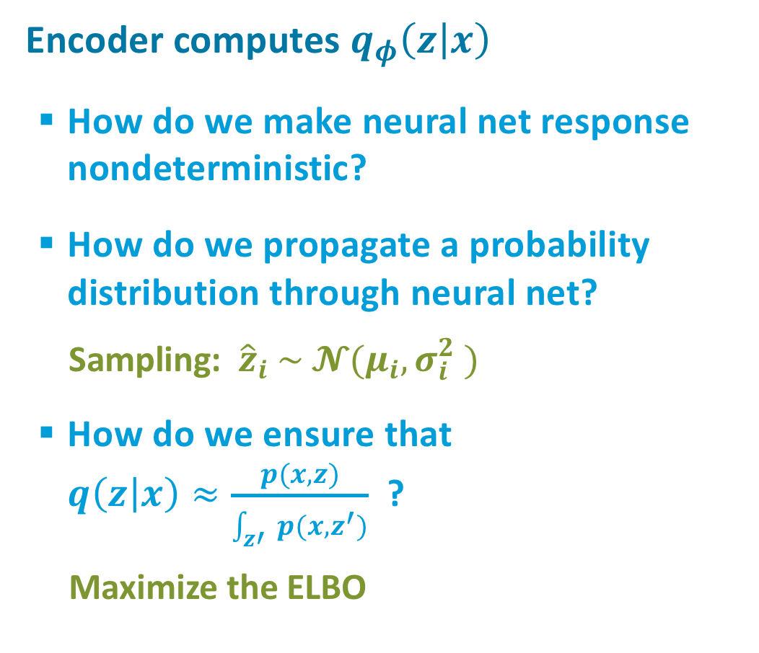







Adding the Encoder
$$x$$
Encoder computes $q_{φ}\left(z | x\right)$
  How do we make neural net response nondeterministic?
  How do we propagate a probability distribution through neural net?
    Sampling: ${\hat{z}}_{i} \sim 𝓝(μ_{i},σ_{i}^{2} )$
  How do we ensure that
  $q\left(z | x\right)≈\frac{p(x,z)}{\int_{z′}{p(x,z^{′})}}$ ?
    Maximize the ELBO
$$θ$$
$$x$$
$$\hat{z}$$
$$θ$$
$$z$$
$$μ_{1}$$
$$μ_{2}$$
$$μ_{3}$$
$$σ_{1}^{2}$$
$$σ_{2}^{2}$$
$$σ_{3}^{2}$$
$$φ$$
$$x$$

Slide 27
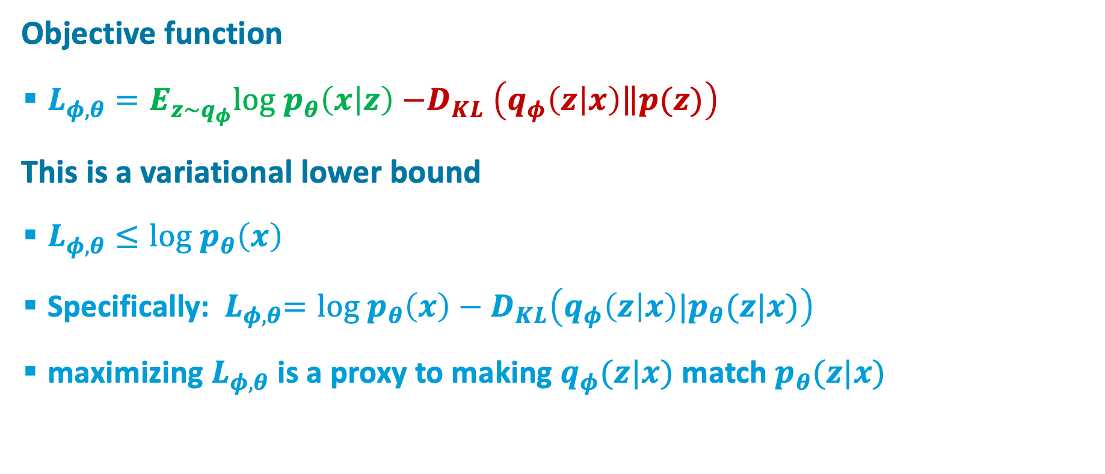
Optimization problem
Objective function
  $L_{φ,θ}=E_{z\sim q_{φ}}{log p}_{θ}\left(x | z\right){−D}_{KL}\left(q_{φ}\left(z | x\right)\left\|p(z)\right.\right)$
This is a variational lower bound
  $L_{φ,θ}≤{log p}_{θ}\left(x\right)$
  Specifically:${ L}_{φ,θ}=log p_{θ}\left(x\right)−D_{KL}\left(q_{φ}\left(z | x\right)|p_{θ}(z|x)\right)$
  maximizing $L_{φ,θ}$ is a proxy to making $q_{φ}(z|x)$ match $p_{θ}(z|x)$

Slide 28
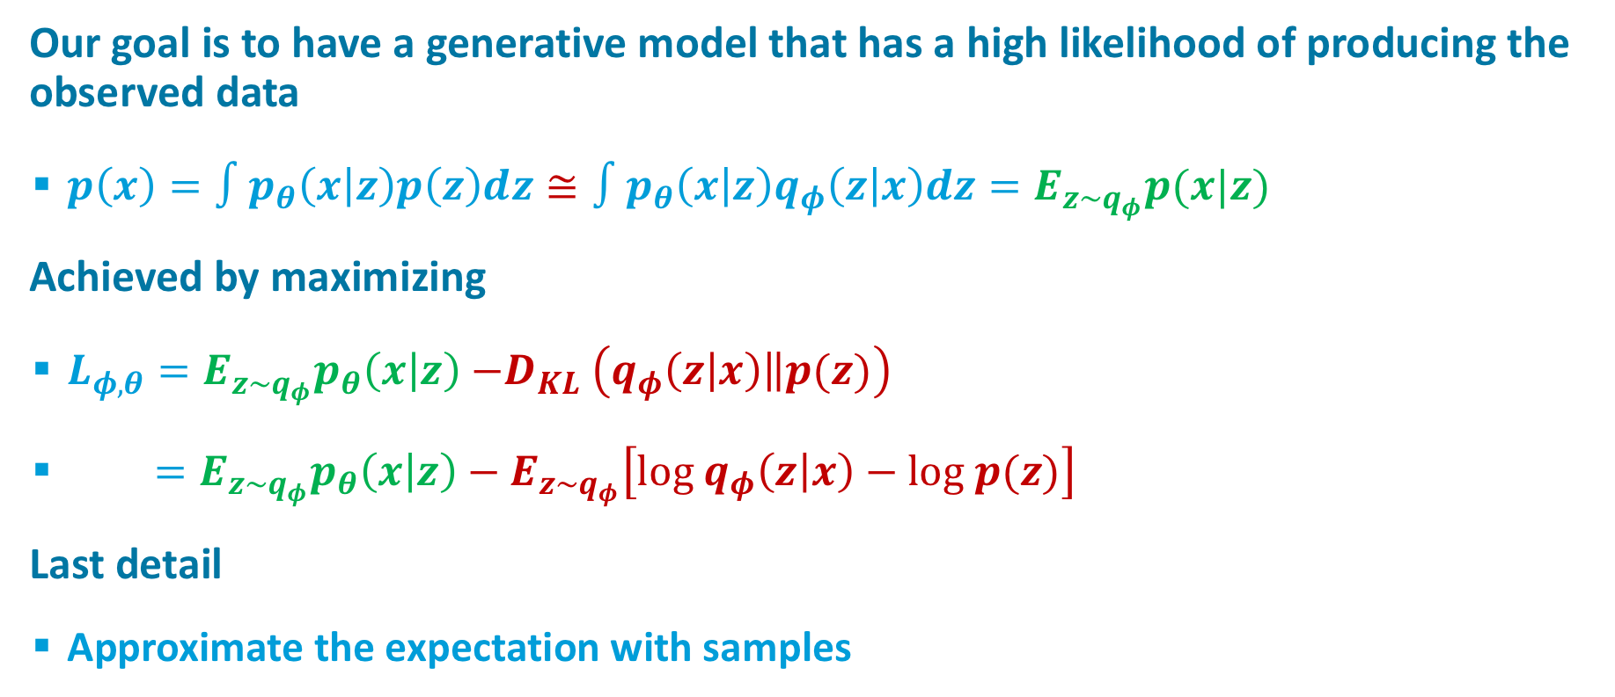
Intuition
Our goal is to have a generative model that has a high likelihood of producing the observed data
  $p\left(x\right)=∫p_{θ}\left(x | z\right)p\left(z\right)dz≅{∫p_{θ}\left(x | z\right)q_{φ}\left(z | x\right)dz=E}_{z\sim q_{φ}}p(x|z)$
Achieved by maximizing
  $L_{φ,θ}=E_{z\sim q_{φ}}p_{θ}\left(x | z\right){−D}_{KL}\left(q_{φ}\left(z | x\right)\left\|p(z)\right.\right)$
  $=E_{z\sim q_{φ}}p_{θ}\left(x | z\right)−E_{z\sim q_{φ}}\left[log{ q}_{φ}\left(z | x\right)−log p(z)\right]$
Last detail
  Approximate the expectation with samples

Slide 29
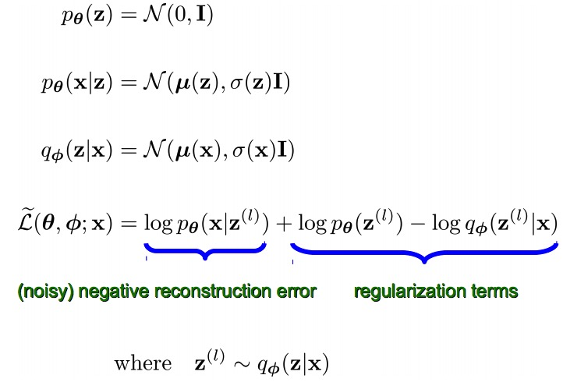
Complete Model
From Kingma ICLR 2014 Slides

Slide 30
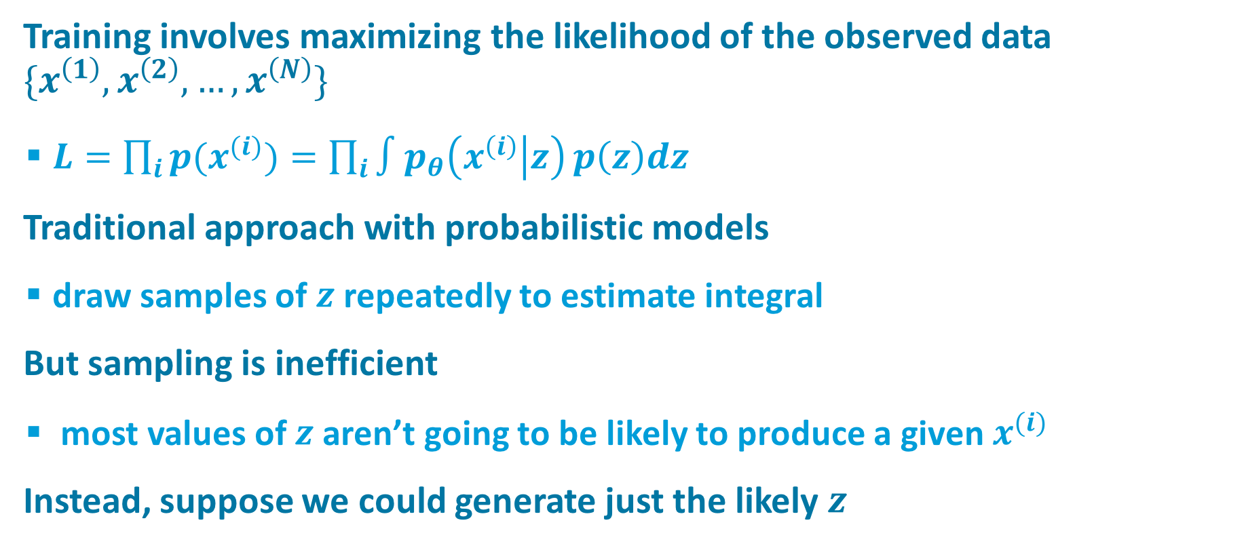
Training the Variational Autoencoder (VAE)
Training involves maximizing the likelihood of the observed data $\{x^{\left(1\right)},x^{\left(2\right)},…,x^{\left(N\right)}\}$
  $L=\prod_{i}{{p(x}^{(i)})=\prod_{i}{∫p_{θ}\left(x^{\left(i\right)} | z\right)}p\left(z\right)dz}$
Traditional approach with probabilistic models
  draw samples of $z$repeatedly to estimate integral
But sampling is inefficient
  most values of $z$aren’t going to be likely to produce a given $x^{(i)}$
Instead, suppose we could generate just the likely $z$

Slide 31
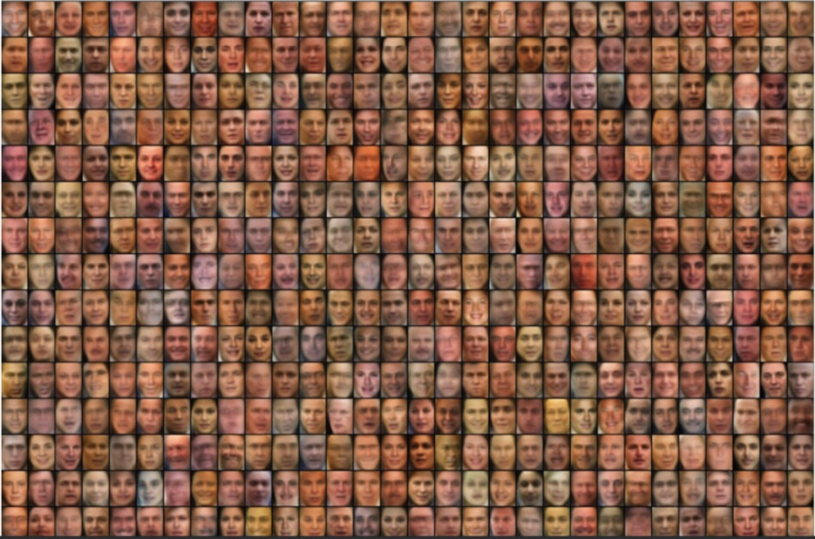
Random Samples From Generative Model
Trained on Faces in the Wild
From Kingma ICLR 2014 slides

Slide 32
Examples
VAE faces
VAE faces demo
VAE MNIST
VAE street addresses

Slide 33
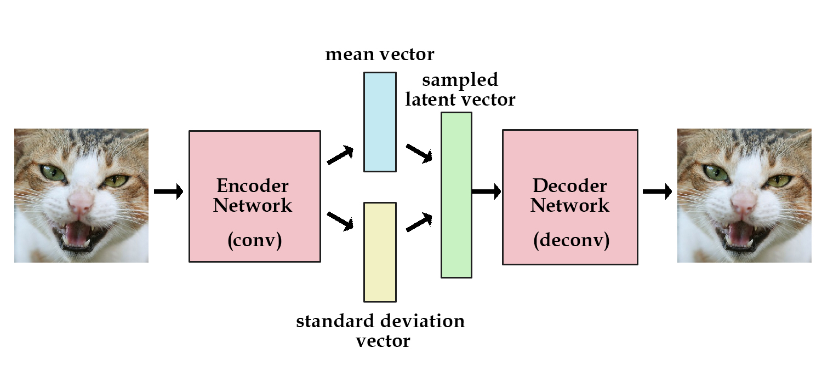
sdfdfd
Image credit: kvfrans.com

Slide 34



Contractive Autoencoders
A good hidden representation will be insensitive to most small changes in the input (while still preserving information to reconstruct the input)
Objective function
  Frobenius norm of the Jacobian
  For logistic hidden:
Tries to make the hidden units saturate,
especially where input-to-hidden weights
are large

Slide 35
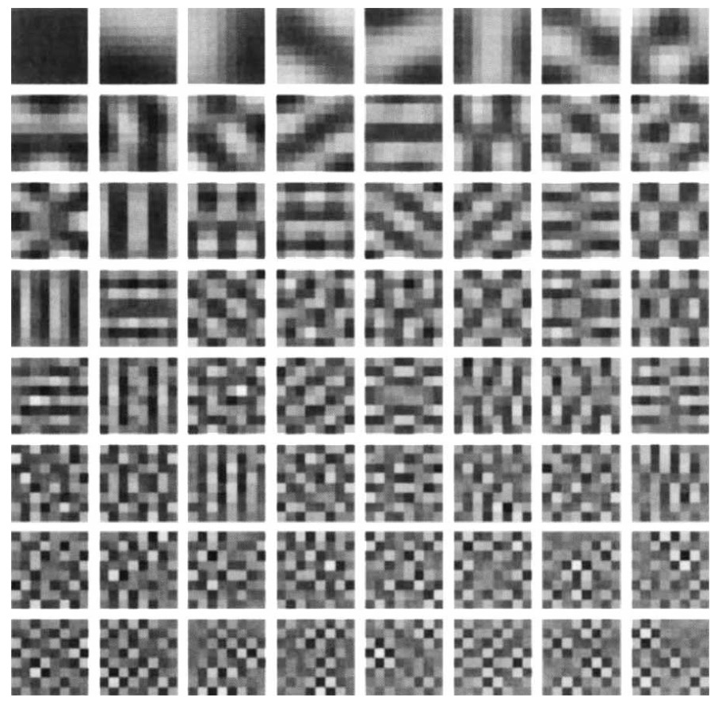
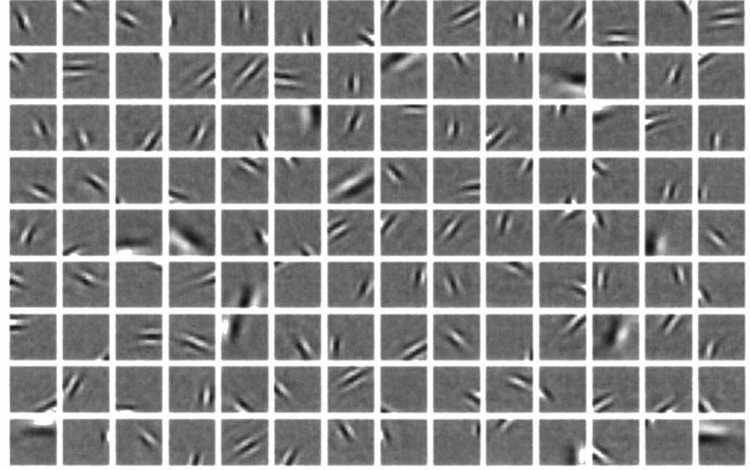
Sparse Encodings
We may wish to have few units in the hidden bottleneck representation for any input
  Biological motivation
E.g., unsupervised training on natural image patches
Olshausen
& Field
(1996)
PCA
Notes:
Bruno A Olshausen and David J Field. Emergence of simple-cell receptive field properties by learning a sparse code for natural images. Nature, 381(6583):607–609, 1996. 11.
Honglak Lee, Alexis Battle, Rajat Raina, and Andrew Y Ng. Efficient sparse coding algorithms. In NIPS, 2006.

Slide 36

Sparse Encoding
Loss function has two components
  information preservation
    input reconstruction in autoencoder
    mutual information in simple encoder
  sparsity constraint
$$ℒ=ℒ_{preservation}+λℒ_{sparsity}$$

Slide 37
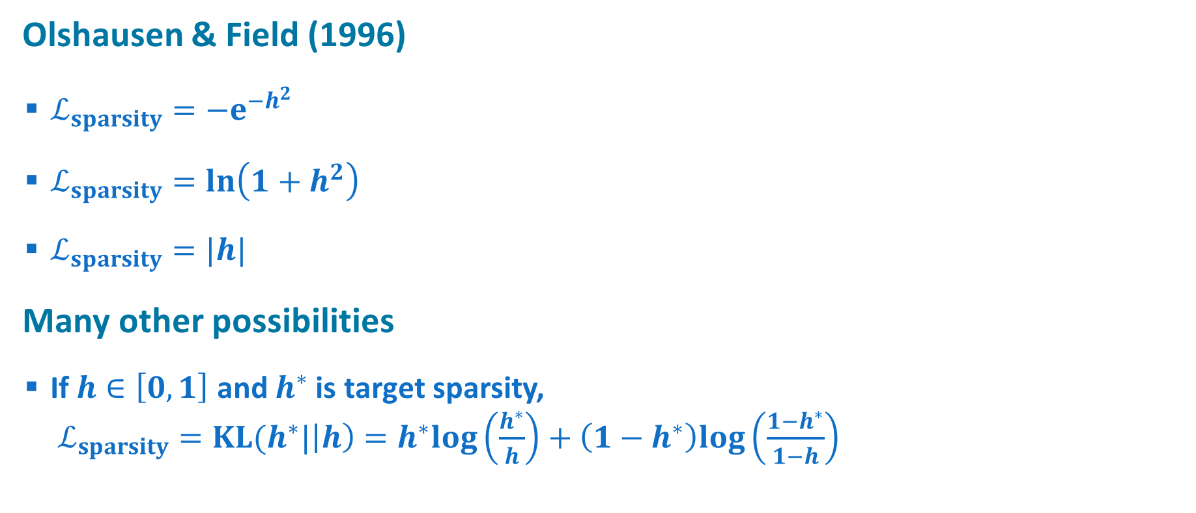
Examples of Sparsity Constraints
Olshausen & Field (1996)
  $ℒ_{sparsity}=−e^{−h^{2}}$
  $ℒ_{sparsity}=ln\left(1+h^{2}\right)$
  $ℒ_{sparsity}=|h|$
Many other possibilities
  If $h∈\left[0,1\right]$ and $h^{∗}$ is target sparsity,
  $ℒ_{sparsity}=KL(h^{∗}|\left|h\right)=h^{∗}log\left(\frac{h^{∗}}{h}\right)+\left(1−h^{∗}\right)log\left(\frac{1−h^{∗}}{1−h}\right)$

Slide 38
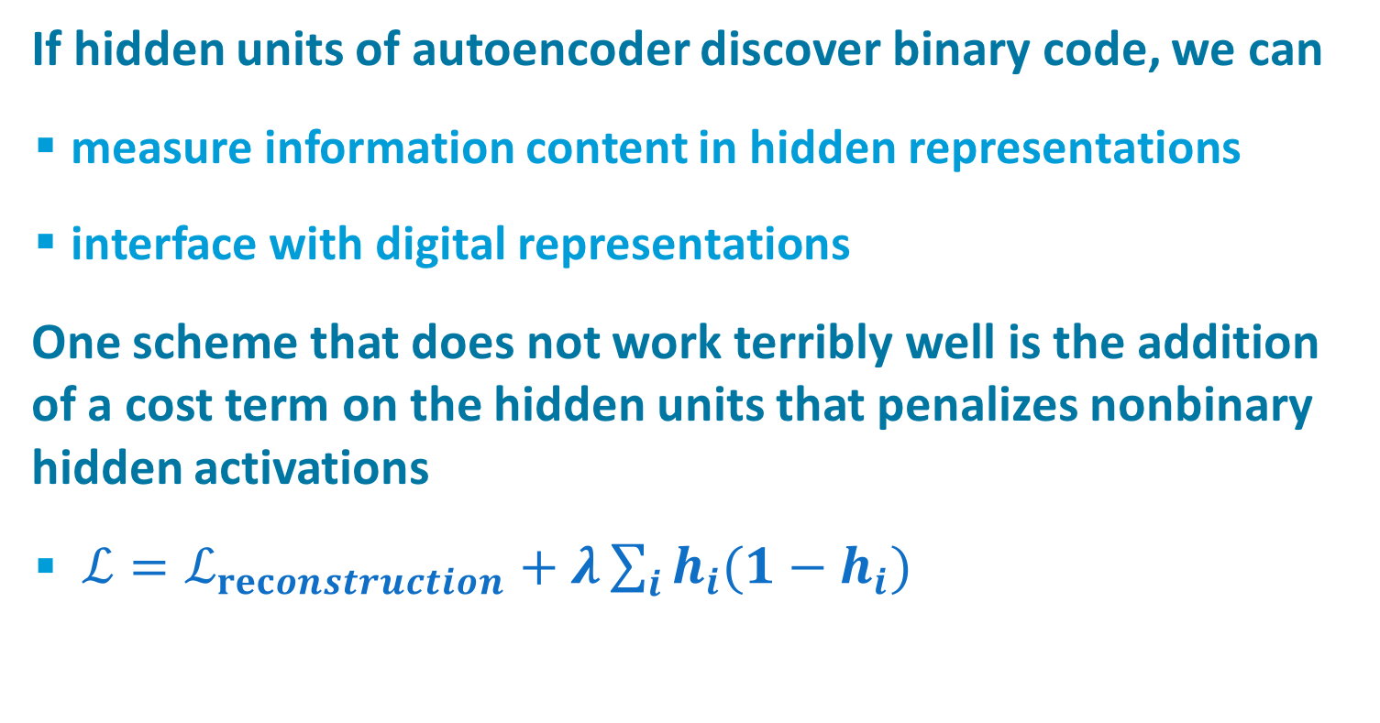
Discovering Binary Codes
If hidden units of autoencoder discover binary code, we can
  measure information content in hidden representations
  interface with digital representations
One scheme that does not work terribly well is the addition of a cost term on the hidden units that penalizes nonbinary hidden activations
  $ℒ=ℒ_{reconstruction}+λ\sum_{i}{h_{i}(1−h_{i})}$
Y
A’
B’
C
B
A
X

Slide 39
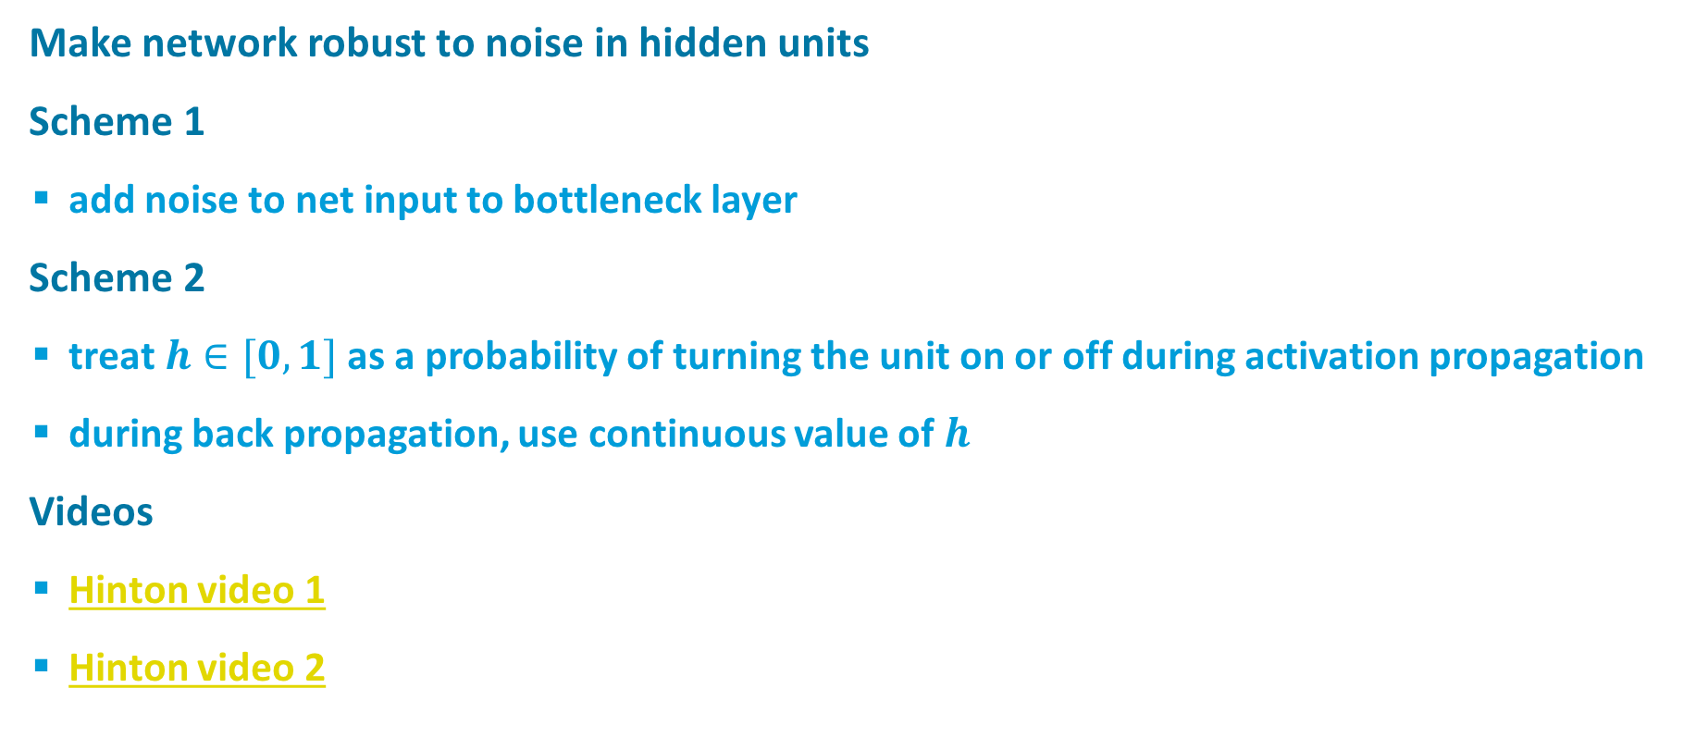
Discovering Binary Codes
Make network robust to noise in hidden units
Scheme 1
  add noise to net input to bottleneck layer
Scheme 2
  treat $h∈[0,1]$ as a probability of turning the unit on or off during activation propagation
  during back propagation, use continuous value of $h$
Videos
  Hinton video 1
  Hinton video 2

Slide 40
Denoising Autoencoders
Randomly set inputs to zero (like dropout on inputs)
Target output has missing features filled in
Visualization
  related to
  attractor nets
Removing features better than features with additive Gaussian noise

Slide 41
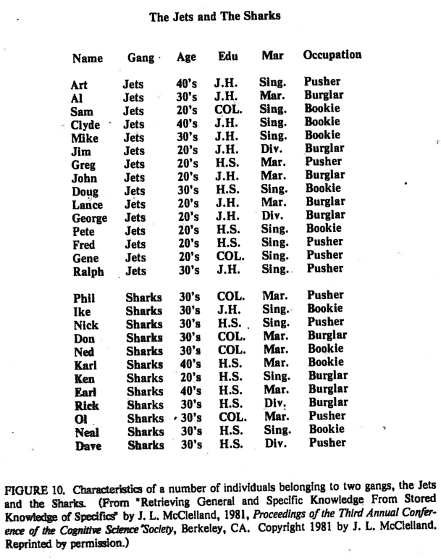
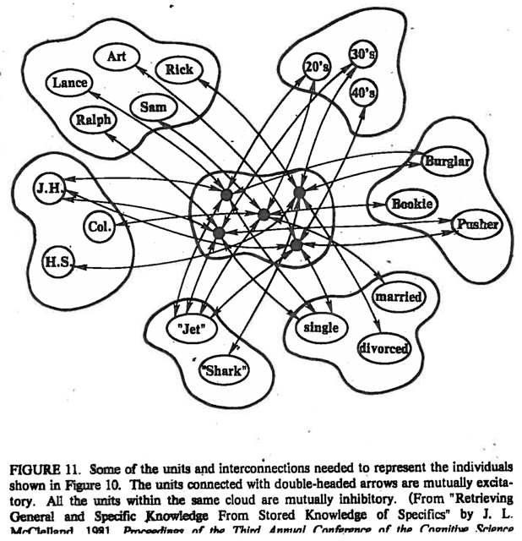
Attractor Networks
For Pattern Completion
Notes:
DEMO in ~/cu/teaching/DeepLearning/code/IAC* runs on windows

Slide 42
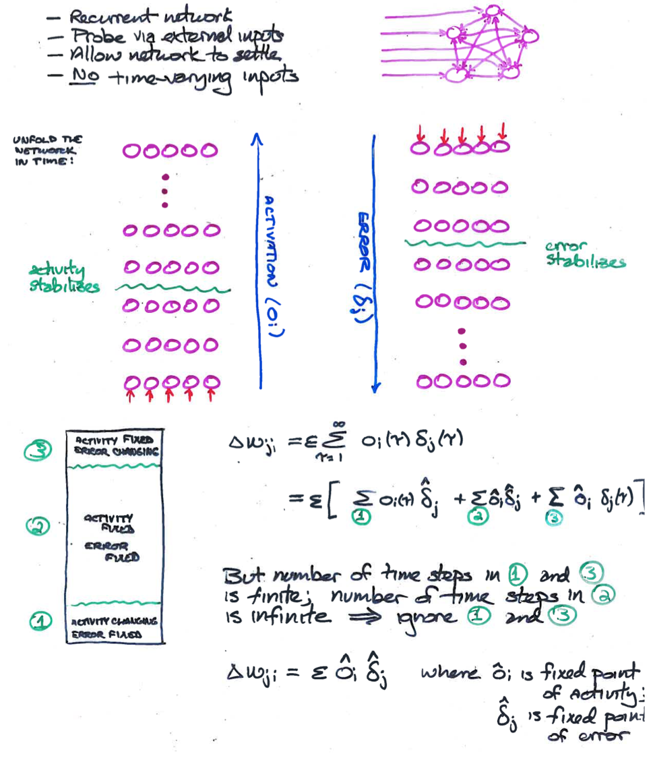
Training Attractor Networks
Almeida /
Pineda
algorithm
Notes:
make one slide with top bit
emphasize that some can be dedicated input, some hidden, some output, some input and output
more general case than feedforward networks

Slide 43
Comments on Almeida / Pineda Algorithm
This method works only if network reaches a fixed (stable) point in both forward and backward phases
  can show that if network is stable in forward direction, it is also stable in the backward direction.
  Can show that network will be stable in the forward direction if weights are symmetric (w_{ij} = w_{ji})
    We’ll see this with Hopfield network
Algorithm makes no guarantee about network dynamics
  i.e., can’t train the net to settle in a short amount of time

Slide 44
Aditya’s Image Superresolution

Slide 45
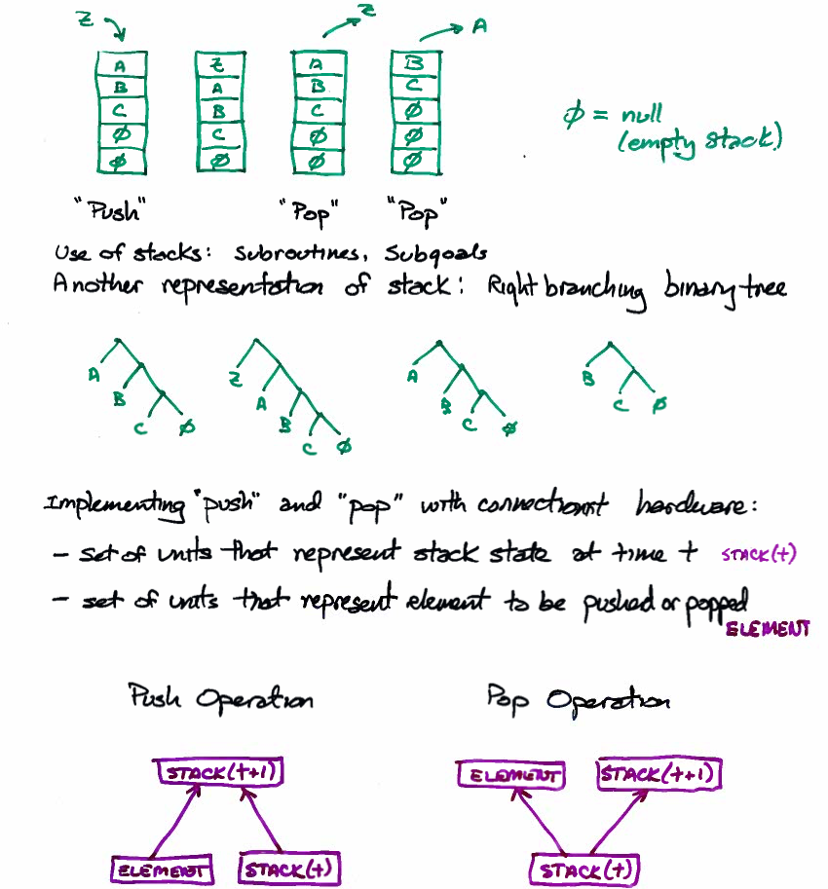
Recursive Neural Nets
Pollack (1991)
Recursive Auto-Associative
Memory (RAAM)
  Representing stacks

Slide 46
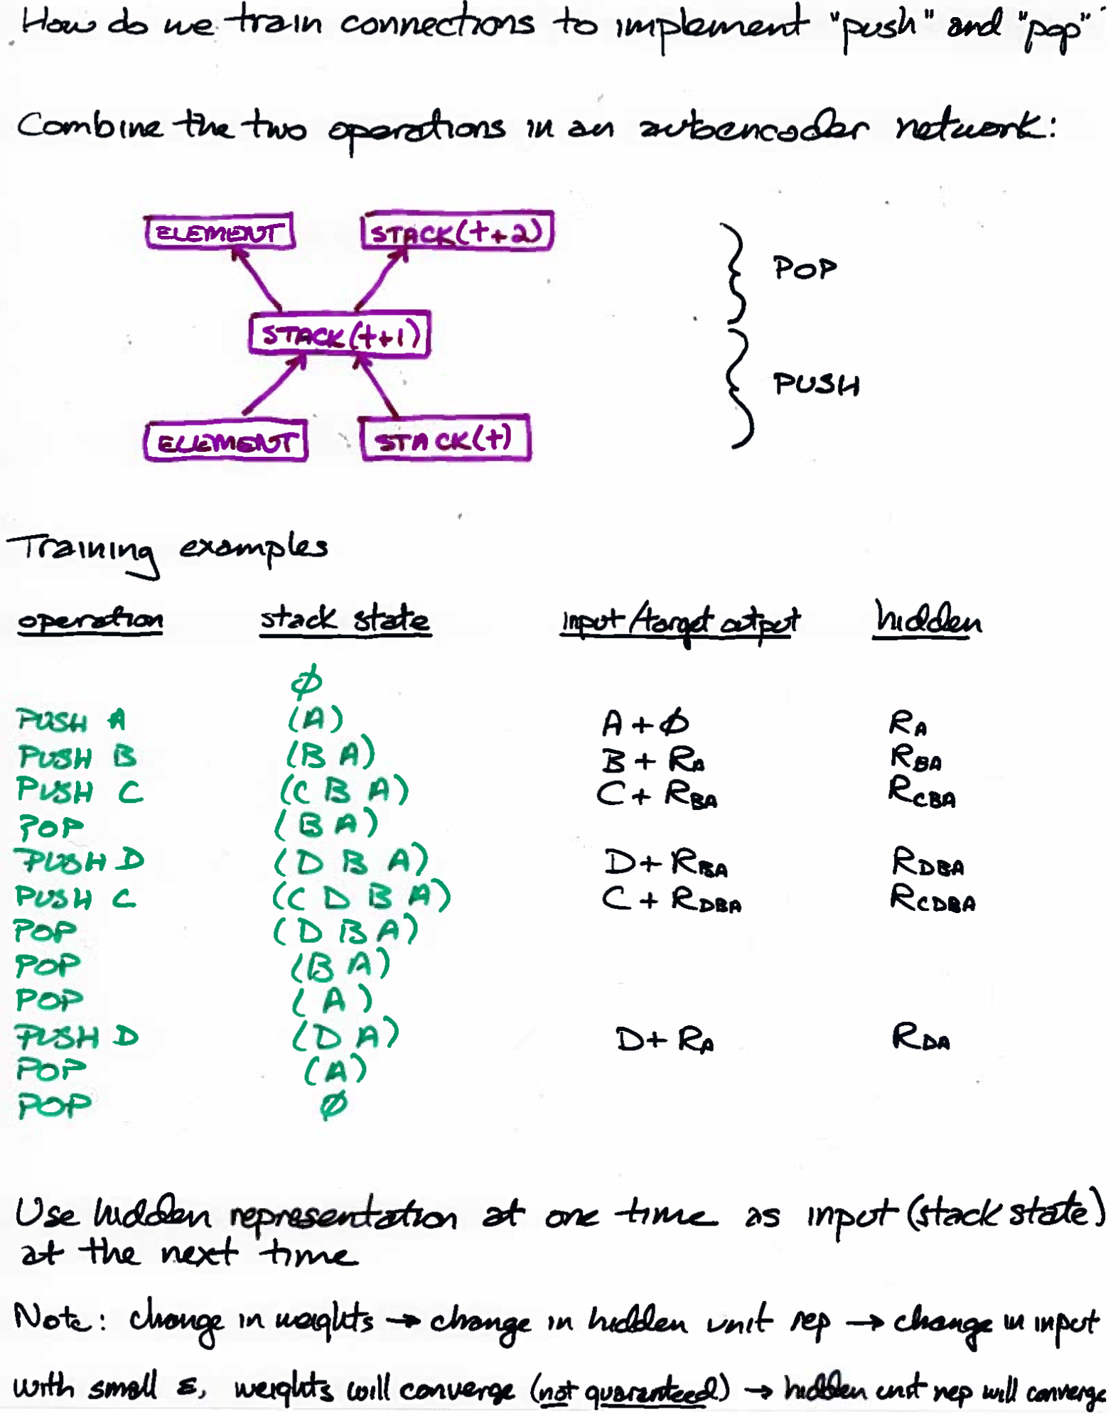
Recursive Neural Nets
Pollack (1991)
Recursive Auto-Associative
Memory (RAAM)
  Representing stacks

Slide 47
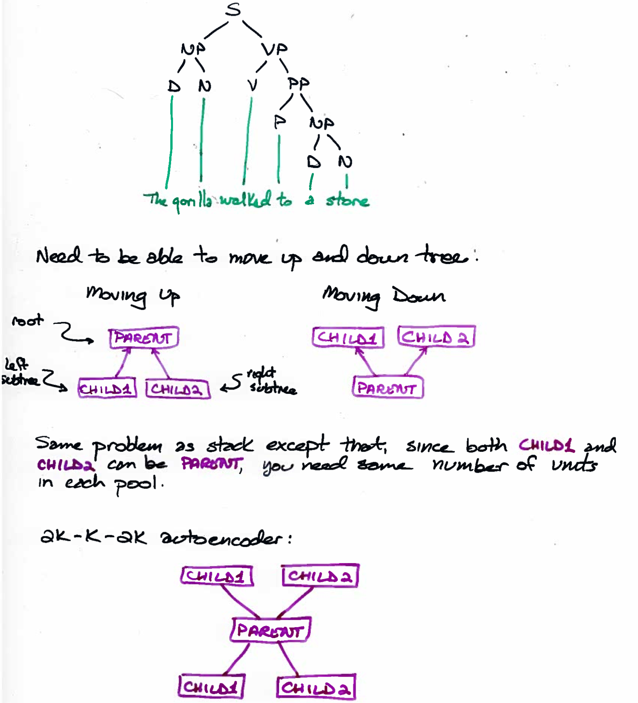
Recursive Neural Nets
Pollack (1991)
Recursive Auto-Associative
Memory (RAAM)
  Representing binary trees

Slide 48
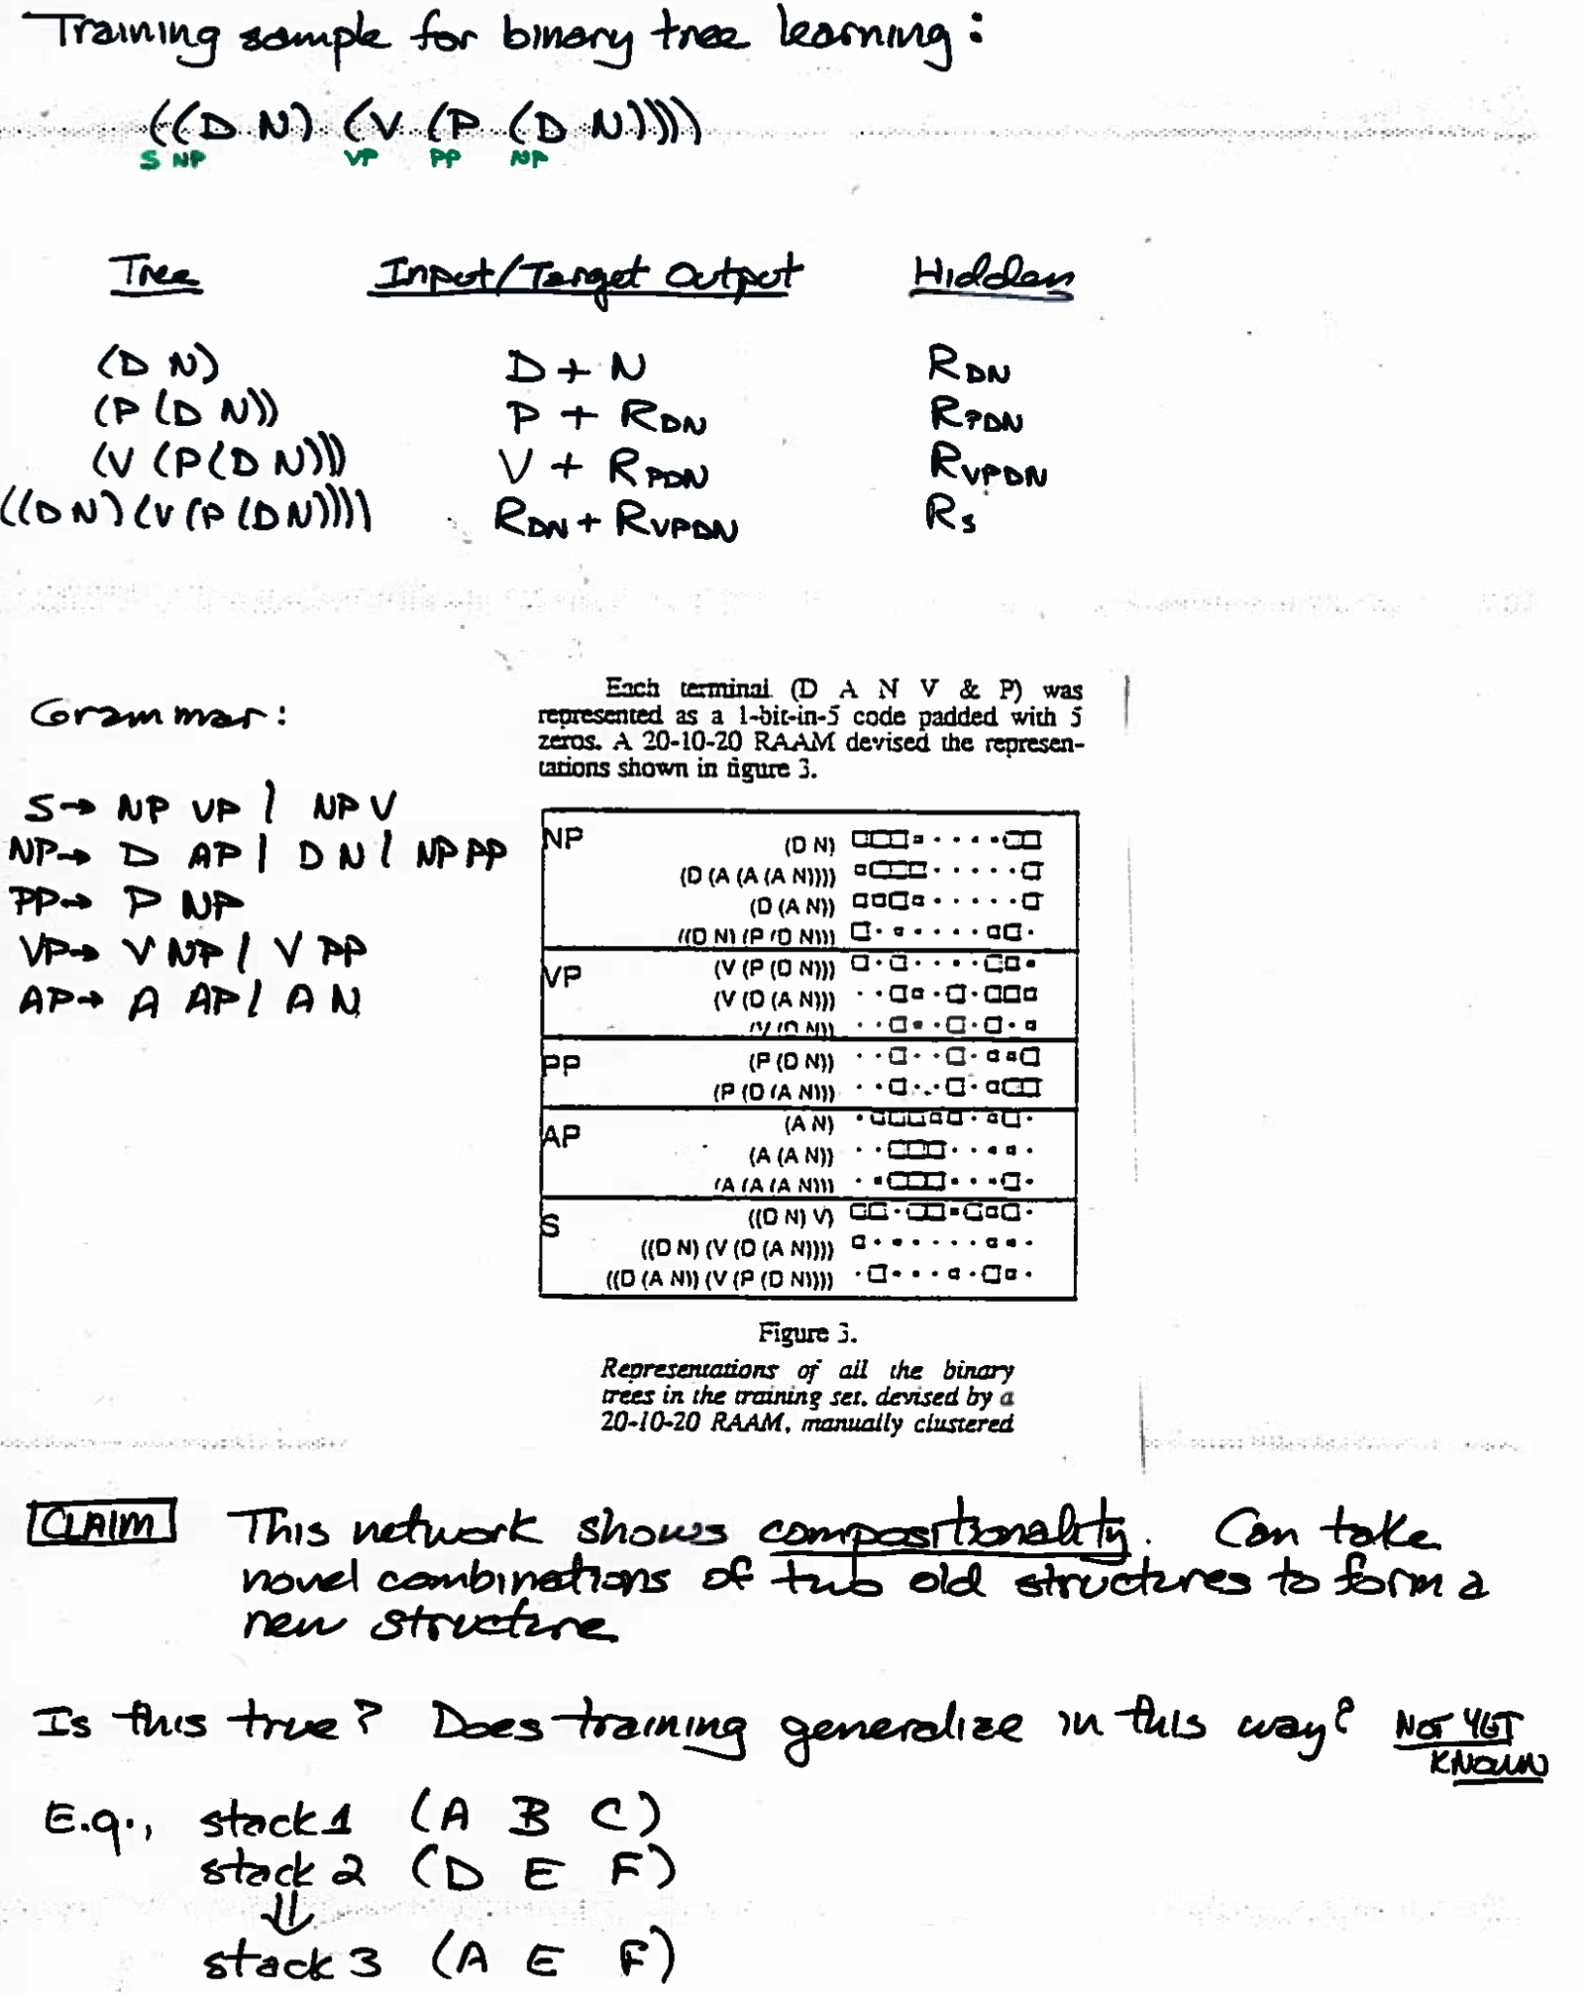
Recursive Neural Nets
Pollack (1991)
Recursive Auto-Associative
Memory (RAAM)
  Representing binary trees

