Slide 1
CSCI 5922 Neural Networks and Deep Learning: Representation
Mike Mozer
Department of Computer Science and Institute of Cognitive Science University of Colorado at Boulder

Slide 2
Representation
Definition?
a formalism for capturing certain key features of some other domain
E.g., a square
A representation makes certain domain information explicit (and easy to compute) and other information implicit (and difficult to compute)
$$\{\left(−2,2\right),\left(2,2\right),$$ $\left(2,−2\right),\left(−2,−2\right),\left(−2,2\right)\}$
Notes:
E.g., with pixel representation:
is it a closed shape?
what does the square look like when you rotate it 45 degrees around its center?
is it smaller or larger than some other shape (just look at the enclosing box)
with coordinate representation:
how many edges does it have?

Slide 3
Representing An English Word
Localist or “one hot” encoding
Neutral representation
each item orthogonal to each other
no expected generalization from one item to another
favored by end-to-end deep learning folks
ABLE | 1 | 0 | 0 | 0 | 0 | 0 | 0 | 0 | 0 | 0 | 0 | 0 | 0
AXLE | 0 | 1 | 0 | 0 | 0 | 0 | 0 | 0 | 0 | 0 | 0 | 0 | 0
BOLT | 0 | 0 | 0 | 1 | 0 | 0 | 0 | 0 | 0 | 0 | 0 | 0 | 0
GEAR | 0 | 0 | 0 | 0 | 0 | 0 | 1 | 0 | 0 | 0 | 0 | 0 | 0
WEAR | 0 | 0 | 0 | 0 | 0 | 0 | 0 | 0 | 0 | 1 | 0 | 0 | 0
ABLE
AXLE
BOLT
Notes:
If you want to encode an input, like an English word, in the standard way
for deep learning, you [*] use a localist or one-hot encoding

Slide 4
Representing An English Word
Distributed orthographic representation
Captures similarity of spelling patterns
natural generalization from word to similarly spelled words
 | A₁ | B₁ | ... | B₂ | ... | X₂ | A₃ | … | L₃ | … | E₄ | R₄ | T₄
ABLE | 1 | 0 | 0 | 1 | 0 | 0 | 0 | 0 | 1 | 0 | 1 | 0 | 0
AXLE | 1 | 0 | 0 | 0 | 0 | 1 | 0 | 0 | 1 | 0 | 1 | 0 | 0
BOLT | 0 | 1 | 0 | 0 | 0 | 0 | 0 | 0 | 1 | 0 | 0 | 0 | 1
GEAR | 0 | 0 | 0 | 0 | 0 | 0 | 1 | 0 | 0 | 0 | 0 | 1 | 0
WEAR | 0 | 0 | 0 | 0 | 0 | 0 | 1 | 0 | 0 | 0 | 0 | 1 | 0
ABLE
AXLE
WEAR
BOLT
GEAR

Slide 5
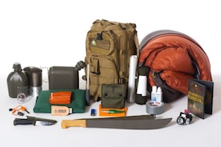
Representing An English Word
Distributed semantic representation
Captures similarity of meaning
ABLE | 1 | 0 | 0 | 0 | 0 | 0 | 0 | 0 | 0 | 1 | 0 | 0 | 0
AXLE | 0 | 1 | 1 | 0 | 0 | 0 | 0 | 1 | 0 | 0 | 0 | 1 | 0
BOLT | 0 | 0 | 1 | 0 | 1 | 0 | 0 | 0 | 0 | 0 | 0 | 1 | 0
GEAR | 0 | 1 | 1 | 0 | 1 | 0 | 0 | 0 | 0 | 0 | 0 | 1 | 1
WEAR | 0 | 0 | 0 | 0 | 0 | 0 | 0 | 0 | 1 | 0 | 1 | 0 | 1
ABLE
AXLE
WEAR
GEAR
BOLT
Notes:
GEAR has 2 meanings
which sort of of representation is best?
word2vec is a nice scheme for getting such distributed representations

Slide 6
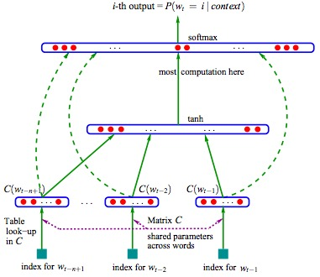
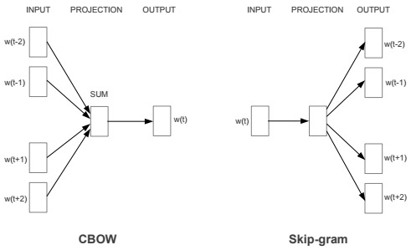
Using Statistics of Natural Language To Discover Word Representations Useful For Other Tasks
Neural Probabilistic Language Model
(Bengio, Ducharme, Vincent, 2003)
Word2Vec
(Mikolov, Chen, Corrado, Dean, 2013)
Uses unlabeled data to determine representations
Notes:
Do we need to worry about representation in the deep learning era??
Neural prob lang model:
- input is the s words leading up to word t, output is word t
Word2vec
- CBOW: input is a set of words before and after word t, output is word t
- skipgram: opposite direction
I'm betting that at the NLP tutorials, much talk of using word2vec representations as input to model.
Kind of a compromise between an end-to-end approach and using domain knowledge.
[*] uses unlabeled data to determine representations
and can be useful for semisupervised learning:
- large corpus of english text unlabeled
- use word2vec to discover distributed representations of words
apply distributed representations to supervised tasks with less data
So if you think of the unlabeled data as 'domain knowledge' this is a way of leveraging deep learning tis a way of combining domain knowledge (in the form of unlabeled data)

Slide 7
Comparison of Representations
Local
Distributed
Neuron activated for only one concept
One neuron activated per concept
Neuron activated for many concepts
Many neurons activated per concept
 | A₁ | B₁ | ... | B₂ | ... | X₂ | A₃ | … | L₃ | … | E₄ | R₄ | T₄
ABLE | 1 | 0 | 0 | 1 | 0 | 0 | 0 | 0 | 1 | 0 | 1 | 0 | 0
AXLE | 1 | 0 | 0 | 0 | 0 | 1 | 0 | 0 | 1 | 0 | 1 | 0 | 0
BOLT | 0 | 1 | 0 | 0 | 0 | 0 | 0 | 0 | 1 | 0 | 0 | 0 | 1
GEAR | 0 | 0 | 0 | 0 | 0 | 0 | 1 | 0 | 0 | 0 | 0 | 1 | 0
WEAR | 0 | 0 | 0 | 0 | 0 | 0 | 1 | 0 | 0 | 0 | 0 | 1 | 0
ABLE | 1 | 0 | 0 | 0 | 0 | 0 | 0 | 0 | 0 | 0
AXLE | 0 | 1 | 0 | 0 | 0 | 0 | 0 | 0 | 0 | 0
BOLT | 0 | 0 | 0 | 1 | 0 | 0 | 0 | 0 | 0 | 0
GEAR | 0 | 0 | 0 | 0 | 0 | 0 | 1 | 0 | 0 | 0
WEAR | 0 | 0 | 0 | 0 | 0 | 0 | 0 | 0 | 0 | 1

Slide 8
Comparing Representations
Local
ABLE
Distributed
A/1, B/2, L/3, E/4
Semi-distributed or sparse
AB, BL, LE

Slide 9
How Many Concepts Can Be Represented Simultaneously?
Local
all of them
Distributed
one
binding problem
Semi-distributed
depends on similarity
ABLE, GEAR, WEAN
A/1, G/1, B/2, E/2, A/3, L/3, E/4, R/4
AB, AR, BL, EA, GE, LE
AN, AR, EA, GE, WE

Slide 10
How Many Neurons Are Required?
Local
many
Distributed
few
Semi-distributed
intermediate
one per word (~2000 four letter words)
one per letter per position (104)
one per letter pair (26² = 676)

Slide 11
Is Similarity Structure Captured?
Local
no: neutral representation
Distributed
yes: overlap, vector dot product, etc.
Semi-distributed
intermediate
ABLE
ABLE
AXLE
BOLT
AXLE
WEAR
ABLE
BOLT
GEAR
AXLE
WEAR
BOLT
GEAR

Slide 12
Does Representation Support Generalization?
1
2
Local
no
easy to build arbitrary mappings
Distributed
yes
similar patterns ⇒ similar consequences
generalization of learning
?
?
AT
AN
AM
IF
IT
IN
1
2
?
?
A/1
I/1
T/2
N/2
M/2
F/2

Slide 13
How Difficult Is It To Interpret Representation?
Local
easy
Distributed
hard
FINK .41 LINK .45 FIND .64
F/1 .48 I/2 .92 N/3 .62 K/4 .23 L/1 .54 D/4 .95

Slide 14
Representing New Concepts
Local
need to add neurons
Distributed
need to specify a unique pattern of activation across the existing neurons
LINE LEFT LIFT
L/1 I/2 N/3 E/4 E/2 F/3 T/4

Slide 15
Tensor Product Representation (Smolensky, 1990)
position
Formalism for representing role-filler pairs
E.g.,
filler: letter
role: position in word
Notation
$r$: role vector
$f$: filler vector
$r⊗f$: outer (tensor) product
1
2
3
4
5
6
7
…
1
0
0
0
0
0
0
…
A
0
0
0
0
0
0
0
0
…
B
0
0
0
0
0
0
0
0
…
C
1
1
0
0
0
0
0
0
…
D
0
0
0
0
0
0
0
0
…
letter
0
0
0
0
0
0
0
…
E
0
F
0
0
0
0
0
0
0
0
…
…
…
…
…
…
…
…
…
…
…
X
0
0
0
0
0
0
0
0
…
Y
0
0
0
0
0
0
0
0
…
Z
0
0
0
0
0
0
0
0
…

Slide 16
Representing Multiple Role-Filler Pairs
$T=\sum_{i}{r_{i}⊗f_{i}}$
E.g.,
{C/1, A/2, B/3}
position
1
2
3
4
5
6
7
…
A
0
1
0
0
0
0
0
…
B
0
0
1
0
0
0
0
…
C
1
0
0
0
0
0
0
…
D
0
0
0
0
0
0
0
…
letter
0
0
0
0
0
0
0
…
E
F
0
0
0
0
0
0
0
…
…
…
…
…
…
…
…
…
…
X
0
0
0
0
0
0
0
…
Y
0
0
0
0
0
0
0
…
Z
0
0
0
0
0
0
0
…

Slide 17
Distributed Roles
Role vectors
1
2
3
What will this type of representation achieve?
Words with the same letter in nearby positions will overlap in similarity
E.g., CAT and ACT
1
2
3
…
position
.5
1
.5
0
0
0
0
…
1
2
3
…
A
0
0
.5
1
.5
0
0
…
0
0
.5
1
.5
0
0
…
B
0
0
0
0
0
0
0
…
CAT
0
0
0
0
.5
1
.5
…
C
.5
1
.5
0
0
0
0
…
D
0
0
0
0
0
0
0
…
1
2
3
…
A
.5
1
.5
0
0
0
0
…
B
0
0
0
0
0
0
0
…
ACT
C
0
0
.5
1
.5
0
0
…
D
0
0
0
0
0
0
0
…

Slide 18
Similarity of ACT and CAT
With localist role representation
$90^{∘}$
With distributed (overlapping) role representation
$80.4^{∘}$

Slide 19
Distributed Filler
position
E.g., vowels vs. consonants or phonetic similarity
A E B D
1
2
3
…
A
0
0
.25
.5
.25
0
0
…
B
.5
1
.5
0
0
0
0
…
A
1
.5
0
0
BET
B
0
0
1
.5
C
0
0
0
0
0
0
0
…
C
0
0
0
0
D
.25
.5
.25
0
0
0
0
…
D
0
0
.5
1
E
0
0
.5
1
.5
0
0
…
E
.5
1
0
0
F
0
0
0
0
A
0
0
.5
1
.5
0
0
…
…
…
…
…
…
B
.5
1
.5
0
0
0
0
…
BAT
X
0
0
0
0
C
0
0
0
0
0
0
0
…
Y
0
0
0
0
D
.25
.5
.25
0
0
0
0
…
Z
0
0
0
0
E
0
0
.25
.5
.25
0
0
…

Slide 20
Representing Magnitudes
E.g., position along a line
Spatial encoding
also known as place or value encoding
local representation
Frequency encoding
also known as variable encoding
has properties of a distributed representation

Slide 21
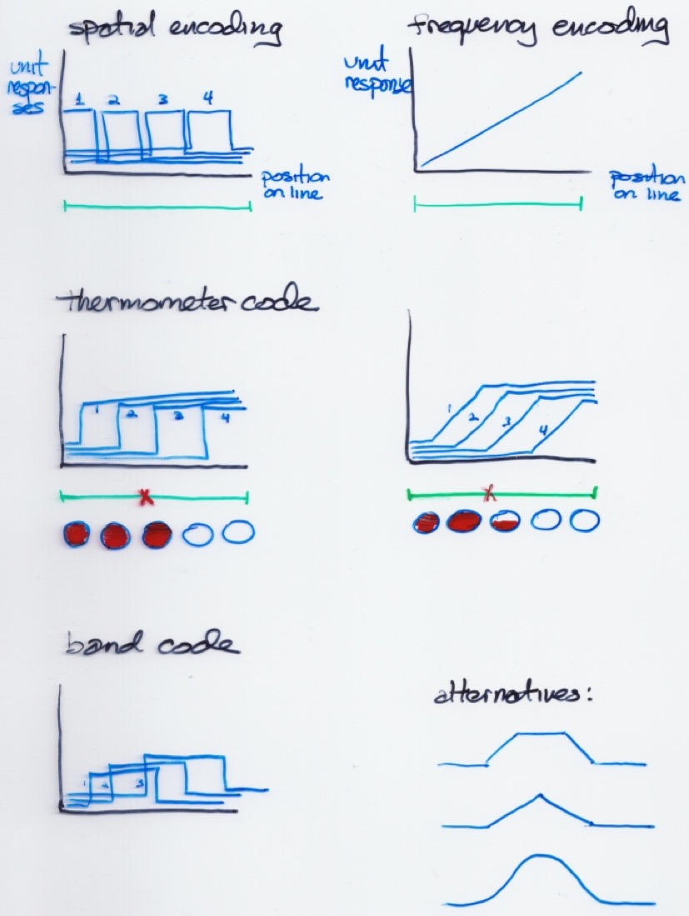

Slide 22
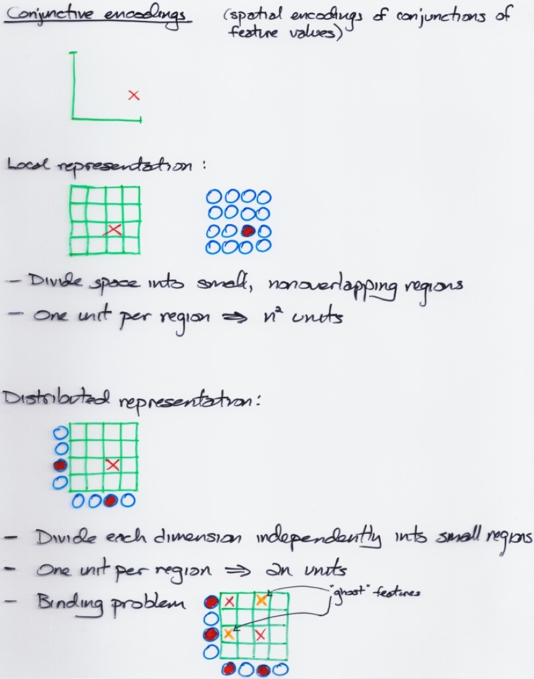

Slide 23
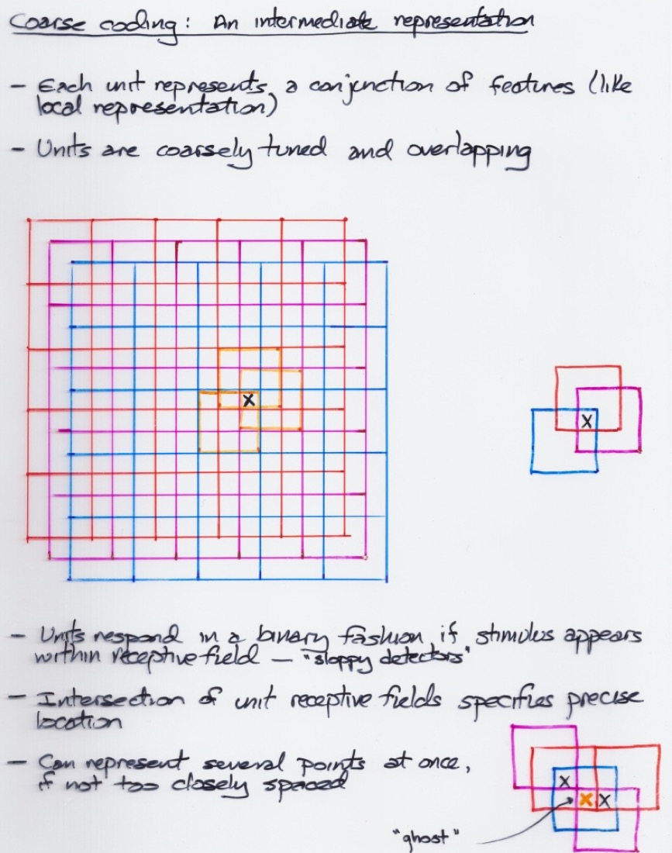

Slide 24
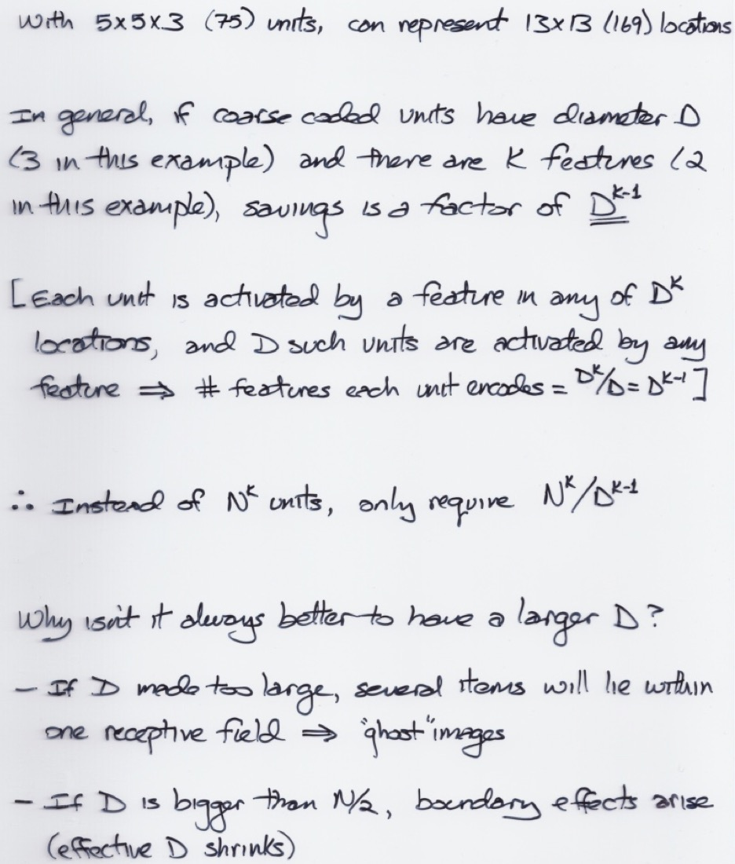

Slide 25
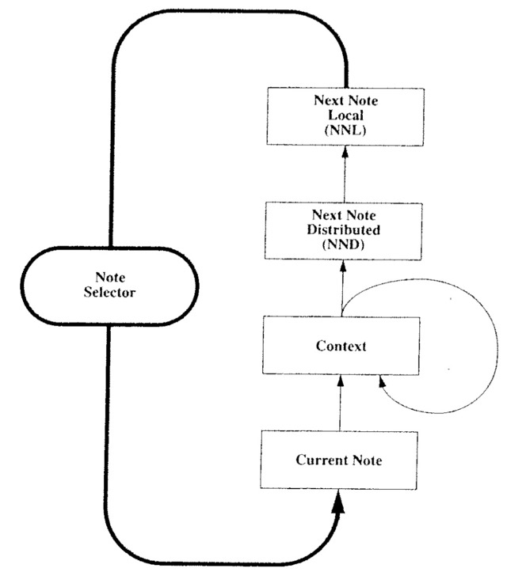
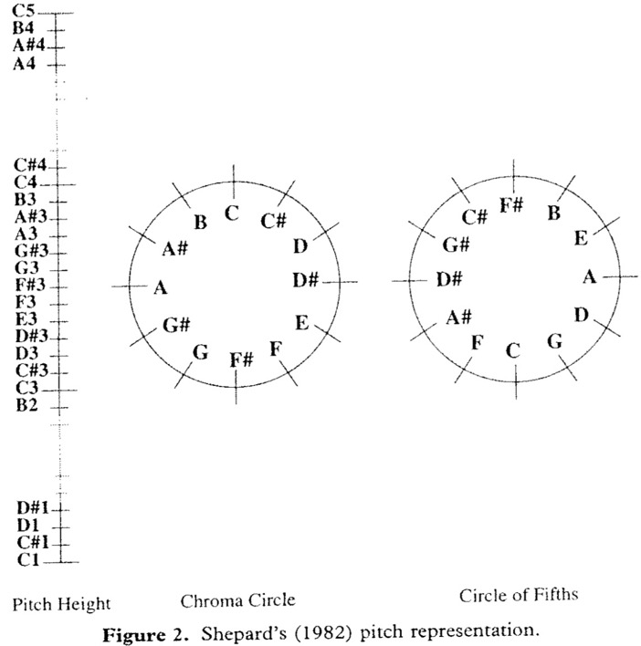
Psychologically Grounded Representations
Music composition network (Mozer, 1994)
Task: predict next pitch in diatonic scale
with one-hot pitch representation 54.5% accuracy
with psychologically grounded representation 98.4% accuracy
Notes:
predicting next pitch in diatonic scale
CONCERT:

Slide 26
Log Scaling
Appropriate for capturing wide dynamic ranges in values
e.g., time
e.g., brightness
Appropriate for capturing human representations
e.g., psychophysical quantities
Weber-Fechner law: $\frac{Δv}{v}=constant$
e.g., churn prediction (length of time with carrier)
Notes:
change in a physical stimulus required to perceive a change

