Slide 1
CSCI 5922: Deep Learning and Neural Networks
Improving Recurrent Net Memories
By Understanding Human Memory
Michael C. Mozer
Department of Computer Science
University of Colorado, Boulder
collaborators: Denis Kazakov, Rob Lindsey
Notes:
As I explained in 1st lecture, my agenda as a cognitive scientist
is partly to improve machine learning architectures through our
understanding of human minds/brains.
Today: project the past year that has consumed me.
Trying to answer this question for the case of memory
The answer isn’t entirely clear, but the journey is the fun part.
[that’s what people always say when their projects fail]

Slide 2
What Is The Relevance Of Human Memory
For Constructing Artificial Memories?
The neural architecture of human vision has inspired computer vision.
Perhaps the cognitive architecture of human memory can inspire the design of neural net memories.
Understanding human memory essential for ML systems that predict what information will be accessible or interesting to people at any moment.
  E.g., selecting material for students to review to maximize long-term retention (Lindsey et al., 2014)
Notes:
Why should we care about human memory?
I have 2 arguments
First, [*] the neural architecture of human vision has been inspirational throughout the history of computer vision.
Perhaps the cog arch of memory can inspire the design of RAM systems.
Second, [*] Understanding human memory IS essential for ML systems that predict what information will be accessible or interesting to people at any moment.

Slide 3
Memory In Neural Networks
Basic Recurrent Neural Net (RNN) Architecture
For Sequence Processing
classification /
prediction /
translation
. . .
memory
GRU
GRU
GRU
GRU
LSTM
LSTM
LSTM
LSTM
. . .
sequence
element
Notes:
[*] Basic RNN arch
Feed in a sequence, one element at a time
[*] LSTM
[*] GRU

Slide 4
Declarative Memory
study
test
Cepeda, Vul, Rohrer, Wixted, & Pashler (2008)
Notes:
Power function for population of individuals and a given item, or population of items and a given individual
Can’t tell what function looks like for an individual and a specific item, because probing memory influences memory (unlike NN models)
Real world studies are scary: med students forget 1/3 of basic science knowledge after 1 yr, ½ by 2 yr, 85% by 25 yr
As many of you may know from your psych 1 courses years back, ...[NEXT]

Slide 5
Forgetting Is Influenced By The Temporal Distribution Of Study
produces more
robust & durable
learning than
Spaced study
Massed study
Notes:
Forgetting is influenced by the temporal distribution of study.
Spaced study produces more robust and durable learning than massed study.
(Usually explained in psych 1 as "don't cram for exam". That's actually a lie.
If you want to do well on the exam, ...)

Slide 6
Experimental Paradigm To Study Spacing Effect
study
session 1
study
session 2
test
intersession
interval (ISI)
retention
interval (RI)

Slide 7
Cepeda, Vul, Rohrer, Wixted, & Pashler (2008)
% Recall
Intersession Interval (Days)
Notes:
Nonmonotonic: short spacing bad, long spacing bad. Optimum in between.
Optimal spacing increases with retention interval

Slide 8
Optimal Spacing Between Study Sessions as a Function of Retention Interval
Notes:
Each dot is one published paper.
The retention interval in the study is on the horizontal axis; the optimal spacing is on the y axis.
Both in log coordinates.
Straight line fit = power-law relationship.
This is evidence for time-scale invariance of memory.
-- rescale time it’s same formula, same exponent, different constant.

Slide 9
Predicting The Spacing Curve
characterization
of student
and domain
forgetting after
one session
Multiscale
Context
Model
intersession
interval
predicted
recall
% Recall
Intersession Interval (Days)
Notes:
We built a model to predict the shape of the spacing curve
Multiscale context model …

Slide 10
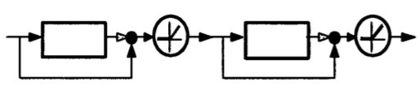
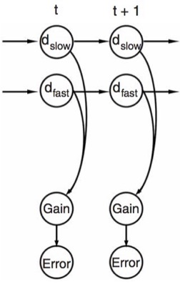
Multiscale Context Model
(Mozer et al., 2009)
  Neural network
  Explains spacing effects
Multiple Time Scale Model
(Staddon, Chelaru, & Higa, 2002)
  Cascade of leaky integrators
  Explains rate-sensitive habituation
Kording, Tenenbaum, Shadmehr (2007)
  Kalman filter
  Explains motor adaptation
Notes:
Rate-sensitive habituation: animal literature – rate, pigeon, blowfly (Sander)
Poke it -> HABITUATION.
Wait 5 min -> shock/jump
RECOVERY FROM HABITUATION
Time for recovery depends on rate at which stimuil are administered
Motor adaptation: as your body changes, the response of your motor system needs to adapt.
Some of these adaptations are due to short term processes, like being exhausted
Some are due to intermediate term processes, like a muscle injury
Some are due to long-term processes, like maturation or muscle atrophy
Even though the mechanisms are different in each model, they share the same key ideas.

Slide 11
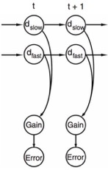

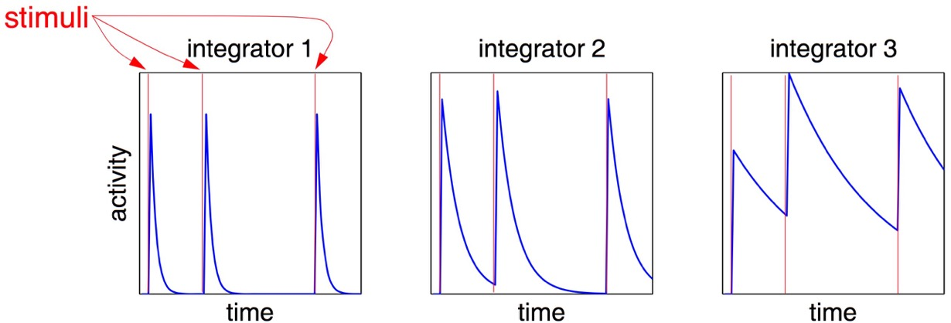
Key Features Of All Three Models
Each time an event occurs
in the environment…
A memory of this event
is stored via multiple traces
Traces decay exponentially
at different rates
Memory strength is
weighted sum of traces
Slower scales are downweighted relative to faster scales
Slower scales store memory (learn) only when faster scales fail to predict event
fast
medium
slow
trace strength
+
+
Notes:
Each time an event OR STIMULUS occurs in the environment,
[*] a memory of this event is stored via multiple traces (redundant representation)
[*] Traces decay exponentially at different rates
[*] Memory strength is weighted sum of traces
[*] Slower Scales store memory (i.e., they learn) only when fast scales fail to predict event
-- type of error correction learning
[*] Slower scales are weighted less heavily
The weighted sum of traces is an exponential mixture…

Slide 12
Exponential Mixtures
Infinite mixture of exponentials gives exactly power function
Finite mixture of exponentials gives good approximation to power function
With , can fit arbitrary power functions
+
+
=
Notes:
[exponential mixture] achieves a sort of scale invariance
If you have an infinite mixture of exponentials, weighted by an inverse gamma density, you get exactly a power function
Any finite mixture of exponentials gives a pretty darn good approximation to a power function.
You don’t need all the flexibility of arbitrary mixture coefficients and time constants.
In MCM, we use a three parameter formiulation to match arbitrary power functions to an arbitrary degree of accuracy.
All 3 models depend on ideas similar to this.
All 3 models do a really nice job of explaining data

Slide 13
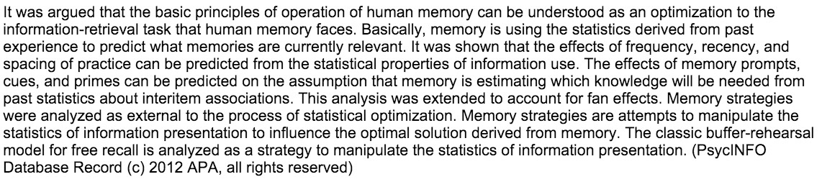
Memory Strength Depends On Temporal History
events
time
memory
strength
time
Notes:
END OF SLIDE: What can we do with a memory that has this characteristic?
I’ll give you two very strong use cases.

Slide 14


Predicting Student Knowledge
?
time

Slide 15


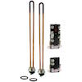
Time Scales and Human Preferences
?
time
Notes:
Now switch gears. Let’s think about a different domain – product recommendation
[*] Over many years, I've hopped on shopping sites and looked for electronic toys.
[*] And other times, I have to replentish my stock of my favorite lentils.
[*] And then every once in a while, I have an emergency that requires a quick purchase.
E.g., water heater
[*] question is: what to recommend at this time?

Slide 16
Time Scale and Temporal Distribution of Behavior
Critical for modeling and predicting many human activities:
  Retrieving from memory
  Purchasing products
  Selecting music
  Making restaurant reservations
  Posting on web forums and social media
  Gaming online
  Engaging in criminal activities
  Sending email and texts
x₁
x₂
x₃
x₄
t₁
t₂
t₃
t₄
Notes:
The time scale and temporal distribution of behavior is critical for modeling and predicting many human activities.
Not just the 2 I mentioned but ...[*]
[*] All of these activities are characterized by events in time.
[*] Discrete events, each associated with a time tag
Typical sequence processing tasks we do with RNNs (e.g., language understanding) do not have the time tags
Also important: gap between events can vary by many orders of magnitude

Slide 17
Recent Research Involving Temporally Situated Events
Discretize time and use tensor factorization or RNNs
  e.g., X. Wang et al. (2016), Y Song et al. (2016), Neil et al. (2016)
Hidden semi-Markov models and survival analysis
  Kapoor et al. (2014, 2015)
Include time tags as RNN inputs and treat as sequence processing task
  Du et al. (2016)
Temporal point processes
  Du et al. (2015), Y. Wang et al. (2015, 2016)
Our approach
  incorporate time into the RNN dynamics
Notes:
...
Our approach: incorporate time into the RNN dynamics
We do this by defining a new type of recurrent neuron, like an LSTM neuron, that leverages the math of temporal point processes

Slide 18

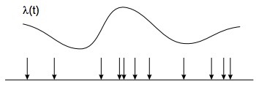
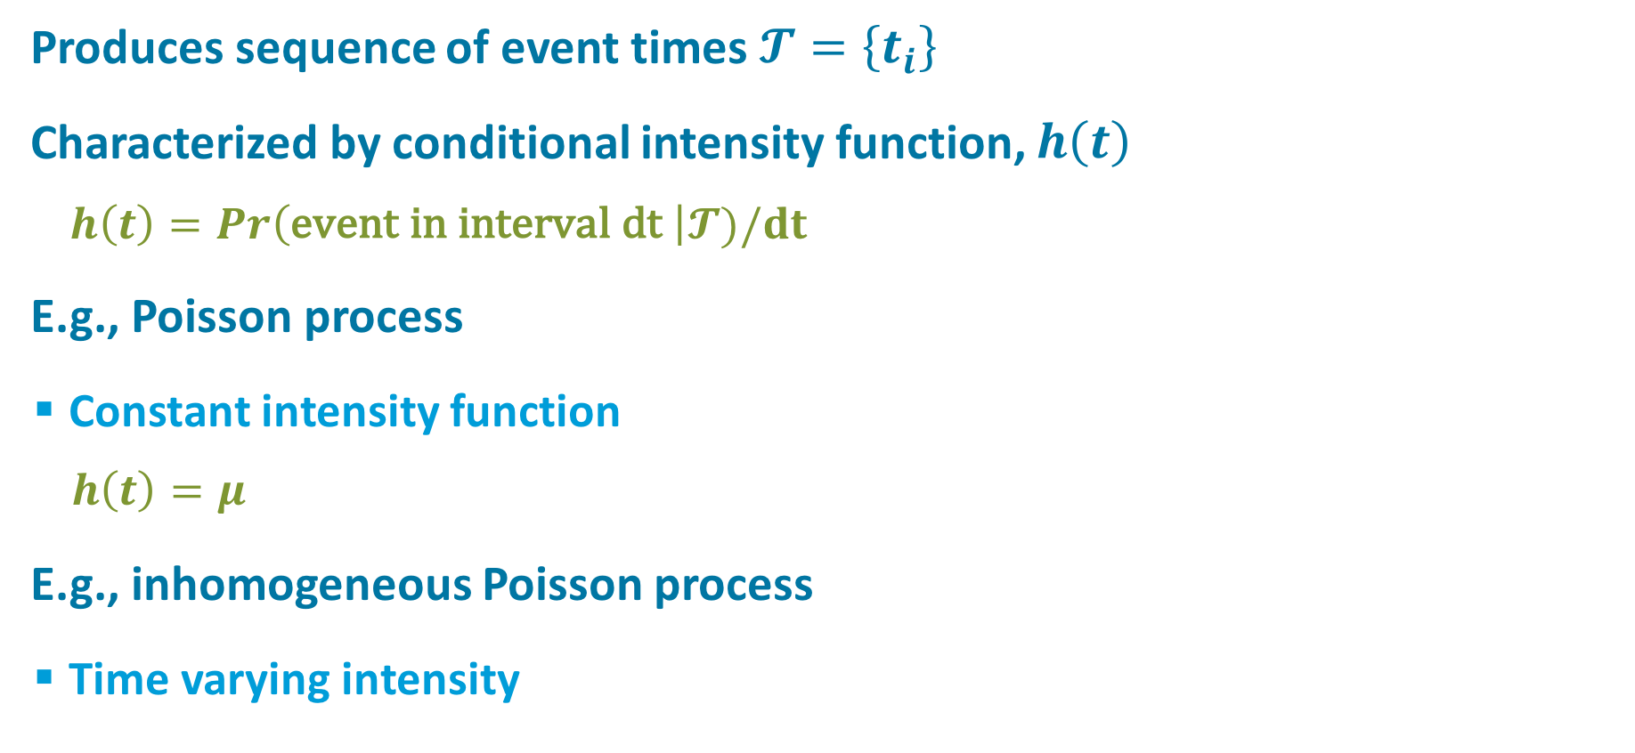

Temporal Point Processes
Produces sequence of event times $𝓣=\left\{t_{i}\right\}$
Characterized by conditional intensity function, $h\left(t\right)$
    $h\left(t\right)=Pr\left(\text{event} \text{in} \text{interval} \text{dt} \right|𝓣)/dt$
E.g., Poisson process
  Constant intensity function
    $h\left(t\right)=μ$
E.g., inhomogeneous Poisson process
  Time varying intensity
$$h\left(t\right)$$
Notes:
Temporal point process is a stochastic process that produces a sequence of event times
Characterized by conditional intensity function, calling it h(t)
Within some small interval dt, h(t) is the event rate
h(t) is the rate of events occurring

Slide 19
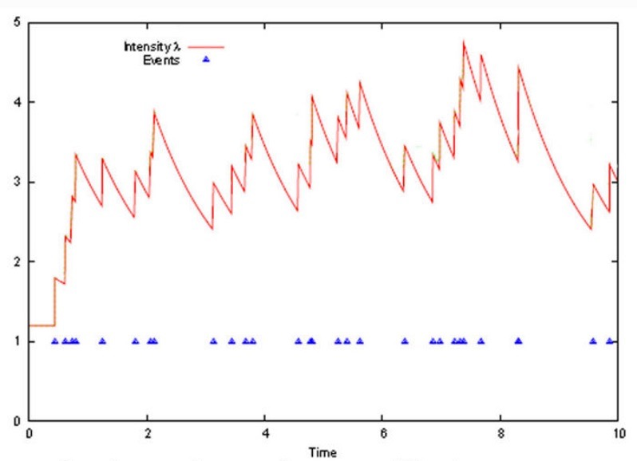
Hawkes Process
Intensity depends on event history
  Self excitatory
  Decaying
Intensity decays over time
  Used to model earthquakes,
  financial transactions, crimes
  Decay rate determines time
  scale of persistence
intensity
h(t)
event stream
Time
Notes:
We've explored HP, where the intensity depends on event history.
Self excitatory: INTENSITY INCREASES WITH EACH EVENT
Decays over time:
EXPONENTIAL KERNEL
[*] Bursty property: useful for modeling phenomena like earthquakes, financial transactions crimes
Just to give you an intuition of where I’m going,
Suppose that events are purchases of a particular product or class of products
The more purchases you make, the more likely you are to make them in the NEAR future
What “near” means depends on the rate of decay here
[*] Decay rate determines time scale of behavioral persistence
Now look at h(t) as hidden unit’s activation:
decaying memory of past events. Like LSTM if decay rate is slow, unlike LSTM, it has built in forgetting

Slide 20
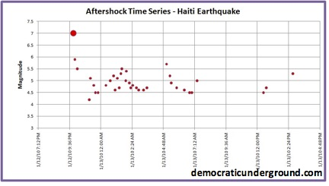
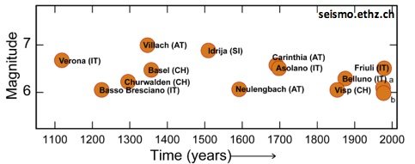
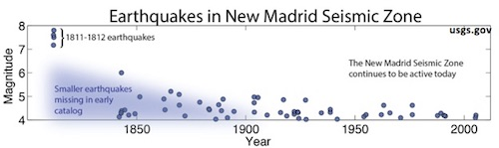
Earthquakes
Notes:
Earthquakes in the alps / haiti / new madrid (Misouri)
bursty property at multiple time scales

Slide 21
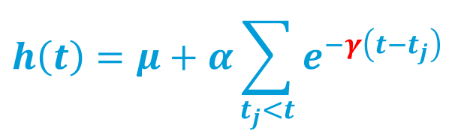






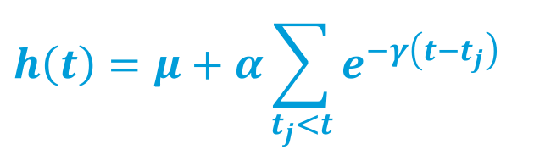

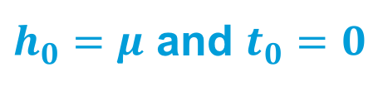

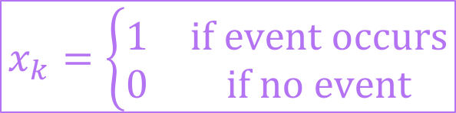
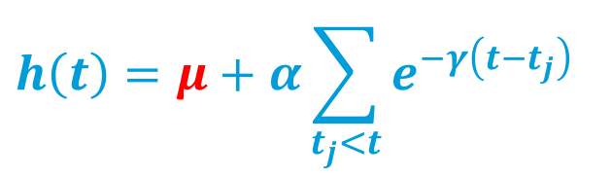
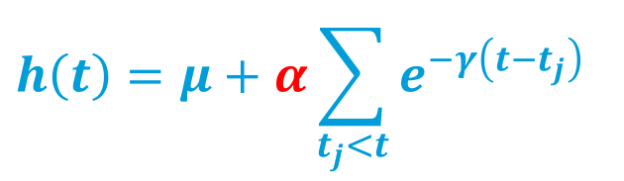
Hawkes Process
Conditional intensity function
Incremental formulation with discrete updates
$$h\left(t\right)=μ+α\sum_{t_{j}<t}{e^{−γ\left(t−t_{j}\right)}}$$
$$h\left(t\right)=μ+α\sum_{t_{j}<t}{e^{−γ\left(t−t_{j}\right)}}$$
$$h\left(t\right)=μ+α\sum_{t_{j}<t}{e^{−γ\left(t−t_{j}\right)}}$$
$$h\left(t\right)=μ+α\sum_{t_{j}<t}{e^{−γ\left(t−t_{j}\right)}}$$
with $𝓣≡\left\{t_{1}, …, t_{j},…\right\}$ times of past events
$h_{0}=μ$ and $t_{0}=0$
$$h$$
$$γ$$
$$μ$$
$$h_{k}=μ+e^{−γ{Δt}_{k}}\left(h_{k−1}−μ\right)+αx_{k}$$
$$α$$
$$x$$
$$Δt$$
$$Δt_{k}≡t_{k}−t_{k−1}$$
$$x_{k}=\left\{\begin{matrix}1 & \text{if} \text{event} \text{occurs} \\ 0 & \text{if} \text{no} \text{event}\end{matrix}\right.$$
Notes:
Here's the conditional intensity function...
[*][*][*]
Incremental formulation :
initialize, and then perform discrete updates at event times, capturing the exponential decay that has occured during [*] the intervening time
add one bit of notation: x
Neural net formulation
h is a recurrent hidden unit which accept input x from the layer below
a bunch of these units each looking for a different event type
[*] may think of mu, alpha, and gamma as neural net parameters but I’m going to make it a bit more interesting in a sec
[*] delta t

Slide 22
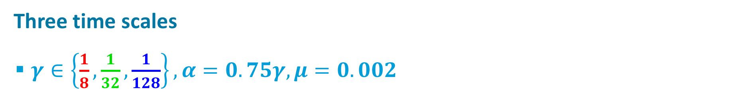
Hawkes Process As A Generative Model
Three time scales
  $γ∈\left\{\frac{1}{8},\frac{1}{32},\frac{1}{128}\right\}, α=0.75γ, μ=0.002$

Slide 23


Prediction
Observe a time series and predict what comes next?
Given model parameters, compute intensity from observations:
Given intensity, compute event likelihood in a $Δt$ window:
?
$$h_{k}=μ+e^{−γ{Δt}_{k}}\left(h_{k−1}−μ\right)+αx_{k}$$
$$\text{Pr}\left(t_{k}≤t_{k−1}+Δt,x_{k}=1|t_{1}, …, t_{k−1}\right)=1−e^{−\left(h_{k−1}−μ\right)\left(1−e^{−γΔt}\right)/γ−μΔt}$$
$$≡Z_{k}(Δt)$$
Notes:
Observe a time series of some event, like purchases of electronics, and predict what comes next...
Given model parameters...
Given intensity, compute likelihood of another event in a given window of the future.
[*] give this expression a name, Z

Slide 24

Key Premise
The time scale for an event type may vary from sequence to sequence
Therefore, we want to infer time scale parameter $γ$ appropriate for each event and for each sequence.
Notes:
MY INTEREST IN WATER HEATERS MAY BE SHORT LIVED, BUT WATER HEATERS ARE JUERGEN'S OBSESSION.
LADY GAGA MAY BE A FLEETING INTEREST OF SEPP'S, BUT SHE IS MY FAVORITE.
can't treat gamma as a parameter to be trained by gradient descent

Slide 25
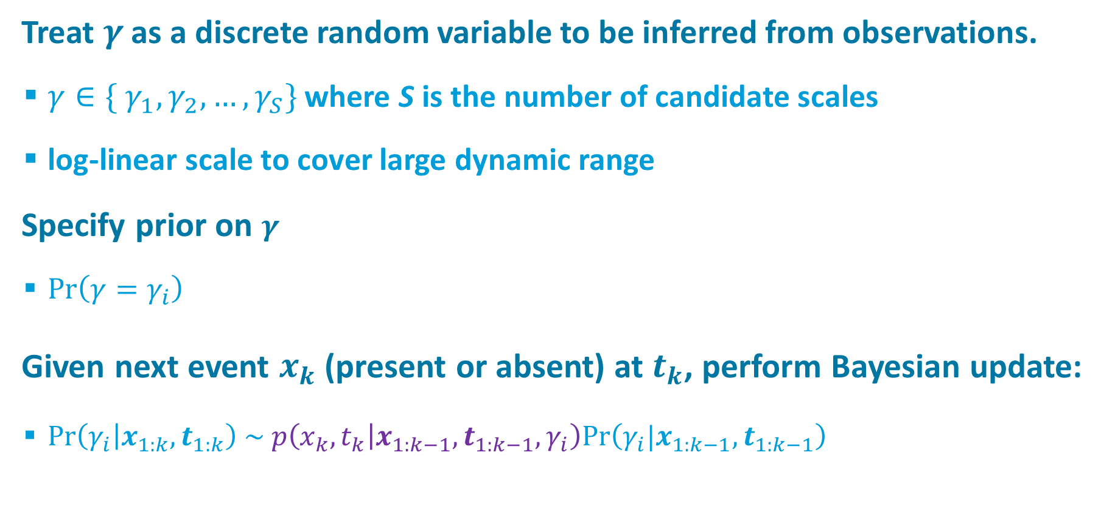
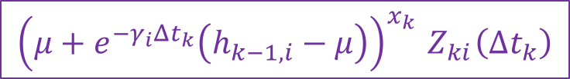
Bayesian Inference of Time Scale
Treat $γ$ as a discrete random variable to be inferred from observations.
  $γ∈\{ γ_{1}, γ_{2}, …, γ_{S}\}$ where S is the number of candidate scales
  log-linear scale to cover large dynamic range
Specify prior on $γ$
  $Pr\left(γ=γ_{i}\right)$
Given next event $x_{k}$(present or absent) at $t_{k}$, perform Bayesian update:
  $\text{Pr}\left(γ_{i} | x_{1:k}, t_{1:k}\right) \sim p\left(x_{k},t_{k} | x_{1:k−1}, t_{1:k−1},γ_{i}\right)\text{Pr}\left(γ_{i}|x_{1:k−1},t_{1:k−1}\right)$
$${\left(μ+e^{−γ_{i}Δt_{k}}\left(h_{k−1,i}−μ\right)\right)}^{x_{k}}{ Z}_{ki}\left(Δt_{k}\right)$$
Notes:
log-linear set to cover a large dynamic range
likelihood comes from HP

Slide 26

$$γ$$
long
medium
short
long
X
Intensity
medium
short
marginal
Notes:
event sequence
[*] resulting intensity functions at short, medium, long time scales
[*] inference over gamma
- each vertical slice represents the posterior over time scales at a given moment
- the distribution shifts from unifrom to focused on the medium time scale
which is what i used to generate the sequence
[*] you can marginalize over gamma
[*] to obtain an expected intensity
without providing the time scale, the medium scale is inferred from data

Slide 27
inferred
true
Notes:
[*] expected intensity marginalizing over time scale

Slide 28
Effect of Spacing

Slide 29

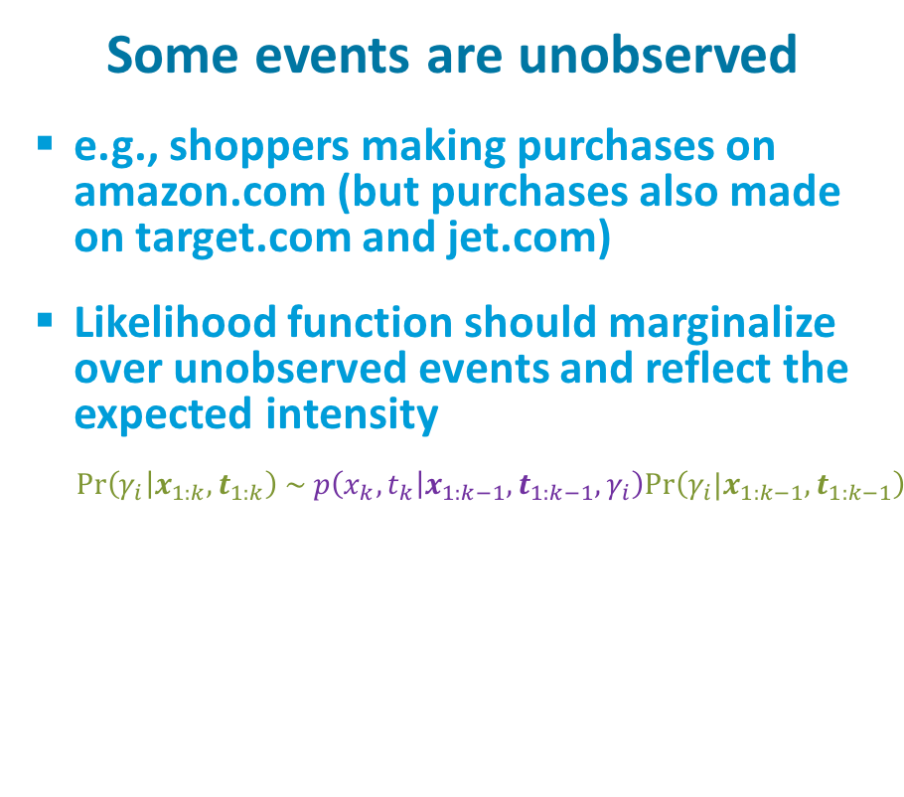
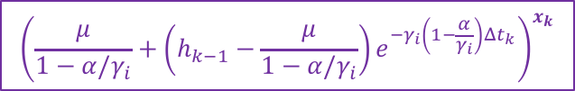
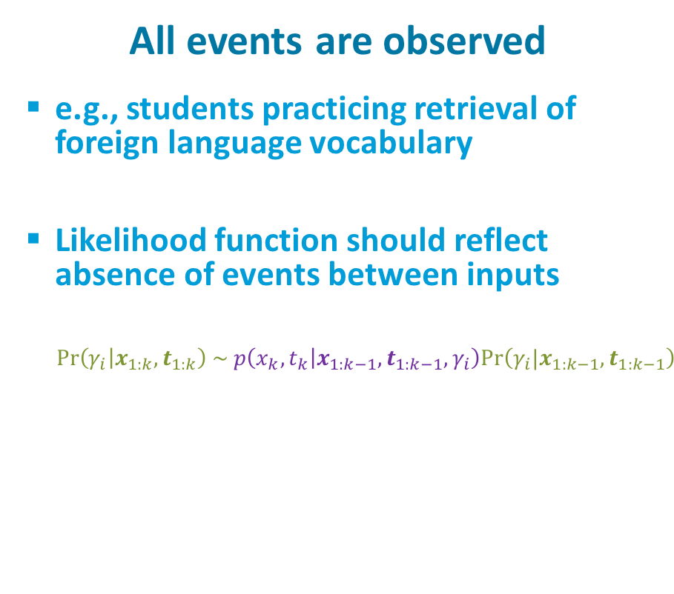
Two Alternative Characterizations of Environment
All events are observed
  e.g., students practicing retrieval of foreign language vocabulary
  Likelihood function should reflect absence of events between inputs
    $\text{Pr}\left(γ_{i} | x_{1:k}, t_{1:k}\right) \sim p\left(x_{k},t_{k} | x_{1:k−1}, t_{1:k−1},γ_{i}\right)\text{Pr}\left(γ_{i}|x_{1:k−1},t_{1:k−1}\right)$
Some events are unobserved
  e.g., shoppers making purchases on amazon.com (but purchases also made on target.com and jet.com)
  Likelihood function should marginalize over unobserved events and reflect the expected intensity
    $\text{Pr}\left(γ_{i} | x_{1:k}, t_{1:k}\right) \sim p\left(x_{k},t_{k} | x_{1:k−1}, t_{1:k−1},γ_{i}\right)\text{Pr}\left(γ_{i}|x_{1:k−1},t_{1:k−1}\right)$
$${\left(μ+e^{−γ_{i}Δt_{k}}\left(h_{k−1,i}−μ\right)\right)}^{x_{k}}{ Z}_{ki}\left(Δt_{k}\right)$$
$${\left(\frac{μ}{1−α/γ_{i}}+\left(h_{k−1}−\frac{μ}{1−α/γ_{i}}\right)e^{−γ_{i}\left(1−\frac{α}{γ_{i}}\right)Δt_{k}}\right)}^{x_{k}}$$

Slide 30
Neural Hawkes Process Memory
Michael C. Mozer
University of Colorado, Boulder
Robert V. Lindsey
Imagen Technologies
Denis Kazakov
University of Colorado, Boulder

Slide 31






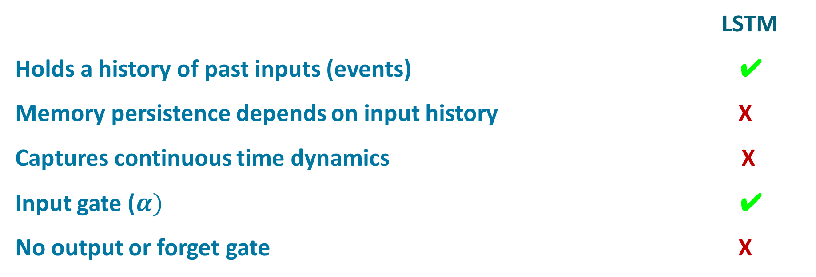
Hawkes Process Memory (HPM) Unit
$$h$$
$$γ$$
$$μ$$
$$α$$
$$x$$
$$Δt$$
LSTM
Holds a history of past inputs (events) ✔
Memory persistence depends on input history X
Captures continuous time dynamics X
Input gate ($α)$ ✔
No output or forget gate X
Notes:
holds history of past events
ESSENTIALLY, BUILDS MEMORIES AT MULTIPLE TIME SCALES
[*] LSTM...
[*] memory persistence depends on input history
SELECTS APPROPRIATE TIME SCALE GIVEN INPUT HISTORY

Slide 32
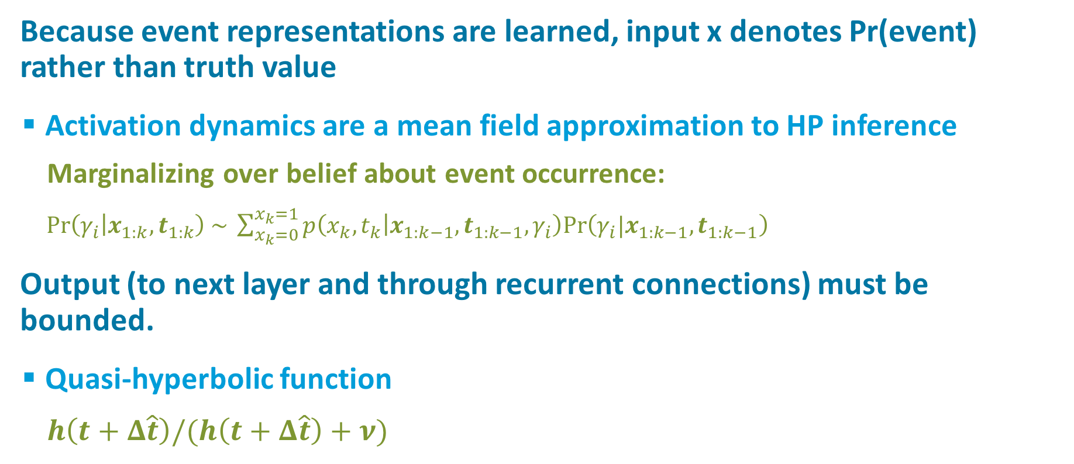
Embedding HPM in an RNN
Because event representations are learned, input x denotes Pr(event) rather than truth value
  Activation dynamics are a mean field approximation to HP inference
    Marginalizing over belief about event occurrence:
    $\text{Pr}\left(γ_{i} | x_{1:k}, t_{1:k}\right) \sim \sum_{x_{k}=0}^{x_{k}=1}{p\left(x_{k},t_{k} | x_{1:k−1}, t_{1:k−1},γ_{i}\right)\text{Pr}\left(γ_{i}|x_{1:k−1},t_{1:k−1}\right)}$
Output (to next layer and through recurrent connections) must be bounded.
  Quasi-hyperbolic function
    $h\left(t+Δ\hat{t}\right)/(h\left(t+Δ\hat{t}\right)+ν)$
Notes:
DETAILS YOU DON'T WANT TO SEE

Slide 33
Generic LSTM RNN
. . .
predicted event
A
B
C
LSTM
LSTM
LSTM
LSTM
. . .
current event
A
B
C
Notes:
To explain HP net, let's start with generic LSTM net

Slide 34


HPM RNN
. . .
predicted event
A
B
C
HPM
HPM
HPM
HPM
. . .
current event
$$Δ\hat{t}$$
$$Δt$$
A
B
C
time to
predicted
event
time
since last
event

Slide 35
Reddit Postings

Slide 36
Reddit
Data
  30,733 users
  32-1024 posts per user
  1-50 forums
  15,000 users for training (and validation), remainder testing
Task
  Predict forum to which user will post next, given the time of the posting
Notes:
OPTIONAL:
Representation
User-relative encoding of forum

Slide 37
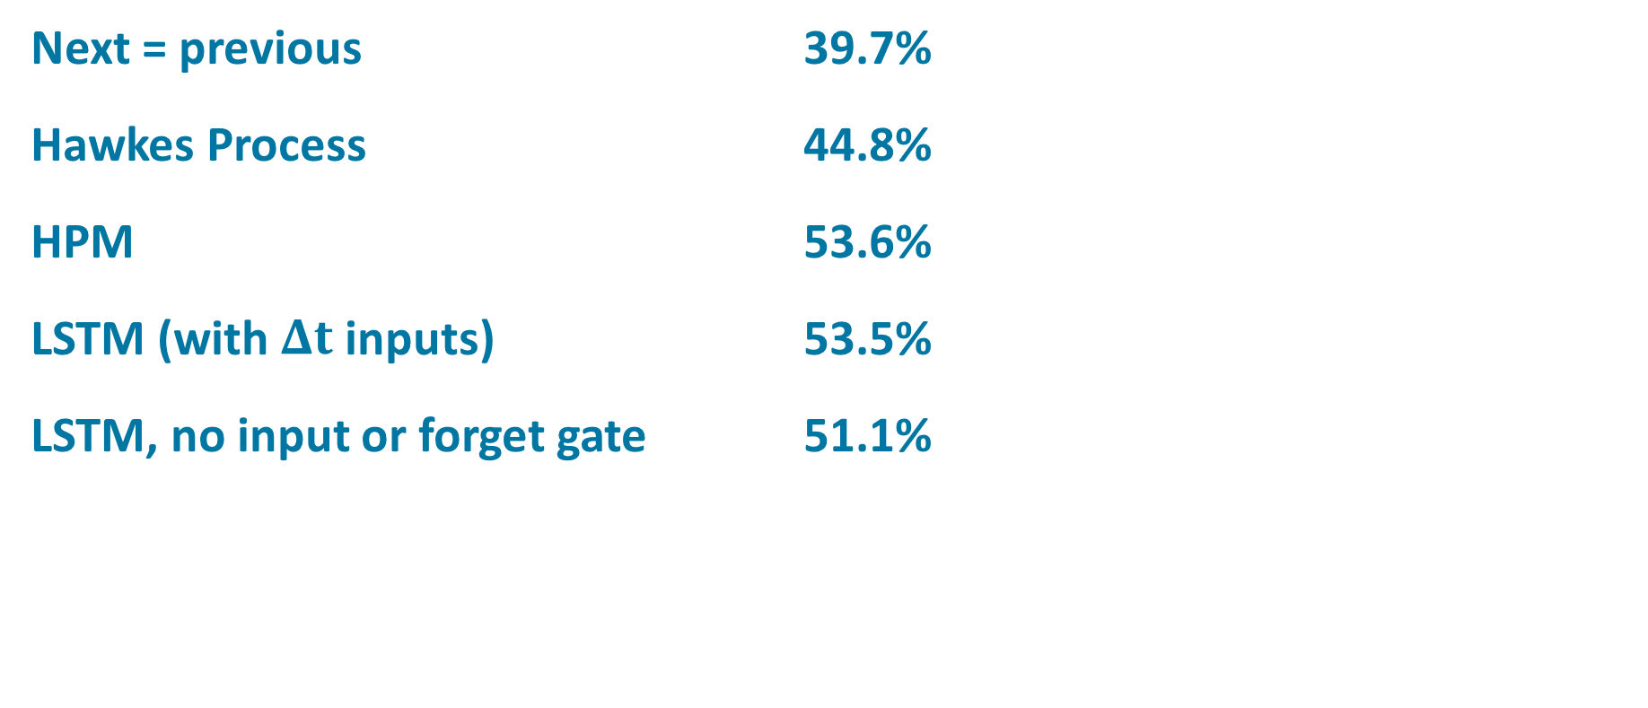
Reddit Results
Next = previous 39.7%
Hawkes Process 44.8%
HPM 53.6%
LSTM (with $Δt$ inputs) 53.5%
LSTM, no input or forget gate 51.1%
Notes:
hope is that HPM is picking up on different aspects of the data than LSTM, since LSTM relies on input gate whereas HPM does not
BEFORE ADVANCING:
last.fm artist choice data set that i won’t talk about. produced results much like reddit

Slide 38
Two Tasks
Event prediction
  Given time of occurrence, which of n event types is most likely?
Event outcome
  Given event type and time of occurrence, predict event outcome.
  E.g., if a student is prompted to apply some knowledge or recall a fact, will they succeed?
      input: `student retrieved item X at time T successfully or unsuccessfully’
      output: `will student retrieve item X’ at time T’ successfully or unsuccessfully?’

Slide 39
Word Learning Study
(Kang et al., 2014)
Data
  32 human subjects
  60 Japanese-English word associations
  each association tested 4-13 times over
  intervals ranging from minutes to
  several months
  655 trials per sequence on average
Task
  Given study history up to trial t,
  predict accuracy (retrievable from memory
  or not) for next trial.

Slide 40
Word Learning Results
Majority class (correct) 62.7%
Traditional Hawkes process 64.6%
Next = previous 71.3%
LSTM 77.9%
HPM 78.3%
LSTM with 𝚫t inputs 78.3%

Slide 41
Other Data Sets
last.fm
  30,000 user sequences
  predict artist selection
  time interval between selections varies from hours to years
COLT
  300 students practicing Spanish vocabulary (~200 words) over a semester
MSNBC
  sequence of web page views categorized by topic (sports, news, finance, etc.)
  10k sequences used for training, 110k for testing
Synthetic bursty
  Poisson distributed events over a finite window, with rate ~ 1/window_duration
  5 event streams

Slide 42
Multiple Performance Measures
Test log likelihood
Test top-1 accuracy
Test AUC

Slide 43
Key Idea of Hawkes Process Memory
Represent memory of (learned) events
at multiple time scales simultaneously
Output ‘appropriate’ time scale based on
input history
Should be helpful for predicting any system that has dynamics across many different time scales
  including human behavior and preferences
Notes:
To wrap up,

Slide 44
Novelty
The neural Hawkes process memory belongs to two classes of neural net models that are just emerging.
  Models that perform dynamic parameter inference as a sequence is processed
    see also Fast Weights (Ba, Hinton, Mnih, Leibo, & Ionescu, 2016) and
    Tau Net (Nguyen & Cottrell, 1997)
  Models that operate in a continuous time environment
    see also Phased LSTM (Neil, Pfeiffer, & Liu, 2016)
Notes:
Jun Tani - papers on multiscale rnns

Slide 45
Not Giving Up…
Hawkes process memory
  input sequence determines the time scale of storage
CT-GRU
  network itself decides on time scale of storage
Notes:
explicitly predict time scale

Slide 46
Continuous Time Gated Recurrent Networks
Michael C. Mozer
University of Colorado, Boulder
Denis Kazakov
University of Colorado, Boulder
Robert V. Lindsey
Imagen Technologies

Slide 47
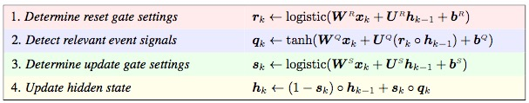








Gated Recurrent Unit (GRU)
(Chung, Ahn, & Bengio, 2016)
Similar to LSTM
  no output gate
  memory activation$h ∈[−1,+1]$
$$r$$
$$h_{k−1}$$
$$x_{k}$$
$$s$$
$$q$$
$$h$$
$$h_{k}$$
Notes:
x_k input at step k; h_{k-1} previous hidden
input and prev hidden feed into:
[*] r: reset gate: determine how much of the hidden state should be fed back
[*] q: event signal based on input and whatever portion of hidden state is fed back
[*] s: storage gate: determine what fraction of the event signal to store (they call UPDATE gate)
[*] hidden update

Slide 48
Reconceptualizing the GRU
Storage gate (s) decides
  fraction of q to store in very
  long term memory
  remainder of q is forgotten immediately
  (infintessimally short term memory)
Can think of storage gate as selecting
time scale of storage of input q
$$r$$
$$h_{k−1}$$
$$x_{k}$$
$$s$$
$$q$$
$$h$$
$$h_{k}$$
Notes:
Reconceptualizing the GRU:
let's look at storage gate

Slide 49
Reconceptualizing the GRU
Retrieval gate (r) decides
  fraction of h to retrieve from very
  long term memory, versus
  fraction of h to retrieve from
  infintessimally short term memory
Can think of retrieval gate as selecting
time scale of retrieval of memory h
$$r$$
$$h_{k−1}$$
$$x_{k}$$
$$s$$
$$q$$
$$h$$
$$h_{k}$$

Slide 50
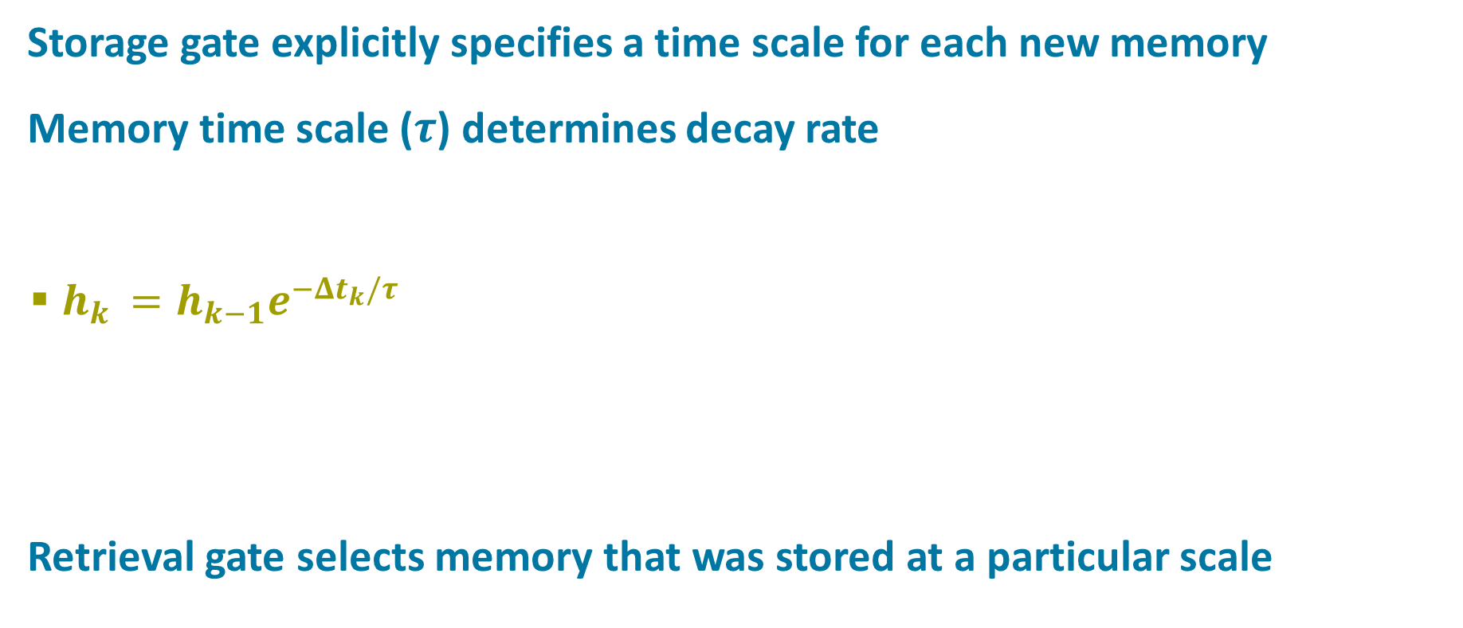




Continuous Time GRU
Storage gate explicitly specifies a time scale for each new memory
Memory time scale ($τ$) determines decay rate
  $h_{k }=h_{k−1}e^{−Δt_{k}/τ}$
Retrieval gate selects memory that was stored at a particular scale
$h$
${Δt}_{k}$
event
$$k−1$$
event
$$k$$

Slide 51












GRU
CT-GRU
$$r$$
$$r$$
$$h_{k−1}$$
$$h_{k−1}$$
+
$$h_{k}$$
$$x_{k}$$
$$s$$
$$x_{k}$$
$$s$$
$$q$$
$$h$$
$$q$$
$$h_{k}$$
$$∆t_{k}$$
Memory is split across time scales
The signal to be stored (q) is deumultiplexed by s
The signal to be retrieved (h) is multiplexed by r
Notes:
memory representation is split across time scale

Slide 52
Time Scales
Represent a continuous span of time scales with a discrete set
  Log-linear spacing of discrete set
Represent any arbitrary scale as a mixture from discrete set
  Goal: match decay half life
Notes:
time scale on horizontal axis (log units)
half life on vertical axis (also log units)
dashed line: the desired relationship
[*] Represent...
open circles = discrete set of scales
[*] Represent...
solid line is what we achieve with a mixture – can get full range
[*]here are decay curves for various time scales:
solid is true exponential decay
dashed is mixture
note that half lives (open circles) match

Slide 53
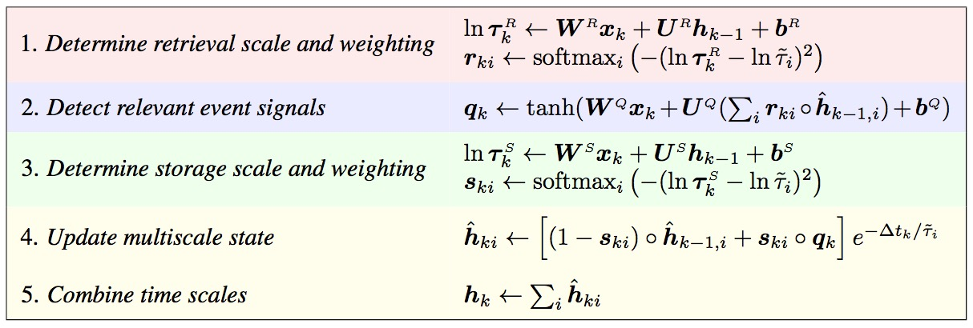



CT-GRU
$$r$$
$$h_{k−1}$$
+
$$h_{k}$$
$$x_{k}$$
$$s$$
$$q$$
$$∆t_{k}$$
Notes:
memory representation is split across time scale

Slide 54
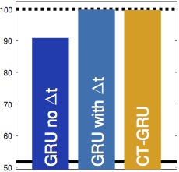
Working Memory Task
Store a symbol for a certain duration
  symbols: A, B, C
  durations: S (1 step), M (10 steps), L (100 steps)
Probe
  Is a specified symbol currently in memory?
100 steps
B
L
A
M
A?
yes
A?
no
Notes:
hard task because many intervening symbols and only delta-t is provided so needs to sum up time

Slide 55
CT-GRU vs. GRU
CT-GRU learns sharper
cut off of memory
CT-GRU learns to use
S/M/L timescales
L
M
S
A
B
C
S
M
L
Storage-Retrieval Lag

Slide 56
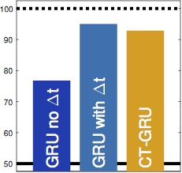
Clustering Task
Detect 3 events in a window of 10 steps
  any order
  other events interspersed
Accuracy

Slide 57
kj
Notes:
orange bar: removing diferent time scales – so just acts like a memory and you can choose which slot to store in

Slide 58
State Of The Research
LSTM and GRU are pretty darn robust
  designed for ordinal sequences, but appears to work well for event sequences
HPM and CT-GRU work as well as LSTM and GRU but not better
  They do exploit different methods of dealing with time
  Explicit representation of time in HPM and CT-GRU may make them more interpretable
Still hope for–at very least—modeling human memory
Notes:
What does this say about domain bias and models? It means I haven’t found the right sort of bias yet
LSTM/GRU have a bias – the recurrent linear self connection – but it’s more of a bias that helps the net propagate gradient signals.
Feels like there has to be more structure in memory systems that we can exploit.
Problem with failure and being stubborn: i’ll probably waste the rest of my life on this
But I welcome any ideas that you have!

