Slide 1
Spring Courses
CSCI 5922 – Probabilistic Models
CSCI 7000 -- Mind Reading Machines Sidney D’Mello W 2:00-4:30 MUEN D418
Can we teach computers how to read peoples’ thoughts and feelings to improve engagement, efficiency, and effectiveness? For example, can computers tell when their users are confused or frustrated, mentally zoned out, cognitively overloaded, or in an optimal mental state? This course will teach you how to make computers smarter and more human-like by reading their users’ minds (much like we do). In this interdisciplinary research-focused course, you will read, present, and discuss key papers in the fields of affective computing, attentional computing, augmented cognition, and multimodal interaction. You will also apply what you learned by developing your own research project. By the end of the course, you will be knowledgeable about the relevant theories and technologies, have conducted hands-on research in the area, and will have sharpened your critical thinking and scientific discourse skills.

Slide 2
CSCI 5922 Neural Networks and Deep Learning: Probabilistic Nets
Mike Mozer
Department of Computer Science and Institute of Cognitive Science University of Colorado at Boulder

Slide 3
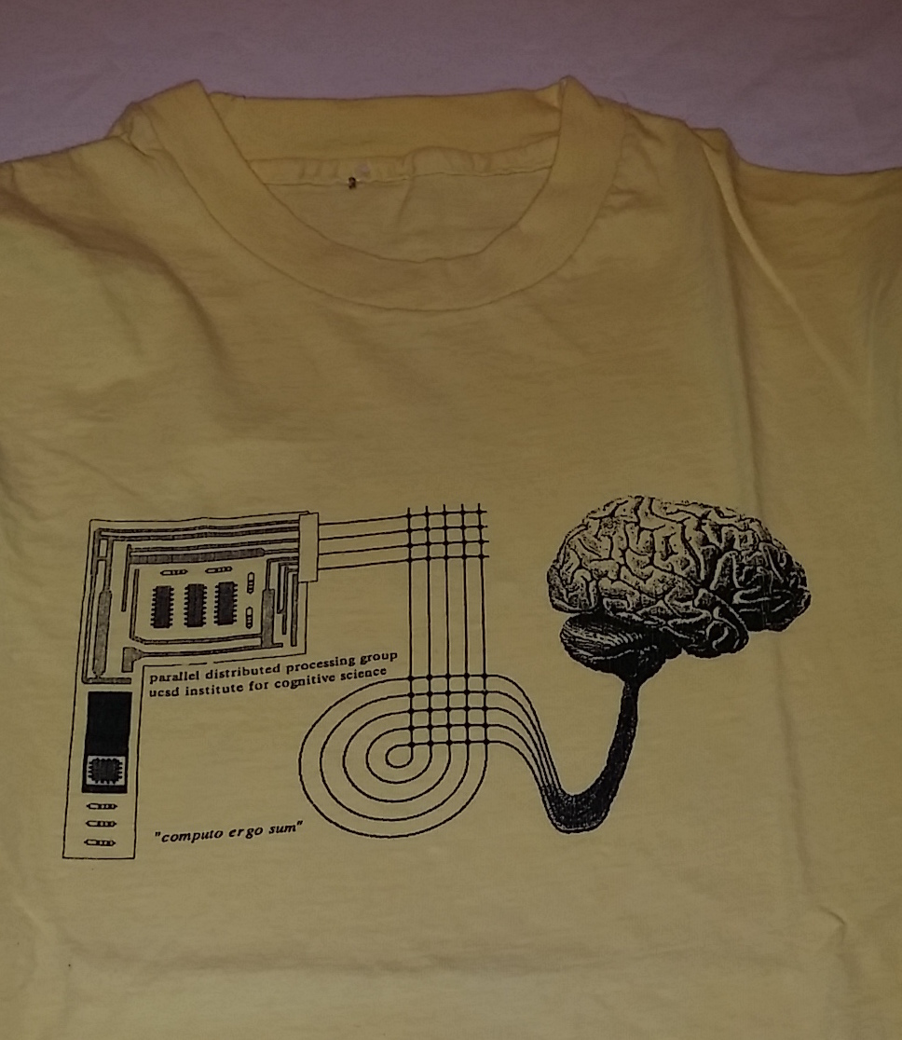
Neural Net T-Shirts

Slide 4
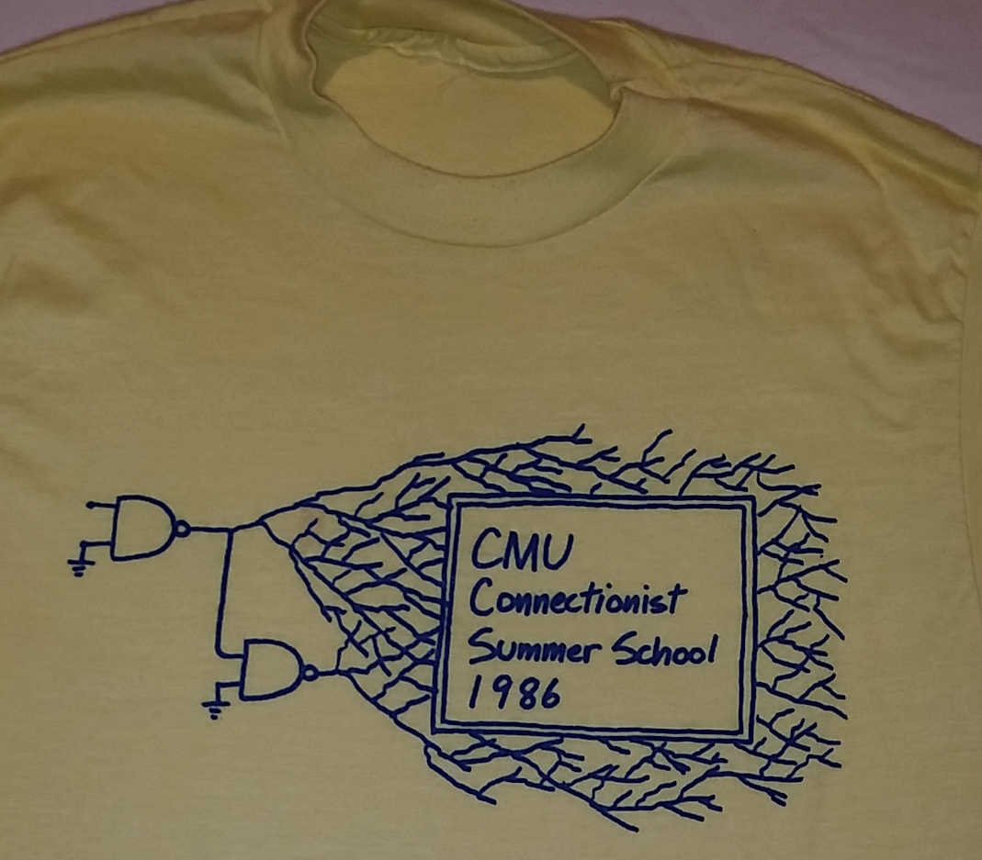
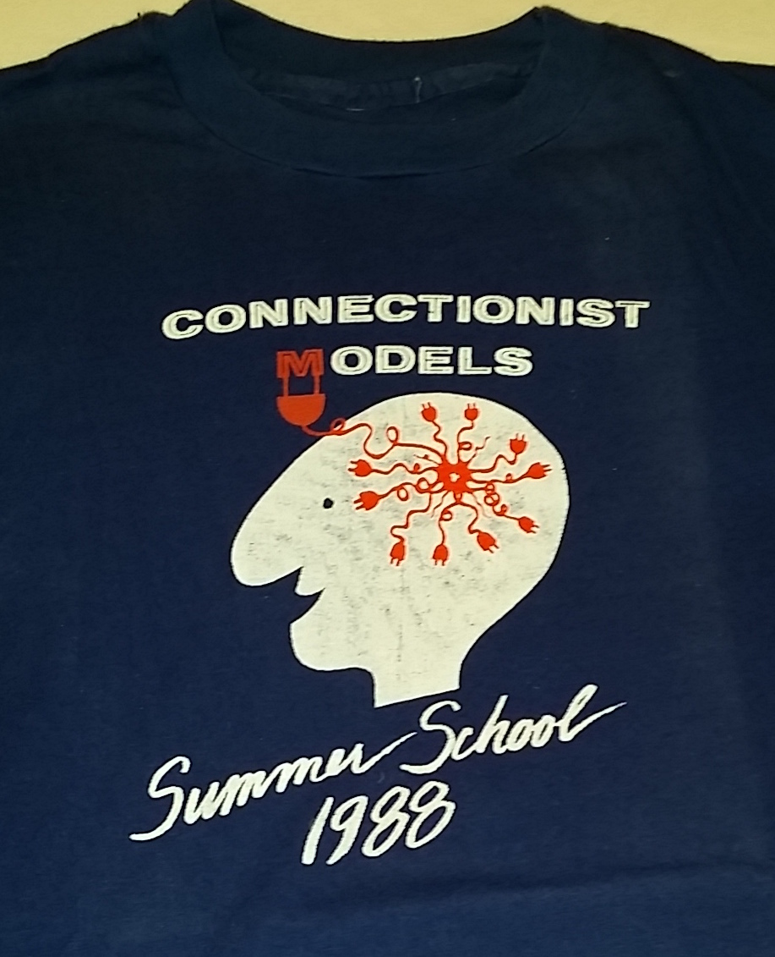
Neural Net T-Shirts

Slide 5
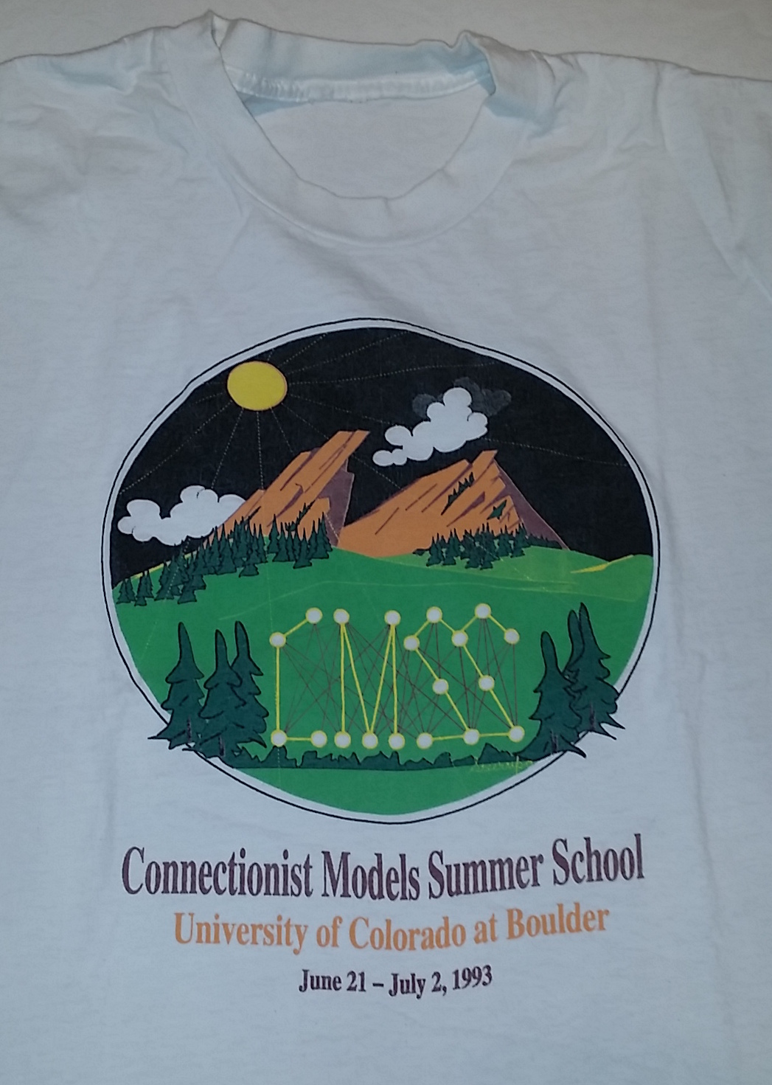
Neural Net T-Shirts

Slide 6
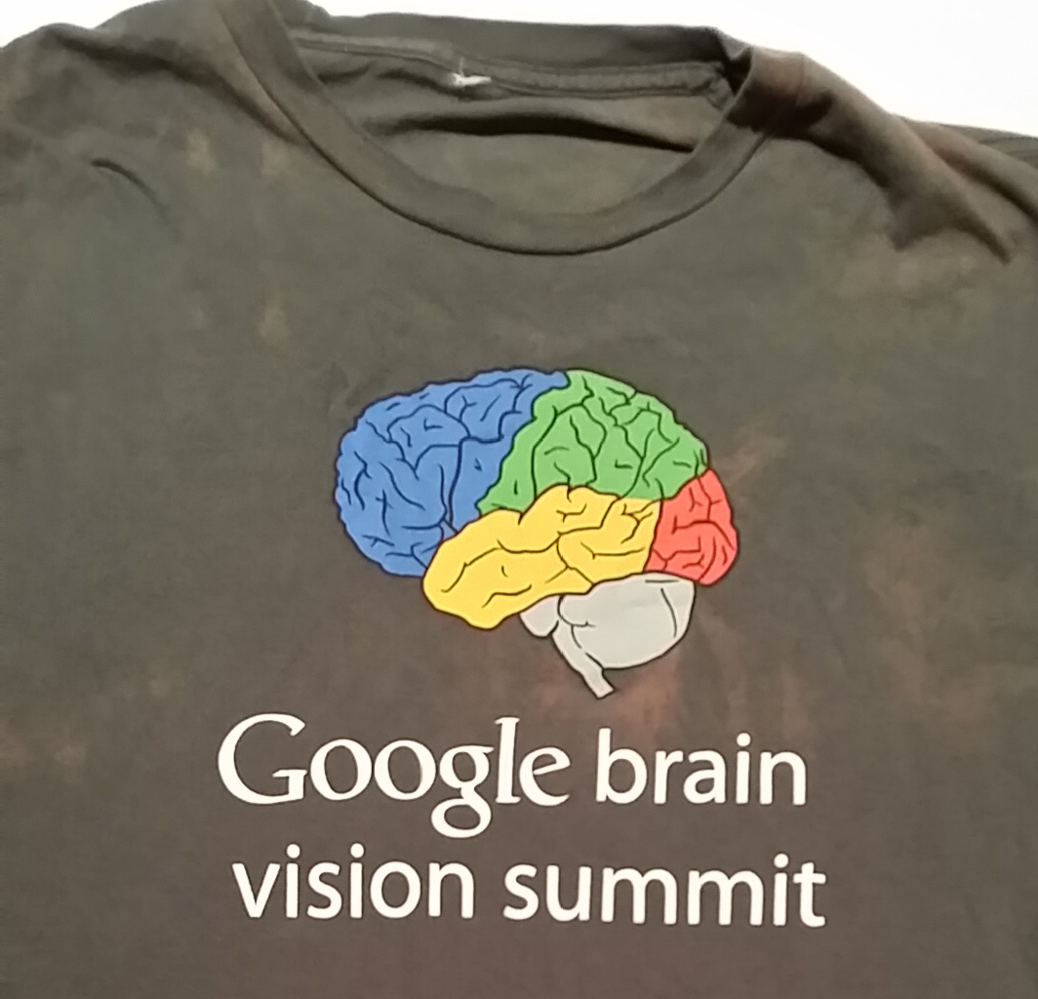
Neural Net T-Shirts

Slide 7
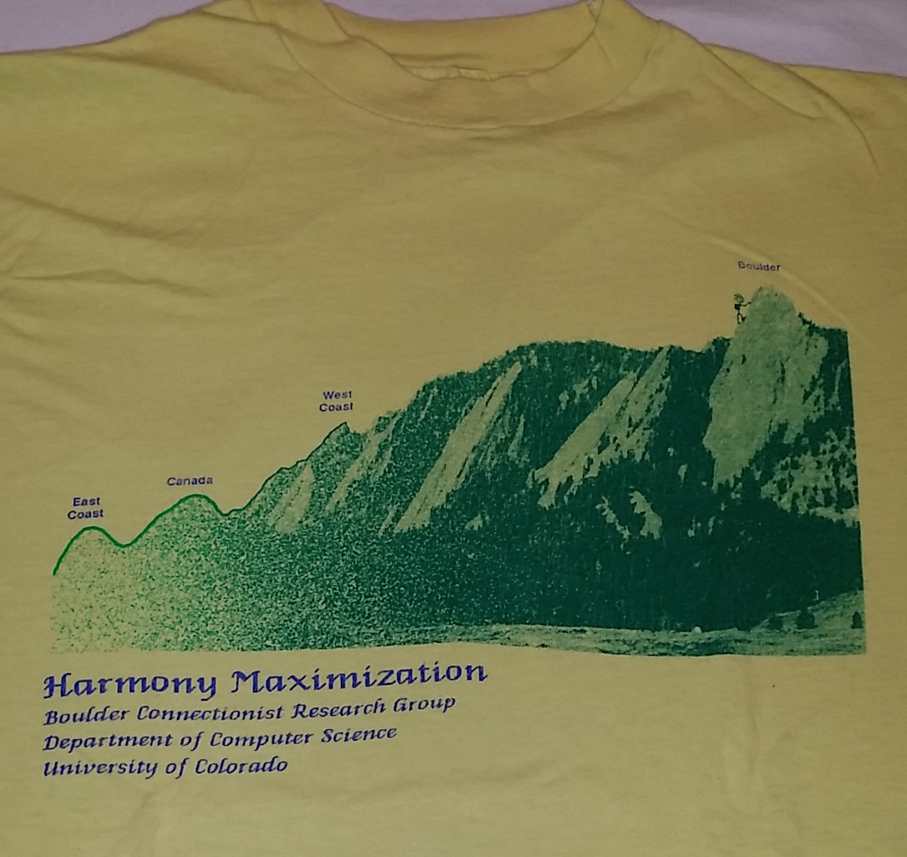
Neural Net T-Shirts

Slide 8
A Brief History Of Deterministic And Stochastic Networks
Boltzmann
Machines /
Harmony Nets
1985
1982
Hopfield
Nets
1986
Back
Propagation
1992 Sigmoid Belief
Networks
2005
Restricted
Boltzmann Machines
and
Deep
Belief
Nets
2009
Deep
Learning
With
Back
Propagation

Slide 9
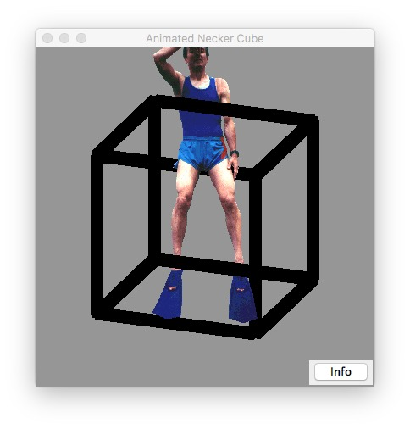
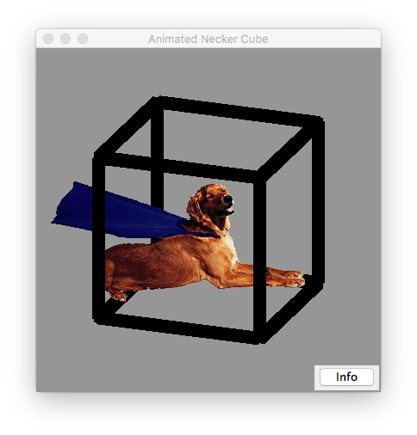
Necker Cube

Slide 10
Selecting One Interpretation of Necker Cube
Notes:
See NeckerApp.jnlp

Slide 11
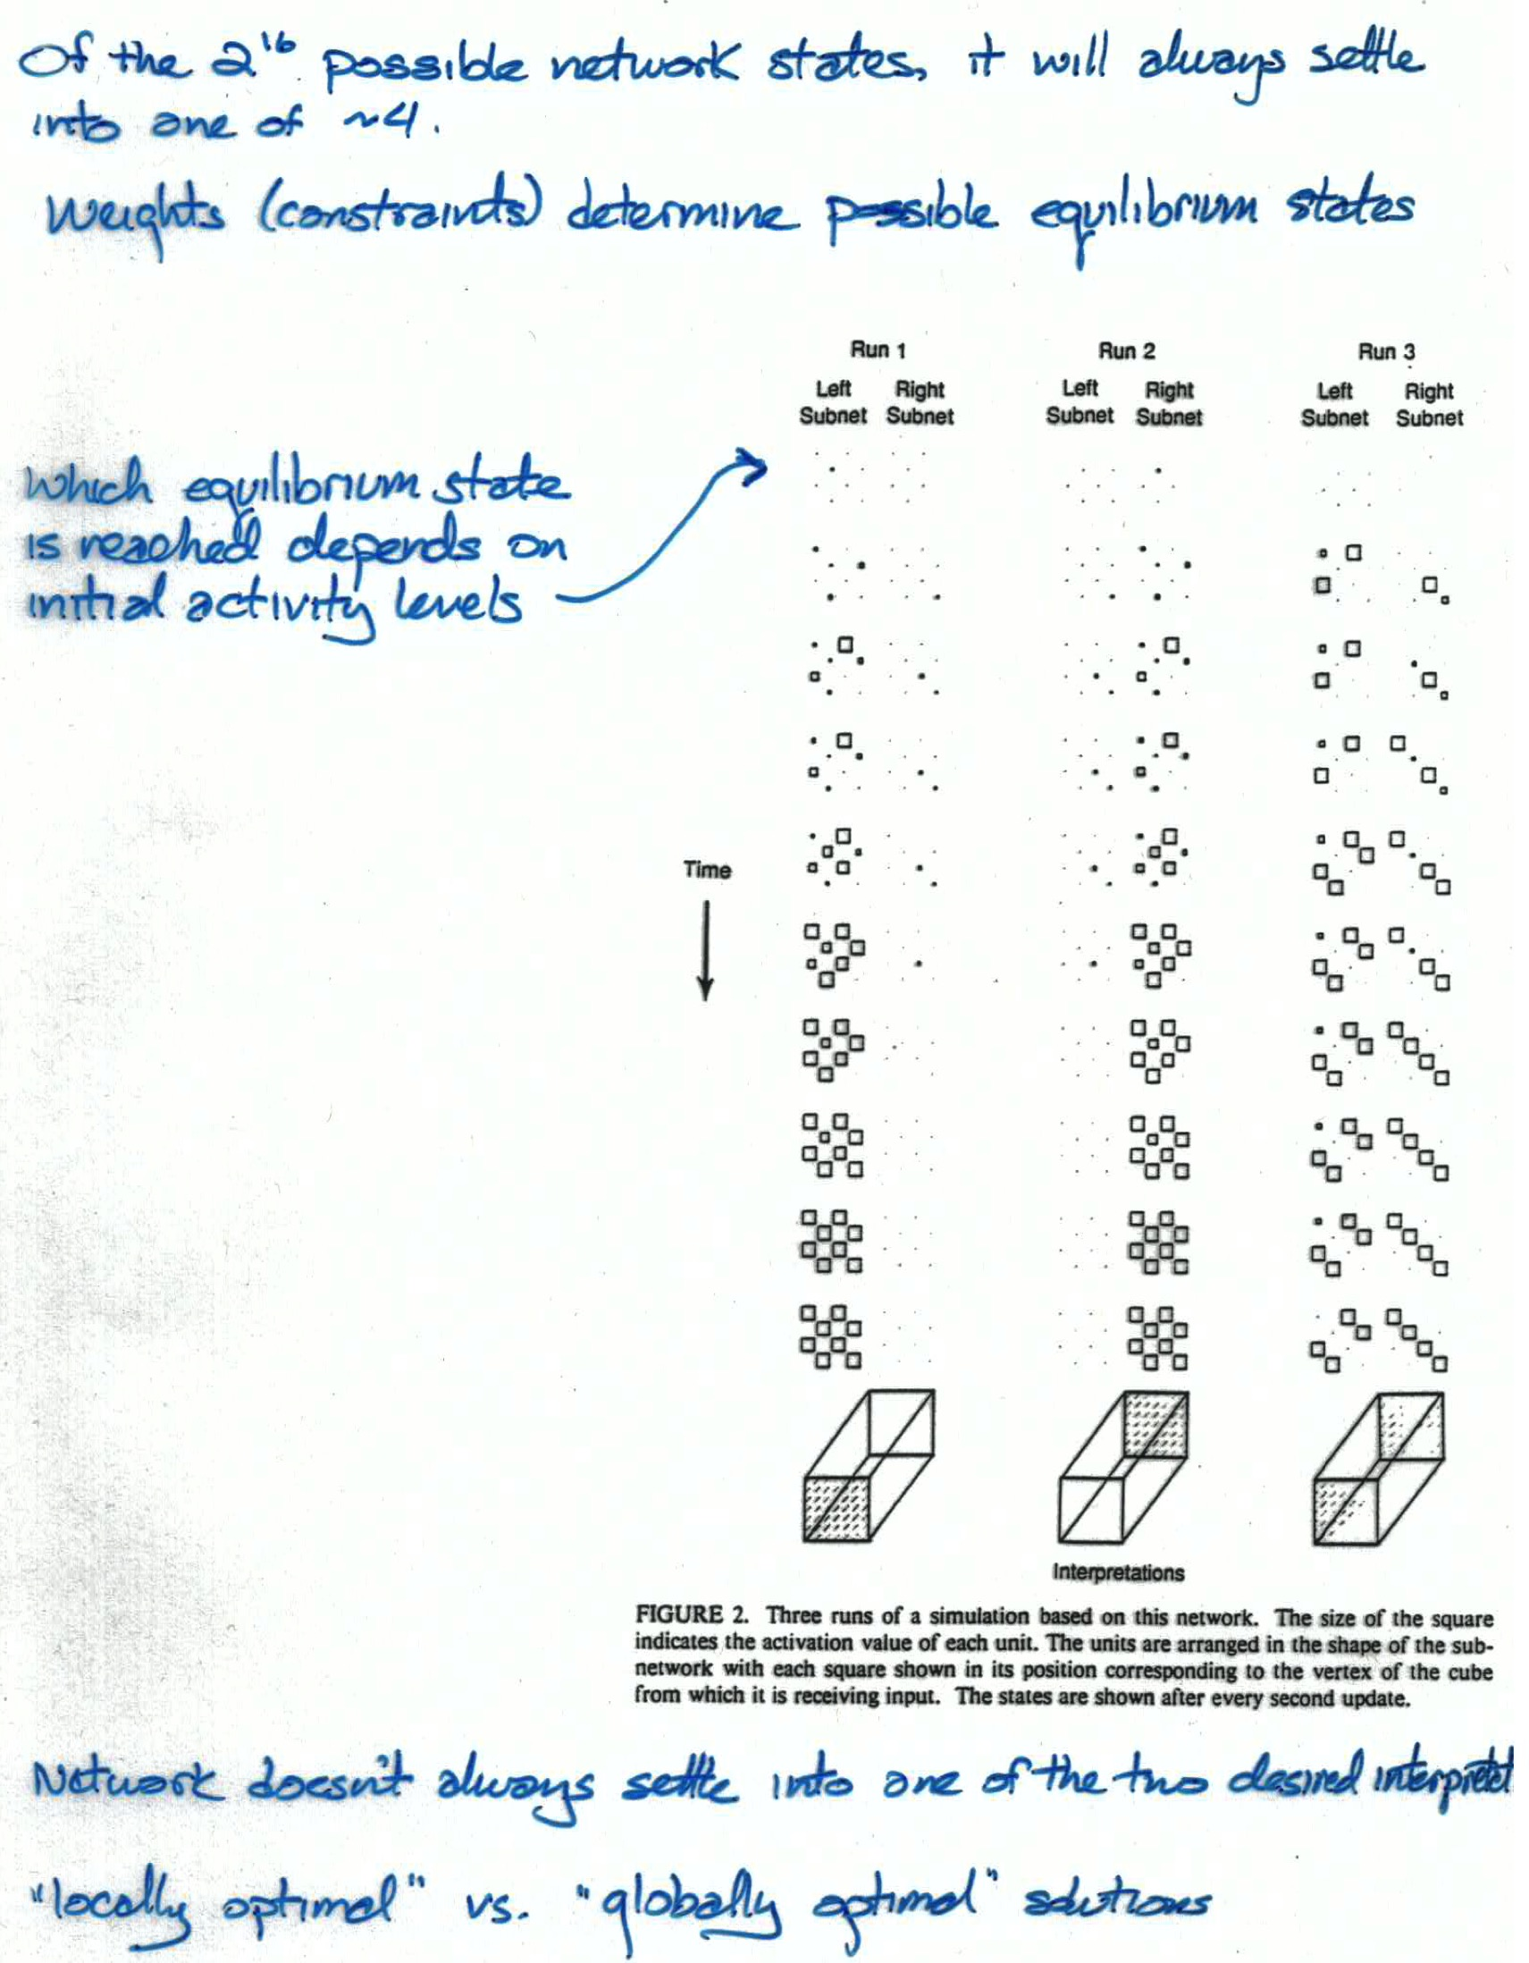

Slide 12
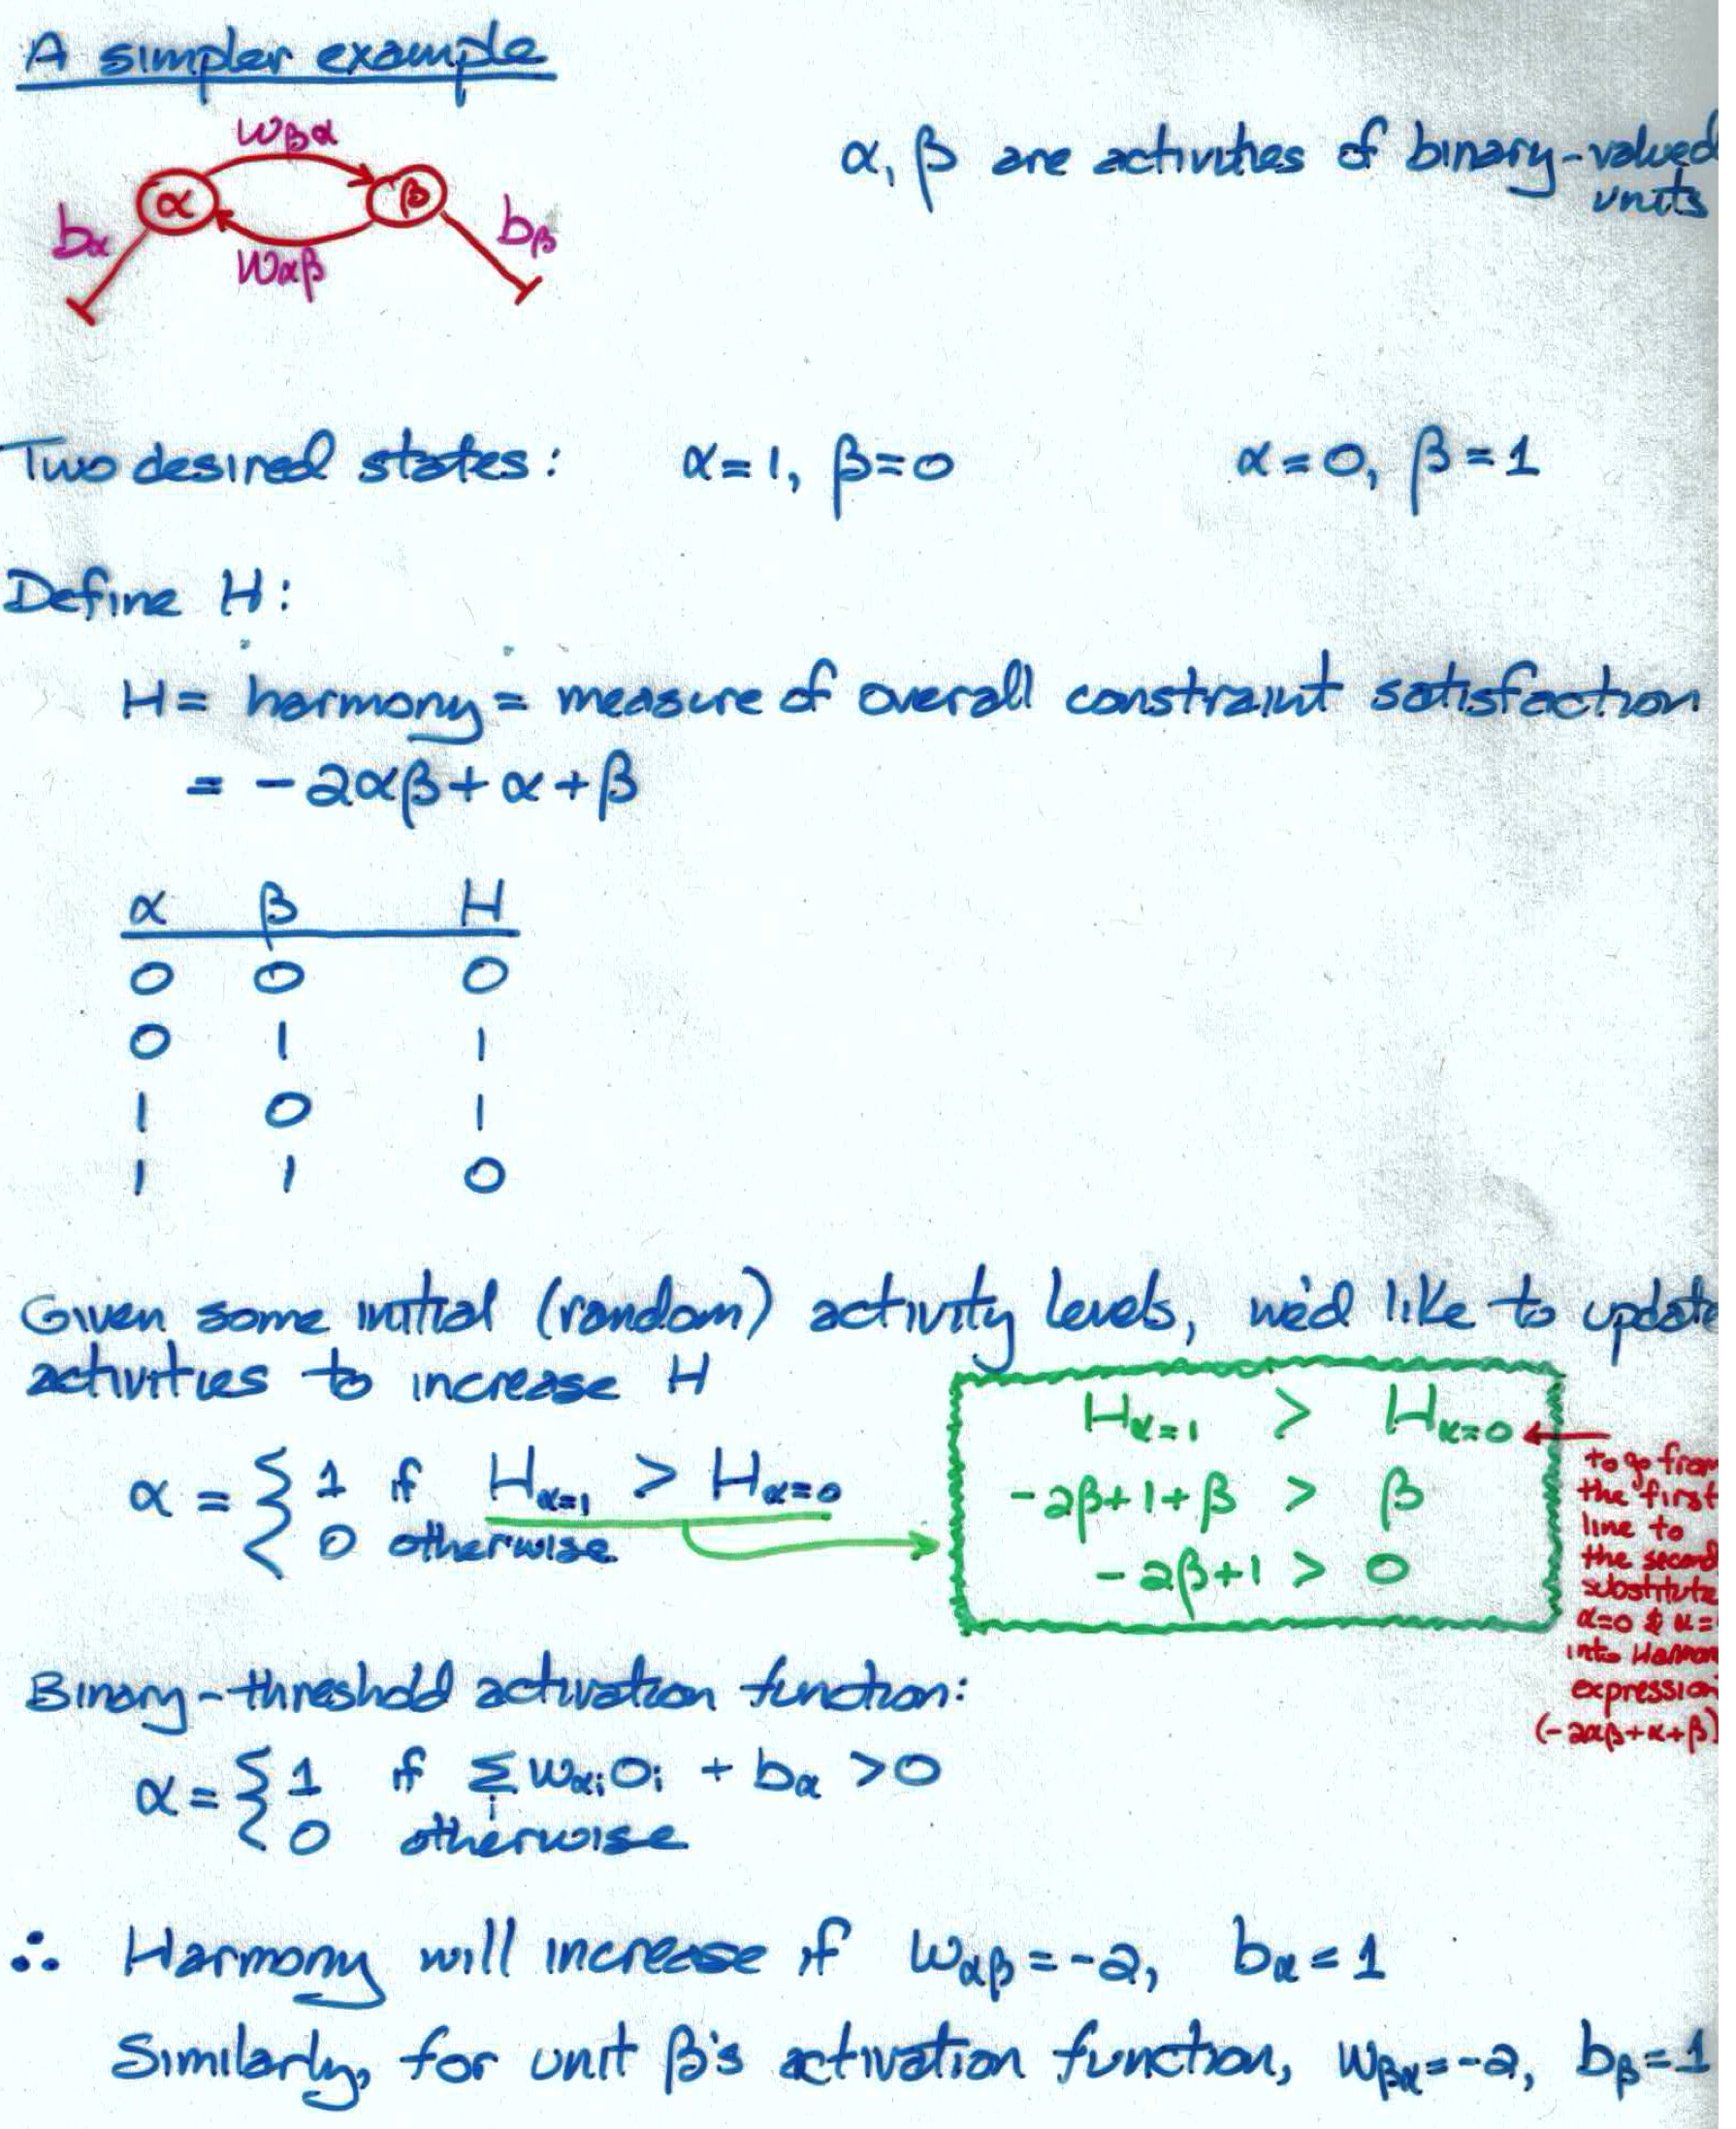

Slide 13
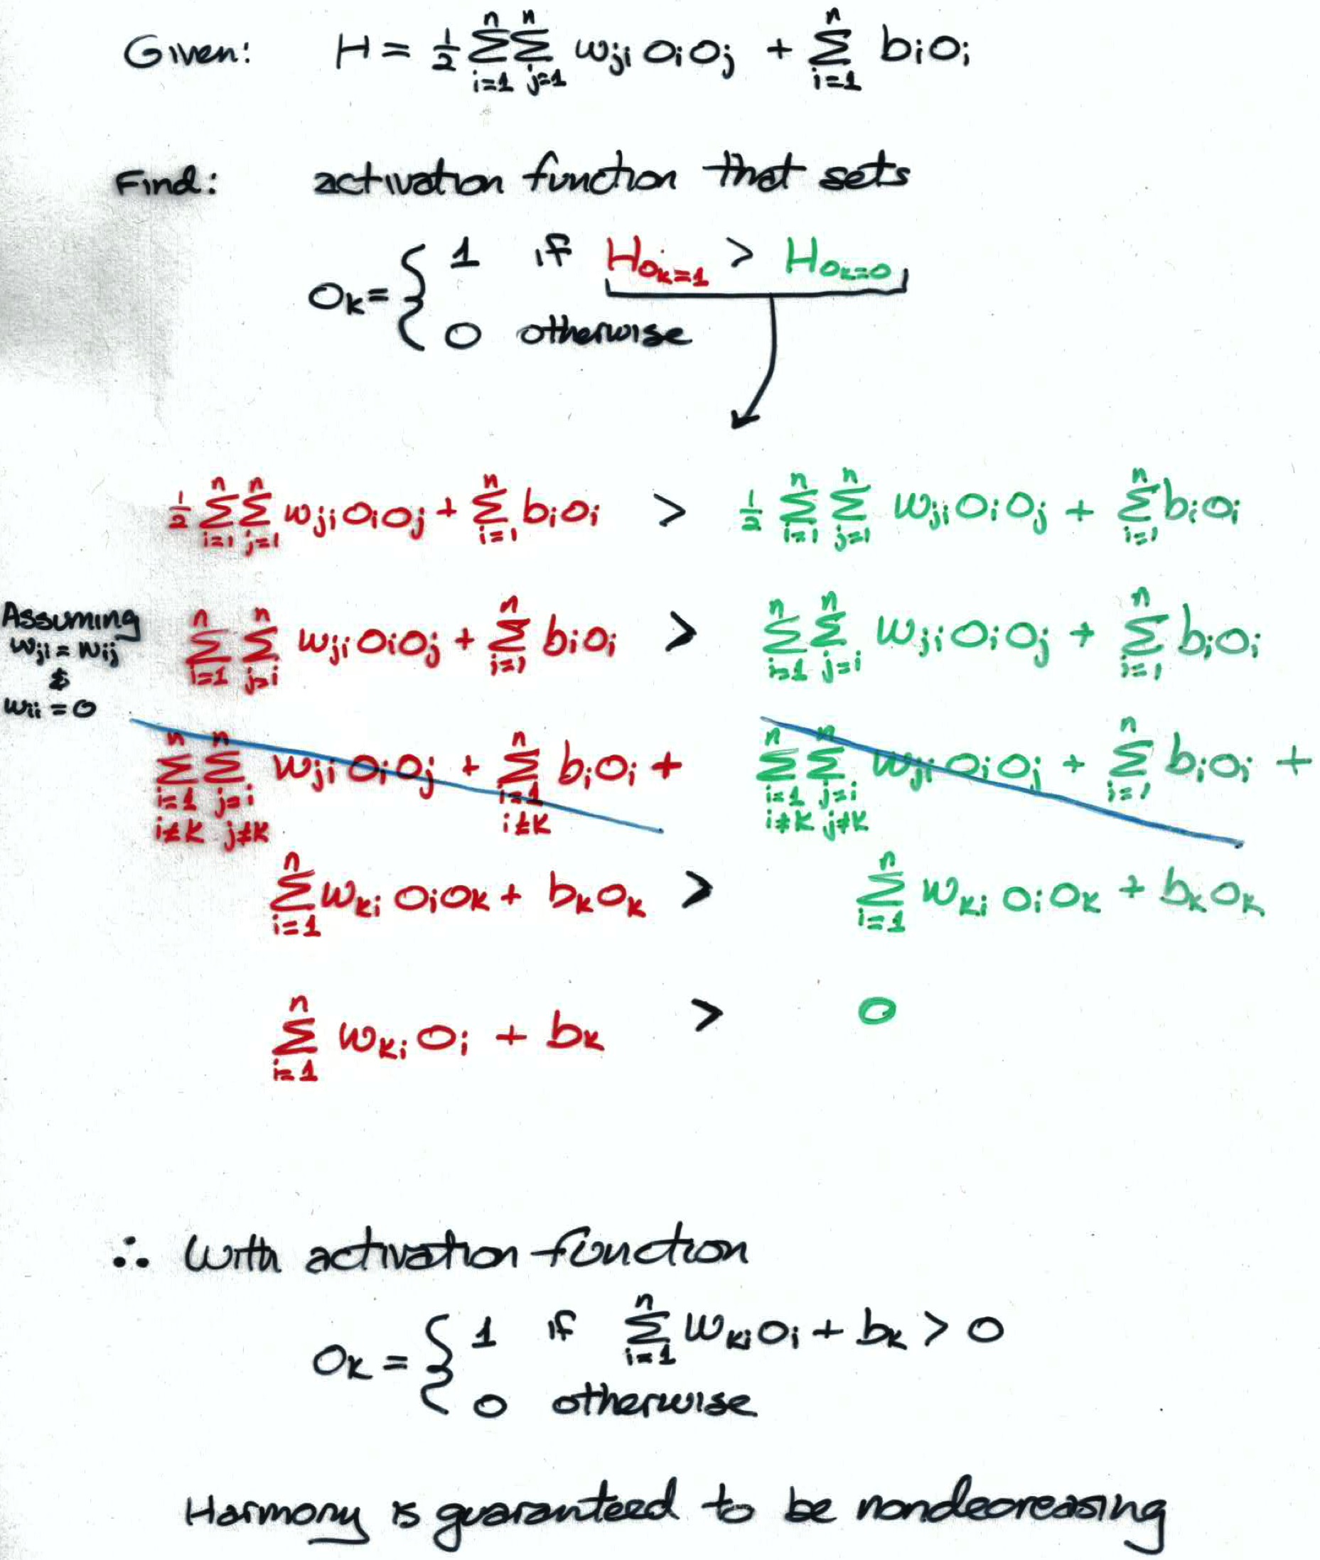

Slide 14
Hopfield Networks
Binary-threshold units
Asynchronous update
Symmetric weights
Solves an optimization problem
minimize energy (or cost or potential)
maximize harmony (or goodness-of-fit)
search for parameters (activities) that produce the best solution

Slide 15
y
h

Slide 16
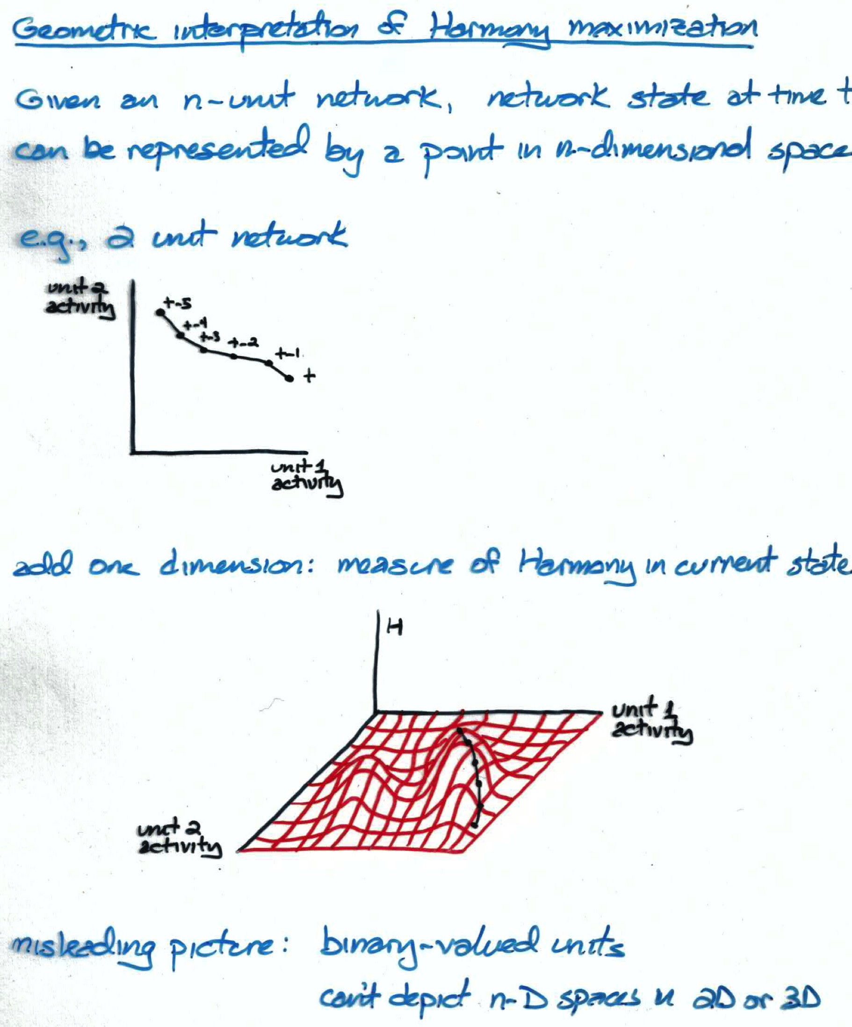

Slide 17
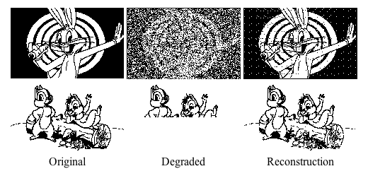
Hopfield Net As Content Addressible Memory
Won’t discuss training procedure because it’s dorky
Hebbian learning
Training on set of patterns causes them to become attractors
Degraded input is mapped to nearest attractor

Slide 18
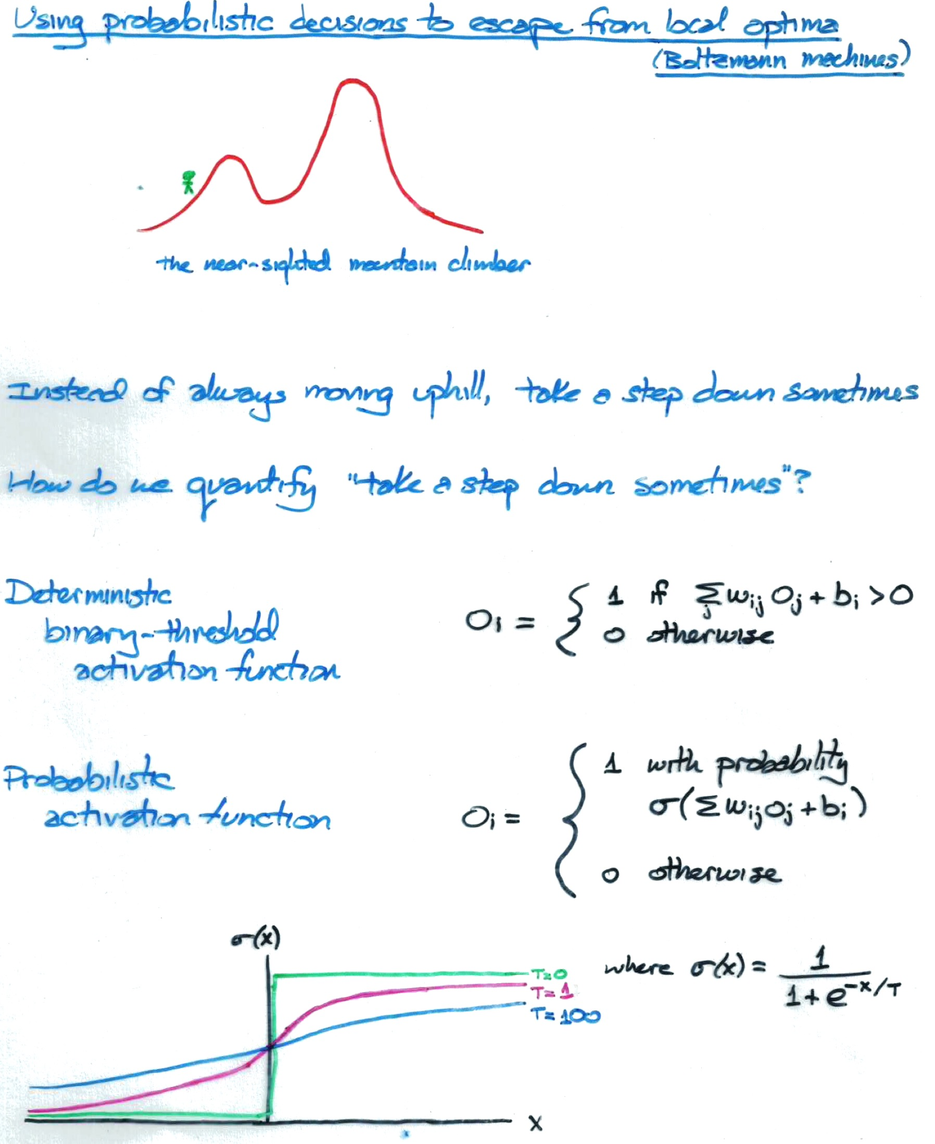

Slide 19
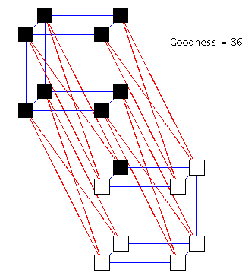
Boltzmann Machine Demo
Necker Cube Demo (Simon Dennis)

Slide 20
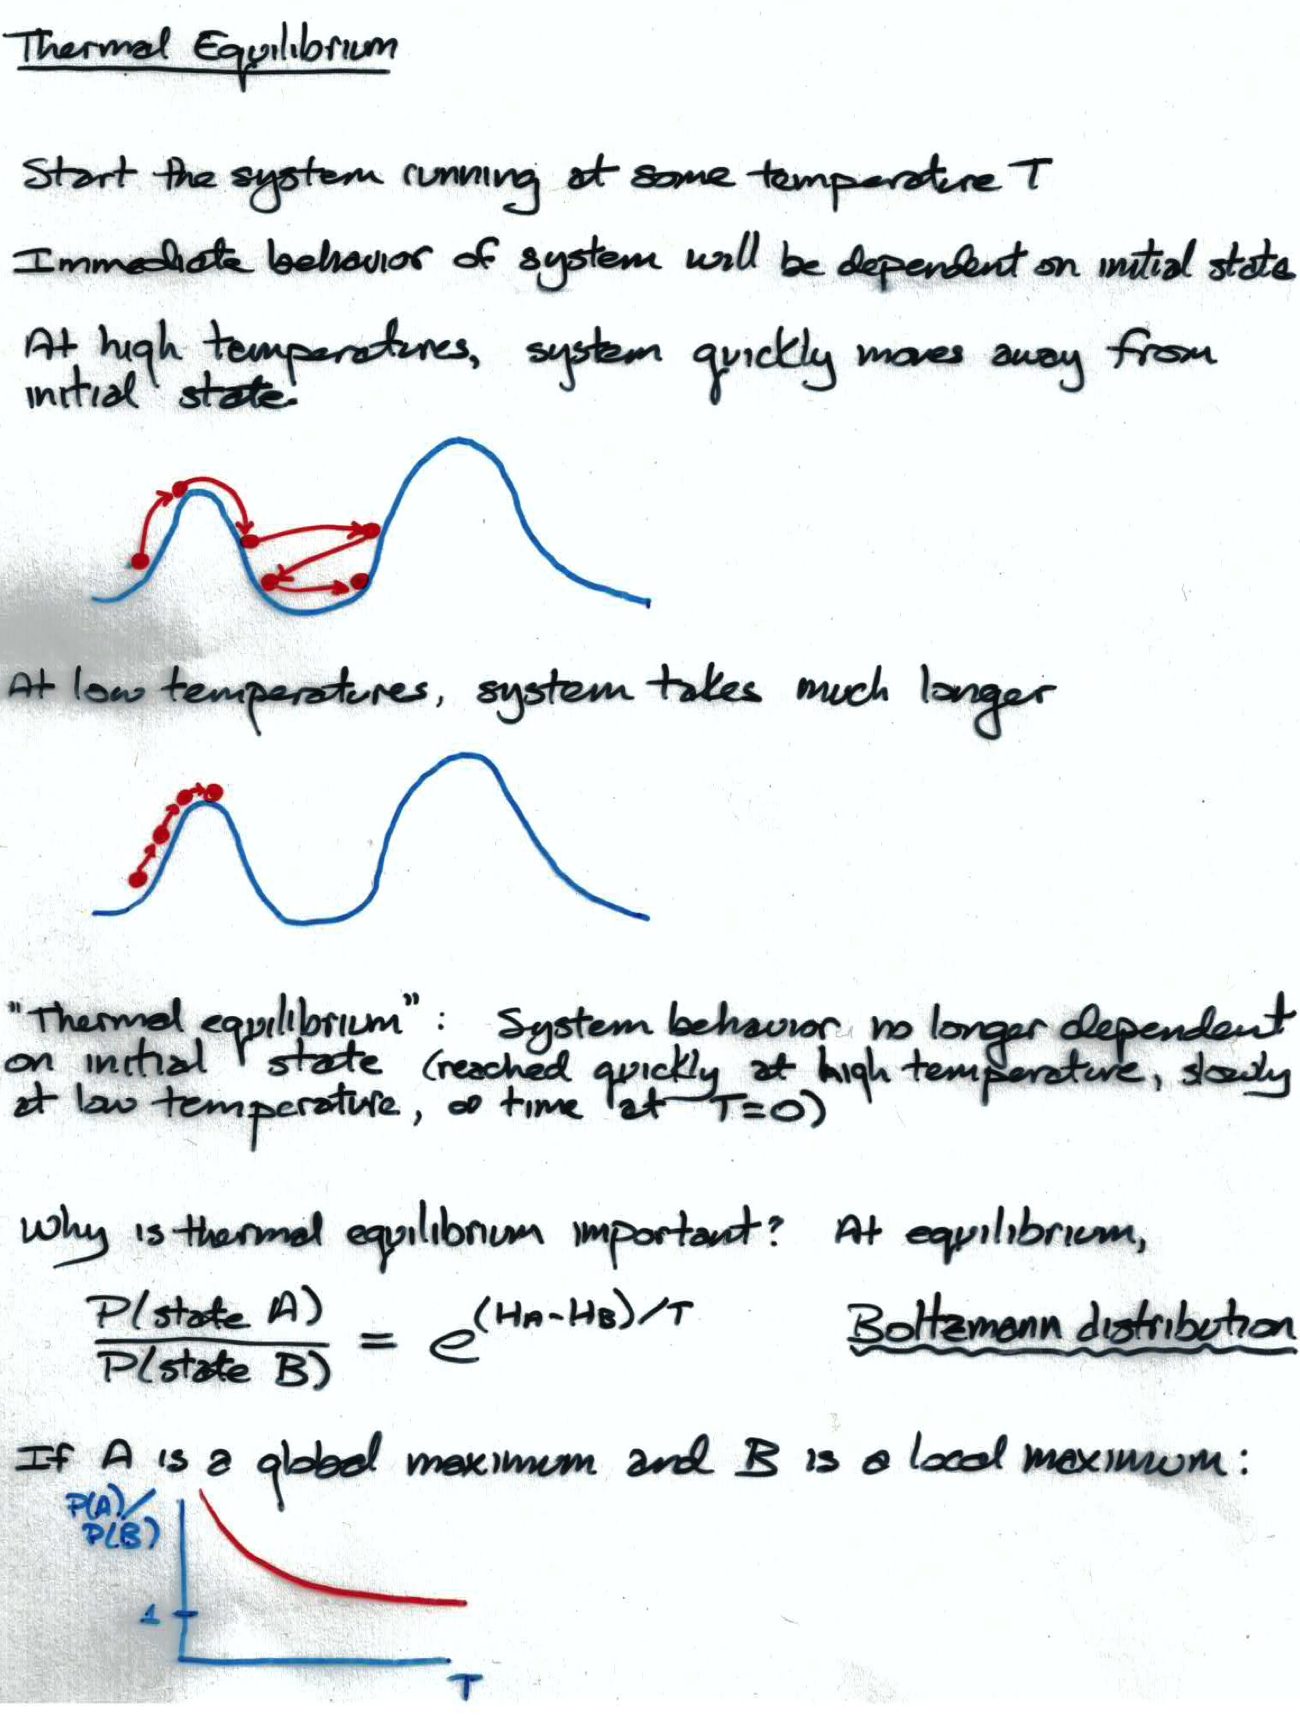
How a Boltzmann machine models data

Slide 21
Three Ways To Specify Inputs
Use input to set initial activations
bad idea: initial activations irrelevant once equilibrium is reached
Use input to clamp or freeze unit activations
clamped neurons effectively vanish from network and serve as bias on hidden neurons
Use input to impose strong bias
set b_{i} such that unit i will (almost) always be off or on

Slide 23
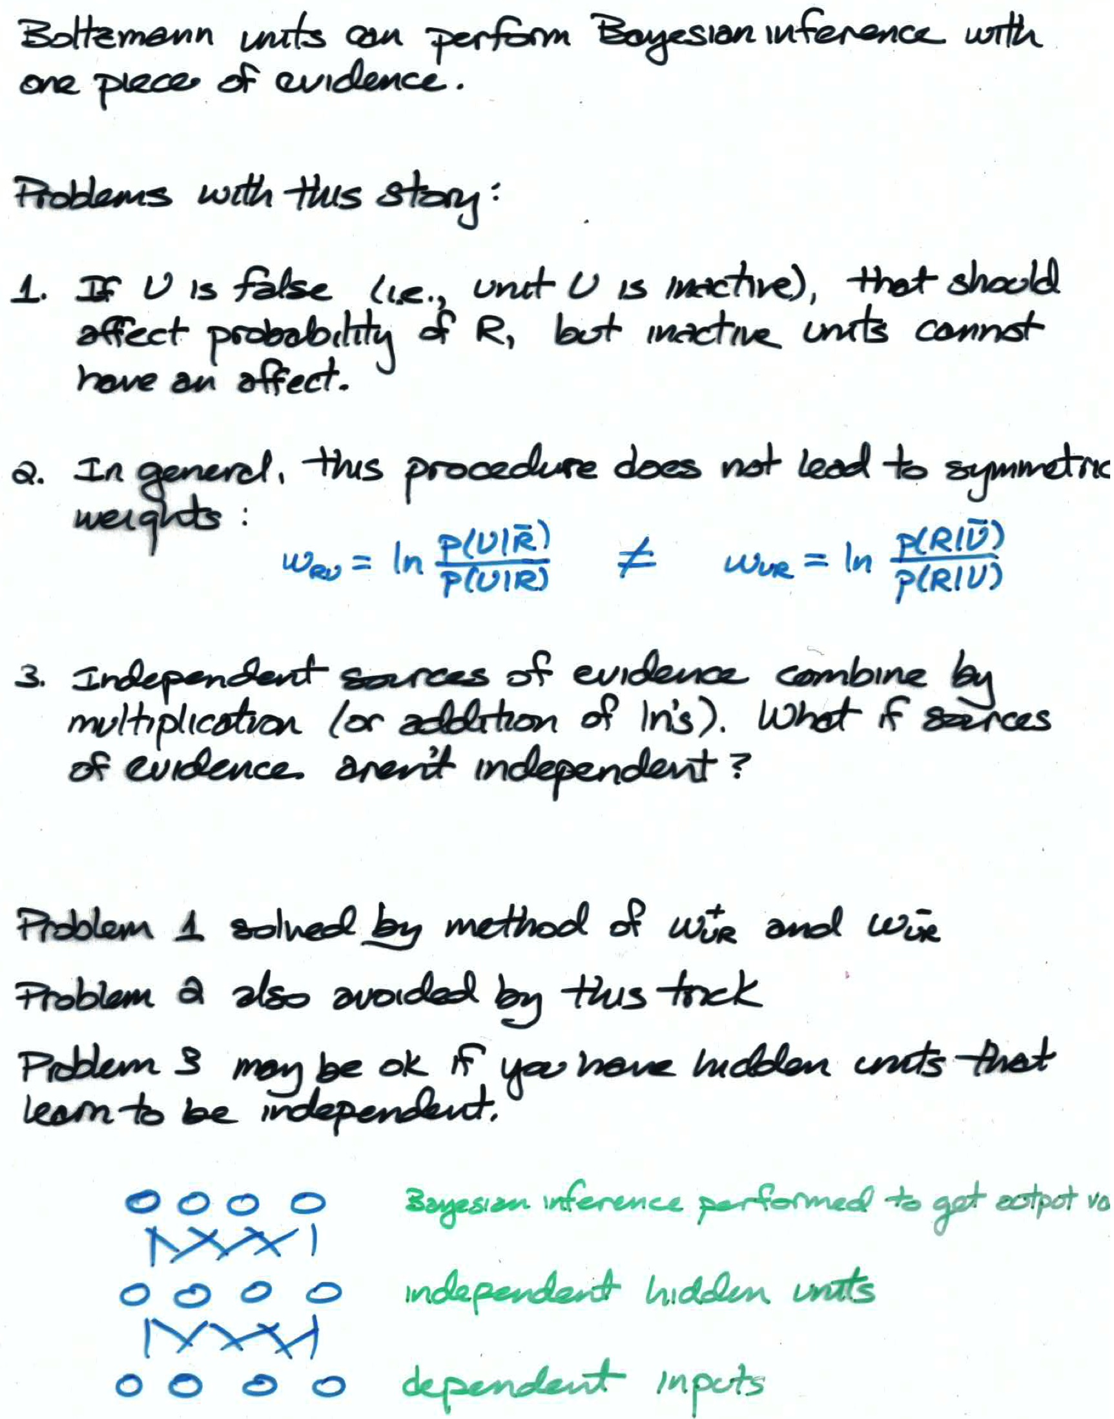

Slide 24
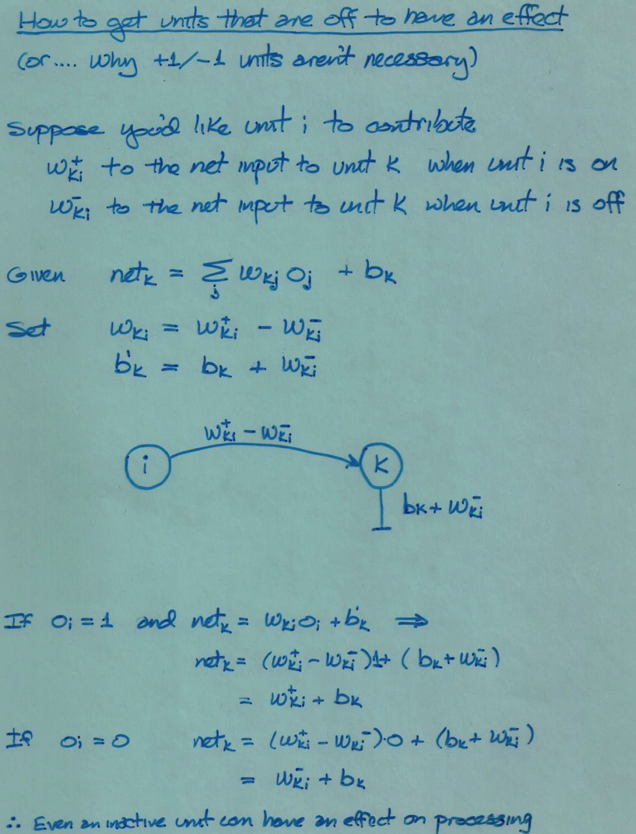

Slide 25
Back To Thermal Equilibrium

Slide 26
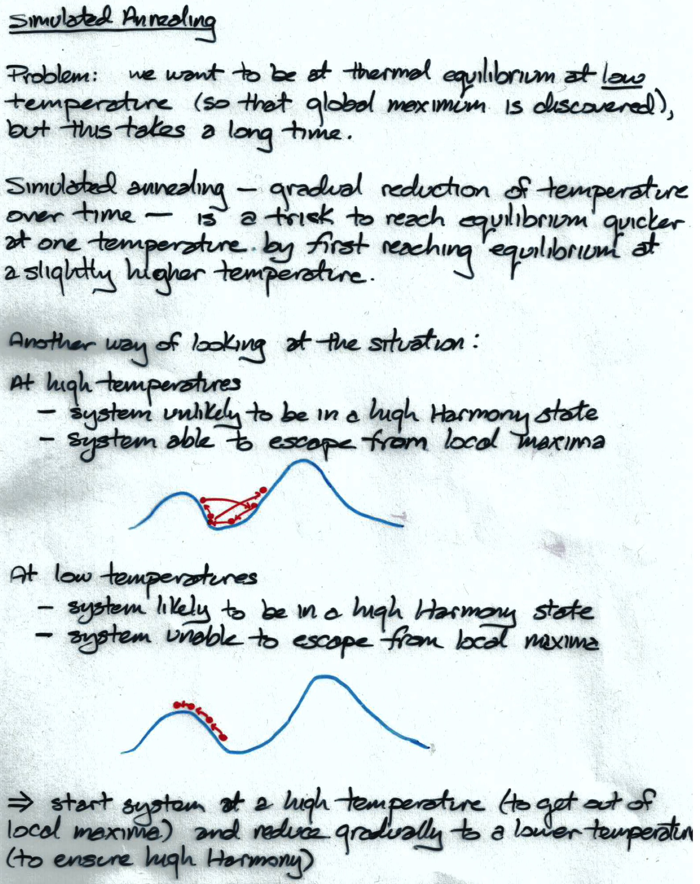
Notes:
statistical physics analogy

Slide 27
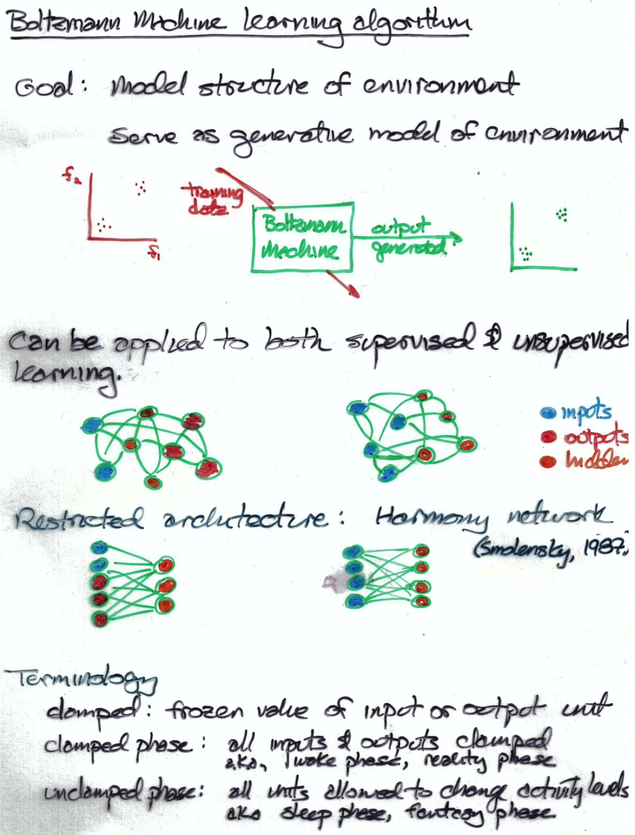

Slide 28
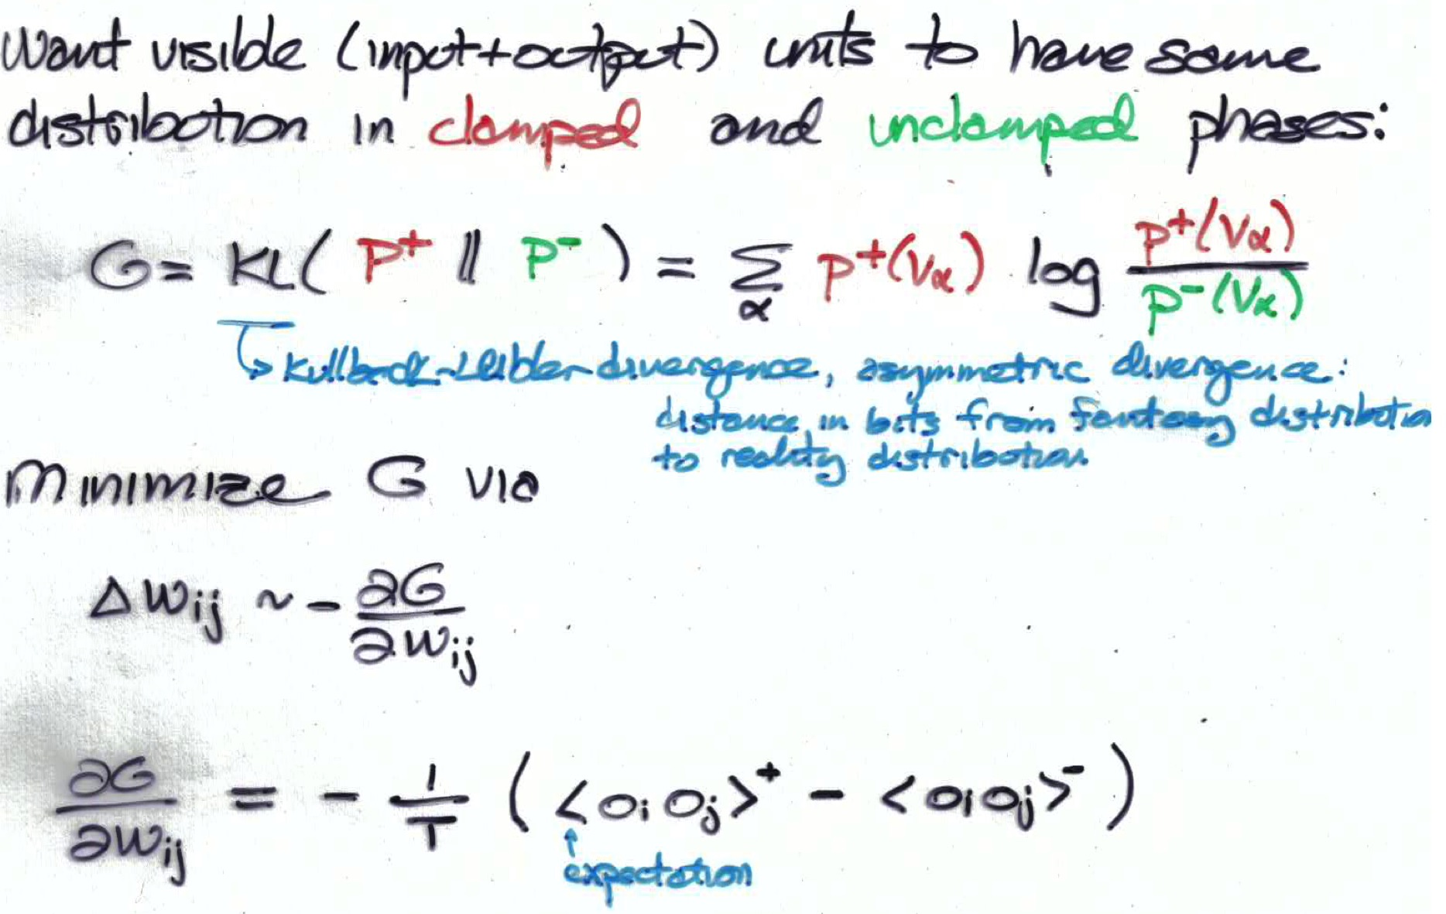
Positive and negative phases
positive phase
clamp visible units set hidden randomly run to equilibrium for given T compute expectations <o_{i}o_{j}>⁺
negative phase
set visible and hidden randomly run to equilibrium for T=1 compute expectations <o_{i}o_{j}>⁻
no need for
back propagation
Notes:
didn’t scale up, computers weren’t fast enough -> people thought boltzmann machines would never be practical

Slide 29
Why Boltzmann Machine Failed
Too slow
loop over training epochs loop over training examples loop over 2 phases (+ and -) loop over annealing schedule for T loop until thermal equilibrium reached loop to sample <o_{i}o_{j}>
Sensitivity to annealing schedule
Difficulty determining when equilibrium is reached
As learning progresses, weights get larger, energy barriers get hard to break -> becomes even slower
Back prop was invented shortly after
The need to perform pattern completion wasn’t necessary for most problems (feedforward nets sufficed)

Slide 30
Comments On Boltzmann Machine Learning Algorithm
No need for back propagation
reaching thermal equilibrium involves propagating information through network
Positive and negative phase
positive phase
clamp visible units set hidden randomly run to equilibrium for T=1 compute expectations <o_{i}o_{j}>⁺
negative phase
set visible and hidden randomly run to equilibrium for T=1 compute expectations <o_{i}o_{j}>⁻
Why Boltzmann machine failed (circa 1985)

Slide 31
Restricted Boltzmann Machine (also known as Harmony Network)
Architecture
Why positive phase is trivial
Contrastive divergence algorithm
Example of RBM learning
Notes:
gibbs sampling /
what if inputs are continuous: then make input units linear with gaussian noise

Slide 32
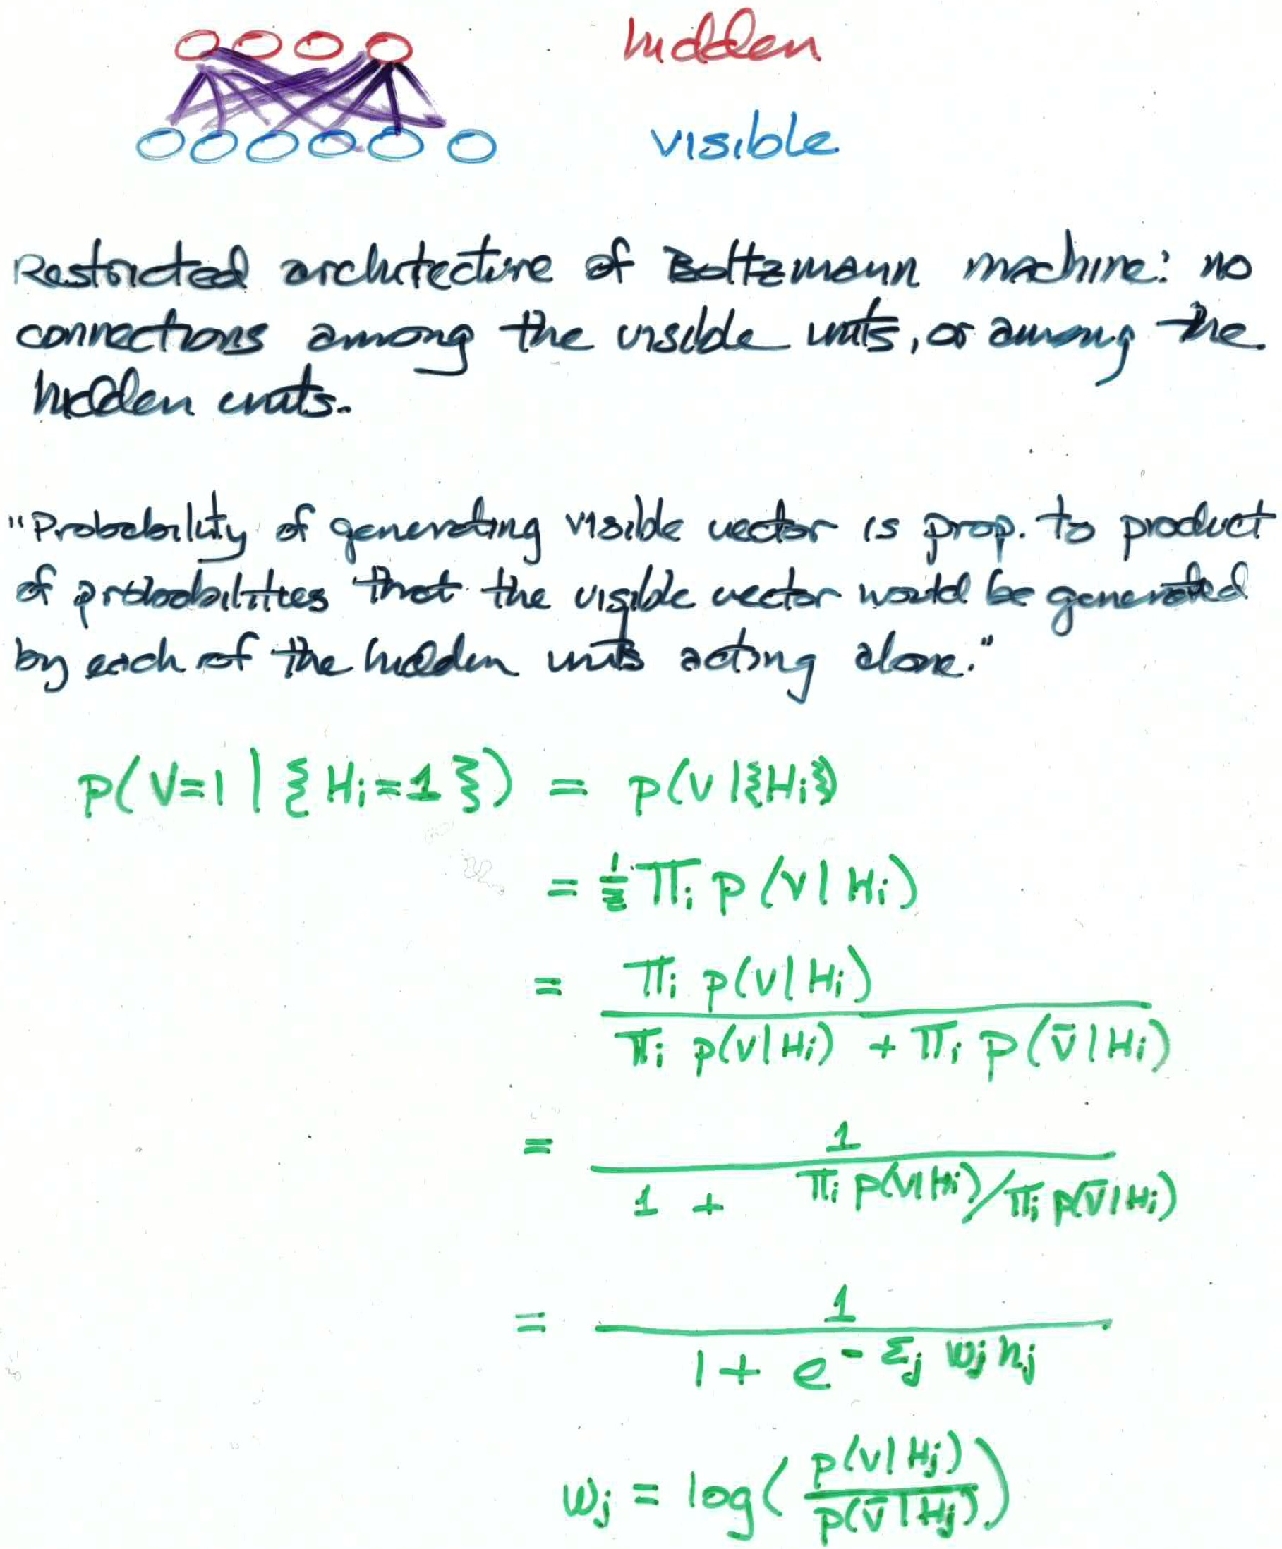
RBM Generative Model As A Product Of Experts

Slide 33
Deep RBM Autoencoder
You’ve
seen this
before
Hinton & Salakhutdinov (2006)
Notes:
Guarantee that stacking improves

Slide 34
Reminder (From Unsupervised Learning Lecture)

Slide 36
USED IN DEEP NETS LECTURE

Slide 37
Deep Belief Nets (DBNs): Using Stacked RBMs As A Generative Model
H3
H2
H3
H2
H2
H1
H1
H1
V
V
Generative model is not a Boltzmann machine
Why do we need symmetric connections between H2 and H3?

Slide 38
Using A DBN For Supervised Learning
1. Train RBMs in unsupervised fashion
2. In final RBM, include additional units representing class labels
3a. Recognition model
Use feedforward weights and fine tune with back prop
3b. Generative model
Alternating Gibbs sampling between H3 and H4, and feedback weights elsewhere
H1
H2
H3
V
H1
H2
H4
L
H3
L
L
H4
H4
H3
H3
H2
H2
H1
H1
V
V

Slide 39
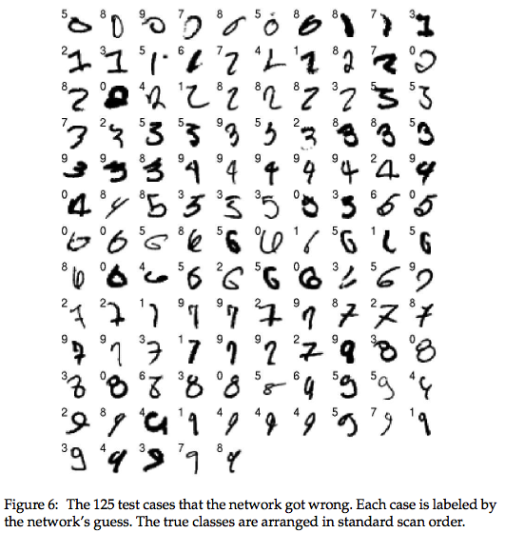
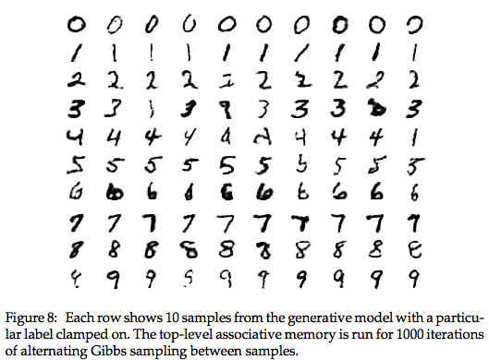
Performance on MNIST (Hinton, Osindero, & Teh, 2006)
generative model
recognition model

Slide 40
Suskever, Martens, Hinton (2011) Generating Text From A Deep Belief Net
Wikipedia
The meaning of life is the tradition of the ancient human reproduction: it is less favorable to the good boy for when to remove her bigger. In the show’s agreement unanimously resurfaced. The wild pasteured with consistent street forests were incorporated by the 15th century BE. In 1996 the primary rapford undergoes an effort that the reserve conditioning, written into Jewish cities, sleepers to incorporate the .St Eurasia that activates the population. Mar??a Nationale, Kelli, Zedlat-Dukastoe, Florendon, Ptu’s thought is. To adapt in most parts of North America, the dynamic fairy Dan please believes, the free speech are much related to the
NYT
while he was giving attention to the second advantage of school building a 2-for-2 stool killed by the Cultures saddled with a half- suit defending the Bharatiya Fernall ’s office . Ms . Claire Parters will also have a history temple for him to raise jobs until naked Prodiena to paint baseball partners , provided people to ride both of Manhattan in 1978 , but what was largely directed to China in 1946 , focusing on the trademark period is the sailboat yesterday and comments on whom they obtain overheard within the 120th anniversary , where many civil rights defined , officials said early that forms , ” said Bernard J. Marco Jr. of Pennsylvania , was monitoring New York

