Slide 1
CSCI 5922 Neural Networks and Deep Learning Leveraging Domain Knowledge
Mike Mozer
Department of Computer Science and Institute of Cognitive Science University of Colorado at Boulder

Slide 2
Means Of Imposing Domain-Appropriate Bias
Data augmentation
Loss function
Representation
Architectural constraints
What you’d like
Prescription for
intelligently customizing
model to your problem
domain
What I can offer
Many examples of creative approaches to exploit various
sorts of domain knowledge and expertise
Notes:
[*] What you really want
[*] what i can offer
[*] let's start with data augmentation

Slide 3
DATA AUGMENTATION
Flips and shifts – alexnet
Imaging conditions – simulating exposure setting (kVp) via constrast level randomization
Order invariance (Hanson, Roads, & Mozer)

Slide 4
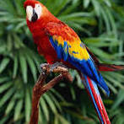
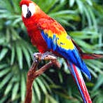
Data Augmentation AlexNet (Krizhevsky, Sutskever, & Hinton, 2012)
Obtain robustness to translation
select random 224x224 sub-images from 256x256 original
Exploiting mirror reversibility of natural images
include horizontal reflections
Obtain invariance to intensity and color of illuminant
add constant (R,G,B) shift to all pixels in image
$\sum_{i}{ε_{i}λ_{i}p_{i}}$
For testing, average predictions of 5 224x224 patches
principal component $i$ of pixel (R,G,B) vector
eigenvalue of PC $i$
$$𝓝\left(0,.1^{2}\right)$$
Notes:
They used a bunch of tricks to augment the already large data set that they had
[*]robustness to translation:
images are already normalized, so not a lot of room to shift
[*] horizontal reflections: std trick in CV
[*] to obtain invariance to intensity of images and
color of light source

Slide 5
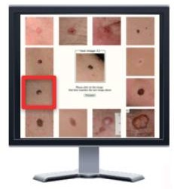
Data Augmentation (Roads & Mozer, 2017)
query image
reference image
Please select the reference image that best matches the query image.
Notes:
Goal: diagnose a query image by judging similarity to multiple reference images
Reference images all have known labels

Slide 6
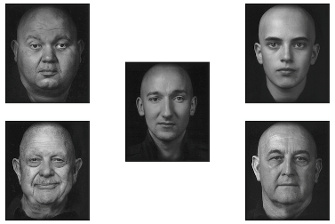
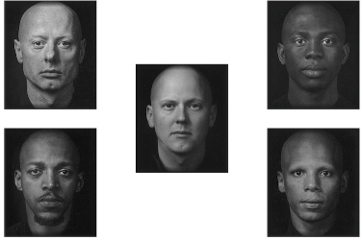
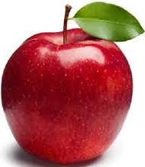
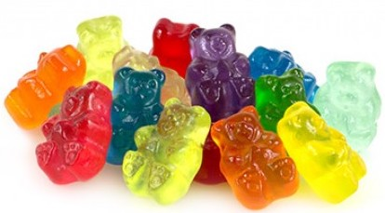
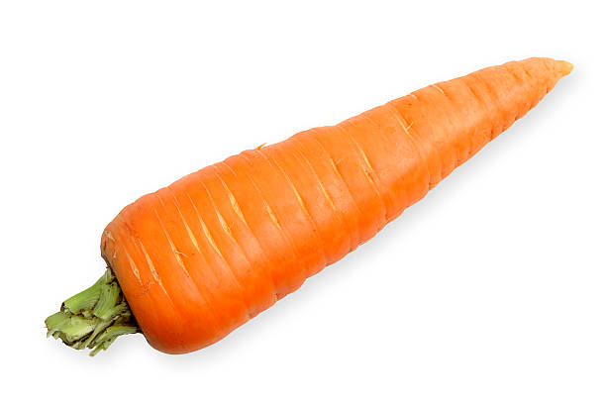
Data Augmentation (Roads & Mozer, 2017)
How does the set of choices influence which reference will be chosen?
Notes:
We did experiments with simpler set of objects: faces.
Problem is that choices depend not just on similarity of the probe to each reference, but on the set of references.
[*] we want to predict how the set of choices influences which one is chosen.
Psychologists refer to this as a contextual effect, and they’re very strong in human behavior:
[*] apple vs. candy bar -> candy.
[*] apple, carrot, candy bar -> apple
the appeal of the apple depends on choices
similarly, what features of the faces you focus on depends on the set of faces (young vs. old)

Slide 7
Data Augmentation (Hanson, Roads, & Mozer, in preparation)
$$y∈\{1,2,3,4\}$$
Neural Net
probe
ref. 1
ref. 2
ref. 3
ref. 4
reference permutations
. . .
Accuracy without data augmentation | Accuracy with data augmentation
38.1% | 46.4%
Notes:
both better than chance but not good.
we're working on models that can get 70-80% correct.

Slide 8
Summary: Imposing Domain-Appropriate Bias Via Data Augmentation
Data augmentation can be used to encourage invariance of various forms.
spatial transformation invariance
image mirror symmetry
order invariance
Could design architecture to enforce invariance, but data augmentation is often simpler.
Requires understanding only of generative process, not recognition process
Notes:
[*][*]generative process: how data are produced
recognition process: how data are processed bottom up

Slide 9
Means Of Imposing Domain-Appropriate Bias
Data augmentation
Loss function
Representation
Architectural constraints

Slide 10
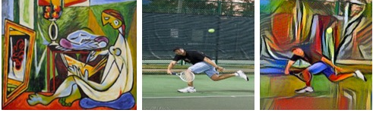
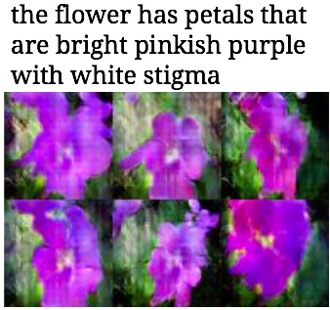
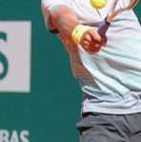
Loss Functions For Image Processing
Gatys, Ecker, &
Bethge, 2015
style
content
Image transformation
Image synthesis
Image reconstruction
original
super-resolution
Notes:
What kind of image processing tasks?
[*] image transformation
[*] synthesis
[*] reconstruction
output is image

Slide 11
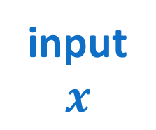
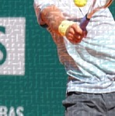
Loss Functions For Image Processing
$$f_{θ}\left(x\right)$$
input
$$x$$
output
$$\hat{y}$$
target
$$y$$
$$ℒ(y,\hat{y})$$
Typical loss functions
pixelwise mean squared error
pixelwise mean absolute error
(probabilistic formulations) likelihood
Loss function
quantifies cost of making errors
must be differentiable
$$ℒ_{MSE}\left(y,\hat{y}\right)=E\left[{\left|y−\hat{y}\right|}^{2}\right]$$
$$ℒ_{MAE}\left(y,\hat{y}\right)=E\left[\left|y−\hat{y}\right|\right]$$
$$ℒ_{LL}\left(y,\hat{y}\right)=\text{ln}\left(p(\hat{y}|y)\right)$$
Notes:
input: often an image or text description

Slide 12
Loss Functions For Image Processing
Typical loss functions are too simple to
capture complexity and structure of images
capture characteristics of human perception
Flurry of recent work aimed at developing improved loss functions
Snell, Ridgeway, Liao, Roads, Mozer, & Zemel (2017)
Dosovitskiy & Brox (2016)
Johnson, Alahi, & Fei-Fei (2016)

Slide 13
Perceptually Grounded Losses
Arose in 1990s, motivated by photo/video digitization and compression
Most popular metric is structural similarity (SSIM)
How well do intensity (luminance), contrast, and structural information match between two images, $x$ and $y$?
computed over small patches of image
Notes:
[*]
explain alpha, beta, gamma
[*]
intensity: mean level in patch
contrast: variability in each patch
structural: covariance between patches

Slide 14
Perceptually Grounded Losses
But images have structure at many scales, not just 11x11 patches
⇒ Multiscale SSIM (MS-SSIM)
iteratively downsamples input images
Final score is aggregated over scales
Common assumption: use 5 downsampling steps, weigh all scales equally
Notes:
[END OF SLIDE]
MS-SSIM loss is fully differentiable:
derivative with respect to output pixels

Slide 15
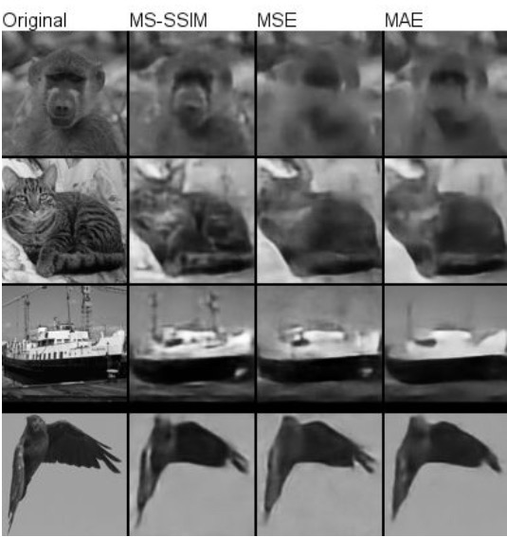
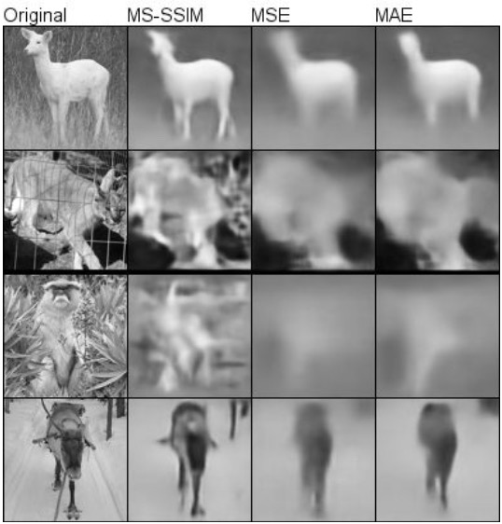
Perceptually Grounded Losses (Snell et al., 2016)
dfdf
Notes:
task: image compression / autoencoder
[*] MS-SSIM
[*] MSE -- same architecture
[*] MAE
[*] [images on right]
more compression
(VAE -- probabilistic model)
i picked nice examples of course but how
to evaluate more formally?

Slide 16
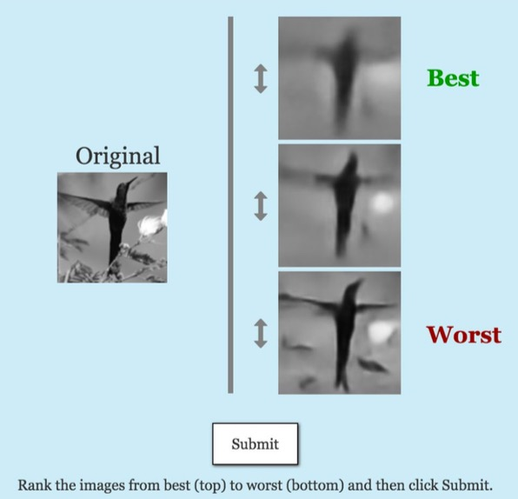
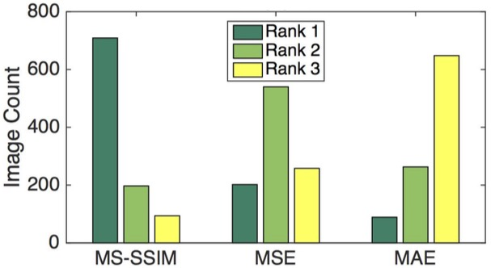
Perceptually Grounded Losses (Snell et al., 2016)
Humans judge images synthesized with $ℒ_{\text{MS}\text{−}\text{SIM}}$ to be higher quality than images synthesized with $ℒ_{\text{MS}\text{E}}$ or $ℒ_{\text{MAE}}$.
Notes:
second set of images: more compression (probabilistic model()

Slide 17
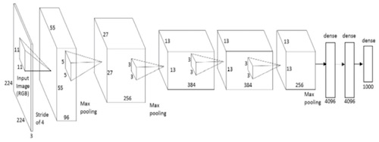
Losses Based On Abstract Features (Dosovitskiy & Brox, 2016)
Instead of comparing target and synthesized image using distance in image space—e.g., $ℒ_{\text{MSE}}$ or $ℒ_{\text{MAE}}$—use distance in an abstract feature space.
$ℒ_{\text{MSE}}=E\left[{\left|y−\hat{y}\right|}^{2}\right]$ versus $ℒ_{\text{feat}}=E\left[{\left|f\left(y\right)−f\left(\hat{y}\right)\right|}^{2}\right]$
Upper layers of a trained classification can provide abstract features.
i.e., $f\left(y\right)={\text{AlexNet}}_{l}\left(y\right)$ where $l$ is the layer of the network
Notes:
L_MSE vs. L_feat – bad terminology – both are MSE but in different spaces
L_pixel would be better
[*]
[end of slide]
How do we know which layer to use?

Slide 18
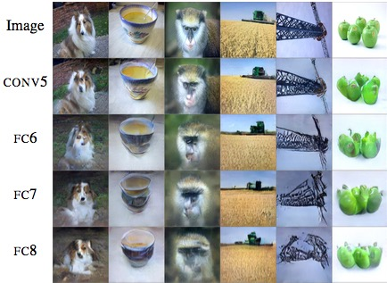
Losses Based On Abstract Features (Dosovitskiy & Brox, 2016)
In order to understand the information contained in upper layers of AlexNet
Build model that takes $\text{AlexNe}{\text{t}}_{l}$ activation and inverts it to reconstruct image
Upper layers preserve much structural and semantic information in image
Deconvolutional NN
$$\text{AlexNe}{\text{t}}_{l}(y)$$
$$y′$$
Notes:
inverting AlexNet
based on these results, they chose the 6th layer (1st fully connected layer)

Slide 19
Losses Based On Abstract Features (Dosovitskiy & Brox, 2016)
$$\begin{matrix}𝓛_{\text{MSE}}+ \\ 𝓛_{\text{adv}}+ \\ 𝓛_{\text{feat}} \end{matrix}$$
$$\begin{matrix}𝓛_{\text{MSE}}+ \\ 𝓛_{\text{adv}} \\ \end{matrix}$$
original
$$ℒ_{\text{MSE}}$$
Losses
$ℒ_{\text{MSE}}$: pixelwise
$ℒ_{\text{adv}}$: adversarial
$ℒ_{\text{feat}}$: using abstract features of AlexNext, layer FC6
Notes:
[end of slide] needed all 3 losses to get improvement
L_feat alone no good

Slide 20
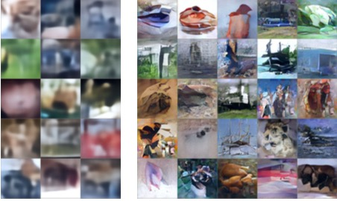
Losses Based On Abstract Features (Dosovitskiy & Brox, 2016)
Samples from a variational autoencoder trained with…
$$ℒ_{\text{MSE}}$$
$$ℒ_{\text{MSE}}+𝓛_{\text{adv}}+𝓛_{\text{feat}}$$
Notes:
inverting AlexNet

Slide 21
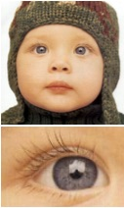
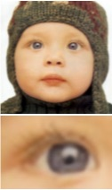
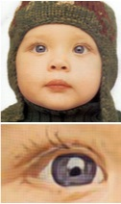
Losses Based On Abstract Features (Johnson, Alahi, & Fei-Fei, 2016)
Very similar approach
uses a different loss network (VGG-16 net from 2014 large-scale image competition)
Superresolution task using only a single loss
original
$$ℒ_{\text{MSE}}$$
$$𝓛_{\text{feat}}$$
Notes:
Similar work from Fei-Fei Li’s group

Slide 22
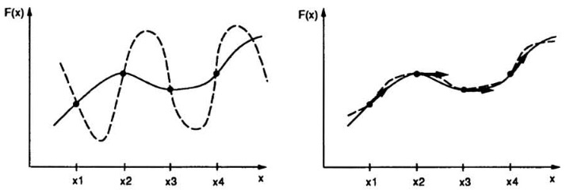
Leveraging Constraints on Function
Approximating a function
with sparse data
Approximating a function
with sparse data
and constraints on $x′$
$$f(x)$$
approx.
$$f(x)$$
true
$$x$$
$$x$$
image credit: Simard, LeCun, Denker, & Victorri (1998)

Slide 23
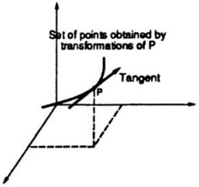
Leveraging Constraints On Function
$$f(x)$$
In 1D, we have only $\frac{df}{dx}$
In higher dimensions, we have derivatives in many directions, as embodied by the Jacobian, $F^{′}\left(x\right)$
Suppose our constraint is on a directional derivative, $\frac{∂f(x)}{∂α}$, for some direction $α$
E.g., $α$ is orientation of an input image
$$x$$
Notes:
[*] different orientations
[*]
As you rotate the 3, you get a manifold of points in the high dimensional input space
Tangent = direction of the manifold at middle orientation
Directional derivative = derivative of function with respect to tangent vector
Why do we care about derivative of function with respect to orientation? … [next slide]

Slide 24
Leveraging Constraints On Function
Domain knowledge
We’d like response of classifier not to change output as image orientation changes
I.e., orientation invariance
Many other forms of invariance can be embodied
in vision, translation and scaling
in speech, shifts in pitch and rate

Slide 25
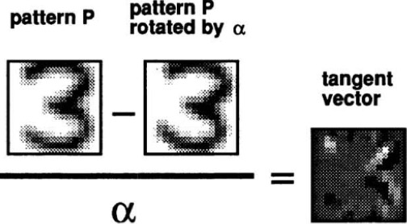
TangentProp: Loss Based On Derivative Constraints (Simard, Victorri, Le Cun, & Denker, 1998)
TangentProp loss for orientation invariance
$ℒ_{\text{tangent}}={\left\|{\left.\frac{∂f\left(s\left(x,α\right)\right)}{∂α}\right|}_{α=0}\right\|}^{2}$
Efficient computation of loss derivative
Tangent vector $∂s\left(x,α\right)/∂α$ can be approximated by finite difference
Given tangent vector, Simard et al. developed efficient algorithm for computing loss derivative
Same order of complexity as back prop with forward pass to propagate tangent vector and backward pass to compute loss derivative
$α$ angle of rotation
$s\left(x,α\right)$ transformation operator
$f$ neural network mapping
Notes:
f: net output
want output not to change as you rotate the input
derivative of net output with respect to angle of rotation is zero

Slide 26
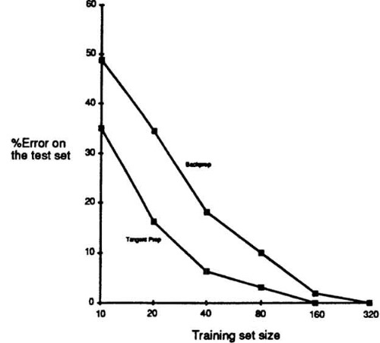
TangentProp: Loss Based On Derivative Constraints (Simard, Victorri, Le Cun, & Denker, 1998)
Other obvious scheme
Data augmentation with additional distortions of input
Augmentation becomes much less efficient when multiple constraints are applied in parallel
e.g., orientation, scale, translation invariance
due to combinatorics
Without
Tangent
Prop Loss
With
Tangent
Prop

Slide 27
Summary: Imposing Domain-Appropriate Bias Via Loss Functions
I presented three examples for computer vision
loss to optimize images for human perception
loss to emphasize accuracy of abstract, semantic features over low-level features
loss to achieve various forms of invariance
The latter two apply to non-vision tasks
Loss functions must of course be differentiable
Loss functions are likely to be used in combination

Slide 28
Means Of Imposing Domain-Appropriate Bias
Data augmentation
Loss function
Representation
Architectural constraints
Notes:
Deep learning is representation learning.
Heretical to talk about building in representations.
And if data set is large enough, maybe that’s true.

Slide 29
REPRESENTATION
psychologically grounded representation
- embeddings [e.g., faces]
- music synthesis net
from Karl’s comp – relational constraints
belongie slides

Slide 30
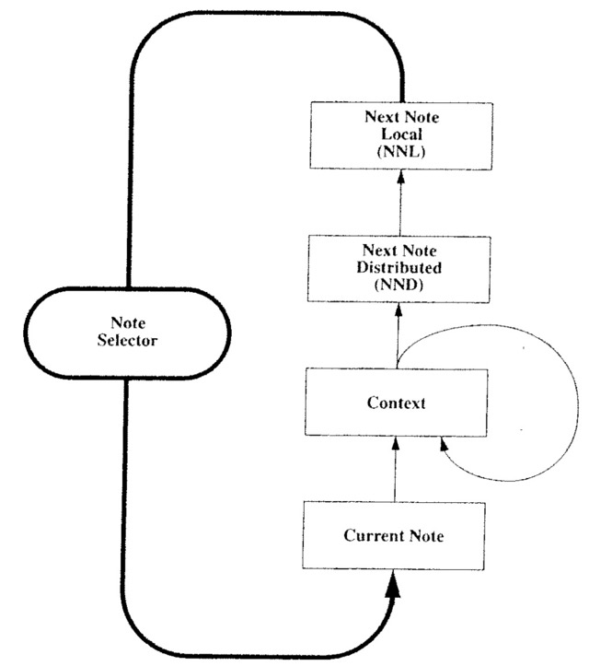
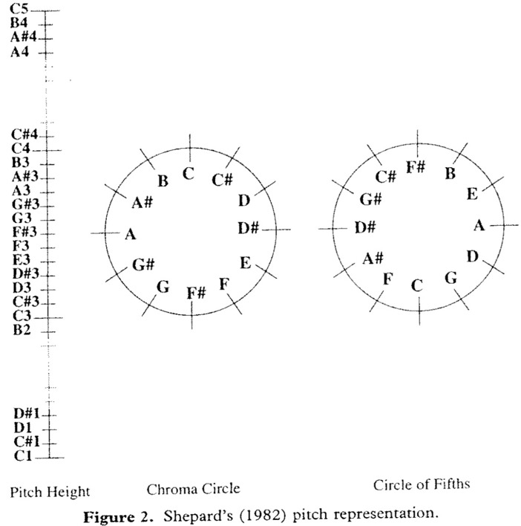
Psychologically Grounded Representations
Music composition network (Mozer, 1994)
Task: predict next pitch in diatonic scale
with one-hot pitch representation 54.5% accuracy
with psychologically grounded representation 98.4% accuracy
Notes:
predicting next pitch in diatonic scale
CONCERT:

Slide 31
Psychologically Grounded Representations
$$y∈\{1,2,3,4\}$$
Neural Net
probe
ref. 1
ref. 2
ref. 3
ref. 4
How to represent faces?
Raw Images | Abstract Features (e.g., age, ethnicity, facial hair, symmetry)
very flexible | convey task relevant information
domain independent | based on domain knowledge
Notes:
how to represent faces: raw images vs. abstract features?

Slide 32
Psychologically Grounded Representations
Derive abstract representation automatically based on human judgments
Triplet constraints
$d_{AB}<d_{AC}$
Many schemes for laying faces in a low-dimensional space such that distance constraints are preserved
- nonmetric multidimensional scaling
- t-STE
- Roads (2017)
B
A
C
Notes:
t-STE : t-distributed stochastic triplet embeddings

Slide 33
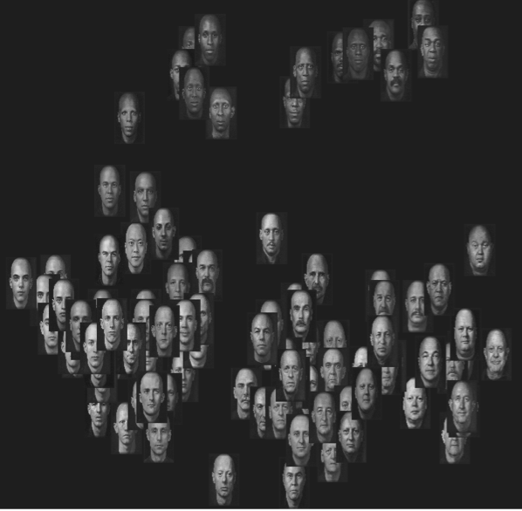
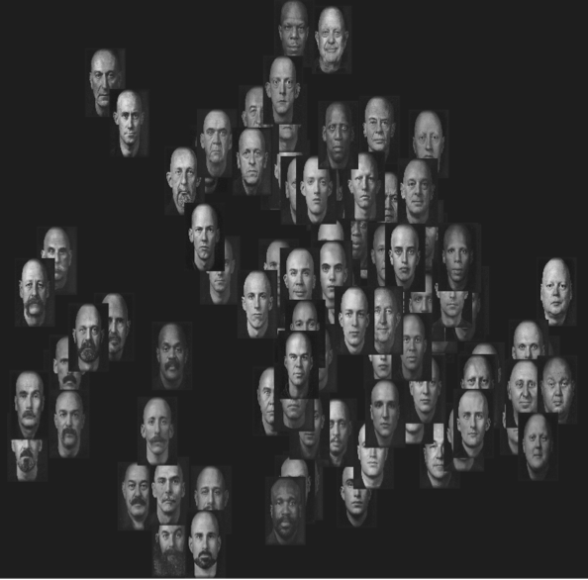
Psychologically Grounded Representations (Jones & Goldstone, 2013)
Jones and
Goldstone
(2013)
Dimension 2
Dimension 4
Dimension 1
Dimension 3
Limitation of this approach
Human intensive
Does not extend to novel objects
Notes:
Input to net I described earlier wasn’t images but rather a representation that is based on human similarity judgments
6dim representation obtained from multidimensional scaling
Embedding: low dimensional distributed representation that captures similarity structure of a domain

Slide 34
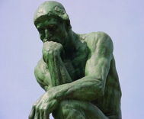
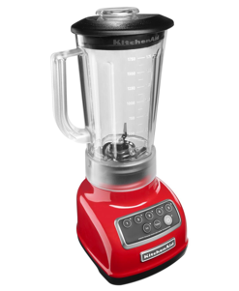
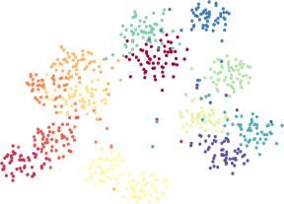
Psychologically Grounded Representation (Wilber, Kwak, Kreigman, & Belongie, 2014)
Human Expertise
SNaCK
Concept Embedding
Computer Vision
+ Deep Learning
Image courtesy of Serge Belongie
Notes:
Get a small number of judgments from a human expert about similarity (triplets) and augment their value with ML
Conv net -> visual similarity kernel

Slide 35
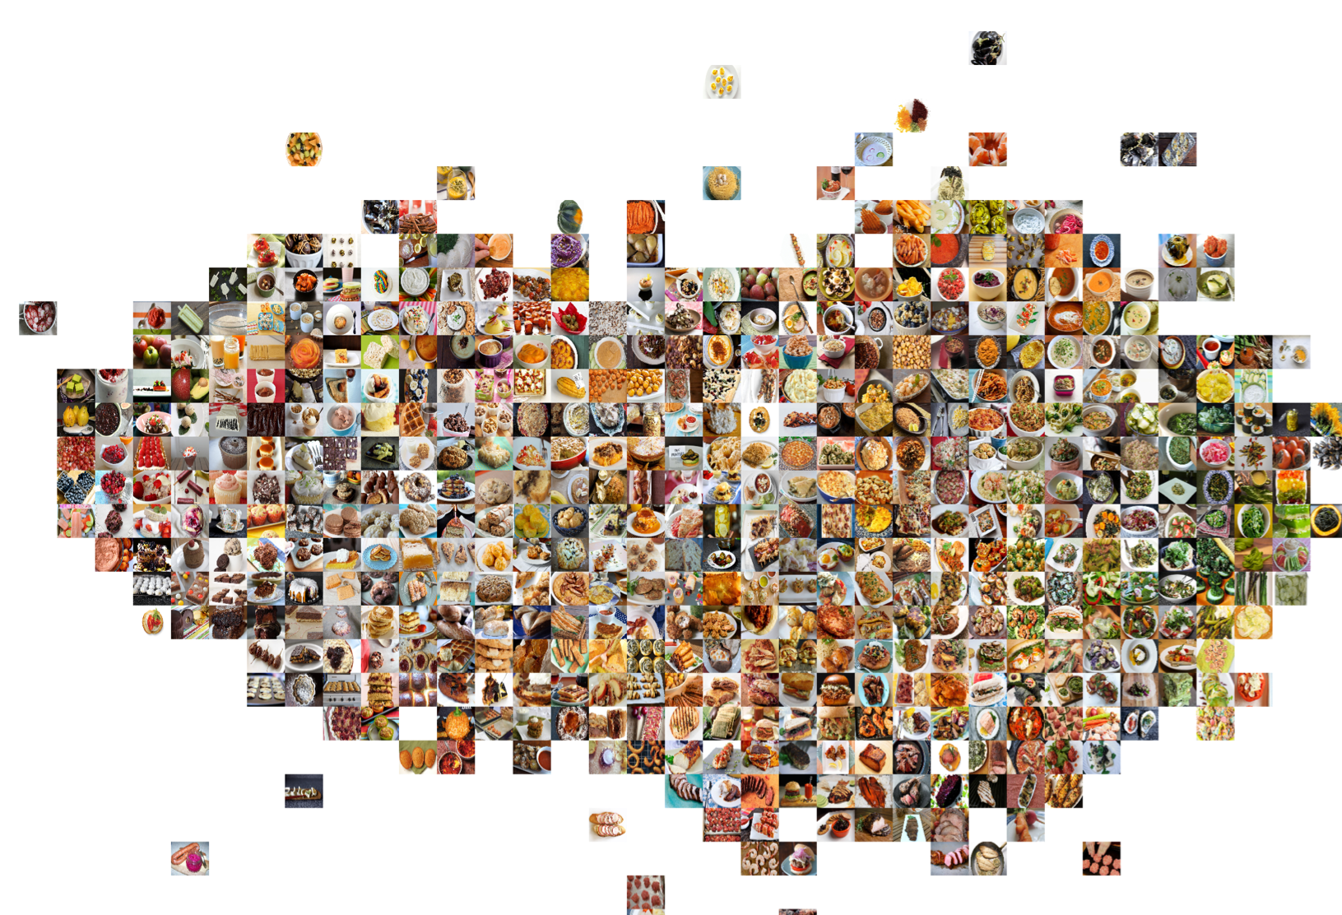
Human judgments based on similarity of taste
Image courtesy of Serge Belongie
Notes:
judgement from humans: which foods taste the same?
visual cues + human judgments to lay the images out in this space
[END OF SLIDE] so how does this work in detail?

Slide 36
Embedding Procedures
observation
latent representation
domain-neutral (low level) features or labels
domain-relevant (semantic) features
face25
Summary to this point
Leverage human judgments to obtain a domain-relevant representation
Use this representation as input to a neural net that can efficiently and robustly learn other tasks
Notes:
[*] observations are domain neutral low-level features, or just labels that index images or words or whatever
[*] latent representation is based on domain-relevant semantic features
[*] Summary…. use this representation as input to a neural net…
e.g., question answering
e.g., predicting human facial judgments
e.g., classifying image as something worth eating or not

Slide 37
Embedding Procedures
observation
latent representation
domain-neutral (low level) features or labels
domain-relevant (semantic) features
face25
$$x$$
encoder
$$z(x)$$
$$\left\|z\left(A\right)−z(B)\right\|<$$
$\left\|z\left(A\right)−z(C)\right\|$
human
judgments
Notes:
to introduce notation: x->z(x)
[*] train with human judgments
[*] one constraint

Slide 38
Relational Constraints For Representation Learning
Type | constraint
direct | $$m^{T}z\left(A\right)=φ$$
equality | $$z\left(A\right)=z(B)$$
absolute distance | $$\left\|z\left(A\right)−z(B)\right\|=δ$$
relative distance | $$\left\|z\left(A\right)−z(B)\right\|<\left\|z\left(A\right)−z(C)\right\|$$
analogy | $$z\left(A\right)−z\left(B\right)=z\left(C\right)−z(D)$$
Ridgeway survey arXiv:1612.05299 [cs.LG]
Notes:
relative distance: soften constraint with a logistic function
[*] absolute distance: used for dimensionality reduction schemes (preserve distance in lower dimensional space)
[*] equality is a special case of absolute distance
[*] direct: some fraction of the dimensions may be known in advance.
-- m is a mask vector that selects out dimensions
[*] analogy: A:B :: C:D (mother:father / aunt:uncle)
ordered from strongest to weakest constraints
These constraints have to be turned into a differentiable loss function
Easy to do: squared difference for the constraints involving equal signs;
inequality -> logistic function

Slide 39
Embedding Representation Learning In Autoencoder
$$x$$
encoder
$$z(x)$$
generator
$$g\left(z\left(x\right)\right)$$
relational
constraints
Allows us to better understand nature of learned $z(x)$ representation by generating synthetic images

Slide 40
Direct Constraint (Kingma, Rezende, Mohamed, & Welling, 2015)
Decompose hidden state into
identity, $I(x)$
style, $S(x)$
$$S(x)$$
$$x$$
encoder
generator
$$g\left(I\left(x\right),S\left(x\right)\right)$$
$$I\left(x\right)$$
direct objective
one-hot vector indicating class membership of $x$
$$ℒ= {\left|I\left(x\right)−t(x)\right|}^{2}$$
Notes:
I is specified directly in a supervised fashion
S becomes residual, because S+I has to be sufficient to regenerate x
call S “style” because it’s everything but identity
VAE

Slide 41
Direct Constraint (Kingma, Rezende, Mohamed, & Welling, 2015)
What is being learned in the “style” (non-identity) representation?
With 2D style vector:

Slide 42
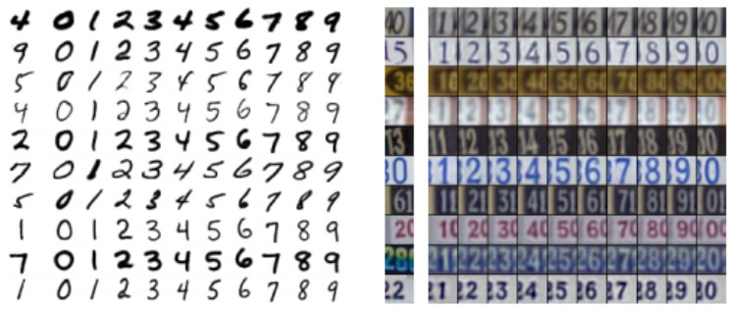
Direct Constraint (Kingma, Rezende, Mohamed, & Welling, 2015)
Notes:
[*] learned style of handprinted digits
[*] learned style of house numbers
Direct constraints aren’t that interesting from a representation perspective because we’re specifying the representation – a class label

Slide 43
Equality Constraint
Equality constraint makes weaker use of class labels
e.g., hard-margin losses (Chopra et al., 2005; Schroff et al., 2015), binomial deviance (Yi et al., 2014), LSSS (Song et al., 2016), histogram loss (Ustinova & Lempitsky, 2016), F-distributed loss (Ridgeway & Mozer, 2017)
$$S(x)$$
$$x$$
encoder
generator
$$g\left(I\left(x\right),S\left(x\right)\right)$$
$$I\left(x\right)$$
equality objective
$$ℒ=\left\{\begin{matrix}f\left(\left|I\left(x_{1}\right)−I\left(x_{2}\right)\right|\right) & \begin{matrix} \\ \end{matrix} \\ −f\left(\left|I\left(x_{1}\right)−I\left(x_{2}\right)\right|\right) & \end{matrix}\right.$$
if $x_{1}$ and $x_{2}$belong
to same class
otherwise
Notes:
hard margin: nonzero loss within some distance margin; zero otherwise
binomial deviance: soft margin that goes to zero gradually
LSSS--margin based on triples -- 2 same class, 1 different
histogram – penalize overlap of within class and between class distributions
F-distributed – leverage F statistic to ensure that classes are reliably separated

Slide 44
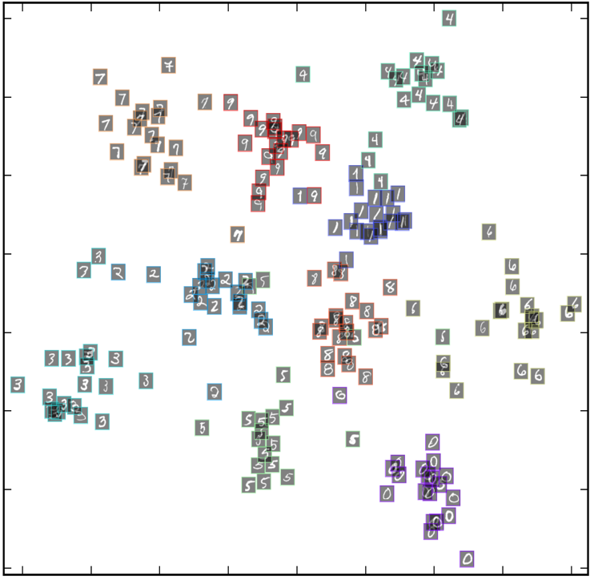
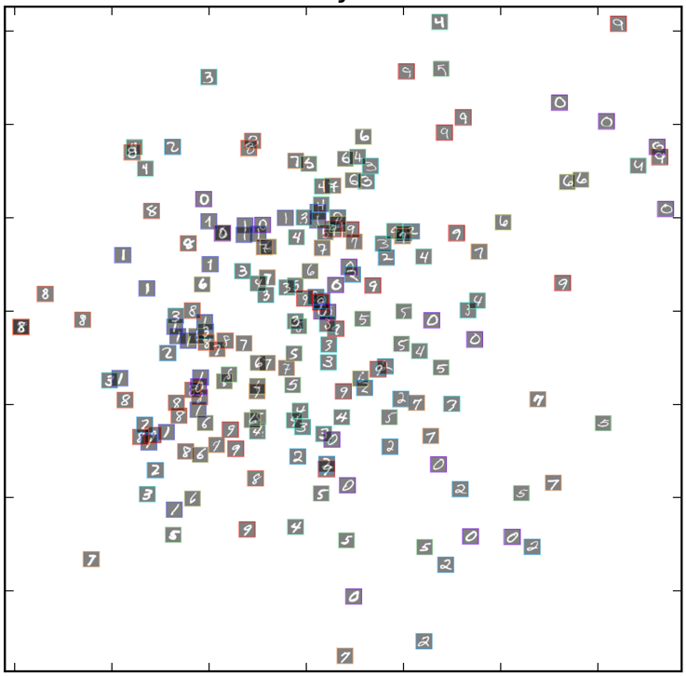
Equality Constraint (Ridgeway & Mozer, 2017)
4
7
9
1
2
6
identity representation
style representation
8
3
5
0
Distributed identity representation preserves similarity structure of classes
Style representation discards class information

Slide 45
Equality Constraint (Ridgeway & Mozer, 2017)
Face data set (from phone unlock app)

Slide 46
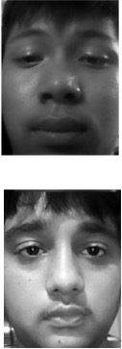
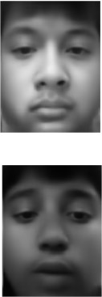
Equality Constraint (Ridgeway & Mozer, 2017)
identity
style
style
identity

Slide 47
Equality Constraint (Ridgeway & Mozer, 2017)
Synthetic glasses

Slide 48
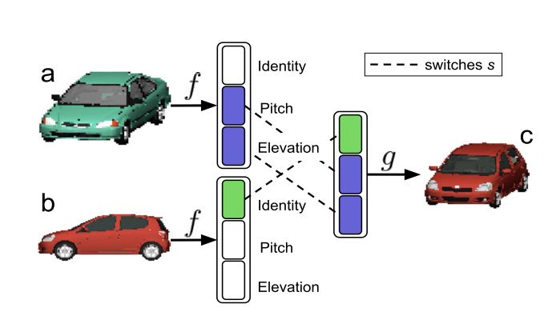
Deep Visual Analogy Making (Reed, Zhang, Zhang, & Lee, 2015)
Images labeled with identity, pitch, and elevation
$$I(x)$$
$$x$$
encoder
$$P\left(x\right)$$
generator
$$g\left(I\left(x\right),P\left(x\right),E\left(x\right)\right)$$
$$E\left(x\right)$$
$$g\left(I\left(b\right),P\left(a\right),E\left(a\right)\right)=c$$
Notes:
z(A)-z(B)+z( C)

Slide 49
Deep Visual Analogy Making (Reed, Zhang, Zhang, & Lee, 2015)
A:B :: C:D
To perform this task, orientation, pose, and identity must be disentangled
A
B
C
D
Notes:
z(A)-z(B)+z( C)

Slide 50
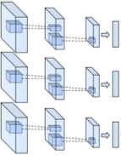
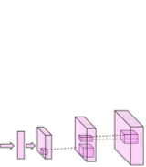
Deep Visual Analogy Making (Reed, Zhang, Zhang, & Lee, 2015)
$$x$$
encoder
$$z(x)$$
generator
$$g\left(z\left(x\right)\right)$$
A
analogy
synthesis
B
C
D
Notes:
z(A)-z(B)+z( C)

Slide 51
Deep Visual Analogy Making (Reed, Zhang, Zhang, & Lee, 2015)
$$ℒ_{\text{nonlin}}={\left|g\left(NeuralNet\left(z\left(B\right)−z\left(A\right),z\left(C\right)\right)\right)−D\right|}^{2}$$
B
A
D
$$ℒ={\left|g\left(z\left(B\right)−z\left(A\right)+z\left(C\right)\right)−D\right|}^{2}$$
C
$$z\left(B\right)−z\left(A\right)+z(C)$$
A
analogy
synthesis
B
C
D
Notes:
z(A)-z(B)+z( C)
g(.) is generator

Slide 52
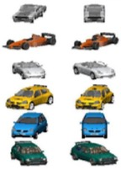
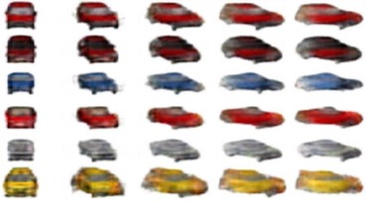
Deep Visual Analogy Making (Reed, Zhang, Zhang, & Lee, 2015)
A
B
C
D
Notes:
[*] synthesize D
[*] can run iteratively and perform the same transformation repeatedly
[*] cars varying in orientation: A and B are rotations

Slide 53
Summary: Imposing Domain-Appropriate Bias Via Representation
Instead of entrusting back propagation to do all the representation discovery necessary for a task, we may discover domain-relevant representations by leveraging
unlabeled data
human judgments
relational knowledge (constraints)
partial labeling of data set
Applications
Provide embedding as starting point for a neural net that can efficiently and robustly learn other tasks
Use embeddings to generate synthetic examples and use for data augmentation
ADD BRETT’S EASE-of-learning
Notes:
hasn’t been exploited to the extent that it ought to be.

Slide 54
Means Of Imposing Domain-Appropriate Bias
Data augmentation
Loss function
Representation
Architectural constraints
Notes:
architectural constraints: connectivity, activation functions, weight duplication

Slide 55
ARCHITECTURE
Neural language model
Siamese networks for embeddings – multiple layers
Family trees
Rueckl what-where network -- modern version Spatial Transformer Networks (2015)
pose-normalized conv nets
[deep RL]

Slide 56
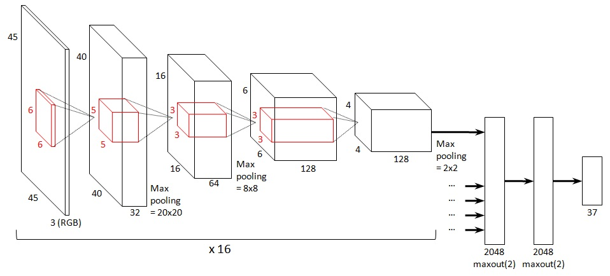
Best-Known Example Of Architectural Bias
Convolutional nets
spatial locality
spatial position homogeneity
spatial scale homogeneity
source: benanne.github.io

Slide 57
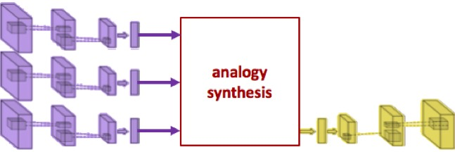
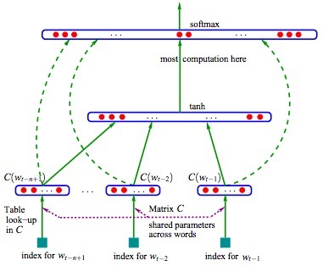
Architectural Bias Via Weight Constraints
E.g., neural probabilistic language model
E.g., deep visual analogies
$$y∈\{1,2,3,4\}$$
Neural Net
probe
ref. 1
ref. 2
ref. 3
ref. 4
Notes:
We’ve run across several examples
Bengio, Ducharme, Vincent, Jauvin (2003) A Neural probabilistic language model
instead of replicating just one layer of weights, also possible to replicate subnetworks, as we saw with Deep Visual Analogies model

Slide 58
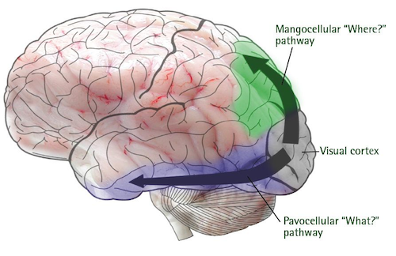
Architectural Bias Via Connectivity
What versus where cortical processing
source: sciencewise.anu.edu.au

Slide 59
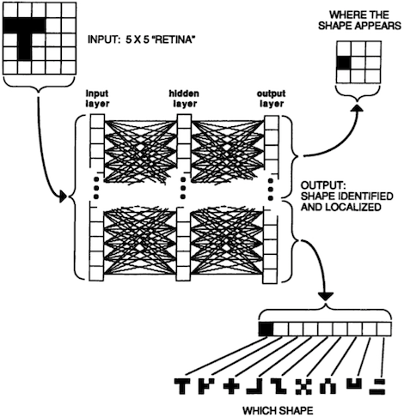
Architectural Bias Via Connectivity
What versus where cortical processing (Rueckl, Cave, & Kosslyn, 1989)
Notes:
[*] generic 3 layer net
[*] vs dividing up hidden layer, some HU to what task, some to where task
splitting architecture didn't affect where task
easy task - find center of mass
[*] but it did affect amount of training and asymptotic performance on the 'what' task

Slide 60
The what-where network treats the two pathways as independent.
But the ‘where’ pathway might help the ‘what’ pathway
If object position is known, image can be transformed into a canonical form.
Simplifies recognition
⇒
Notes:
if object position is known (i.e., how object is instantiated in the image), image can be transformed into canonical form
simplifies recognition – more like template matching

Slide 61
Objects undergo a variety of transformations as they are instantiated in an image.
E.g., 2D affine (rigid) transformations
translation, rotation, dilation, skew
Can we invert these transformations to obtain an image with the object in a canonical form?
Spatial transformer network
Notes:
affine (rigid)
spatial transformer network: specialized architecture for handling image transformations

Slide 62
Spatial Transformer Networks (Jaderberg, Simonyan, Zisserman, & Kavukcuoglu, 2015)
Localization net: analogous to ‘where’ subnet of previous model
determine instantiation parameters $θ$ (translation, rotation, …)
Grid sampling: remap input to a canonical form
For each location $(m,n)$ in output V, use transformation specified by $θ$ to determine corresponding location $\left(x,y\right)$in input U
interpolate from neighborhood in U around $\left(x,y\right)$ with differentiable kernel (e.g., bilinear)
Notes:
U: input image, drawn as a box to represent (x,y,feature planes)
V: output image
[*] localization net
[*] grid sampling
[*] for each location...
[*] interpolate
Use a kernel function centered on (x,y).
Needs to be smooth function in order to be differentiable.
They like a bilinear kernel -- decreasing function of distance on x dimension multiplied by decreasing function of distance on y dimension

Slide 63
Spatial Transformer Networks (Jaderberg, Simonyan, Zisserman, & Kavukcuoglu, 2015)
ERROR RATES | MNIST rotations | MNIST rotations, translations, scaling | Street view house numbers
state of the art CNN | 1.2% | 0.8% | 4.5%
ST-CNN | 0.7% | 0.5% | 3.9%
Notes:
MNIST digits:
(left) original,
(middle) with frame of reference (red = left, green = top). not shown is a mirroring transform for the “4”
(right) transformed representation
Street view house numbers; dataset of 200k real world images. task is to recognize sequence

Slide 64
Spatial Transformer Networks (Jaderberg, Simonyan, Zisserman, & Kavukcuoglu, 2015)
Fine-grain classification of birds
6k training images, 5.8k test, 200 species of birds
Multiple spatial transformers to capture different aspects of birds
ERROR RATES | CUB-200-2011 birds
state of the art generic CNN | 17.7%
2xST-CNN | 16.9%
4xST-CNN | 15.9%
2 STs
4 STs
Notes:
[*] multiple spatial transformers:
take input and feed into 2 or 4 different spatial transformers, and build CNN on top of transformer, then combine outputs to identify. Leave it to learning to figure out what parts should be localized.
[*] 2 spatial transformers
[*] 4 spatial transformers
i thought this was super cool, and interesting, because there's a group at Cornell very interested in bird images

Slide 65
Pose Normalized CNNs (Van Horn, Branson, Perona, & Belongie, 2014)
Use supervised learning approach to detect head and body
ERROR RATES | CUB-200-2011 birds
spatial transformer net (4xST-CNN) | 15.9%
pose-normalized CNNs | 14.6%
Domain
knowledge!
Notes:
transformation normalizes so that head points to right, body points to right (“warping”)

Slide 66
Summary: Imposing Domain-Appropriate Bias Via Architecture
Various schemes to incorporate inductive bias into architecture, specifically:
weight constraints
connectivity
activation functions
specialized processing modules
trained with end-to-end learning (Spatial transformer nets)
trained with distinct objectives (Pose-normalized nets)

Slide 67
Means Of Imposing Domain-Appropriate Bias
Data augmentation
Loss function
Representation
Architectural constraints

