Slide 1
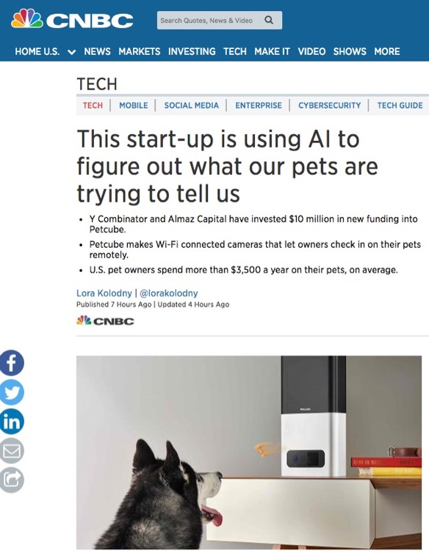
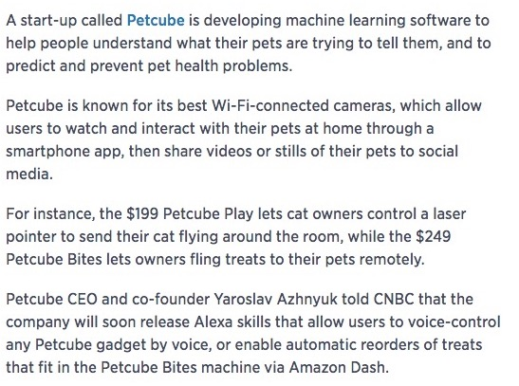
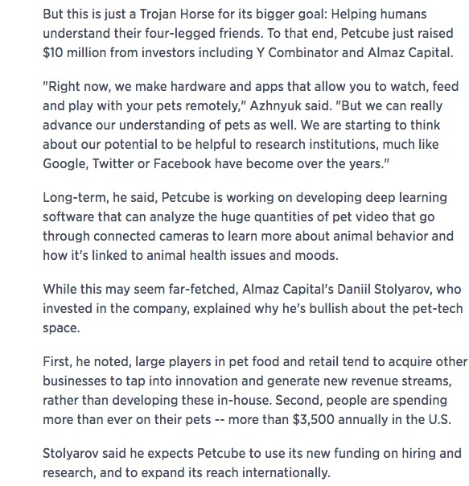

Slide 2
CSCI 5922 Neural Networks and Deep Learning Language Modeling
Mike Mozer
Department of Computer Science and Institute of Cognitive Science University of Colorado at Boulder

Slide 3
Statistical Language Models
Try predicting word t given previous words in string
“I like to eat peanut butter and …”
$P\left(wt \right|w1, w2, …, w_{t−1})$
Why can’t you do this with a conditional probability table?
Solution
$n$-th order Markov model
$P(w_{t}|w_{t−n},w_{t−n+1}, …, w_{t−1})$

Slide 4
N-grams
$n$-th order Markov model needs data on sequences of $n+1$ words
Google n-gram viewer

Slide 5
What Order Model Is Practical?
~170k words in use in English
~20k word (families) in use by an educated speaker
1st order Markov model
400M cells
if common bigrams are 1000 more likely than uncommon bigrams, then you need 400B examples to train a decent bigram model
Higher order Markov models
data sparsity problem grows exponentially worse
Google gang is elusive, but based on conversations, maybe they’re up to 7th or 8th order models
Tricks like smoothing, stemming, adaptive context, etc.

Slide 6
Neural Probabilistic Language Models (Bengio et al., 2003)
Instead of treating words as tokens, exploit semantic similarity
Learn a distributed representation of words that will allow sentences like these to be seen as similar
The cat is walking in the bedroom. A dog was walking in the room. The cat is running in a room. The dog was running in the bedroom. etc.
Use a neural net to represent the conditional probability function $P(w_{t}|w_{t−n},w_{t−n+1}, …, w_{t−1})$
Learn the word representation and the probability function simultaneously

Slide 7
Hinton Video
Neural probabilistic language models

Slide 8
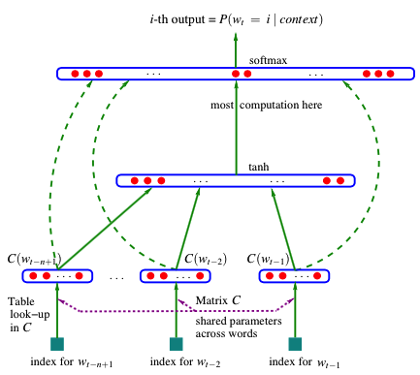
Scaling Properties Of Model
Adding a word to vocabulary
cost: $n_{H1}$ connections
Increasing model order
cost: $n_{H1}×n_{H2}$ connections
Compare to exponential growth with probability table look up
H₂
H₁

Slide 9
Performance
Perplexity
geometric average of $1/P(w_{t}|model)$
smaller is better
Corpora
Brown
1.18M word tokens, 48k word types
vocabulary size reduced to 16,383 by merging rare words
800k used for training, 200k for validation, 181k for testing
AP
16M word tokens, 149k word types
vocabulary size reduced to 17964 by merging rare word, ignoring case
14M training, 1M validation, 1M testing

Slide 10
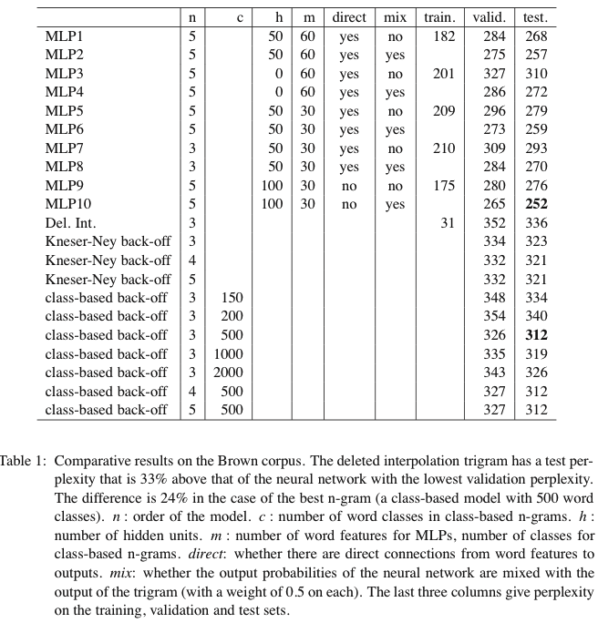
Performance
Pick best model in class based on validation performance and assess test performance
24% difference in perplexity
8% difference in perplexity
Notes:
remember, this was ~2000

Slide 11
Model Mixture
Combine predictions of a trigram model with neural net
could ask neural net to learn only what trigram model fails to predict
$E={\left(target−trigramModelOut −neuralNetOut\right)}^{2}$
Probably going to be more of these combinations of memory-based approaches + neural nets
+
neural
net
trigram
model

Slide 12
Hinton Video
Dealing with large number of possible outputs

Slide 13
Continuous Bag of Words (CBOW) (Mikolov, Chen, Corrado, & Dean, 2013)
Trained with
4 left context
4 right context
Position of input words does not matter
hence ‘bag of words’
$w_{t}$ localist
softmax
$$∑$$
…
$w_{t−2}$ embedding
$w_{t−1}$ embedding
$w_{t+1}$ embedding
$w_{t+2}$ embedding
…
table look up
index for $w_{t−2}$
index for $w_{t−1}$
index for $w_{t+1}$
index for $w_{t+2}$
Notes:
CBOW- 4 to the left, 4 to the right
Skip-gram more successful

Slide 14
Skip-gram model (Mikolov, Chen, Corrado, & Dean, 2013)
Trained on each trial with a different range R
$R∈\left\{1,2,3,4,5\right\}$ drawn uniformly
$w\left(t−R\right)…w\left(t+R\right)$
De-emphasize more distant words
$$w_{t−2}$$
localist
$$w_{t−1}$$
localist
$$w_{t+1}$$
localist
$$w_{t+2}$$
localist
softmax
…
$w_{t−2}$ embedding
$w_{t−1}$ embedding
$w_{t+1}$ embedding
$w_{t+2}$ embedding
…
copy
$w_{t}$ embedding
index for $w_{t}$
Notes:
CBOW- 4 to the left, 4 to the right
Skip-gram more successful
Contrastive training: output should be one for “quick” -> “brown” (as in quick brown fox) but 0 for “quick”-”rat”. Must specify number of noise examples

Slide 15
Training Procedure
Hierarchical softmax on output
can reduce # output from $V$ to $\log_{2}\left(V\right)$
doesn’t seem to be used in later work
Noise-contrastive estimation
Assign high probability to positive cases (words that occur)
Assign low probability to negative cases (words that do not occur)
Instead of evaluating all negative cases, sample $k$ noise words
candidate sampling methods
Subsampling of common words
e.g., “I like the ice cream”

Slide 16
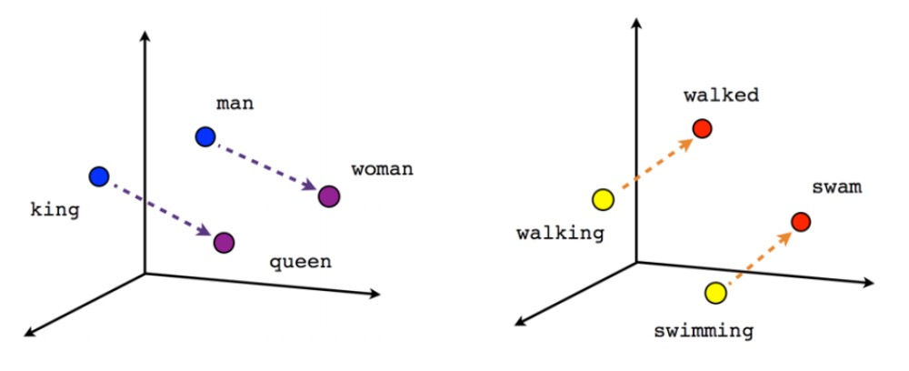
Word Relationship Test
z⁻¹[z(woman)-z(man)+z(king)] = queen?

Slide 17
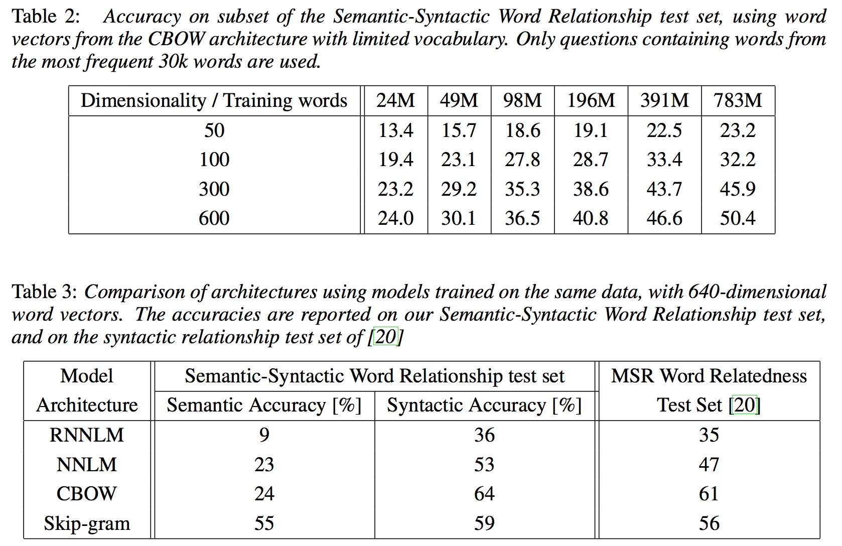

Slide 18
Domain Adaptation For Large-Scale Sentiment Classification (Glorot, Bordes, Bengio, 2011)
Sentiment Classification / Analysis
determine polarity (pos vs. neg) and magnitude of writer’s opinion on some topic
“the pipes rattled all night long and I couldn’t sleep”
“the music wailed all night long and I didn’t want to go to sleep”
Common approach using classifiers
take product reviews on the web (e.g., tripadvisor.com)
bag-of-words input, sometimes includes bigrams
each review human-labeled with positive or negative sentiment
Problem
domain specificity of vocabulary

Slide 19
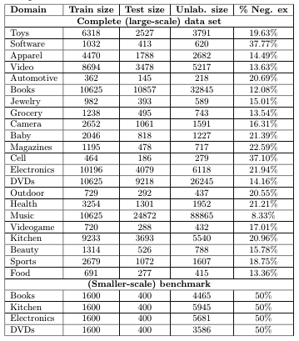
Transfer Learning Problem a.k.a. Domain Adaptation
Source domain S (e.g., toy reviews)
provides labeled training data
Target domain T (e.g., food reviews)
provides unlabeled data
provides testing data

Slide 20
Approach
Stacked denoising autoencoders
uses unlabeled data from all domains
trained sequentially (remember, it was 2011)
input vectors stochastically corrupted
not altogether different in higher layers from dropout
validation testing chose 80% removal (“unusually high”)
Final “deep” representation fed into a linear SVM classifier trained only on source domain
copy

Slide 21
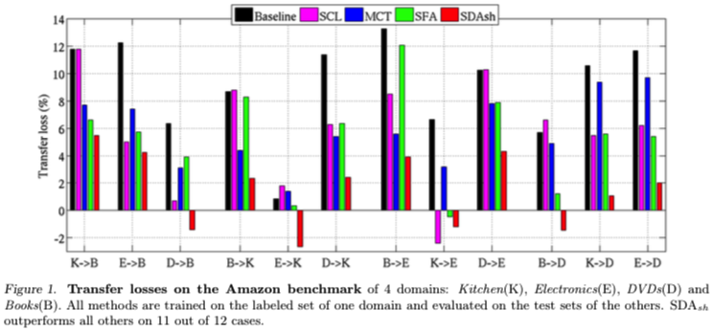
Comparison
Baseline – linear SVM operating on raw words
SCL – structural correspondence learning
MCT – multi-label consensus training (ensemble of SCL)
SFA – spectral feature alignment (between source and target domains)
SDA – stacked denoising autoencoder + linear SVM
Notes:
SDA wins on 11 of 12 transfer tests

Slide 22
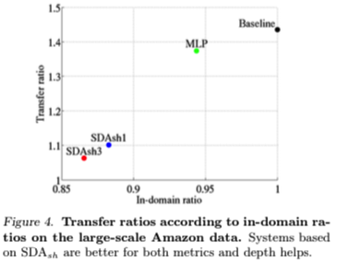
Comparison On Larger Data Set
Architectures
SDAsh3: 3 hidden layers, each with 5k hidden
SDAsh1: 1 hidden layer, each with 5k hidden
MLP: 1 hidden layer, std supervised training
Evaluations
transfer ratio
How well do you do on S->T transfer vs. T->T training?
in-domain ratio
How well do you do on T->T training relative to baseline?

Slide 23
Sequence-To-Sequence Learning (Sutskever, Vinyals, Le, 2014)
Map input sentence (e.g., A-B-C) to output sentence (e.g., W-X-Y-Z)

Slide 24
Approach
Use LSTM to learn a representation of the input sequence
Use input representation to condition a production model of the output sequence
Key ideas
deep architecture
LSTM_{in} and LSTM_{out} each have 4 layers with 1000 neurons
reverse order of words in input sequence
abc -> xyz vs. cba -> xyz
better ties early words of source sentence with early words of target sentence
LSTM_{in}
LSTM_{out}
INPUT
OUTPUT

Slide 25
Details
input vocabulary 160k words
output vocabulary 80k words
implemented as softmax
Use ensemble of 5 networks
Sentence generation requires stochastic selection
instead of selecting one word at random and feeding it back, keep track of top candidates
left-to-right beam search decoder

Slide 26
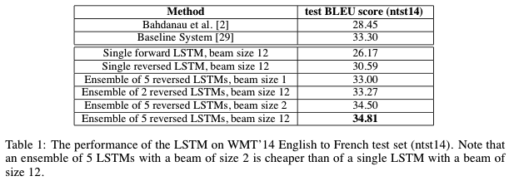
Evaluation
English-to-French WMT-14 translation task (Workshop on Machine Translation, 2014)
Ensemble of deep LSTM
BLEU score 34.8
“best result achieved by direct translation with a large neural net” [at the time]
Using ensemble to rescore 1000-best lists of results produced by statistical machine translation systems
BLEU score 36.5
Best published result
BLEU score 37.0
Notes:
Workshop on machine translation 2014

Slide 27
Translation

Slide 28
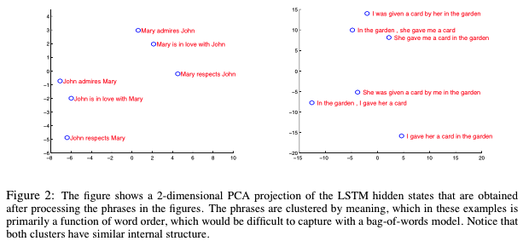
Interpreting LSTM_{in} Representations

Slide 29
Google Translate Fails
https://youtu.be/3-rfBsWmo0M

Slide 30
BIDIRECTIONAL NETS
bidirectional lstm
one possibility:
https://pdfs.semanticscholar.org/325e/918672ef37fddb3ebb8fc426c2ce41f7f7a0.pdf

