Slide 1
CSCI 5922
Neural Networks and Deep Learning:
Introduction 2
Mike Mozer
Department of Computer Science and
Institute of Cognitive Science
University of Colorado at Boulder
Notes:
position
audience

Slide 2
Hinton’s Brief History of Machine Learning
What was hot in 1987?
  back propagation, neural networks
What happened the past 30 years?
  Computers got faster
  Data sets got larger
  Software tools improved (TensorFlow, Theano, Keras)
What is hot in 2017?
  back propagation, neural networks
Notes:
old people love to talk about history
i know it's really annoying to young people but now that i'm old i understand.
and history is particularly relevant for the topics i'll be presenting.
it’ll help you appreciate how all this new exciting stuff is really old and not so new.

Slide 3
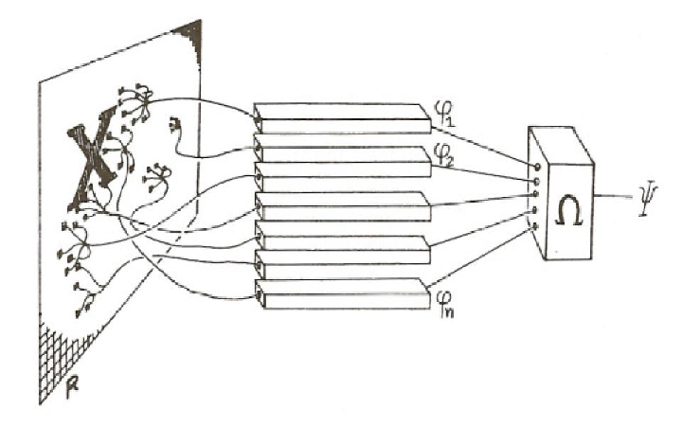
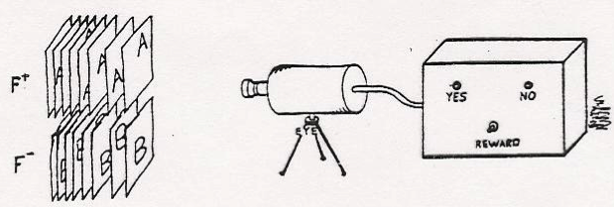
Neural Network History
1962
    Frank Rosenblatt, Principles of Neurodynamics: Perceptrons and the Theory of Brain Mechanisms
    Perceptron can learn anything you can program it to do.

Slide 4
Neural Network History
1969
    Minsky & Papert, Perceptrons: An introduction to computational geometry
    There are many things a perceptron can’t in principle learn to do
Notes:
Early computational complexity analysis:
how does learning time scale with size of problem?
how does network size scale with problem?
How much information does each weight need to represent?
Are there classes of functions that can or cannot be computed by perceptrons of a certain architecture?
e.g., translation invariant pattern recognition

Slide 5
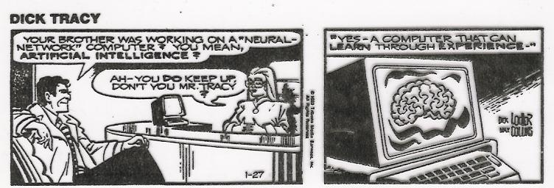
Neural Network History
1970-1985
    Attempts to develop symbolic rule discovery algorithms
1986
    Rumelhart, Hinton, & Williams, Back propagation
    Overcame many of the Minsky & Papert objections
    Neural nets popular in cog sci and AI
circa
1990

Slide 6
Neural Network History
1990-2005
    Bayesian approaches
      take the best ideas from neural networks – statistical computing, statistical learning
    Support-Vector Machines
      convergence proofs (unlike neural nets)
    A few old timers keep playing with neural nets
      Hinton, LeCun, Bengio, O’Reilly
    Neural nets banished from NIPS!

Slide 7
Neural Network History
2005-2012
    Attempts to resurrect neural nets with
      unsupervised pretraining
      probabilistic neural nets
      alternative learning rules

Slide 8
Neural Network History
2012-present
    Most of the alternative techniques discarded in favor of 1980’s style neural nets with
      lots more training data
      lots more computing cycles
      a few important tricks that improve training and generalization (mostly from Hinton)

Slide 9
2013

Slide 10
What AI Can Do Now
Everyday human stuff
👓 Recognize objects in images
🗺 Navigate a map of the London Underground
👂 Transcribe speech better than professional transcribers
🌎 Translate between languages
😮 Speak
❓ Pick out the bit of a paragraph that answers your question
😡 Recognize emotions in images of faces
🙊 Recognise emotions in speech
Travel
🚘 Drive
🚁 Fly a drone
🅿️ Predict parking difficulty by area
Science & medicine
💊 Discover new uses for existing drugs
🚑 Spot cancer in tissue slides better than human epidemiologists
💉 Predict hypoglycemic events in diabetics three hours in advance
👁 Identify diabetic retinopathy (a leading cause of blindness) from retinal photos
🔬 Analyze the genetic code of DNA to detect genomic conditions
🕵 Detect a range of conditions from images
⚛️ Solve the quantum state of many particles at once
Agriculture
🌱 Detect crop disease
🚜 Spray pesticide with pinpoint accuracy
🌽 Predict crop yields
🥒 Sort cucumbers
Security
💰 Spot burglars in your home
🙊 ️Write its own encryption language
🚓 Predict social unrest 5 days before it happens
🕵️ Unscramble pixelated images
😈 Detect malware
✅ Verify your identity
💳 Anticipate fraudulent payment attacks before they happen
Finance
📈 Trade stocks
🏡 Handle insurance claims
Law
⚖ Predict the outcomes of cases at the European Court of Human Rights with 79% accuracy
📚 Do legal case research
💰 Do due diligence on M&A deals
🚩 Flag errors in legal documents
Games & tests
🤓 Beat 75% of Americans in a visual intelligence test
📺 Beat humans at Jeopardy
🎮 Absolutely nail Super Mario
👾 Play Breakout like a total pro
⚫️ Play Go better than humans
❤️ ️Beat the best human players at Texas Hold ’Em poker
Assistance
📅 Schedule meetings by email
🏃 Be your personal trainer
Programming
🖥 Write software unit tests
Meteorology
⛈ Identify potentially threatening weather
Creativity
🎨 Paint a pretty good van Gogh
📝 Write poems that get published
🎼 Write music
🖍 Design logos
🍳 Come up with its own recipes
🏈 ️Write sports articles for the Associated Press
🎬 Write film scripts
⚽ Play soccer badly
🎧 Recommend songs you’ll like
Boring but important
💋 Lip-read better than humans
🔋 Optimize energy usage in air-conditioning units in Google’s data centers
Full-on unbelievable stuff
👺 Become a Twitter troll
🎭 Collaborate (or become aggressive)
∞ Write its own machine learning software
Experts predict when AI will exceed human performance
Business Insider 2017

Slide 11
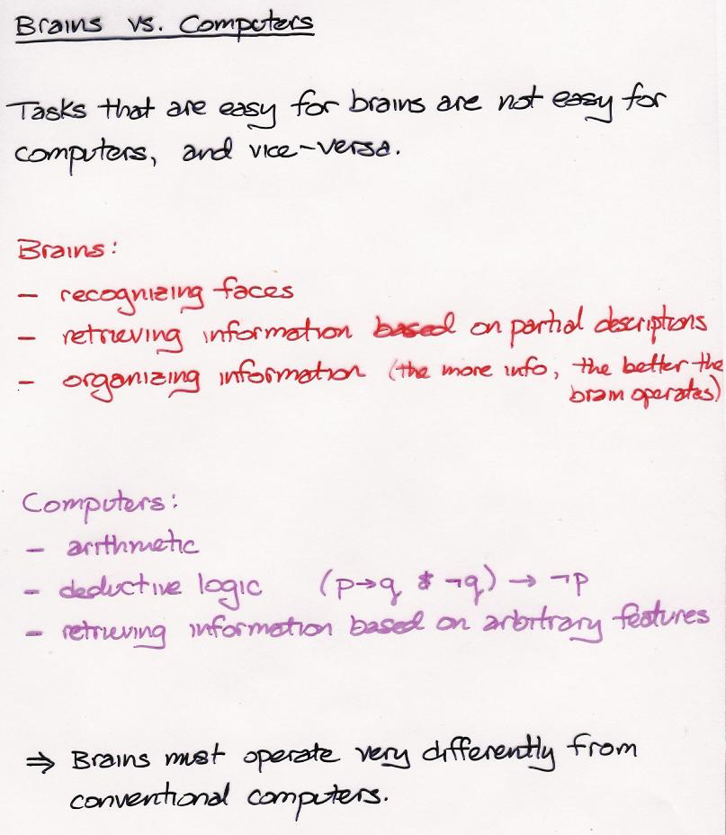

Slide 12
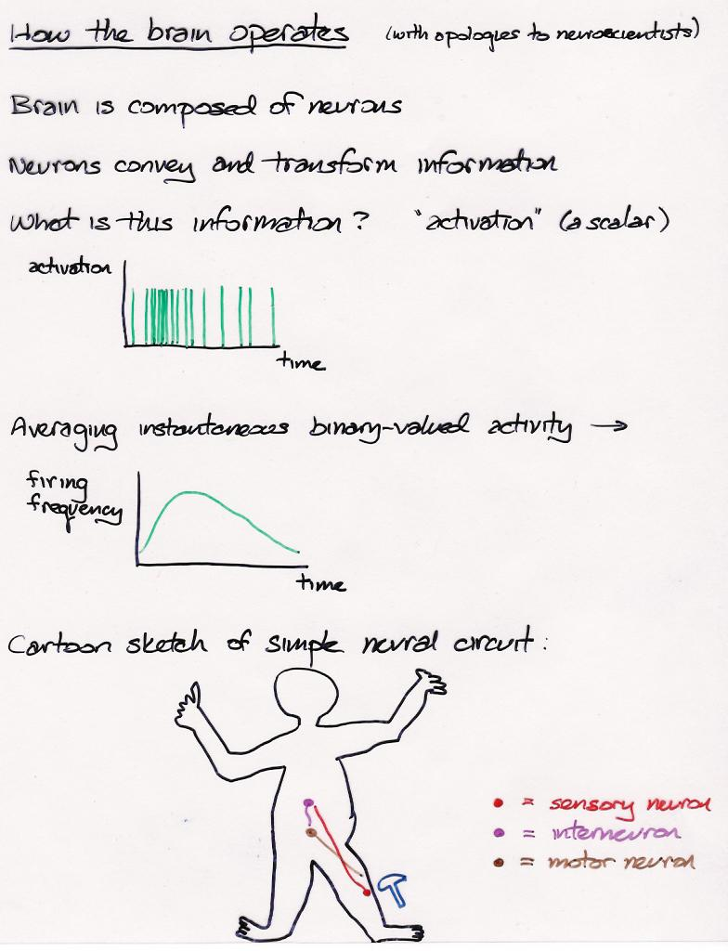

Slide 13
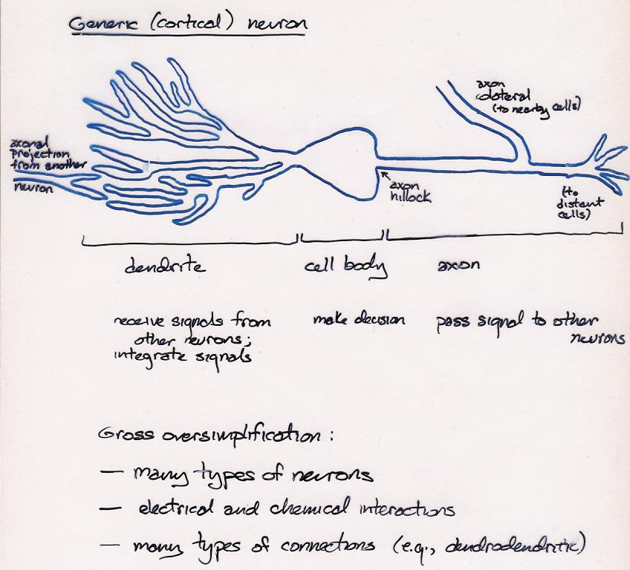

Slide 14
Key Features of Cortical Computation
Neurons are slow (10^{–3} – 10^{–2} propagation time)
Large number of neurons (10¹⁰ – 10¹¹)
No central controller (CPU)
Neurons receive input from a large number of other neurons (10⁴ fan-in and fan-out of cortical pyramidal cells)
Communication via excitation and inhibition
Statistical decision making (neurons that single-handedly turn on/off other neurons are rare)
Learning involves modifying coupling strengths (the tendency of one cell to excite/inhibit another)
Neural hardware is dedicated to particular tasks (vs. conventional computer memory)
Information is conveyed by mean firing rate of neuron, a.k.a. activation

Slide 15
Conventional computers
  One very smart CPU
  Lots of extremely dumb memory cells
Brains, connectionist computers
  No CPU
  Lots of slightly smart memory cells

Slide 16
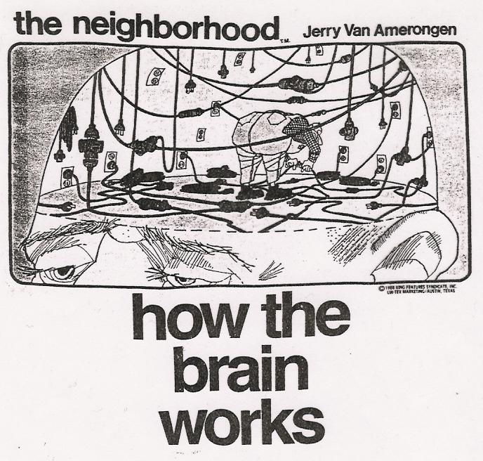

Slide 17
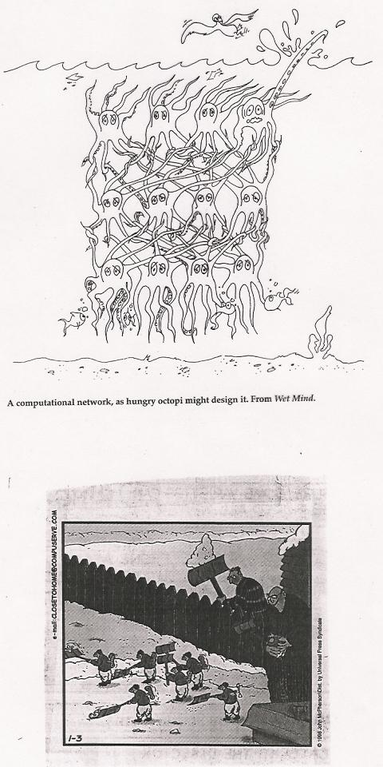

Slide 18
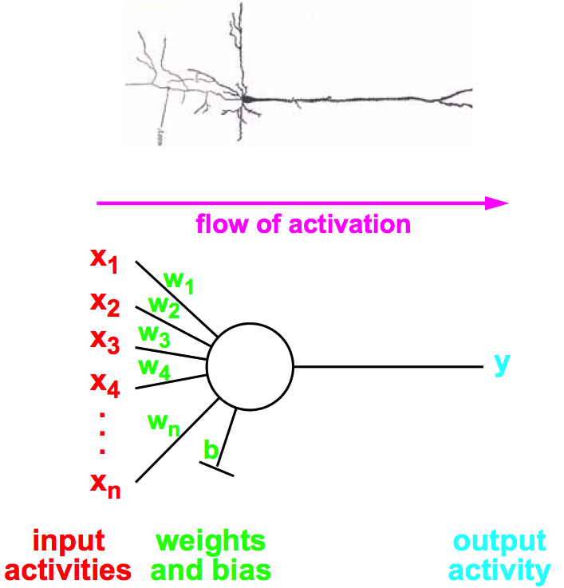
Modeling Individual Neurons

Slide 19
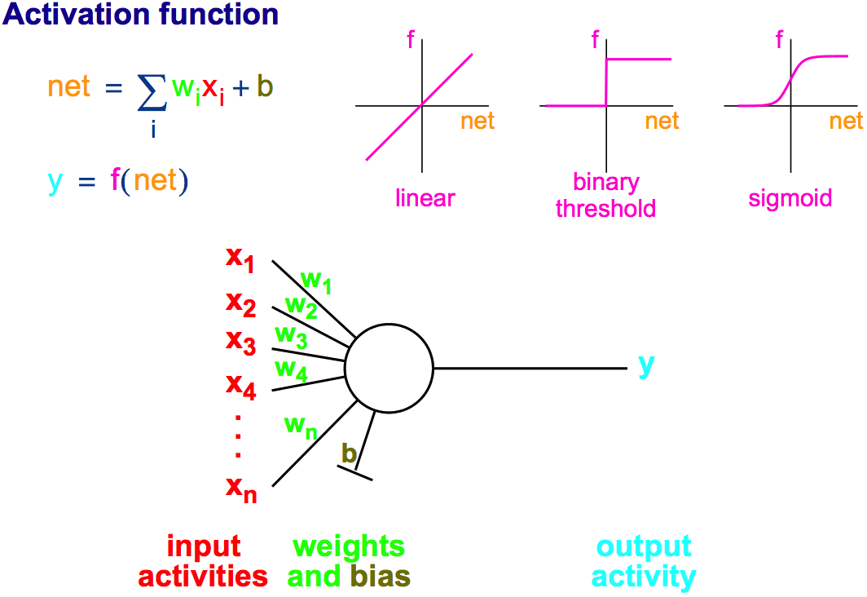
Modeling Individual Neurons
rectified

Slide 20
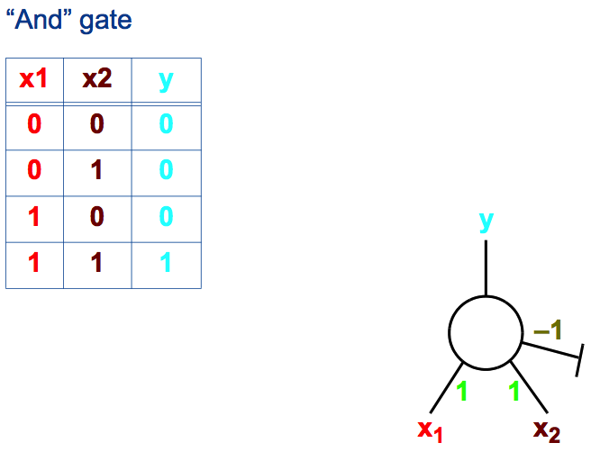
Computation With A Binary Threshold Unit
= 1 if net > 0

Slide 21
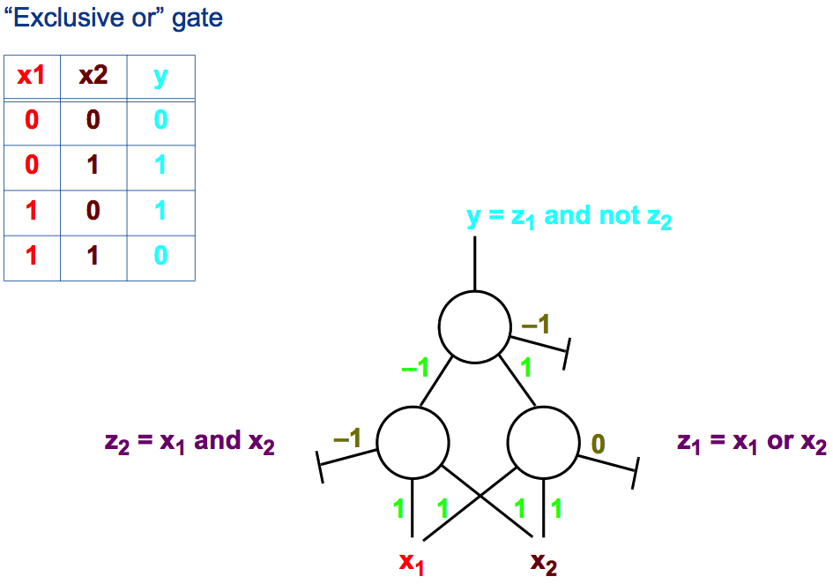
Computation With A Binary Threshold Unit
0

Slide 22
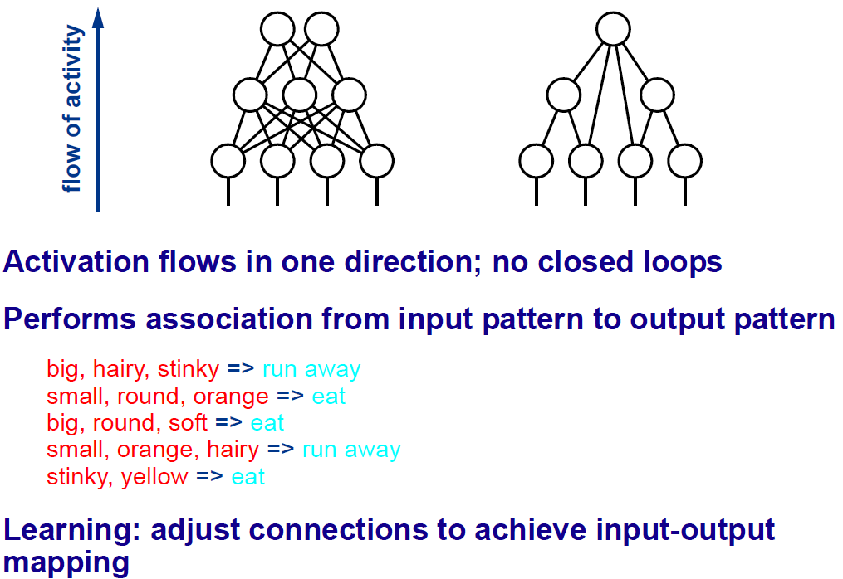
Feedforward Architectures

Slide 23
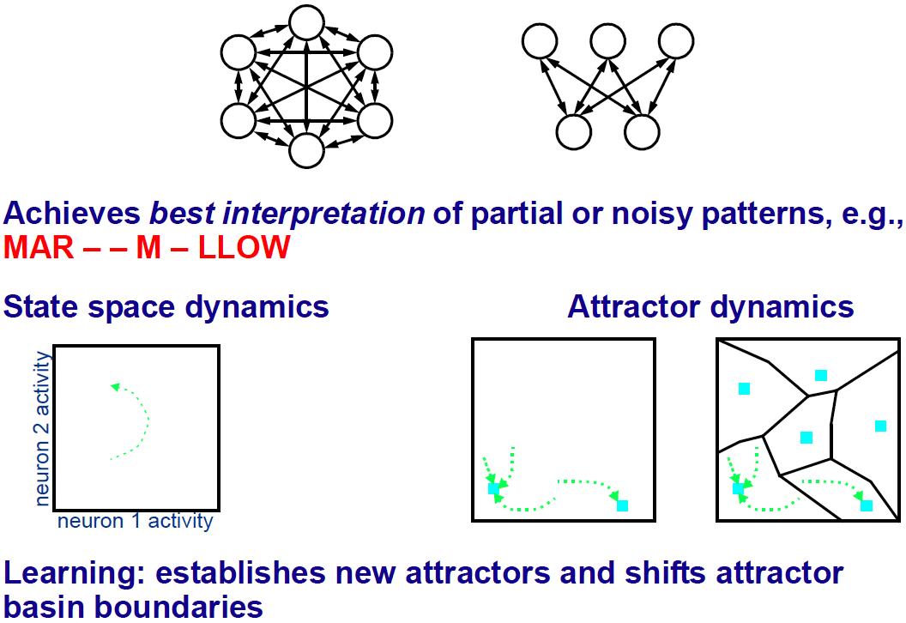
Recurrent Architectures

Slide 24
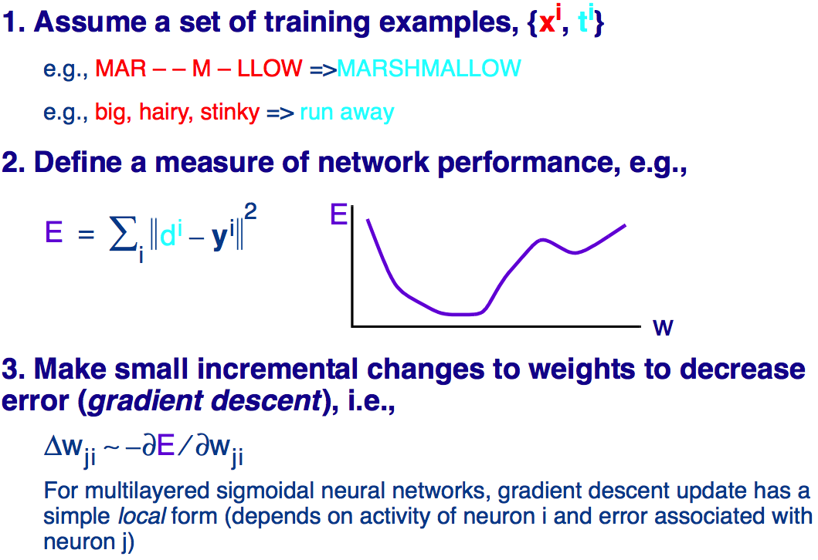
Supervised Learning In Neural Networks

