Slide 1
CCSI 5922
Neural Networks and Deep Learning:
Introduction 1
Mike Mozer
Department of Computer Science and
Institute of Cognitive Science
University of Colorado at Boulder
Notes:
position
audience

Slide 2

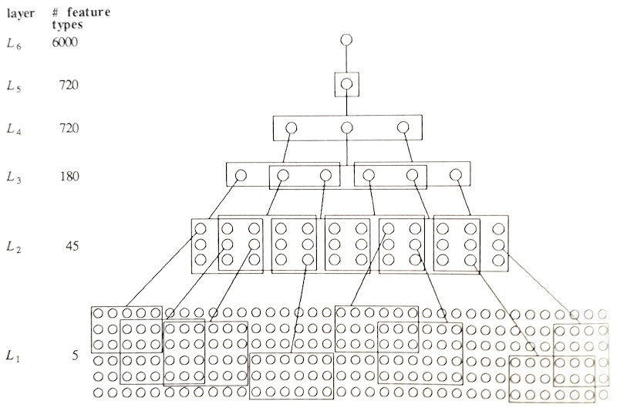
Mozer (1987)
Notes:
thesis: not much more to be done with convolutional nets!

Slide 3
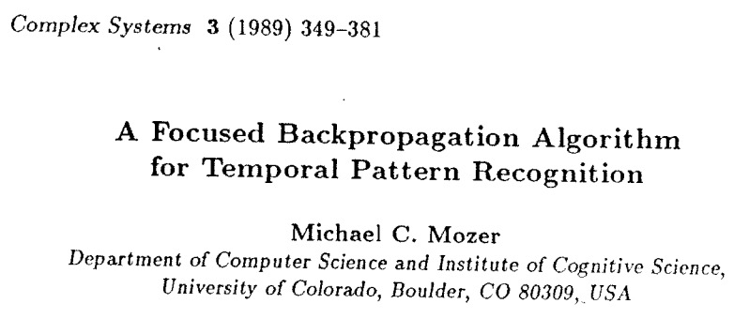
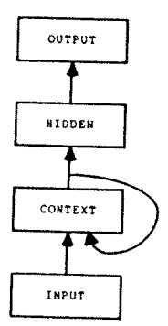

Mozer (1992)
Units with a 1-1 linear self connection
Notes:
Juergen / Sepp as postdocs -> added some gates -> LSTM ‘that’s an ugly architecture’

Slide 4
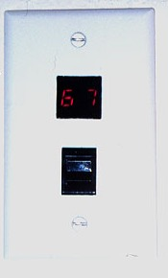
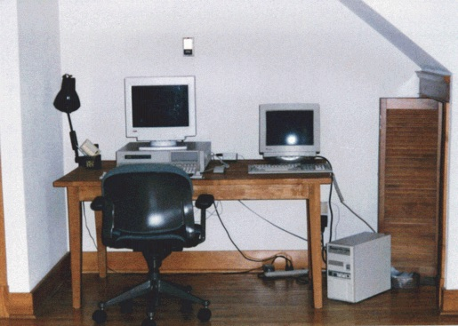
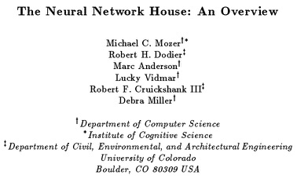
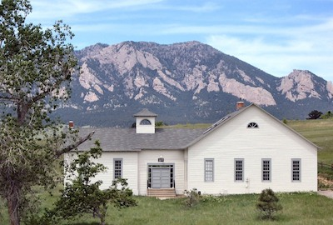
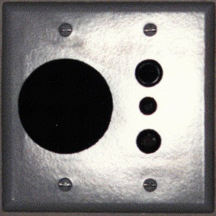
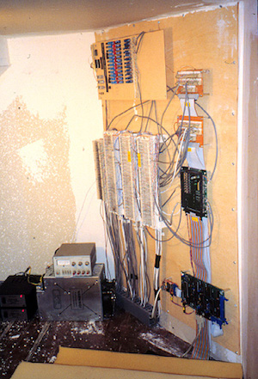
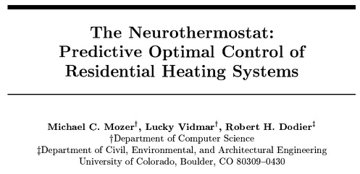
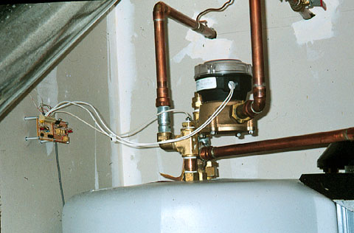
Mozer et al. (1995)
Adaptive House

Slide 5


Slide 6
Current Research Interests
Human optimization
  developing software tools to improve how people learn, remember, make decisions
Cognitively informed machine learning
  developing machine learning algorithms that leverage insights from human perception and cognition
Notes:
Two interrelated threads…
I’ll talk about some of this work during my lectures, but let me give you a few other examples to give you the flavor

Slide 7
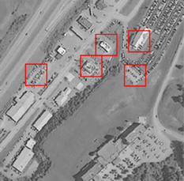
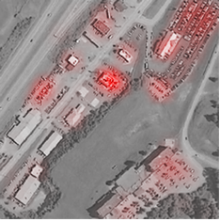
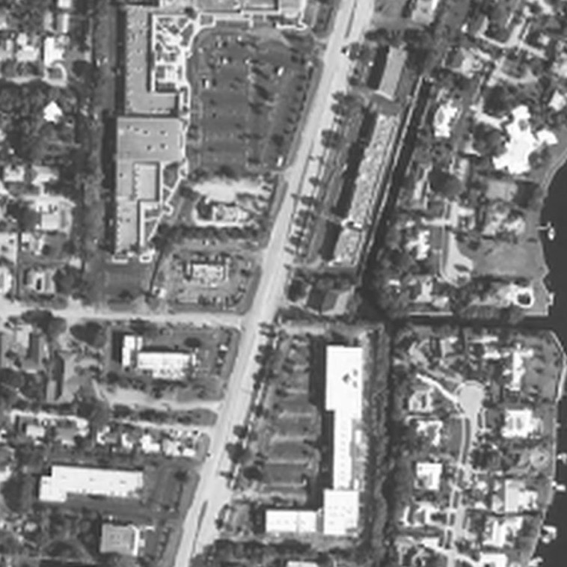
Human-Machine Cooperative Visual Search
(Kneusel & Mozer, 2017)
Hard
Highlighting
Soft
Highlighting
population | d’
human | 2.23
classifier | 2.28
human + hard highlights | 2.64
human + soft highlights | 2.80
Notes:
Challenging visual search problems where people are imperfect but machines aren’t yet to the level of people

Slide 8
Rating Decontamination
(Wilder, Jones, & Mozer, in preparation)
1
neither bad
nor wrong
10
extremely
evil
Sequential dependencies in ratings
  movies, homework grades, length of a line
Given contamination introduced by sequential dependencies, we can train models to decontaminate sequences
  obtains 5-25% improvement in quality of human judgments
testifying falsely for pay
stealing a hotel towel
shooting striking workers
yelling at a slow driver
poisoning a barking dog
poisoning a barking dog

Slide 9
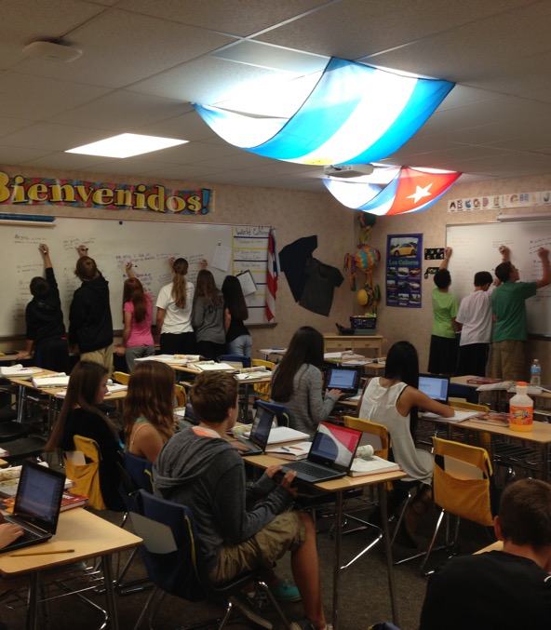
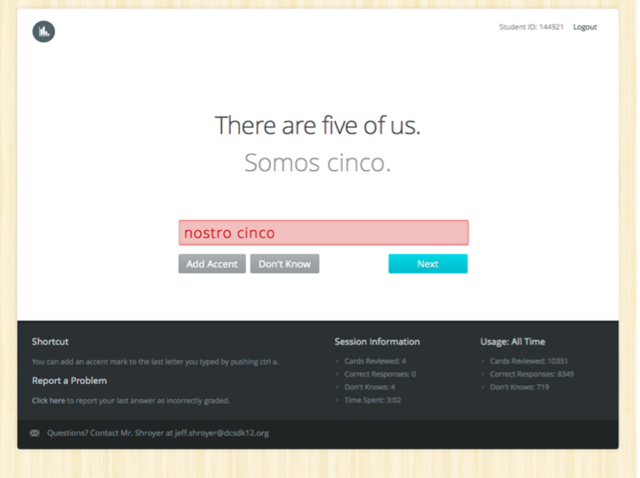
Personalized Review For Promoting Long-Term Retention
(Lindsey, Shroyer, Pashler, & Mozer, 2014)
12.4%
16.5%

Slide 10
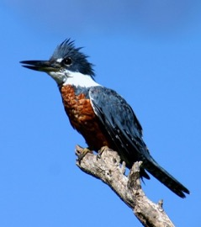
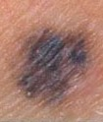
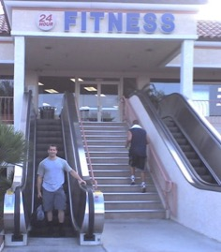
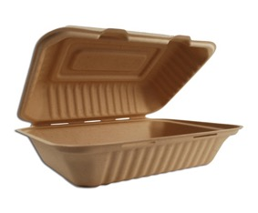
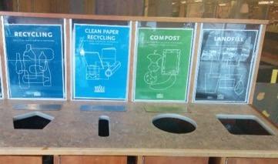
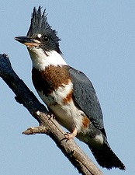

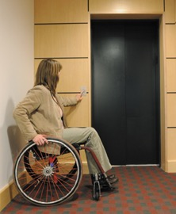

Training Humans To Categorize
(Roads & Mozer, 2017)
Ringed Kingfisher
Benign
Ironic
Compost
Belted Kingfisher
Melanoma
Not Ironic
Paper
Notes:
psychologists study these dopey artificial stimuli
Tim Rogers – words and concepts
Karen Schloss

Slide 11
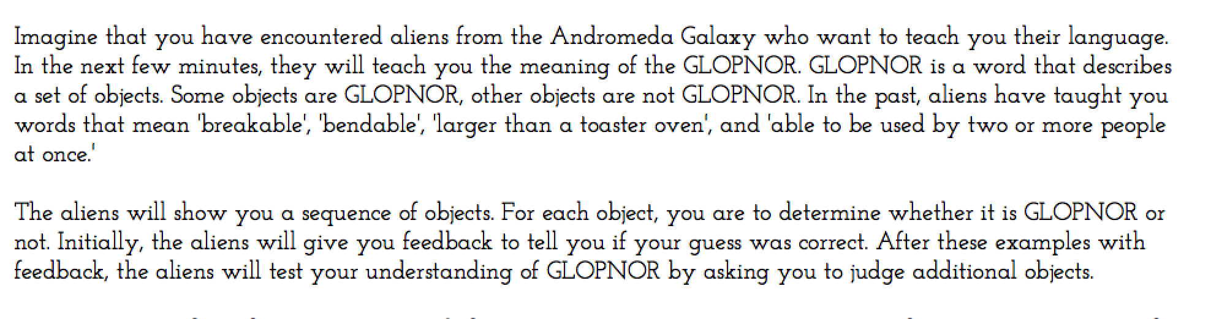

Concept Learning Experiment
Hal Pashler
UC San Diego

Slide 12
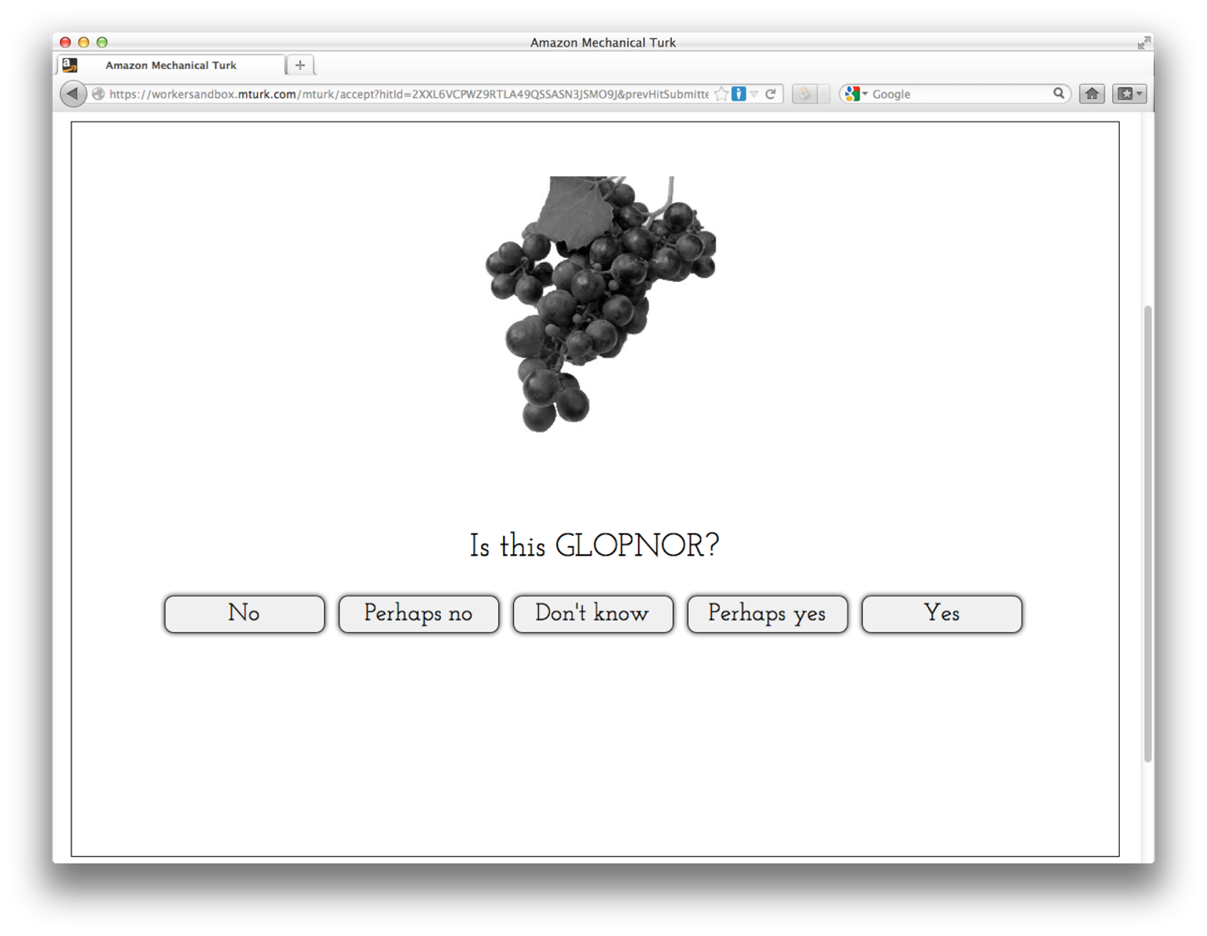

Slide 13
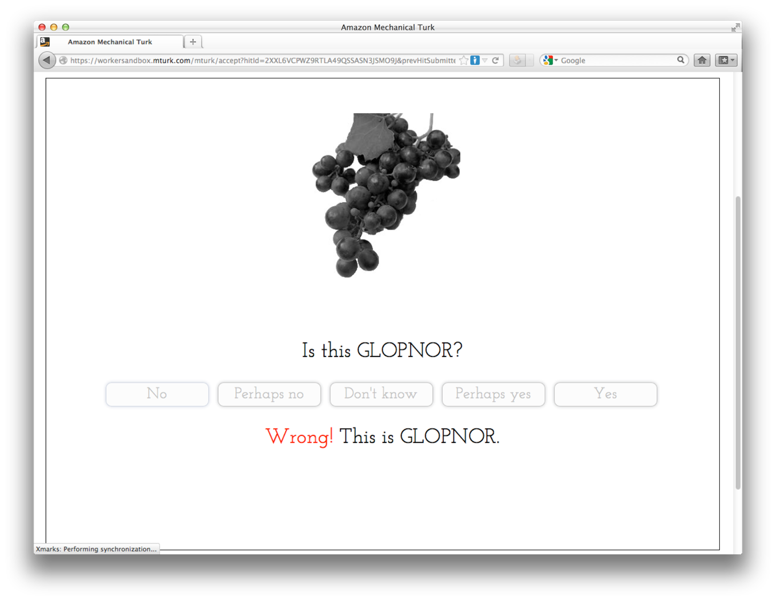

Slide 14
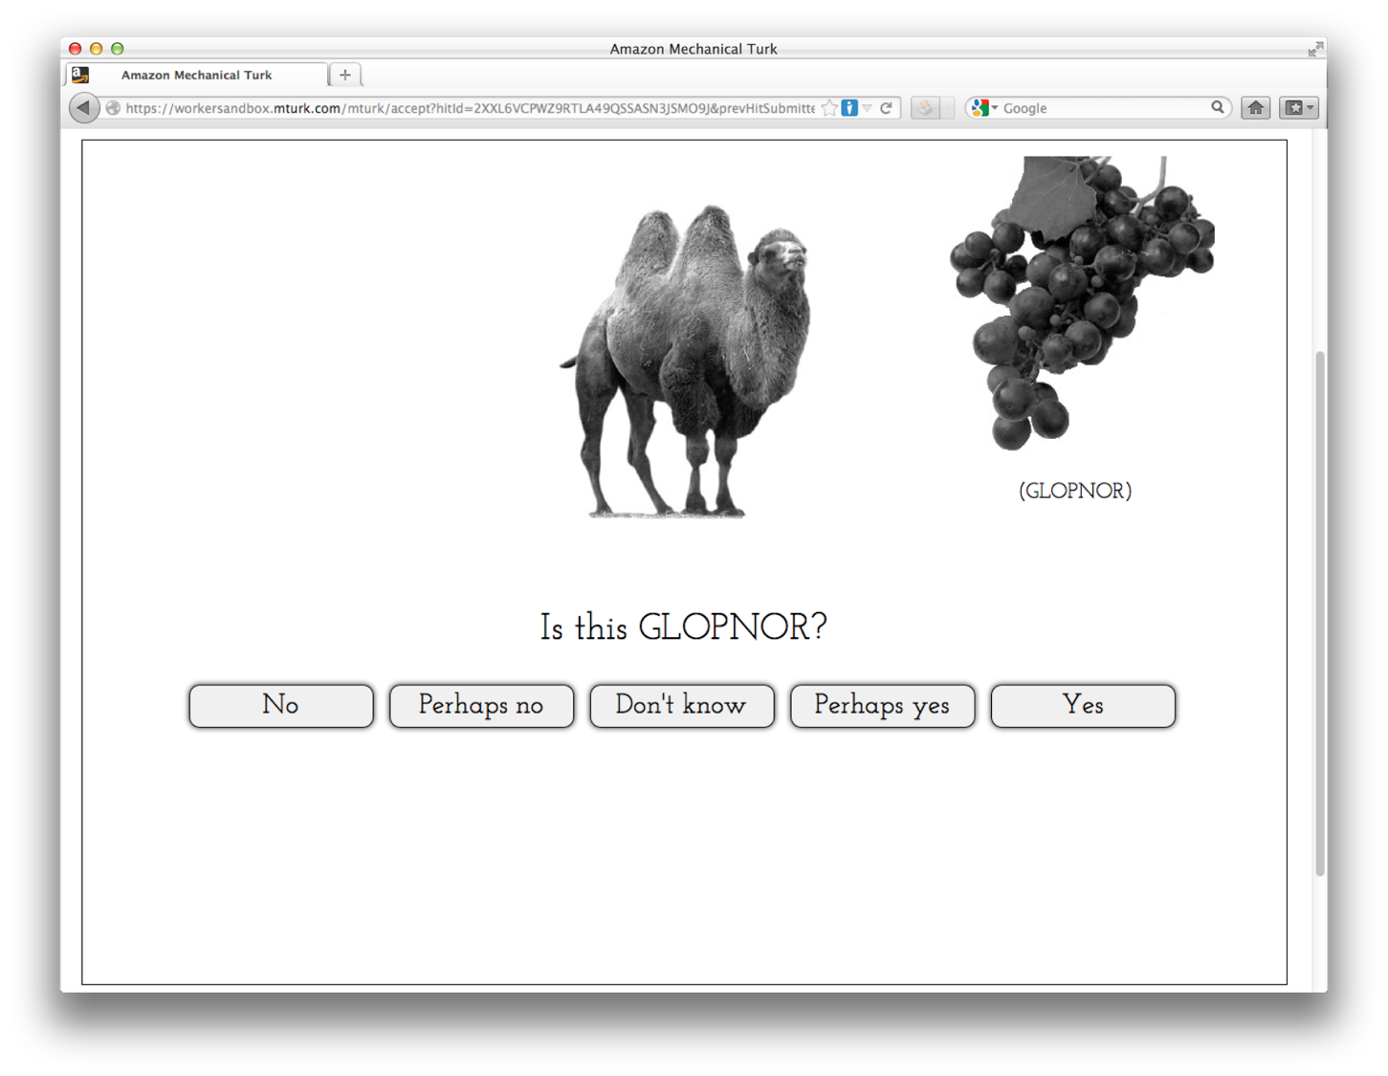

Slide 15
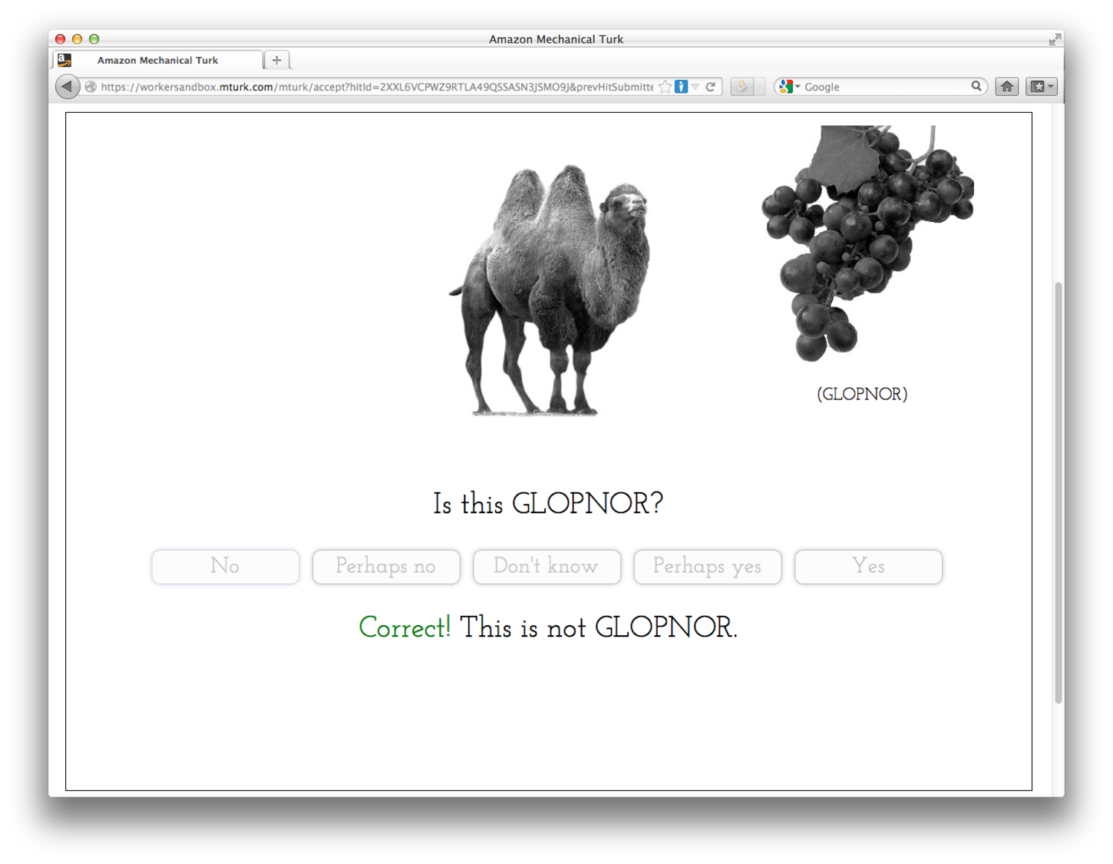

Slide 16
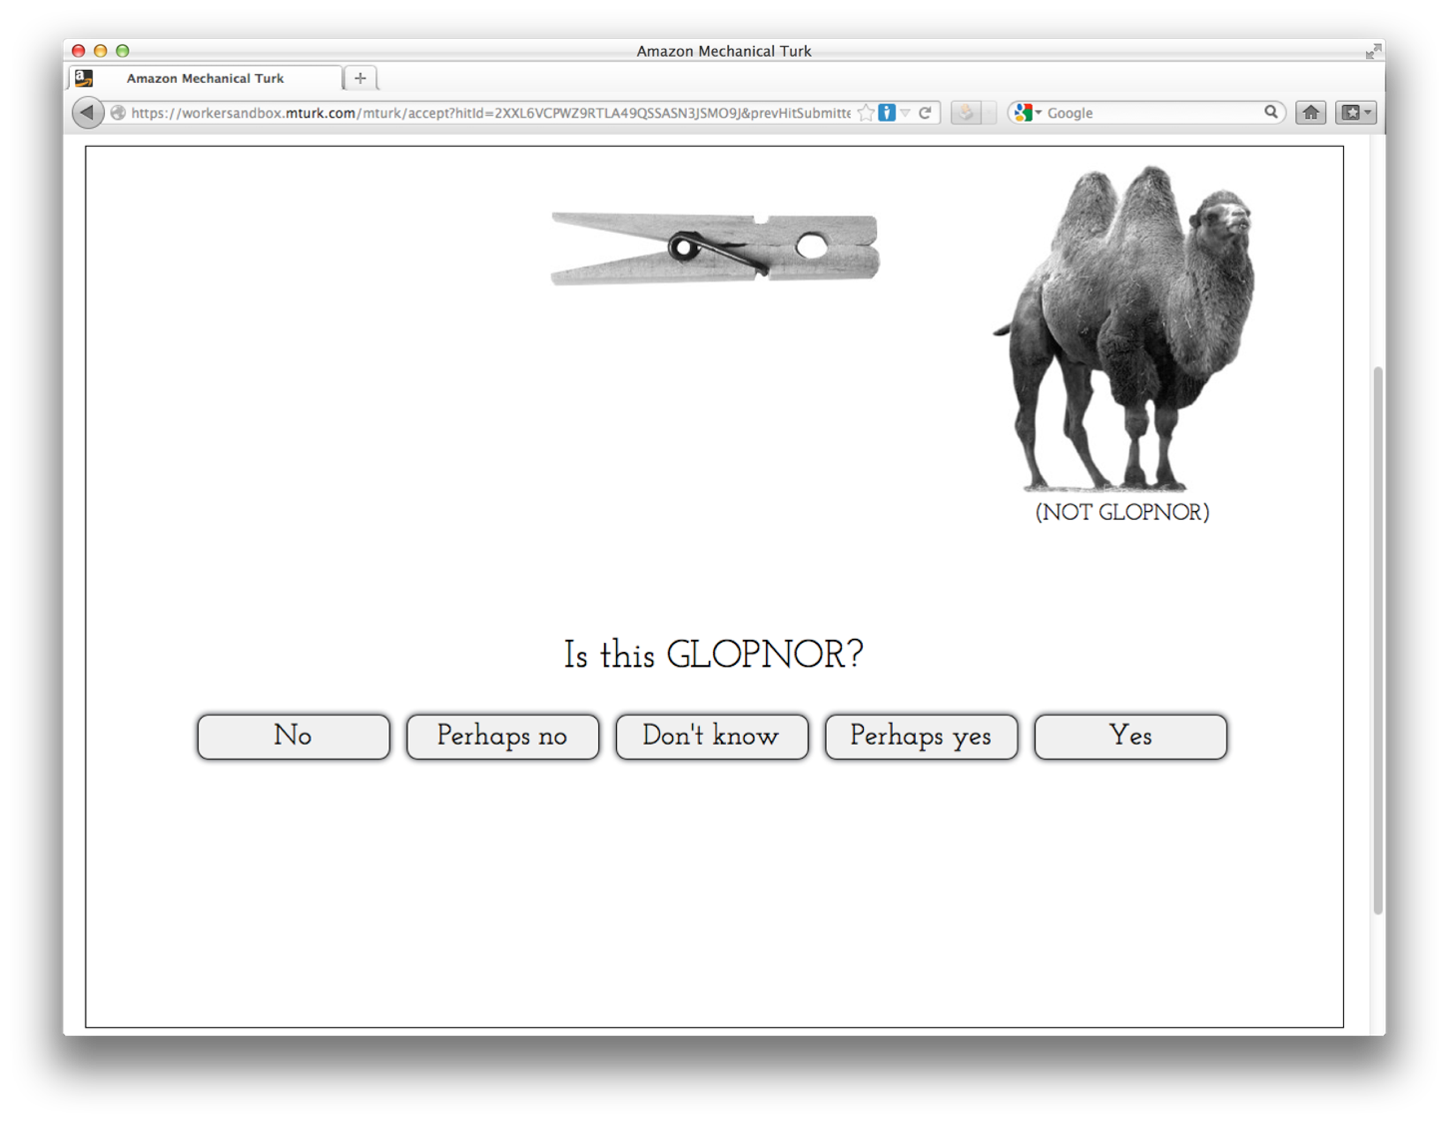

Slide 17
Recurrent Neural Net:
Generic Model of Domain-Independent Human Learning?
(Roads & Mozer, 2017)
AUC

