Slide 1
Neural Network Hardware
History, physical limits, Human Level Hardware
Teddy Weverka ted@fathomcomputing.com
Member of the graduate faculty CU Boulder

Slide 2
NN hardware
60’s neural networks
  ADALINE- Widrow Hoff LMS
  array of tapped delay lines - spawned array signal processing, MIMO
80’s neural networks
  The Physics of Computation
    Mead, Hopfield and Feynman
    Center for Computation and Neural Systems,- Dimitri Psaltis, Yaser Abu-Mastafa
  Synaptics, Foveon
Current FPGA, GPU, ASIC
  Intel Stratix, NVIDIA, Nervana, Google TPU
Fundamental limits
    Energy (heat)
    Area-time tradeoffs
      Multiplications, communications
    Optical links, multiply and add – electronic nonlinearity, memory
Human level AI - Fathom Computing

Slide 3
Hardware is cheap, Data is expensive OR vice versa
Notes:
Widrow- hardware, no diff NN, sig processing, machine with knobs, ADELINE,
Mine signal processing for ideas for NN.

Slide 4
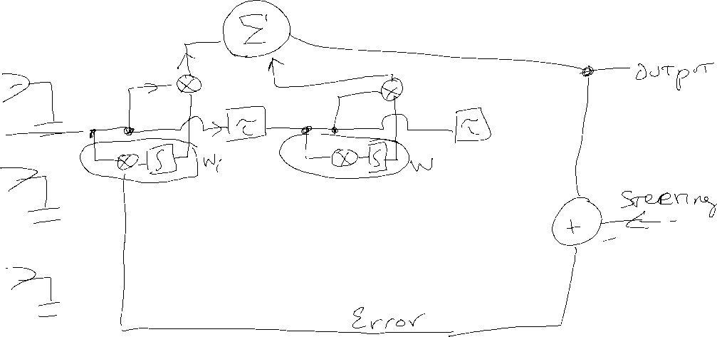
STAP
STAP – error fed back to adapt weights
Interchange order of multiply, add, delay
Weights are sum of outerproduct of error
Notes:
Covariance Matrix instead of LMS in reduced layers?

Slide 5
Physical limits
Where are the most resources required?
N to M neurons -> NM Multiply Accumulate
Multipliers
Connections
  (systolic VM multiplier)
Energy, Real Estate
heat and chip area

Slide 6
Broadcast vector to matrix, and collect
Systolic MA fixes real estate consumption.
Still have energy required to send data across chip

Slide 7
ASIC
Intel Stratix 10
  20 TMAC = 10,000 multipliers @~2 GHz
Google TPU
  45 TMAC = 64k MAC @ 700 MHz
Intel Nervana
  TBD
NVIDIA GPU Titan X
  10 TMAC

Slide 8
4x45*10^12 multiply-add (256x256 multiplier/accum. running at 700MHz)

Slide 9
11*10^15=64*4*45*10^12 multiply-adds??
But is it useful?
Notes:
Organize wires carefully

Slide 10
Connections matter
Tiling ASICs to create larger NN - Bisection bandwidth

Slide 11
Large Scale Distributed Implementations
  Fit nn size on one ASIC?
  Asynchronous stochastic gradient descent
  Distribute problem to multiple ASICs, Copy weights
Analog Hardware
Bit depth

Slide 12
All Hardware is Heat Sink Limited
Notes:
Why is this man smiling?

Slide 13
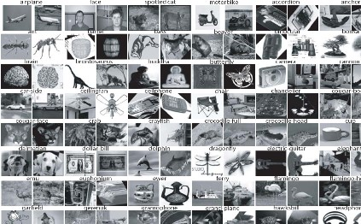
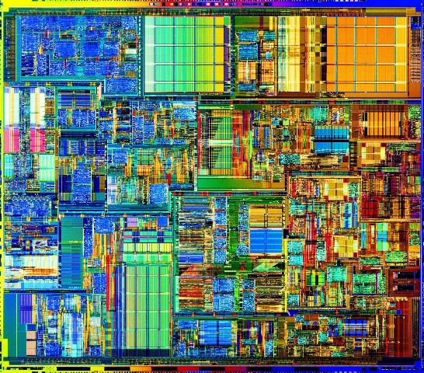
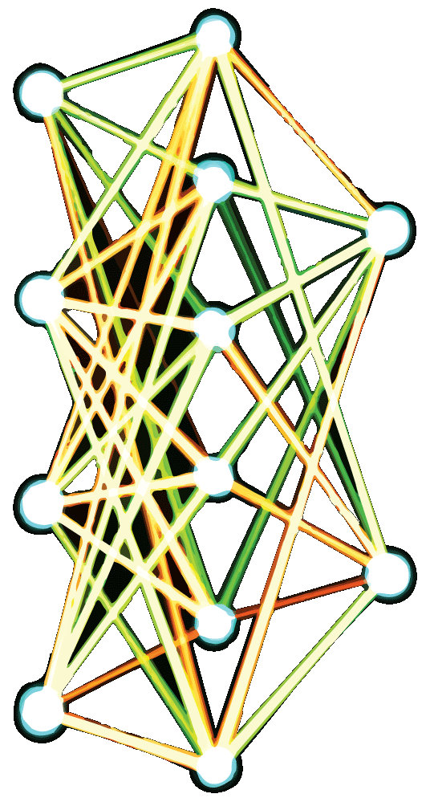
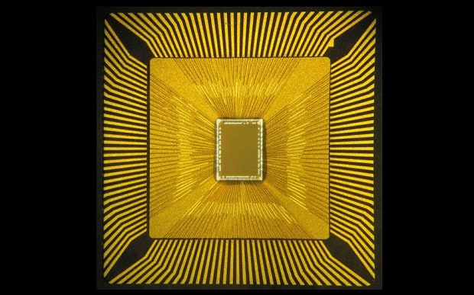
Building superintelligence requires 3 things:
Algorithm
Data
Hardware
Notes:
The motivation to ask this question comes from the question: “how do we build superintelligence?” "Many of you are working on the algorithms and the data parts (connection to audience). I'm working on the hardware to build superintelligence (teaser about yourself), so I'm going to share a few thoughts with you today on the hardware for superintelligence.“ More data would be wonderful. But requires more hardware to run it in relevant timespans. I’m going to talk about hardware today.

Slide 14
Human Brain->
10^11 Neurons
10^4 synapses/neuron
10^(2or 3) /second
10^18 synaptic multiply adds/second
“We’re not going to get human-level abilities until we have systems that have the same number of parameters in them as the brain… right now the biggest neural nets are a million times smaller than the brain”
Geoffrey Hinton, Google
Notes:
But is it Useful?

Slide 15
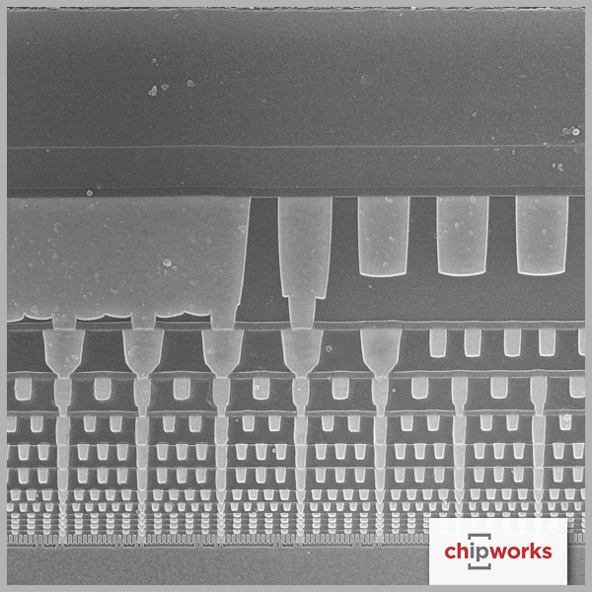
Limitations of current computers
Computer performance is limited by:
  energy dissipation
  interconnect bandwidth density
The source of nearly all energy dissipation is signal transmission in interconnects (CV^2, C=capacitance, V=voltage)
Interconnect bandwidth density is limited by resistance/capacitance (RC delay) and wire interconnect geometry (wires can’t pass through each other)
Performance limitation: wiring
Notes:
This comes from real physical limitations of electronics. Communicating is costly. In energy, time.

Slide 16
Electronics vs Optics
Electronics
Optics
High energy dissipation from long interconnects
Low bandwidth
Wires can’t pass through each other
Very low energy dissipation
Very high bandwidth
Light can pass through itself

Slide 17
Fathom Optical NN
Optics for Communication, multiplexed multiply and add
3 custom ASICs with optical modulators/detectors
Notes:
VM multiply natural in 3D.
Multiplexing natural in optics
Hv=

