Slide 1
CSCI 5922
Neural Networks and Deep Learning
Generative Adversarial Networks
Mike Mozer
Department of Computer Science and
Institute of Cognitive Science
University of Colorado at Boulder

Slide 2
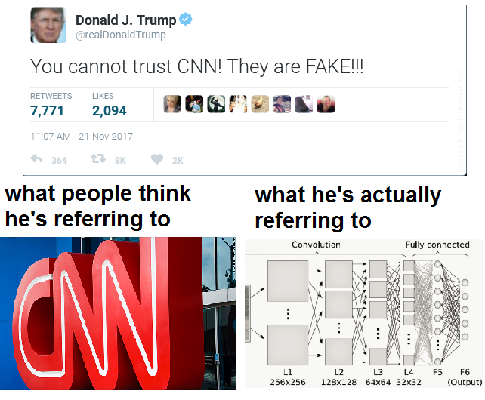
From statsmemes @ facebook
(Thanks Adi!)
Notes:
delete after 2017

Slide 3
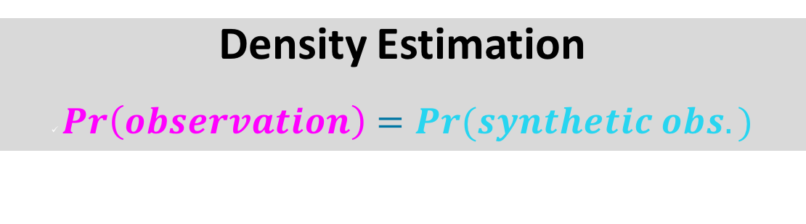
Probabilistic Generative Models
Real world
observations
=
goal of
modeling
Model
synthetic
observations
Density Estimation
$Pr\left(observation\right)=Pr(synthetic obs.)$

Slide 4
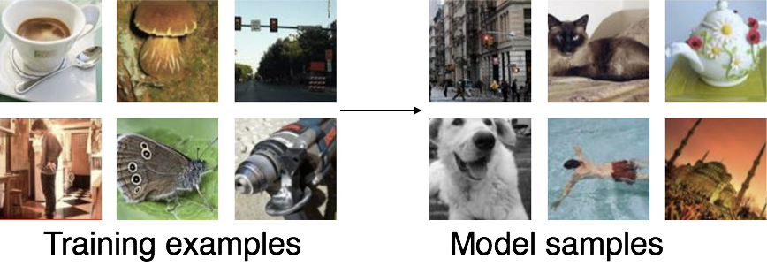

Synthesizing Examples
From Probabilistic Generative Model
$$Pr(obs.)$$
Goodfellow (2017)
Goodfellow NIPS tutorial and accompanying paper (arXiv:1701.00160v4 [cs.LG]) provided some figures

Slide 5
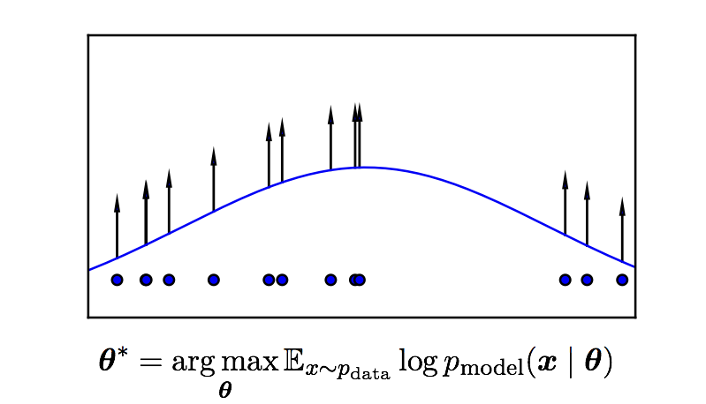
Maximum Likelihood Estimation
Goodfellow (2017)

Slide 6
Density function $Pr_{\text{model}}(x|θ)$
Explicit and analytical
  e.g., Gaussian
  can sample directly from model
Explicit and approximate
  e.g., Boltzmann machine
  can estimate probability by running Markov chain monte carlo
Implicit
  GAN
  can’t estimate probability but can draw from distribution with given probability

Slide 7
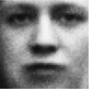
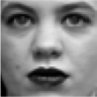
Adversarial Networks
real or fake?
Generative
Model
Real world
Discriminative
Model

Slide 8

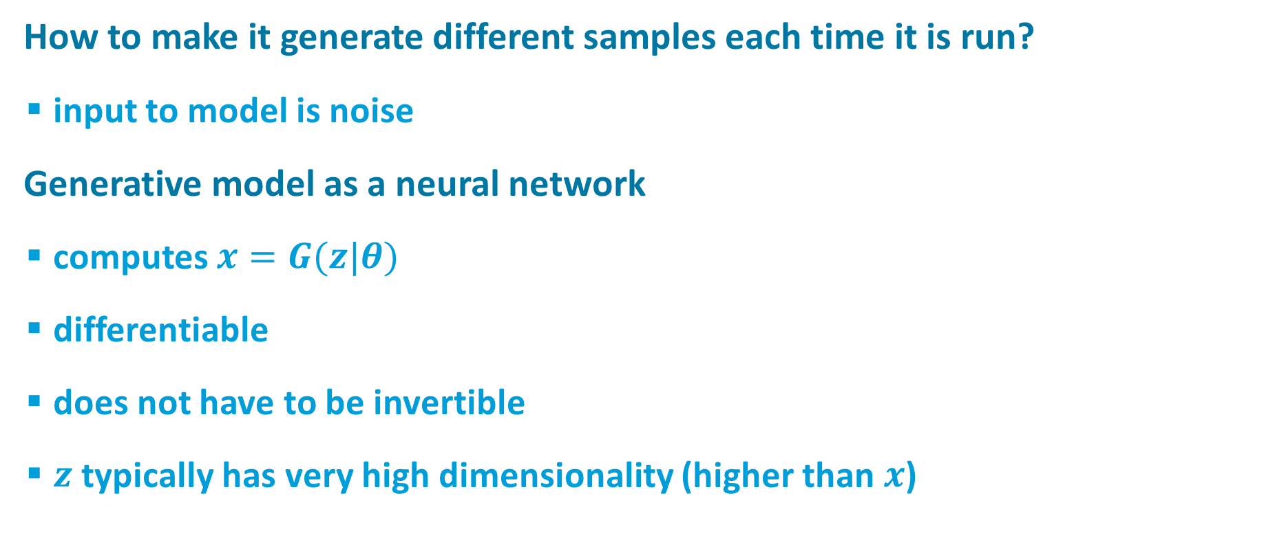
Generative Model
How to make it generate different samples each time it is run?
  input to model is noise
Generative model as a neural network
  computes $x=G(z|θ)$
  differentiable
  does not have to be invertible
  $z$typically has very high dimensionality (higher than $x$)
noise ($z$)
Generative
Model

Slide 9
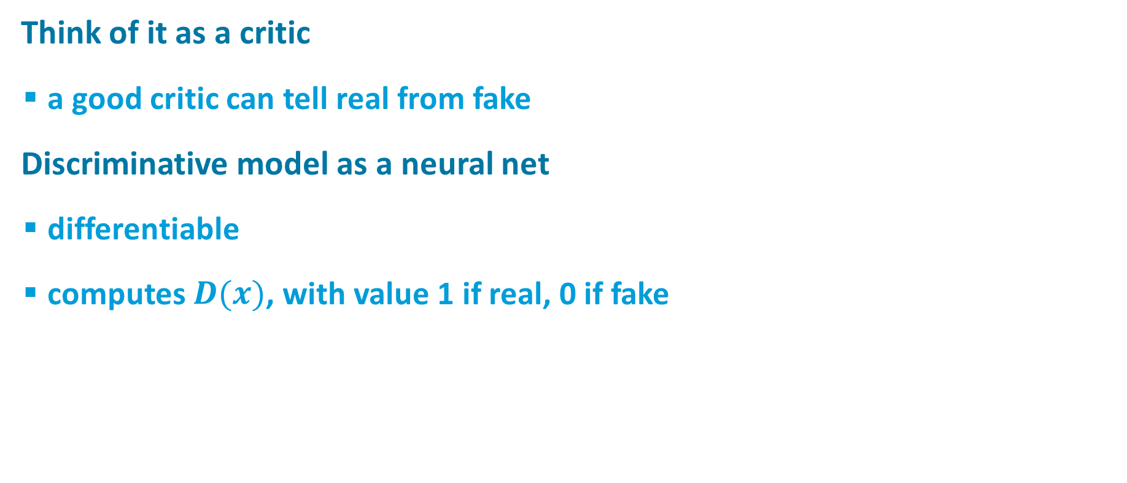
Discriminative Model
real or fake?
Think of it as a critic
  a good critic can tell real from fake
Discriminative model as a neural net
  differentiable
  computes $D(x)$, with value 1 if real, 0 if fake
Discriminative
Model

Slide 10

Training Procedure: Basic Idea
real or fake?
G tries to fool D
D tries not to be fooled
Models are trained simultaneously
  As G gets better, D has a more challenging task
  As D gets better, G has a more challenging task
Ultimately, we don’t care about the D
  Its role is to force G to work harder
Discriminative
Model
Real world
noise ($z$)
Generative
Model

Slide 11
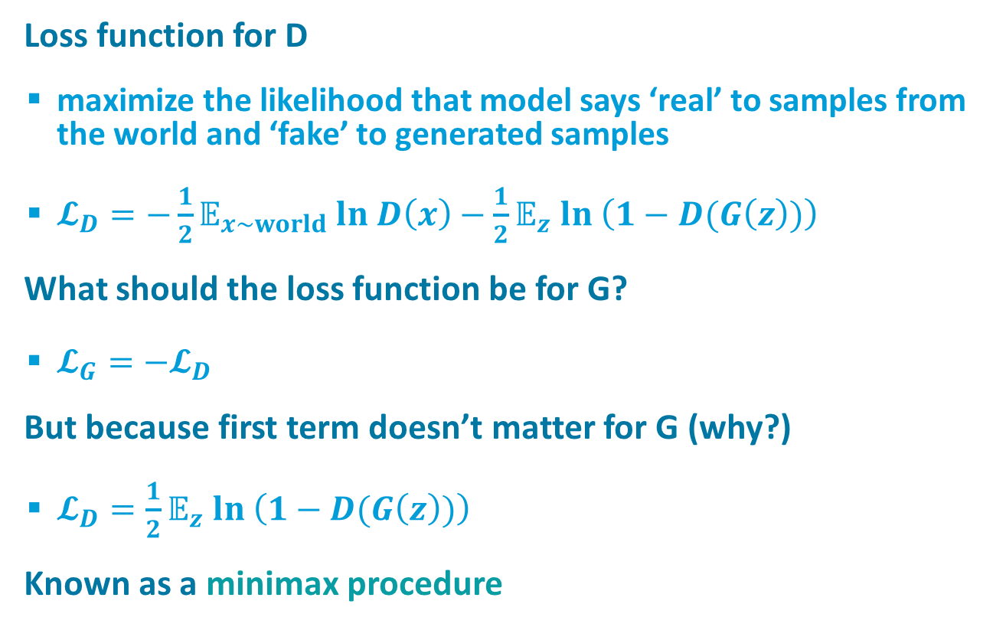
Loss Functions
real or fake?
Loss function for D
  maximize the likelihood that model says ‘real’ to samples from the world and ‘fake’ to generated samples
  $𝓛_{D}=−\frac{1}{2}𝔼_{x\sim world} ln D\left(x\right)−\frac{1}{2}𝔼_{z} ln \left(1−D(G\left(z\right))\right)$
What should the loss function be for G?
  $𝓛_{G}=−𝓛_{D}$
But because first term doesn’t matter for G (why?)
  $𝓛_{D}=\frac{1}{2}𝔼_{z} ln \left(1−D(G\left(z\right))\right)$
Known as a minimax procedure
Discriminative
Model
Real world
noise ($z$)
Generative
Model

Slide 12
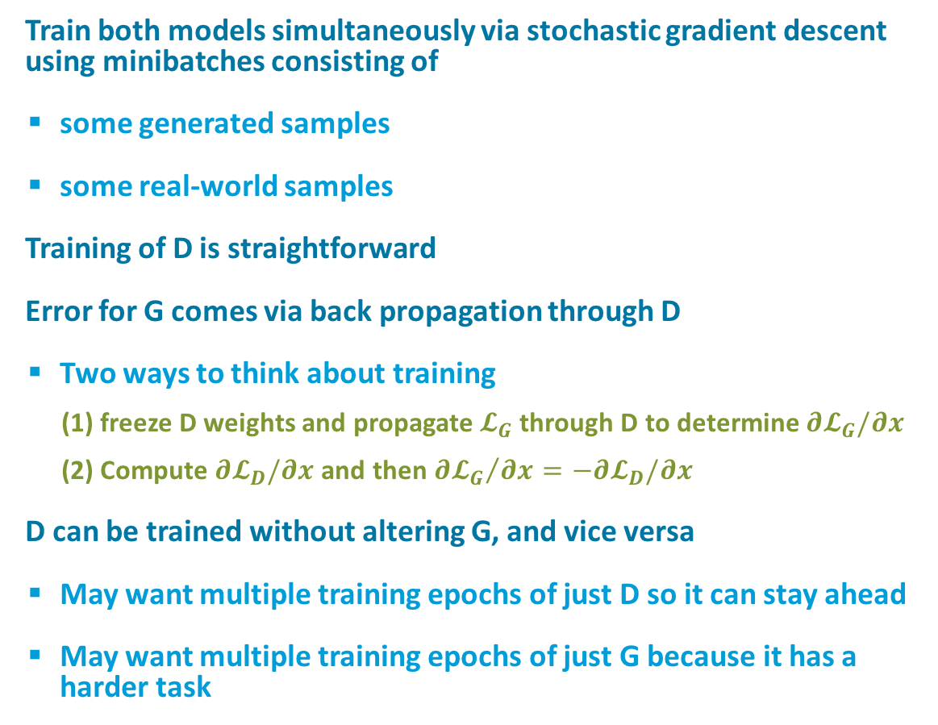
Training Procedure
real or fake?
Train both models simultaneously via stochastic gradient descent using minibatches consisting of
  some generated samples
  some real-world samples
Training of D is straightforward
Error for G comes via back propagation through D
  Two ways to think about training
    (1) freeze D weights and propagate$𝓛_{G}$ through D to determine $∂𝓛_{G}/∂x$
    (2) Compute $∂𝓛_{D}/∂x$ and then ${∂𝓛_{G}}/{∂x}=−∂𝓛_{D}/∂x$
D can be trained without altering G, and vice versa
  May want multiple training epochs of just D so it can stay ahead
  May want multiple training epochs of just G because it has a harder task
Discriminative
Model
Real world
noise ($z$)
Generative
Model

Slide 13
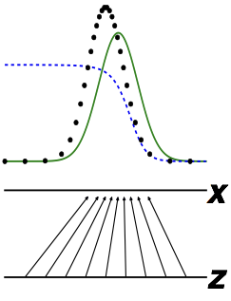

The Discriminator Has a Straightforward Task
real or fake?
D has learned when
  $D\left(x\right)=Pr\left(real | x\right)= \frac{Pr(x|real)}{Pr(x|real)+Pr(x|synthesized)}$
Discriminative
Model
real
discriminator
model
Real world
noise ($z$)
Generative
Model
Goodfellow (2017)

Slide 14
Three Reasons That It’s a Miracle GANs Work
real or fake?
G has a reinforcement learning task
  it knows when it does good (i.e., fools D) but it is not given a supervised signal
  reinforcement learning is hard
  back prop through D provides G with a supervised signal; the better D is, the better this signal will be
Can’t describe optimum via a single loss
  Will there be an equilibrium?
D is seldom fooled
  but G still learns because it gets a gradient telling it how to change in order to do better the next round.
Discriminative
Model
Real world
noise ($z$)
Generative
Model

Slide 15
Do Generator Losses Matter?
(Goodfellow, 2014)
All losses seem to produce sharp samples

Slide 16
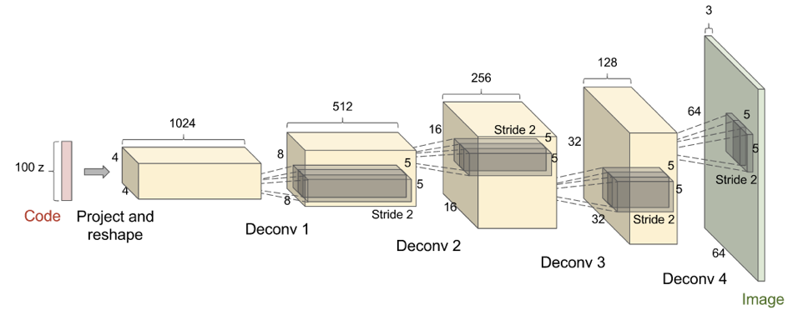
Deconvolutional GANs (DCGAN)
(Radford et al., 2015)
Goodfellow (2017)
Batch normalization important here, apparently

Slide 17
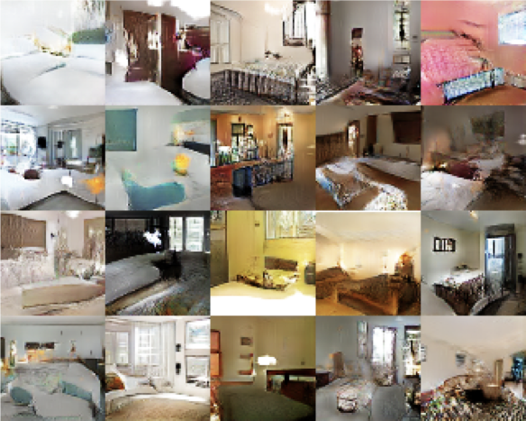
Deconvolutional GANs (DCGAN)
(Radford et al., 2015)
Based on LSUN data set
  10 scene categories
  20 object categories
ArXiv 1506.03365
Goodfellow (2017)

Slide 18

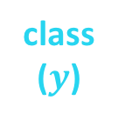

Using Labels Can Improve Generated Samples
Denton et al. (2015) Salimans et al. (2016)
real
class 1
real
class $n$
fake
noise
($z$)
Discriminative
Model
Generative
Model
class
($y$)
Notes:
GAN in lower right corner
LAPGAN next to it
6 classes from LSUN
Yellow circled images are closest real examples [to show it’s not just generating training data]

Slide 19
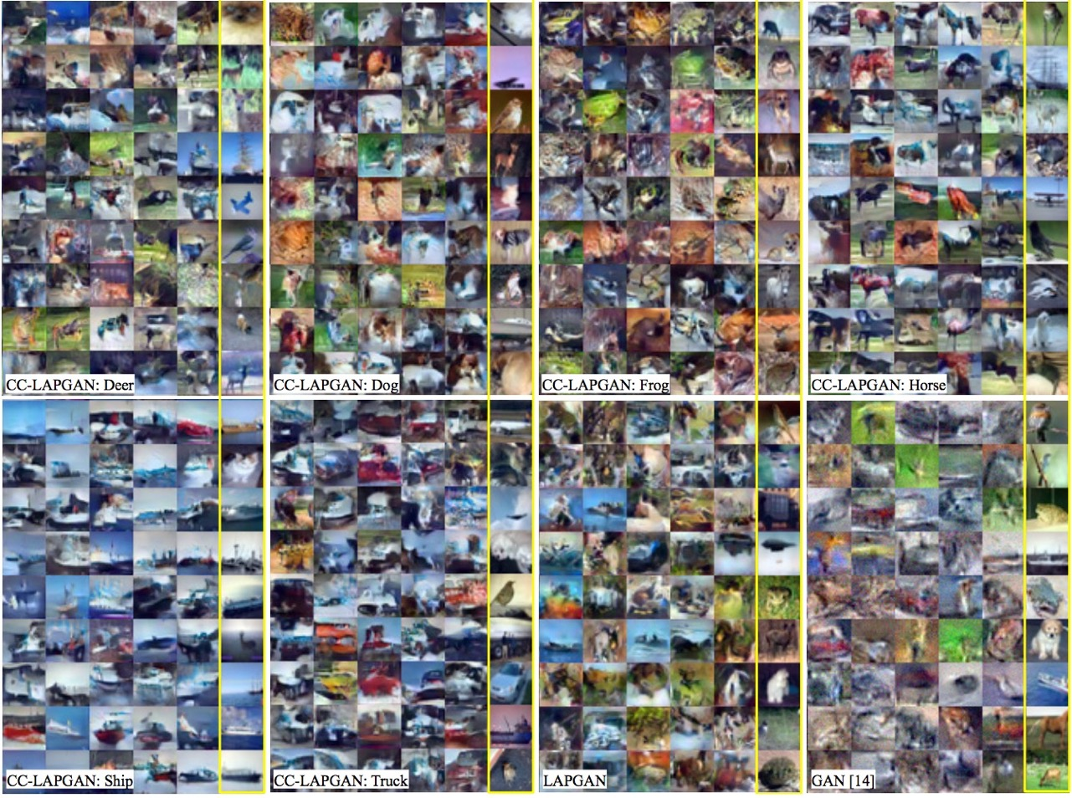
Using Labels Can Improve Generated Samples
(Denton et al., 2015)
LAPGAN: multiresolution deconvolutional pyramid
CC-LAPGAN: class conditional LAPGAN
GAN: original Goodfellow model
Notes:
GAN in lower right corner
LAPGAN next to it
6 classes from LSUN
Yellow circled images are closest real examples [to show it’s not just generating training data]

Slide 20
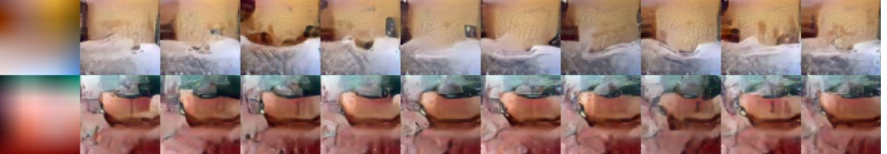
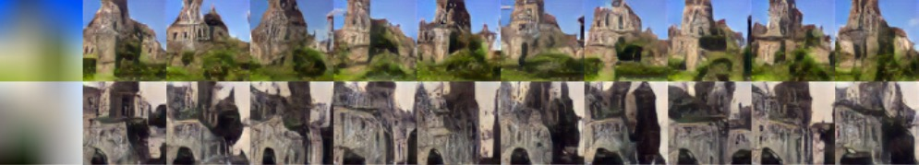
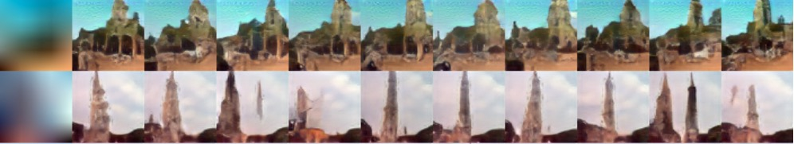
With Image Pyramid, Can Also Seed Generator
With Low-Res Image + Class (Denton et al., 2015)
bedroom
church
tower
Notes:
columns are different draws

Slide 21
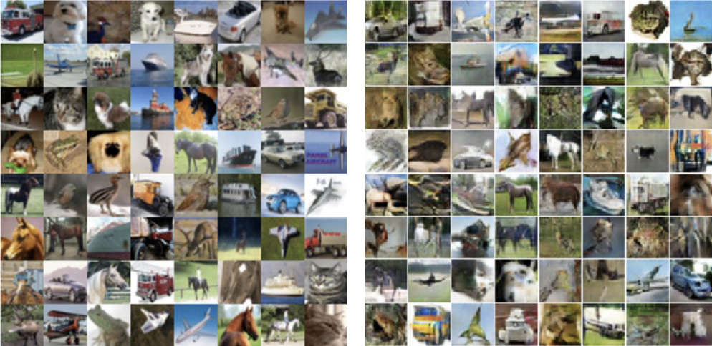
Schemes to Ensure Samples Are Diverse
(Salimans et al., 2016)
Use nearest neighbor on latent representation to detect samples in a minibatch that are too similar
CIFAR training images
Synthesized images

Slide 22
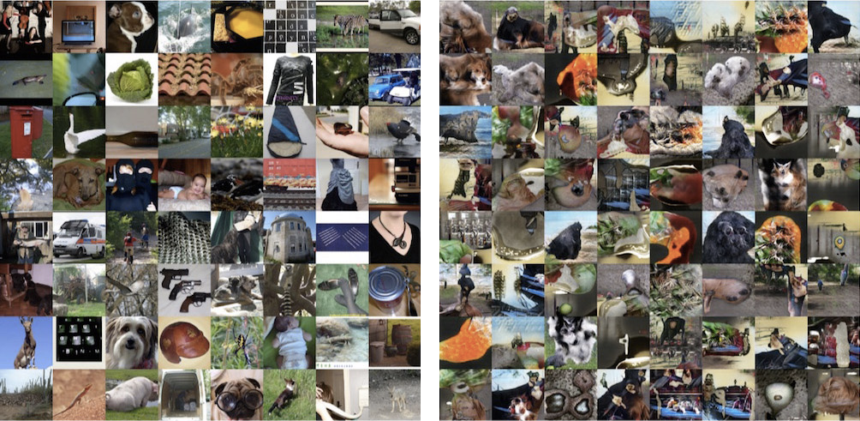
kjkjkj
ImageNet training images

Slide 23
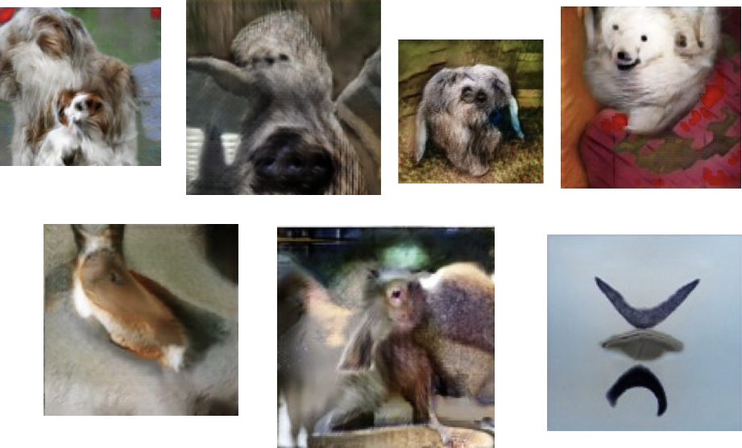
Cherry Picked Results
Goodfellow (2017)

Slide 24
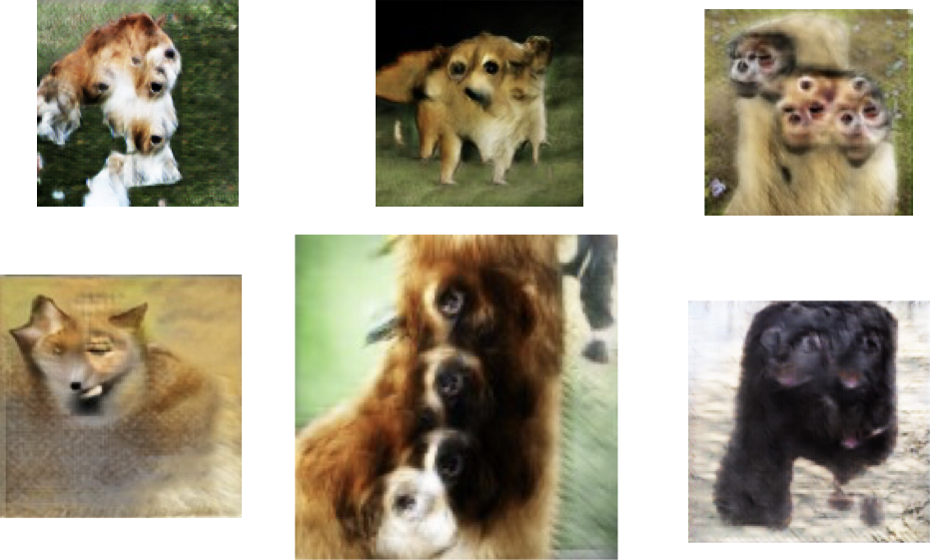
Problems With Counting
Goodfellow (2017)

Slide 25
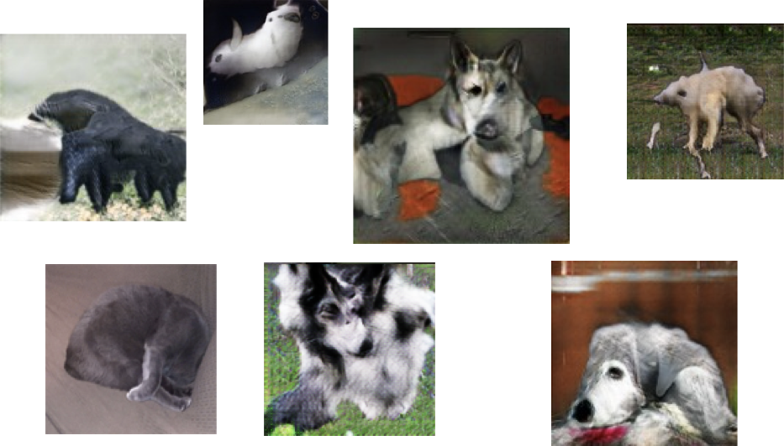
Problems With Perspective
Goodfellow (2017)

Slide 26
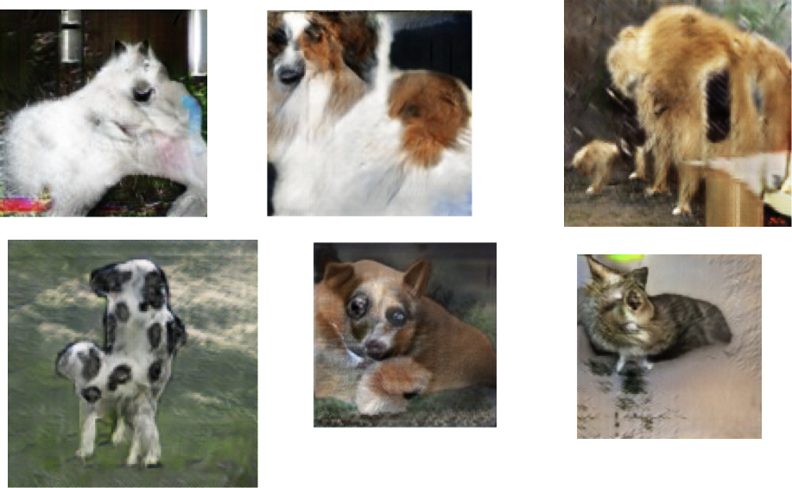
Problems With Global Structure
Goodfellow (2017)

Slide 27
Beyond Labels: Providing Images as Input to Generator:
Next Video Frame Prediction (Lotter et al., 2016)
MSE tends to produce blurry images on any task
  when you can’t predict well, predict the expectation
Notes:
Adversarial is sharper
What’s the architecture here? Generative model receives current frame as input (vs. random vector)

Slide 28
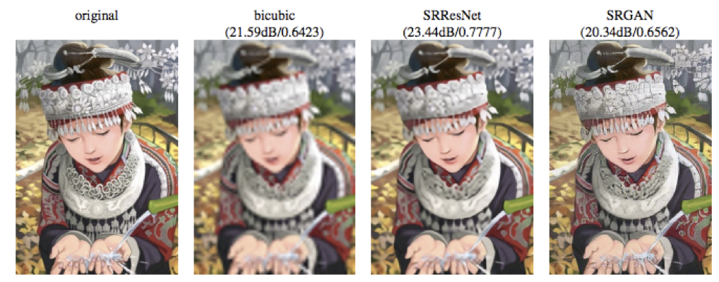
Beyond Labels: Providing Images as Input to Generator:
Image Super-Resolution (Ledig et al., 2016)
Notes:
Generative model receives low res image as input

Slide 29
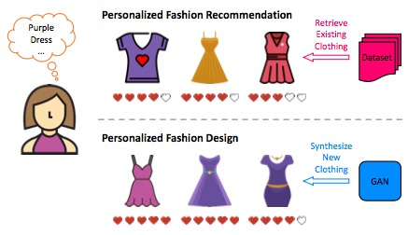
Visually-Aware Fashion Recommendation and Design
With GANs (Kang et al., 2017)
Recommender systems predict how much a particular user will like a particular item
  Can predict based on features of item (e.g., movie director, dress length)
  Can also predict directly from images
Twist here is that instead of
predicting from a predefined set,
generate images that would be liked.

Slide 30
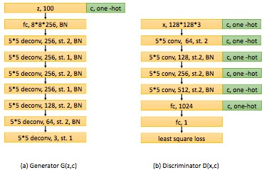
Visually-Aware Fashion Recommendation and Design
With GANs (Kang et al., 2017)
Use class-conditional generator and discriminator

Slide 31
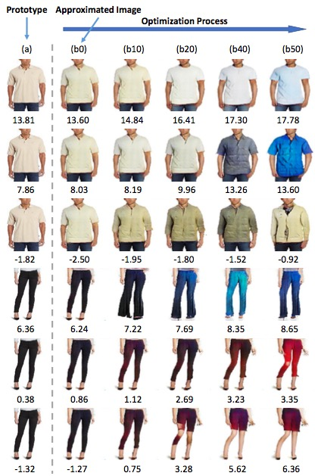
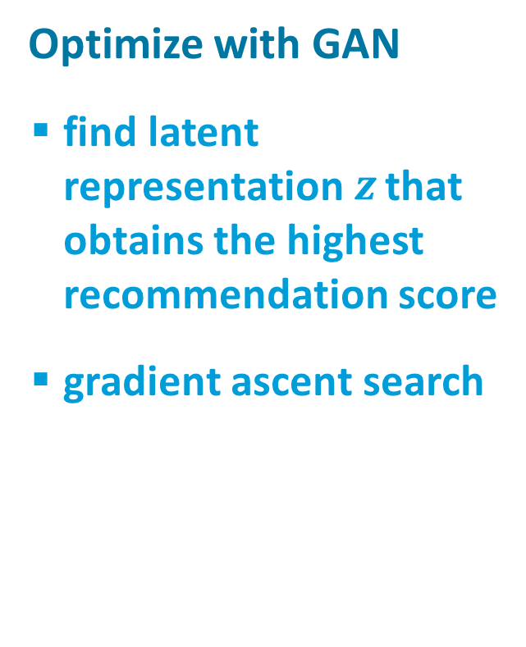
Visually-Aware Fashion Recommendation and Design
With GANs (Kang et al., 2017)
Optimize with GAN
  find latent representation $z$ that obtains the highest recommendation score
  gradient ascent search

Slide 32
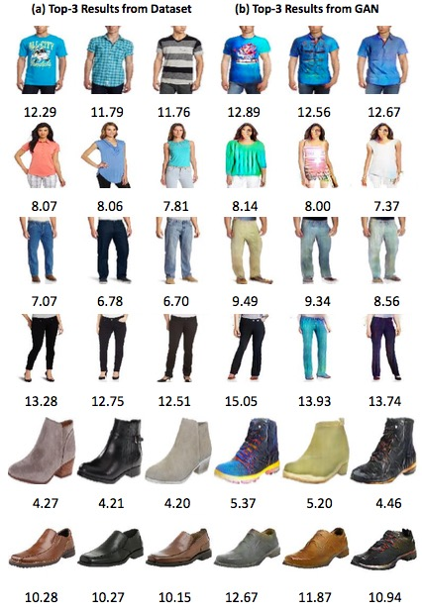

Slide 33
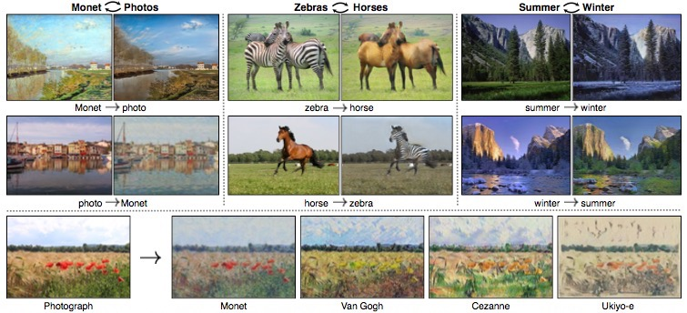
Cycle GANs
(Zhu et al., 2017; arXiv:1703:10593v2 [cs.CV])
Given two image collections
  algorithm learns to translate an image from one collection to the other
  does not require corres-pondence between images

Slide 34
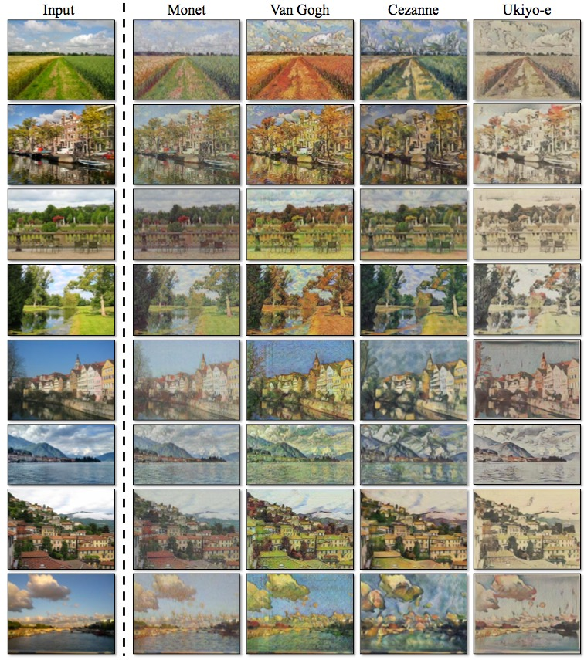
Photos
to paintings

Slide 35
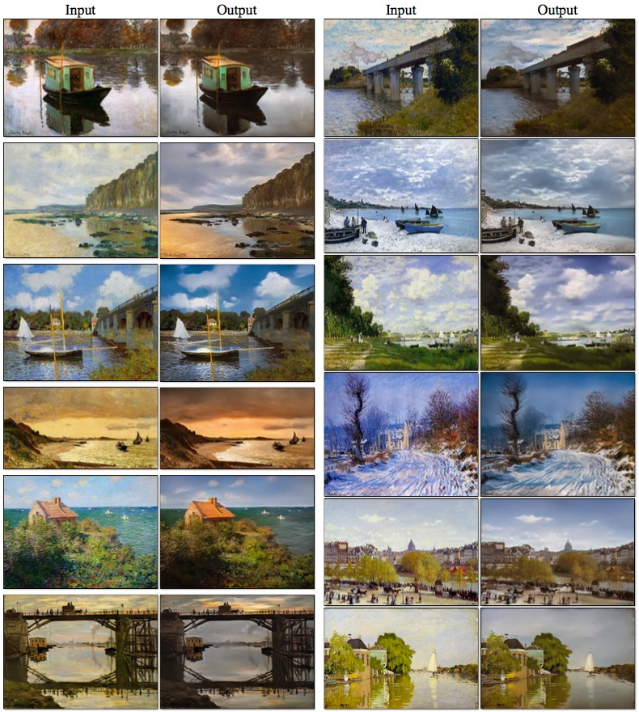
Paintings
to photos

Slide 36
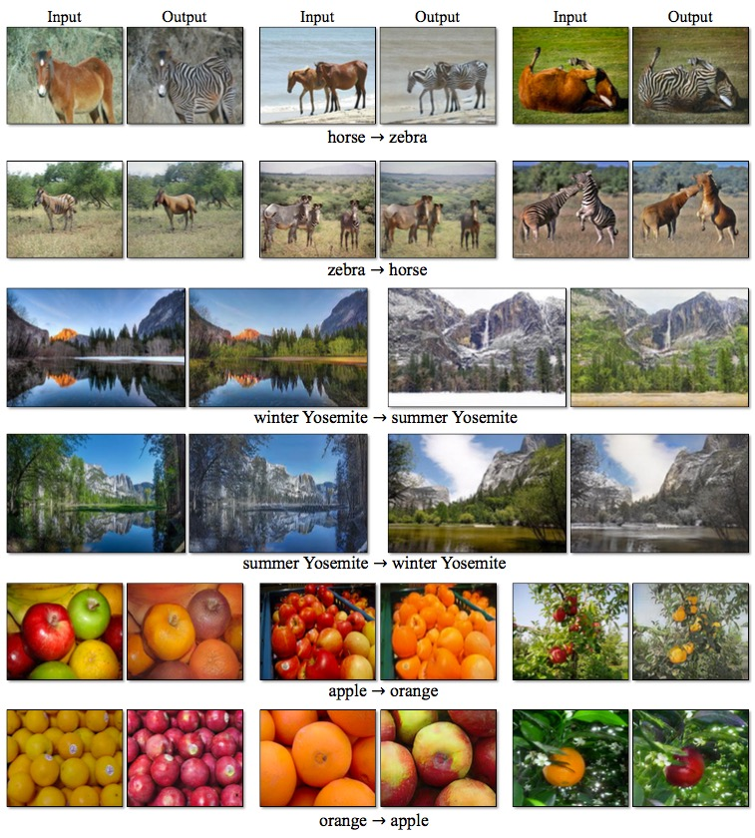

Slide 37
Star GAN
High resolution image synthesis
Notes:
https://www.theverge.com/2017/10/30/16569402/ai-generate-fake-faces-celebs-nvidia-gan
Also the new NVIDIA GAN paper seems really cool. Here's the demo vid.
https://www.youtube.com/watch?time_continue=1&v=XOxxPcy5Gr4

