Slide 1
CSCI 5922
Neural Networks and Deep Learning
Deep Nets
Mike Mozer
Department of Computer Science and
Institute of Cognitive Science
University of Colorado at Boulder

Slide 2
Why Stop At One Hidden Layer?
E.g., vision hierarchy for recognizing handprinted text
    Word output layer
    Character hidden layer 3
    Stroke hidden layer 2
    Edge hidden layer 1
    Pixel input layer

Slide 3
From Ng’s group

Slide 4
Why Deeply Layered Networks Fail
Credit assignment problem
  How is a neuron in layer 2 supposed to know what it should output until all the neurons above it do something sensible?
  How is a neuron in layer 4 supposed to know what it should output until all the neurons below it do something sensible?

Slide 5
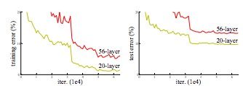
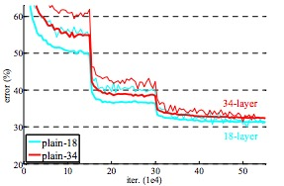
Deeper Vs. Shallower Nets
Deeper net can represent any mapping that shallower net can
  Use identity mappings for the additional layers
Deeper net in principle is more likely to overfit
But in practice it often underfits on the training set
  Degradation due to harder credit-assignment problem
  Deeper isn’t always better!
CIFAR-10
ImageNet
thin=train,
thick=valid.
He, Zhang, Ren, and Sun (2015)

Slide 6
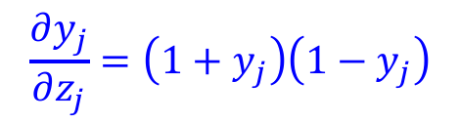


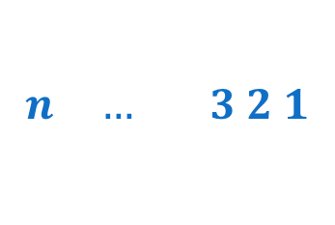


Why Deeply Layered Networks Fail
Vanishing gradient problem
  With logistic or tanh units
  Error gradients get squashed as they are passed back through a deep network
$$y_{j}=\frac{1}{1+exp⁡(−z_{j})}$$
$$\frac{∂y_{j}}{∂z_{j}}=y_{j}\left(1−y_{j}\right)$$
$$\frac{∂y_{j}}{∂z_{j}}=\left(1+y_{j}\right)\left(1−y_{j}\right)$$
$$y_{j}=\tanh\left(z_{j}\right)$$
gradient
$$n … 3 2 1$$
layer

Slide 7
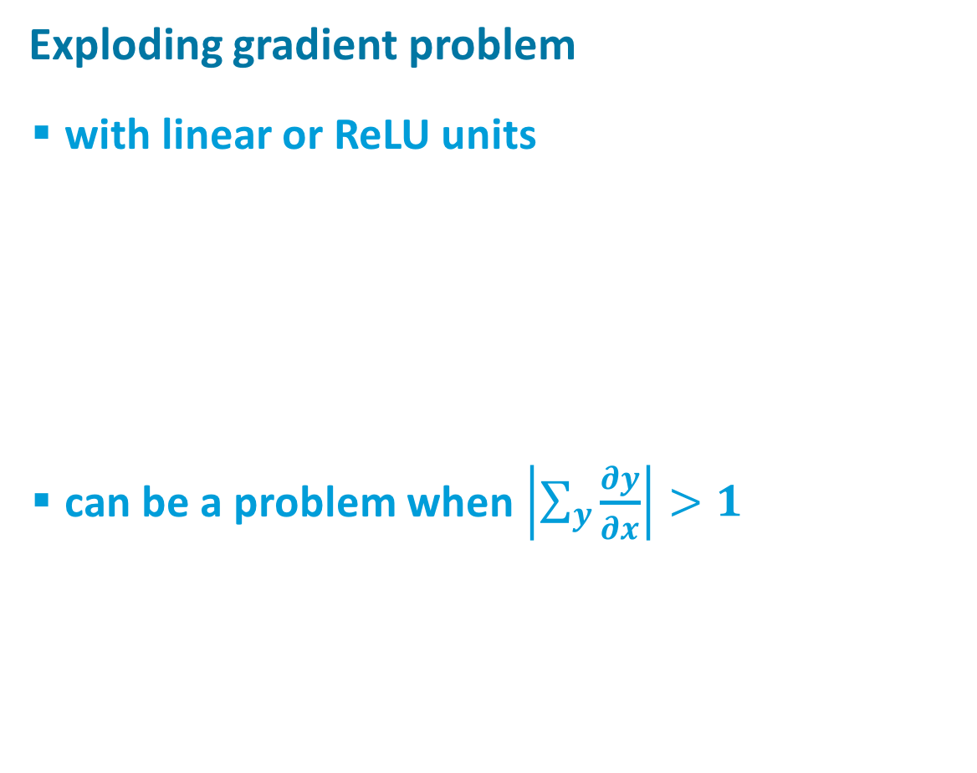
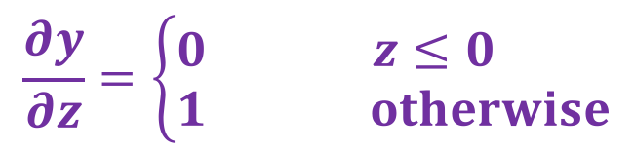

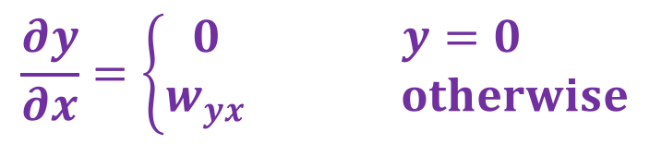


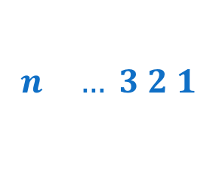
Why Deeply Layered Networks Fail
Exploding gradient problem
  with linear or ReLU units
  can be a problem when $\left|\sum_{y}{\frac{∂y}{∂x}}\right|>1$
gradient
$$\frac{∂y}{∂z}=\left\{\begin{matrix}0 & z≤0 \\ 1 & otherwise\end{matrix}\right.$$
$$n … 3 2 1$$
layer
    $$y=\text{m}\text{ax}(0,z)$$
$$\frac{∂y}{∂x}=\left\{\begin{matrix}0 & y=0 \\ w_{yx} & otherwise\end{matrix}\right.$$
$$y$$
$$x$$

Slide 8
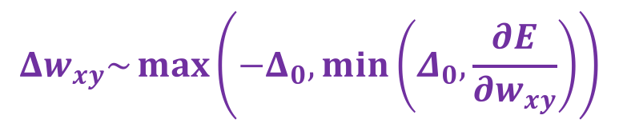
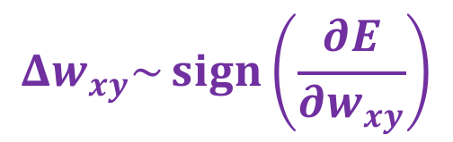
Hack Solutions
gradient
Using ReLUs
  can avoid squashing of gradient
Use gradient clipping
  for exploding gradients
Use gradient sign
  for exploding & vanishing gradients
$$n … 3 2 1$$
layer
$$Δw_{xy}\sim \max\left(−Δ_{0},min⁡\left(Δ_{0},\frac{∂E}{∂w_{xy}}\right)\right)$$
$$Δw_{xy}\sim \operatorname{sign}\left(\frac{∂E}{∂w_{xy}}\right)$$
Notes:
sign is all we need to go in the right direction
dot prod of true gradient and sign(gradient) > 0 -> moving downhill

Slide 9
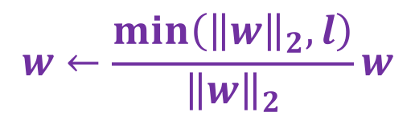
Hack Solutions
Hard weight constraints
  avoids sigmoid saturation for vanishing gradients
  may prevent gradients from blowing up by limiting error gradient scaling
$$w←\frac{min\left({\left\|w\right\|}_{2},l\right)}{{\left\|w\right\|}_{2}}w$$

Slide 10
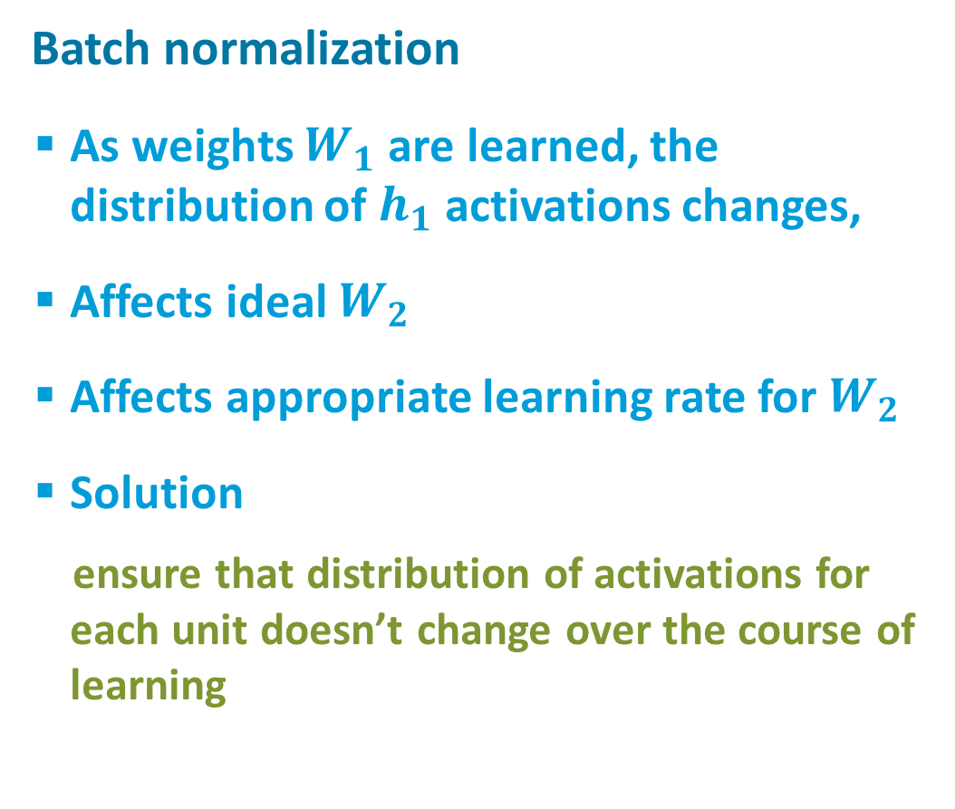



Hack Solutions
Batch normalization
  As weights $W_{1}$ are learned, the distribution of $h_{1}$ activations changes,
  Affects ideal $W_{2}$
  Affects appropriate learning rate for $W_{2}$
  Solution
    ensure that distribution of activations for each unit doesn’t change over the course of learning
$$W_{2}$$
$$h_{1}$$
$$W_{1}$$

Slide 11
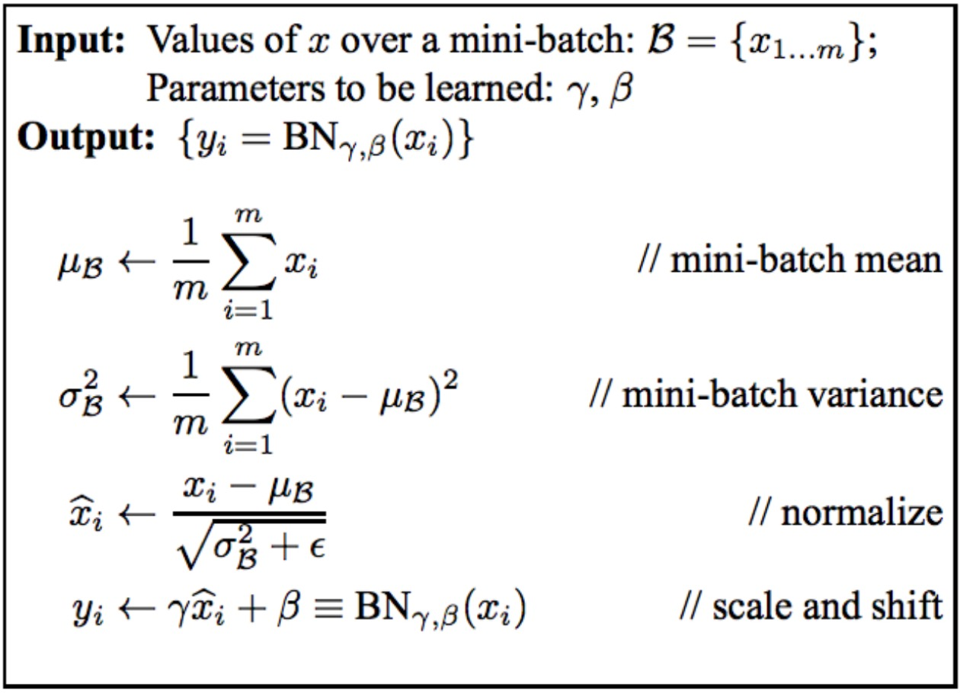

Hack Solutions
Batch normalization [LINK]
  $x_{i}$: activation of a unit in any layer for minibatch example $i$
  parameters $γ_{i}$ and $β_{i}$ trained via gradient descent
  separate parameters for each neuron
$$W_{2}$$
$$h_{1}$$
$$W_{1}$$
Notes:
logic of separate parameters: net can always undo normalization if it wants so not restricting computational capabilities

Slide 12
Hack Solutions
Unsupervised layer-by-layer pretraining
  Goal is to start weights off in a sensible configuration instead of using random initial weights
  Methods of pretraining
    autoencoders
    restricted Boltzmann machines (Hinton’s group)
  The dominant paradigm from ~ 2000-2010
  Still useful today if
    not much labeled data
    lots of unlabeled data

Slide 13
Autoencoders
Self-supervised training procedure
Given a set of input vectors (no target outputs)
Map input back to itself via a hidden layer bottleneck
How to achieve bottleneck?
  Fewer neurons
  Sparsity constraint
  Information transmission constraint (e.g., add noise to unit, or shut off randomly, a.k.a. dropout)

Slide 14
Autoencoder Combines
An Encoder And A Decoder
Decoder
Encoder

Slide 15
Stacked Autoencoders
...
copy
deep network
Note that decoders can be stacked to produce a generative domain model

Slide 16
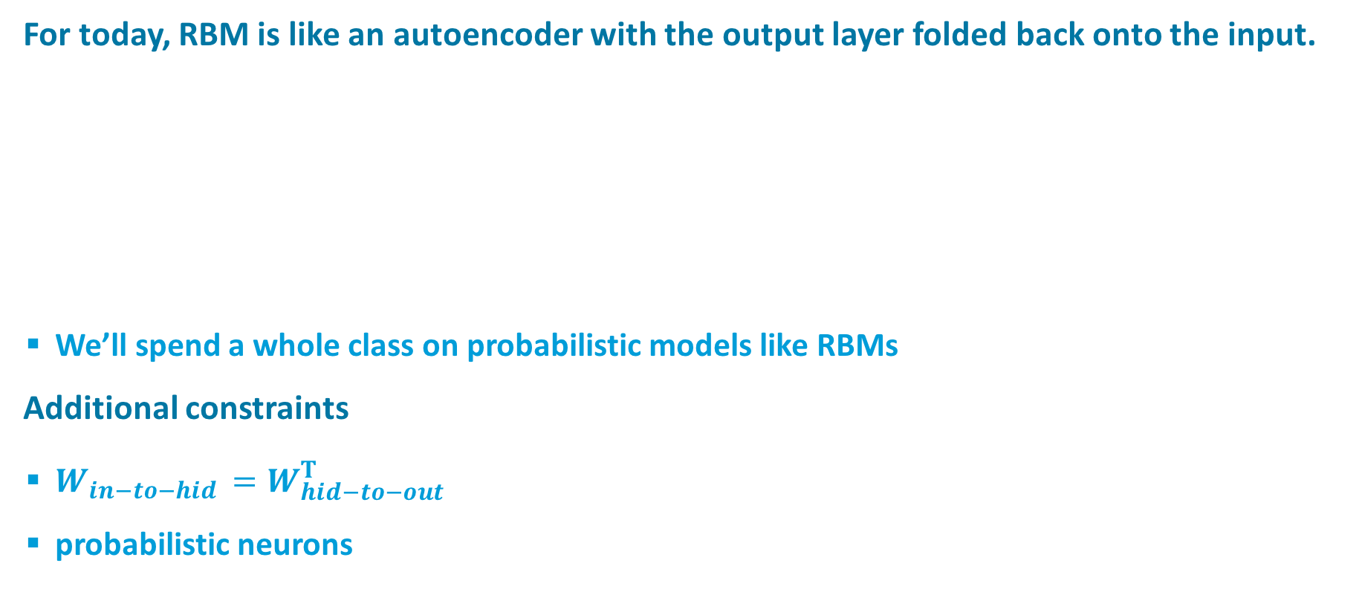
Restricted Boltzmann Machines (RBMs)
For today, RBM is like an autoencoder with the output layer folded back onto the input.
  We’ll spend a whole class on probabilistic models like RBMs
Additional constraints
  $W_{in−to−hid }=W_{hid−to−out}^{T}$
  probabilistic neurons

Slide 17
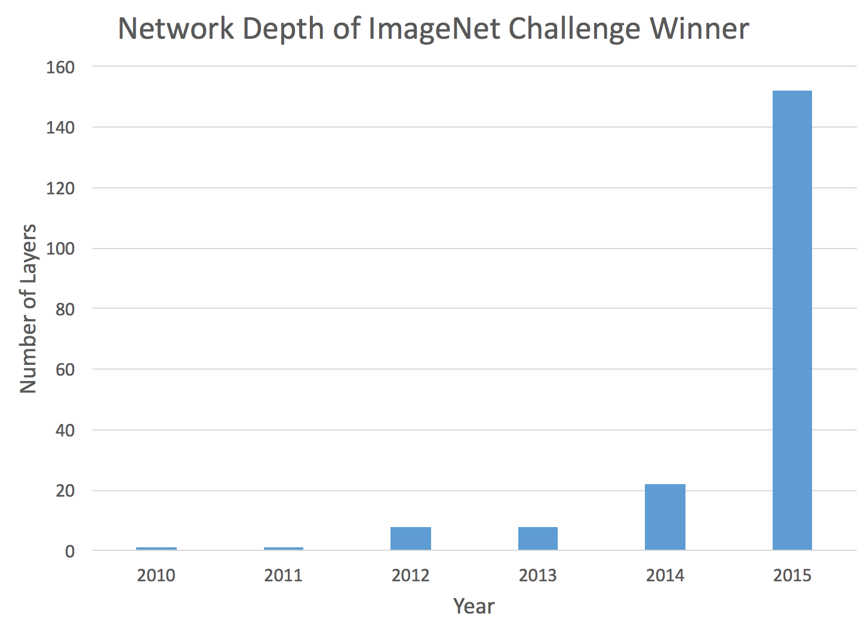
Depth of ImageNet Challenge Winner
source: http://chatbotslife.com
Notes:
Where did 150 layers come from?!??!

Slide 18
Trick From Long Ago To Avoid Local Optima
Add direct connections from input to output layer
Easy bits of the mapping are learned by the direct connections
  Easy bit = linear or saturating-linear functions of the input
  Often captures 80-90% of the variance in the outputs
Hidden units are reserved for learning the hard bits of the mapping
  They don’t need to learn to copy activations forward for the linear portion of the mapping
Problem
  Adds a lot of free parameters

Slide 19
Latest Tricks
Novel architectures that
  skip layers
  have linear connectivity between layers
Advantage over direct-connection architectures
  no/few additional free parameters

Slide 20
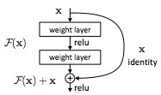
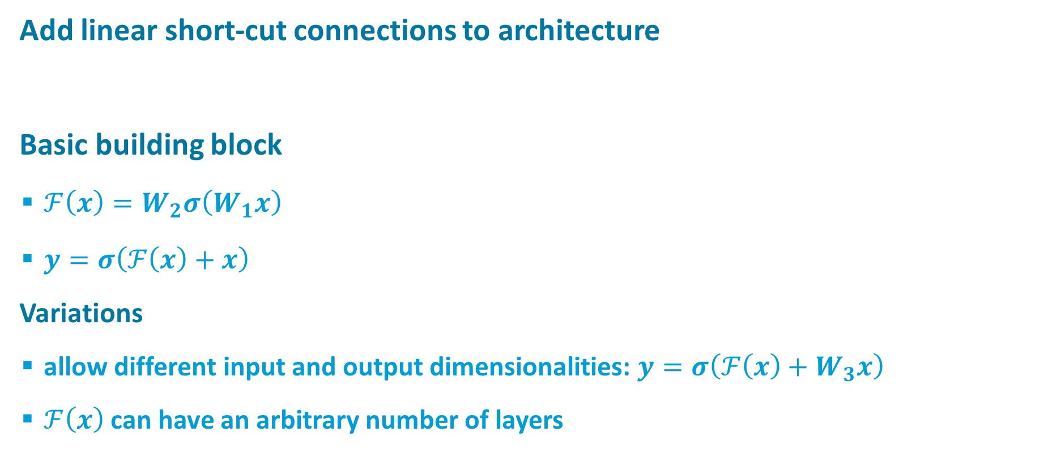
Deep Residual Networks (ResNet)
Add linear short-cut connections to architecture
Basic building block
  $ℱ\left(x\right)=W_{2}σ\left(W_{1}x\right)$
  $y=σ\left(ℱ\left(x\right)+x\right)$
Variations
  allow different input and output dimensionalities: $y=σ\left(ℱ\left(x\right)+W_{3}x\right)$
  $ℱ\left(x\right)$ can have an arbitrary number of layers
activation flow
He, Zhang, Ren, and Sun (2015)

Slide 21
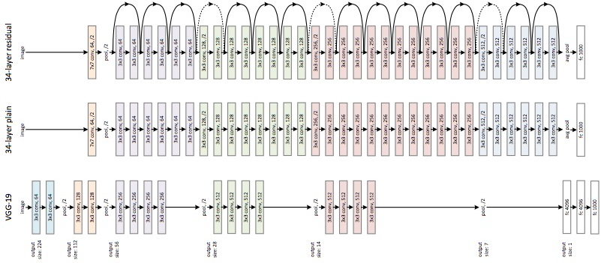
ResNet
kklk
He, Zhang, Ren, and Sun (2015)
Notes:
VGG net: imagenet competition winner
conv layers have 3x3 filters
multiple layers with same image size
number of features is the same for given image size
halving of spatial array and doubling of number of features›

Slide 22
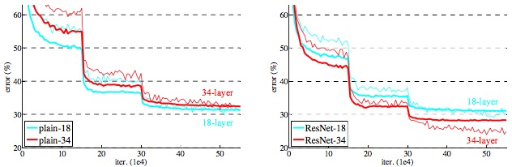

ResNet
Top-1 Error %
He, Zhang, Ren, and Sun (2015)

Slide 23
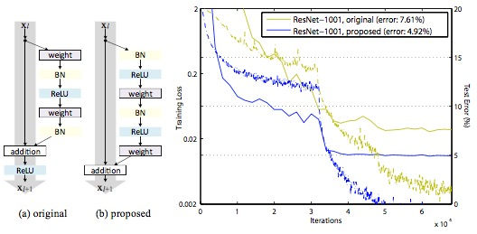
A Year Later…
Do proper identity mappings
He, Zhang, Ren, and Sun (2016)
Notes:
BN = batch normalization
OTHER PAPERS TO DO:
Bridging the gaps between residual learning, recurrent neural networks, and visual cortex (Liao & Poggio)
Deep Nets with Stochastic Depth (Huang) – random dropout of layers

Slide 24
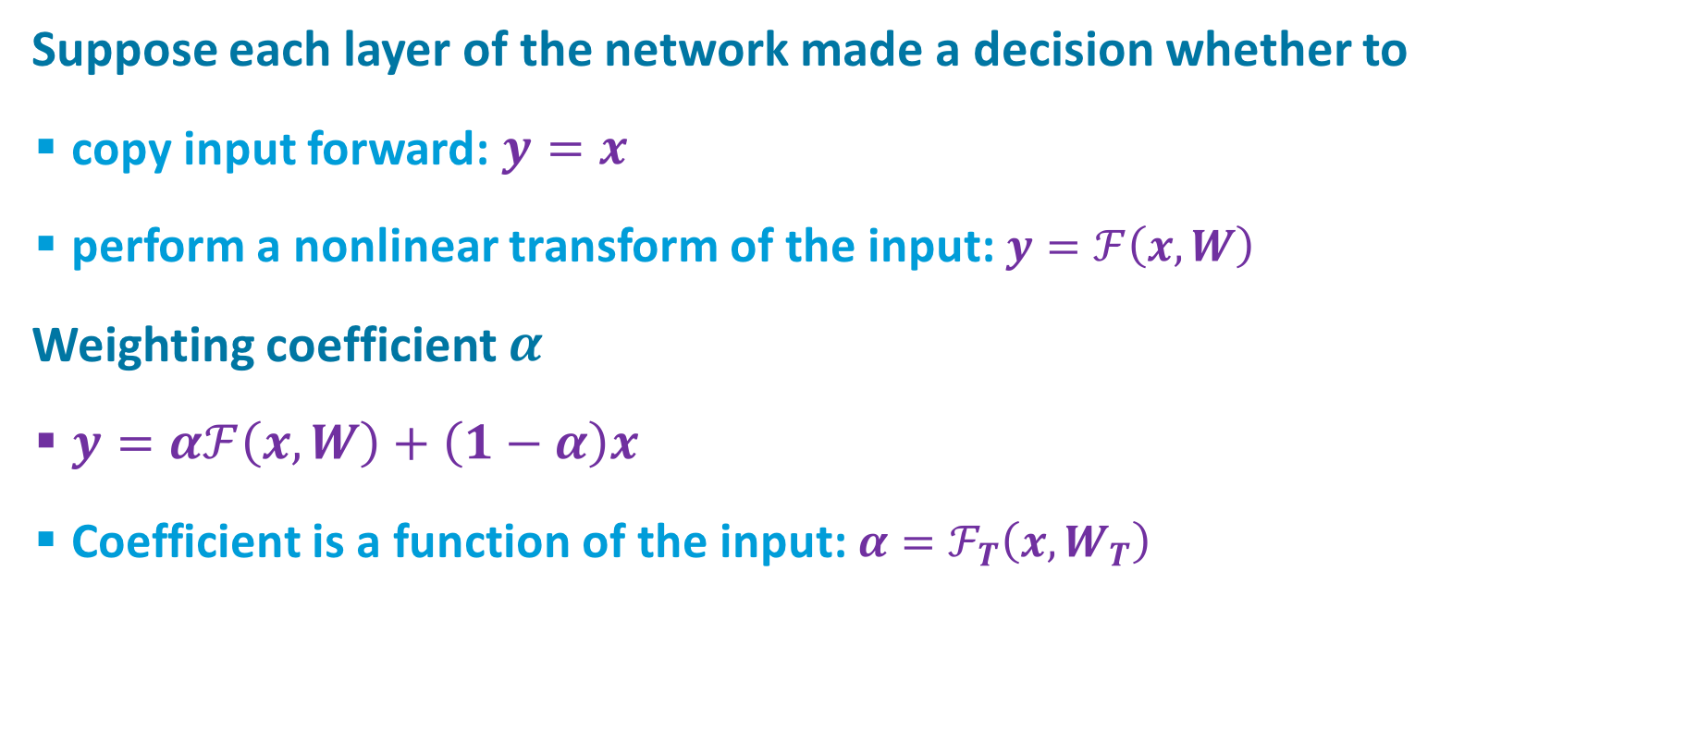
Highway Networks
Suppose each layer of the network made a decision whether to
  copy input forward: $y=x$
  perform a nonlinear transform of the input: $y=ℱ\left(x,W\right)$
Weighting coefficient $α$
  $y=αℱ\left(x,W\right)+\left(1−α\right)x$
  Coefficient is a function of the input: $α=ℱ_{T}\left(x,W_{T}\right)$
Srivastava, Greff, & Schmidhuber (2015)

Slide 25
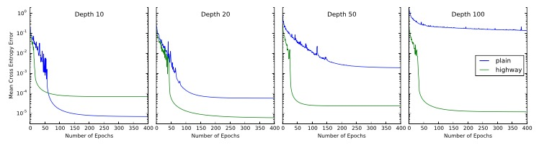
Highway Networks Facilitate Training Deep Networks
Srivastava, Greff, & Schmidhuber (2015)

