Slide 1
Spring Courses
CSCI 5922 – Probabilistic Models (Mozer) CSCI 7000 -- Mind Reading Machines (Sidney D’Mello) CSCI 7000 – Human Centered Machine Learning (Chenhao Tan)

Slide 2
CSCI 5922 Neural Networks and Deep Learning: Final Project Ideas
Mike Mozer
Department of Computer Science and Institute of Cognitive Science University of Colorado at Boulder

Slide 3
Denoising RNNs
Analog to denoising autoencoders
noise robustness
Why is noise in RNNs so devastating?
it amplifies over time

Slide 4
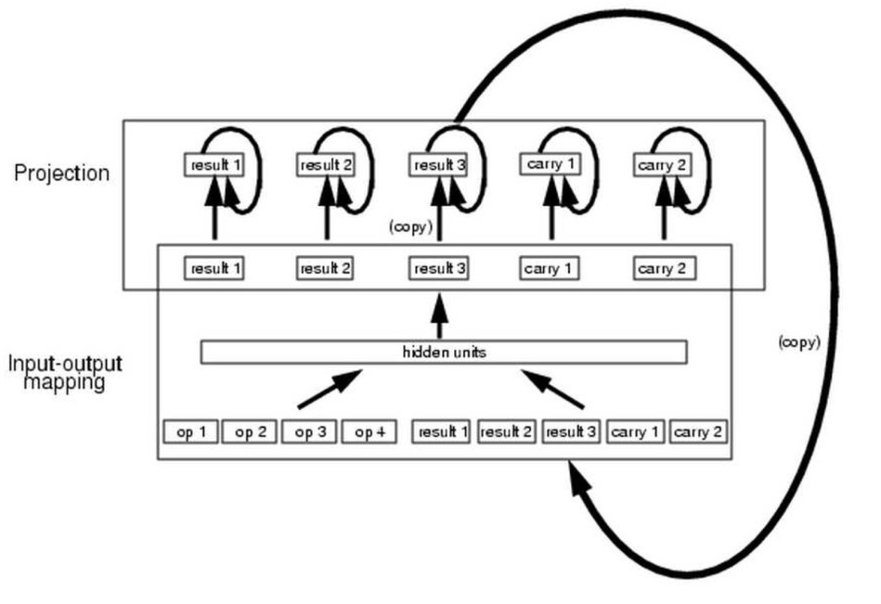
Denoising RNNs: Motivation
Challenge
Architecture

Slide 5
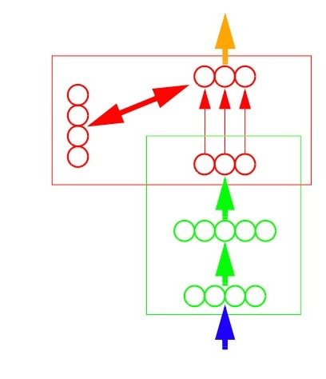
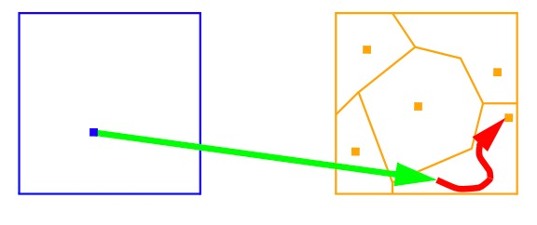
Denoising RNNs
Mapping-projection architecture

Slide 6
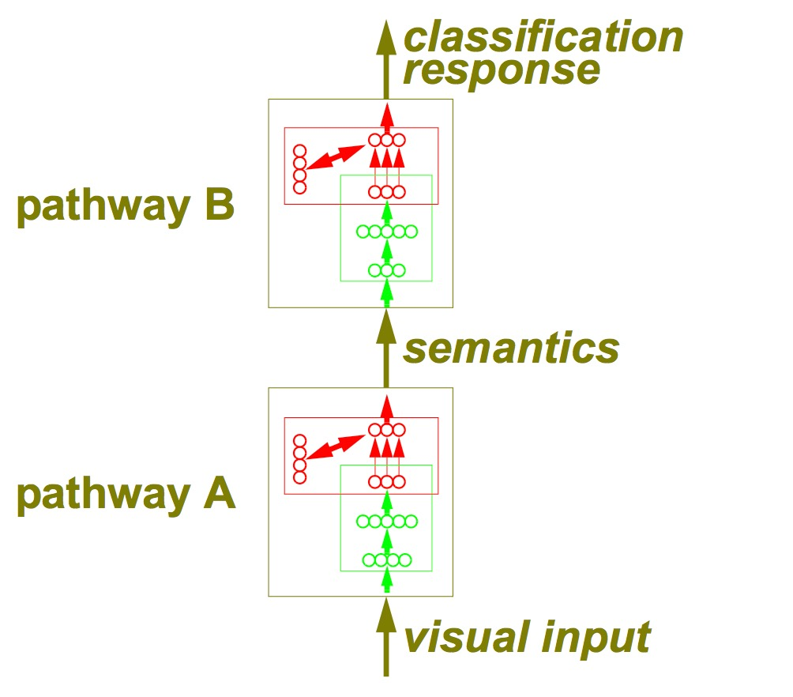
Denoising RNNs
A theory of (access) consciousness

Slide 7
Denoising RNNs
Specific project idea
use parity network from assignment 6
add in attractor net dynamics

Slide 8
Denoising RNNs
within
time
step
across
time
steps

Slide 9
Denoising RNNs
…
…
…
…
…

Slide 10
Denoising RNNs
training signal
…
…
…
noise
…
…
training signal
noise
noise

Slide 11
$h:$ activation of the hidden layer
$η$: noise vector, $η\sim 𝓝(0,?)$
attractor net dynamics
$a_{0}=0$
$a_{t,j}=σ\left(\sum_{i}{{w_{ji}a}_{t−1,i}}+B_{j}\right)$
$B_{j}=v_{j}+{σ^{−1}(h}_{j}+η_{j})$
Use $σ≡tanh$
where $w$ is a weight matrix with $w_{ij}=w_{ji}$ and $w_{ii}=0$
where $v$is a bias vector
Use layer normalization to prevent gradients from being squashed (see section 3.1 of Ba et al. 2016)

Slide 12
Multiscale Word2Vec

Slide 13
Using Deep Encoders to Represent Deep Image Similarity Structure and to Predict Human Judgments

Slide 14
Max Pooling in Time
Max pooling has been extremely successful in conv nets for vision
Convolutional nets have also been used for temporal sequence processing
1D vs. 2D structure
Has max pooling been applied for temporal sequence processing?
with convolutional nets
with recurrent nets?

Slide 15
Capsule Networks (Sabour, Frost, & Hinton, 2017)

Slide 16
Visual recognition is primarily about identifying objects.
Each object has
an identity, which is of primary interest
instantiation parameters
position, size, orientation, deformation, velocity, hue, texture, etc.

Slide 17
Disentangling
Conv nets implicitly encode instantiation parameters.
e.g., suppose we have a feature in a convolutional layer that detects a straight edge
Activation of a neuron represents “edge at orientation Q in position R”
Each neuron encodes a conjunction of identity and instantiation parameters – an entangled representation
Capsule networks
Each capsule encodes a conjunction of identity and instantiation parameters – a disentangled representation
One capsule might replace several topographic feature maps
edge
position = R
orientation = Q

Slide 18
Binding
Old psychology experiments
Treisman and Schmidt (1982)
Mozer (1983)
Binding problem
how do you keep track of which attributes are connected to which other attributes
7 X O T 9
LINE LACE

Slide 19
The goal of capsule networks is to construct a representation that
explicitly disentangles identity and instantiation parameters
binds identity with its instantiation parameters
edge
position = R
orientation = Q

Slide 20
Part-Whole Hierarchies
Any object is made of parts which themselves might be viewed as objects.
The parts will have instantiation parameters, all the way down the parse tree.
The object may be defined not only by set of parts that compose it, but also the relationship among their instantiation parameters.
human
arm
torso
leg
thumb
index finger
wrist

Slide 21
Capsule
Each capsule detects a specific object identity.
Output of a capsule A capsule will encode
probability that a given object is present in the image
instantiation parameters of the object
Vector encoding
$v_{j}$: output of capsule $j$
$0≤\left\|v_{j}\right\|≤1$ indicates the probability of object present
$v_{j}/\left\|v_{j}\right\|$ indicates instantiation parameters

Slide 22
Mapping From Capsules in One Layer to the Next
layer $l+1$
$$v_{j}$$
squash summed prediction vector
to ensure its length <= 1
$$s_{j}$$
sum the predictions of each part
if consistent, then vector is large
if inconsistent then cancellation
$${\hat{u}}_{j|i}$$
from the object part, predict
the instantiation parameters
of the object
$$W_{ij}$$
layer $l$
$$u_{i}$$

Slide 23
One More Detail: Couplings
Any given object part can be part of only a single object
The two objects need to compete for part
$c_{ij}:$how strongly is (part) capsule $i$coupled with (object) capsule $j$
coupling increases dynamically if part instantiation parameters are consistent with object instantiation parameters
L
T
edge
edge
edge

Slide 24
Mapping From Capsules in One Layer to the Next
$c_{ij}:$how strongly is (part) capsule $i$coupled with (object) capsule $j$
coupling starts off weak
coupling increases dynamically if part instantiation parameters (${\hat{u}}_{j|i}$) are consistent with object instantiation parameters ($v_{j}$)
increasing the coupling from part $i$to object $j$ reduces the coupling to all other objects $k$
$$v_{j}$$
$$s_{j}$$
$${\hat{u}}_{j|i}$$
$$W_{ij}$$
$$u_{i}$$

Slide 27
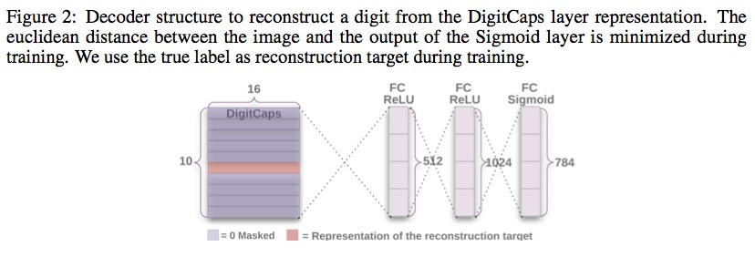
Then The Hacks Begin
“Reconstruction as a regularization method”

Slide 28
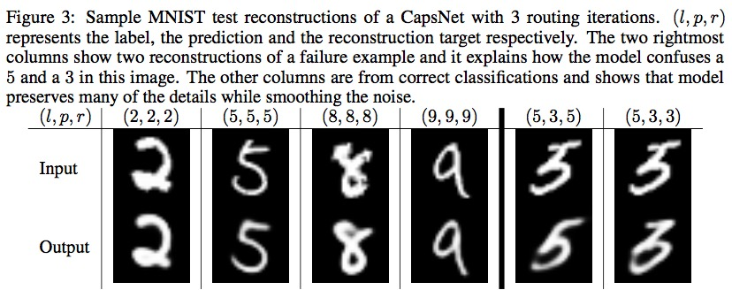

Slide 29
Cool Stuff

Slide 30
Cool Stuff

Slide 31
CIFAR-10
10.6% error rate
about the same as first-round errors with conv nets
Tricks
ensemble of 7 models
none-of-the-above category for softmax so that each part didn’t need to be explained by an object
orphan parts

