Slide 1
Bias and Variance
(Machine Learning 101)
Mike Mozer
Department of Computer Science and
Institute of Cognitive Science
University of Colorado at Boulder
Notes:
position
audience

Slide 2
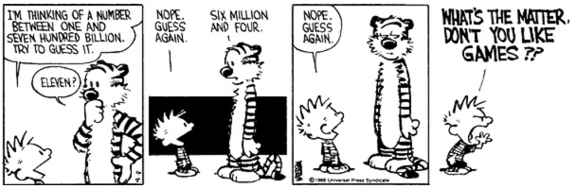
Learning Is Impossible
What’s my rule?
  1 2 3 ⇒ satisfies rule
  4 5 6 ⇒ satisfies rule
  6 7 8 ⇒ satisfies rule
  9 2 31 ⇒ does not satisfy rule
Possible rules
  3 consecutive single digits
  3 consecutive integers
  3 numbers in ascending order
  3 numbers whose sum is less than 25
  3 numbers < 10
  1, 4, or 6 in first column
  “yes” to first 3 sequences, “no” to all others

Slide 3
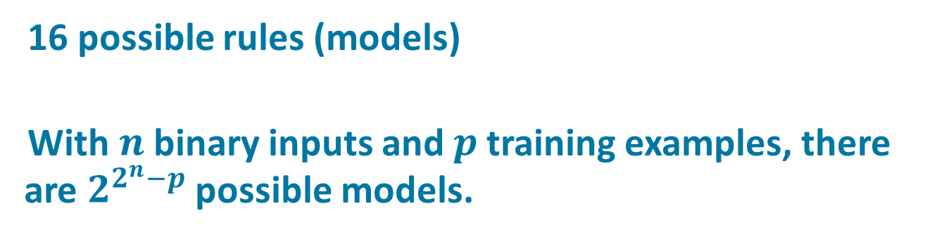
“What’s My Rule” For Machine Learning
x1 | x2 | x3 | y
0 | 0 | 0 | 1
0 | 1 | 1 | 0
1 | 0 | 0 | 0
1 | 1 | 1 | 1
0 | 0 | 1 | ?
0 | 1 | 0 | ?
1 | 0 | 1 | ?
1 | 1 | 0 | ?
16 possible rules (models)
With $n$ binary inputs and $p$ training examples, there are $2^{2^{n}−p}$possible models.

Slide 4
Model Space
models
consistent
with data
correct
model
all possible
models
More data helps
  In the limit of infinite data, look up table model is fine
Notes:
Size of model class = complexity

Slide 5
Model Space
models
consistent
with data
correct
model
all possible
models
restricted
model
class
Restricting model class can help
Or it can hurt
Depends on whether restrictions are domain appropriate
Notes:
Size of model class = complexity

Slide 6
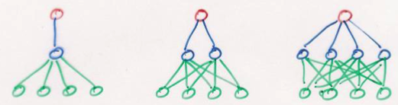
Restricting Models
Models range in their flexibility to fit arbitrary data
simple model
constrained
small capacity may
prevent it from
representing all
structure in data
complex model
unconstrained
large capacity may
allow it to fit quirks
in data and fail to
capture regularities
high bias
low variance
low bias
high variance
Notes:
constrained : unconstrained :: parametric : nonparametric

Slide 7
Bias
Regardless of training sample, or size of training sample, model will produce consistent errors
Notes:
[*] underpredicts at the ends; overpredicts at the center

Slide 8
Variance
Different samples of training data yield different model fits

Slide 9
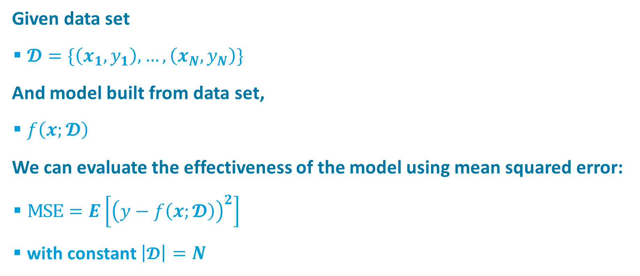
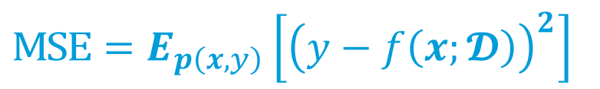
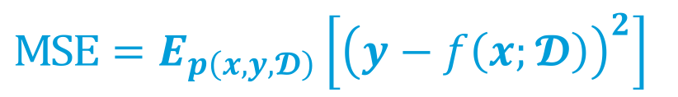
Formalizing Bias and Variance
Given data set
  $𝓓=\{\left(x_{1},y_{1}\right), …, \left(x_{N}, y_{N}\right)\}$
And model built from data set,
  $f\left(x;𝓓\right)$
We can evaluate the effectiveness of the model using mean squared error:
  $\text{MSE}=E\left[{\left(y−f\left(x;𝓓\right)\right)}^{2}\right]$
  with constant $\left|𝓓\right|=N$
$$\text{MSE}=E_{p\left(x,y\right)}\left[{\left(y−f\left(x;𝓓\right)\right)}^{2}\right]$$
$$\text{MSE}=E_{p\left(x,y,𝓓\right)}\left[{\left(y−f\left(x;𝓓\right)\right)}^{2}\right]$$
Notes:
MSE Expectation: the way you're used to seeing it
[*] p(x,y) over environment of inputs and outputs
[*] p(x,y,D) over environment and all possible data sets
Imagine I give each person their own data set, they build model, and we average MSE across all possible data sets of size N

Slide 10


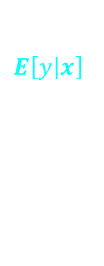

$\begin{aligned}{\text{MSE}}_{x}&=E_{𝓓|x}\left[{\left(y−f\left(x;𝓓\right)\right)}^{2}\right] \\ &\begin{aligned}=&{\left(E_{𝓓}\left[f\left(x;𝓓\right)\right]−E\left[y\left|x\right.\right]\right)}^{2} \\ &{+ E}_{𝓓}\left[{\left(f\left(x;𝓓\right)−E_{𝓓}\left[f\left(x;𝓓\right)\right]\right)}^{2}\right] \\ &+ E\left[{\left(y−E\left[y\left|x\right.\right]\right)}^{2}\right]\end{aligned}\end{aligned}$
bias:
difference between average model prediction (across data sets) and the target
variance of models (across data sets) for a given point
intrinsic noise in data set
$$E_{𝓓}\left[f\left(x;𝓓\right)\right]$$
$$E_{𝓓}\left[f\left(x;𝓓\right)\right]$$
$$E\left[y\left|x\right.\right]$$
Notes:
LET’S FOCUS ON A GIVEN X in test set. D is still RV
[*] mathematically equivalent to these three terms
[*] bias based on fits to simple (linear) model
bias neg at left and right ends; pos in center
bias vs bias^2
[*] variance based on fits to complex model
[*] graphs have E_D(model))
[*] residual or intrinsic noise in data set
either because we lack the input features to predict deterministically or because of true randomness
mathematical fact!
now we can return to models varying in complexity…

Slide 11
Bias-Variance Trade Off
MSE
variance
bias²
Notes:
MSE is high on left because bias^2 is high
MSE is high on right because variance is high
[*] optimal complexity

Slide 12
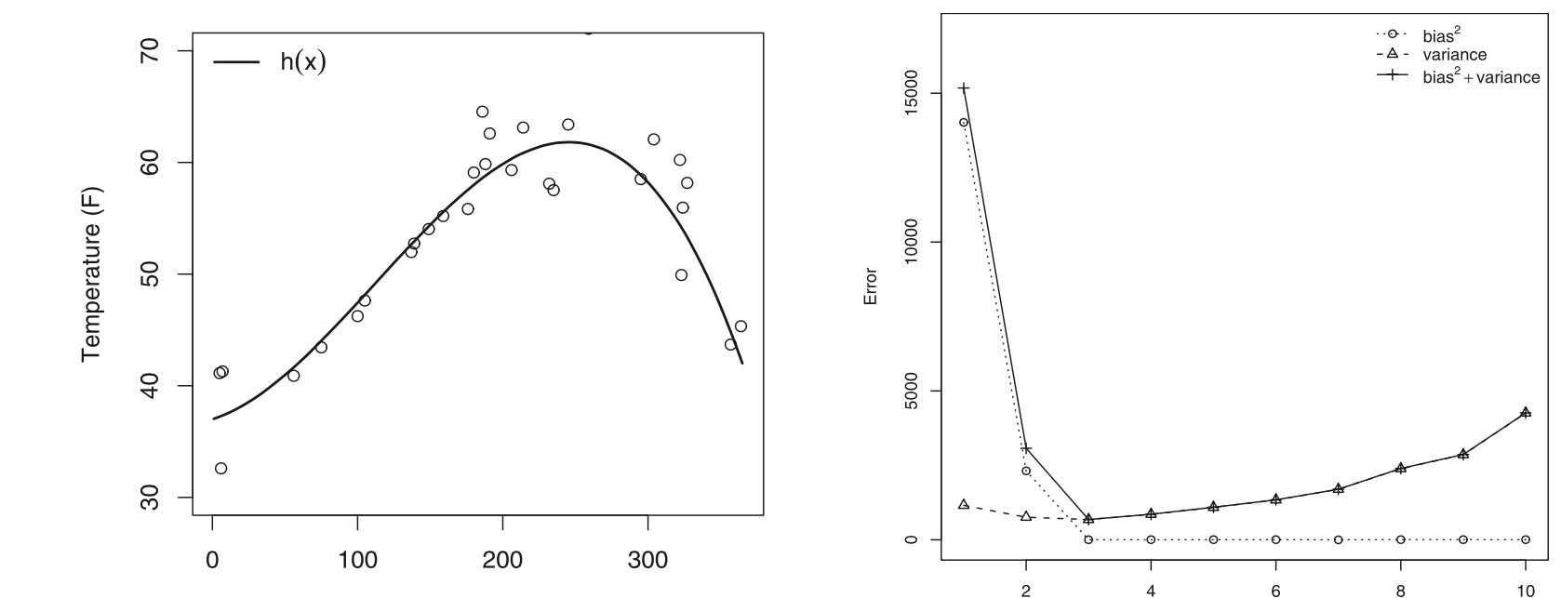
MSE_{test}
variance
bias²
model complexity
(polynomial order)
Gigerenzer & Brighton (2009)
Notes:
here’s an example with actual (simulated) data
left: made up function, 30 observations with noise
imagine fitting with polynomials of various orders
[*]test error from the function mean, split into bias^2 and variance

Slide 13
Bias-Variance Trade Off Is Revealed Via Test Set Not Training Set
MSE_{test}
MSE_{train}
Notes:
early stopping and deep nets bengio ICLR
batch norm
understanding deep learning rethinking generalizationf
kushner H Weak confergence methods and singularly perturbed stochastic control and filtering problems
Borkar – stochastic approximation with two time scales
l.dickens@ucl.ac.uk

Slide 14
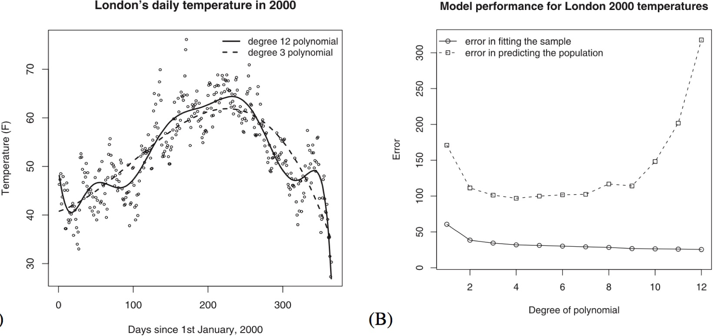
Bias-Variance Trade Off Is Revealed Via Test Set Not Training Set
MSE_{test}
MSE_{train}
Gigerenzer & Brighton (2009)
Notes:
London’s mean daily temp in 2000. 3d and 12th order polynomial fit with least squares
[*] mean error in fitting samples of 30 observations and mean prediction error of same models, for varying polynomial degrees

Slide 15
Back To The Venn Diagram…
correct
model
all possible
models
high bias,
low variance
model class
low bias,
high variance
model class
Bias is not intrinsically bad
if it is suitable for the problem domain

Slide 16
Current Perspective In Machine Learning
We can learn complex domains using
  low bias model (deep net)
  tons of training data
But will we have enough data?
  E.g., speech recognition
more
data
more
data
Notes:
[*] What does tons of training data do for us in terms of bias-variance trade off?
Doesn’t affect bias
[*] Reduces variance
[*] allows more complex model to be used [shift of optimal complexity to the right]

Slide 17
Scaling Function
    Single-speaker, small vocabulary, isolated words
    Multiple-speaker, small vocabulary, isolated words
    Multiple-speaker, small vocabulary, connected speech
    Multiple-speaker, large vocabulary, connected speech
    Intelligent chatbot / Turing test
log required
data set size
domain complexity
(also model complexity)
Notes:
[*]single speaker, small vocab
[*] mult speaker, small vocab
[*] connected speech, small vocab
projected scaling?
[*] connected speech, large vocab
multiple speaker, large vocab connected speech…
took a long time to get here.
didn’t expect to see it in my lifetime

Slide 18
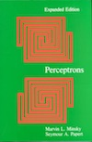
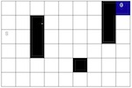
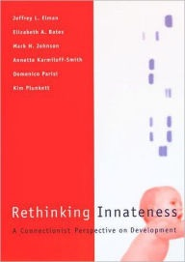
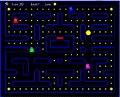
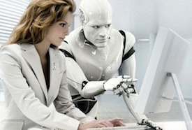
The Challenge To AI
In the 1960s
  Neural nets (perceptrons) created wave of excitement
  But Minsky and Papert (1969) showed challenges to scaling
In the 1990s
  Neural nets (back propagation) created wave of excitement
  Worked great on toy problems but arguments about scaling
  (Elman et al., 1996; Marcus, 1998)
Now in the 2010s
  Neural nets (deep learning) created a wave of excitement
  Researchers have clearly moved beyond toy problems
  Nobody is yet complaining about scaling
  But there is no assurance that methods won’t disappoint again
Will it scale?
1995
2015
?
Notes:
Minsky and Papert: computational complexity analysis -- amount of data required, amount of time to converge, number of hidden units required

Slide 19
Solution To Scaling Dilemma
    Use domain-appropriate bias to reduce complexity of learning task
log required
data set size
domain complexity
(also model complexity)
Notes:
If you’re Geoff Hinton you may think this is cheating. But, unfortunately for us, none of us are Geoff Hinton.

Slide 20
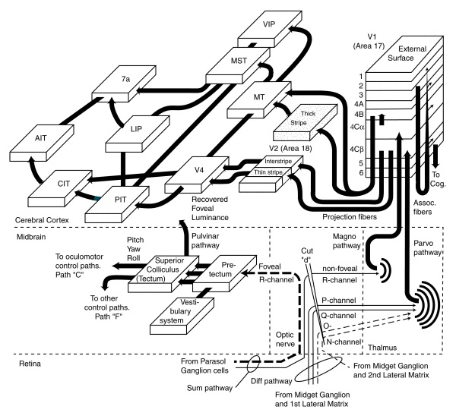
Example Of Domain-Appropriate Bias: Vision
Architecture of primate visual system
  visual hierarchy
  transformation from simple, low-order
  features to complex, high-order features
  transformation from position-specific
  features to position-invariant features
source: neuronresearch.net/vision
Notes:
Example of a domain-appropriate bias: CONV NETS FOR VISION
hierarchy of visual layers; simple,
position specific -> position invariant
simple -> complex

Slide 21
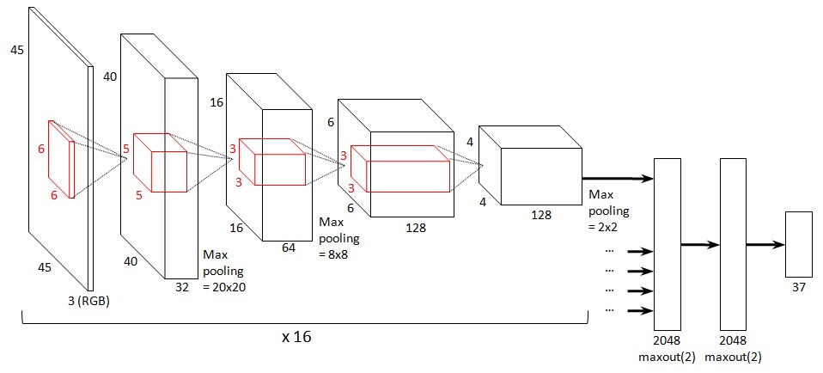
Example Of Domain-Appropriate Bias: Vision
Convolutional nets
  spatial locality
    features at nearby locations in an image are most likely
    to have joint causes and consequences
  spatial position homogeneity
    features deemed significant in one region of an
    image are likely to be significant in others
  spatial scale homogeneity
    locality and position homogeneity should apply
    across a range of spatial scales
source: neuronresearch.net/vision
source: benanne.github.io
Notes:
[END OF SLIDE]
I love the Goodfellow, Bengio, & Courville text
But it says nothing about domain-appropriate bias and how to incorporate knowledge you have into a model.
I love tf/theano/etc. but like all simulation environments, they make it really easy to pick defaults and use generic
domain-independent methods.
ML is really about crafting models to the domain, not tossing unknown data into a generic architecture.
Deep learning seems to mask this issue.

