Slide 1
SSL and advanced mitm
John Black
CU Hacking Club
2014

Slide 2
Symmetric Key Crypto
Alice and Bob share a (random, secret) key K
How did they share it? We’ll see…
Let’s call Alice “A” and Bob “B”
A wants to send message M to B using key K
A generates E(K, M) = C
C stands for “ciphertext”
A sends C to B
B computes E⁻¹(K, C) = M

Slide 3
Symmetric Key Crypto (cont)
Note: only K is secret, the algorithm E (and its inverse) are publicly known
E and E⁻¹ are efficient
AES is built into the x86 these days
This stuff works for chunks of data
Network packets
Files on disk

Slide 4
Symmetric Authentication (aka MACs)
A and B share another key K’
It needs to be different from K
A sends MAC(M, K’) = sig along with M
Note: no encryption here, though we could if we wanted to
B receives sig* and M*
B computes MAC(M*, K’) and makes sure it matches sig*
If not, he rejects the communication as inauthentic

Slide 5
Symmetric Key crypto
Common encryption algorithms
AES-CBC128, RC4
Common MAC algorithms
HMAC-SHA256, CBC-MAC, CMAC
Combined algorithms
EAX, GCM, OCB

Slide 6
Public Key Crypto
B generates sk_{B}, pk_{B}
They have a mathematical relationship
Important: sk_{B} is not efficiently computable just given pk_{B}
A wants to send M to B
A computes E(pk_{B}, M) = C
A sends C to B
B computes D(sk_{B}, C) = M

Slide 7
Public Key Crypto (cont)
Public Key is much slower than symmetric key crypto
Cuz math
Notice that A cannot decrypt what she just encrypted
Unlike symmetric key crypto
The most famous (and widely-used) public key cryptosystem is RSA
Based on the assumed-difficulty of factoring

Slide 8
Public Key Authentication (aka Signatures)
RSA can be used for authentication just like MACs
But here we have a signing key and a verification key
The signing key is kept private and the verification key is public

Slide 9
Summing Up
Symmetric Crypto (fast!)
Encryption
Authentication (MACs)
Public Key Crypto (slow)
Encryption
Authentication (Signatures)

Slide 10
SSL (but not really)
SSL Hello
pk_{s}
C
S
(K_{enc}, K_{mac}) under pk_{s}
“Welcome” under (K_{enc}, K_{mac})
CC# under (K_{enc}, K_{mac})

Slide 11
SSL (but not really) Notes
Public Key crypto used to bootstrap faster symmetric crypto
Note we used symmetric encryption, MACs, public-key encryption
But not signatures (yet)
But what’s the problem?

Slide 12
MitM Attack
hello
hello
pk_{A}
pk_{S}
C
A
S
(K_{enc}, K_{mac}) under pk_{A}
(K_{enc}, K_{mac}) under pk_{S}
“Welcome” under (K_{enc}, K_{mac})
“Welcome” under (K_{enc}, K_{mac})
CC# under (K_{enc}, K_{mac})
CC# under (K_{enc}, K_{mac})

Slide 13
How to MitM someone
ARP cache poisoning
You have to be on the LAN with the victim
Tell them you’re the gateway
Fake WiFi APs
Presumes victim is wireless and in range
WiFi Pineapple makes this easy
Run a Tor exit node
People do this, so beware!
Moral of the story: easy if you’re physically nearby or they use Tor

Slide 14
Combatting MitM
Enter the CA
Certificate Authority
Examples: VeriSign (now Symantec), Comodo, RSA (the company)
CA has sk_{CA} and vk_{CA}
Amazon wants to give you pk_{A} and convince you it’s legit
Amazon first sends pk_{A} to CA
CA signs pk_{A} with sk_{CA}
CA wraps this with meta-data and gives this back to Amazon as a certficiate

Slide 15
How to get vk_{CA} into browser
CA’s need to convince browser makers to embed their verification keys in the browser’s key store
On a MAC this is done in OS X and browsers rely on this
Well, Chrome and Safari do at least
Let’s put all of this together!

Slide 16
SSL (really this time)
SSL Hello
cert_{S}
C validates cert_{S} using appropriate vk_{CA} then extracts pk_{S} from cert_{S}
C
S
(K_{enc}, K_{mac}) under pk_{s}
“Welcome” under (K_{enc}, K_{mac})
CC# under (K_{enc}, K_{mac})

Slide 17
Self-Signed Certs
You can issue a self-signed cert just like the big CAs
But since the cert won’t be in the browser’s or OS’s cert store, the browser will object
https://www.pcwebshop.co.uk/

Slide 18
MitM fails against SSL now
hello
hello
??
cert_{S}
C
A
S
(K_{enc}, K_{mac}) under pk_{S}
(K_{enc}, K_{mac}) under pk_{S}
“Welcome” under (K_{enc}, K_{mac})
“Welcome” under (K_{enc}, K_{mac})
CC# under (K_{enc}, K_{mac})
CC# under (K_{enc}, K_{mac})

Slide 19
SSL in the browser
Really there are three ways we encounter https
1) 302’s
We type in “google.com”, we go to http://google.com, that site redirects to https://www.google.com
2) Click on a link
Within a site, from a web search, etc
3) Bookmarks
One thing we DON’T do is type “https” ourselves

Slide 20
SSLStrip
Serve a plain http version of SSL sites!
The MitM speaks https to the server, but serves the victim a plain http version of the site
But doesn’t the site look different without https?
Yes, but would you notice the lock icon missing?

Slide 21
Making people feel better
You can set the favicon to a lock icon!

Slide 22
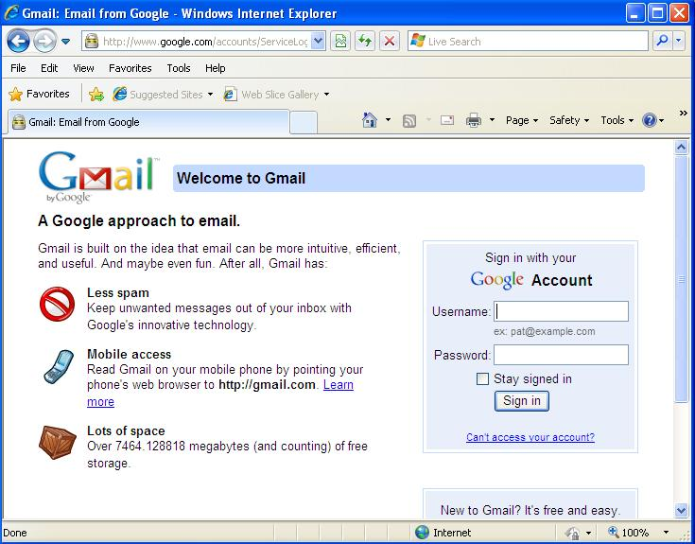

Slide 23
SSLStrip (details)
If someone clicks an https bookmark (or types in “https”) this attack doesn’t work
But if the “https” comes over the network (think 302s or links in pages) SSLStrip can convert them to http
Owned
A few other things need to be stripped too
Sessions are a pain, secure cookies, but all can be handled if you’re clever

Slide 24
Moxie Marlinspike
He wrote SSLStrip and presented it at BlackHat 2009
http://www.thoughtcrime.org/software/sslstrip/
Written in python using twisted
It’s on my to-do list to read through the source
He deployed this on a Tor exit node
0% of people demurred when given a stripped page

Slide 25
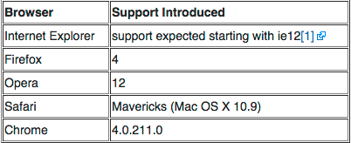
HSTS – Oh no!
Http Strict Transport Security
Response to SSLStrip!
2012, RFC 6797
Header from server
Strict-Transport-Security: max-age=31536000
Now browser will speak only https to that site for 1 year
Notes:
chrome://net-internals/#hsts

Slide 26
Ways Around This?
If you can MitM the HSTS header, you could strip it
If you miss it, you have to wait a year
Augh!
Another idea from Leonard Nve in Blackhat Asia 2014

Slide 27
Nve’s Attack
You SSLStrip but also run a spoofed DNS
http request for (say) mail.google.com is redirected (in SSLStrip) to something similar like gmail.google.com via a 302
This URL isn’t in the HSTS list!
Browser issues a DNS request for this name
Spoofed DNS server responds with SSLStrip IP as before
Note SSLStrip and fake DNS must communicate!
SSLStrip proceeds as before

Slide 28
Playing Around
Stock on the wifi pineapple
Enjoy
Questions?

