Slide 1
BITCOIN – 2014
John Black Spring 2014

Slide 2
Digital Currency
Chaum’s ideas in the 1980’s
All ideas required a central bank or single point of trust
Chaum started a company
DigiCash in 1990
Bankrupt in 1998
Lots of other companies you’ve never heard of have attempted digital cash

Slide 3
Enter Bitcoin
Developed by Satoshi Nakamoto in 2009
A pseudonym
No one knows who this guy actually is
And it’s apparently not this guy:

Slide 4
Bitcoin devs
Nakamoto has apparently bowed out
Bitcoin was taken over by open-source devs
Still going strong

Slide 5
Bitcoin Overview
The most widely-used digital currency in the world
About $6B market cap at current exchange rates
About 12M bitcoins in existence
Current exchange rate is about $500/coin
Completely P2P
No central authority
The P2P networking piece is fascinating, but we won’t talk about it
Often called a “cryptocurrency”
Uses hash functions (primarily SHA-256 and RIPEMD160)
Uses digital signatures (RSA)

Slide 6
Exchange Rate Volatility

Slide 7
Why Bitcoin?
Novel
Not tied to any authority or jurisdiction
What is money anyway?
Demand creates value
Anonymous
It’s not, actually
No regulation
Good or bad?
This will change soon, I’m guessing

Slide 8
How it’s used
Various exchanges
Mt Gox was the largest, but recently shutdown
Cool people/places accept it
Virgin Galactic accepts Bitcoin
Reddit, Zynga, OKCupid, Domino’s Pizza
Shady places accept it
Silkroad
Pirate Bay

Slide 9
Where do Bitcoins come from?
Fifty coins generated in the “Genesis Block”
More are generated with each transaction
Whoever verifies a transaction first gets a reward
Generating these rewards is called “mining”
The first reward amounts were 50 BTC
The reward halves every 210,000 validated transactions
Roughly once every four years, so it’s happened once so far; current reward is 25 BTC ($12,500)
The smallest unit of Bitcoins is a “satoshi”, which is 10⁻⁸ BTC
In 2140 CE, the reward will fall below 1 satoshi and therefore no further Bitcoins will be created
There will be 21 million BTC then; that’s the end

Slide 10
Transaction Fees
Verifying transaction is (purposely) hard
That’s why you get so much money for doing it!
There are also transaction fees paid to the verifier
These have normally been set to 0 since the reward for mining is already pretty good
Lately the fees have risen to provide an added incentive
The fees are taken from the payer as a “tax”
In 2140 CE, transaction fees will be the only incentive remaining

Slide 11
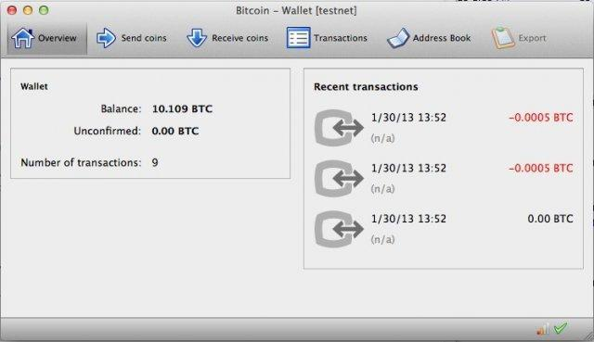
How does Bitcoin actually work?
You start by installing a “wallet” program

Slide 12
Bitcoin Address
To receive money, you tell your wallet to generate an “address”
This causes the wallet to generate a public-key/secret-key pair
The public key is hashed and published as your “address”
Why is it hashed? No good reason, really
You publish your address
Or just tell the payer your address
Why no CA to bind address to your identity?

Slide 13
Receiving Money
Suppose I want to pay you 1 BTC
I need your address
You generated it as in the previous slide
I generate a “transaction” record and sign it
Contains the amount, some metainfo, and your address
Also has hash of previous transaction that granted me the money I’m using
Signed by my secret key
If I lose the secret key associated to the transaction that granted me the bitcoins I’m sending you, I lose that money!

Slide 14
Transaction Record
1. {"hash":"7c4025...", hash of all following
2. "ver":1,
3. "vin_sz":1,
4. "vout_sz":1,
5. "lock_time":0,
6. "size":224,
7. "in":[
8. {"prev_out":
9. {"hash":"2007ae...", hash of previous transaction
10. "n":0},
11. "scriptSig":"304502... 042b2d..."}],
12. "out":[
13. {"value":"0.31900000", 0.319 BTC being sent
14. "scriptPubKey":"OP_DUP OP_HASH160 a7db6f OP_EQUALVERIFY OP_CHECKSIG"}]} a7db6f is intended recipient

Slide 15
Verifying Transactions
Why not just check to see if I properly signed the transaction record?
I could be cheating!
Maybe I don’t own the coins I’m sending
Maybe I already spent those coins with someone else
So instead the “bitcoin network” verifies the transaction
This is hard-by-design because there is a nice payoff for doing it
It also means a cheater would have to have more computing power than the rest of the network

Slide 16
The Blockchain
Every verifier (or “miner”) on the network has an entire history of all transactions
Called the “blockchain”
This is a chain of transactions that tracks where each bitcoin has been
Every transaction has the hash of the previous transaction that granted the coins
Once a transaction has been verified, it is added to the blockchain by all nodes of the network

Slide 17
How to Mine Bitcoins
Suppose you want to verify a transaction
Suppose the transaction is “hello”
Compute SHA256(“hello:0”)
a61bb398117fe…
Compute SHA256(“hello:1”)
61b7a90017562…
…
Compute SHA256(“hello:917712”)
0000718a5dce3… winner!

Slide 18
How hard is this?
To get a leading 0 digit in hex, assuming SHA256 is random
1/16 chance
16 expected trials
Two leading 0’s
256 expected trials
In reality, to verify a bitcoin transaction you have to get below the target
This should take about 10 mins given the power of the network
This is recalibrated every 2 weeks

Slide 19
Current Exp # Hashes for Target
For the current target we need about
2^{64.8975} hashes to get below the target
This can be parallelized of course
Full scaling when parallelized
Great use of botnets!
Believe me, people have studied the economics of how much power is worth exerting to get rewards

Slide 20
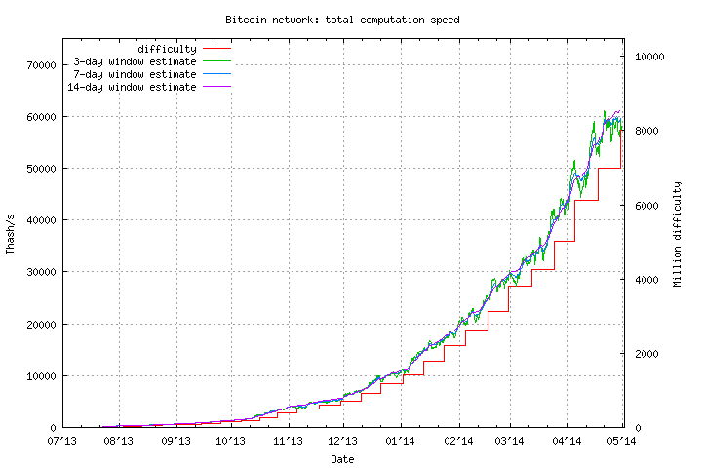
Growth in Computation Speed

Slide 21
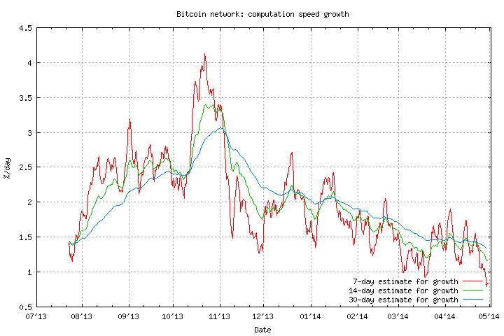
Growth Percentage Tracks Value

Slide 22
Announcing Verification
Once an entity verifies the transaction it broadcasts it to the network
The other nodes stop trying to compete
Because they already lost
Other nodes verify that the transaction is valid
Money spent was legitimately owned
Verifier got below the target
Then transaction is added to the end of the blockchain
Blockchain cannot fork
Details omitted

Slide 23
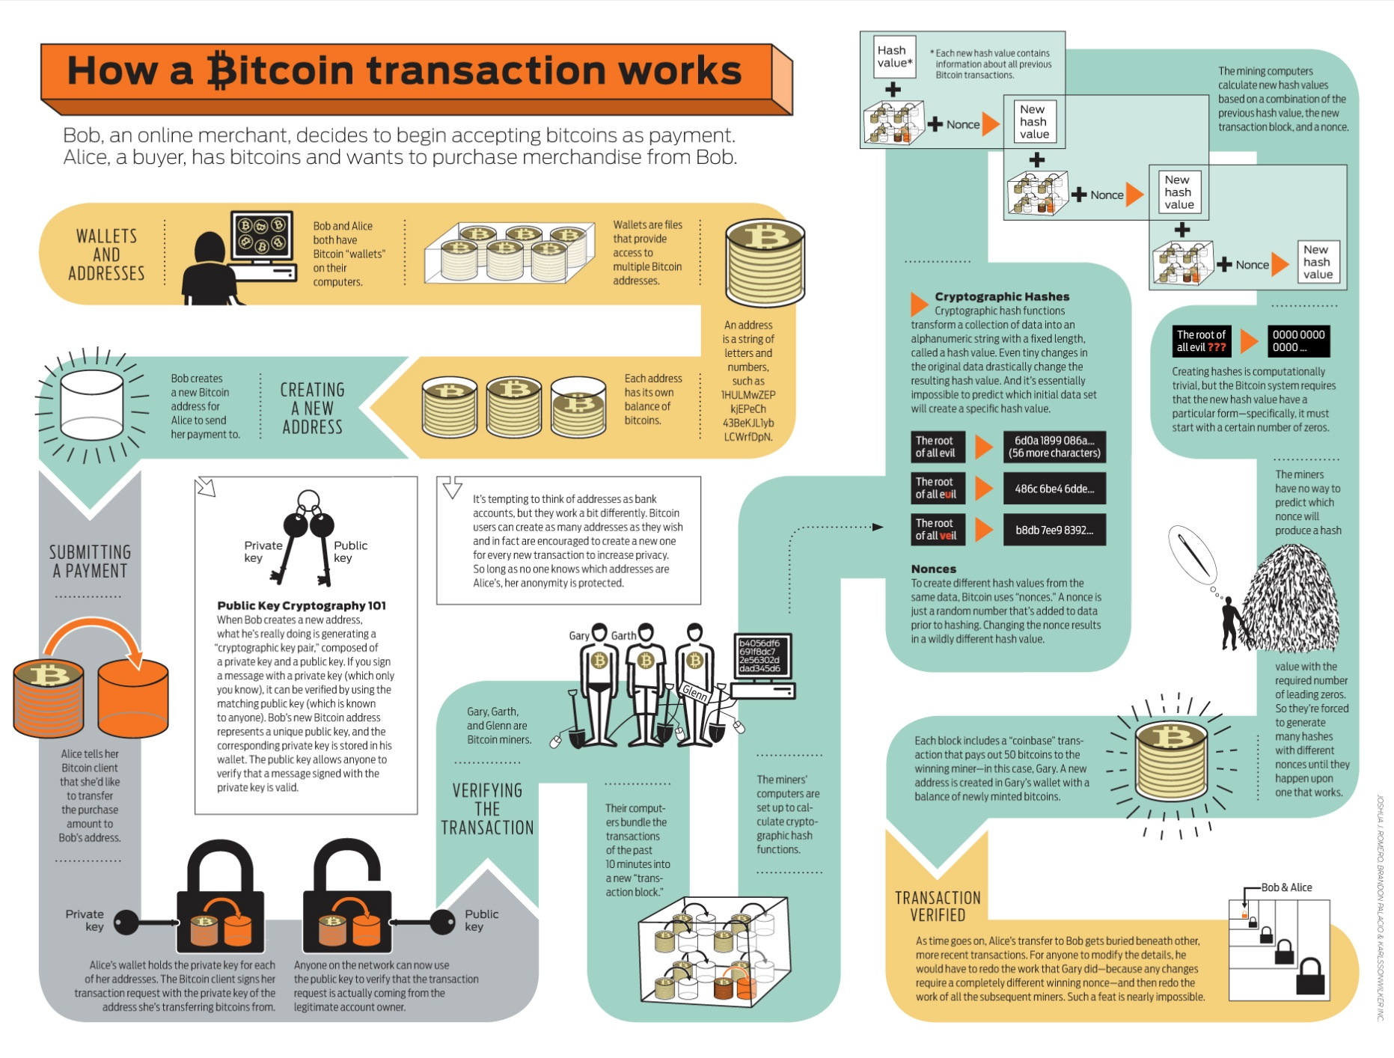

Slide 24
Should you mine bitcoins?
No

