Slide 1
Upside-down-ternet – 2014
John Black Spring 2014

Slide 2
Scamps

Slide 4
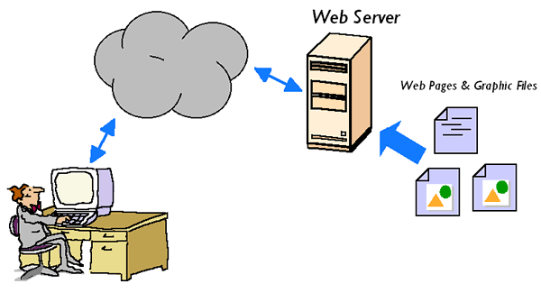
Web Basics
Client is the Browser (usually)
A web server is a machine that listens on port 80 (usually) and communicates via TCP/IP

Slide 5
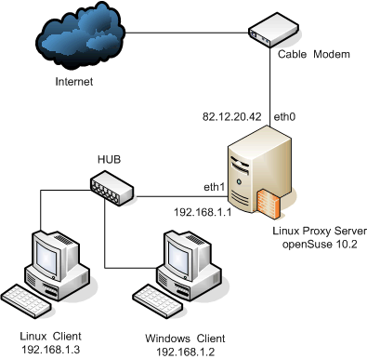
Proxies
A proxy sits between the users and the network
A web proxy processes inbound/outbound web traffic
Filtering (malware, forbidden content)
Caching (efficiency)
Monitoring (bandwidth charges)
Limits (no Facebook except at lunchtime)

Slide 6
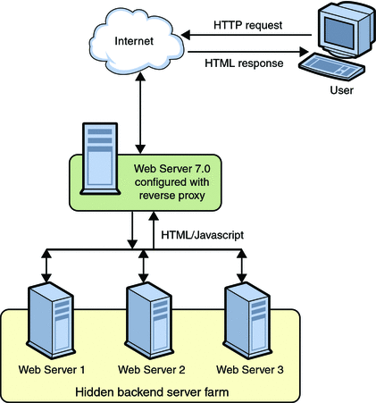
Reverse Proxies
Sometimes the server side uses them
Load balancing
SSL optimization
Compression
Hiding internal LAN

Slide 7
Squid Proxy
The most popular open-source proxy is called Squid
Squid was developed at CU in the mid-90s
Squid is a caching web proxy running via TCP on port 3128 (usually)
Incoming http requests are checked to see if they’ve been served before and are cacheable
If so, Squid serves the request from its cache
If not, Squid serves the request normally and caches the result
Not everything can be cached of course

Slide 8
URL Rewriting
Squid can also use local scripts to rewrite URLs
Ie, transform one URL into another
To tell Squid how to do this, you provide a script (perl, python, C, etc…) that receives a line like this:
URL client_ip "/" fqdn user method urlgroup [ kvpairs]
Script then outputs new URL in its place

Slide 9
mogrify
mogrify is part of the free open-source image manipulation toolkit called Imagemagick
mogrify can do lots of simple image transforms on the command line, including resizing, rotating, sharpen/blur, etc
/usr/bin/mogrify –flip squid.gif

Slide 10
A URL rewriter that flips images
#!/usr/bin/perl
$|=1; $count = 0; $pid = $$;
while (<>) {
chomp $_;
if ($_ =~ /(.*\.jpg)/i) {
$url = $1;
system("/usr/bin/wget", "-q", "-O","/var/www/images/$pid-$count.jpg", "$url");
system("/usr/bin/mogrify", "-flip","/var/www/images/$pid-$count.jpg");
print "http://127.0.0.1/images/$pid-$count.jpg\n";
}
. . .
else {
print "$_\n";
}
$count++;
}

Slide 11
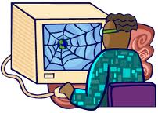
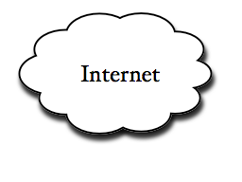
Putting it all together
if rewritten
cached?
possibly rewritten URL
If not rewritten
flip.pl
image?
mogrify
/var/www/images
local store

Slide 12
Let’s see how it works!
Point my Chrome browser (Mac OS X) to the squid proxy running on a CU-hosted VM called hitchens (public IP)
I do this by setting my proxy to hitchens.cs.colorado.edu port 3128
Note: Squid is configured to allow source IPs from 10.0.0.0/8 and a few others like my home static IP
Leaving Squid wide-open leads to problems
I have an Apache2 server running on hitchens as well

Slide 13
Other Options
Squid can be configured in all kinds of ways
Run only certain times of day, certain days of the week, certain IP addresses, etc.
We could use mogrify to blur images instead of flipping them
Maybe do very blurry 12am-6am, then lessen it gradually through the day?

Slide 14
Other ways to direct traffic
Having to change browser settings is inconvenient
How to direct traffic so that I can MitM someone to use my squid proxy transparently?
DNS Poisoning
ARP Cache poisoning
Fake Wireless AP
Etc

