Slide 1
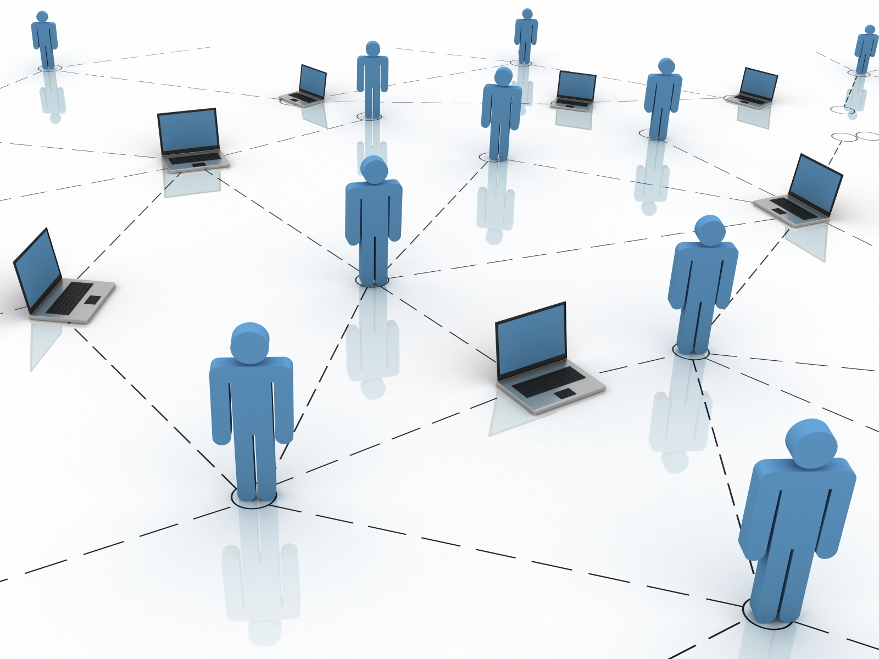
WiFace: A Secure GeoSocial Networking System Using WiFi-based Multi-hop MANET
Communication with Anyone Anytime Anywhere
Lan Zhang, Xuan Ding, Zhiguo Wan, Ming Gu
Tsinghua University, Beijing, China
Xiang-Yang Li
Illinois Institute of Technology, USA

Slide 2
Outline
Introduction
WiFace
Architecture and Design
Experiments and Evaluations

Slide 3
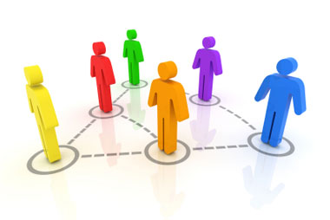
Introduction

Slide 4
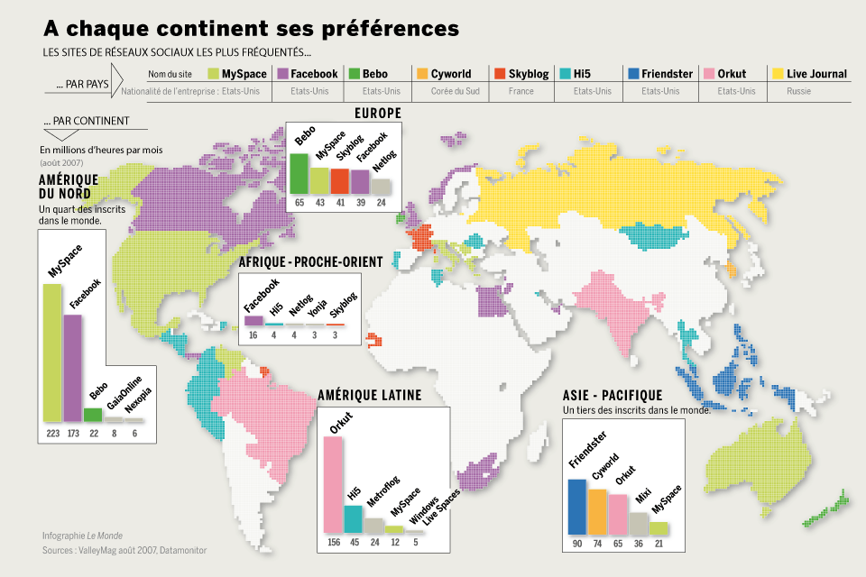
Mobile Social Networks
Mobile Social networks in our lives
Global personal mobile phones is expected to reach 4.6 billion. Most of them have wireless interfaces(Wi-Fi, Bluetooth)
Numerous mobile social networking services all over the world.
There is a strong demand for co-located people to communicate and share. A convenient and smart communication platform is needed.

Slide 5
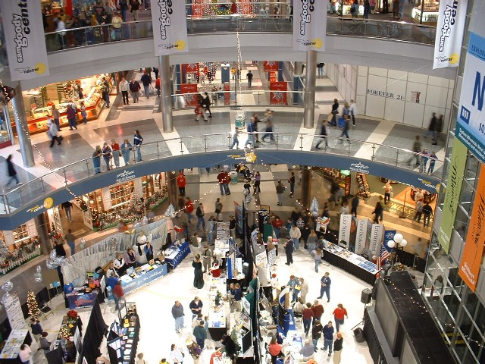
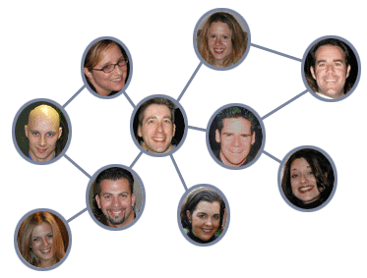
Geo-Social Networks
Geo-social Networks
In a sports event
In shopping mall
In a classroom, office building…
What people need:
Share feeling, news, photo, video…
Make friends with people nearby
Chat with friends nearby for free
Broadcast notices or advertisements
Gather to vote for some decision
Play interactive games
……
Characteristic：
Not know each other initially
Share mutual interest
Close geographically
No convenient way to interact

Slide 6
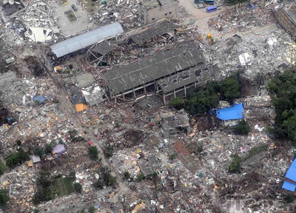
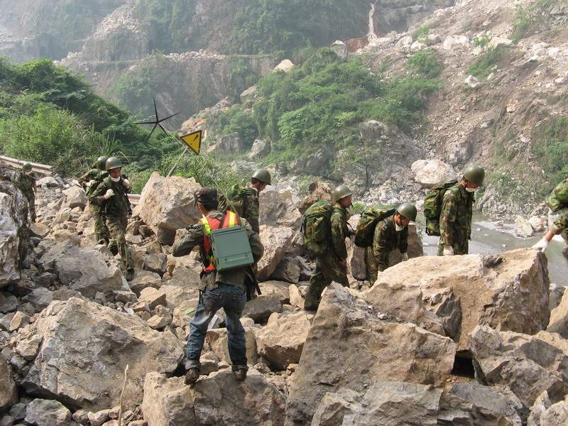
Mobile Social Networks
Current Mobile Social Networks
Twitter, JuiceCaster(US), MocoSpace(Japan) and QQ(China)
FourSquare, Bright-Kite, Fon11, Loopt
Rely on centralized servers and the Internet or cellular networking access, which will incur certain cost to end-users and may not always be available
Location techniques like GPS, or hotspot trilateration and appropriate devices are required
Difficult for indoor use
What if the infrastructure is unavailable……
Disaster scenarios
Wilderness
In a basement
……

Slide 7
WiFace

Slide 8
GSN based on MANET
Solution: A geo-social networking system on ordinary mobile devices, which works when some of the users can access to the cloud component, and also can work efficiently without any networking infrastructure or GPS module
Two components:
MoNet: Mobile Ad Hoc network platform based on personal mobile devices.
Multi-hop based on Wi-Fi can be constructed easily
The limited multi-hop coverage implies that the end-users are not far away
WiFace: Secure distributed geosocial networking application
Supports common social networking activities
Also offers efficient content sharing and special co-located services (like broadcasting notices or querying the location-based information. )
Can be used in both indoor and outdoor
Can work with and without infrastructure.
Applications
A lot of potential applications

Slide 9
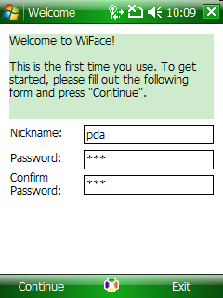
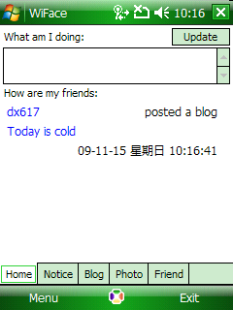
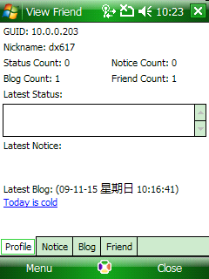
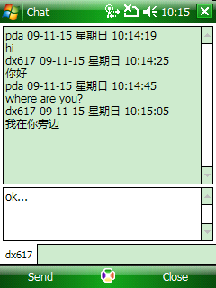
WiFace
A Secure GeoSocial networking System Using WiFi-based Multi-hop MANET
Find the users and make friends with people nearby
Update Statuses
Share blogs, feeling, news, photo, video
Chat with friends nearby for free
Broadcast notices or advertisements
Wiface

Slide 10
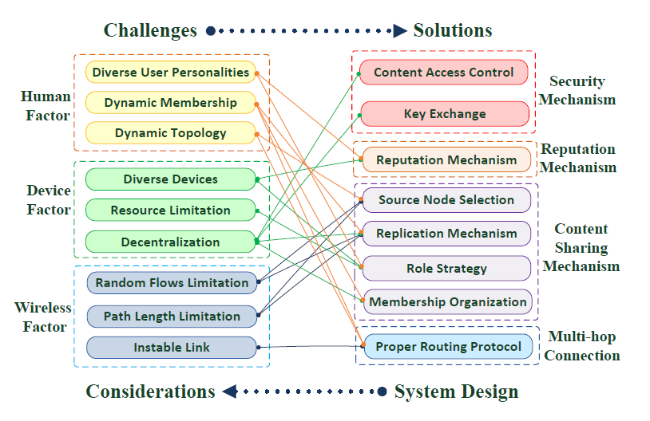
Challenges->Solutions

Slide 11
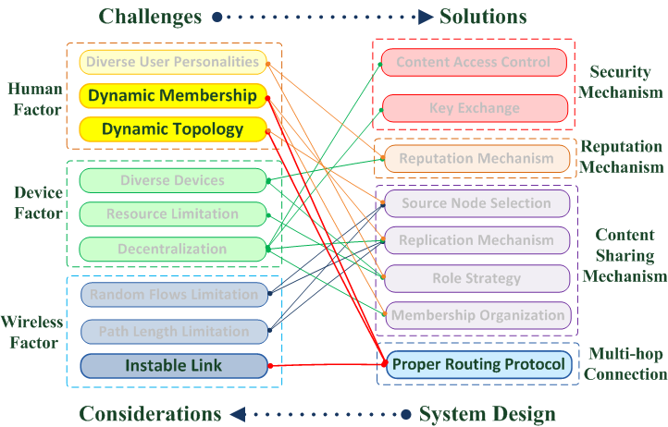
Challenges->Solutions
Proper Routing Protocol:

Slide 12
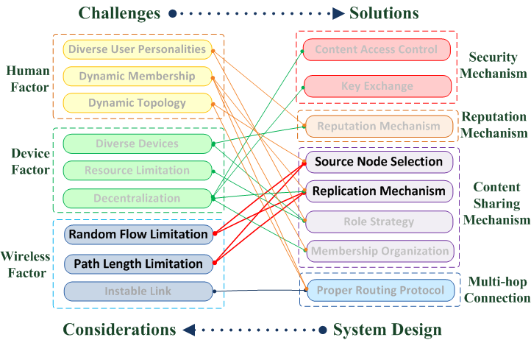
Challenges->Solutions
Capacity Limitation of MANET:

Slide 13
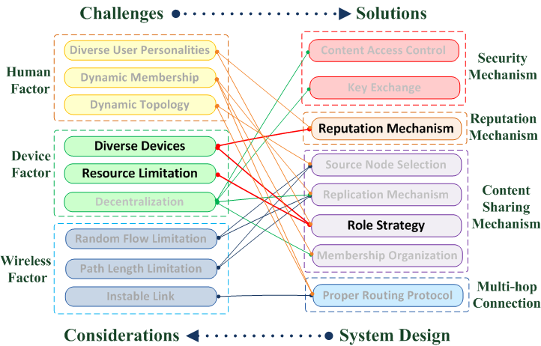
Challenges->Solutions
Diverse Devices and Limited Resources:

Slide 14
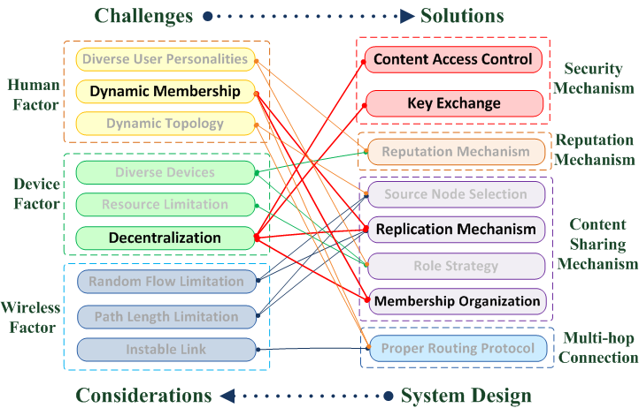
Challenges->Solutions
Dynamic Membership and Decentralization:

Slide 15
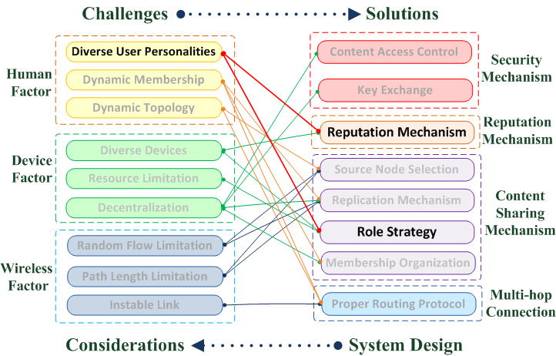
Challenges->Solutions
Diverse User Personalities:

Slide 16
WiFace Contributions
Existing Solutions
Rely on infrastructure
Central servers
Internet access
Not always available
Require special location devices(e.g. GPS)
Faces the difficulty for indoor use
Cost for internet access
WiFace-- GSN based on MANET：
Not rely on infrastructure
Feasible at anyplace
work efficiently with and without the infrastructure
No need for special location devices
Fast deployment
Indoor and outdoor
No cost
WiFace is the first social networking system on MANET
WiFace adopts a decentralized P2P architecture
where each instance can be at the same time a client and a server
All the existing social networking services are provided in a C/S form
Notes:
. In fact, applications for MANET are rare.

Slide 17
WiFace Contributions
A comprehensive architecture design
Suitable routing protocol
Don’t need any modification to other network stacks
Support standard socket programming for applications development
A series of light-weight but efficient protocols

Slide 18
Architecture & Design

Slide 19
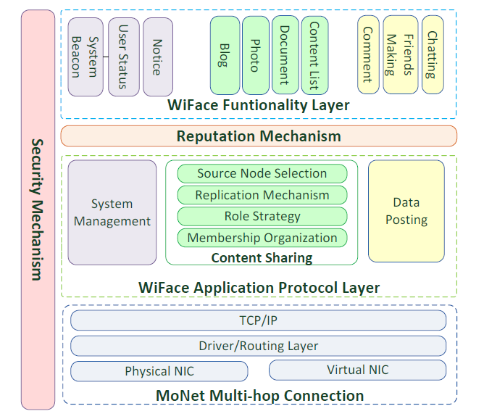
WiFace Architecture

Slide 20
MoNet
Between the link layer and the network layer.
It is responsible for processing packets,
as well as routing.
Support the multi-hop communication, as an additional network link without affecting other physical NICs.

Slide 21
Routing Protocol
Mainly focus on two crucial aspects:
the node mobility and dynamic network topology
(2) the instable link quality
Extensive experiments are carried out in Two typical scenarios for WiFace:
a meeting hall (indoor)
an athletic field surrounded by a track (outdoor)
DSR with three link quality metrics: HOP, ETX, and WCETT.
According to the results, the DSR protocol with HOP as the link metric is a more suitable choice for the typical WiFace application.

Slide 22
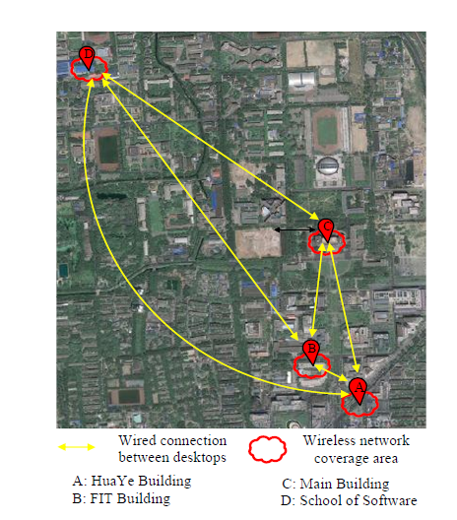
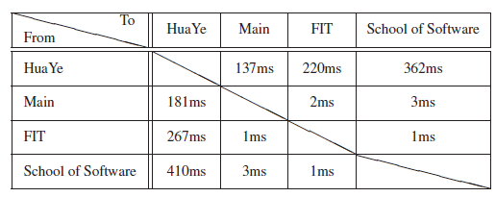
Network Scope Expansion
Expand network with wired VPN connection to cover 4 buildings in Tsinghua University.
106 on-line users
The average maximum throughput of a 3-hop path between two nodes in different buildings is about 3.8Mbps

Slide 23
WiFace Application Layer

Slide 24
Content Sharing Protocol
Effective content sharing (including browsing blogs, sharing photos, videos and other documents) among decentralized dynamic nodes is crucial and challenging.
Active cooperative content sharing protocol:
Applicable to mobile devices, takes advantage of short paths, resourceful devices and node mobility
Role Strategy: assign responsibilities among diverse devices by endowing them with different role levels.
Source Node Selection: choose the node with shortest hop length path; Choose the node whose move direction is arriving; Choose the node with a higher role level.
Replication Mechanism: a content item is not only stored by the creator but may also be replicated automatically by nodes with a non-zero role level.
Reputation Mechanism: calculate a node’s reputation based on its role level and the amount of content items replicated and transmitted by it.

Slide 25
Security Mechanisim

Slide 26
Security Mechanism
3 types of keys
Account key: used for user authentication and encrypting one’s private content.
Friend key: in WiFace each pair of friends share a same confidential 128-bit symmetric key to form a secure channel for private communication and content sharing between two friends.
Content key: it is a 128-bit symmetric key generated for encrypting a specific content item.
Friend key exchange:
We design and a scheme combining two-party elliptic curve Diffie-Hellman (ECDH) and the interlock protocol to construct a friend key without a trusted authority.
Taking no account of users’ response time to challenge questions, it only takes about 1.5 seconds in PDA and 0.6 second in PC to complete the friend-key
exchange without any authorities.
Access control:
Generate a content key to encrypt the content itself
Attach the content key encrypted respectively with the friend keys of those friends whom he authorizes to

Slide 27
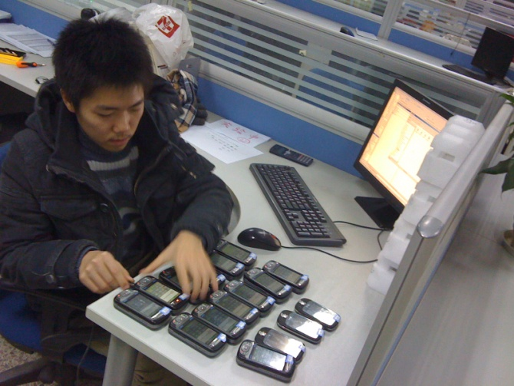
Experiments & Evaluation

Slide 28
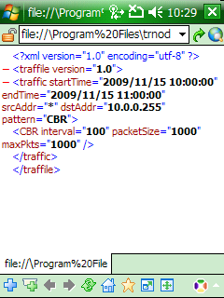
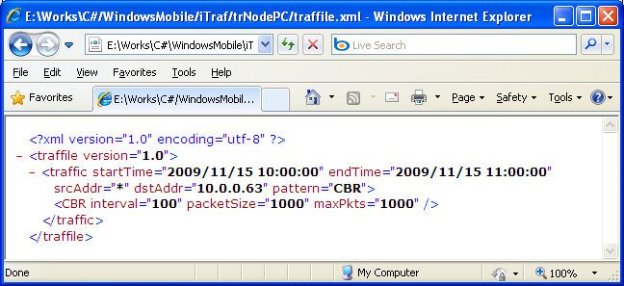
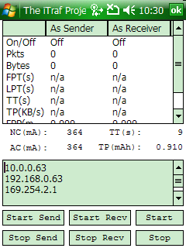
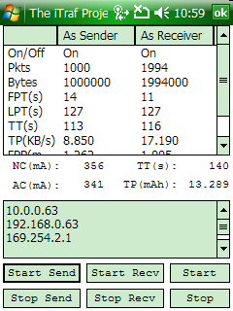
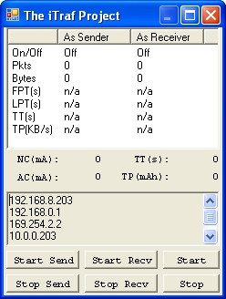
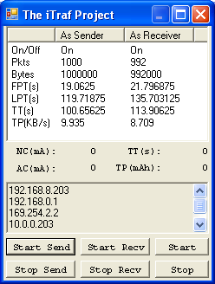
Experiments
Intelligent experiment tools
For large scale automatic experiments
Intelligent agent
序

Slide 29
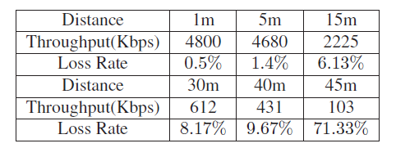
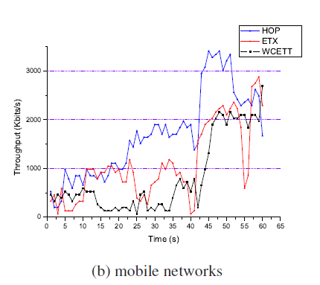
Experiments
MoNet test
We conduct comprehensive in-the-field experiments to evaluate the performance of MoNet.
Throughput and loss rate
Arrival Rate
Multi-hop performance

Slide 30
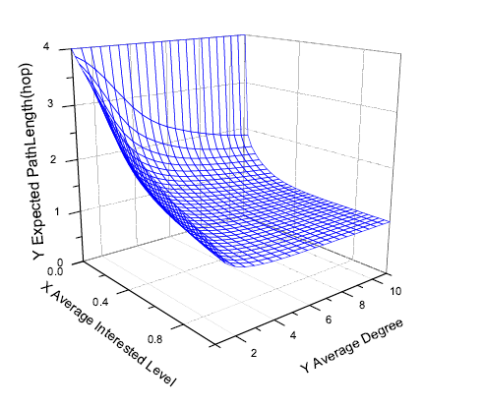
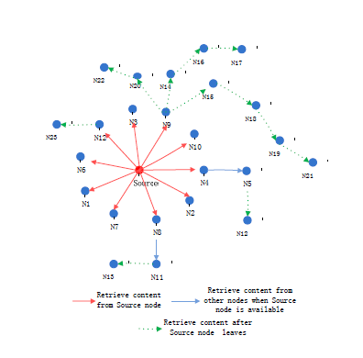
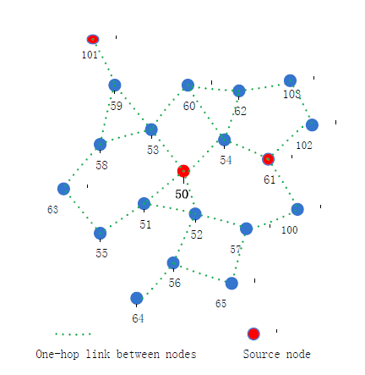
Experiments
Decentralized content sharing
Result: our content sharing protocol can significantly shorten the content transmission paths, reduce conflicted flows, and improve content persistence and availability in the changing population.
Scenario 1
20 users on a playground.
3 users published blogs at random time.
The other users read them randomly.
Scenario 2
only one source node published a blog at the beginning.

Slide 31
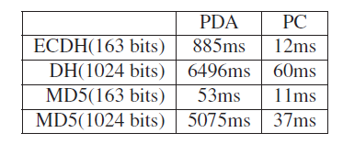
Experiments
Security mechanism
Key exchange and Access Control
It only takes about 1.5 seconds in PDA and 0.6 second in PC to complete the key exchange without any authorities

Slide 32
Experiments
Real Usage Results
Used as a WiFi-based mobile ad hoc flea market
We deployed 106 heterogeneous mobile nodes including mobile phones, laptops and desktops in an area of 1200m * 800m.
During the experiment, users accomplished a large number of real-world auctions and trades, as well as chatted with each other on line.

Slide 33
Thanks!

