Slide 1
WhereStore: Location-based Data Storage for Mobile Devices Interacting with the Cloud
Patrick Stuedi, Iqbal Mohomed, Doug Terry
Microsoft Research

Slide 2
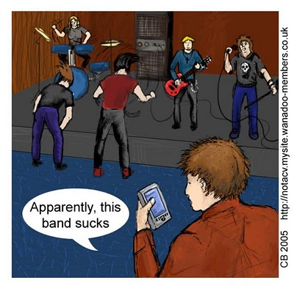
Smartphones are ubiquitous
17% market share
225’000 applications on AppStore with over 5 billion downloads

Slide 3
Mobile/Cloud applications
Applications use cloud for storage and computation
computing
data sharing
storage
queries
3G/Wifi
Problems:
High network latency
Temporary network disconnections
Possible Solution: Caching
What data should we cache?

Slide 4
Location-based application usage
Finding: applications and application data are used in a location-based manner [Trestian IMC’09]
Examples:
Browsing the web for ingredients needed for a given recipe
Useful in a grocery shop after work
Not useful when at work
Schedule for the work day
Useful while on the way to work
Not useful when driving home after work
Traffic news
Good know about traffic in certain regions before a user gets there
Useless once a user is in traffic

Slide 5
WhereStore: Key Idea and Challenges
Key idea:
Use a user’s location history to determine his future locations
Pre-fetch and cache data for future locations of the user
Challenges
Predicting future locations
When to cache?
Opportunities
Use storage space of phone efficiently

Slide 6
Feasibility Study
How much data for a certain geographical region do some of today’s web applications store?
If we cache content, how fast will it be outdated?
Experiments with popular web applications: YouTube, Flickr

Slide 7
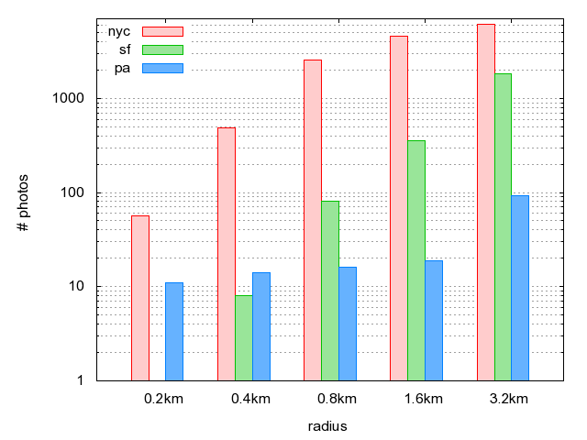
Flickr: photos for a region of size x

Slide 8
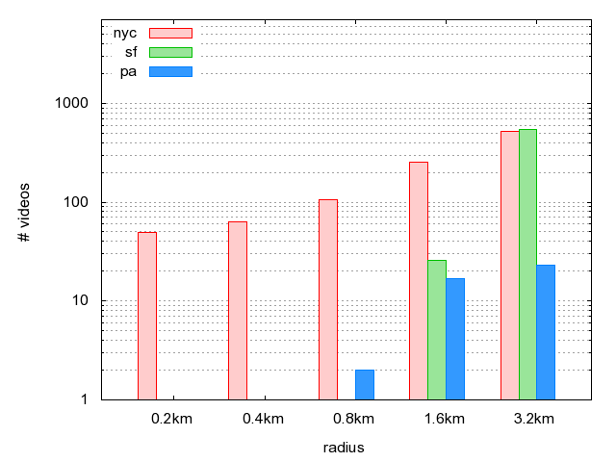
Youtube: videos for a region of size x

Slide 9
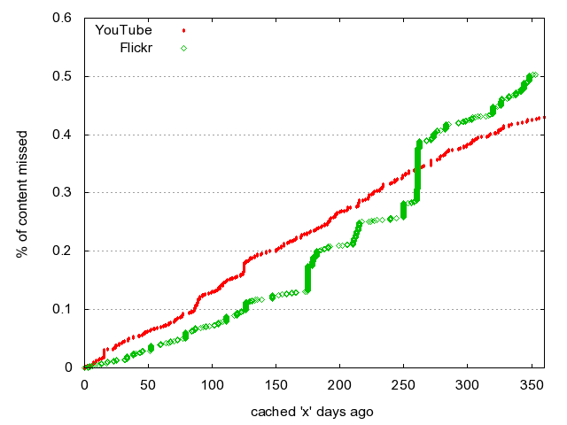
Staleness of data

Slide 10
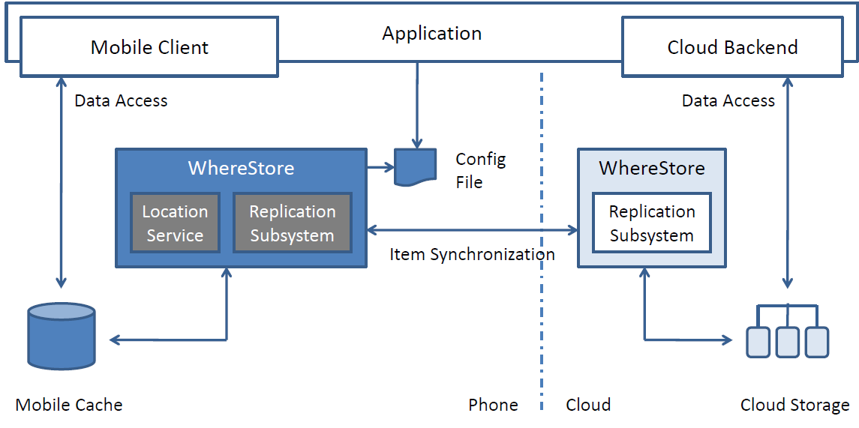
System Architecture

Slide 11
Synchronizing with the cloud using Cimbiosys
groups.include(“new york”) AND groups.include(“reviews”)
groups : set<string>
priority: int
Filter
new york
Partial Replication
Platform
Synchronization
Partial Replication
Platform
reviews
Data
Data
Phone
Cloud

Slide 12
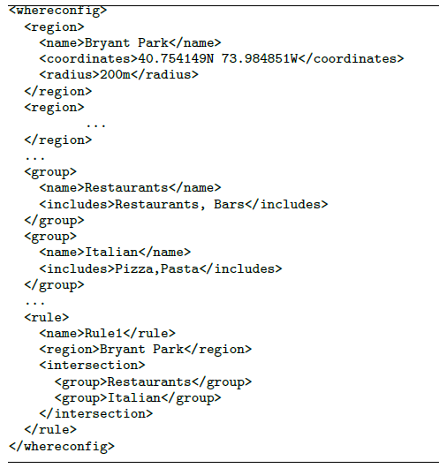
How WhereStore creates the filter
Location Prediction
Config
File
Filter

Slide 13
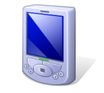
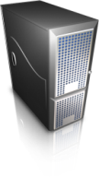
Managing Location Data
StarTrack:
Framework and infrastructure for managing user’s track data
Track: Time-ordered sequence of location readings
StarTrack API:
Operations on tracks: store, manipulate, compare, query, …
Application
API
StarTrack Server
StarTrack Client
Location Manager
Track Database

Slide 14
Location Prediction
WhereStore uses the location data to produce a transition graph
Nodes in the graph are frequent places the user has visited
Edges between nodes are weighted depending on the frequency of trips between a start and an endpoint
For any current location, the predicted future location is given by the transition graph
shopping
home
gym
work
bar

Slide 15
Current state
Filter based cache replication implemented
Windows Mobile
Windows Azure
Cimbiosys
Integrating location prediction
Future
Automatically create configuration file
Consider also context other than location
Integrating with different external systems (like HTML5/Webstore

Slide 16
Conclusion
WhereStore: Location-based cache for mobile applications interacting with the cloud
Pre-fetch and cache data for future locations of the user
System built on top of Cimbiosys (partial replication platform) and StarTrack (location track management)

