Slide 1
Leveraging fast VM fork for next generation mobile perception
Eyal de Lara
Department of Computer Science
University of Toronto

Slide 2
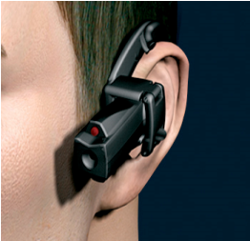
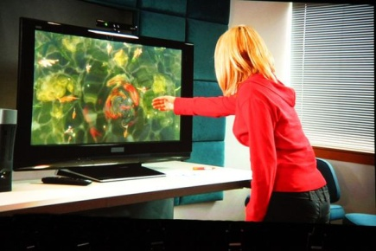
Next Generation Context Aware Applications
Health & assisted living, advertising, gaming, travel, social networking, task assistance and education, etc…
Examples:
Augmented reality
Face recognition
Automatic translation
Activity recognition

Slide 3
The Problem
Huge pressure on mobile devices in terms of compute capacity, communication, and power budget
High data rate sensors (Cameras and microphones)
Compute intensive (real time classification & online learning)
Interactive

Slide 4
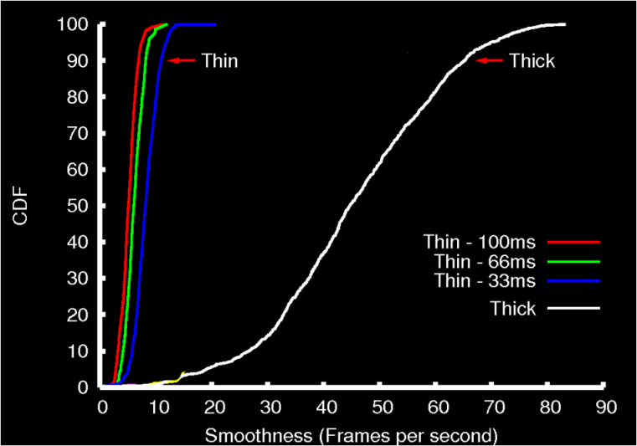
The Cloud isn’t the Solution
Too much latency for real-time responsiveness
Even 30 msec latency affect interactive performance
Example latencies:
Internet 2 RTT 50 – 200 msec.
Median 3G RTT is 200 msec.

Slide 5
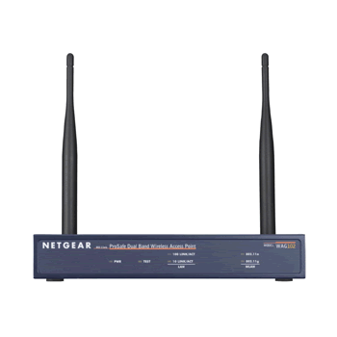
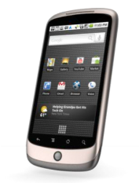
Cloudlet in the Access Point
Bring the cloud closer:
The Case for VM-based Cloudlets in Mobile Computing, Satyanarayanan, Bahl, Caceres, Davies
Cloudlet: “data center in a box”
Lots of cores with no power constraints one network hop away
Leverage existing 802.11 protocols for service discovery, encryption, billing and authentication with no extra overhead
Provides tight coupling between the network and the computation
Incremental deployment
802.11n AP with a n-core CPU
Low latency, high bandwidth
Notes:
Leverage the AP-cloudlet as the computational resource. The AP could also be a good proxy for doing the heavy weight crunching and shipping data to the cloud that maintains the object/face recognition database.

Slide 6
Challenges
Mechanisms to guarantee execution integrity
Privacy: Client should trust that no sensitive data is retained
Correctness of execution: Clients and service provider should trust the correctness of the computation
Developing applications that span the client, AP and cloud
Seamless migration of execution between client, AP and cloud
Supporting flexible business models
Give users access to proprietary algorithms in exchange for context
Provide micropayments to cloudlet owners in exchange for cycles
Broker connections between advertisers and customers

Slide 7
Challenges
Mechanisms to guarantee execution integrity
Privacy: Client should trust that no sensitive data is retained
Correctness of execution: Clients and service provider should trust the correctness of the computation
Developing applications that span the client, AP and cloud
Seamless migration of execution between client, AP and cloud
Supporting flexible business models
Give users access to proprietary algorithms in exchange for context
Provide micropayments to cloudlet owners in exchange for cycles
Broker connections between advertisers and customers

Slide 8
SnowFlock: VM Fork
Stateful swift cloning of VMs
State inherited up to the point of cloning
Local modifications are not shared
Clones make up an impromptu/transient cluster
Master is persistent
Clones state is ephemeral
Virtual Network
VM 0
VM 1
VM 2
VM 3
VM 4
Host 0
Host 1
Host 2
Host 3
Host 4
Notes:
Fork: read-only mem, they die

Slide 9
SnowFlock API
tix = sf_request_ticket(howmany)
prepare_computation(tix.granted)
me = sf_clone(tix)
do_work(me)
if (me != 0)
send_results_to_master()
sf_sync()
else
receive_results()
sf_join(tix)
Just like UNIX fork()
Block…
scp … more in the future
Child VMs are gone
Notes:
Drive analogies with fork()

Slide 10
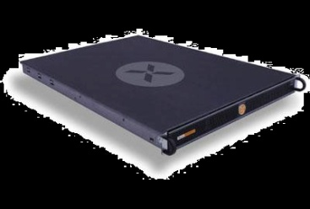
Approach
Migrate computation to cloudlet
Scale application on cloudlet

Slide 11
SnowFlock Insights
VMs are BIG: Don’t send all the state!
Clones need little state of the parent
Clones exhibit common locality patterns
Clones generate lots of private state
Notes:
Insights: locality, little actual state

Slide 12
Why SnowFlock is Fast
Send only what you really need
Multicast
Network hardware parallelism
Prefetch: exploit locality patterns
Heuristics
Don’t send if I’ll overwrite
Malloc: exploit apps generating new state

Slide 13
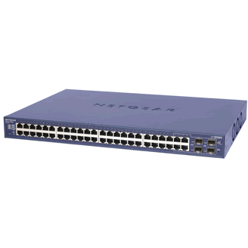
The Secret Sauce
3. Multicast: exploit net hw parallelism
4. Multicast: exploit locality to prefetch
5. Heuristics: don’t fetch if I’ll overwrite
1. Start only with the basics
2. Fetch state on-demand
State:
Disk, OS, Processes
Clone 1
Private
State
Virtual
Machine
?
Multicast
VM Descriptor
VM Descriptor
VM Descriptor
Metadata
“Special” Pages
Page tables
GDT, vcpu
~1MB for 1GB VM
Clone 2 Private State
?
Notes:
Let us now walk through the animation that introduces the key mechanisms
- we start of with a VM

Slide 14
Cloning Time
Clone set up
Multicast descriptor
Xend
resume
code
Wait for clones to start
VM spawn
(from descriptor)
Contact all hosts
Xend suspend code
VM suspend
(make descriptor)

Slide 15
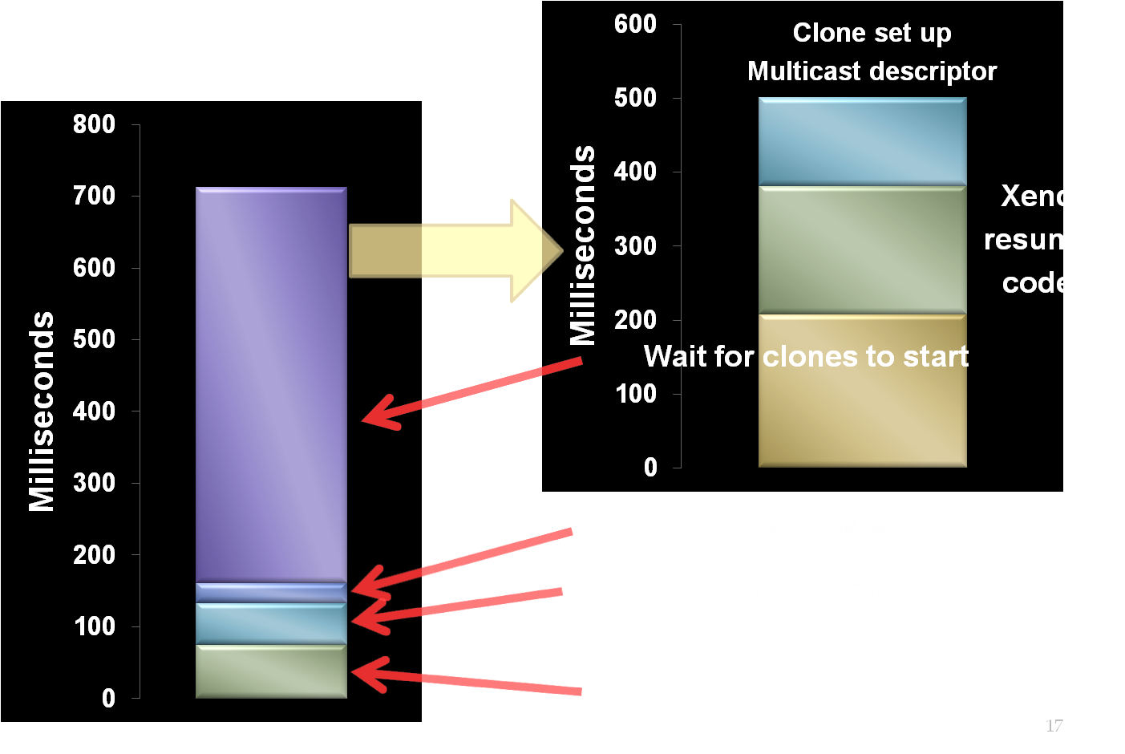
Cloning Time
32 VMs
800 Milliseconds

Slide 16
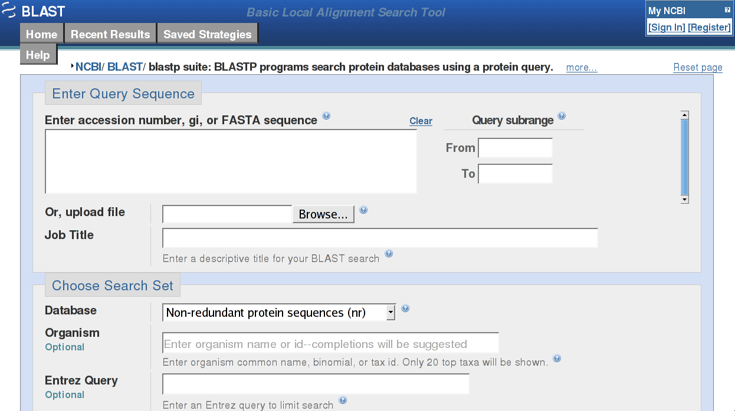
High Performance Cloud Computing
Near-interactive parallel Internet service
Leverage parallelism to do the task in seconds
Examples
Bioinformatics
NCBI BLAST
EBI ClustalW2
Render farm
Quantitative finance farm
Compile farm

Slide 17
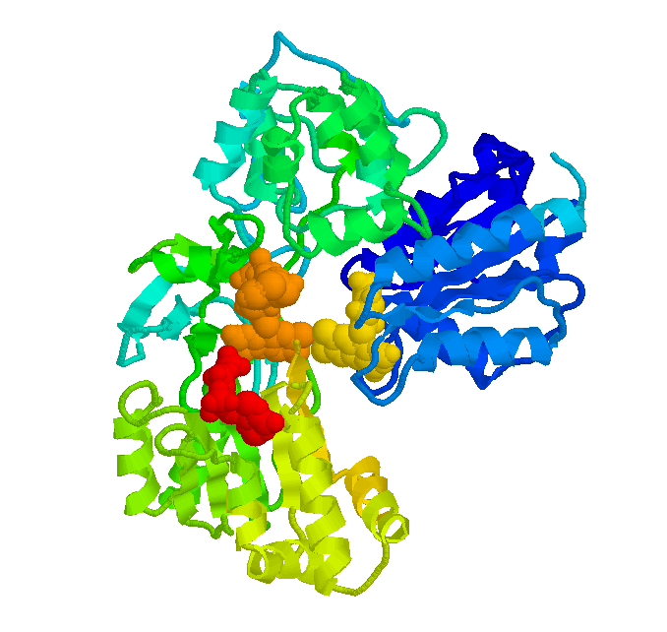
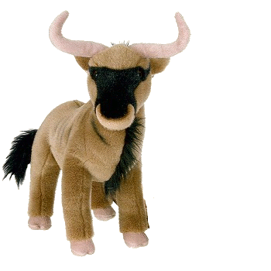
Experimental Setup
Cluster of 32 Dell PowerEdge, 4 cores
128 total processors
Xen 3.0.3 1GB VMs, 32 bits, linux pv 2.6.16.29
Obvious future work
Applications
Bioinformatics: BLAST, SHRiMP, ClustalW
Quantitative Finance: QuantLib
Rendering: Aqsis (RenderMan implementation)
Parallel compilation: distcc

Slide 18
Application Run Times
143min
87min
110min
61min
7min
20min
128 processors
(32 VMs x 4 cores)
1-4 second overhead
Notes:
Ideal is really ideal
Low is good

Slide 19
Open Challenges
Hierarchical VM fork support
VM fork over wireless

Slide 20
Conclusions
Cloudlets are an attractive solution for next generation context aware apps
VM fork lends itself well for cloudlet computing.
Sub-second cloning time
Negligible runtime overhead
Notes:
Let people finish their questions

Slide 21
Thanks!
http://sysweb.cs.toronto.edu/snowflock
http://sourceforge.net/projects/snowflock
delara@cs.toronto.edu
Questions?

