Slide 1

Sparse Factor Analysis for Learning Analytics
Andrew Waters, Andrew Lan,
Christoph Studer, Richard Baraniuk
Rice University

Slide 2



Learning Challenges
One-size-fits-all
Poor access to high-quality materials ($)
Inefficient, Slow feedback
unpersonalized cycle

Slide 3
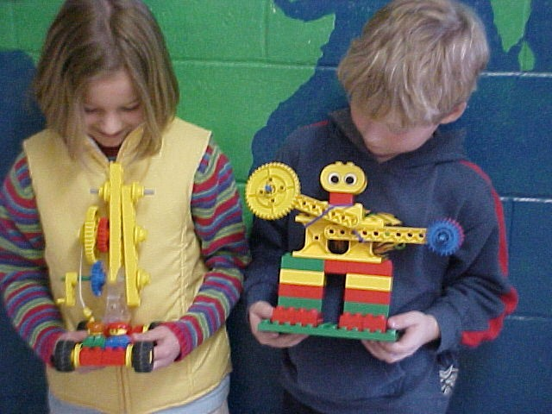

Personalized Learning
Adaptation
  to each student’s background,
  context, abilities, goals
Closed-loop
  tools for instructors and students
  to monitor and track their progress
Cognitively informed
  leverage latest findings from the
  science of learning
Automated
  Do this automatically data
Data
(massive, rich, personal)

Slide 4
Jointly Assess Students and Content
Latent factor decomposition (K concepts):
Which concepts interact with which questions
How important is each concept for each question
Which questions are easy / difficult
How well have students mastered each concept
Do this solely from binary Q/A (possibly incomplete) data

Slide 5
Statistical Model
Partially observed data
Inverse link function (probit/logit)
Intrinsic difficulty
of Question i
Concept mastery of Student j
Concept weight for Question i

Slide 6
Model Assumptions
Model is grossly undetermined
We make some reasonable assumptions to make it tractable:
- low-dimensionality
- questions depend on few concepts
- non-negativity
SPARse Factor Analysis (SPARFA) model
We develop two algorithms to fit the SPARFA model to data

Slide 7
SPARFA-M: Convex Optimization
Maximize log-likelihood function
Use alternate optimization with FISTA [Beck & Teboulle ‘09] for each subproblem
Bi-convex: SPARFA-M provably converges to local minimum

Slide 8
SPARFA-B: Bayesian Latent Model
Use MCMC to sample posteriors
Efficient Gibbs’ Sampling
Assume probit link function
C
μ
Z
Y
W
Sparsity
Priors:
Key Posteriors:

Slide 9
Ex: Math Test on Mechanical Turk
High School Level
34 questions
100 students
SPARFA-M
w/ 5 concepts
Visualize W, μ

Slide 10
Tag Analysis
Goal: Improve concept interpretability
Link tags to concepts
T₁
C₁
T₂
C₂
.
.
.
.
.
.
T_{M}
C_{K}

Slide 11
Algebra Test (Mechanical Turk)
34 questions, 100 students
Concepts decomposed into relevant tags

Slide 12
Synthetic Experiments
Generate synthetic Q/A data, recover latent factors
Performance Metrics:
Compare SPARFA-M, SPARFA-B, and non-negative variant of K-SVD

Slide 13
Ex: Rice University Final Exam
Signal processing course
44 questions
15 students
100% observed data
SPARFA-M, K=5 concepts

Slide 14
Student Profile
Student Profile: Student’s understanding of each Tag
Average Student Profile on Rice Final Exam
Student 1 Profile on Rice Final Exam
SPARFA automatically decides which
tags require remediation

Slide 15
STEMscopes
8th grade Earth Science
80 questions
145 students
SPARFA-B: K=5 Concepts
Highly incomplete data:
only 13.5% observed

Slide 16
STEMscopes – Posterior Stats
Randomly selected students
Single concept
(Energy Generation)
Student 7 and 28 seem
similar:
S7: 15/20 correct
S28: 16/20 correct
Very different posterior variance:
Student 7: Mix of easy/hard questions
Student 28: Only easy questions – cannot determine ability

Slide 17
Conclusions
SPARFA model + algorithms fit structural model to student question/answer data
  Concept mastery profile
  Relations of questions to concepts
  Intrinsic difficulty of questions
SPARFA can be used to make automated feedback / learning decisions at large scale

Slide 18

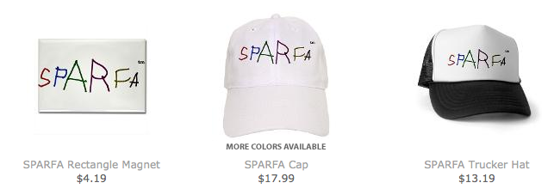


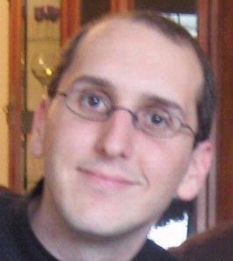
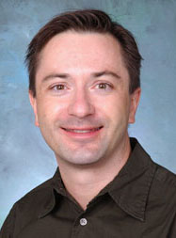
➔ Go to www.sparfa.com

