Slide 1
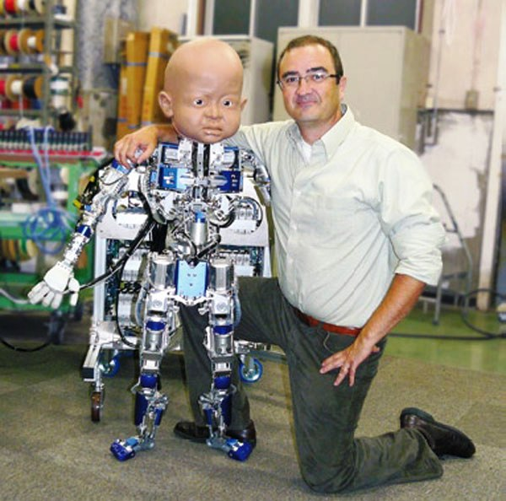
Personalizing Education With Machine Learning
Workshop Organizers
Mike Mozer, Rob Lindsey
University of Colorado, Boulder
Javier Movellan, Jake Whitehill
UC San Diego
Thanks to our sponsor

Slide 2
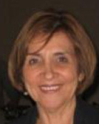
Distinguished Commentators
Doris Alvarez
Director, TDLC Educator’s Network
Founding principal, UCSD Preuss School
Harold Pashler
Psychology, UCSD

Slide 3
Participants
Academic Departments
Cognitive Science
Computer Science
Education
Electrical Engineering
Philosophy
Psychology
Research Organizations and Companies
Coursera.org
Mycollegefn.org
Nexus Research and Policy Center
Scientific Learning
Socos LLC

Slide 4
Why Education And Machine Learning?
Notes:
Most of the workshops at NIPS have titles that a normal person wouldn’t have a clue about.
We don’t have that problem.
And most of the workshops start with a tutorial to motivate the question or approach.
We don’t really need that tutorial.
However, if you want a tutorial, Emma Brunskill and Geoff Gordon gave a beautiful one on Monday and the video should be on the web soon.

Slide 5
Schedule Overview
Morning Talks
Optimal teaching
Detecting engagement and affect with computer vision
MOOCs
Afternoon Talks
Latent state inference
Posters
All of the above topics
Latent concept inference
Inferring student roles in online discussion forums
Notes:
Optimal teaching: what sort of policy should an instructor adopt to maximize student understanding?
What type of examples should be shown to a student? Should the student be asked a question or provided with more information?
MOOC: Massive open online courses
Latent state inference: we want to know what level of understanding a student has achieved. What bits of knowledge are fragile? What misconceptions does the student have? How strong and stable is the learning?

Slide 6
Morning Schedule
7:45 Jerry Zhu
A computational teaching theory for Bayesian learners
8:10 Emma Brunskill
Pedagogical activity selection: Drawing insight from sequential decision making under uncertainty
8:35 Jacob Whitehill
A stochastic optimal control perspective on affect-sensitive teaching
9:00 Break and poster session
9:30 Min Chi
Empirically evaluating the application of reinforcement learning to the induction of effective and adaptive pedagogical strategies
9:45 Vikram Ramanarayanan
A framework for automated analysis of videos of informal classroom educational settings
10:00 Andrew Ng
The online revolution: Education for everyone
Notes:
Sebastian was going to be here representing Udacity, but had to cancel NIPS at last moment

Slide 7
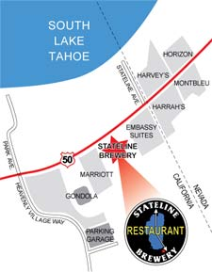
Break
Presenters are invited to lunch at noon courtesy of
Stateline brewery?
Hard rock café?
Notes:
Get count, get preference

Slide 8
Videotaping
If you’re willing to have your video put on the web, sign release form
Rajnish Kumar techtalks.tv

Slide 9
Afternoon Schedule
15:30 Richard Scheines
Machine learning, causal model search, and educational data
15:55 April Galyardt
Modeling student strategy usage with mixed membership models
16:15 Anna Rafferty
Using inverse reinforcement learning to diagnose learners’ misconceptions
16:40 Yanbo Xu
A dynamic higher-order DINA model to trace multiple skills
17:00 Break and poster session
17:20 Vivienne Ming, Norma Ming
Inferring conceptual knowledge from unstructured student writing
17:40 Andrew Waters
Learning analytics via sparse factor analysis
18:05 Robert Lindsey
Inferring history-dependent memory strength via collaborative filtering: Toward the optimization of long-term retention

